Slide 1
Welcome to the Online Celebration of the Class of 2020 Audiology Doctoral Students

Slide 2
Welcome and congratulations
Inspiring your future as an audiologist
Presentation of the students – soon to be Doctors of Audiology
Hooding ceremony
Thoughts and reflections offered by the students
Other thoughts and reflections
Toast and good luck -- Keep in touch!

Slide 3
Inspiring your Future as an Audiologist
Dr. Maged Haimed Class of 2011

Slide 4
Presentation of the Audiology Class of 2020

Slide 5
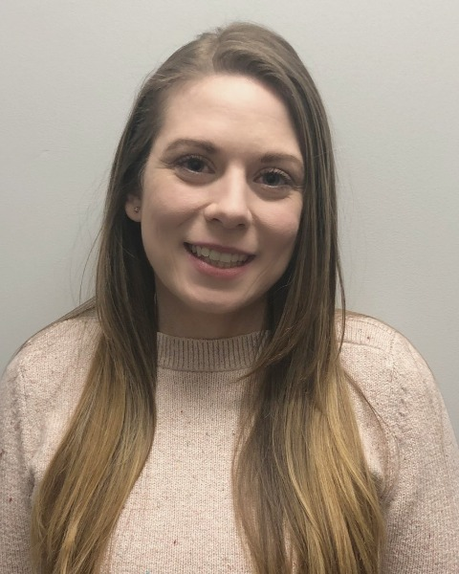
Dr. Danielle Acosta

Slide 6
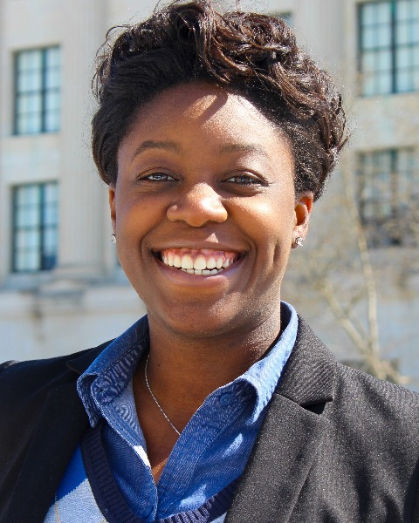
Dr. Marla Durand

Slide 7
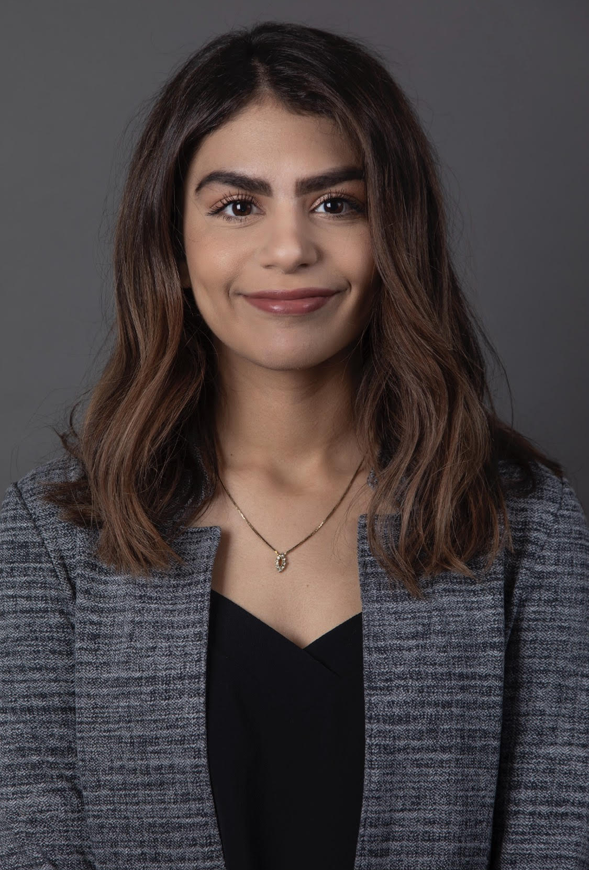
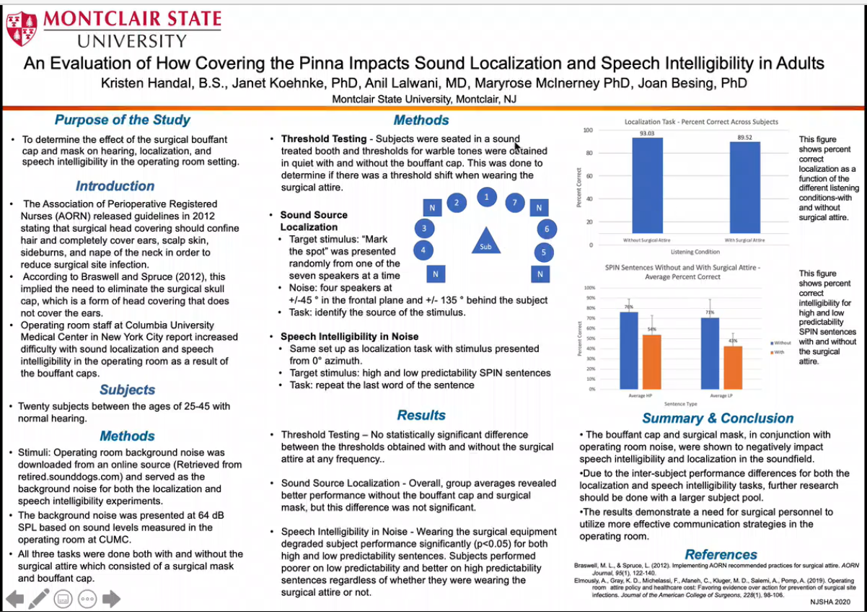
Dr. Kristen Handal

Slide 8
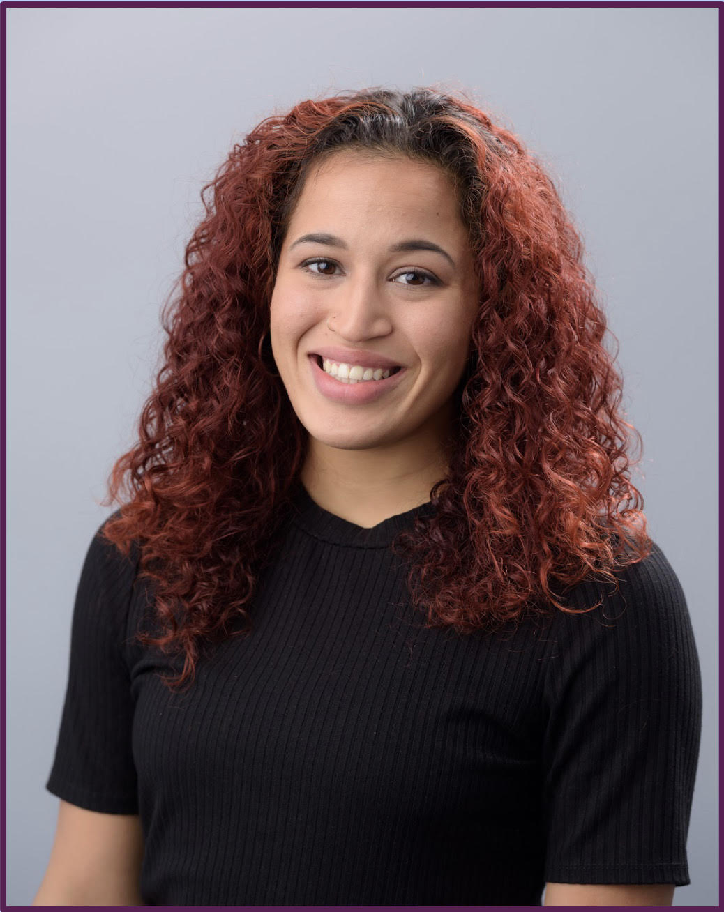
Dr. Ariel Monserrate

Slide 9
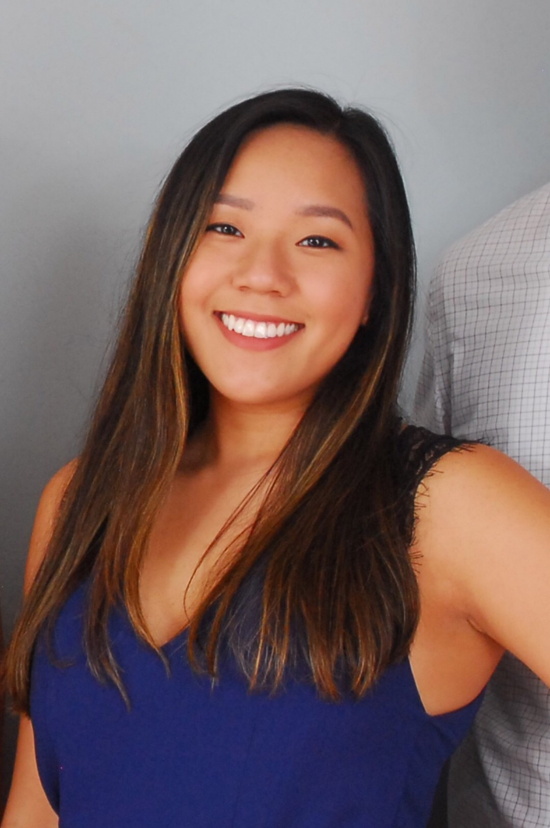
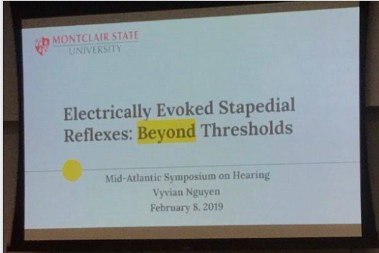
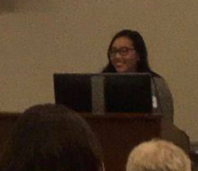
Dr. Vyvian Nguyen

Slide 10
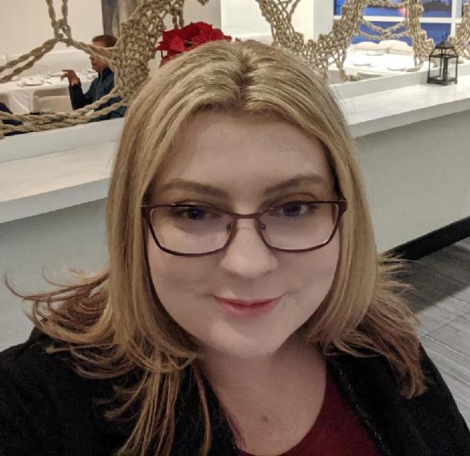
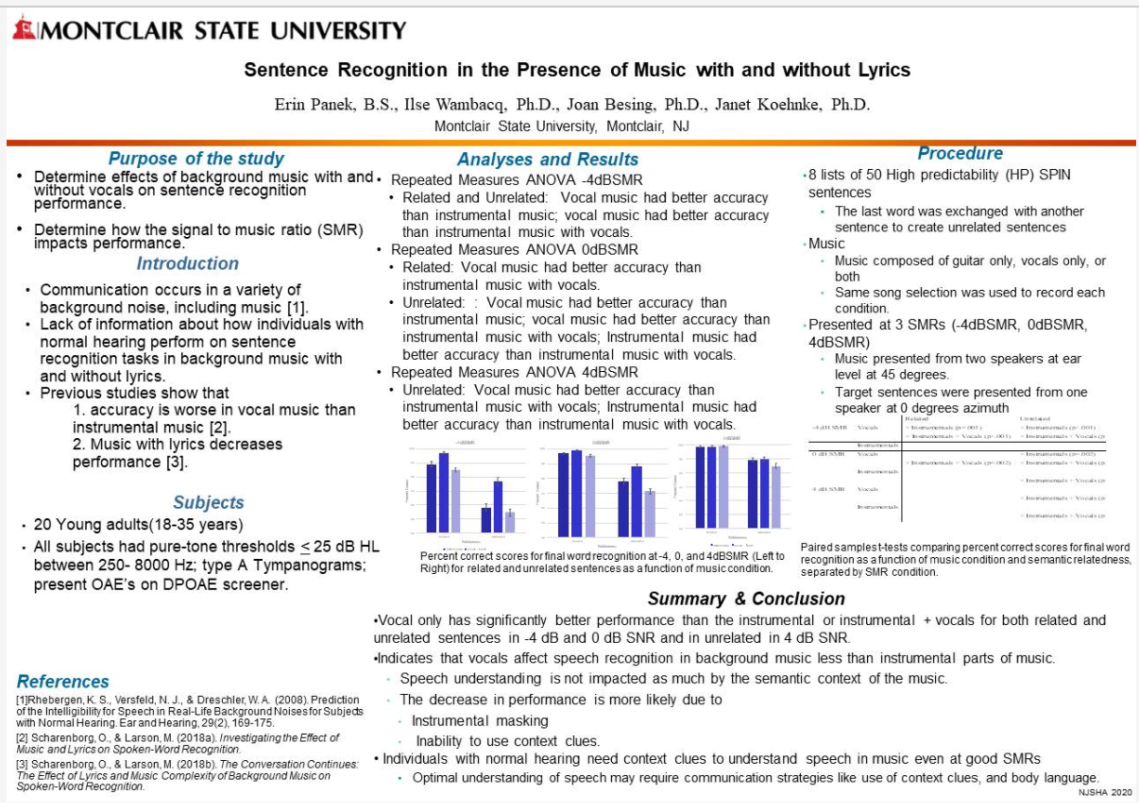
Dr. Erin Panek

Slide 11
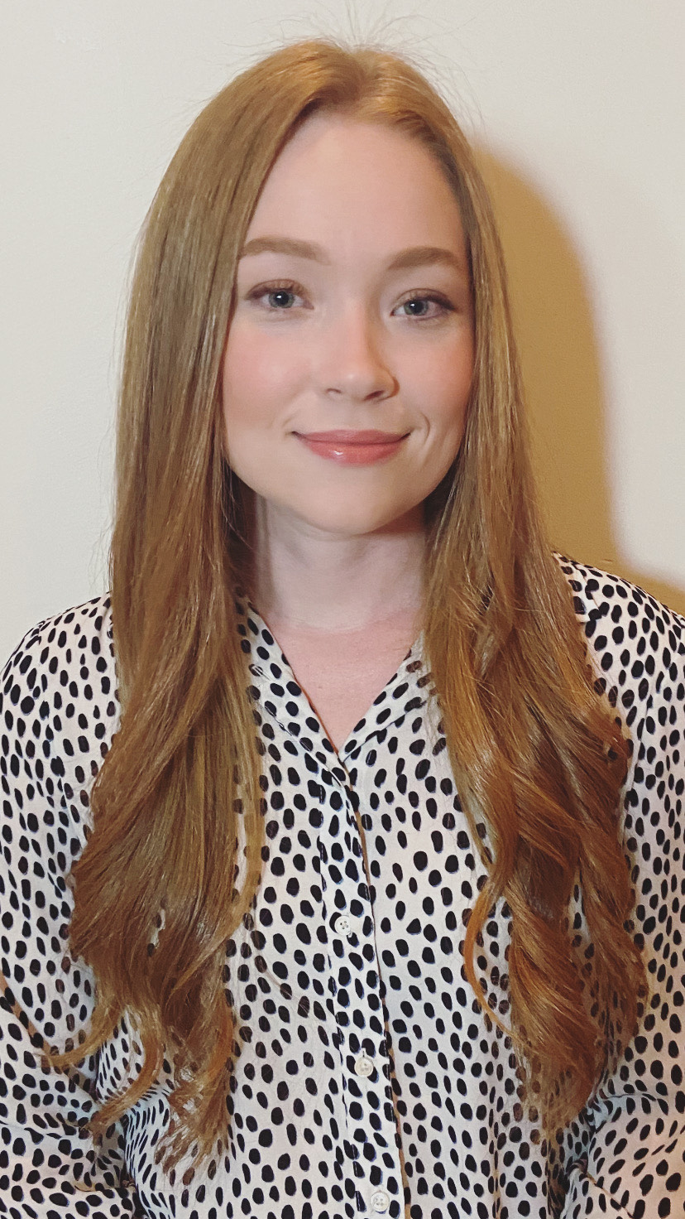
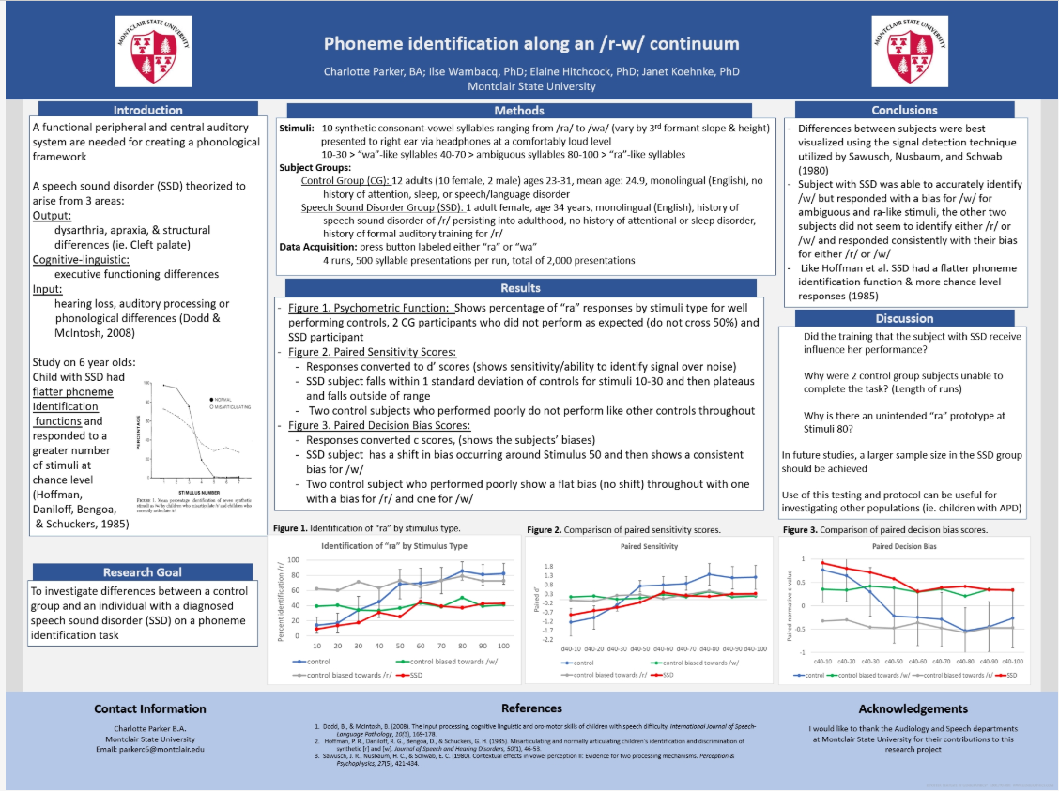
Dr. Charlotte Parker

Slide 12
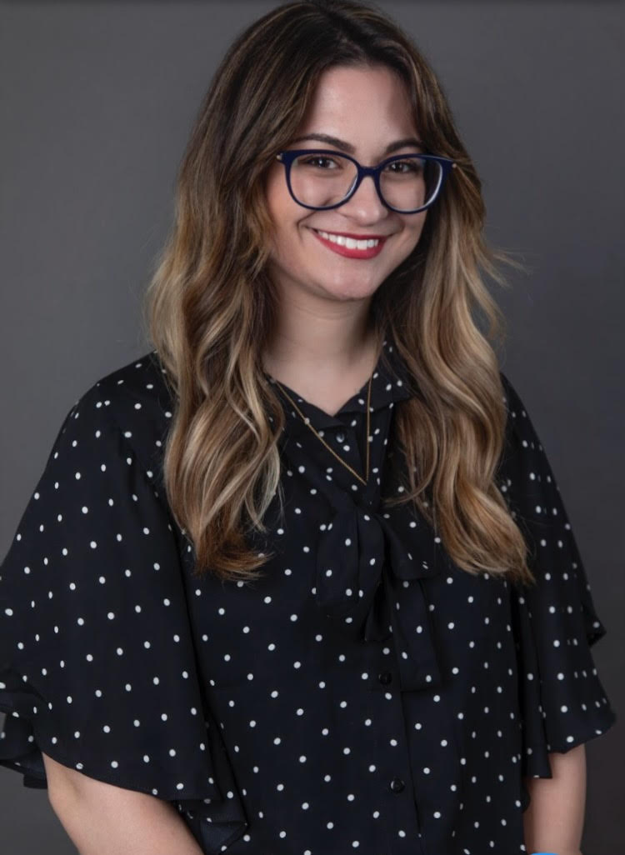
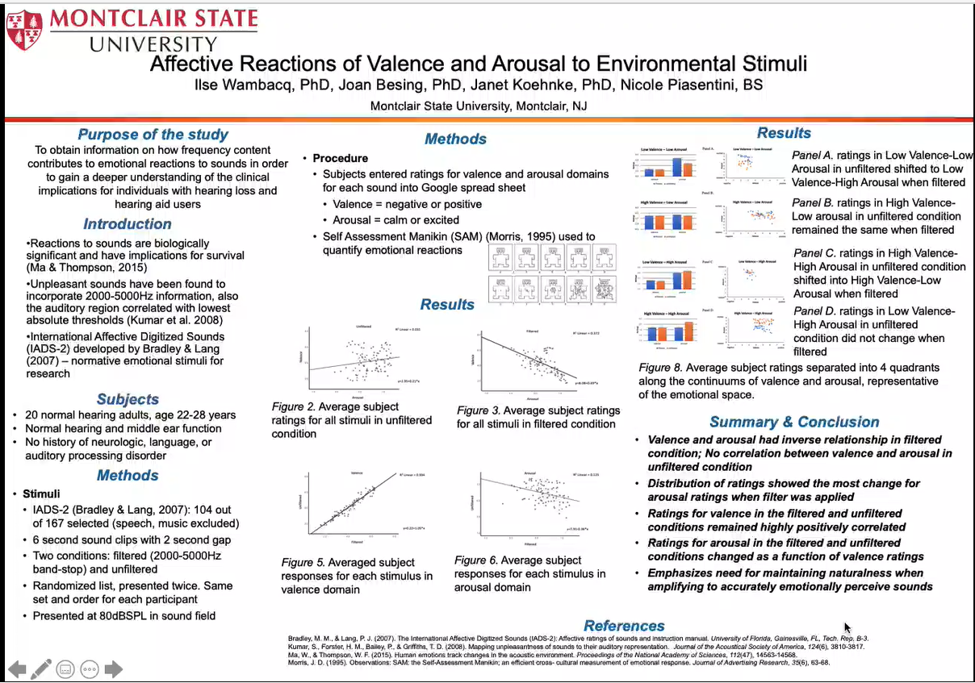
Dr. Nicole Piasentini

Slide 13
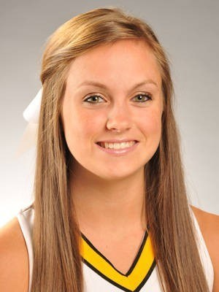
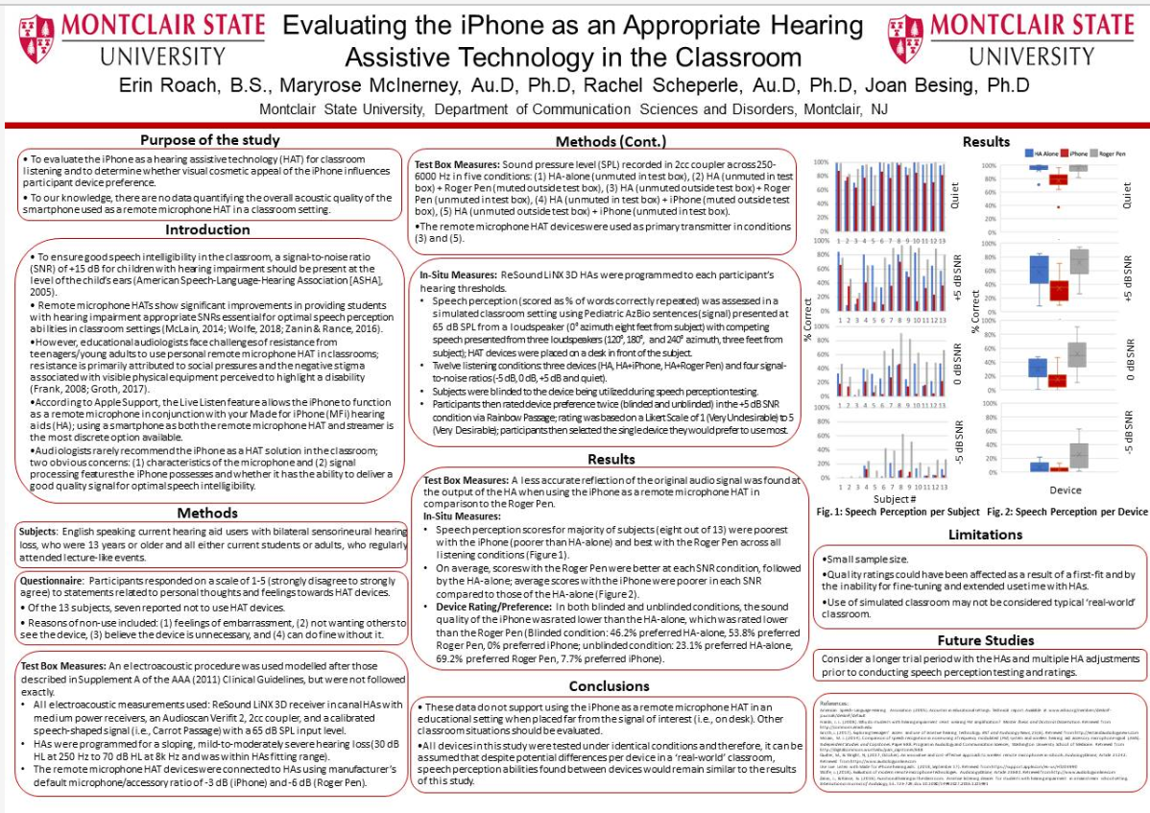
Dr. Erin Roach

Slide 14
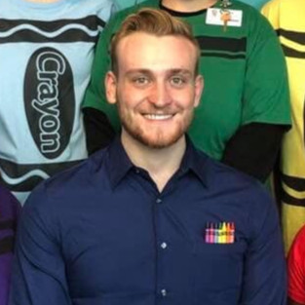
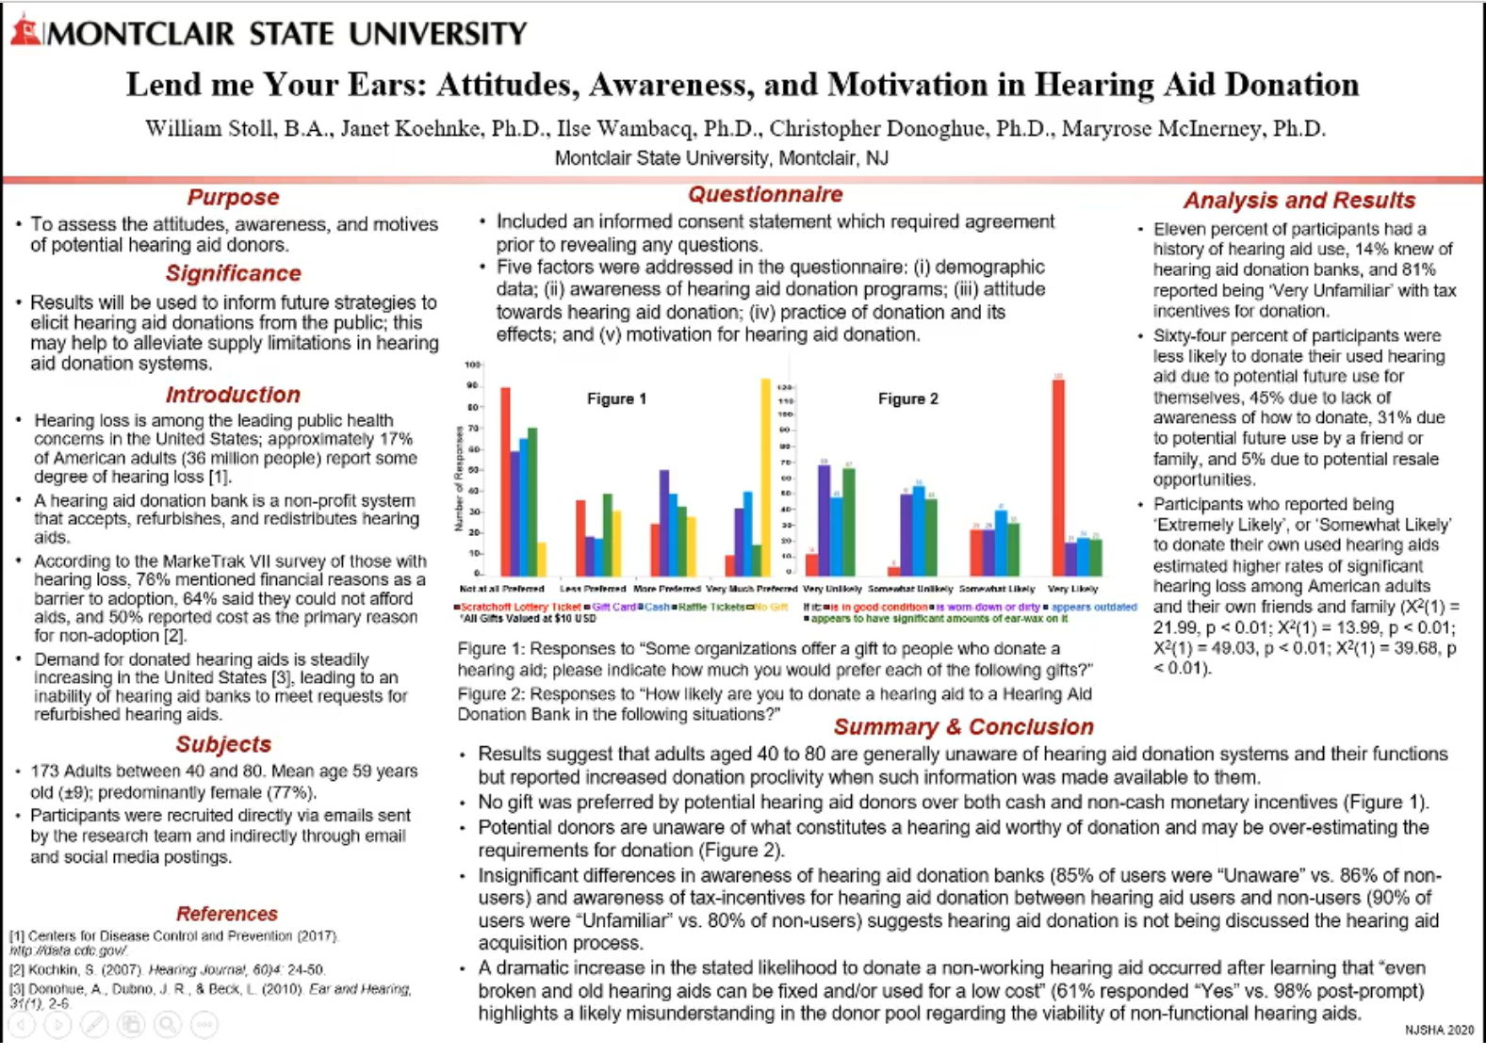
Dr. William Stoll

Slide 15
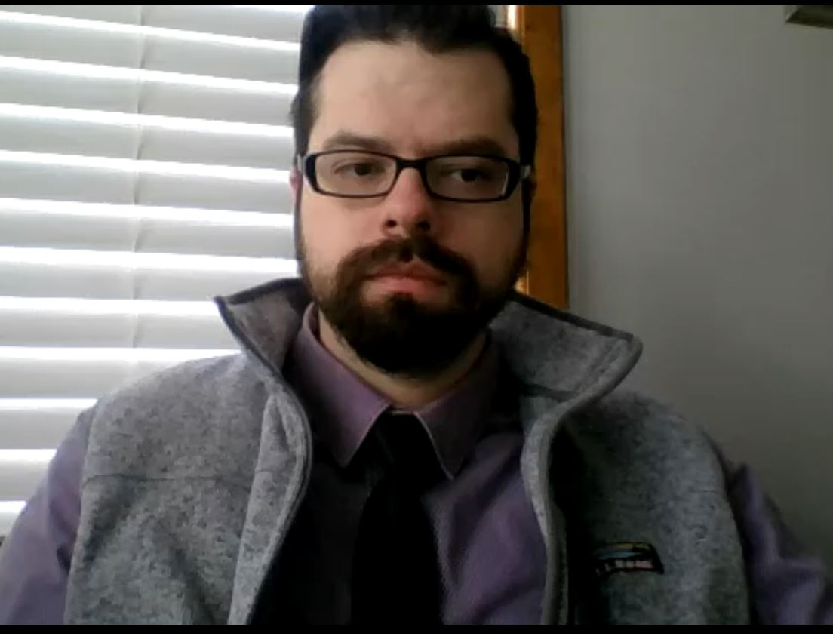
Dr. Kyle Smith

Slide 16
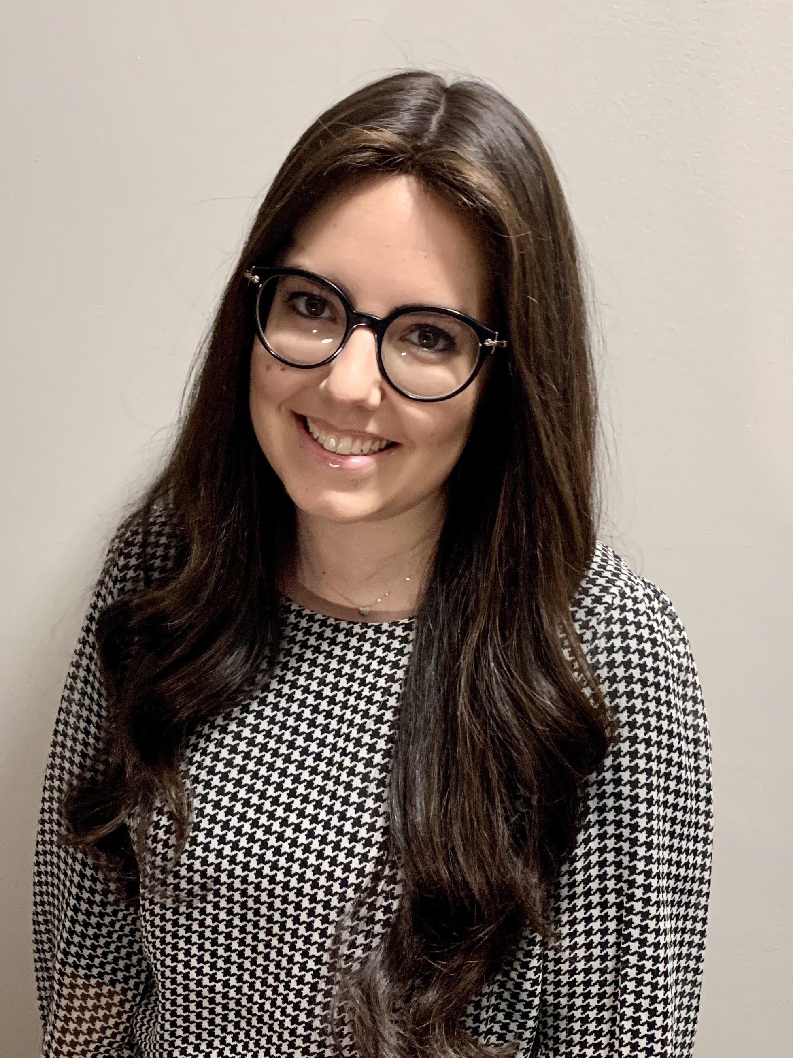
Dr. Shalva Trestman

Slide 17
Toast
Greetings graduates, family members and friends I’m thrilled to see everyone today for this wonderful occasion
Your accomplishments are worthy of celebration.
You have acquired a world-class education
made connections with your classmates and faculty members,
clinical preceptors and other mentors that will extend throughout your professional career.
Each of you will soon embark on your careers across the state, the region and perhaps across the nation.
Your career paths will likely be diverse but you are rooted in your Montclair State connection.
We encourage you to build and maintain the relationships you have developed during your tenure at Montclair.
So let’s toast to you and welcome you as alumni.

Slide 18
