Slide 1
Quantitative Reasoning for Faculty
Dr. Eileen Murray
Department of Mathematics
February 12, 2020
Office for Faculty Advancement

Slide 2
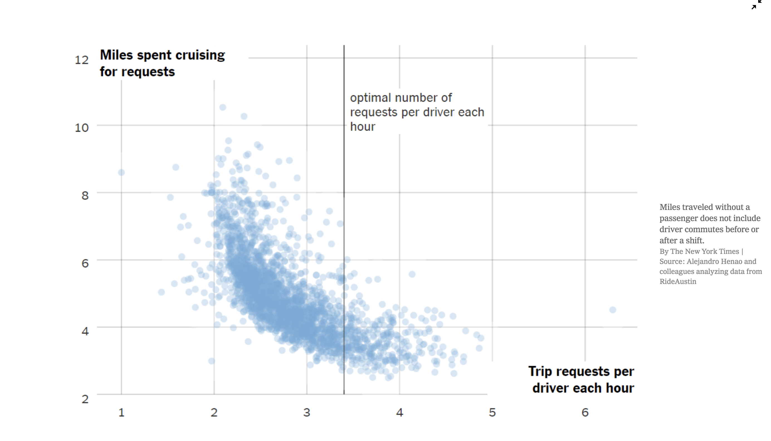
What do you notice? Talk about what you noticed that supports your claim.
What do you wonder? What are you curious about that comes from what you notice?
What’s going on in this graph? Write a catchy headline that captures the graph’s main idea.

Slide 3
Why should we care?
Quantitatively literate citizens need to know more than formulas and equations. They need a predisposition to look at the world through mathematical eyes, to see the benefits (and risks) of thinking quantitatively about commonplace issues, and to approach complex problems with confidence in the value of careful reasoning. Quantitative literacy empowers people by giving them tools to think for themselves, to ask intelligent questions of experts, and to confront authority confidently. These are skills required to thrive in the modern world.
Mathematics and Democracy, The Case for Quantitative Literacy
Notes:
Mathematics and Democracy, The Case for Quantitative Literacy, Steen, L.A. (ed.). National Council on Education and the Disciplines, 2001.

Slide 4
A rose by any other name…
Quantitative literacy
Numeracy
Mathematical literacy
Mathematical competencies
Mathemacy

Slide 5
Definitions
Programme for International Student Assessment (PISA)
“[A]n individual’s capacity to identify and understand the role that mathematics plays in the world, to make well-founded mathematical judgements and to engage in mathematics, in ways that meet the needs of that individual’s current and future life as a constructive, concerned, and reflective citizen.”
International Life Skills Survey (ILSS, 2000)
"An aggregate of skills, knowledge, beliefs, dispositions, habits of mind, communication capabilities, and problem solving skills that people need in order to engage effectively in quantitative situations arising in life and work.”

Slide 6
Skills
Arithmetic: Having facility with simple mental arithmetic; estimating arithmetic calculations; reasoning with proportions; counting by indirection (combinatorics).
Data: Using information conveyed as data, graphs, and charts; drawing inferences from data; recognizing disaggregation as a factor in interpreting data.

Slide 7
Skills
Computers: Using spreadsheets, recording data, performing calculations, creating graphic displays, extrapolating, fitting lines or curves to data.
Modeling: Formulating problems, seeking patterns, and drawing conclusions; recognizing interactions in complex systems; understanding linear, exponential, multivariate, and simulation models; understanding the impact of different rates of growth.

Slide 8
Skills
Statistics: Understanding the importance of variability; recognizing the differences between correlation and causation, between randomized experiments and observational studies, between finding no effect and finding no statistically significant effect (especially with small samples), and between statistical significance and practical importance (especially with large samples).

Slide 9
Skills
Chance: Recognizing that seemingly improbable coincidences are not uncommon; evaluating risks from available evidence; understanding the value of random samples.
Reasoning: Using logical thinking; recognizing levels of rigor in methods of inference; checking hypotheses; exercising caution in making generalizations.

Slide 10
Quantitative Literacy across Disciplines

Slide 11
Health & Wellness
Doctors need both understanding of statistical evidence and the ability to explain risks with sufficient clarity to ensure “informed consent.”
Medicine requires subtle understanding of statistics (to assess clinical trials), of chance (to compare risks), and of calculus (to understand the body’s electrical, biochemical, and cardiovascular systems).
Social workers need to understand complex state and federal regulations about income and expenses to explain and verify their clients’ personal budgets.

Slide 12
Social Sciences
The social sciences rely increasingly on data either from surveys and censuses or from historical or archeological records; thus statistics is as important for a social science student as calculus is for an engineering student.
Interpretation of historical events increasingly depends on analysis of evidence provided either by numerical data (e.g., government statistics, economic indicators) or through verification and dating of artifacts.
Study of language has been influenced by quantitative and logical methods, especially in linguistics, concordances, and the new field of computer translation.

Slide 13
Business & work
Looking for patterns in data to identify trends in costs, sales, and demand
Developing a business plan, including pricing, inventory, and staffing strategies for a small retail store
Optimizing networks to develop efficient ways to plan work processes
Understanding the value of statistical quality control and statistical process control

Slide 14
QL in your course
Choose a course you teach.
Write down an example/assignment from this course where you have either (1) incorporated QL, (2) thought to include QL but didn’t, or (3) think that QL could be incorporated.
What resources/supports do you want/need that would help you effectively incorporate this example/assignment in your course?

Slide 15
Quantitative Literacy: Why Numeracy Matters for Schools and Colleges
For democracy to prosper and flourish, we need citizens who not only are able to seek and judge information, to take a stance, to make a decision, and to act in such contexts. Democracy also needs citizens who can come to grips with how mankind perceives and understands the carrying constructions of the world, i.e., nature, society, culture, and technology, and who have insight into the foundation and justification of those perceptions and that understanding. It is a problem for democracy if large groups of people are unable to distinguish between astronomy and astrology, between scientific medicine and crystal healing, between psychology and spiritism, between descriptive and normative statements, between facts and hypotheses, between exactness and approximation, or do not know the beginnings and the ends of rationality, and so forth and so on. The ability to navigate in such waters in a thoughtful, knowledgeable, and reflective way has sometimes been termed “liberating literacy” or “popular enlightenment.”
Notes:
Niss, M., “Quantitative Literacy and Mathematical Competencies,” in Quantitative Literacy: Why Numeracy Matters for Schools and Colleges, Madison, B. L., and Steen, L.A. (eds.), National Council on Education and the Disciplines. Proceedings of the National Forum on Quantitative Literacy held at the National Academy of Sciences in Washington, D.C., December 1-2, 2001.

Slide 16
Quantitative Literacy across Disciplines
Hester et al. (2014 ) noticed that biology students are often not able to apply quantitative skills in biological contexts. Therefore an introductory molecular and cell biology course was established in which the authors integrated the application of mathematical skills with biology content throughout. A pre/post course outcome assessment shows that the students are more successful in integrating mathematics and biology items and “ made comparable gains on biology items, indicating that integrating quantitative skills into an introductory biology course does not have a deleterious effect on students’ biology learning” (p. 54).
Ramful and Narod (2014 ) investigated ways in which proportional reasoning is involved in the solution of chemistry problems in stoichiometry. The main result shows, that the proportionality tasks arising in chemistry are more complex and difficult as compared to those in the mathematics curriculum. Jukić, Matić and Dahl (2014 ) report about a case study considering the retention of differential and integral calculus concepts of a second-year student of physical chemistry at a Danish university. Their main result is that a successful application of calculus in a physical chemistry study program does not strengthen the original calculus learnt.

Slide 17
Quantitative Literacy before MSU
Reason abstractly and quantitatively.
Mathematically proficient students make sense of quantities and their relationships in problem situations. They bring two complementary abilities to bear on problems involving quantitative relationships: the ability to decontextualize—to abstract a given situation and represent it symbolically and manipulate the representing symbols as if they have a life of their own, without necessarily attending to their referents—and the ability to contextualize, to pause as needed during the manipulation process in order to probe into the referents for the symbols involved. Quantitative reasoning entails habits of creating a coherent representation of the problem at hand; considering the units involved; attending to the meaning of quantities, not just how to compute them; and knowing and flexibly using different properties of operations and objects.

Slide 18
Quantitative Literacy before MSU
A. Reason quantitatively and use units to solve problems.
1. Use units as a way to understand problems and to guide the solution of multi-step problems; choose and interpret units consistently in formulas; choose and interpret the scale and the origin in graphs and data displays.
2. Define appropriate quantities for the purpose of descriptive modeling.
3. Choose a level of accuracy appropriate to limitations on measurement when reporting quantities.

Slide 19
Quantitative Literacy before MSU
Interpreting Categorical and Quantitative Data
Summarize, represent, and interpret data on a single count or measurement variable
Summarize, represent, and interpret data on two categorical and quantitative variables
Interpret linear models

