Slide 1
Teaching Strategies f or Large Classes: from Political Science to
Earth & Environmental Science
Tony Spanakos, Political Science, and Josh Galster, Earth & Environmental Studies

Slide 2
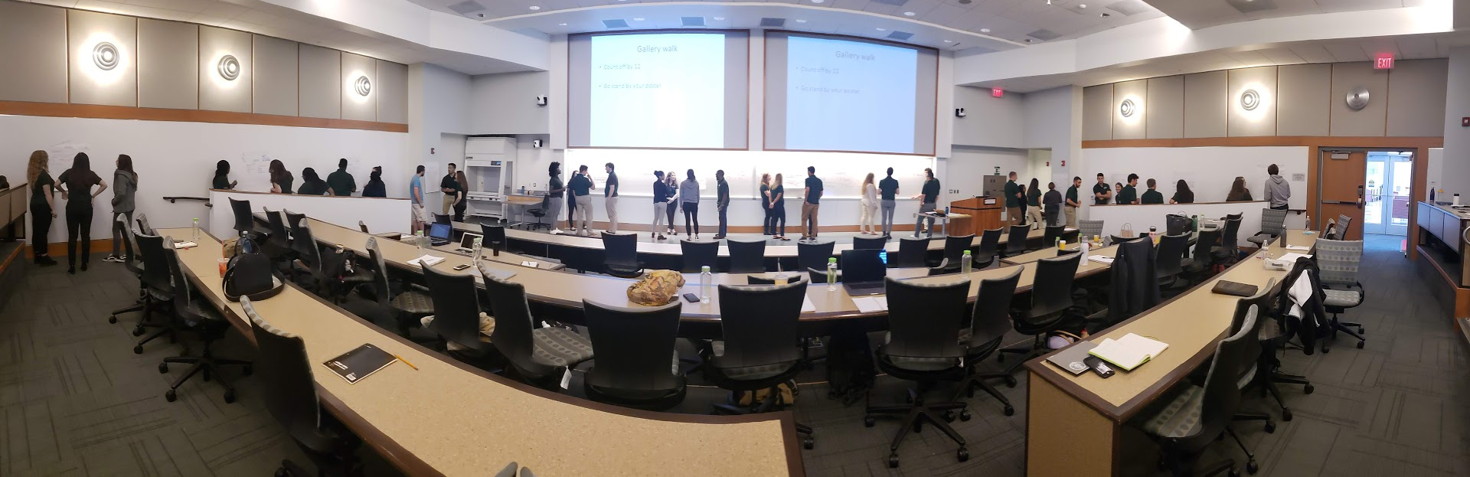
Today’s goals
What makes large classes unique
How to approach & design a large course
Strategies for delivering a large class

Slide 3
Some initial questions to consider…
Who’s taught one?
Raise your hand if…
Who are the enrolled students? Majors? Non-majors? A mix?
Course goals?
Notes:
Going to poll the audience here to see what they think is the cutoff for a large class vs. not.

Slide 4
Do the course goals include:
Teaching material/content?
Building specific skills?
Some combination of the two?
How will the class size affect which of these are prioritized and what techniques we use?

Slide 5
A matter of balance
Engage with the students to keep things interesting
Conveying important or foundational knowledge
Would it be different for majors vs more of a General Education population?
What are some key concepts that you want students to remember in 6 months?

Slide 6

Large classes and challenges
Take a minute and write down 2-3 challenges for teaching large classes
Turn to a neighbor and share 1-2 of them.
Montclair State Photography

Slide 7
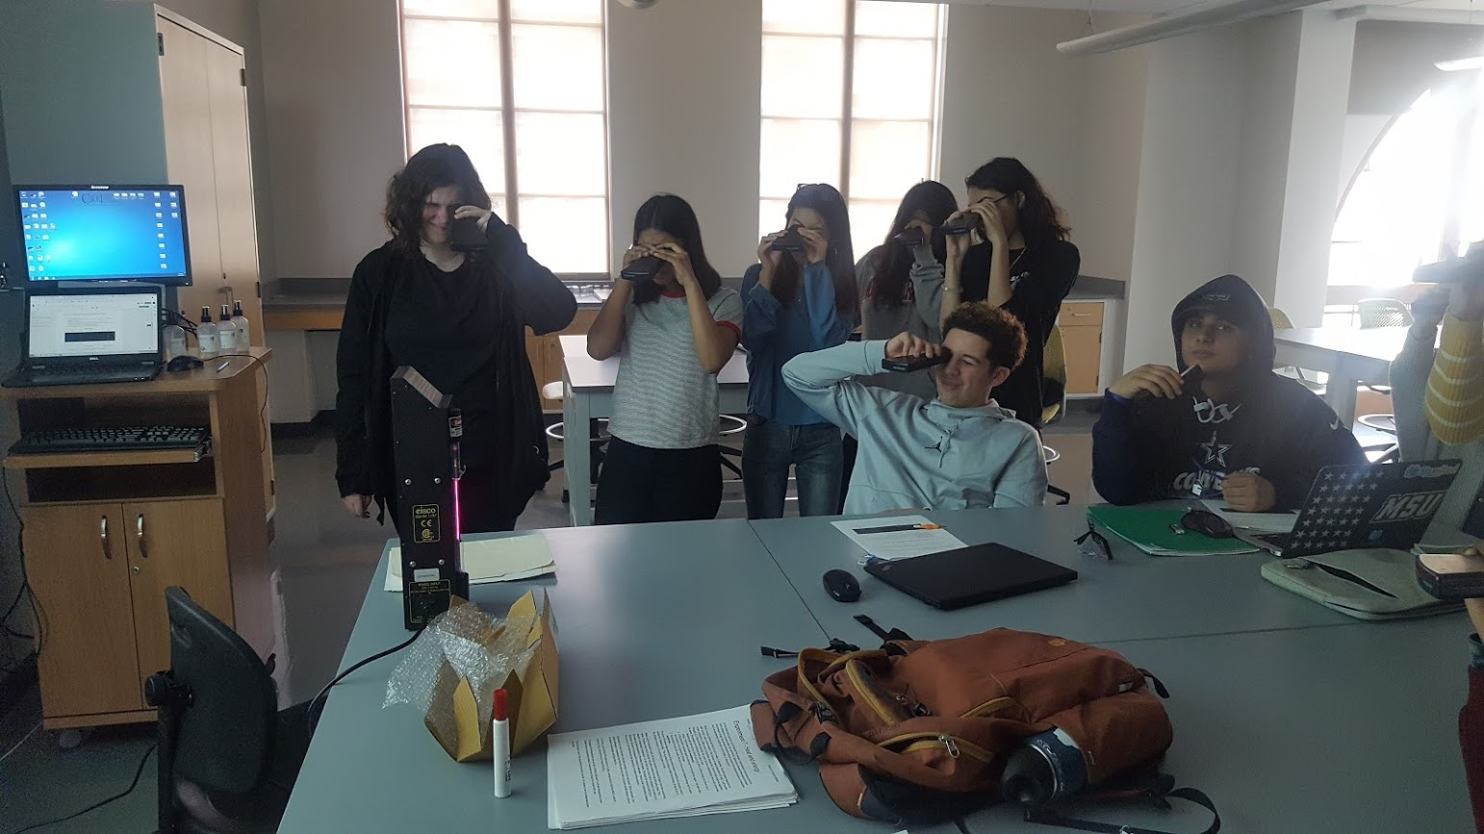
Classroom Goals and Techniques
General goals
  Student centered
  Engagement
    Make it relevant to their lives
    Bring your personal story
Use style that is comfortable for you/ makes sense for the subject
Balance:
  enjoyment/motivation with
  learning material (content and skills) actively
  Getting feedback
  May need to cover less…

Slide 8
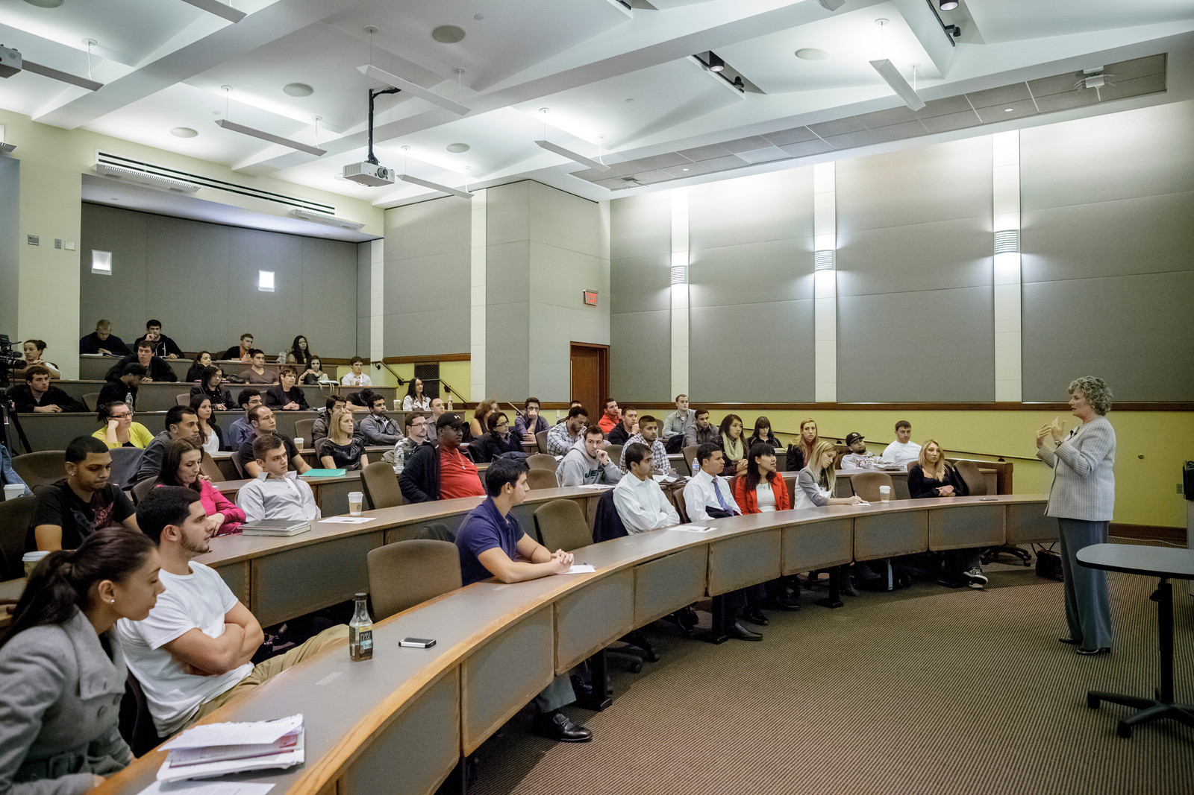
Classroom Space
Spacing issues
Seating
Server concerns
Alumni Ellyn McColgan speaking to SBUS students about her career in business.
Montclair State Photography

Slide 9
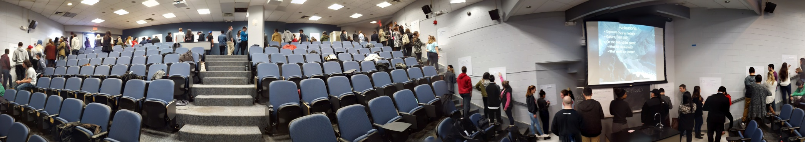
Tactics and Techniques
  Participation on day one
  Participation: polling, sticky notes, polls everywhere
  Padlet
  Each class – goals, beginning and end
  Two minute papers/during class/end of class questions

Slide 10
What to Do or Prioritize in Your Classrooms?

Slide 11
Today’s goals
What makes large classes unique
How to approach & design a large course
Strategies for delivering a large class

Slide 12
Supplemental material
Montclair State’s Office for Faculty Advancement page on Teaching Large classes:
https://www.montclair.edu/faculty-advancement/teaching-and-learning-resources/teaching-topics__trashed/teaching-large-classes/

Slide 13
Engagement Triggers - examples
Interpreting Graphs
Making Calculations
Demonstration/making predictions
Brainstorming
Reading to solve a problem
Physical prop
Evocative visual/picture
Cartoons
News Clips & Articles
Video clips
Think-Pair-Share
Minute paper
Muddiest Point
ConcepTests
Question of the Day
Small group discussion
Clicker
Google Earth (or other tech)
http://serc.carleton.edu/NAGTWorkshops/earlycareer/teaching/LargeClasses.html

Slide 14
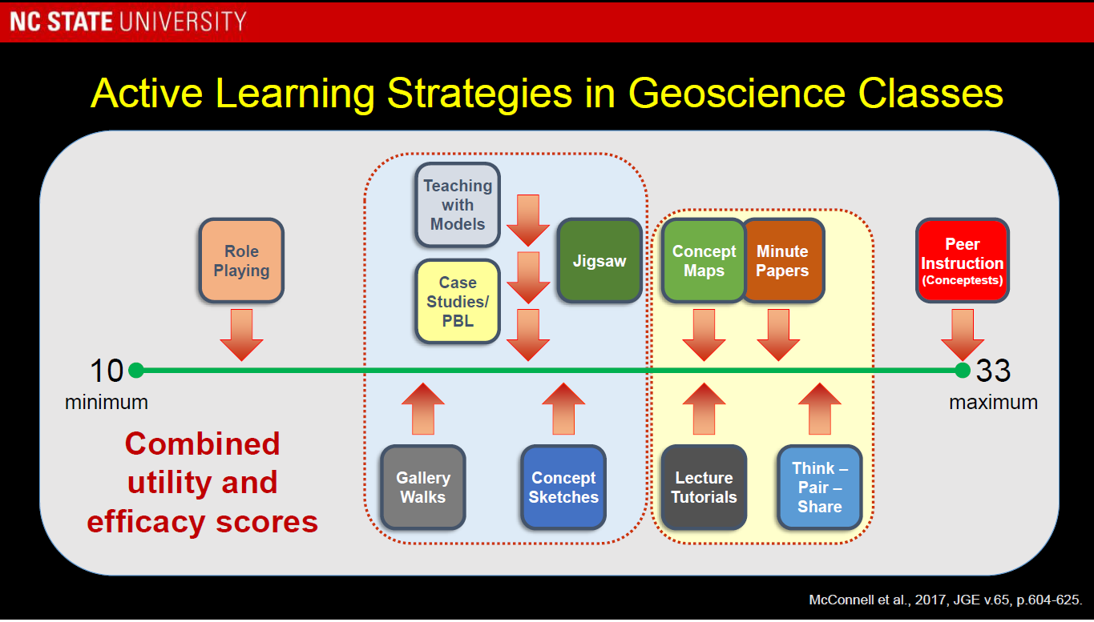
From David McConnell’s 2019 talk

