Slide 1
Clean water
The struggle for environmental justice in flint and standing rock

Slide 2
Water uses
Notes:
Sources: http://styletips101.com/skin-care/skin-care-during-winter.html
http://dantudor.com/how-the-habit-of-drinking-water-will-make-you-a-more-effective-coach/
http://braindiet.com/6-dangerous-chemicals-you-must-avoid-while-washing-dishes/
http://www.todayifoundout.com/index.php/2014/01/causes-pasta-froth/
http://modernfarmer.com/2015/07/irrigation-101/

Slide 3
Is there a human right to water?

Slide 4
The human right to water
“The human right to water entitles everyone to sufficient, safe, acceptable, physically accessible and affordable water for personal and domestic uses. An adequate amount of safe water is necessary to prevent death from dehydration, to reduce the risk of water-related disease and to provide for consumption, cooking, personal and domestic hygienic requirements.”
Notes:
The UN did not recognize water as a human right until General Comment NO 15
Discusses consumption
Cooking
Personal and Domestic Hygiene
Safe, acceptable, accessible, affordable water

Slide 5
Human right of water and COMMUNITY
Notes:
Sources: https://newsela.com/articles/st-louis-fountains-schools/id/21247/
https://www.amazon.com/Samsung-RF31FMESBSR-Refrigerator-Automatic-Sparkling/dp/B00COKDPUQ

Slide 6
Environmental racism
Environmental Racism
Environmental Justice

Slide 7

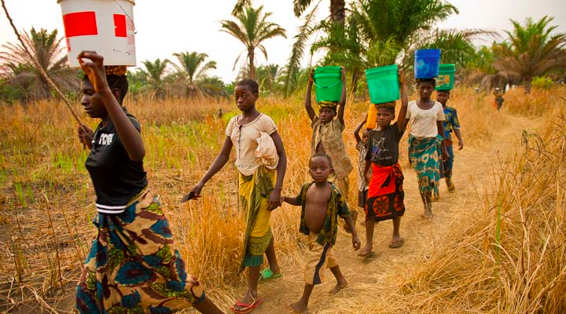
Sources: https://www.nature.org/ourinitiatives/regions/africa/wherewework/tanganyika-people-slideshow.xml
http://www.broadsidedpress.org/responses/2016flint/Flint-TallyingUp.pdf
Notes:
Sources: https://www.nature.org/ourinitiatives/regions/africa/wherewework/tanganyika-people-slideshow.xml
http://www.broadsidedpress.org/responses/2016flint/Flint-TallyingUp.pdf

