Slide 1
The Gender wage gap
Presentation by: Amanda Fins

Slide 2
The Do Now
Please Define:
Feminism
Sexism
Gender
Discrimination
Implicit Bias

Slide 3
Terms Defined
Feminism: The theory of the political, economic, and social equality of the sexes; also organized activity on behalf of women's rights and interests.
Sexism: Prejudice and/or discrimination against people based on their real or perceived sex. It’s based on a belief that there is a natural order based on a person’s sex

Slide 4
Continued…
Discrimination: The denial of justice and fair treatment by both individuals and institutions in many arenas, including employment, education, housing, banking and political rights. Discrimination is an action that can follow prejudicial thinking.
Implicit bias: the unconscious attitudes, stereotypes and unintentional actions (positive or negative) towards members of a group merely because of their membership in that group.

Slide 5
Is sexism in the past?

Slide 6
The Gender Wage Gap
“Women make 77 cents to every man’s dollar”
The gender wage gap is a measure of what women are paid relative to men. It is commonly calculated by dividing women’s wages by men’s wages, and this ratio is often expressed as a percent, or in dollar terms.

Slide 7
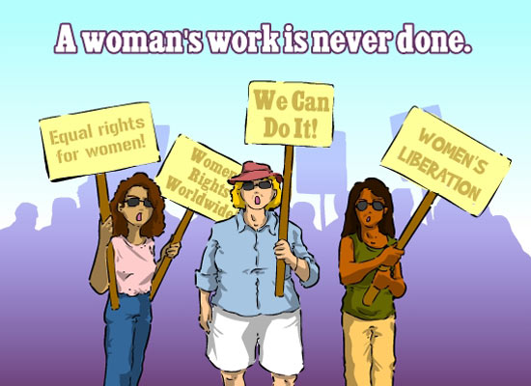
Why should this matter to you?
"A Woman’s Work Is Never Done Women’s Equality Day." AskIdeas.com. N.p., n.d. Web. 4 Apr. 2017. <https://www.askideas.com/a-womans-work-is-never-done-womens-equality-day/>.

Slide 8
How much are women actually losing?
On average one woman loses about $10,000 a year
In her lifetime she loses about $400,000

Slide 9
Who does this wage gap affect?
Short answer: EVERYONE
The wage gap affects all women from all walks of life and affects men as well.

Slide 10
Class Discussion
Why are these arguments problematic?
1. The wage gap has nothing to do with sexism; it has to do with differences in individual career choices that men and women make.

Slide 11
Continued…
2. The wage gap decreases the more education a woman has
http://graphics.wsj.com/gender-pay-gap/

Slide 12
Continued…
3. Men are more willing to work long hours without advance notice

Slide 13
How do we close the gap?
Eliminate pay secrecy
Eliminating pay negotiation
Having employers not rely on previous salaries when determining the salary for a new employee
Making work easier on mothers such as with: affordable child care, paid parental leave, more flexible hours.

Slide 14
What role can you play?
With a different group, think about 1-3 things you personally can do to apply this lesson to yourself now or in the future

Slide 15
Reflection Time
Everyone write down at least one comment or question about anything you heard in the presentation today

