Slide 1
What was your last meal? List the ingredients.
Notes:
Hello everyone, my name is Heather Francis. I’m a junior at Montclair State University, currently interning for the Human Rights Education Project on Food Insecurity. I’m studying International Justice, with a concentration in Environmental Justice and minoring in Nutrition and Food Science. Today I will be teaching you about Food Insecurity, and together we will brainstorm ways we as students can end Food Insecurity.
To begin class, I ask you think about the last meal you had, whether that be breakfast, lunch or last night’s dinner. Write down a list of ingredients for the meal, and think about where each individual part of the meal came from. Rate how nutritious this meal will be from 1 to 10.
Why do you think that was nutritious? Why do you think this?
Have students write down these ingredients in notepaper in their notepaper provided in the folder.
For example, if you ate an apple this morning, the apple came from a farm. Or if you ate a poptart, that came from a store, but where did the ingredients come from?
After 3 minutes, we’ll come back to a discussion.
Now that you’ve had time to think about your most recent meal, may I have a few students share what their most recent meal was, and the extent they know where the spefici meal, and its’ ingredients came from?
The point of this activity was to encourage you to being thinking about your personal relationship with food.

Slide 2
Notes:
When you hear “food insecurity,” what definition comes to your mind?

Slide 3
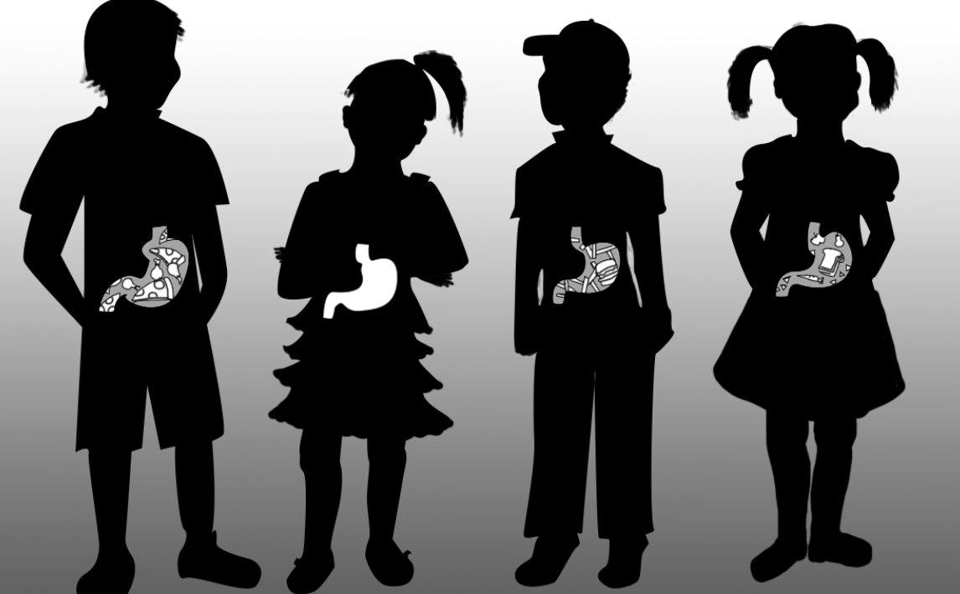
Food Insecurity
Food insecurity refers to USDA’s measure of,
To limited or uncertain availability of nutritionally adequate foods, and,
2) A lack of access, at times, to enough food for an active, healthy life for all household members.
Notes:
There two definitions for food insecurity: By the USDA definition it means a limited or uncertain availability of nutritional adequate foods, and a lack of access, at times, to enough food for an active, healthy life for all household members.
Food-insecure households are not necessarily food insecure all the time. Food insecurity may reflect a household’s need to make trade-offs between important basic needs, such as housing or medical bills, and purchasing nutritionally adequate foods.
Some individuals sell their food stamps for cash so they can pay rent, utilities, or hospital fees that month. This is an illegal practice, but is regularly used.
Most individuals who are food insecure, are living on $2.00 a day for food, which is not enough for a “healthy meal” or sometimes a meal at all. Mothers, who bore the child caring costs, more likely than not are the most affected by food insecurity because they feed their everyone in the house first before themselves.

Slide 4
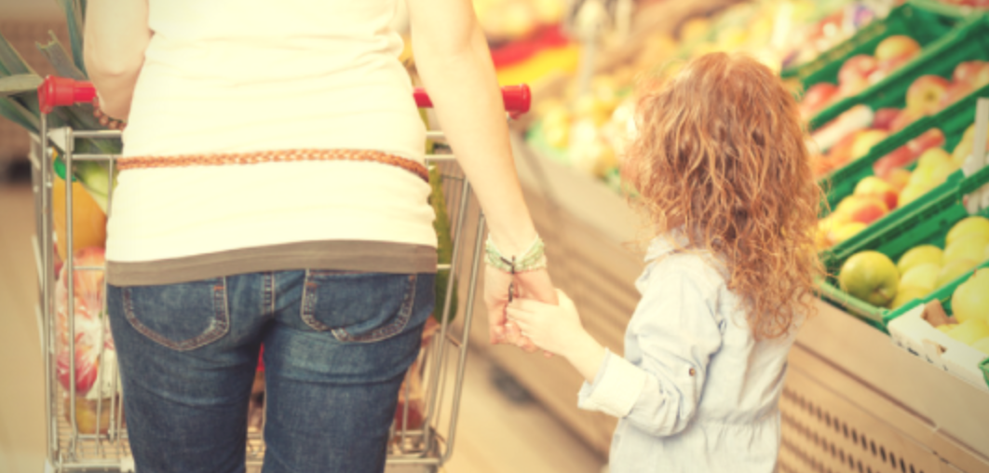
How many Americans are food insecure?
Food Insecurity affects 1/5 of the American population, affecting close to 49 million individuals
Notes:
Ask students first, “How many Americans are food insecure before placing the answer on the screen.

Slide 5
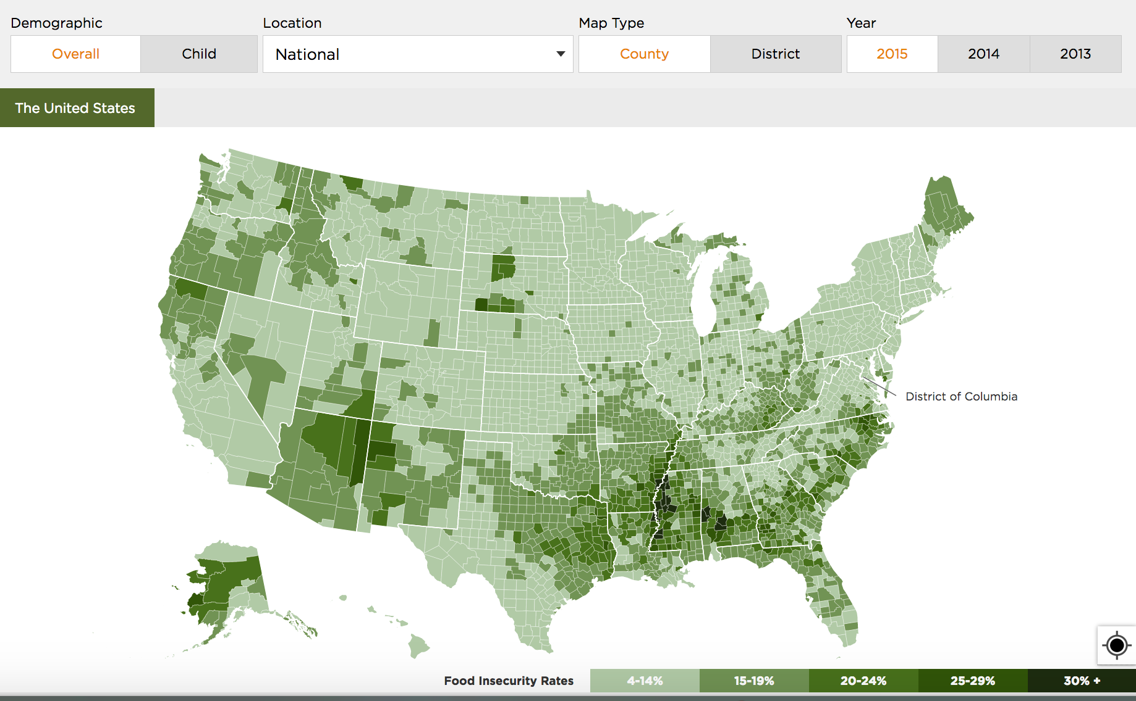
Food Insecurity in America
Notes:
This map is an overview of food insecurity in America. The darker the square on the map, the more condensed food insecurity is in that area.
From this map, can anyone draw observations about where in the country exists?
Food Insecurity is more prevalent in southeast United States, North east, Hawaii, and Parts of the West Coast
Why do you think Food Insecurity is the most condensed in the Southern United States?
Extreme poverty, obesity, and marginalized groups of individuals are effected by food insecurity. Those represented in the map are more likely to live in extreme poverty, and face issues of marginalization.

Slide 6
Who is most effected by food insecurity?
Notes:
Individuals who are at high-risk of being food insecure are more likely to live in Southern United States
Most of these high-risk counties have experienced persistent poverty
Persistent poverty is more likely to exist diverse communities, so consequentially food insecurity affects more immigrants, Latino, and black Americans
Immigrants are morel likely to face the harshest burdens of Food Insecurity because there is a little assistance from the government available, these individuals aren’t able to obtain a license, and they’re working jobs that pay little to nothing.
Populous counties with low rates of food insecurity are home to some of the largest numbers of food- insecure people.
For example, Los Angeles County, California has a relatively low rate of food insecurity of 12%, but is home to an estimated 1.2 million food- insecure individuals, including more than 480,000 food-insecure children

Slide 7
About 1 million New Jerseyeans are living with Food Insecurity
Notes:
New Jersey has one of the highest cost of living in the country, we have one of the highest percentages of immigrants, and between two major cities: Philadelphia and New York. New Jersey has about 1 million individuals living with food insecurity. Our population is 9 million, so that means every 1 in 9th person is living with food insecurity.
Is that fair?

Slide 8
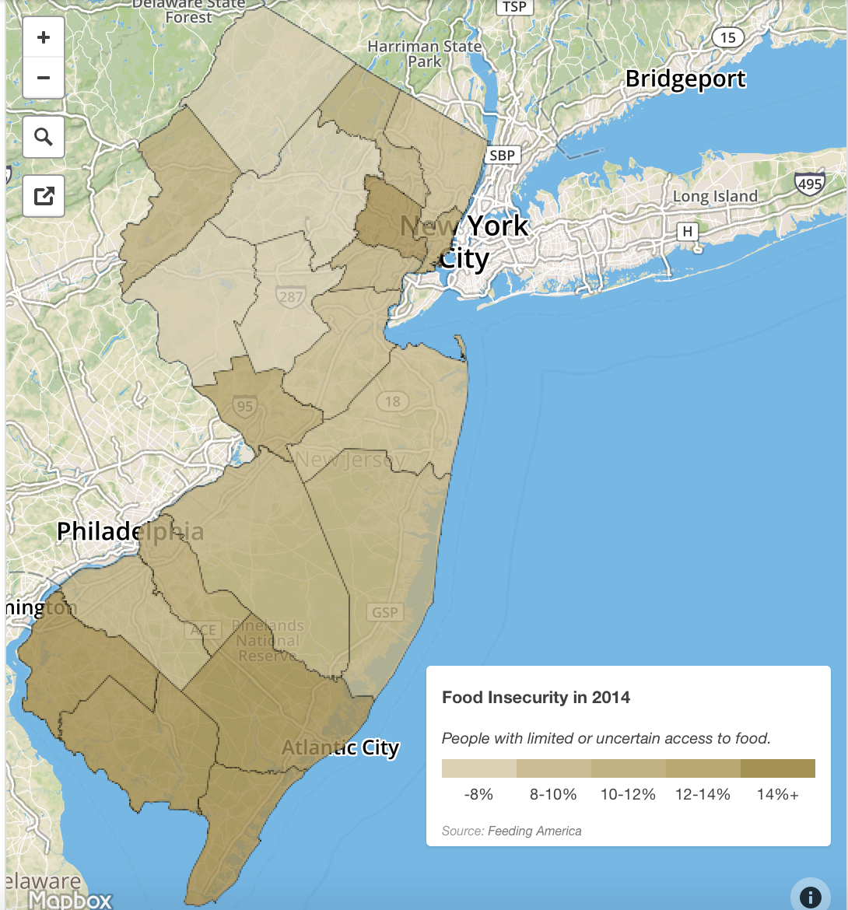
Food Insecurity in New Jersey
Notes:
As you can see, this map is similar to the map of America where the darker regions reflect a higher amount of food insecure individuals.
Essex County, in North Jersey portrays a higher amount of Food Insecure individuals, which is where Newark sits.
South Jersey has a higher proportion of food insecure individuals.
Can you draw any conclusions or observations from this map?

Slide 9
Let’s go grocery shopping!
Notes:
Split the class in half or into four groups (if the class is larger than 20 students)
In your folder, there is a work sheet titled Walmart vs. Whole Foods.
Ask students the following questions after the activity
- Was this activity difficult?
What if you had to choose based on your income? Would it be different?
Let’s say you have a middle-class income, $59,000 a year, and you can choose to shop? Where would you go? And why?
From this activity, can some tell me what any of this has to do with Food Insecurity?
Why is there a stigma on shopping at Whole Foods? Why is there is stigma for shopping at Walmart?

Slide 10
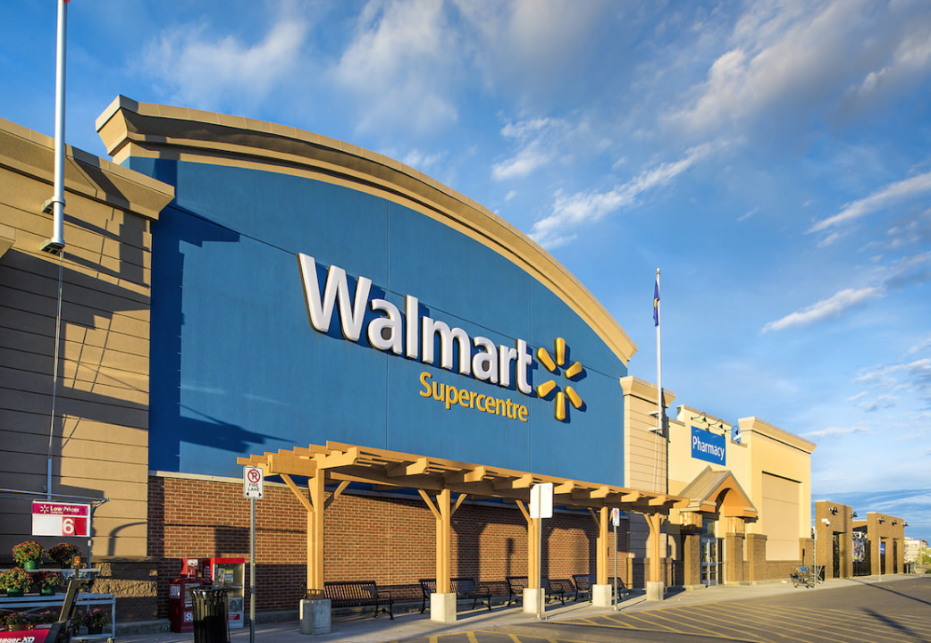
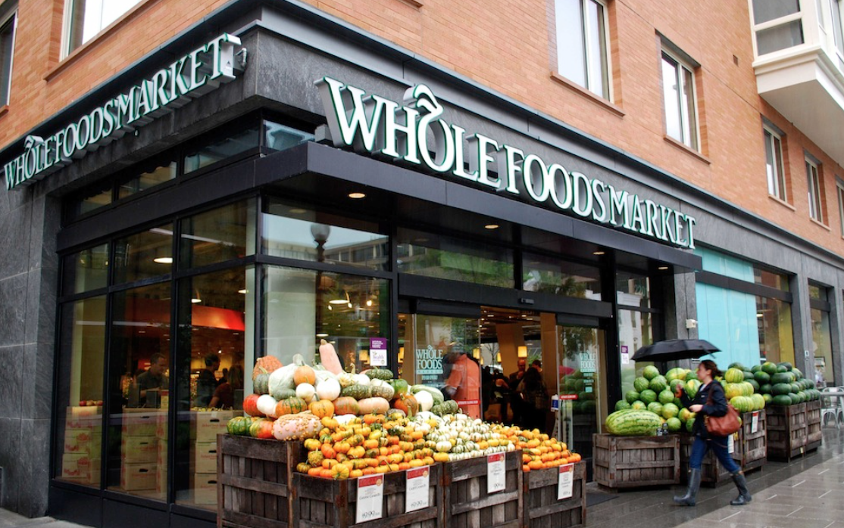
Notes:
Let’s talk about shopping!
Big grocery store chains, take billions of dollars annually in “slotting fees” and “vendor allowances” from big food corporations wanting to get there products predominately place.

Slide 11
Notes:
Whole Foods is one of very few grocery stores doing anything for low-income areas
Their mission: “to improve communities by providing good jobs, access to fresh foods and by serving as a unifying presence through events and various outreach program”
Placed in Newark, creating new jobs for individuals in the area that provides benefits and salary
Still struggles to attract shoppers because of high-prices
In Newark specifically, Whole Foods comes in, angering local residents because of the high expense of food, and high amount of low-income individuals living in the area.
Newark has been facing a lot of criticism for undergoing gentrification, which is the renovation of urban areas to house middle-class and more affluent individuals. Whole Foods is a part of this “gentrification” process. This gentrification, offered jobs to individuals living in urban areas where they are now able to make a decent living because Whole Foods pays a living wage, while offer health benefits to their employees.
Whole Foods is considered “whole paycheck,” meaning, consumers are more likely to spend most of their pay check at Whole Foods. Walmart is dirt cheap, and has lower prices than most grocery store. Yet, as many of you pointed out. There is more to food than cost. Shopping at Whole Foods, you’re more locally to shop organic, local, non-gmo, and this store does not add any artificial colors, sweeteners, or preservatives. Walmart, you have some of those choices but the cheaper version that is non-organic sits on the shelf next to it, with a lower price. In our society we are taught to spend less, to have more.
This is problematic, because this affects our health. By choosing to eat at fast food restaurants, or buy frozen meals out of cost, we are compromising our well-being. For food insecure individuals, they don’t have the choice. They are forced to shop at grocery stores like Walmart, where food costs little-to-nothing. This is why on average, those who are food insecure are more likely to be overweight, obese, and face health issues like heart disease or diabetes.
Shouldn’t we support individuals who eat healthy? Shouldn’t we support individuals who don’t? Why create an environment in our society where we judge individuals who don’t have the choice to eat healthy, don’t understand the lack of choice they have to eat healthy, don’t understand their purchasing powering, or utilize their purchasing power to eat healthy?
What does it mean to be healthy anyway, right? We are taught from a young age to eat your greens, and all your veggies. What does this really mean? What does the government have to say about it?

Slide 12
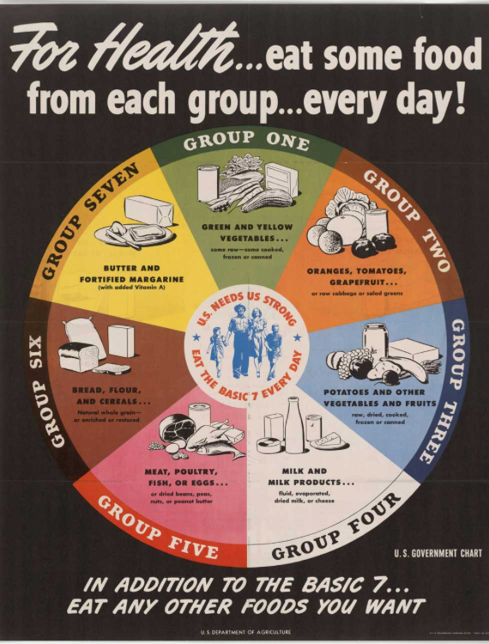
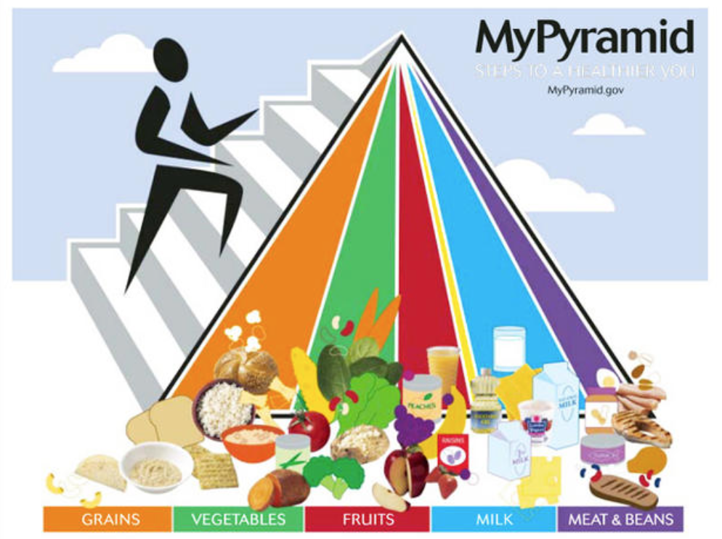
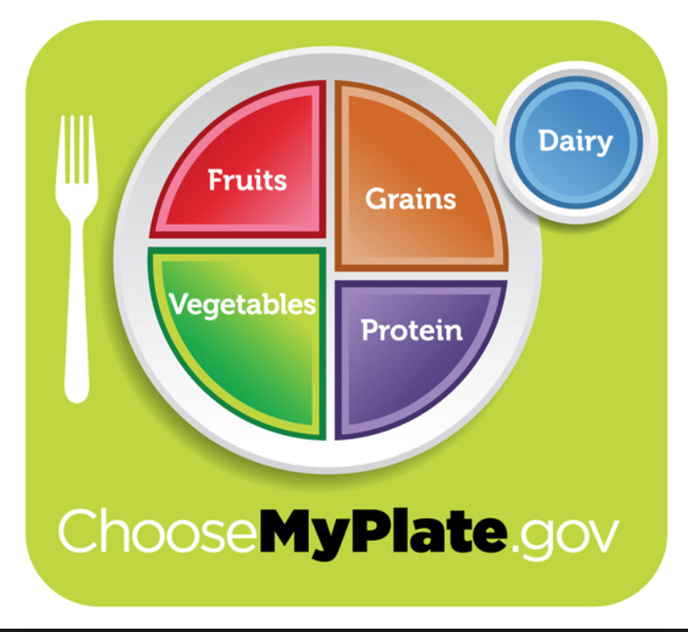
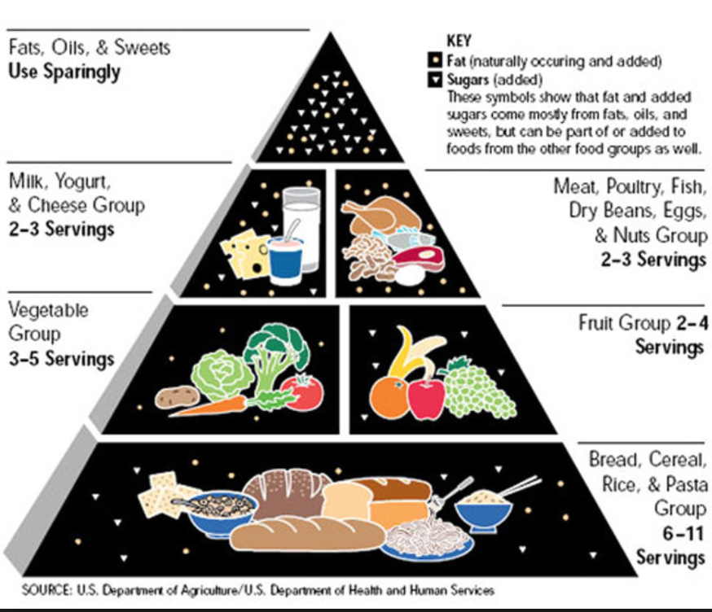
Notes:
What role does the U.S. government play in our food industry?
The USDA (United States Department of Agriculture) and the FDA (Food and Drug Administration) creates laws about food labeling, labeling requirements for terms: organic, fair trade, non-gmo, and provides nutritional guidelines on what to eat.
On this slide, I have a timeline of different food pyramids beginning in the early 1900’s, to now, using the My Plate.
Referring to the first pyramid:
industries objected to the position of the USDA and stigma of how little servings consumers were being recommended.
The meat and dairy industries were worried they were going to lose money, even though science claimed consumers should eat less servings of meat and dairy
Soda companies pressured the USDA to use language that didn’t ask consumers to avoid certain products, but instead focus on certain foods containing necessary nutrients
Take all of this with a grain of salt, especially guidelines for “how to eat,” because cultures practice different ways of eating, those live in food insecurity don’t have the ability to follow these guidelines, and these guidelines are constantly changing, and are confusing.
Our government guides consumer on how to eat, but they also place regulations on food labels in our society. They have huge role in determining what aid is given to those who need food, who are living on basically $2.00 a day.
Ask students: What issues do you think food insecurity causes for our communities?
-dependency on governmental assistance
-higher health complications including diabetes, obesity, cancer, heart complications, depression, eating disorders, and more
-inability to purchase high quality fruit and vegetables
Ask students: Do you think individuals wish to be food insecure?
-No they don’t, but there’s no support to end food insecurity only to sustain the ongoing dependency on governmental assistance

Slide 13
Governmental Assistance
SNAP (Supplemental Nutrition Assistance Program)
WIC (Supplemental Assistance Program for Women, Infants, and Children)
Notes:
Ask students: Who here knows what SNAP and WIC are?
I just want to give you a basic overview of both of these program our country currently provides. Our President, Donald Trump has introduced the Harvest Box, which would upend the SNAP and WIC program. We aren’t going to talk about the Harvest Box, but I included an article about it. The reason I’m not going to talk about it, is because currently New Jersey residents are part of these two programs and these are more relevant to this lesson.
SNAP is the Supplement Nutrition Assistance Program, and it is a federally funded program that provides low-income individuals and familys the opportunity to purchase food. SNAP beneficiaries purchases food through an EBT card, known as a “Quest” Card. Stores must apply to be a SNAP licensed store.
WIC is a state-run program helping low-income families purchase healthy food through WIC checks they receive in the mail. WIC checks have a list of certain food items customers are only allowed to by. Just like SNAP, a store must be a licensed WIC store for individuals to use their checks.

Slide 14
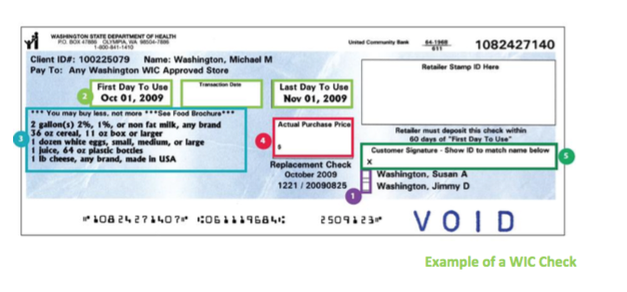
Notes:
This is an example of WIC check.
On this check, individuals were allowed milk, cereal, eggs, juice, and cheese.
Some checks don’t have the opportunity for families to purchase fruit/vegetables, and if they do, it is very little.
WIC does not account for allergies, or cultural selection of foods. WIC is problematic because it is selective, and only available to those who don’t have allergies, or can’t eat meat/dairy/eggs out of personal choice, or because of their culture.

Slide 15
Notes:
Food Justice: Ask Students if they know what Food Justice is
Food Justice is the right of communities to grow, sell, buy, and eat healthy food.
What is healthy food?
This question is difficult to answer because our media portrays healthy as “moderation” and you never see commercials with fruit or vegetables.
The next activity will go into depth on the confusion on what it means to be healthy

Slide 16
What do our parents, friends, media, and the government say about eating healthy?
Notes:
After our conversation today, have students split up into groups of four, and have them discuss the implications of these four topics that effect our food choices:
Each group will get one of these topics and a poster to write on
Each group will write down how food insecurity is effected by these four topics
Parents
Friends
Media
Government
After the activity
ask students how they believe these choices can overwhelm individuals who are living with food insecurity?
Ask students about how they personally feel about healthy eating choices and the importance of it?
Ask students if they believe our schools should focus more on how to lead a healthy lifestyle?

Slide 17
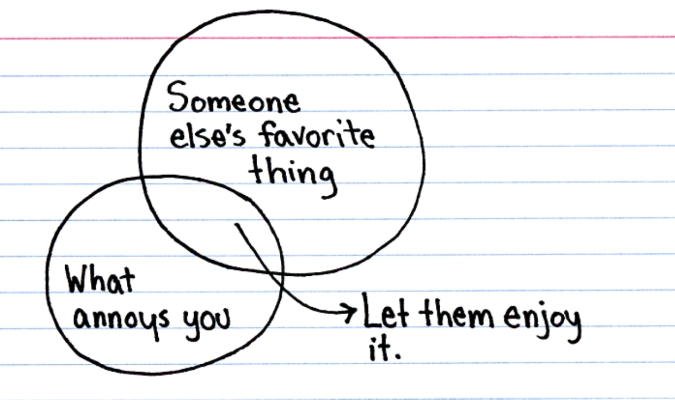
Notes:
Don’t Yuck My Yum
Write down everything you’ve eaten that someone has called disgusting or “ew”
Think about the times you have done that to someone else, and write down what it was
In discussion, ask students what food they’ve discussed
Why do you think it’s important to not make fun of someone for what they’re eating?
Cultural reasons
Spiritual
Religion
Food Insecurity-not having enough to eat, forced to eat crappy food, there’s no other choice?
Environmental Reasons
Non-harming
What does this have to do with food insecurity?
It has to do with Food Insecurity, because there’s a stigma at school for individuals who receive free-reduced lunch, and if students only get their breakfast or lunch from school, and students are complaining about the food, they may feel pressured to not buy the school food. There’s a huge stigma, and most students who receive free or reduced lunch don’t take the opportunity to purchase it out of fear of judgement from students

Slide 18
Notes:
Ask students what they can do to end food insecurity at an individual level (below are a list of answers):
Volunteer
Food Banks
Community Food Kitchens
Soup Kitchens
Create a Community Garden
Support expansion of government programs
Write letters to representatives
Community sponsored programs
Organize a Food Drive
Food Pantry- at college campuses, why not a high school?
Don’t Yuck my Yum
Support local farms
Purchase local foods
Purchase Fair Trade, Vegan, Plant-Based, Kosher, Hilal, Cruelty-Free, Organic

Slide 19
THANKS!
Any questions?
You can find me at:
francish2@montclair.edu
Notes:
Careers in food justice
List of resources, articles
GWU- geroge washington university

