Slide 1
Women of Cover
A closer look into hijab, it’s meaning, and common misconceptions
By: Renad Suqi

Slide 2
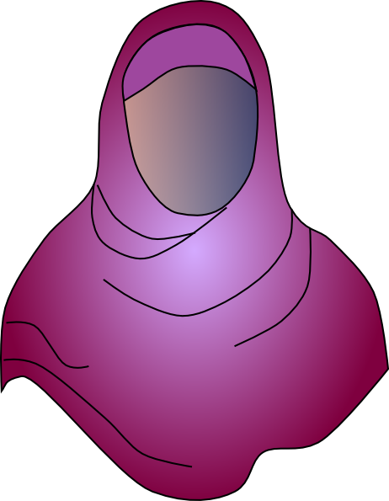
What is Hijab?

Slide 3
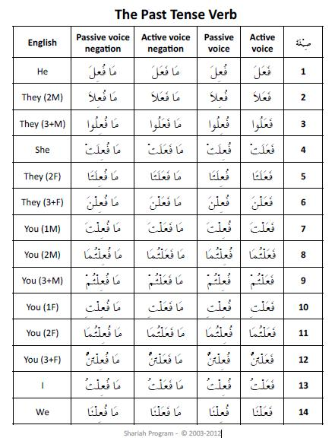
Trilateral Root Word and Meaning
ح-ج-ب ‘hijab’ –Arabic word meaning “covering”

Slide 4
Political and Social Controversy
Hijab has come to signify much more than just a piece of cloth to cover the head.
Besides it being a religious symbol to many Muslim women, in recent years it has become a sign for social and political movements around the world.
One prime example of this ( outside the U.S) is Iran.

Slide 5

1979 Revolution and it’s Effects on Women.
In 1936, Reza Shah outlawed the wearing of the veil(hijab)
The educated/upper class inherited western dress, education, and economic policies

Slide 6
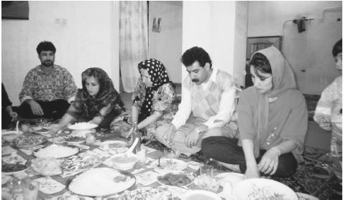
1979 Revolution and it’s Effects on Women.
That wasn’t the case for the poor/ working class women, many of whom continued to practice veiling despite political overrule.
Because veiling was outlawed, these women were forced to stay in their homes or risk having their veils removed and being detained by police.

Slide 7
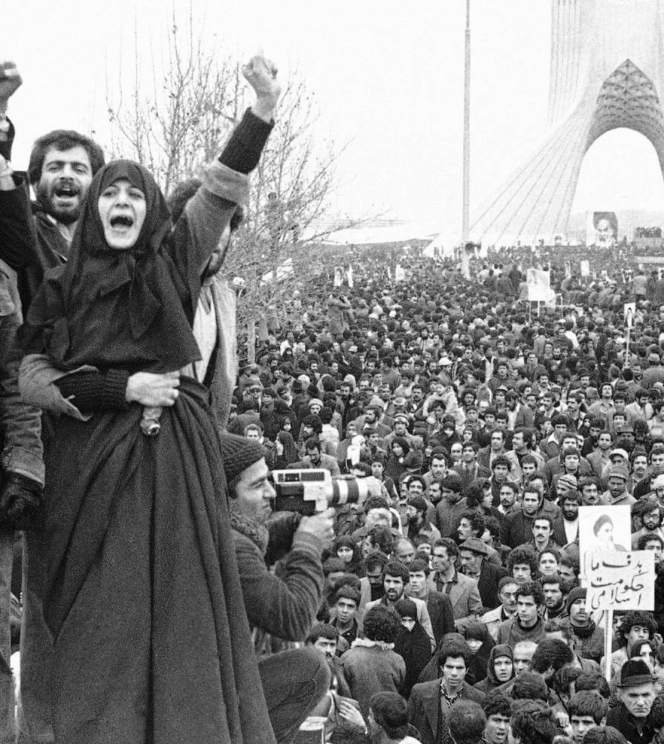
The Veil became a symbol for the religious vs. political power in Iran
The populist movement of 1979 overthrew the Shah and established the modern day republic.
This political shift in power led to the instatement of new laws
One being the compulsory veiling of women.

Slide 8
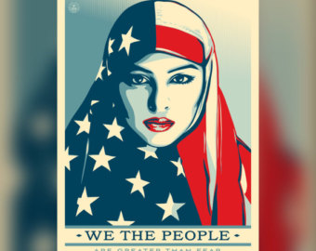
Hijab and the West
In the U.S, the first amendment protects the freedom of religion and therefore protects the right to wear hijab.
What many Muslim women battle in the U.S are the stereotyping, perception, and media representation of veiled women.
Many of these false perceptions are derived from political and social issues in the east (ex: Iran)

Slide 9
https://www.youtube.com/watch?v=t1x5Zu18f7U
While watching this video, make a list of key points that stood out to you

Slide 10
High school Junior forced to sit out of basketball due to her headscarf
https://www.washingtonpost.com/sports/highschools/after-playing-all-season-maryland-girl-held-out-of-basketball-game-for-wearing-a-hijab/2017/03/13/63fe82be-0767-11e7-8884-96e6a6713f4b_story.html?utm_term=.2292c54009dd
10 minutes to read article, split into groups of 3-4 ( 10 min)
Pick a phrase that stand out and explain why it did.
Group question: “ how would you solve this issue?”

