Slide 1
The Syrian Refugee Crisis
By: Nasrin Younus
Montclair State University

Slide 2
Objective
Students will be able to understand how the refugee crisis of Syria originated, what is happening today in America regarding this situation and what is being done to address the crisis.
Notes:
Before starting power point introduce myself my background etc. career goals and my own experience with Syrian refugees.

Slide 3
What do you know about the Syrian Refugee Crisis?
Notes:
Students will write their thoughts and then form discussions as a class

Slide 4
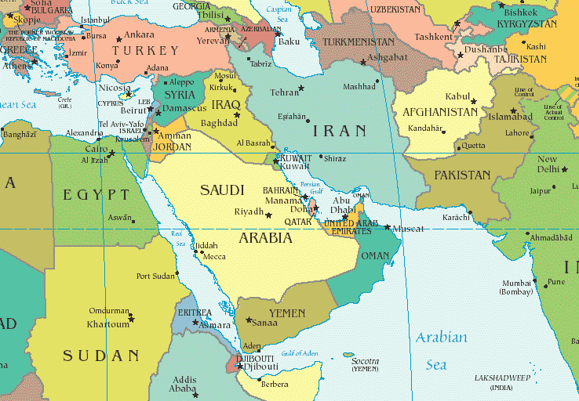
Where is Syria?

Slide 5
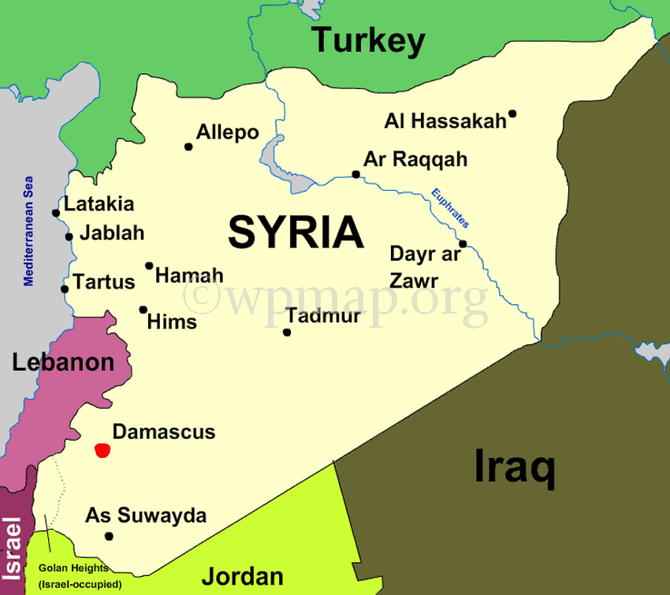

Slide 6
How it all started

Slide 7
The Syrian Civil War
2011 Syrian civilians wanted more democracy, freedom and change Syrians tried to overthrow their President Bashar Al-Assad who was a dictator. In response, the Assad regime has retaliated by killing protesters and it became violent. Rebel groups were formed to overthrow the Assad regime and thus the civil war took place.

Slide 8
Rebels
2013 The rebel groups are trying to overthrow the Assad regime, so they are fighting the Syrian government. Even though the Rebels are trying to help citizens, they have destroyed government buildings and homes, igniting fear. Syrian cities have become war zones. This has forced people to flee from their homes to be safe and survive.

Slide 9
Refugees
The aftermath of the Civil War has left Syria as a war zone. Since 2011, Syrian families have fled to all parts of Europe and the Middle East, this has caused the “Syrian Refugee Crisis.”

Slide 10
Why are Syrian Refugees a “crisis”?

Slide 11
The Syrian Refugee Crisis
Syrian Refugees are entering neighboring countries like Turkey, Greece, Jordan, Germany and also the U.S. A common fear amongst people is that these refugees are threats and will cause danger. People fear the unknown and what they might bring along with them.

Slide 12
The Syrian Refugee Crisis
Some Europeans and Americans fear letting in the Syrian Refugees because they fear how their countries will be affected. However, Syrian refugees are not the ones causing terror, they are afraid of terrorism just as much as any American and European, probably even more since it is directly affecting their lives, which is why they are refugees in the first place.
Notes:
Some people in the host country, whether its Germany or Greece or USA, are fearful of change and unsure how letting in Syrian refugees will affect their countries. Host countries will have to aid in resettlement-- a process that involves finding shelter, education, and employment for new arrivals. Some people fear this will cost a lot of money or result in more job competition.

Slide 13
Why is it Important?
The Syrian Refugee Crisis is a global humanitarian crisis. Syrian Families are fleeing with small children by foot, boat and other risky paths to survive. What would you take? What would be hardest? What about small children and elders?
Notes:
Questions used as discussion in class

Slide 14
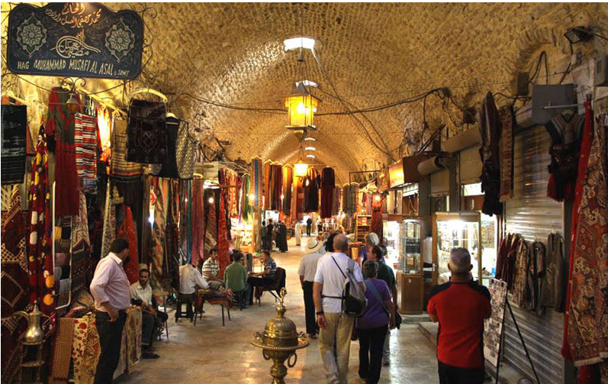
Syria Before & After

Slide 15
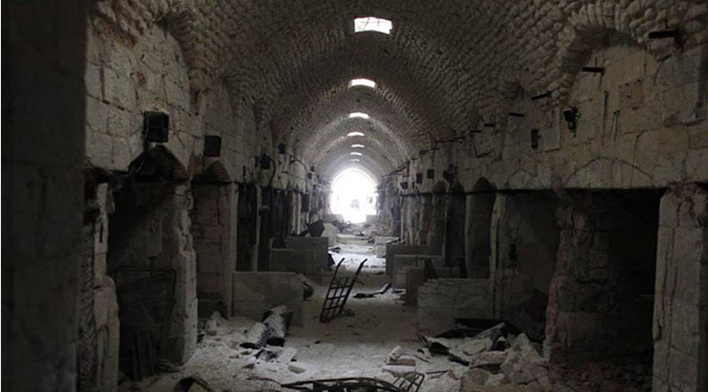

Slide 16
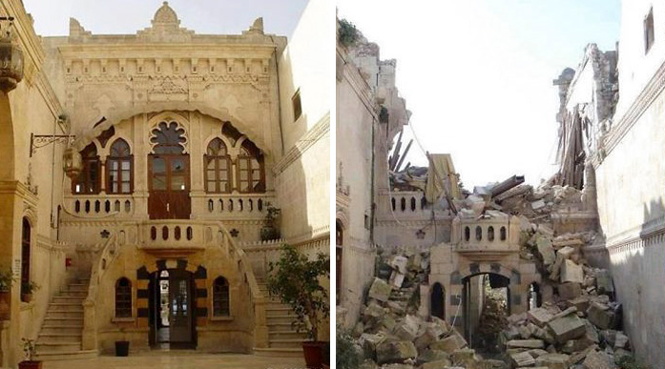

Slide 17
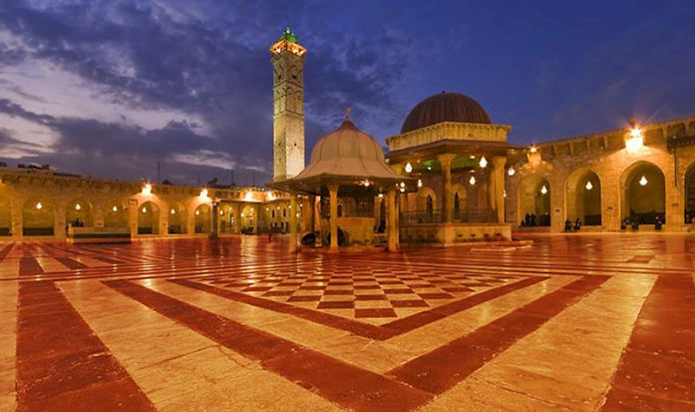

Slide 18
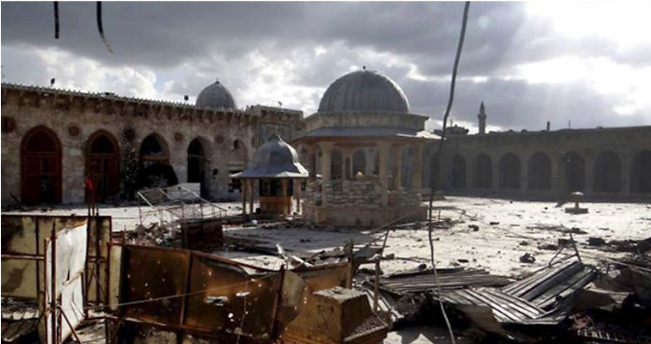

Slide 19
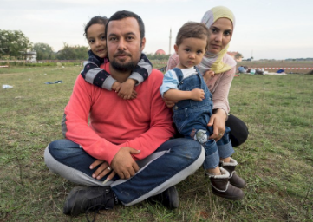
The Plight of Refugees
Ahmad Al-Matar, a cardiologist from Hassaka in Syria, pictured with his wife and their daughters, Preševo, Serbia, September 2015.
Notes:
© Giles Clarke/Getty Images Reportage

Slide 20
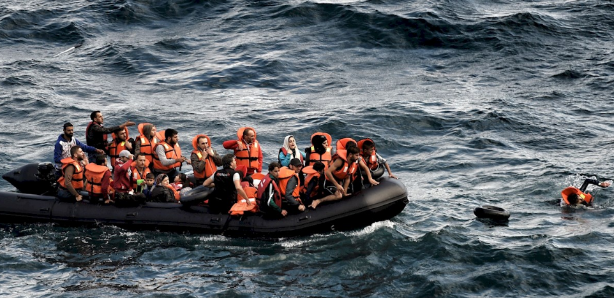
Refugees and migrants try to reach the Greek island of Lesvos after crossing the Aegean sea from Turkey, 30 September 2015. - ©AFP/Getty Images

Slide 21
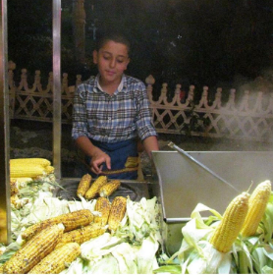
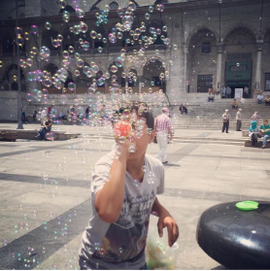
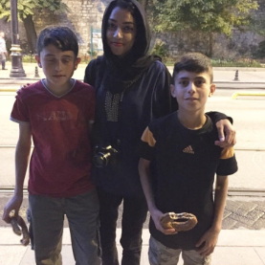
Refugees in Turkey

Slide 22
What’s happening in New Jersey?
http://america.aljazeera.com/watch/shows/live-news/2015/12/how-one-syrian-refugee-family-is-coping-in-new-jersey.html While you are watching the film, make a list of the things you think are most important to this Syrian family.
Notes:
Students will answer this question while watching the video

Slide 23
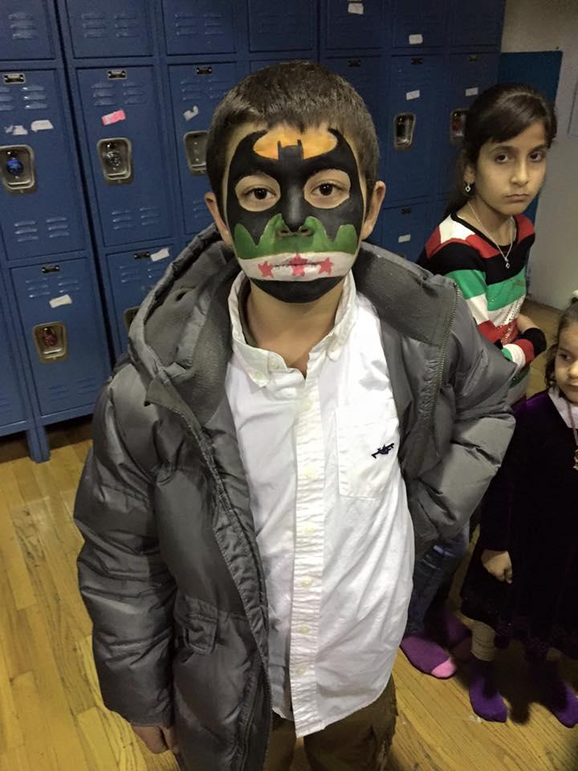
Close to home experiences
Ihsan Charity’s refugee welcome party at North Hudson Islamic Center in New Jersey in December 2015.

Slide 24
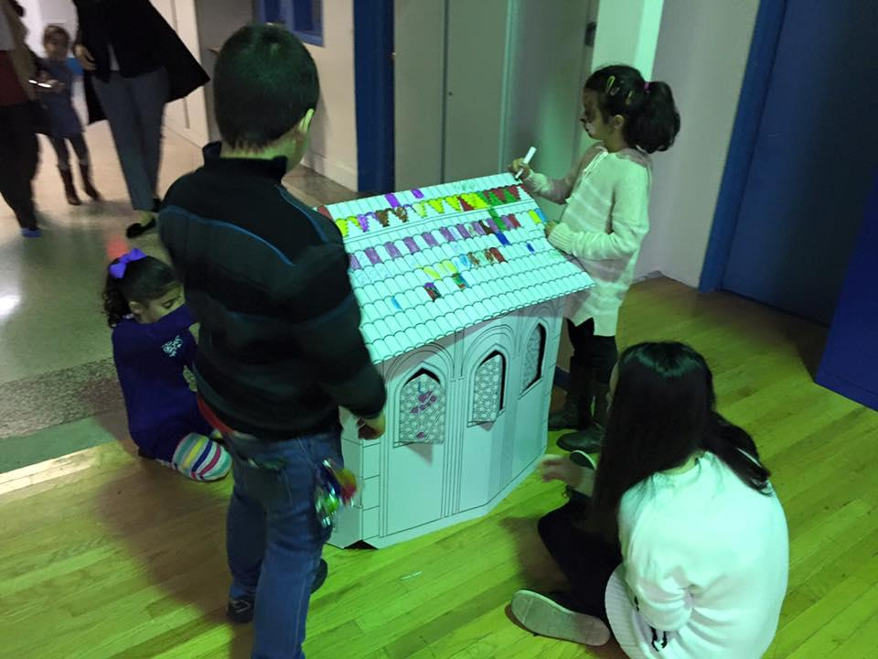
Refugee kids have face paint and various arts and crafts project for entertainment.

Slide 25
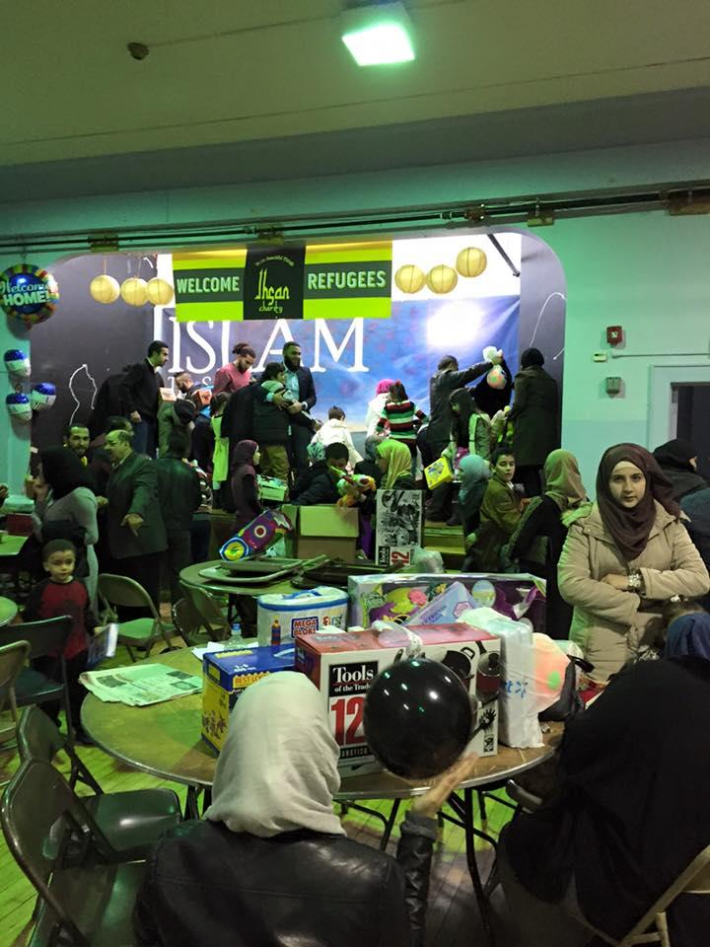
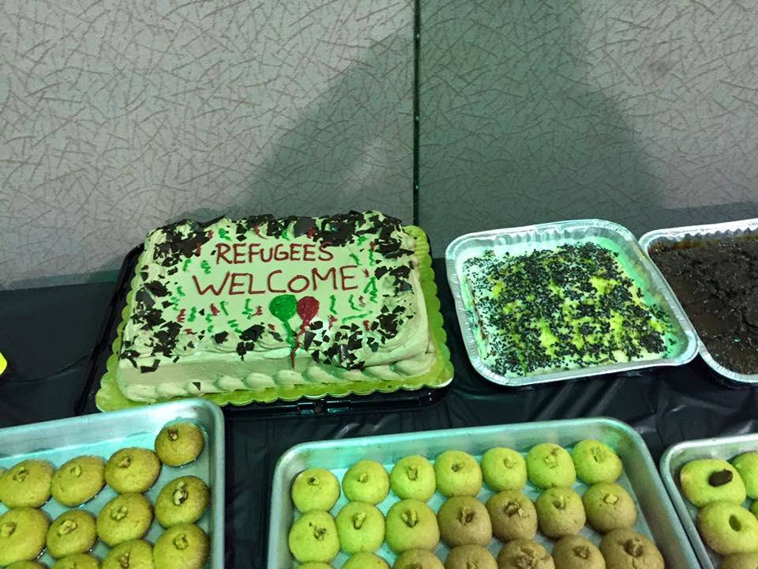
Entertainments for the refugee families and gifts as well as delicious Middle Eastern dessert .

Slide 26
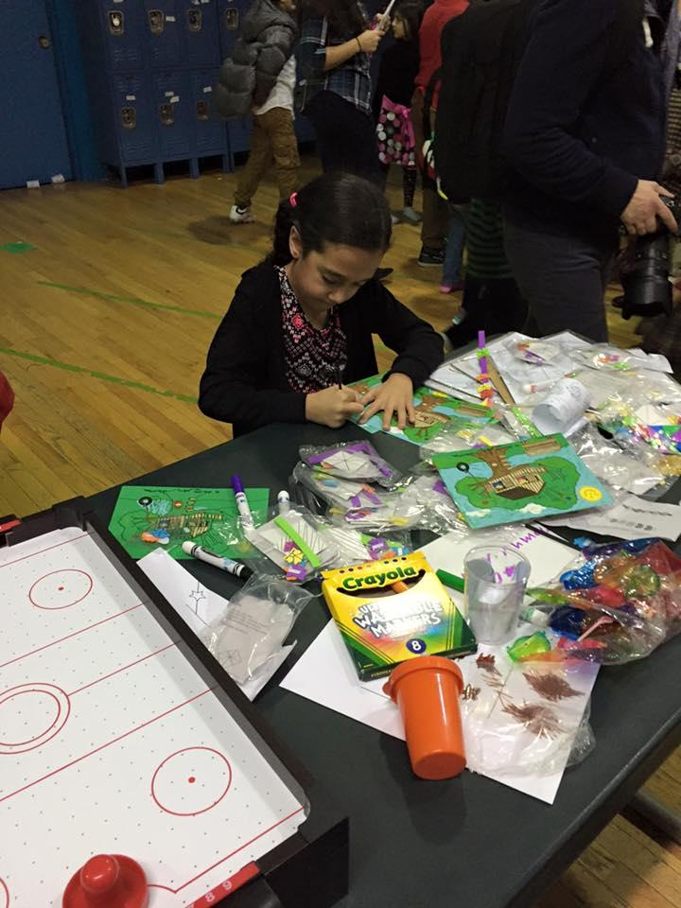
Families came together to show refugees that they are not alone in their new homes.

Slide 27
How do Syrian Refugees in America feel? What challenges might the refugees face? How are other countries helping them? What are the top 5 things we can do to help Syrian refugees in New Jersey?
Notes:
Evaluation : Students will be divided into groups and reflect on the selected questions. Each question will be assigned to different groups.

Slide 28
Things we can do
Volunteer for helping Syrian refugees resettled in the U.S
Support non-profit organizations that are helping the cause of Syrian refugees
Write warm letters to refugees
Donate clothes and essentials like basic home needs, medicine etc.
Cook meals for refugees
Notes:
Present after reflections International Refugee Assistance Project. https://refugeerights.org/ IRC

Slide 29
8 ways to solve the world refugee crisis by Amnesty International
1. Opening up safe routes to sanctuary for refugees is one important solution.
2. It also means resettling all refugees who need it. Resettlement is a vital solution for the most vulnerable refugees
3. World leaders also need to put saving lives first.
4. And whether they travel by land or by sea, people fleeing persecution or wars should be allowed to cross borders, with or without travel documents.
5. All countries should investigate and prosecute trafficking gangs who exploit refugees and migrants, and put people’s safety above all else.
6. Governments also need to stop blaming refugees and migrants for economic and social problems, and instead combat all kinds of xenophobia and racial discrimination.
7. “Financially broke” is how Antonio Guterres, the UN High Commissioner for Refugees, described UN agencies in September 2015.
8. The world has a very short memory. In the aftermath of World War II, most countries agreed to protect refugees through the 1951 Refugee Convention, and through UN agencies like the UNHCR.

Slide 30
Question and Answer session
Notes:
Allow students to ask questions and also give feedback on lesson plans

