Slide 1
Human trafficking

Slide 2
Notes:
https://www.usnews.com/news/best-countries/slideshows/5-of-the-worst-countries-for-human-trafficking
What four countries do you think have the highest rates of people being trafficked?

Slide 3
Countries with the highest human trafficking rates:
Russia
China
Iran
Venezuela
Notes:
There are many different reasons why these countries have such high rates. It can be anything from migration problems to being a poor country, uneducated, not having strict laws against trafficking

Slide 4
Estimated World Statistics
27 million are currently trafficked across the world
49,105- have been identified as human trafficking victims, but have not been rescued yet
80% are women and girls
50% are under 18
161 Countries are identified as being affected by human trafficking
62 countries have NEVER convicted someone for human trafficking
Notes:
The United Nations recognizes 193 countries to be in existence.
https://freeholdarea-nj.aauw.net/files/2014/01/z-Human+Trafficking+Statistics.pdf
Current world statistics are very hard define. Majority of the people being trafficked are not calling the police saying "hey just wanted to let you know that I am being trafficked" It's impossible to figure out the exact numbers.

Slide 5
Notes:
What three states do you think have the highest human trafficking rates?
What state do you think New Jersey is on the list?

Slide 6
States with the highest human trafficking rates:
1. California
2. Ohio
3. Florida
7. New Jersey

Slide 7
What is Human Trafficking?
As defined by the United Nations: Trafficking in Persons as the recruitment, transportation, transfer, harboring or receipt of persons, by means of the threat or use of force or other forms of coercion, of abduction, of fraud, of deception, of the abuse of power or of a position of vulnerability or of the giving or receiving of payments or benefits to achieve the consent of a person having control over another person, for the purpose of exploitation.
Third leading cause of international crime after Drug trafficking and Arms trafficking.
Notes:
Human trafficking involves anyone who is taken against their will and forced into slavery of any kind.
No more fine lines of being trafficked- if you are trafficked you are a victim
https://www.unodc.org/unodc/en/human-trafficking/what-is-human-trafficking.html

Slide 8
What are the Types of trafficking?
Forced labor
Sex trafficking
Domestic servitude
Child soldiers
Notes:
Forced labor: Compelling a person to complete difficult manual labor such as mining, farming, construction. Often involves men and boys.
Sex trafficking: Compelling a person to work as a prostitute– perform sex acts against his or her will. Mostly girls and women, some boys and men.
Domestic Servitude: Compelling a person to work as a housekeeper, child care worker, or other household labor against their will. Mostly girls and women.
Child soldiers: Forcing a person to serve in the military against their will, mostly boys and men.

Slide 9
How do traffickers recruit victims?
(add photo)

Slide 10
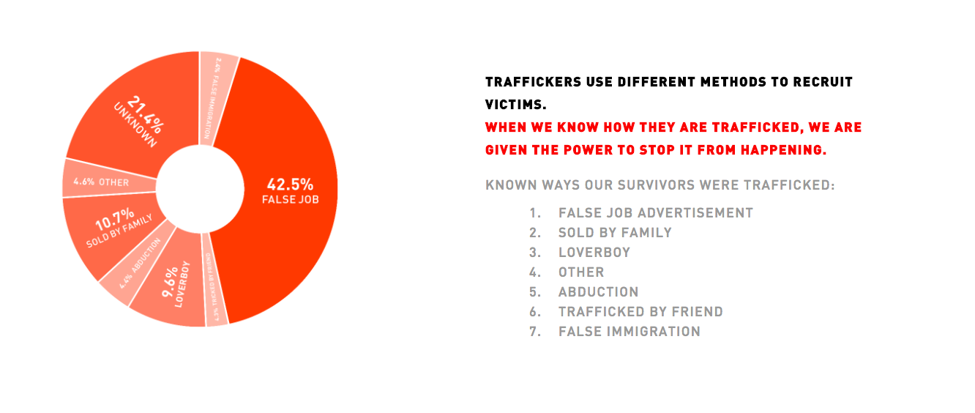
Notes:
http://www.a21.org/content/human-trafficking/gnjb89?permcode=gnjb89&site=true.
This is a global perspective. Statistics are very hard to find in the USA and NJ.

Slide 11
Who is most At risk for trafficking?
Homeless
Those in foster care
Abused
Neglected
Suffering trauma
Violence in the home
Substance/Drug abusers
Notes:
Everyone is at risk of being a victim of human trafficking. Human trafficking is not specific in victims. What makes you have a chance for not being at risk is being aware. Be smart about your surroundings and the people you hang out with. If you see something say something. Don't get in the car with a stranger or let your best friend be in a weird relationship with a boy who tries to convince her to do stupid things.

Slide 12
What are the U.S. Laws against trafficking?
2000 Trafficking Victims Protection Act (TVPA) Victims are able to get a special visa (T Visa) that allows them to stay in the country legally.
Trafficking is a crime under federal and international law.
Goes against the 13th amendment which makes it a federal crime which abolished slavery in the United States.
Notes:
https://polarisproject.org/current-federal-laws

Slide 13
How does NJ prosecute human trafficking?
First degree crime
“N.J.S.2C:43-6, the term of imprisonment imposed for a crime of the first degree under paragraph (2) of subsection a. shall be either a term of 20 years during which the actor shall not be eligible for parole, or a specific term between 20 years and life imprisonment, of which the actor shall serve 20 years before being eligible for parole.”
Retribution to the victim as well
Notes:
http://www.nj.gov/oag/dcj/humantrafficking/statutes.html

Slide 14
Blue campaign anti trafficking video
https://www.youtube.com/watch?v=35uM5VMrZas
Notes:
Ask students to write down a list of everything they learn from the video they didn’t know before. Then, after the video finishes, ask students to compare lists with 1-2 people sitting next to them. Then share as a class—make list on the board if you want…

Slide 15
Recent case study in NJ:

Slide 16
October 19, 2017 bust in NJ:
Atlantic County Prosecutor's Office
Atlantic County Sheriff's Office
Atlantic City Police Department
New Jersey Human Services Police Department
Egg Harbor Township Police Department
Galloway Township Police Department
Cape May County Prosecutor's Office
Fairfield Police Department
Essex Fells Police Department
Monmouth County Sheriff's Office
Ocean Township Police Department
Monmouth County Prosecutor's Office
West Caldwell Police Department
Caldwell Police Department
New Jersey State Police
Essex County Prosecutor's Office
New York/New Jersey Port Authority Police Department
Irvington Police Department
Hudson County Prosecutor's Office
Notes:
Oct 19, 2017- 42 people were arrested in relation to human trafficking. 6 arrests were made in North Jersey, 3 in Central Jersey, and 33 in South Jersey. 84 were rescued.
Kent , Spencer . “42 Pimps, Prostitutes in N.J. Arrested in FBI Child Sex Trafficking Bust.” NJ.com, NJ.com, 19 Oct. 2017www.nj.com/news/index.ssf/2017/10/42_pimps_prostitutes_in_nj_arrested_in_fbi_child_s.html. Accessed 22 Oct. 2017

Slide 17
MAYS LANDING, NJ CASE
Marcus Tukes was sentenced to ten years in prison after pleading guilty to human trafficking.
At least three victims, all girls under 18 years old.
Forced to work as sex slaves.
Sentencing is scheduled for Nov. 17, 2017
So What?

Slide 18
What single event created a major human trafficking disaster in NJ?
Notes:
45 arrested and 16 juveniles rescued in relation to the Super Bowl prostitution bust.
This bust was done prior to the Super Bowl occurring.
The Super Bowl drew an estimate of 400,000 visitors to the NY/NJ area which causes trafficking rates to increase.
The demand for those being trafficked during the Super Bowl goes up immensely
Chris Christie had law enforcement focusing heavily on being prepared for trafficking during this time

Slide 19
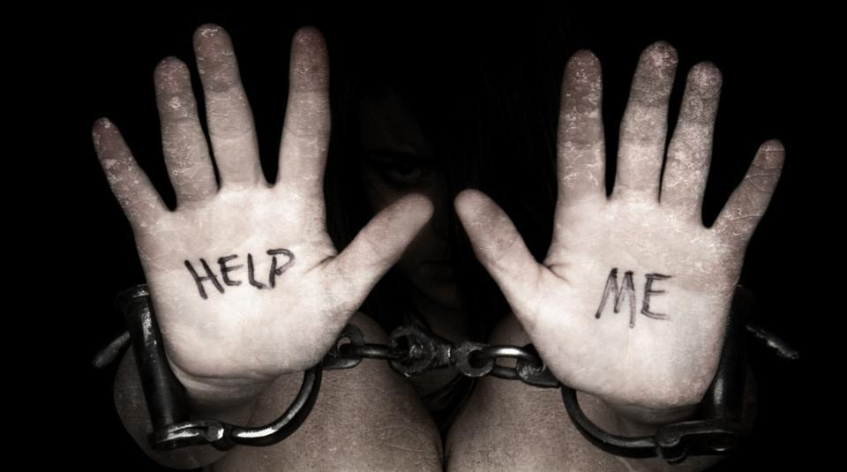
How does someone become a victim of trafficking in NJ?

Slide 20
Holly Austin Smith: NJ Survivor
June of 1992
She met a man while in a shopping mall
Eventually he convinced her to runaway
She ran away and two hours later was forced into prostitution
She was only in 8th grade when he took complete control of her life
Notes:
While she was working as a prostitute an officer recognized that she was under age and arrested her for prostitution. Eventually she would be recognized as a victim
http://hollyaustinsmith.com/hollys-story/

