Slide 1
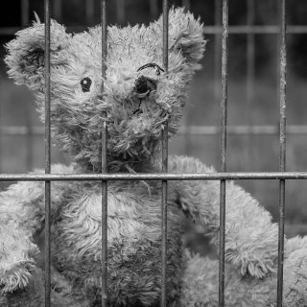
US Juvenile Justice System: From Playgrounds to Prison
Dominique-Faith Worthington (2019)

Slide 2

Content Warning
This lesson may bring up sensitive emotions for some students.
The space is designed to be open with mutual respect for all student perceptions. It is understood to be mindful of tones and privacy.
All students are encouraged to participate.

Slide 3
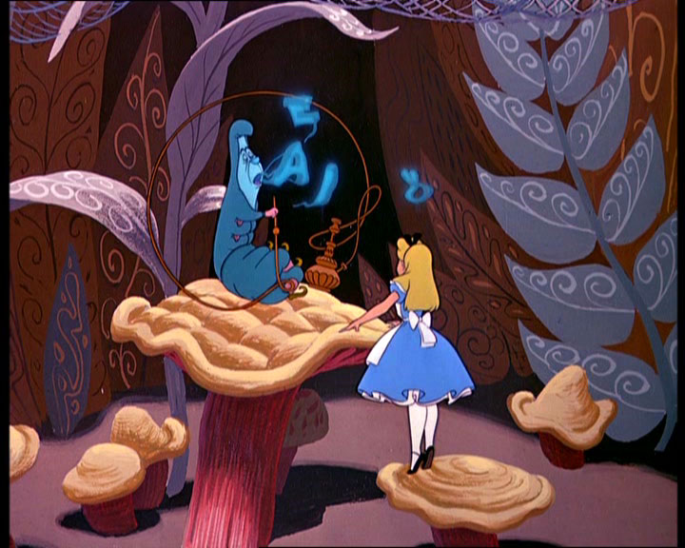
Who Are You????
What is a juvenile offender?
Could you imagine being charged as a juvenile offender?

Slide 4
1. Tried to hit another person, but did not succeed.
2. Drink alcohol, use drugs, or be around those who are using or having the
substances on them.
3. Shoplifting minor articles or major items.
4. Delivered a package for someone else.
5. Entered a movie theater, carnival, or other type show or entertainment
place without paying.
6 Associating with anyone who does the listed activities or being around
when these things happen.

Slide 5
Do you know …?
How many juveniles are incarcerated every year?
What is a JLWOP ?
The US Supreme Court found JLWOP to be unconstitutional yet, there are states that still uphold these sentences. Do you agree?

Slide 6
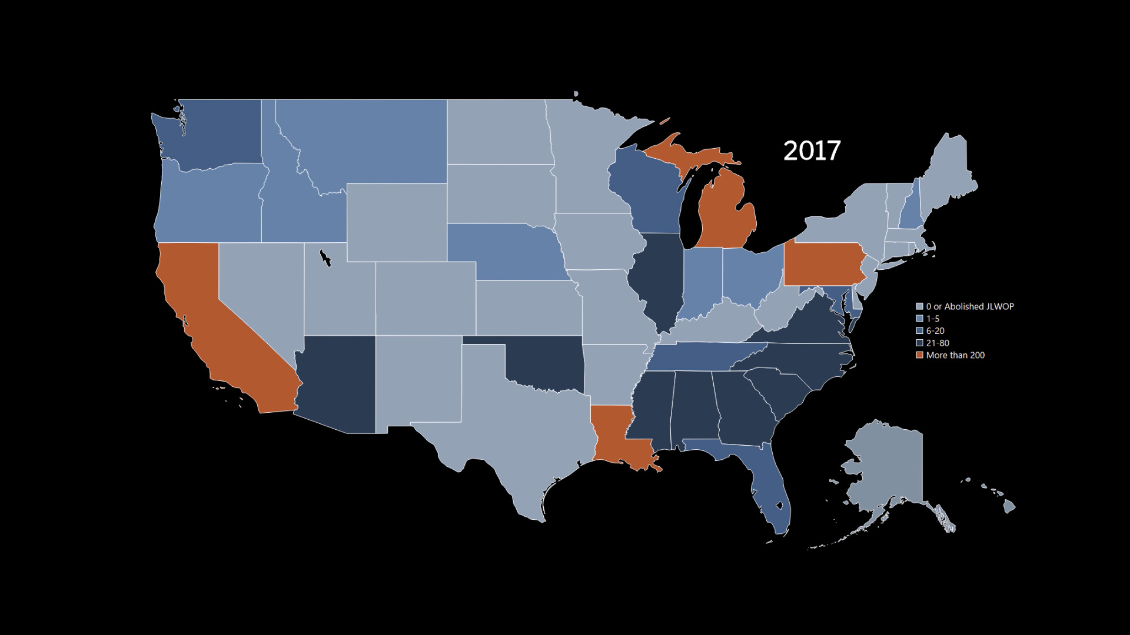

Slide 7
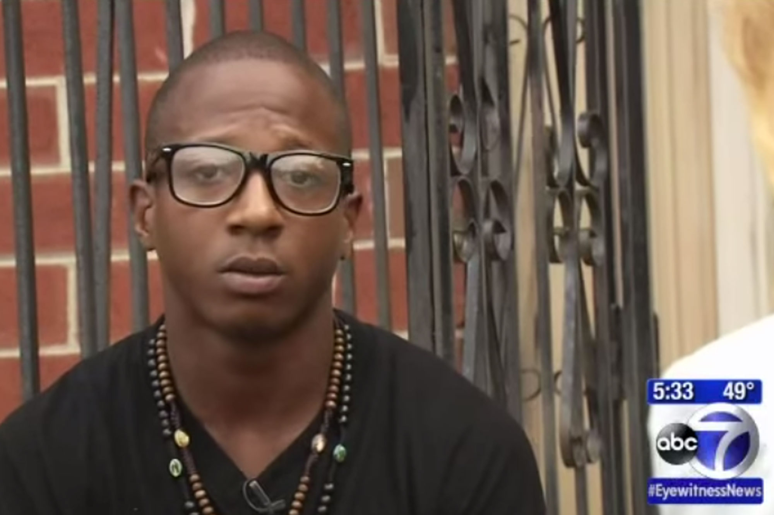
Kalief Browder

Slide 8
What is the purpose of incarceration?
Do You think Juveniles should be tried as adults?
Is the no more bail rule in NJ fair? How does it affect you?

Slide 9
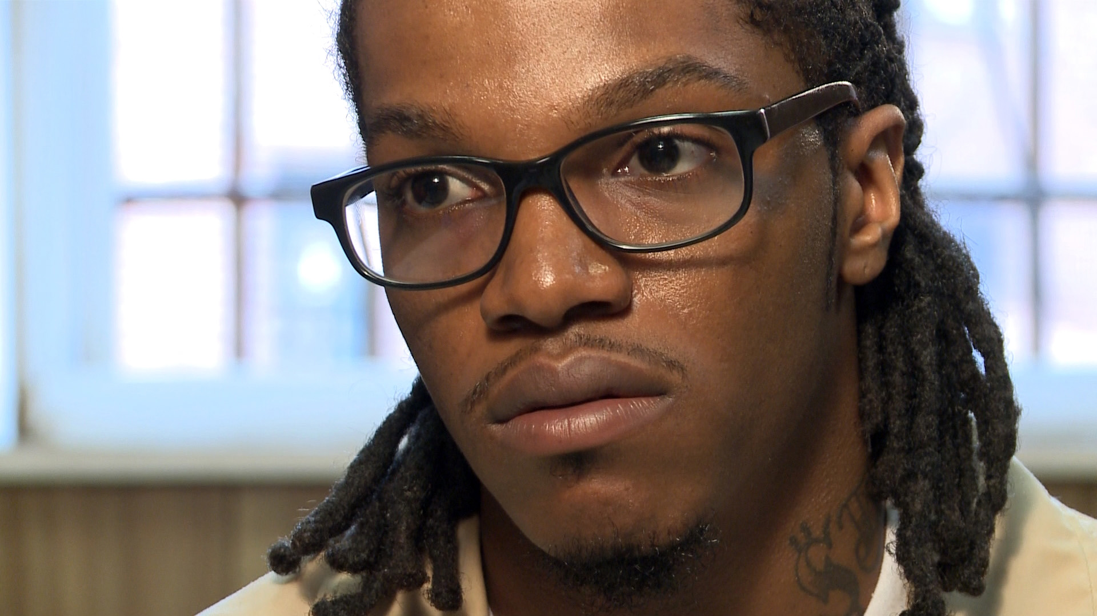
Touree Moses
Steve McCarthy

Slide 10
Can a juvenile offender reform and become a law-abiding citizen?
Mr. Gill visits Touree in prison and encourages him to complete his High School education. Why?
What would you have done if you were Mr. Gil trying to help Touree?
How or why can a student reform the system?

Slide 11
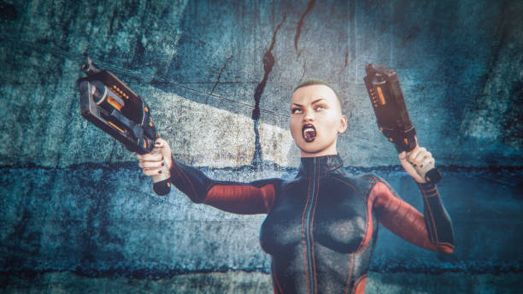
Case Study #1
Istock photo 2019

Slide 12
Two young teenage girls lure a classmate into the woods and then attempt to murder him. One holds him down while the other stabs him repeatedly. He is left for dead, but later rescued by a biker in the area.
When captured by the police later that day, the two girls claim they were trying to please an imaginary character from a video game. A judge finds the two girls are mentally ill.
What is appropriate justice for the victim and mentally ill defendants? Should the defendants be tried and face prison time? If so, as juveniles or adults?
Wilkin, T. (2018).

Slide 13

Case Study #2
Meyer (2019)

Slide 14
A male juvenile age 12 accidentally killed his playmate while
wrestling with her. He was charged with first degree murder and
found guilty. Under Florida law, he was sentenced to prison for
life without parole (LWOP)
A male juvenile age 15 walked into his high school and used an
automatic gun to murder 11 classmates. He was found guilty and
sentenced to LWOP.
The US Supreme Court had passed law to overturn JLWOP sentencing.
With this new law both prisoners will be given a chance to recover, reconcile and come up for parole, should this law stay passed? ABC News (2015)

Slide 15

Case study #3
Pixabay (2019)

Slide 16
In May 2018 NJ State Supreme Court agreed with Rutgers law clinic
stating the use of Megan's Law forcing juvenile sex offenders to
register for life is a violation of NJ Constitution.
Is this the correct way to fix the problem with Megan’s law? By
changing the registration requirement or should we change enforcement
of the law?
Rutgers Law (2018)

Slide 17

Jenifer Pruitt is serving a JLWOPS for guilt by association…
To Be Hated
By Kayla Eaves
Aljazeera America, 2014

Slide 18
Reference ABC News (2015). "2 Teens At Center of Juvenile Crime Debate. "https://abcnews.go.com/US/story?id=93887&page=1&page=1 Meyer, J.A. (2019). " Central States News: Iowa Male Refused To Wrestle Female in State Tournament. “http://groucho-karl-marx.blogspot.com/2011/02/central-states-news-iowa-male-refused.html
Istock photo 2019 "Violent video game." Dreamstime Photo https://www.dreamstime.com/ Pixabay (2019). "Couple holding Hands. "https://www.pexels.com/photo/hands-love-people-friends-70464/ Rutgers Law (2018). "Rutgers Law Clinic Share Court Victory For Juvenile Offenders." https://law.rutgers.edu/news/rutgers-law-clinics-share-court-victory-juvenile-offenders
Schwartzapfel, B. (2014). Sentence young: the story of life without parole for juvenile offenders. http://america.aljazeera.com/features/2014/1/sentenced-young-thestoryoflifewithoutparoleforjuvenileoffenders.html Wilkin, T. (2018). "The Slender Man". Case Juvenile Delinquency or adult crime? https://inhomelandsecurity.com/slender-man/
List of question “Who are you”-This content downloaded from 130.68.1.32 on Mon, 04 Mar 2019 04:34:13 UTC All use subject to https://about.jstor.org/terms
JLWOP Map- https://juvenilelwop.org/

