Slide 1
Understanding the Burqa: Should it be Banned?
By: Fathia Balgahoom

Slide 2
What is Islam?
One of the three Abrahamic Faith
Muslims follow the Quran
Believes in the Prophets
Two Sects of Muslims:
Shia
Sunni
Five Pillars of Islam
This Photo by Unknown Author is licensed under CC BY-SA

Slide 3
The Different Types of Islamic Veils

Slide 4
Anti-Muslim Bias
Since 9/11, there has been a spike in anti-Muslim bias and hate crimes towards Muslims
These attacks can include Quran burnings, property damages, intimidation and etc.
There was controversy over building mosques and cultural centers for Muslims
The FBI reported 257 incidents of anti-Muslim hate crimes in 2015, a 67% increase from the previous year
With the rising sentiment, a survey done by the Pew Research Center found that 49% of Americans think at least “some” Muslims in the U.S. are anti-American, including 11% who think “most” or “almost all” are anti-American
Another survey found that 46% of Americans thought Islam was more likely than other religions to encourage violence.

Slide 5
What is the Burqa Ban?
The burqa ban is a ban set by many European countries that prohibits certain articles of clothing in public which include the burqa, niqab and any other piece of clothing that disguises one’s identity.

Slide 6
When Was The Ban Introduced? What events led up to the Burqa Ban?
It was introduced by France in 2010
However there were events leading up to the burqa ban
The country of France believes in “liberty, equality, and fraternity”
In 2004, they had banned all religious items in the public school system which include crosses and hijabs.
This Photo by Unknown Author is licensed under CC BY-NC-ND

Slide 7
What do you think are some arguments for and against Burqa Ban?

Slide 8
Arguments For/Against the Ban
For
“We are liberating women from the oppression they have faced in the society they were forced to live in”
Security Issues
Communication difficulties
Against
It is a part of a my identity
Discrimination of the Muslim woman

Slide 9
Aftermath of the Burqa Ban
The law wasn’t enforceable and was ignored by many Muslim women
Showcased defiance from some Muslim women who didn’t wear the Burqa before
Isolation of many Muslim women who feel as though they cannot freely express themselves
Spread of the ban across Europe
This Photo by Unknown Author is licensed under CC BY

Slide 10
Why do you think the ban had the backlash that it did? Can you think of any recent stories that are similar to this?

Slide 11
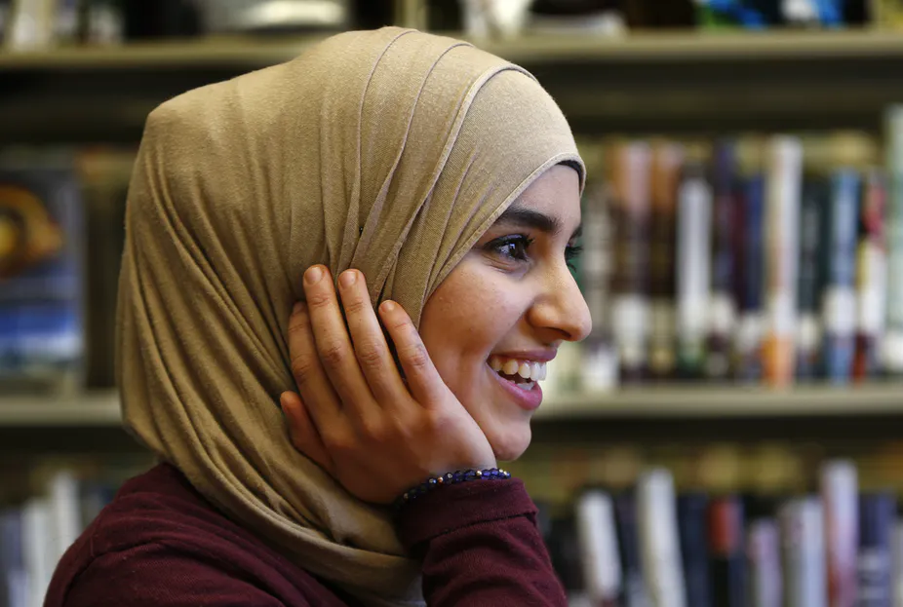
Activity With the Text
Directions:
Before reading the article, have the students write down 2-3 perceptions they have about Muslim women and the hijab
Read the article
After they have finished reading the article, students will get into small groups of 3-4
In these groups, students will discuss what they learned from the article and see if their thoughts have changed
https://theconversation.com/why-do-muslim-women-wear-a-hijab-109717

Slide 12
European Court of Human Rights’ Response
An anonymous French citizen had filed a suit to the ECHR that the Burqa Ban had violated the following articles in the ECHR’s constitution:
3
8
9
10
11
14
This Photo by Unknown Author is licensed under CC BY-SA

Slide 13
Countries That Have Imposed A Similar Ban
Belgium
Netherlands
Denmark
Italy
Austria
This Photo by Unknown Author is licensed under CC BY-SA

