Slide 1
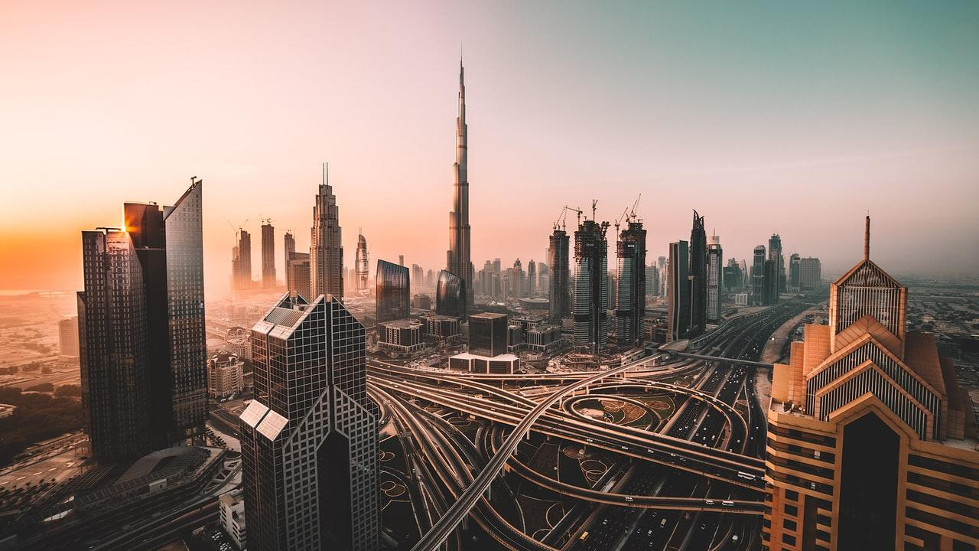
The Color of Pollution: Environmental Racism in America
By: Alexis Haroun

Slide 2
What exactly is environmental racism?
environmental justice : the fair treatment of people of all races, cultures, incomes, and educational levels with respect to the development and enforcement of environmental laws, regulations, and policies
environmental racism: racial discrimination in environmental policy, such as targeting communities of color as sites for polluting industries and waste disposal
Do you ever wonder where your trash goes?
Where toxic waste goes?
Where all the factories go?

Slide 3
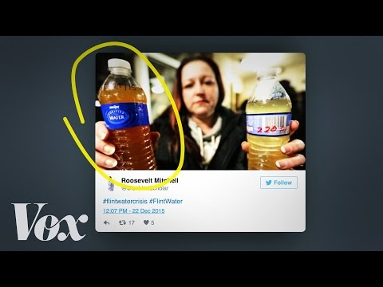
Case study
Flint, Michigan

Slide 4
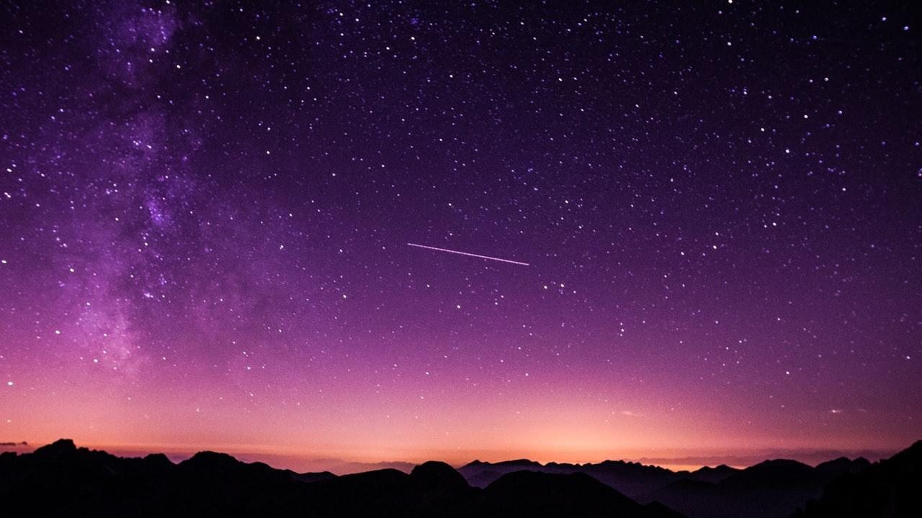
Why is this a violation of human rights?
The UN committee on Economic, Social and Cultural rights states that we have the obligation to avoid measures that could prevent the enjoyment of a right such as health.

Slide 5
Lead Poisoning
Toxic for all ages- especially children up to 3 years old
Occurs when one has too much exposure through breathing, eating, and drinking.
harm to the production of red blood cells, less absorption of calcium needed for bones, brain and kidney damage
Can result in hospitalization as well as damages for life

Slide 6
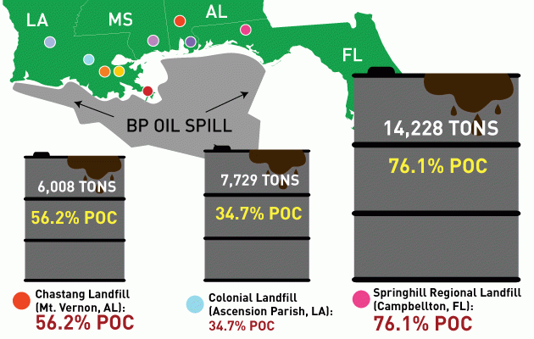
Case study
Oil spill: Gulf of Mexico
Thousands of tons of oil from this clean up have been thrown upon these communities of majority color. These are called “sacrifice zones”
The waste put into these landfills include:
- oil-soaked boom
- oil-stained sand
- oil-soaked sea grass
-Tar balls
These sources can cause cancer and later end up in the water sources of these areas.

Slide 7
Ask yourself….
Is the suffering of a small group of people okay if it helps the majority of people?

Slide 8
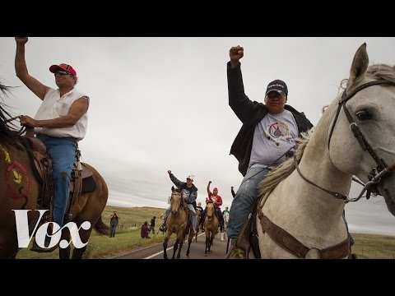
Case study
Native American Land in North Dakota

Slide 9
Why is this happening?
Dr. Robert Bullard said it best when he said, “ When certain lands are seen as exploitable, the people that happen to be living there are viewed as expendable. Hence the genocide of Native people and the exploitation of slaves. At the same time, pollution is seen as just a byproduct of moving to the highest level of the economy. Smoke, air pollution, water pollution...that is the smell of progress.”
At the end of the day people will do whatever they can to get more MONEY

Slide 10
What can you do?
It starts with education. Tell your friends, family, social media about what you learned today. Create more awareness and in turn, more people willing to speak up
If you can vote, do research on the political candidates and the policies that they hold.
Join organizations!!

