Slide 1


Transgender Identity and Discrimination: How to Be An Ally
By: Jos Hinojosa

Slide 2



Who am I?
My name is Jos Hinojosa
I’m from West New York, NJ
I attend Montclair State University
I am a sophomore studying Child Advocacy

Slide 3
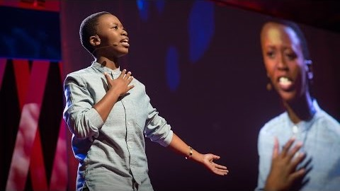
A powerful poem about what it feels like to be transgender

Slide 4
What does Transgender mean?
Transgender is a term used to describe people whose gender identity differs from the sex they were assigned at birth.
Gender identity is a person's internal, personal sense of being a man or a woman (or boy or girl.)
For transgender people, the sex they were assigned at birth and their own internal gender identity do not match.

Slide 5
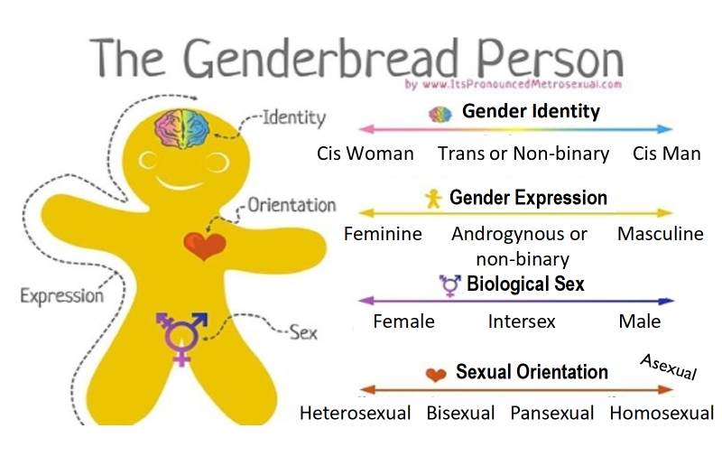
What is the difference between gender and sexual orientation?
Notes:
Sexual orientation describes a person's enduring physical, romantic, and/or emotional attraction to another person
Gender identity describes a person's, internal, personal sense of being a man or a woman, or someone outside of the gender binary.
Like everyone else, transgender people have a sexual orientation.

Slide 6
Debunking myths about transgender individuals
Myth 1: Surgery is a top priority for all transgender individuals
Myth 2: Children aren’t old enough to know their gender identity
Myth 3: You can tell someone is transgender by looking at them
Myth 4: Transgender only includes male-to-female transition or female-to-male
Notes:
The desire and ability to transition differs across individuals. While some pursue hormone therapy and gender reassignment surgeries, others lack access to them or are barred by discrimination. Others have no interest in full genital surgery
Some children genuinely identify with a gender different from the one assigned to them at birth at a very early age. And some others won’t conform to gender norms — but won’t necessarily grow up to identify as transgender.

Slide 7

Experiences of transgender youth

Slide 8
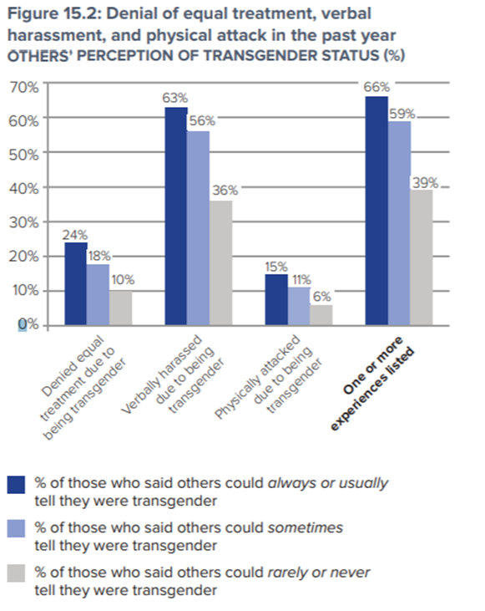
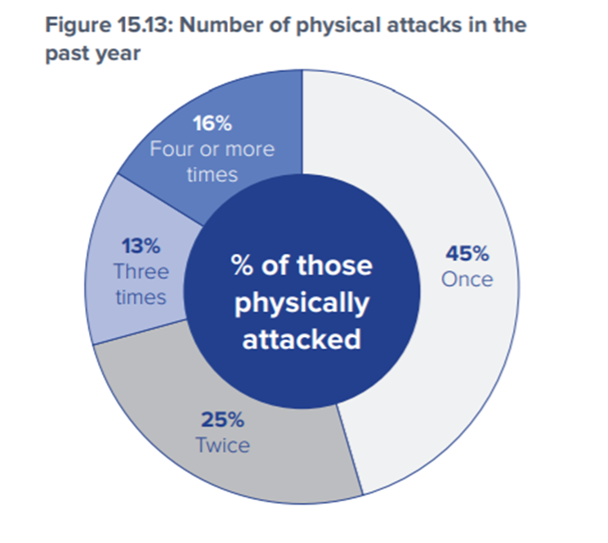
Different forms of discrimination
Notes:
Transgender individuals face discrimination in the workplace, school, health, and housing
Being that transgender people are often fired, (47%) or not even hired for the job due to their gender identity, it leaves a high number of transgender individuals to live in poverty.
Transgender students are often bullied and harassed. (78%)
They are not always allowed to use the bathroom their gender corresponds with.
An alarming number of transgender individuals are homeless at some point in their life. (29%)

Slide 9
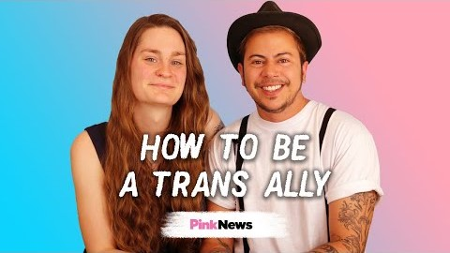
How to be an ally
Notes:
The Basics: Things to remember about being an ally
There is no one way to be a ‘perfect’ ally.
You don’t have to understand someone’s identity to respect it.
You can’t always tell if someone is transgender simply by looking at them.
Transgender is an adjective and should never be used as a noun and never needs an "-ed" at the end.
Interacting with transgender people
If you don’t know what pronouns to use, ask.
Be careful and considerate about what other questions you ask
Someone’s transgender identity is their private information to share, or not
Avoid compliments or advice based on stereotypes about transgender people, or about how men and women should look or act.

Slide 10
How can we support transgender individuals?
Being Outspoken
Speak out in support of transgender people and transgender rights.
Support transgender people who experience discrimination
Learn about policies affecting transgender people
Push for support and inclusivity, not simply tolerance

