Slide 1



The Foster Care to Prison Pipeline
Abigail Levine

Slide 2

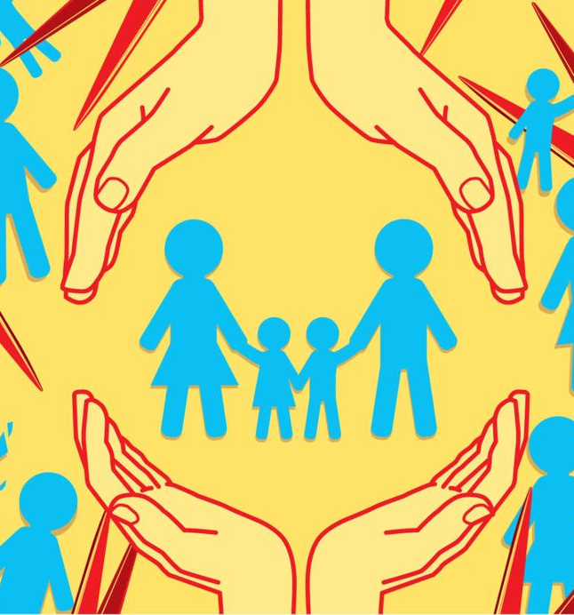
Foster Care
The foster care system ensures all children have a home
Many – but not all - are not adopted

Slide 3

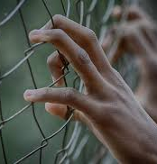
What is the Foster Care
to Prison Pipeline?
The Foster Care to Prison Pipeline reveals children in foster care are 67% more likely to become incarcerated
Half of foster youth are arrested, spend at least one night in a correctional facility, or are convicted

Slide 4



Causes
Trauma
Instability
Insufficient mental health services

Slide 5

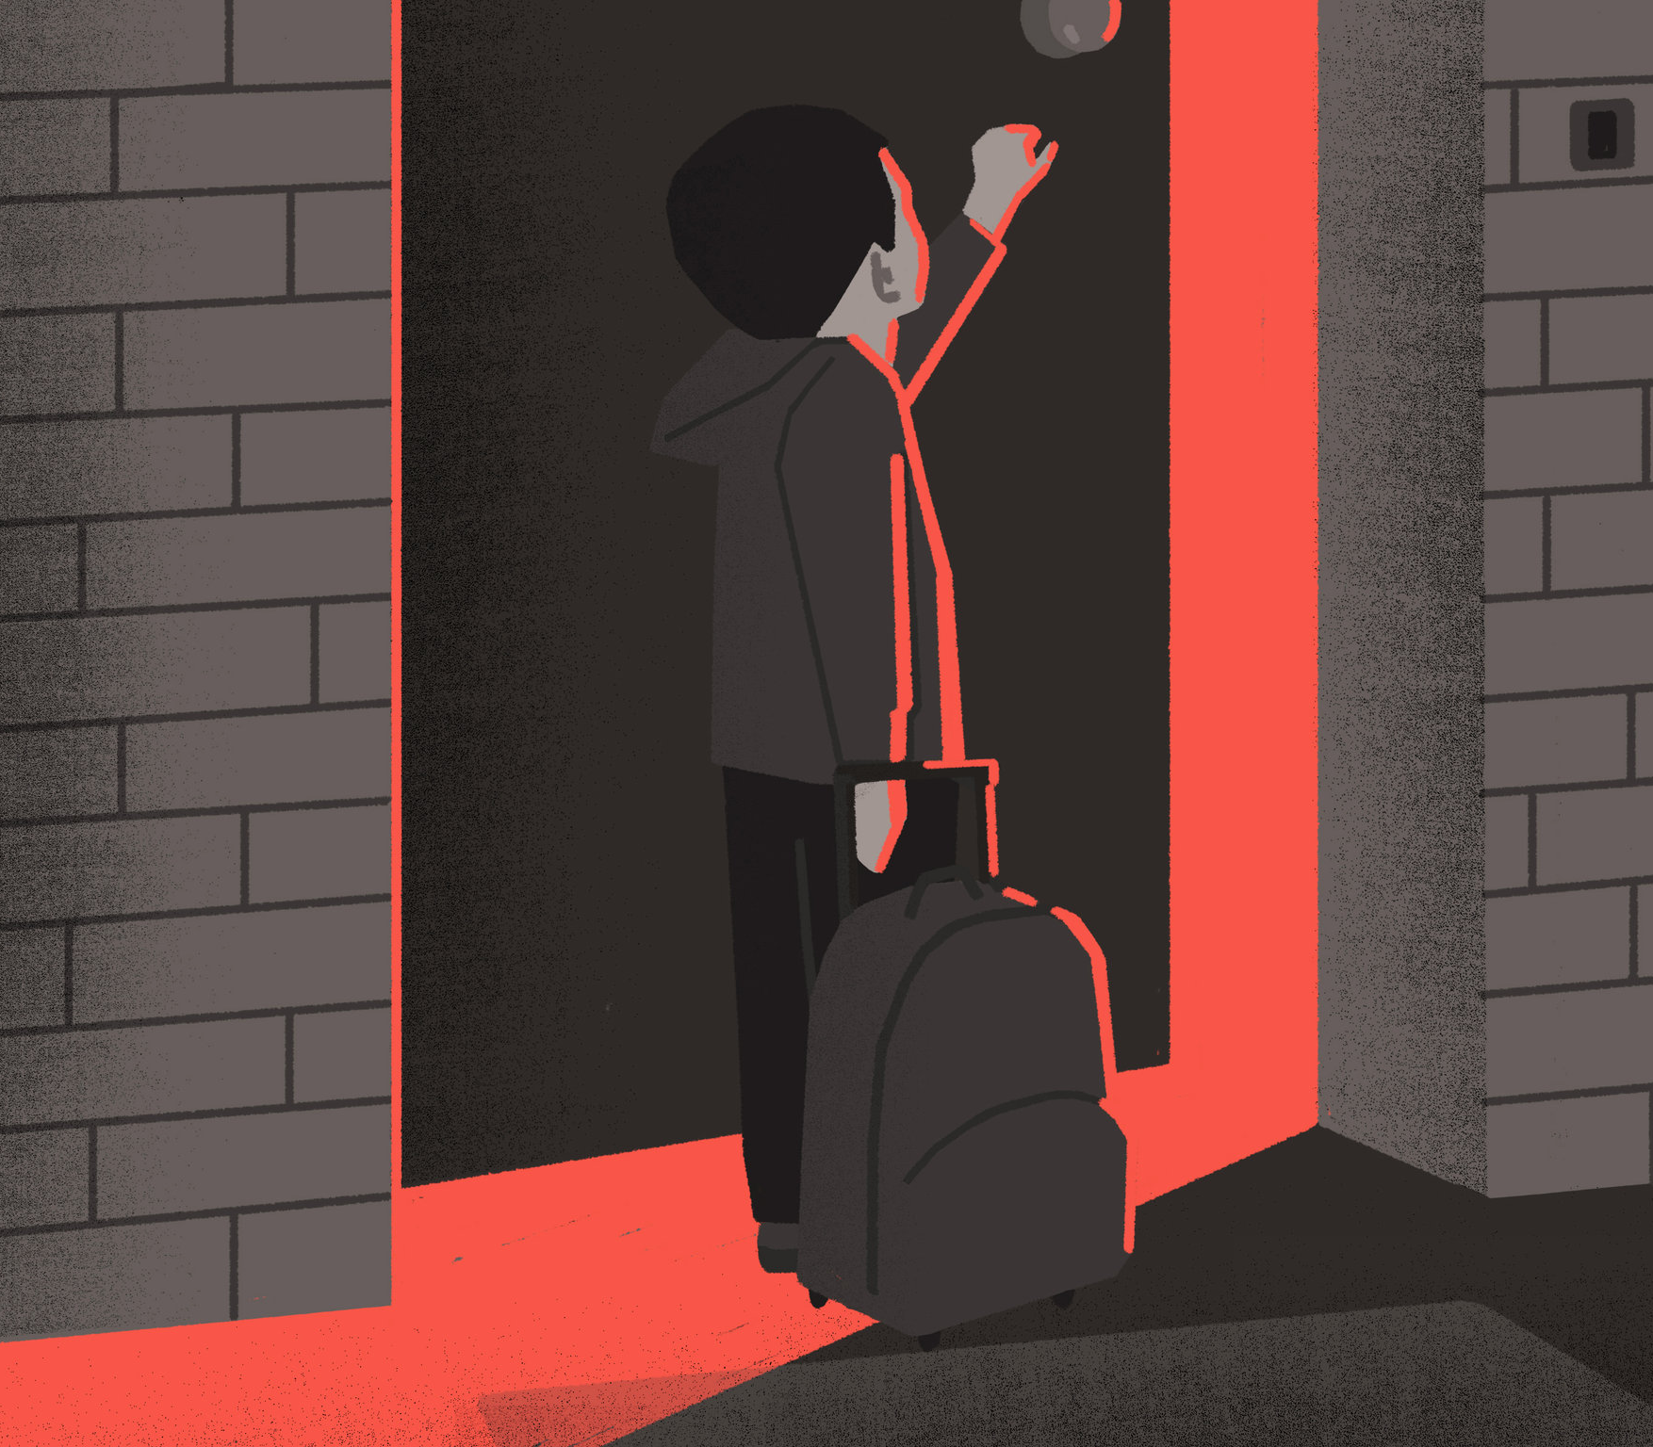
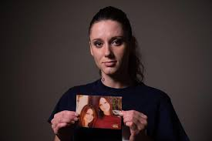
Michelle Voorhees’ Story
Large image

Slide 6

How do you cope with change?
Think of a rapid change you experienced …
What helped you adapt?
Is there anything you wish you had or could have done?

Slide 7


Impact on their future
Difficulty gaining housing
Behavioral and mental health problems
Substance abuse
Incarceration

Slide 8
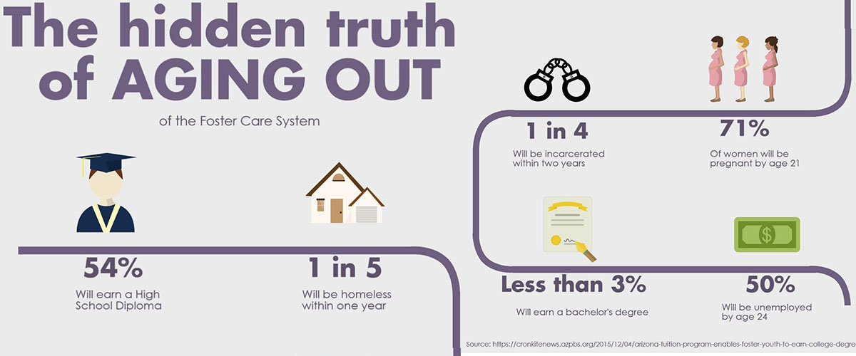

Slide 9


Rerouting the Pipeline
Transitional housing
Financial support
Access to budgeting and career training

Slide 10
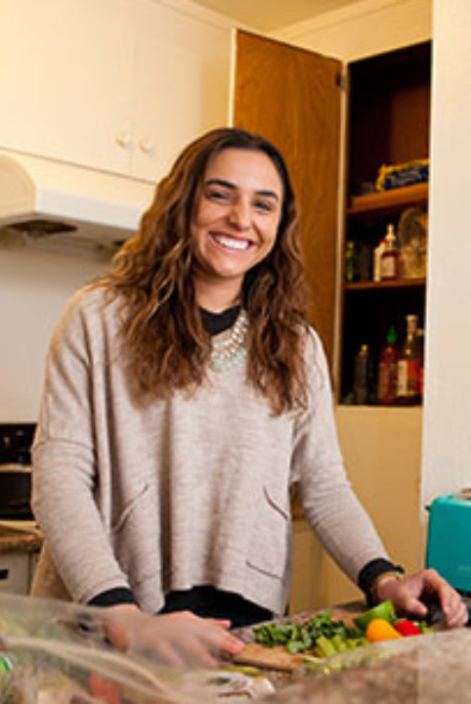


Pamela Bolnick
Foster care to success
To read more: https://nationswell.com/first-place-for-youth-foster-care-transitional-support/

