Slide 1
Performance Assessment Review (PAR)
PAR Form Completion Instructions

Slide 2
Performance Assessment Review
This presentation will take you step by step through the process of completing the PAR form which is available on line in a fillable format
The format of this presentation will consist of a:
Blank sample of each section of the form
Brief discussion of each section of the PAR form
Completed example of each section of the form

Slide 3
Getting Started
It may be helpful for you to have a hard copy of YOUR Organization’s PAR form available as you proceed through this presentation since forms will vary slightly from organization to organization
At the end of the presentation, there is a “Tip Sheet” that may also be beneficial to you in completing the PAR form

Slide 4
Any Good Performance System Must:
Link performance to Core Mission Areas, Goals, and Strategies
Tie individual results to program results
Measure individual results
Enable skill development
and job enrichment
Mission and Goals
Individual Results
Program Results

Slide 5
Overview of the
PAR Appraisal Process
Job Expectations Agreement
What the job is
How well it is to be done?
Final Assessment
How well was it done
throughout
the entire cycle?
Interim Assessment
How well was it done
during the first six
months of the cycle?

Slide 6
Participants in the PAR Process
Ratee: Employee being rated
Rater: Immediate supervisor who receives and/or dispenses the work
Reviewer: Rater’s supervisor or manager. Role is to check for consistency. Responsible for setting goals and expectations for unit/division

Slide 7
Job Expectations Conference
Job Expectations
Review Core Mission Areas & Department Mission Statement
Outline Major Goals for Unit
Establish Major Ratee Goals
Determine Major Job Responsibilities
Set Specific, Measurable Essential Criteria
Review pre-defined Performance Factors selected by agency and discuss their application

Slide 8
Identification Section
This section includes information which identifies the employee being evaluated:
Ratee Name
Ratee Title
Rating Period
Rater Name
Department/Agency-Location
The Identification Section will be the header throughout the document
SAMPLE

Slide 9
Section 1: Job Expectations
Major Goals of the Unit/Work Group
Major Goals of Ratee
Signatures
Acknowledgment of PAR elements
Confirmation of meeting
Agree/Disagree
Acknowledgment of Ratee’s position
Ratee Comments

Slide 11
Job Expectations: Major Goals of Unit/Work Group
Governor’s Predefined Core Mission Areas that relate to your organization
Goals of the organization
Division’s purpose
Work Unit or Group’s overall purpose as it relates to/supports the overall Core Mission of the organization

Slide 12
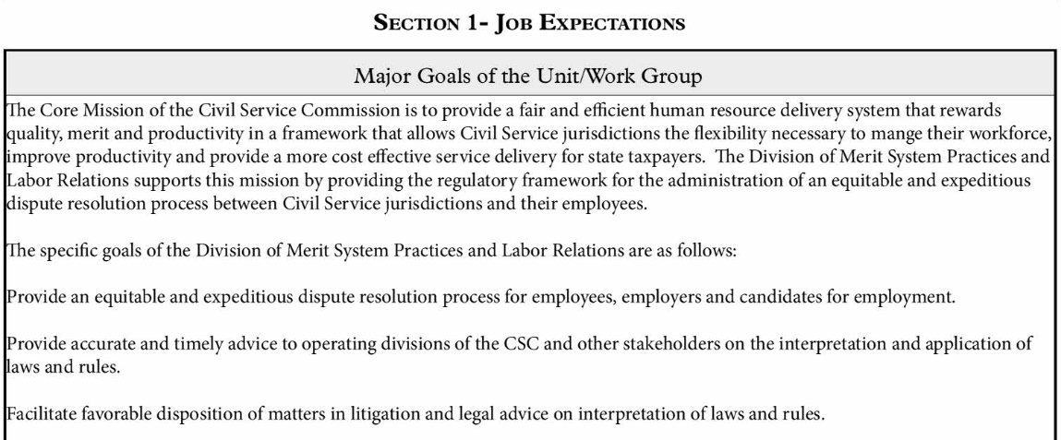
SAMPLE

Slide 14
Job Expectations Major Goals of the Ratee
Identifies the individual goals of the ratee that support the work unit’s purpose(s)
The major goals of the Ratee should be identified, communicated and discussed at the Job Expectations Agreement session

Slide 15
SAMPLE

Slide 16
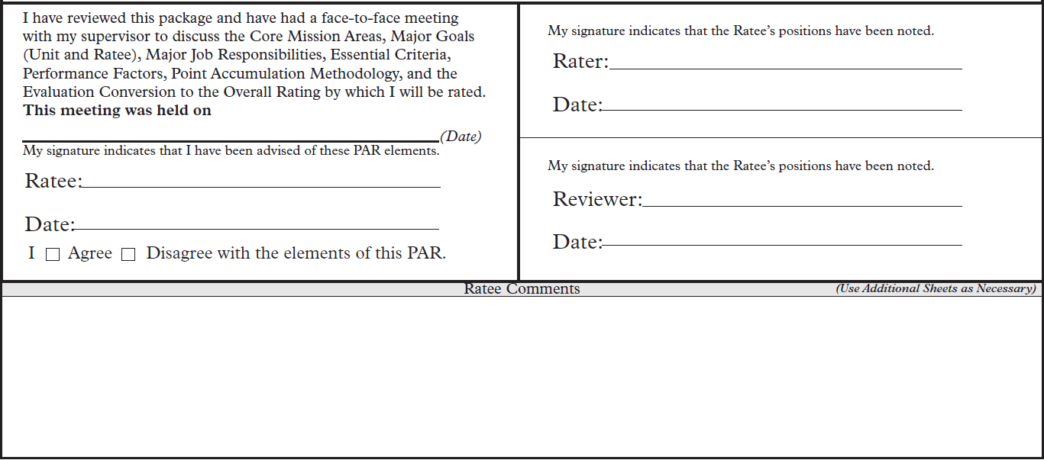

Slide 17
Certification of Job Expectations Agreement
During Initial Meeting/After the Entire PAR is Discussed:
Job Expectations are discussed and clearly explained
Date that the face to face meeting was held
After any revisions/comments, both rater & ratee sign & date PAR form
Ratee checks either “agree” or “disagree”
PAR is then forwarded to the reviewer
*NOTE: We will return to the Certification of Job Expectations Agreement section after review of Sections 1, 2, & 3

Slide 18
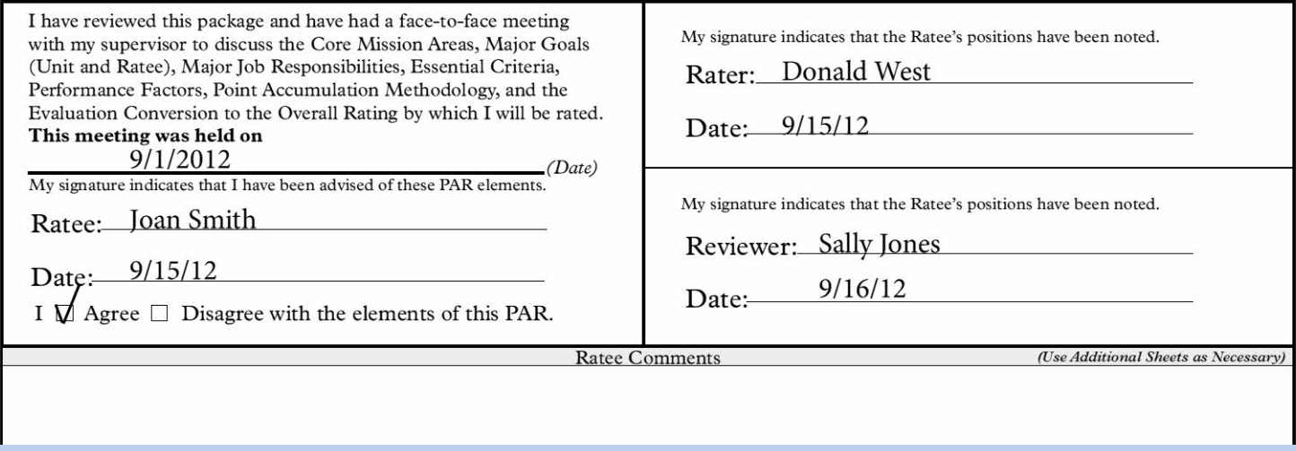
SAMPLE

Slide 19
Section 1: Job Expectations also includes:
Major Job Responsibilities
Essential Criteria

Slide 20
Major Job Responsibilities and Essential Criteria

Slide 21
Major Job Responsibilities
What are they?
Generally 6-10 broad duties, tasks or responsibilities which must be accomplished to achieve the unit’s goal.

Slide 22
Major Job Responsibilities Should:
Contribute to the Goals and Objectives
Be Critical to the job
Require a significant amount of Time
Include any that are Required by Statute or Regulation
Be Done Often
Accurately reflect the Actual Work over which employee has control (responsibility, authority and resources to act)

Slide 23
SAMPLE

Slide 25
Essential Criteria
What are they?
Essential Criteria are statements of conditions that exist when a job responsibility has been completed successfully
How many are
required?
At least one (1) Essential Criteria for every Major Job Responsibility

Slide 26
Principles of Essential Criteria
Specific
Measurable
Attainable
Reasonable
Time Related

Slide 27
SAMPLE
*NOTE: The next screen will have additional Job Responsibilities and Essential Criteria for this employee

Slide 28
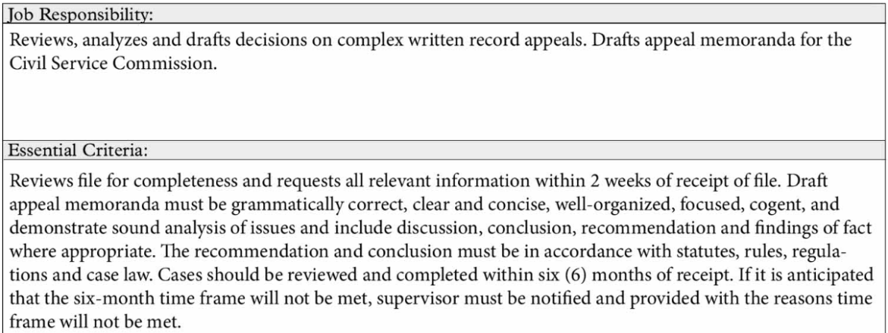
SAMPLE

Slide 29
Section 2: Performance Factors: Purpose
Align Core Mission Areas, agency goals and objectives with performance
Provide a uniform guide for evaluating performance
Predefined by the organization

Slide 30
Section 2: Performance Factors
Job Achievement Factors
Job Related Factors
*Refer to the hard copy of your organization’s PAR so you know which factors your organization has chosen

Slide 31
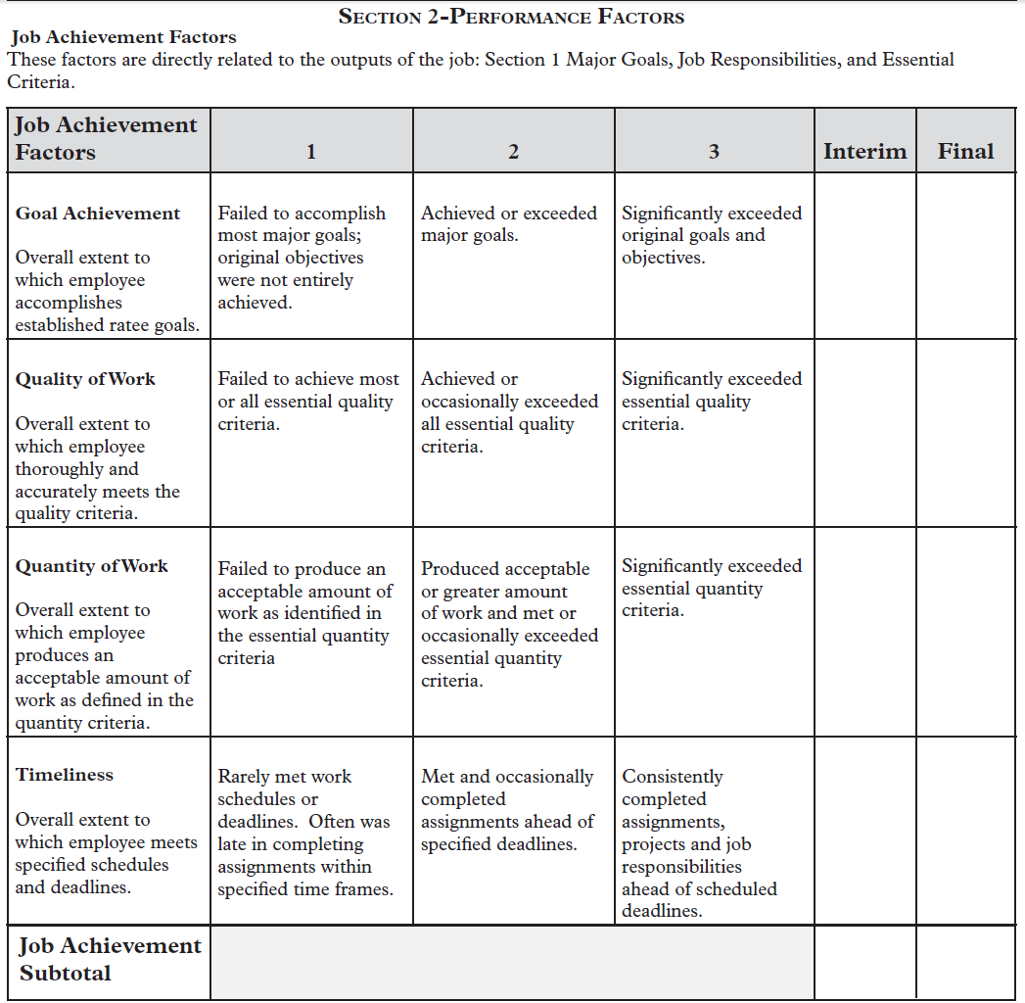

Slide 32
Section 2: Performance Factors
Job Achievement Factors
These factors are directly related to the output of the job: Section 1 - Major Goals, Job Responsibility, and Essential Criteria
The Organization predetermines Job Achievement Factors

Slide 33
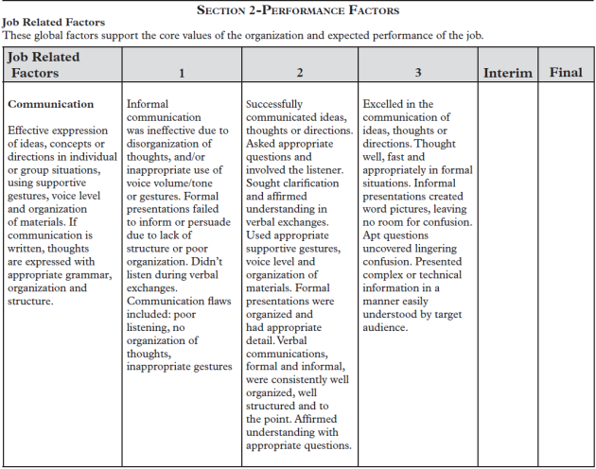
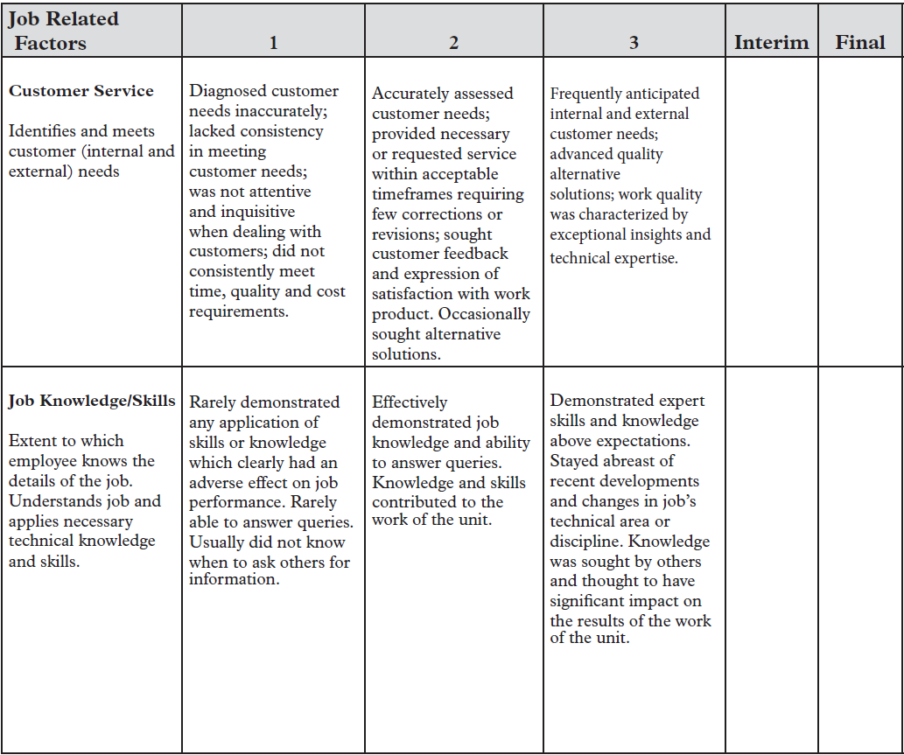
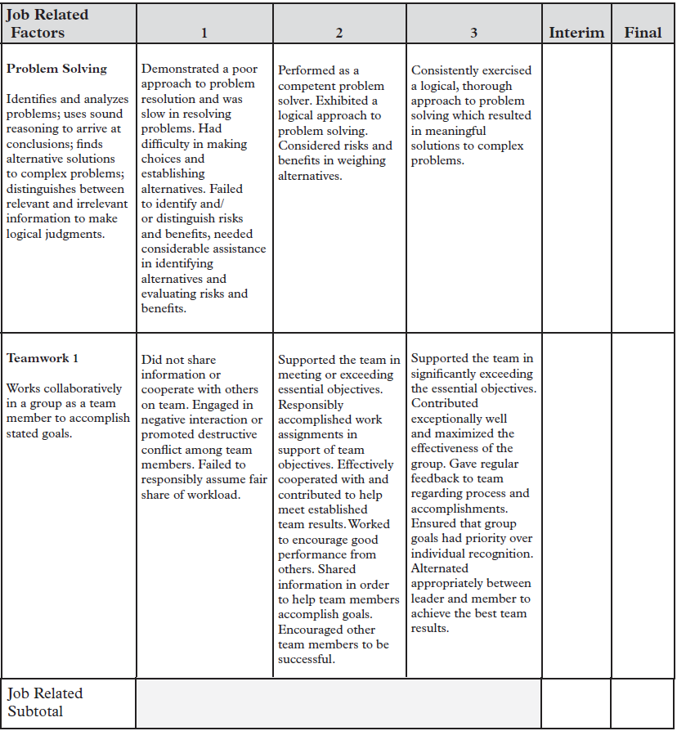

Slide 34
Section 2: Performance Factors
Job Related Factors
These global factors support the Core Values of the organization and expected performance of the job
The Organization predetermines Job Related Factors

Slide 35
Section 3: Computation & Conversion to Overall Rating
Subtotals of Job Achievement and Job Related Performance Factors are added to determine Grand Total points
Grand Total points are converted to the Overall Evaluation Rating. For example:
09-13 points = Unsatisfactory Final Rating (1)
14-22 points = Successful Final Rating (2)
23-27 points = Exceptional Final Rating (3)
*NOTE: Point values will vary by organization depending upon
the number of “Job Performance Factors” each organization selects

Slide 36
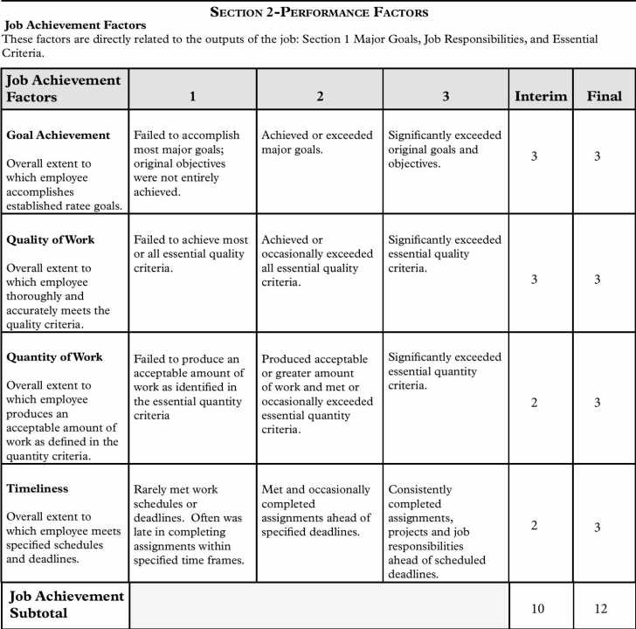
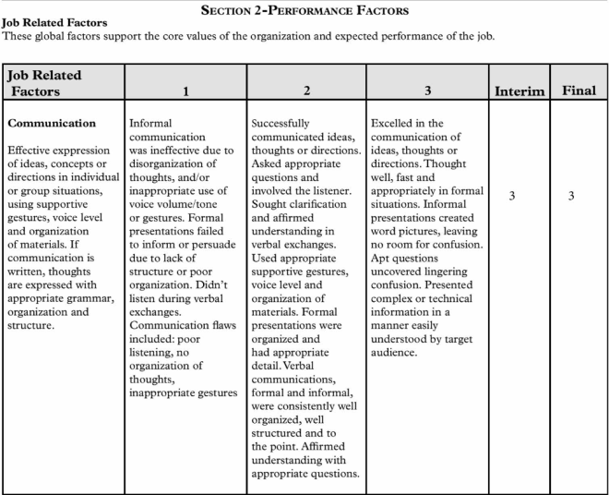
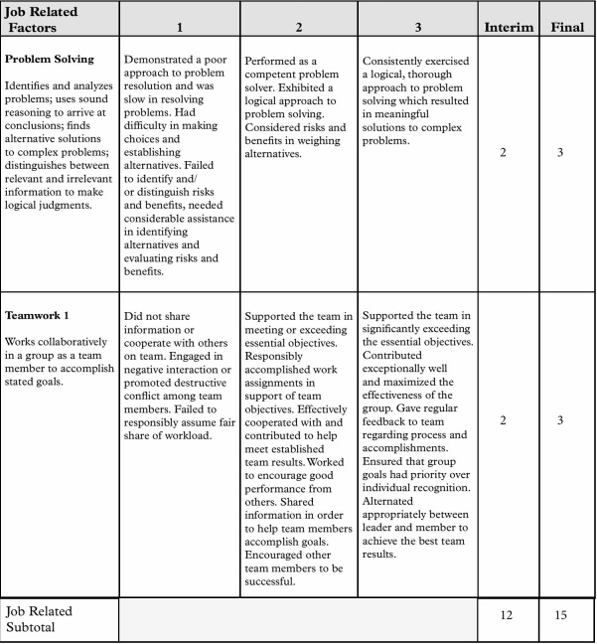
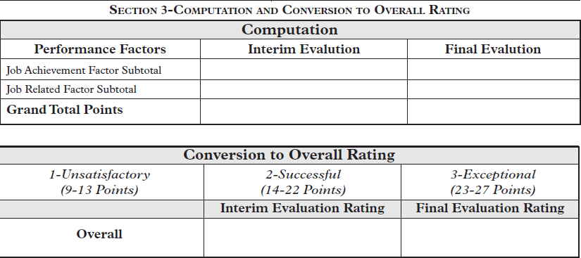

Slide 37
Performance Factors: Rating Mechanism
Job Achievement
Review written descriptors against Ratee’s Goals, Job Responsibilities, and Essential Criteria
Determine evaluation points for each factor
Subtotal points
Job Related
Review written descriptors against Ratee’s Overall Performance
Determine evaluation points for each factor
Subtotal points

Slide 38
Ratings are done on a 3-point scale
Unsatisfactory - Failed to achieve most essential criteria. Rarely met work schedules or performance criteria
Successful - Met or occasionally exceeded essential criteria. Produced acceptable or greater amounts of work
Exceptional - Significantly exceeded essential criteria consistently in a sustained job performance

Slide 39
Job Expectations are written at the “Successful” level
Justifications should be written for all ratings
If the Ratee’s performance is at the “Exceptional” or “Unsatisfactory” level, the Rater should prepare specific documentation to support those ratings
We will discuss this again later in the presentation
*NOTE: At this point in the PAR Review, all of the expectations of the ratee have been discussed with the employee. Now is when the ratee and rater will sign the Certification in Section 1 – Job Expectations

Slide 40
SAMPLE
2

Slide 41
Sections 4 & 5:
Interim and Final Justification Sheet and Development Plan
Section 4 & 5 are identical with the exception of the time periods they cover:
Interim = First 6 months
Final = Entire 12 months

Slide 42
Interim and Final Evaluation Conferences
Determine evaluation points and rating justification; Recognize and document positive contributions and areas needing improvement
Determine job performance gaps and action plan to close gaps
Mutually develop action plan for development and improvement
Mutually establish specific deadlines for improvement
Set follow-up meeting if necessary
Interim Rating covers the 1st six months
Final Rating covers the ENTIRE year

Slide 43
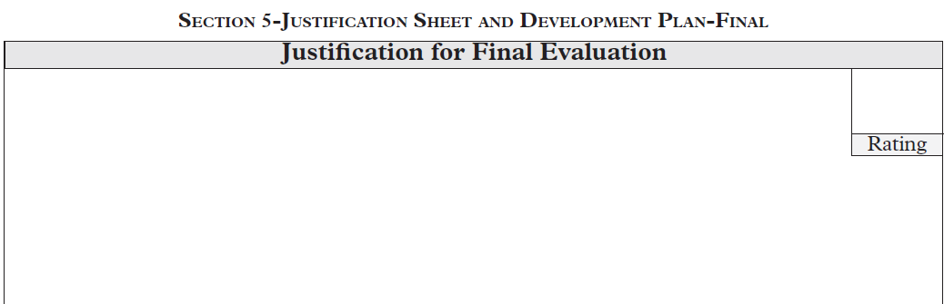

Slide 44
Justification Sheet
Justification
Recognize and document positive contributions, as well as areas needing improvement
Provide justification for the overall Rating
Cite specific examples of performance that support an Exceptional or Unsatisfactory Rating

Slide 45
Justification: Do’s and Don’ts
DO:
Give reasons, both positive and negative, that substantiate the rating
Review the “Fact Sheet of Significant Events” which will be reviewed shortly, and any other documentation in preparing the justification
DON’T:
Repeat the rating term and think that this is sufficient evidence: e.g. “Joan’s performance is Commendable”
Include issues that are not related to the performance of the job

Slide 46
SAMPLE
2
3

Slide 47
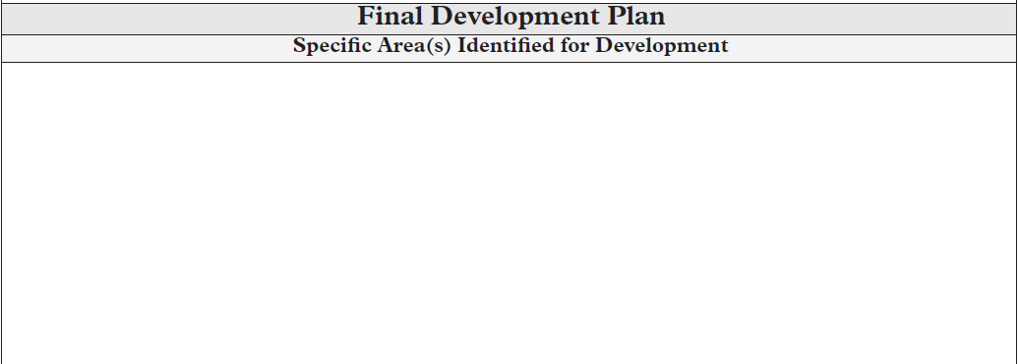

Slide 48
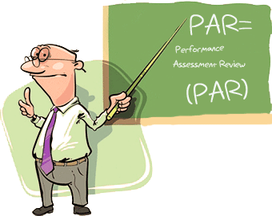
Development Plan Specific Area(s) Identified for Development
Identify skills and competencies targeted for improvement
Focus on improvement in order of importance
Mutually develop a plan of action
Include resources needed,
obstacles, and alternatives

Slide 49
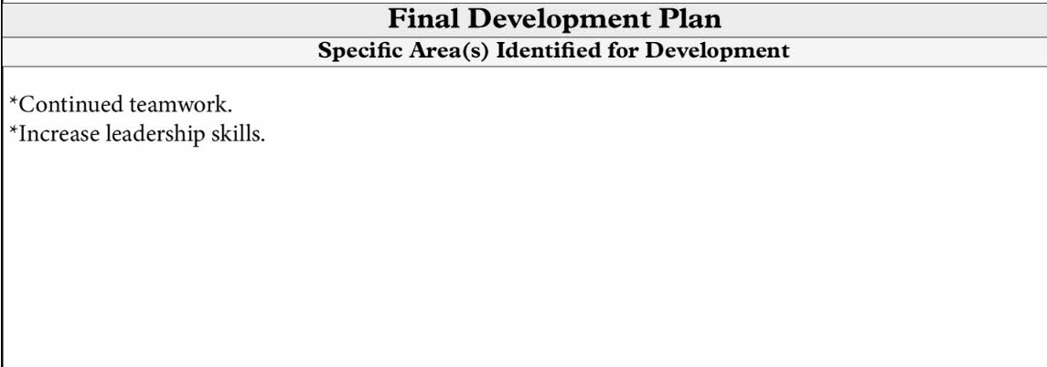
SAMPLE

Slide 50
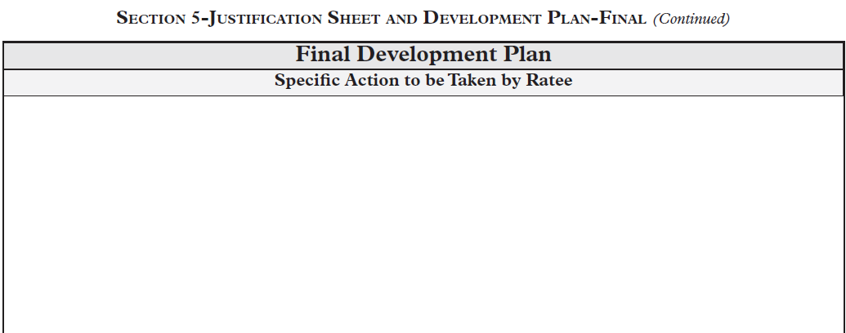

Slide 51
Development Plan Specific Action to be Taken by Ratee
Actions may include:
Take on special projects or assignments
Attend classroom training courses
Utilize Online Training (LMS)
Perform library research or other relevant readings
Work with a peer or closely with a Manager
Attend seminars and workshops
Enroll in local and national professional organizations

Slide 52
SAMPLE

Slide 53
Section 6: Fact Sheet of Significant Performance Events

Slide 54
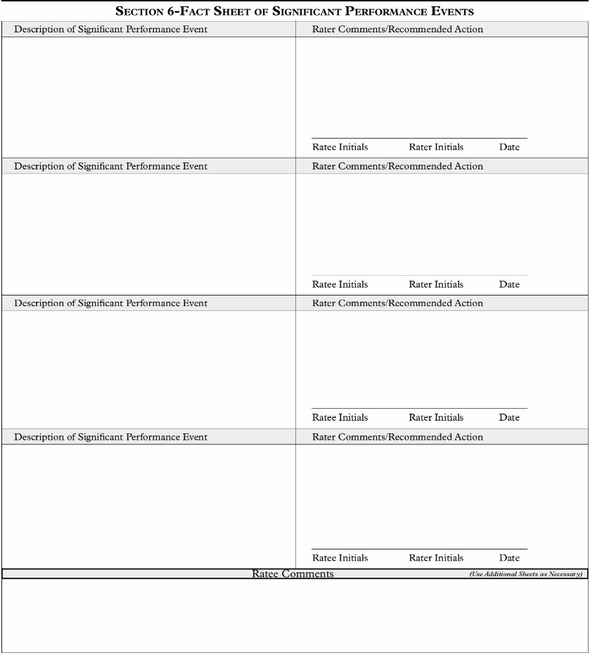

Slide 55
Fact Sheet of Significant Performance Events
Used to record any noteworthy event, positive or negative, that occurs throughout the rating cycle
Any Significant Event that represents performance below or above the Successful level should be recorded
Events should be documented as they occur, with both rater and ratee initialing the documentation
All involved parties are encouraged to request
entries on the form; Rater determines significance

Slide 56
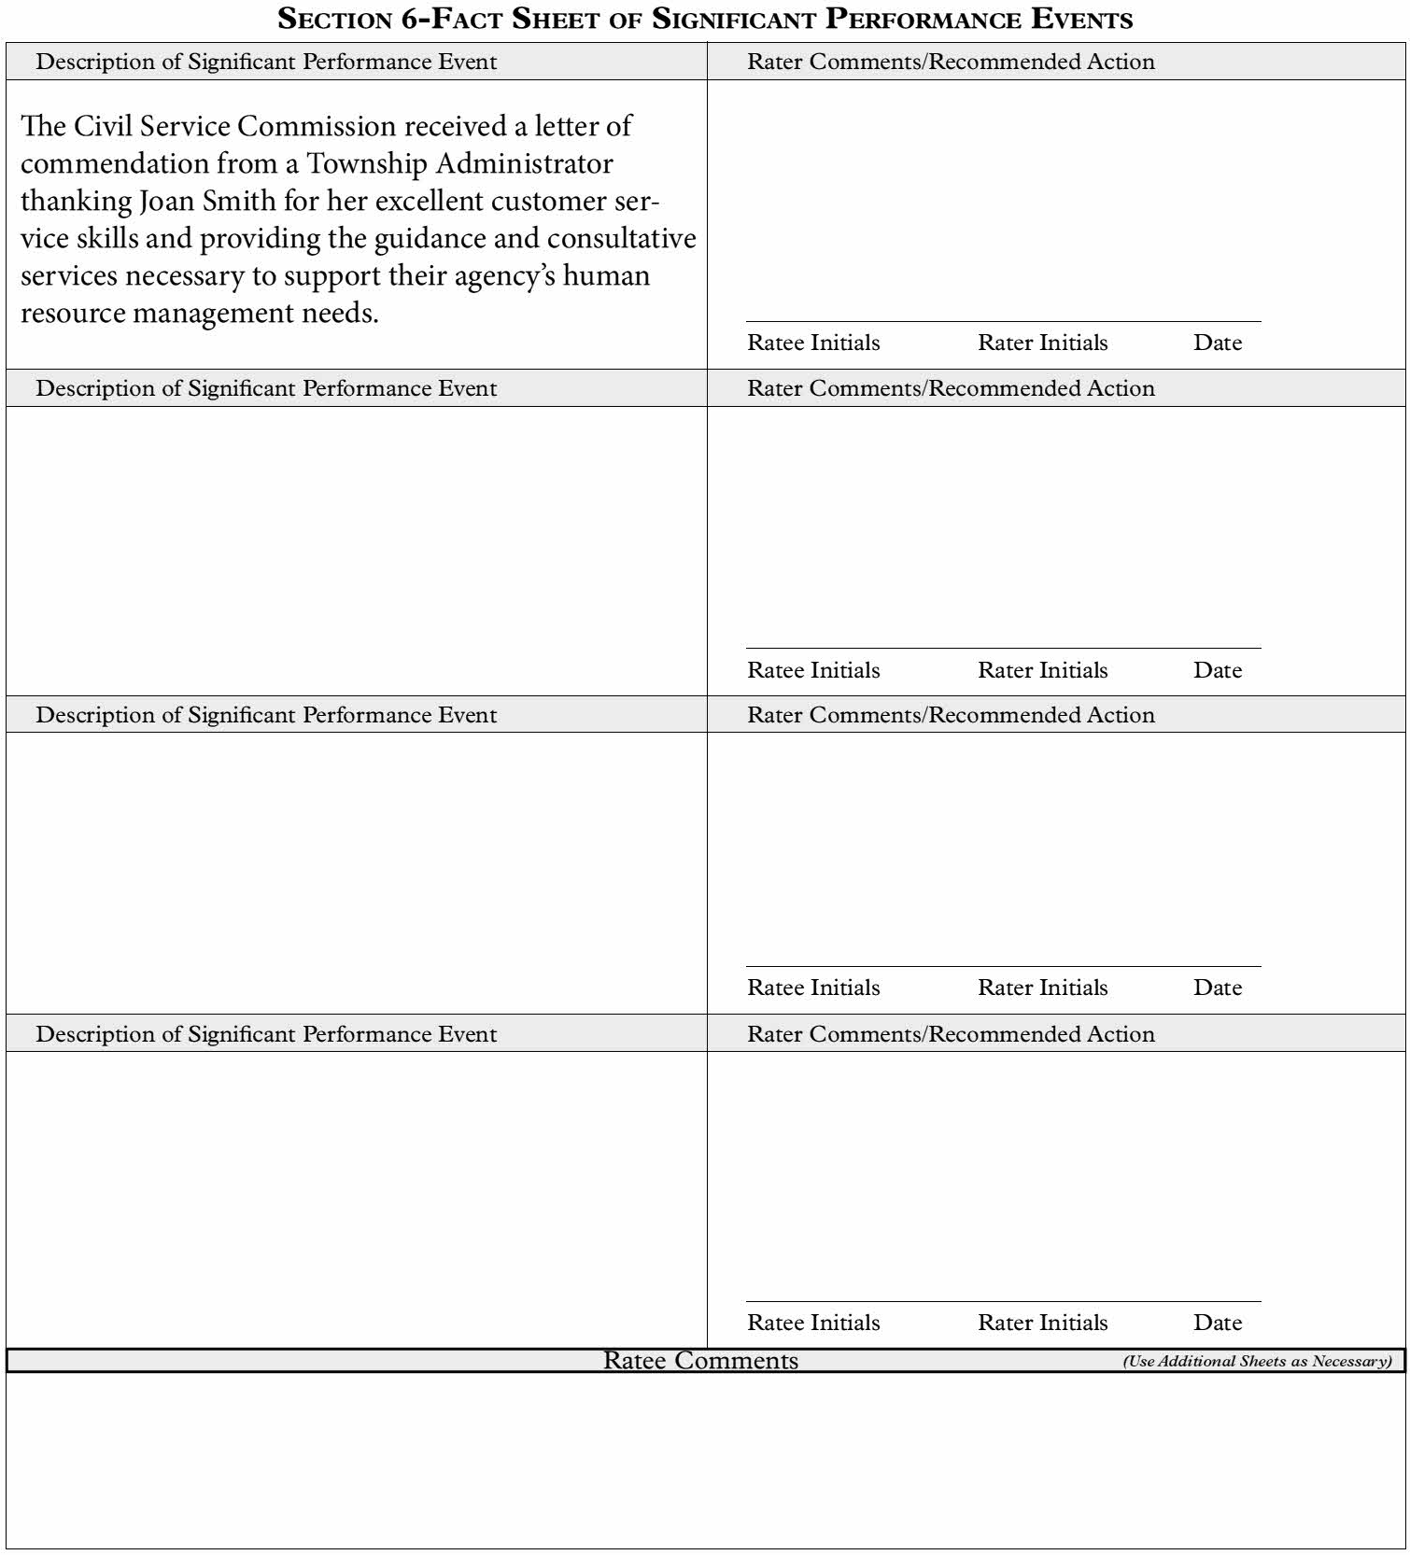
SAMPLE

Slide 57
Certification of Interim and Final Evaluations
Review & discuss Sections 1, 2, 3 and 4. Rating, Justification and Development Plan.
Date the face to face meeting was held
After any revisions/comments, both rater & ratee sign & date PAR form
Ratee checks each of 3 boxes with either “agree” or “disagree”
PAR is then forwarded to the reviewer

Slide 58
SAMPLE

Slide 59
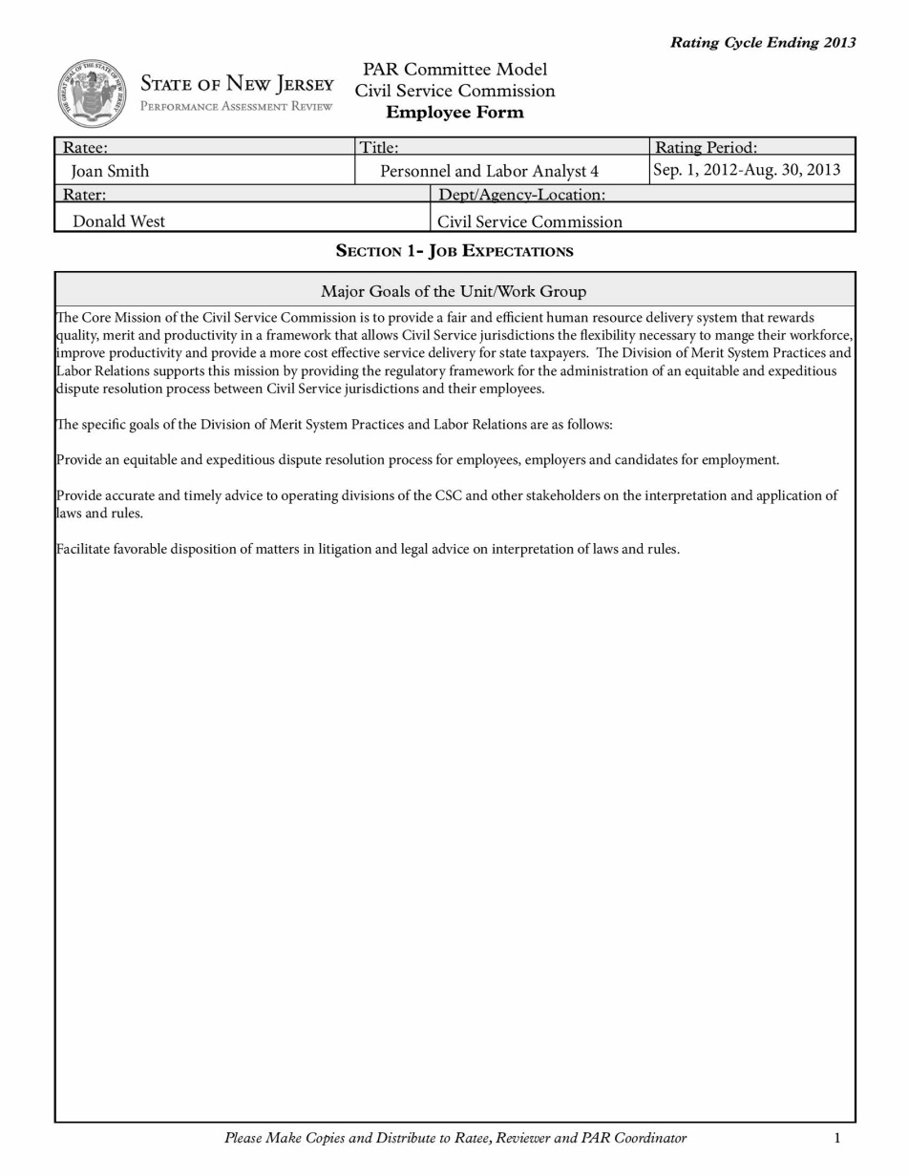
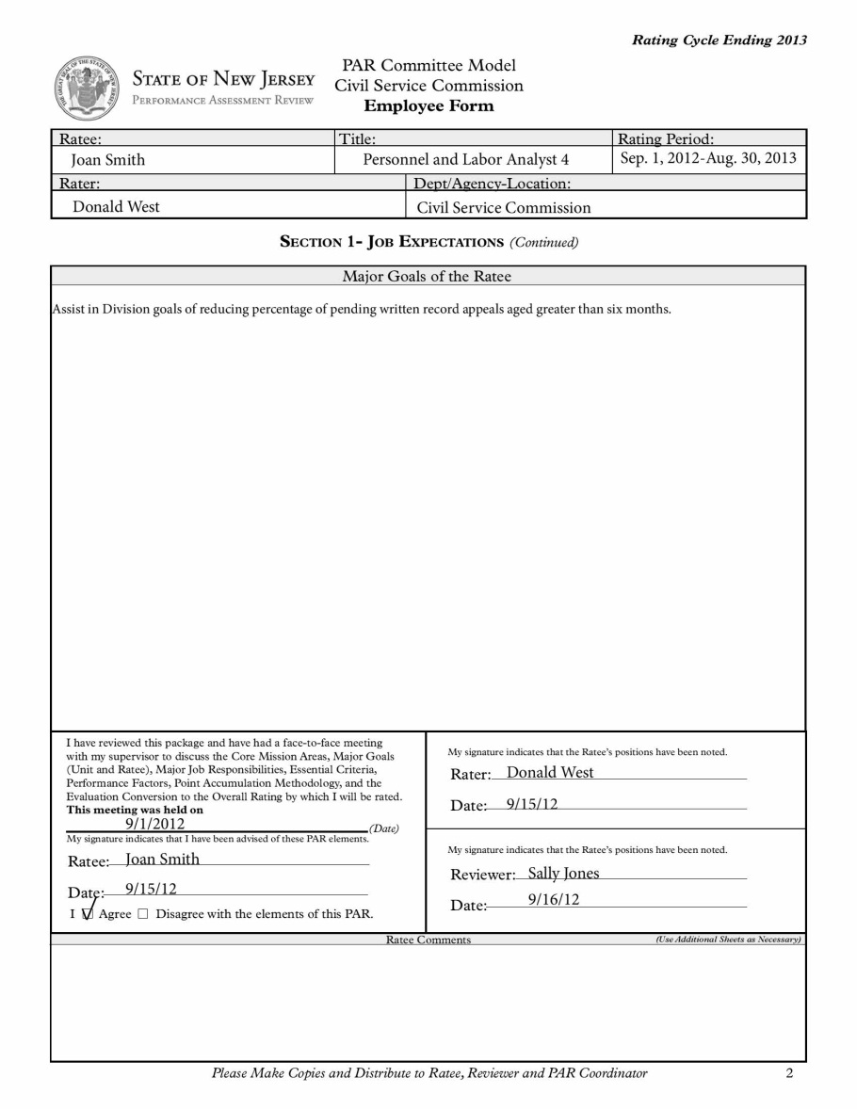
SAMPLE

Slide 60
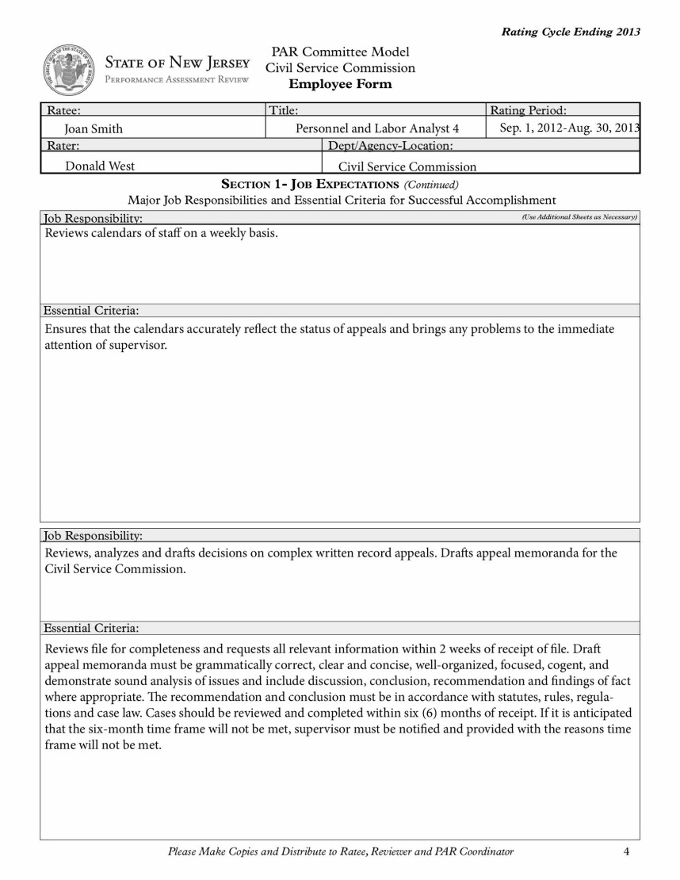
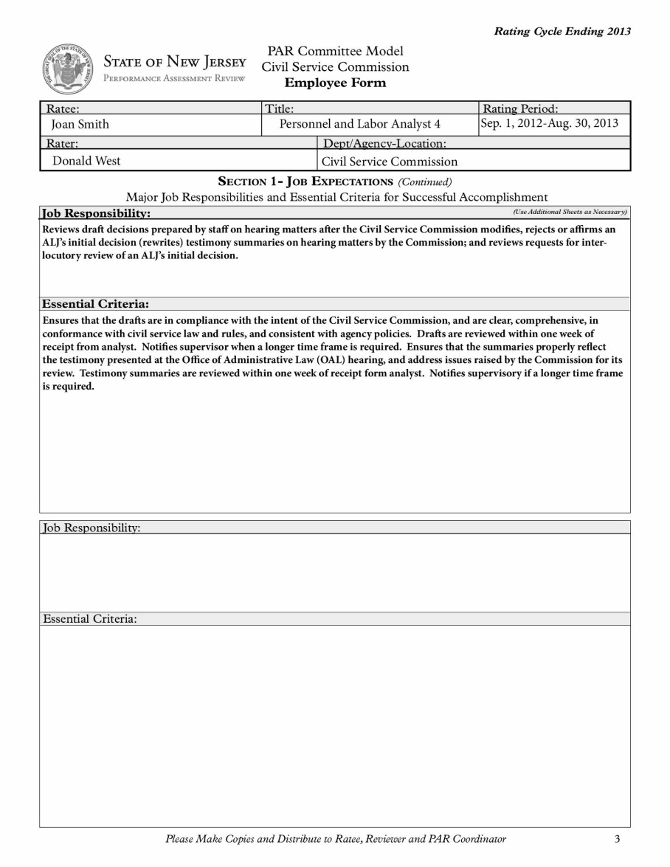

Slide 62
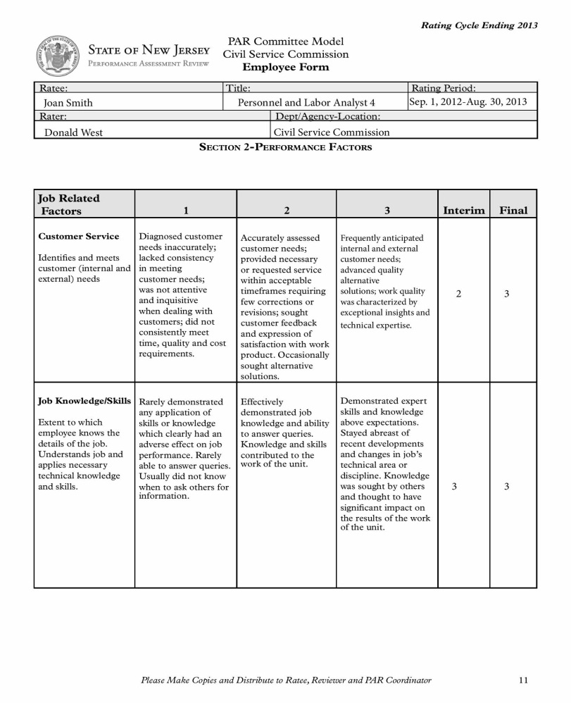
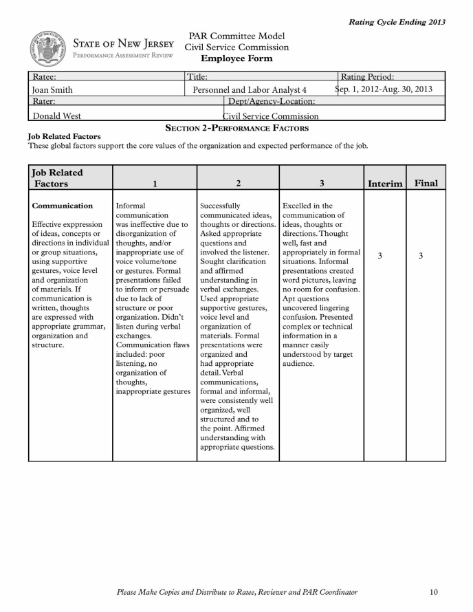

Slide 63
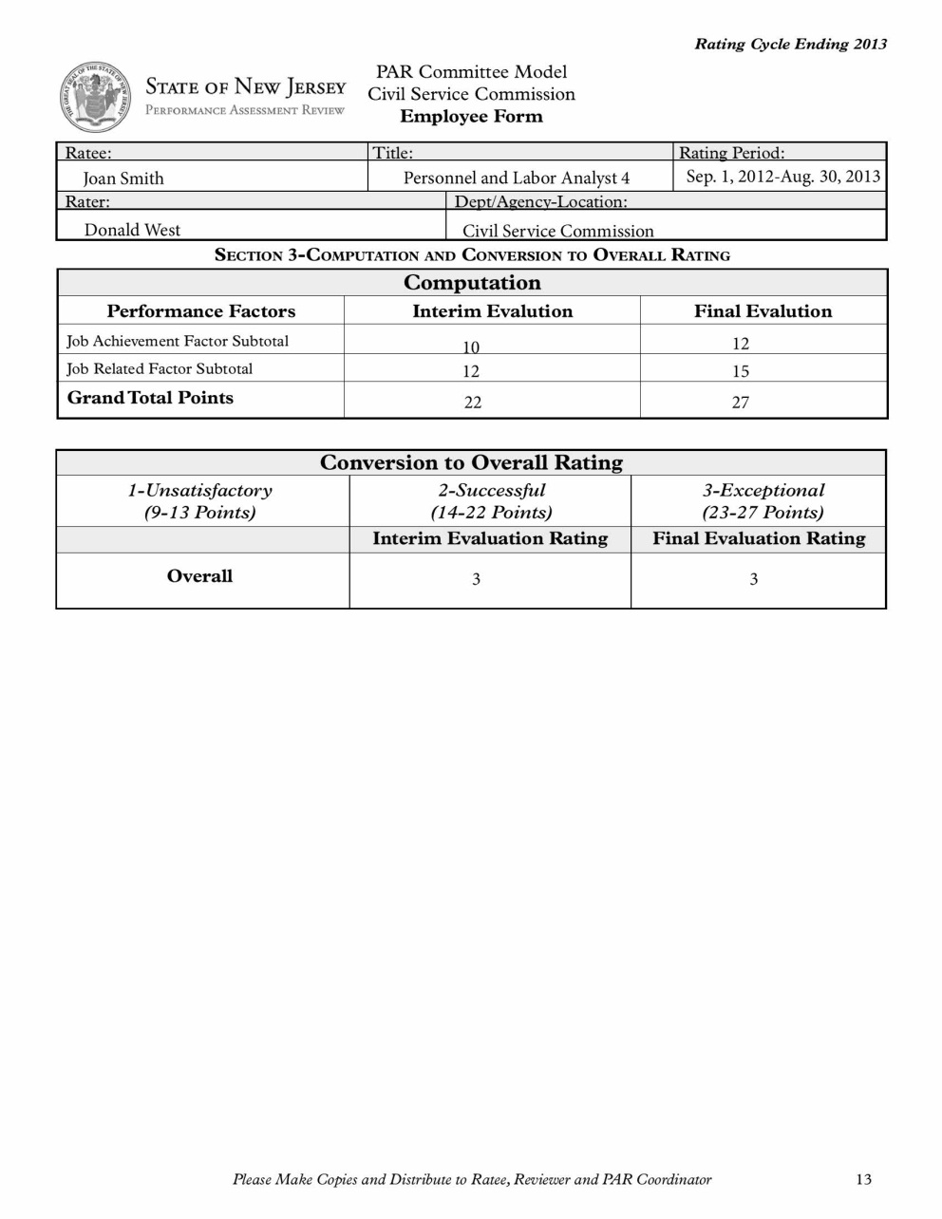

Slide 64
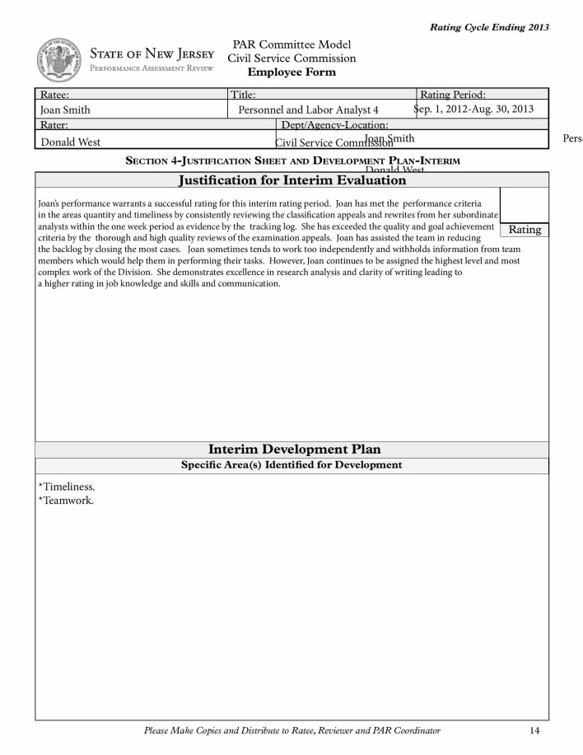
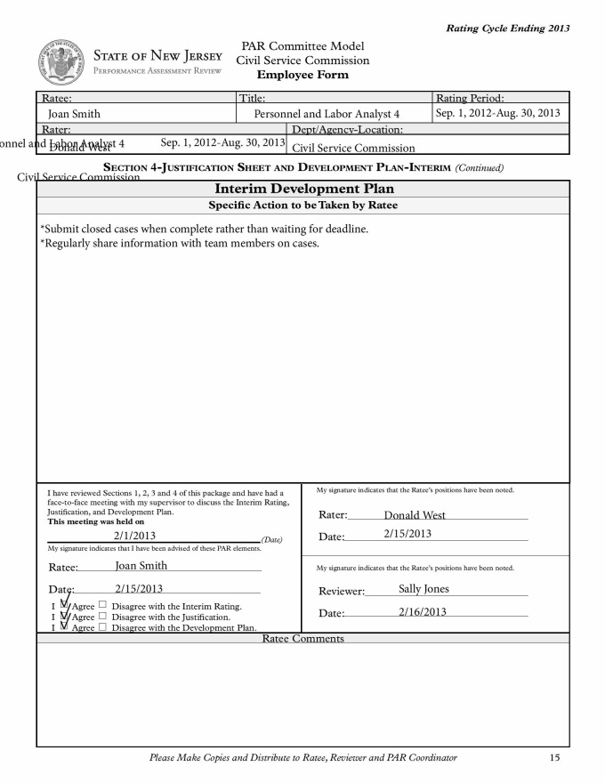
2

Slide 65
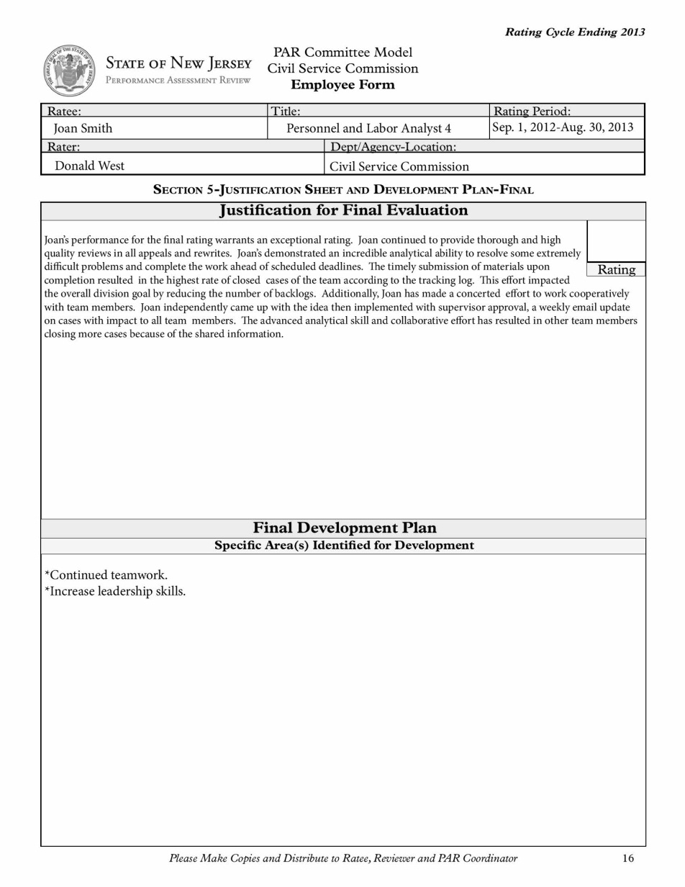
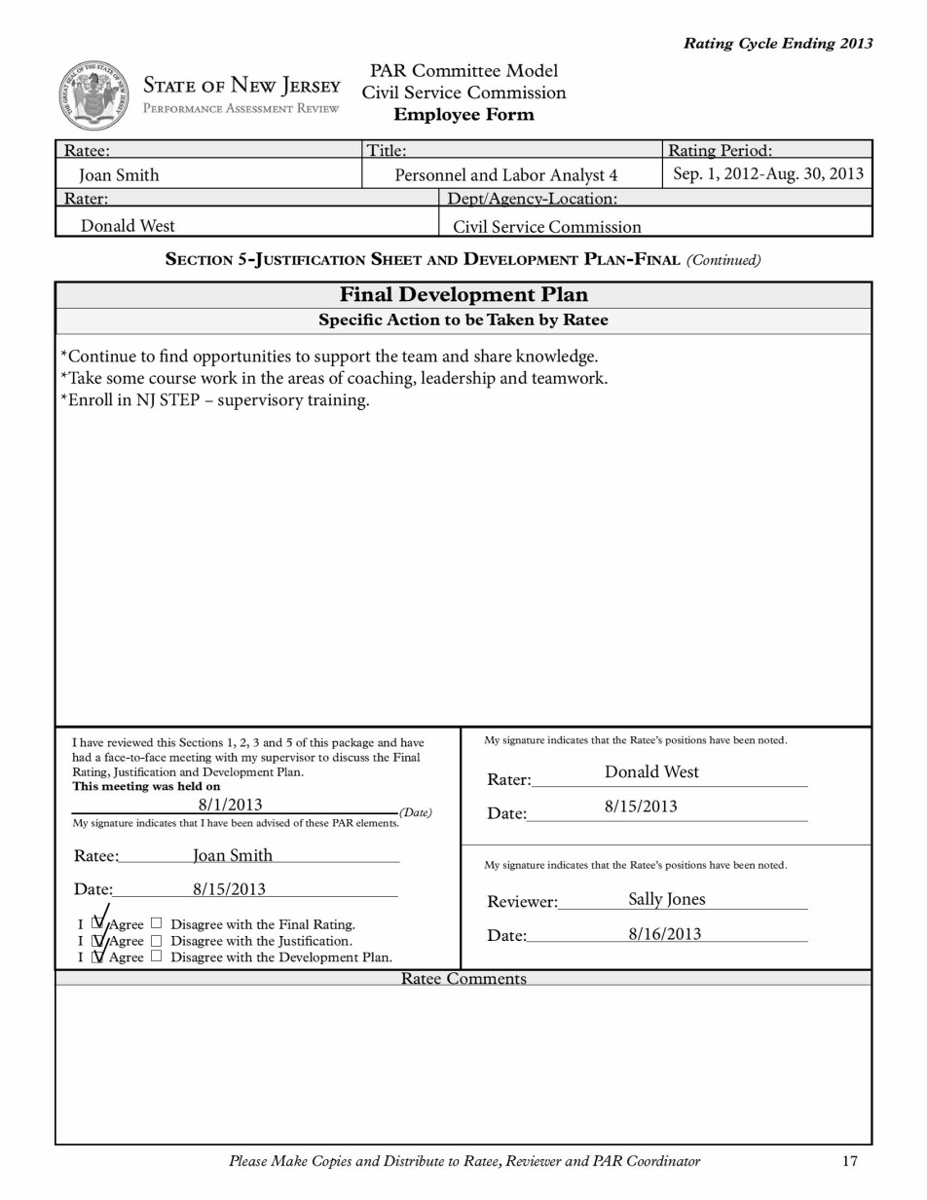
3

Slide 66
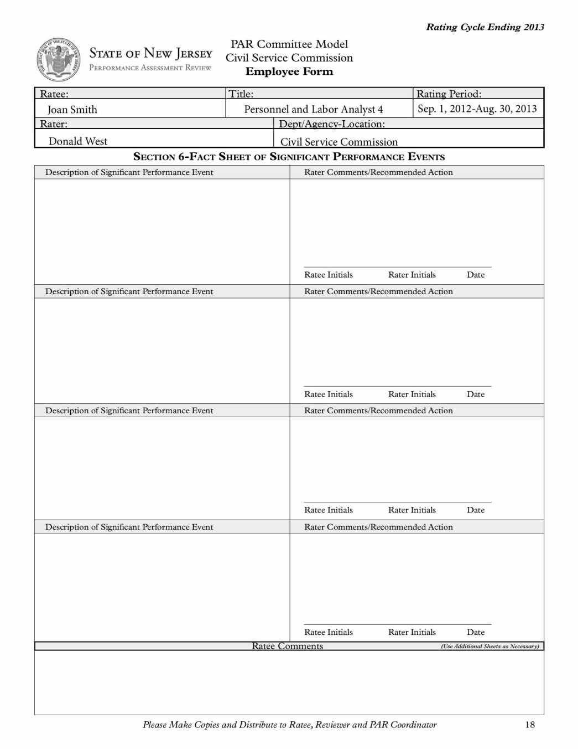
The Civil Service Commission received a letter of commendation from a Township Administrator thanking Joan Smith for her excellent customer service skills and providing the guidance and consultative services necessary to support their agency’s human resource management needs.

Slide 67
Tip Sheet
You should save the PDF immediately once you start working within the form.
Save in your documents: File>Save As>PDF
Recommended naming convention: 2013 PAR_“employee name”. Example: 2013 PAR_Joan West
To check spelling within the form:
Go to Edit>Check Spelling>In Comments, Fields & Editable Text
Or Use key command F7
If you want to email the PDF you can do so from within Adobe Reader:
File>Attach to Email. A panel will open on the right hand side. Select Attach to Email and press Attach button and outlook will open with the PDF attached.
The form is designed to allow the user to type in the Ratee’s name, Title, Rating Period, Rater, and Department/Agency-Location one time then it will auto populate on every page.
The form calculates the Job Achievement Subtotal and Job Related Subtotal for the user.
Also once the Interim Evaluation Rating and Final Evaluation Rating is keyed into the Conversion to Overall Rating, the rating is placed onto the Justification Sheet and Development Plan.

Slide 68
Thank you for your participation!
If you have any further questions or concerns regarding PAR, please contact your PAR Coordinator or Human Resource Manager.
The Civil Service Commission will have further PAR training opportunities at the request of the agency

