Slide 1
Workday 2020
Performance Management Overview for Professional Staff

Slide 2
Agenda
Professional Staff Reviews - What’s New
Employee Self-Evaluation
Immediate Supervisor’s review
Demo
Unit Head/Vice President review
President’s review
Demo
Next Steps – Key Dates

Slide 3
Workday 2020 Performance Management
What Is Changing
What Is Not Changing
All reviews completed in Workday
Improved visibility into review process
Reappointment Notifications
Final documents stored in Workday
Review Periods/Cycles
Evaluation Process
Reviewers and Approvers

Slide 4
Review Period/Cycles
In First Year of Service | One Year | Notification - January
Completed One or Two Years of Service | One Year | Notification – October
Completed More Than Two Years of Service and Less Than Five Years of Service | One Year | Notification – September
Completed Five Years of Service and Are Eligible for Their Initial Multi-Year Contract | Multi-Year | Notification - September
Completed Five Years of Service and on Multi-Year Contract Which Expires June 30, 2020 | Multi-Year | Notification - Jan./Feb.

Slide 5
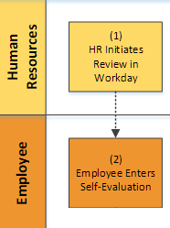
Managerial/Professional Review Process
HR initiates the performance review in Workday
Automated workflow routes the review to employee to complete Self-Evaluation.
See Handout

Slide 6
Employee Self-Evaluation Inbox Item
Help text contains instructions and due dates
Professional Staff
Employee rates their performance, and adds supporting documents, if any.

Slide 7
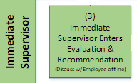
Immediate Supervisor’s Evaluation
Immediate Supervisor has 2 steps to complete:
Complete a written assessment
Make a reappointment recommendation

Slide 8
Immediate Supervisor Step 1
1. Complete written assessment.

Slide 9
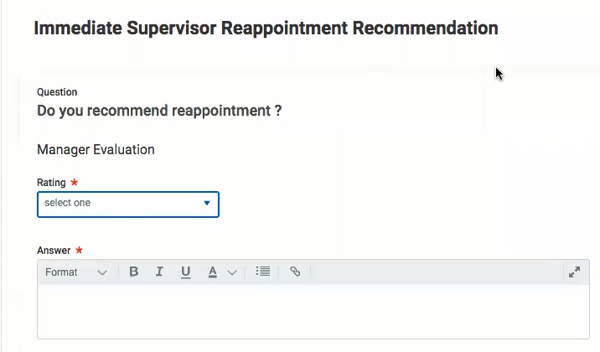
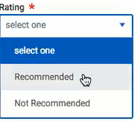
Immediate Supervisor Step 2
2) Make a reappointment recommendation

Slide 10

Employee & Supervisor view
Demo

Slide 11
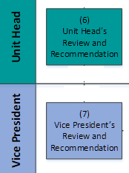
Unit Head and Vice President Review & Approval
Unit Head and Vice President will:
Review Employee and Immediate Supervisor assessments
Make a reappointment recommendation
Complete a written assessment

Slide 12
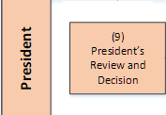
President Approval & Recommendation
President will:
Review all previous assessments
Make a recommendation decision
Employee receives an email notification of President’s decision and recommendation to the Board.

Slide 13
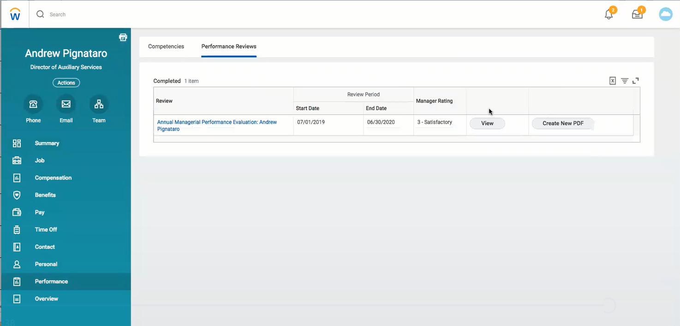

Workday Profile: Performance Reviews
Allgood

Slide 14
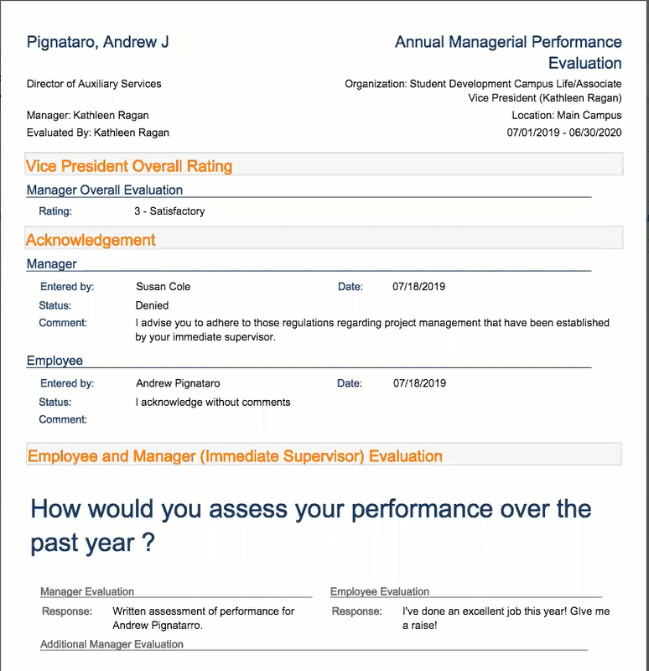
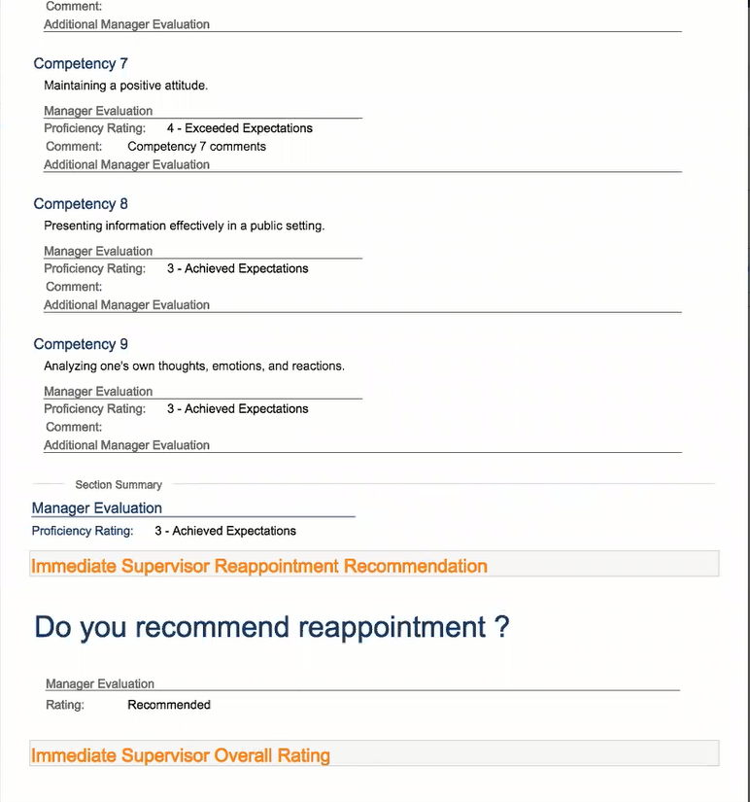
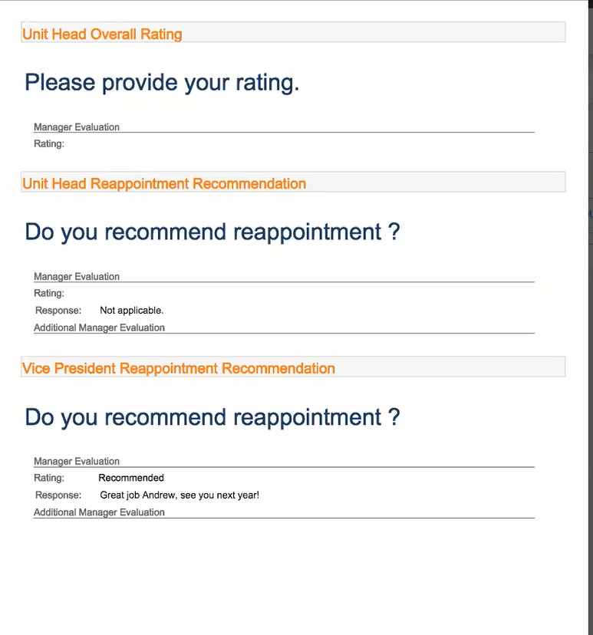
Final Performance Review .PDF Document
Allgood,
Allgood

Slide 15
Additional Reviewers
Demo

Slide 16
Next Steps: Key Dates
October 15: User Acceptance Testing begins
October 15: Training Registration begins
November 4: Training Available
January 2: Performance Management Live in Workday
* Reviews started in Fall 2019 will continue using the existing process.

