Slide 1
Office of the
Dean of Students
Red Hawk Standards
Summer 2020 Orientation

Slide 2
Welcome To
Montclair State University!!!!
Montclair State University became the Red Hawks in 1989 and in 2001, “Rocky” was named as our school mascot. We even have a Team Rocky who get to work with Rocky throughout campus
Did you know?

Slide 3
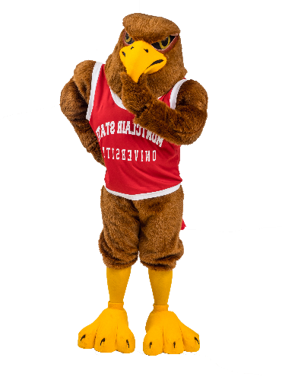
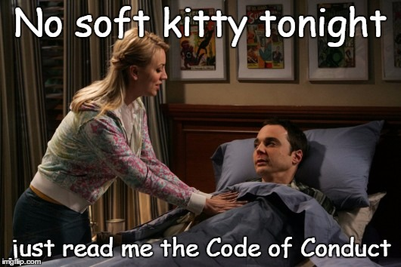
Please review the University Code of Conduct located at:
https://www.montclair.edu/policies/all-policies/code-of-conduct/

Slide 4
Quick review of Canvas:
Use “Preponderance” as standard of evidence.
If in presence or aid in violation, can be held accountable via “Complicity”.
Communication will come via University email.
Policies apply on- and off-campus.
We have University Police, not security.

Slide 5
Quick review of Policies
(see CANVAS and Code for more details):
Alcohol
Only allowed in Village Apartments and only for 21+.
Drugs
Not allowed.
Distribution (intent) = Expulsion
Possession = Loss of housing.
Medical Amnesty
When someone needs help, be a good Red Hawk and call for them so that they may receive Amnesty.

Slide 6
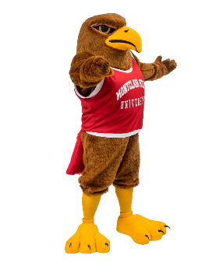
Quick review of Policies
(see CANVAS and Code for more details):
Academic Dishonesty
Intentional or otherwise, still can be a violation, regardless of amount.
Classroom Behavior
Faculty can remove students from their classes if students fail to abide by their instructions.
Smoking
Effective September 2020, smoking (including electronic/vaping/Juuls/Hookah) is not allowed on campus.

Slide 7
Quick review of Policies
(see CANVAS and Code for more details):
Residence Halls/Fire Safety
You will be held accountable for your guests.
Tampering with fire safety will result in loss of housing.
Threat or Infliction of Bodily Harm
No fighting allowed.
Weapons
Not allowed (imitation or real will lead to removal from University).

Slide 8
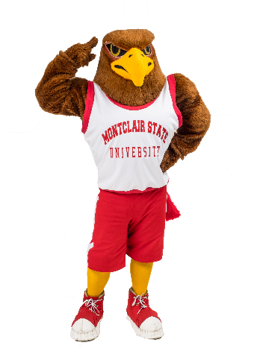
Quick review of Sanctions
(see CANVAS and Code for more details):
Only outcomes with “sanctions” are reportable for records’ check.
University Warning
University Probation
University Suspension
1-2 semesters/Transcript Notation/NO REFUND
University Expulsion
Permanent/Transcript Notation/NO REFUND

Slide 9
Need to know….
Regulations/Requirements due to COVID-19
You will receive communication regarding requirements for on-campus safety. This may entail:
Social Distancing
Masks (covering nose & mouth)
# of students in classes
# of students in housing
Dining locations
Students who do not comply with requirements may be subject to disciplinary action.

Slide 10
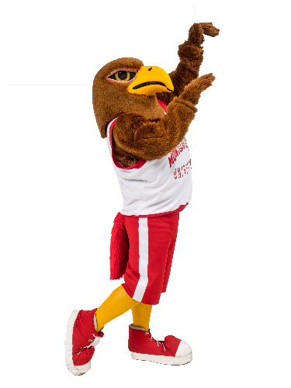
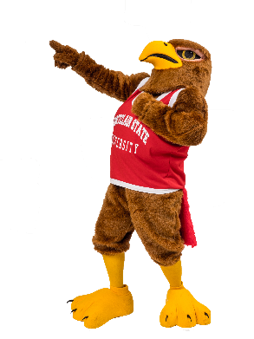
Storytelling and Numbers…
Let’s look at graduation numbers compared to students who have been suspended/expelled…
2015-2016?
2017-2018?
2018-2019?
2019-2020?
2016-2017?
5110
5235
TBD☺
4654
5086
24
14 Suspensions
10 Expulsions
18
12 Suspensions
6 Expulsions
11
7 Suspensions
4 Expulsions
14
6 Suspensions
8 Expulsions
15
8 Suspensions
7 Expulsions
Which number will you be???
"Choice, not chance, determines your destiny" -Aristotle
Did you know?
61 students lost their housing during 2019-2020 academic year due to policy violations.
Notes:
Same as before.

Slide 11
Jerry S. Collins, M.S. Ed.
Director of Student Conduct
Office of the Dean of Students
College Hall, Suite 348
collinsje@mail.montclair.edu
Ignorance is not an excuse. If you are unsure if you can have/do something, again….. ASK SOMEONE. Remember, as both adults and students, it is your responsibility to know the policies so that you have a fulfilling experience during your years at Montclair State University.
Tara Mellor
Associate Director, Residence Life
Office of Residence Life
Bohn Hall
mellort@mail.montclair.edu

