Slide 1
Poster Printing
By Adam Parker SH204 parkera@mail.montclair.edu

Slide 2
Poster Instructions Page 1
Print your poster on a regular printer first to check for layout and obvious errors only use the poster printer once it has been checked and double checked!
Note http://www.montclair.edu/its-all-here/logos/ has the MSU logo in different colors and sizes.
Leave plenty of time (At least 1 week) before you need the poster so if there are any complications either with the printer or the poster there is time to do something about it.

Slide 3
Poster Instructions Page 2
Wake computer from sleep by moving the mouse/turning on if powered down
Insert USB drive or find file online that you want to print
Copy this file to the desktop

Slide 4
Instructions Page 3
Open program ‘HP Instant Printing 3’ from the all programs menu. Be patient it may take a few seconds to start!

Slide 5
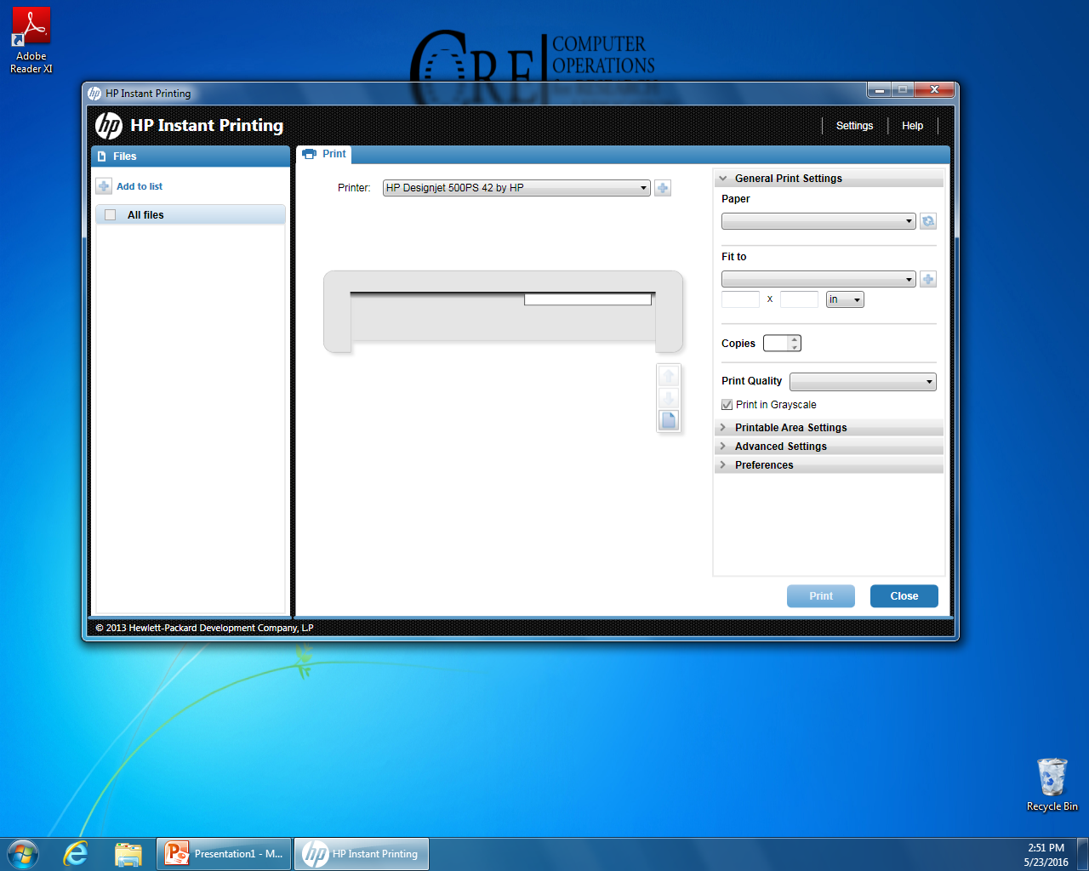
Poster Instructions Page 4
Click ‘Add to List’
Find your file on the desktop, click ‘open’

Slide 6
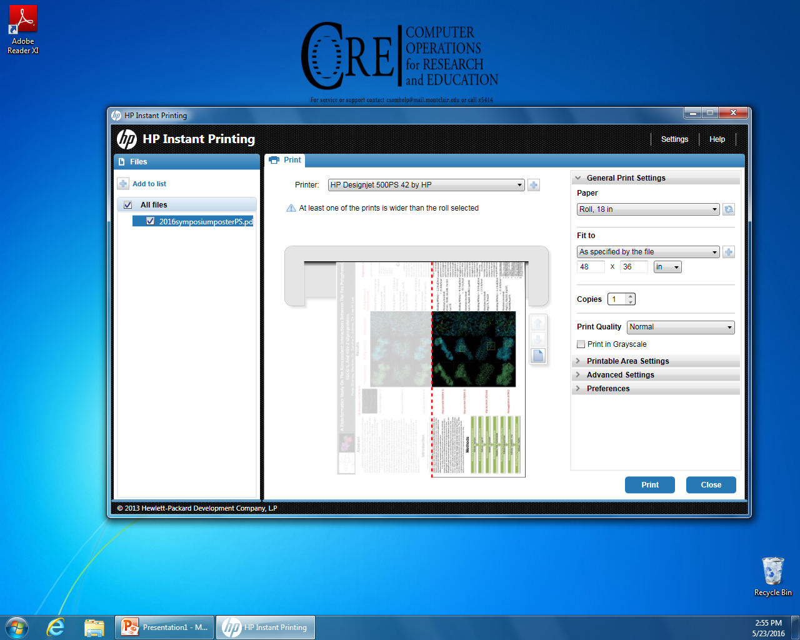
Poster Instructions Page 5
Under ‘Paper’ change to
‘Roll, 42”’
Under ‘Fit to’ you can specify by the roll or the file. Fitting to the roll means you do not have to cut any edges and the largest dimension will be the length of the roll (42”)
Under ‘Printable area settings’ you can change the orientation (Deselect autorotate)

Slide 7
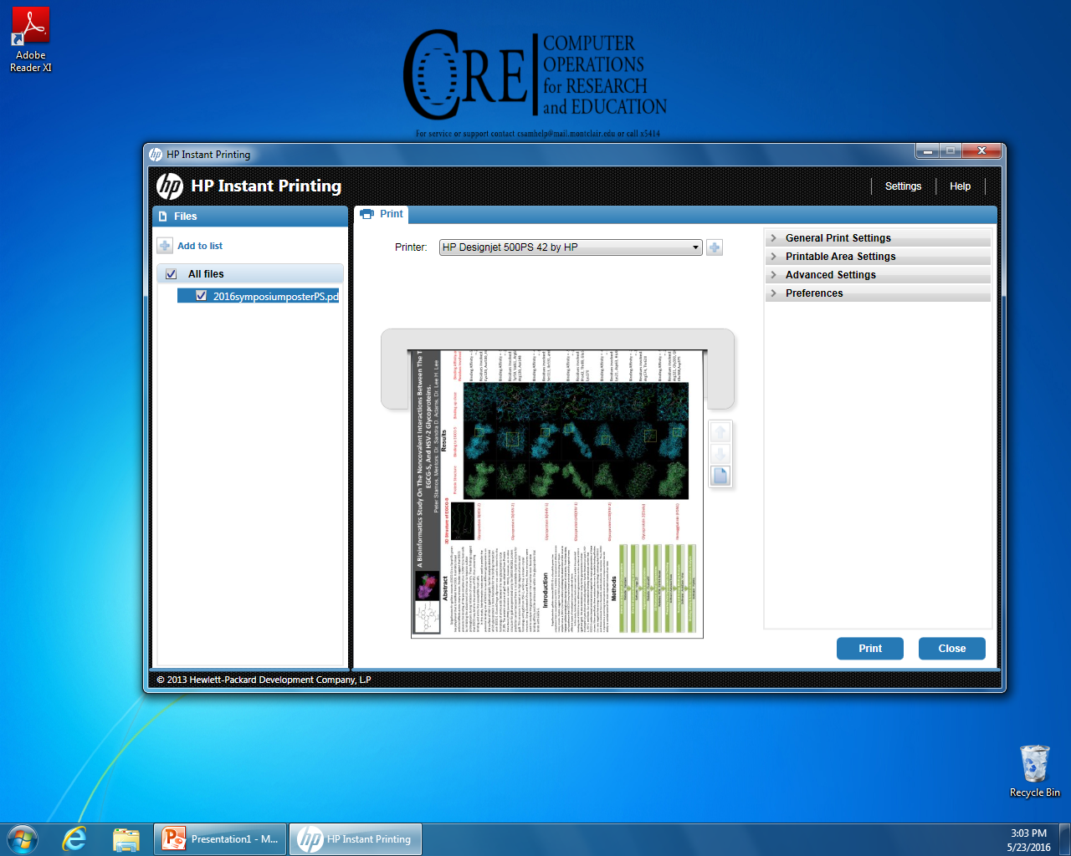
Poster Instructions Page 6
Once you are happy with the preview and settings (Check all!) click print. Ask Adam Parker or another faculty member to check if you are unsure.
It may take a few minutes to start printing, please be patient!

Slide 8
Poster Instructions Page 7
Once your poster has finished printing the printer will cut the poster please allow time for ink to dry (5-10mins)
Shutdown the printing program
Remove your USB or shut down your browser/logout

Slide 9
Poster Instructions Page 8
For any questions or problems please contact Adam Parker via parkera@mail.montclair.edu or other Biology staff if Adam is unavailable.

