Slide 1
Using Technology in the Counselor Education Classroom
2009 ACES CONFERENCE
Dr. Kim C. O’Halloran
Associate Dean
Assistant Professor, Counseling & Educational Leadership

Slide 2
Overview
Pressure to integrate technology into courses
Concerns about losing the valuable relationships that develop from direct student interaction
Need to teach our students to function as professionals within the technology framework that future clients may expect.

Slide 3
Overview
Three approaches that utilize technology to:
  meet student demands for convenience
  enhance learning experiences
  allow students to integrate course material into their professional identity

Slide 4
Challenges
Increase Classroom Discussion and Collaboration Without Reducing Course Content
Time Management Issues
  Information Intensive Course Content
Nontraditional Master’s Level Students
Variety of Learning Styles

Slide 5
Peer-Led Online Discussions
Allow students to:
  take responsibility for their own learning
  collaborate in developing understandings of course material
  model peer consultation behavior

Slide 6
Peer-Led Online Discussions
Types of Courses/Discussions
  Hybrid
  Accelerated
Discussion Method
  Question response vs. observations from readings
  Lead peers three times during semester
  Peer commentary
  Grading

Slide 7
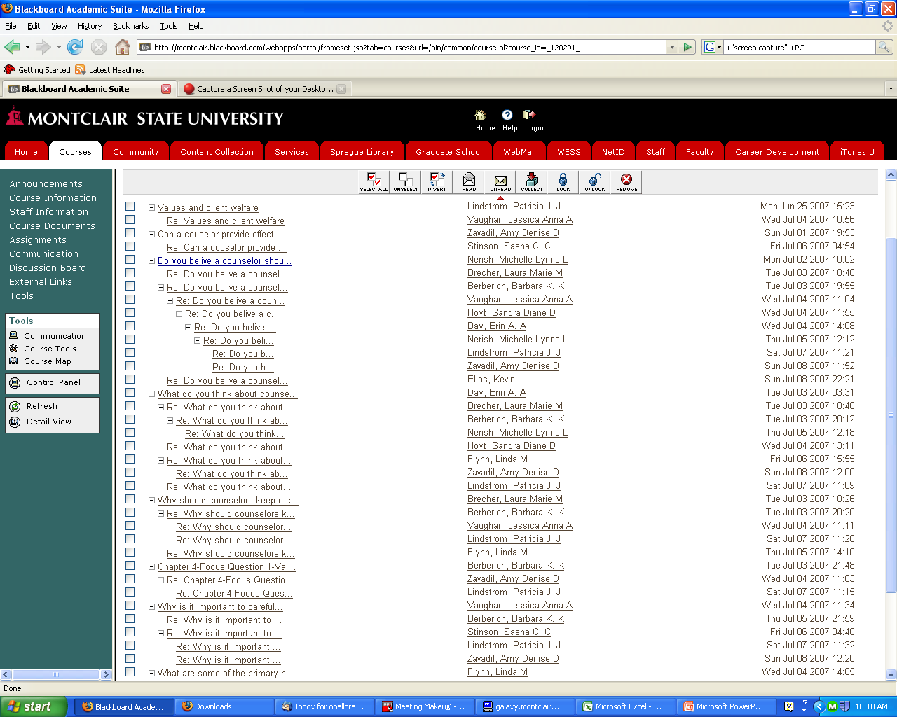

Slide 8
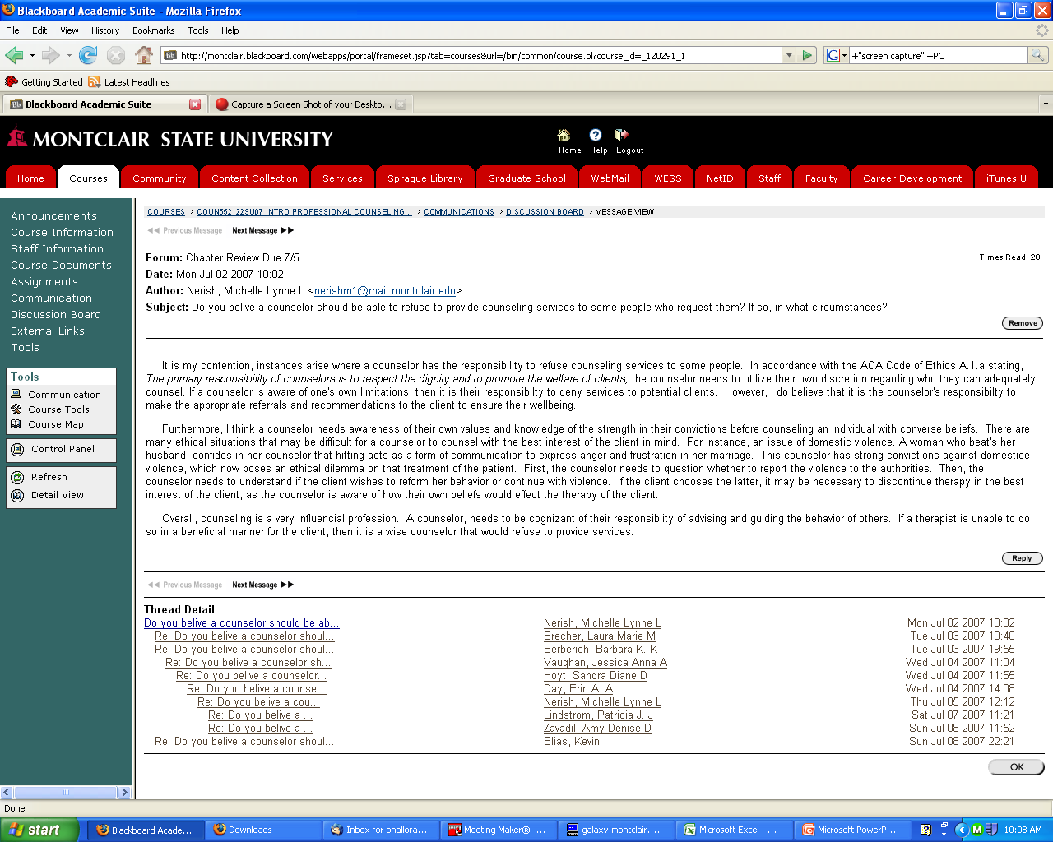

Slide 9
Peer-Led Online Discussions
Pre- and Post-Course Survey
  Previous experience with online learning
  Perceptions regarding online learning & styles
  Implemented in Introduction, Ethics and Student Services concentration courses
Results - Overall
  Changes over time regarding familiarity
  Familiarity did not affect perception
  Examining other demographics

Slide 10
Peer-Led Online Discussions
Results – Positive Perceptions:
  Flexibility (time, work from home, etc.)
  Peer feedback
  Accommodates different learning styles
  Collaborative/constructive learning
  Learn to be more focused & disciplined
  Convenient access to course documents
  Better able to develop thorough and thoughtful responses to cases and material

Slide 11
Peer-Led Online Discussions
Results – Negative Perceptions:
  More pressure to respond to classmates
  Volume of reading and responses can be overwhelming
  Less time to learn who fellow students are (by face)
  Continuous amounts of information (as opposed to once/twice per week)

Slide 12
Overall - Lessons Learned
Start slowly – less is more
Plan the use of technology
Educate students with technophobia
Connect discussions/information from online into face-to-face classes

Slide 13
Overall - Pedagogical Impact
Able to use hands-on activities in class
Increase class discussion and collaboration
Greater integration of material into knowledge base

Slide 14
Overall - Learning Impact
Repeated exposure
Anywhere anytime learning
Learning styles
Students feel more technologically savvy

Slide 15
Discussion & Questions

