Slide 1
How I Integrate Videopodcasting
Utilize In Hybrid Classes
  Introduction To Counseling
  Counseling Theories
  Group Counseling: Theory And Practice
  Career Counseling
Face To Face Classes
  Group Counseling: Theory And Practice
  Counseling Practicum
Utilize In Other Classes Easily
iTunes University
  Able To Have Access After Class Is Over
  Use For Studying For Comprehensive Exams

Slide 2
Videopodcasting -Available Programs
Lecture 123
  Increased Technology Knowledge
  Questions And Answers
Snapkast
  Easy To Use
  PC Windows XP Only
Profcast
  Easy To Use
  Mac Only

Slide 3
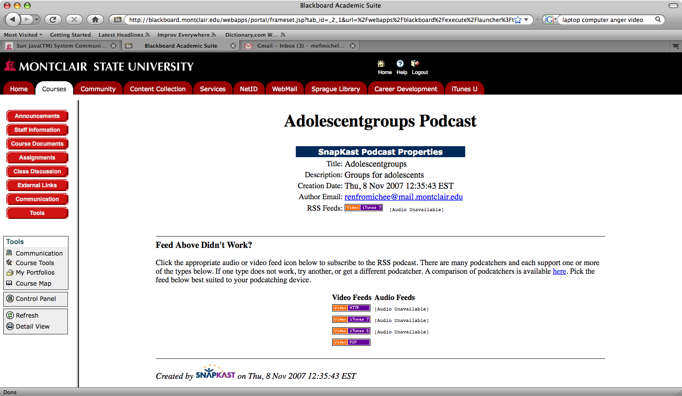

Slide 4
Videopodcasting - Lessons Learned
Plan Ahead
Hard To Speak To Air
Start Slowly – Less Is More

Slide 5
Videopodcasting - Lessons Learned
Content More Important Than Special Effects
More Slides and Less Print
More Short Videopodcasts vs. One Large Videopodcast

Slide 6
Videopodcasting – Student Considerations
Educate Students With Technophobia
Upload Plain PowerPoint
Open Bb Thread for Questions
Use Information for Class Activities
Discuss When Class Meets

Slide 7
Videopodcasting - Pedagogical Impact
Record once, use in many classes
Reduces lecture time
Able to use hands-on activities in class

Slide 8
Videopodcasting - Pedagogical Impact
Increase class discussion and collaboration
Higher test scores
Greater integration of material into knowledge base

Slide 9
Videopodcasting - Learning Impact
Repeated exposure
Anywhere anytime learning
Learning styles

Slide 10
Videopodcasting - Learning Impact
Students feel more technologically savvy
Fun to use
Free use of Video iPods/iPod Touches for duration of course
iTunes integration

Slide 11
Second Life – The New Frontier
Total integration into material
You can create the experience
Hands on learning
Fun!
To learn more: www.secondlife.com
For Educators: http://sl.nmc.org/
Come Join us! http://sl.nmc.org/create.php
Second Life for Dummies

Slide 12
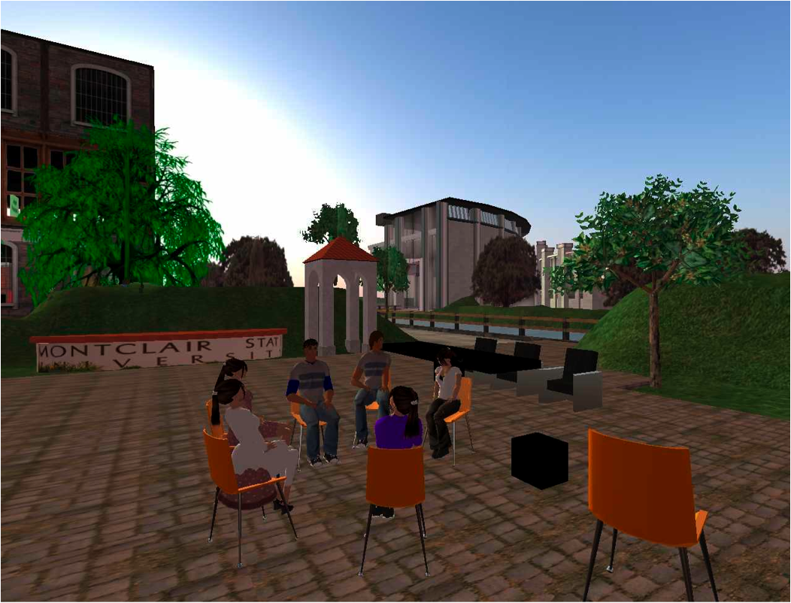

Slide 13

The Theorists Project

Slide 14
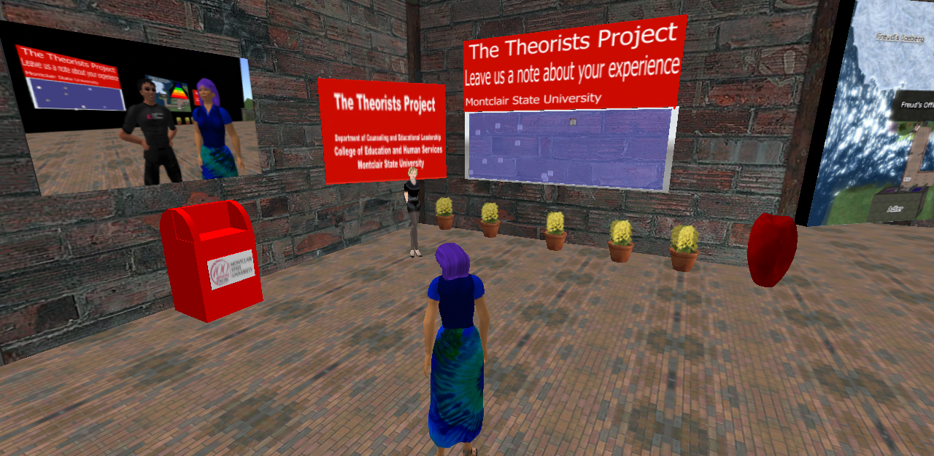
Welcome Center

Slide 15
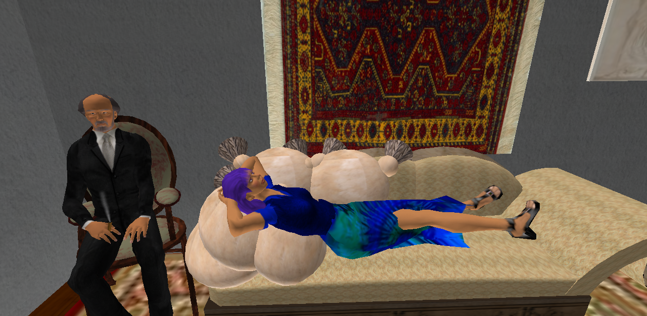
Freudbot

Slide 16
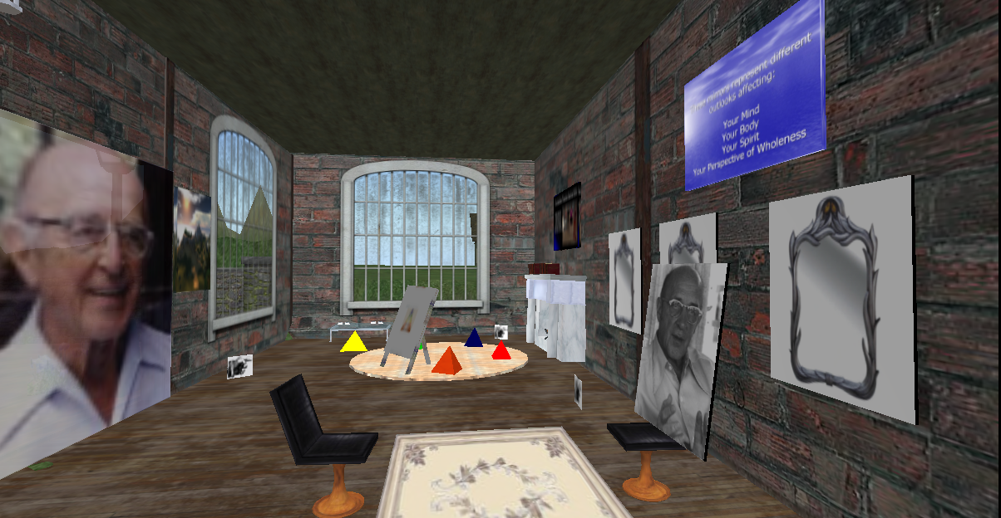
Carl Roger’s Room

Slide 17
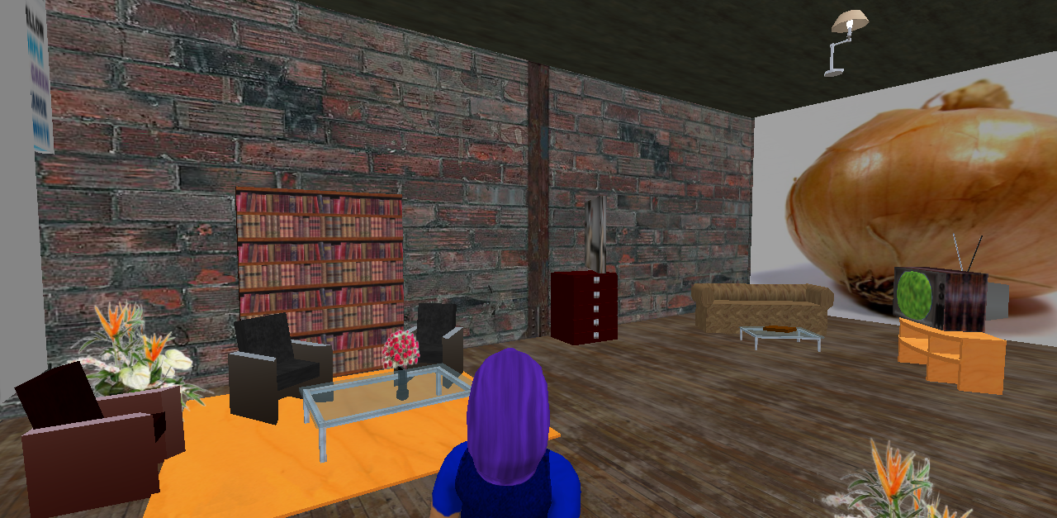
Fritz Perl’s Room

Slide 18
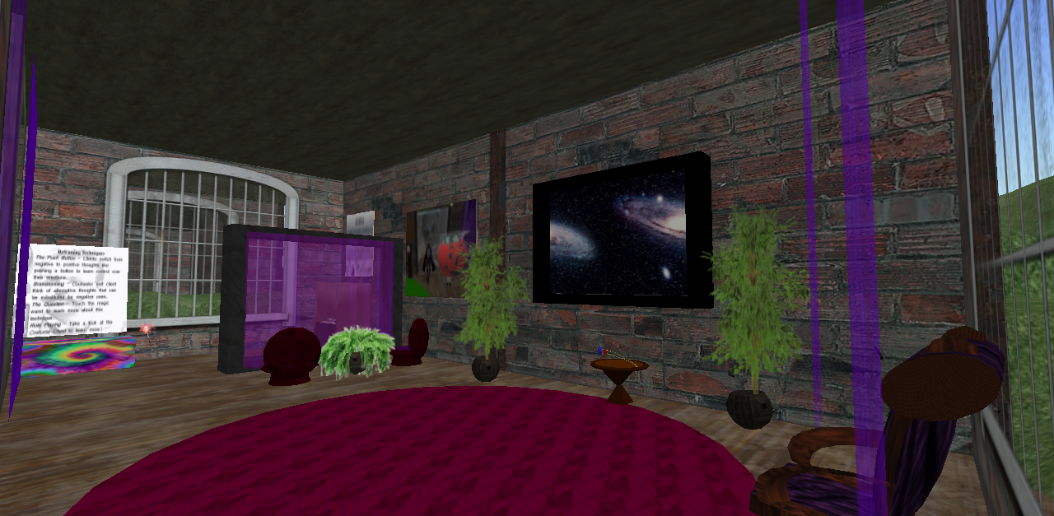
Alfred Adler’s Room

