Slide 1
Financing your Graduate Education
Assistantships &
Financial Aid

Slide 2
The Assistantship Program
Administered by
The Graduate School at
Montclair State University
Caren Ferrante
Graduate Student Services Coordinator

Slide 3
What is the Assistantship Program?
First-time degree seeking students
Academic experience complimentary to degree program
Enhance student experience and support academic goals
Collaborate with students, faculty, and staff
Weekly service hours to an academic department in exchange for a commensurate compensation package
1 in 12 graduate students

Slide 4
What would an Assistantship look like?
Assignments
Instructional support
Research
Fieldwork
Contract Terms
Full year
One semester
Compensation
Stipend
Tuition and fees

Slide 5
Am I eligible for an Assistantship?
Fully matriculated in a degree program (you need an admissions decision!)
Full-time enrollment once appointed (with exceptions)
Minimum incoming or current GPA
Masters: 3.0
Doctoral: 3.2
Assistantships are NOT available to students:
Seeking a certificate or certification only
Who are student teaching
Maintaining a non-degree status
In an online-only program

Slide 6
How do I apply for an Assistantship?
Upon initial application for your degree program
Within the application for admissions
After initial application for your degree program
If you had indicated interest upon initial application but didn’t
receive an assistantship your first semester.
If you had not indicated interest upon initial application but
change your mind.
Via e-mail to gradschool@montclair.edu
Include your CWID & semester for consideration

Slide 7
Does an Assistantship impact other funding eligibility?
On-campus employment
University Foundation scholarships/awards
Financial Aid
FA considers the value of tuition and fee remission when determining eligibility for aid
Acceptance of an assistantship may impact award

Slide 8
When and how will I know?
Fall 2018 hiring period: 3/1/18 – 7/31/18
Each department handles their own interviewing and selection of students
Departments submit recommendations to TGS
TGS handles the hiring
No offer is official unless/until you receive a formal offer letter and contract from TGS
TGS’s official form of communication is e-mail

Slide 9
Contacting The Graduate School
Email – gradschool@montclair.edu
Location –The Graduate School, 4th Floor
Phone – (973) 655 – 5147
Fax – (973) 655 – 7869
Visit us on the web!
https://www.montclair.edu/graduate/current-students/grad-assistantships/

Slide 10
Questions?

Slide 11
The Financial Aid Process
Understanding the Steps for a Smoother Transition

Slide 12
What is Financial Aid?
Financial Aid is an umbrella term that includes
Loans
Scholarship
Any funds that do not come from you personally

Slide 13
Aid Eligibility
High School Diploma or Equivalent
Enrollment in an eligible program
U.S. citizen or eligible non-citizen
Valid Social Security Number
Sign certifying statements on the FAFSA
FAFSA filers must answer the drug question
Male students must be registered with Selective Service
Or must consent to registration while completing FAFSA

Slide 14
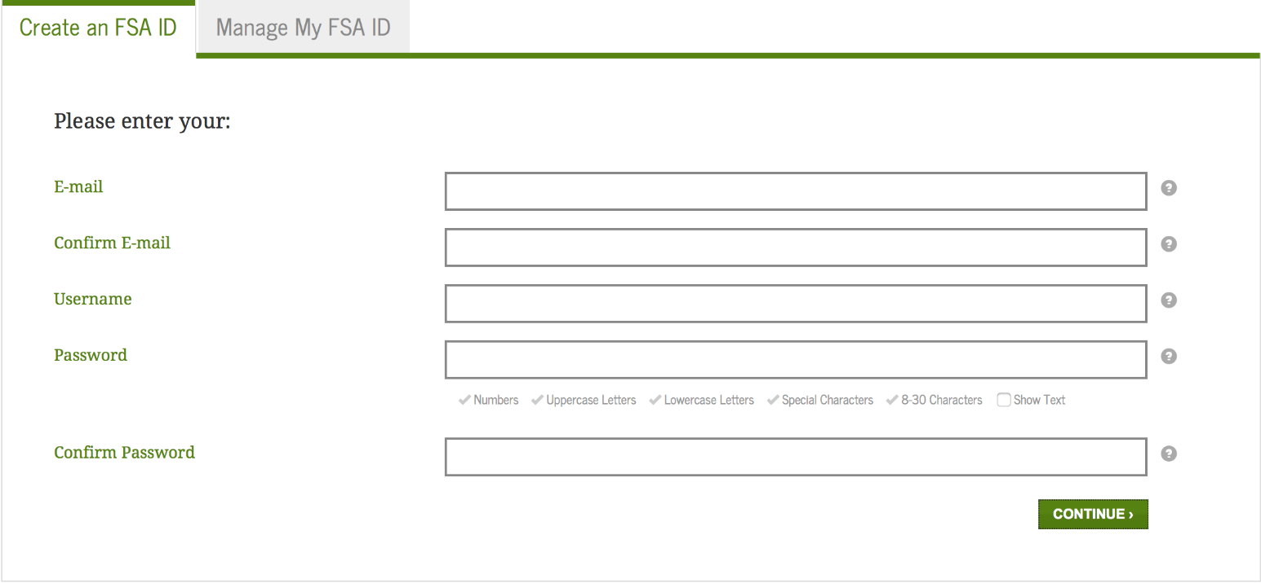
Steps to Receiving Aid:
Apply for an FSA ID at fsaid.ed.gov

Slide 15
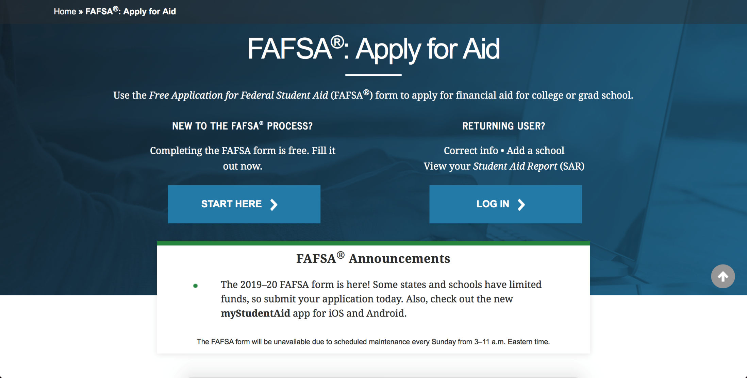
Steps to Receiving Aid:
Complete FAFSA application at fafsa.gov

Slide 16
Types of Aid: Loans
Federal Direct Loans
Federal Graduate PLUS Loan
(Credit check required)
Alternative Private Loans
(Credit check required)

Slide 17
Explanation of Loans
Loans on award
Federal Direct loans – no credit check
In the student’s name
Repayment begins 6 months after student is no longer enrolled at least half-time (4.5 credits)
This is an unsubsidized loan:
Interest accrues while student is enrolled
Fixed rate of 6.6%
Students must go to www.studentloans.gov and sign their master promissory note and complete entrance counseling in order for loans to pay against the bill

Slide 18
Explanation of Loans
Loans not on award
Federal Graduate PLUS loan
Based on credit check
Endorser (co-signer) if necessary
7.6% interest rate
Repayment Options:
1. Standard immediate repayment
2. Interest only payments
3. Full deferment

Slide 19
Explanation of Loans
Private loans
provided through lenders such as banks or educational loan lenders
Do a compare of several private loans:
www.elmselect.com
Review Interest Rates and Repayment Terms
Truth in Lending Act – requires a number of steps to be taken by the borrower and the lender before a loan can be disbursed
Private loans can take up a month or more to process

Slide 20
Programs Eligible for Federal Aid
All Doctorial, Masters and CRI admits
Some programs are on a trimester schedule
Three terms in one academic year (1/3, 1/3, 1/3)
Financial aid funding is split over the three terms

Slide 21
Eligible Certificate Programs – (CER)
Advanced Counseling
Teaching Middle Grades Math
Teaching English to Speakers of Other Languages
American Diet Association
Paralegal Studies
Translating Spanish
Artists Diploma
Drug and Alcohol Counselor Certification
Music Therapy
Nutrition and Exercise Science

Slide 22
Eligible Advanced Certification – (CRA)
Supervisor Advance Certification
Principal Certification

Slide 23
Eligible Certification Programs – (CRE)
Reading Specialist Certification
Substance Awareness Coordinator
School Counselor Certification

Slide 24
Eligible Certificate Programs – (CRI)
All Initial Teacher Certification Programs and the P-3 Abbott Programs
Federal student aid regulations require the university to treat students in these programs as fifth year undergraduates
When filing the FAFSA, you must identify as an undergraduate
if defined as a dependent, provide parental information
Awarded as an undergraduate student
$12,500 Stafford Loans for AY
Includes Subsidized Loan

Slide 25
All Other Programs –
Eligible for private loans only

Slide 26
Contacting the Financial Aid Office
Email – financialaid@montclair.edu
Location – Red Hawk Central
Phone – (973) 655 – 4461
Fax – (973) 655 – 7712
*Please have the CWID number available when contacting our office*
Visit us on the web!
www.montclair.edu/red-hawk-central

Slide 27
Questions?

