Slide 1
Navigating Financial Aid

Slide 2
What is Financial Aid?
Financial Aid is a comprehensive term that includes
Grants
Scholarships
Loans
Work Study

Slide 3
Types of Aid: Grants
Pell Grant (Federal)
SEOG (Federal) – based on eligibility and FAFSA filing date
Tuition Aid Grant – TAG (State) – link directly from the FAFSA or complete a separate form with NJ HESAA directly
- www.njgrants.org
Educational Opportunity Fund - EOF (State) - Find out more information before applying to college

Slide 4
Types of Aid: Private Scholarships
High School Guidance Office
Local library resources
Local businesses, civic organizations, churches, private companies
Parent/Guardians’ place of
employment
Contact businesses directly
Scholarship search engines
(finaid.org, Fastweb.com, collegeboard.org, scholarships.com, etc.)

Slide 5
Types of Aid: Loans
Stafford Loans (Federal)
Parent PLUS Loans (Federal) - parents apply (credit check required)
Alternative Private Loans - anyone can apply (credit check required)

Slide 6
Types of Aid: Work Study
Jobs on campus
Meet eligibility criteria
Funding comes from government instead of department budget

Slide 7
To ensure maximum consideration for aid, check requirements for each college:
Required application materials
Priority Deadline:
February 1st

Slide 8
Application Process
Every school has different requirements
Submit the Free Application for Federal Student Aid (FAFSA)
FAFSA available as of October 1st
prior-prior year update (use 2017 income data for 19-20 FAFSA)
Montclair State University’s Priority Deadline is February 1st

Slide 9
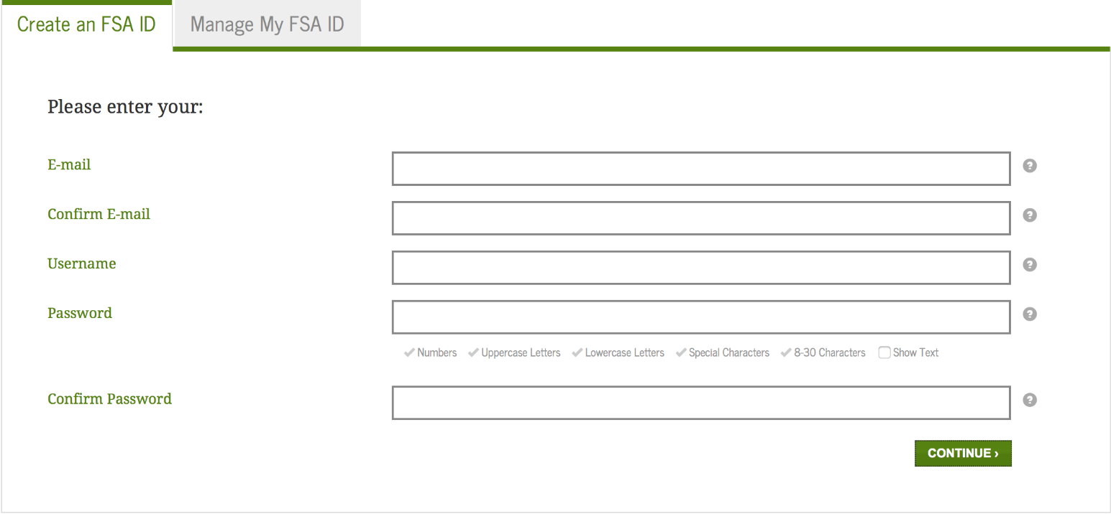
Steps to Receiving Aid: Step 1 – FSA ID
Apply for an FSA ID
fsaid.ed.gov
The student and parent need their own separate FSA ID’s

Slide 10
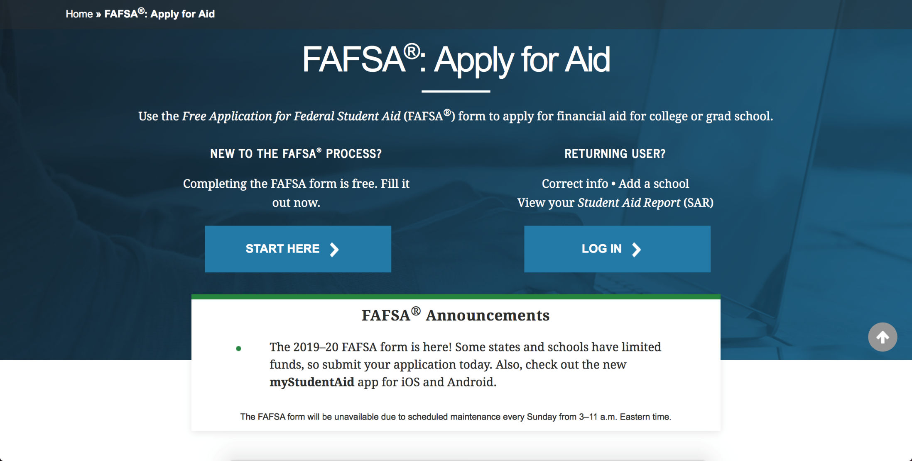
Step 2 - Complete the FAFSA
www.fafsa.gov

Slide 11
Use the IRS Data Retrieval Tool (DRT)
For both student and parent
If certain tax filing conditions are met:
FAFSA will take you to the IRS website to auto complete some of the income data
Data that comes back into the FAFSA will be cloaked
MSU recommends you use the DRT –
Eliminates some paperwork later

Slide 12
What Data to Report
Income Prior Prior (2017)
_________________________________________________
Savings/Investments As of filing date
_________________________________________________
Family Size Project for
academic year

Slide 13
Remember…
NJ residents must complete the additional state questionnaire for the Tuition Aid Grant
Once submitted, use the link from the FAFSA confirmation page to HESAA’s NJFAMS portal to complete the additional data elements for Tuition Aid Grant (TAG) and NJ STARS (II) eligibility.

Slide 14
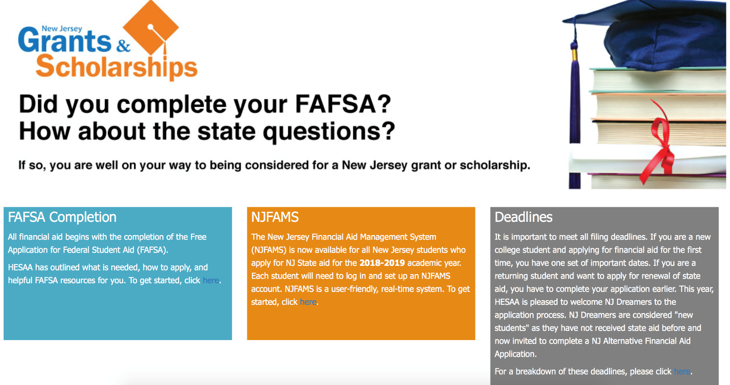
If you forget…
Go directly to www.njgrants.org
Applicants who bypass answering the State questions, should log into NJFAMS to create a user ID and password to check and complete any outstanding items on their “To Do” list

Slide 15
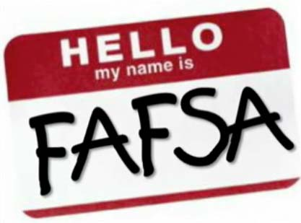
Step 3 – Check the SAR
Once you submit the FAFSA, you will receive a Student Aid Report (SAR)
via email
Check for errors or omissions
If you cannot see your SAR, you may have errors that have to be corrected on the FAFSA

Slide 16
FAFSA is a Snapshot
of your
current
financial situation
Update your FAFSA only if you made a mistake
Any other updates should go through the Financial Aid office
Constantly updating your FAFSA can create issues with your aid

Slide 17
Common Mistakes
Using incorrect Social Security Numbers
Putting parent income information in student area
Listing income tax paid as equal to total income
Incorrect marital status for parent(s)
Leaving questions blank (0 is an answer)

Slide 18
Where does FAFSA go?
Federal processor
Social Security Administration
Homeland Security
Selective Service
IRS
Schools Listed
State of NJ (HESAA)

Slide 19
Aid Eligibility
High School Diploma or Equivalent
Enrollment in an eligible program
U.S. citizen or eligible non-citizen
Valid Social Security Number
Sign certifying statements on the FAFSA
Must answer the drug question
Male students must be registered with Selective Service

Slide 20
Remember…
This is financial AID not a GIFT
In most cases, families will have some financial responsibility. Discuss costs as a family
The earlier you start with the process, the better
Montclair State University will receive your FAFSA once you are accepted to the University
Read school website for information about the financial aid process and requirements

Slide 21
Questions?

