Slide 1
The Financial Aid Process
Understanding the Steps for a Smoother Transition

Slide 2
Notification
NEST is Montclair State’s primary way of contacting students
It is the students’ responsibility to check NEST and Montclair State email regularly for updates.

Slide 3
NEST
NEST allows students to review and manage their administrative activities including:
Financial Aid
Billing
Holds
Direct Deposit
Registration
Class Schedule
Grades
Student Forms

Slide 4
What is Financial Aid?
Financial Aid is an umbrella term that includes:
Grants
Work
Scholarships
Loans
Any funds that do not
come from you

Slide 5
Explanation of Awards ~Grants
Grants – (do not need to be paid back)
Eligibility is determined on your FAFSA application
Includes:
Federal Pell and SEOG
Institutional grant eligibility
NJ Tuition Aid Grant (NJ TAG)
Students must complete the State Application at www.njgrants.org
This process is required for NJ TAG, EOF, NJ Stars

Slide 6
Explanation of Awards ~Work
Work Study
Based on EFC eligibility and awarded on a first come, first awarded basis
Students must get a job on campus to receive these funds
Paid to the student biweekly, not to the bill

Slide 7
Explanation of Awards ~Loans
Loans on award
Stafford Direct Loans
Federal loans for students enrolled at least half-time
In the student’s name
Fixed interest rate (4.53% 19-20 academic year interest rate)
Typically most affordable type of student loans
Repayment 6 months after student is no longer enrolled at least half-time.
Subsidized
Interest does not accrue while student is enrolled
Unsubsidized
Interest does accrue while student is enrolled.
Students must go to www.studentloans.gov and sign the master promissory note and complete entrance counseling in order for loans to pay against the account

Slide 8
Explanation of Awards ~Parent Loans
Loans on award
Parent PLUS loan - (7.08 19-20 interest rate)
Federal loan for parents of dependent undergraduate students to help pay education expenses
If PLUS loan is denied, additional unsubsidized loan is applied in student’s name
To apply visit www.studentloans.gov
Credit check required
Repayment Options:
Immediate monthly repayment
Interest only repayment
Complete deferment

Slide 9
www.studentloans.gov
Students will use this website to sign their master promissory note and complete the entrance counseling for their Stafford Loans
Parents will use this website to apply for the Parent PLUS loan and sign the promissory note for the PLUS loan

Slide 10
Explanation of Awards ~Private Loans
Loans on award
Private loans
Student loan funds that are offered through banks or educational loan lenders
Can be borrowed by student and/or parent
Students will need a co-signer
ELMselect.com will provide you with a list of historical private lenders, while allowing you to access and compare private loan interest rates.
Truth in Lending Act- requires a number of steps to be taken by the borrower and the lender before a loan can be disbursed

Slide 11
When Should I apply?
Our Recommendations:
Do not apply for Parent PLUS or private loans until July (Credit checks expire)
Apply for the whole academic year
Have your finances sorted out no later than July
Bills are due in August
Start researching NOW!!

Slide 12
Explanation of Awards
Loans on award
Scholarships
Merit Based Scholarships
offered through the Undergraduate Admissions Office
Departmental Scholarships
Based on your major
Students can apply after attending MSU for at least 1 semester
Outside Scholarships (private groups)
HS Guidance Office
Place of employment
Church
https://www.montclair.edu/red-hawk-central/paying-for-college/

Slide 13
Can My Student Be Considered Independent?
There are only a few cases in which the federal government considers a student independent:
24 years or older
Married
Have a child of their own which the student supports
Veterans
Orphan or ward of the court
Homeless
In a legal guardianship
Graduate Student

Slide 14
We Have a Special Circumstance…
The Federal Government allows review of a financial aid award package if there was a loss of income due to:
Unemployment
Loss of untaxed benefit (social security benefits, child support, etc.)
Separation/Divorce
Death of a wage earner
Medical expenses that have been itemized on your federal tax return
https://www.montclair.edu/red-hawk-central/paying-for-college/application-process/request-for-review/

Slide 15
Why Doesn’t Montclair Have My FAFSA?
Parent AND/OR student did not sign the FAFSA
You did not apply Montclair’s school code on FAFSA (002617)
It is important that student go back to the FAFSA 48 hours after completing it to ensure that it was correctly processed

Slide 16
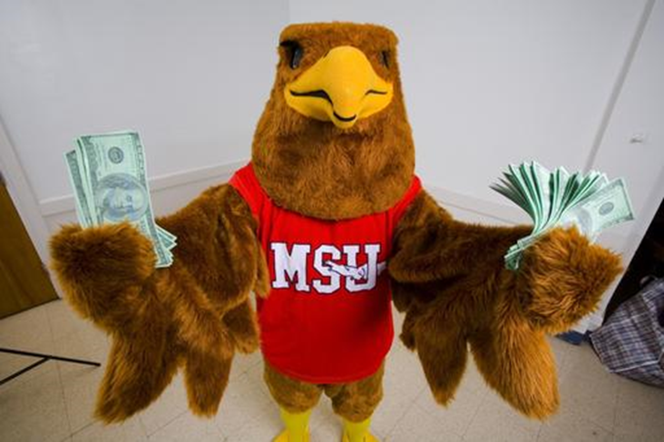
Red Hawk Dollars and Books
USE REFUNDS WISELY!
Excess funds can be moved to Red Hawk Dollars or returned back to the student via check or direct deposit

Slide 17
Contacting Financial Aid
Email – financialaid@montclair.edu
Location – Red Hawk Central
Phone – (973) 655 - 7600
Fax – (973) 655 - 7712
*Please have the CWID number available when contacting our office*
Visit us on the web!
www.montclair.edu/red-hawk-central/paying-for-college

Slide 18
Questions?

