Slide 1

Office of Research
Montclair State University
New Faculty Workshop - September 27, 2021
R2 Doctoral University: Montclair State is a dynamic research institution, designated an R2 – Doctoral University – High Research Activity – by the Carnegie Classification of Institutions of Higher Education.
Scott Herness, Vice Provost for Research and Dean, the Graduate School
Hila Berger, Director of Research Compliance and Regulatory Programs,
Office of Research Compliance
Ted Russo, Director, Office of Sponsored Programs
Notes:
1

Slide 2
RESEARCH INTEGRITY & COMPLIANCE @ MSU
Notes:
2

Slide 3








Compliance Areas

Slide 4
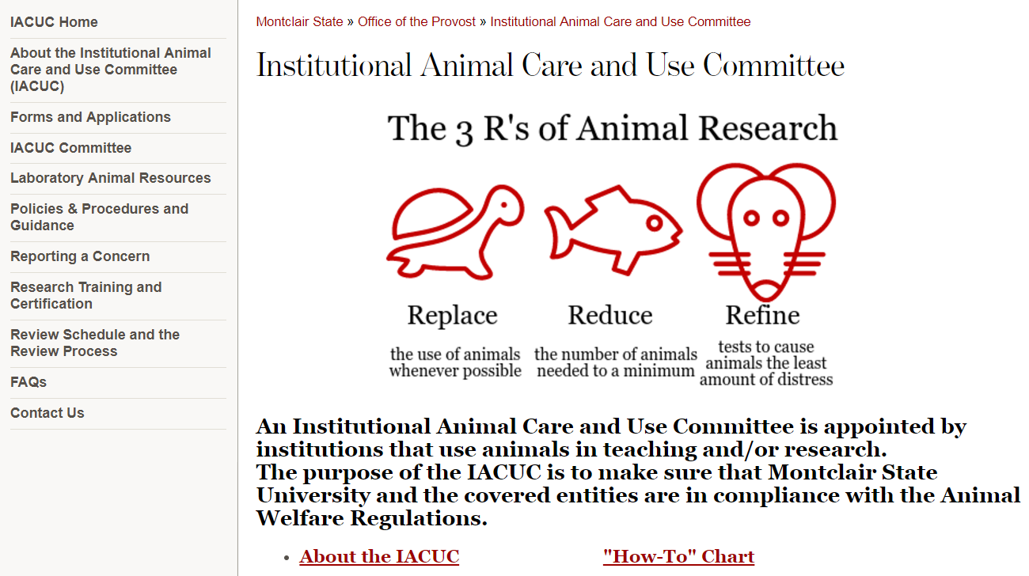
iacuc@Montclair.edu
Sabrina Jung, Compliance Coordinator
Dr. Lisa Hazard, IACUC Chair
Laura Conour, DVM, DACLAM, Attending Veterinarian conourl@montclair.edu

Slide 5
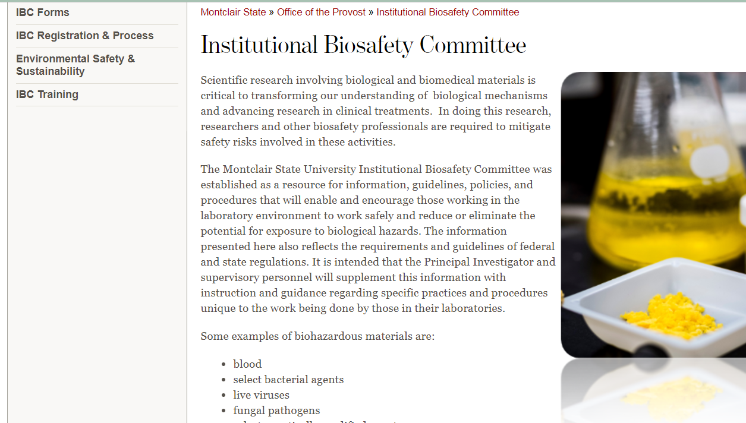
ibc@Montclair.edu
Biosafety Officer: Gena Coffey
IBC Chair: Dr. Elena Petroff

Slide 6
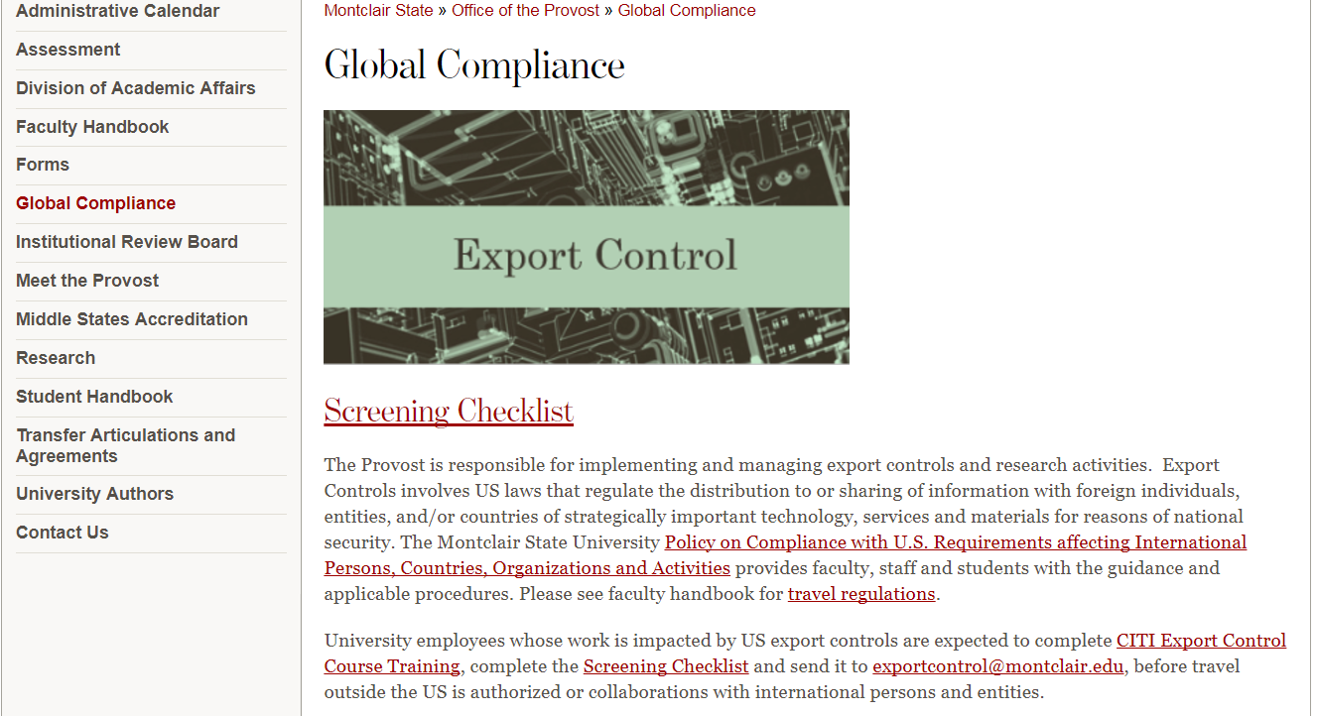
Global Compliance Email: exportcontrol@montclair.edu
Associate University Counsel - 973-655-5225
Research Compliance Officer - 973-655-7781
Director of OSP - 973-655-3219

Slide 8
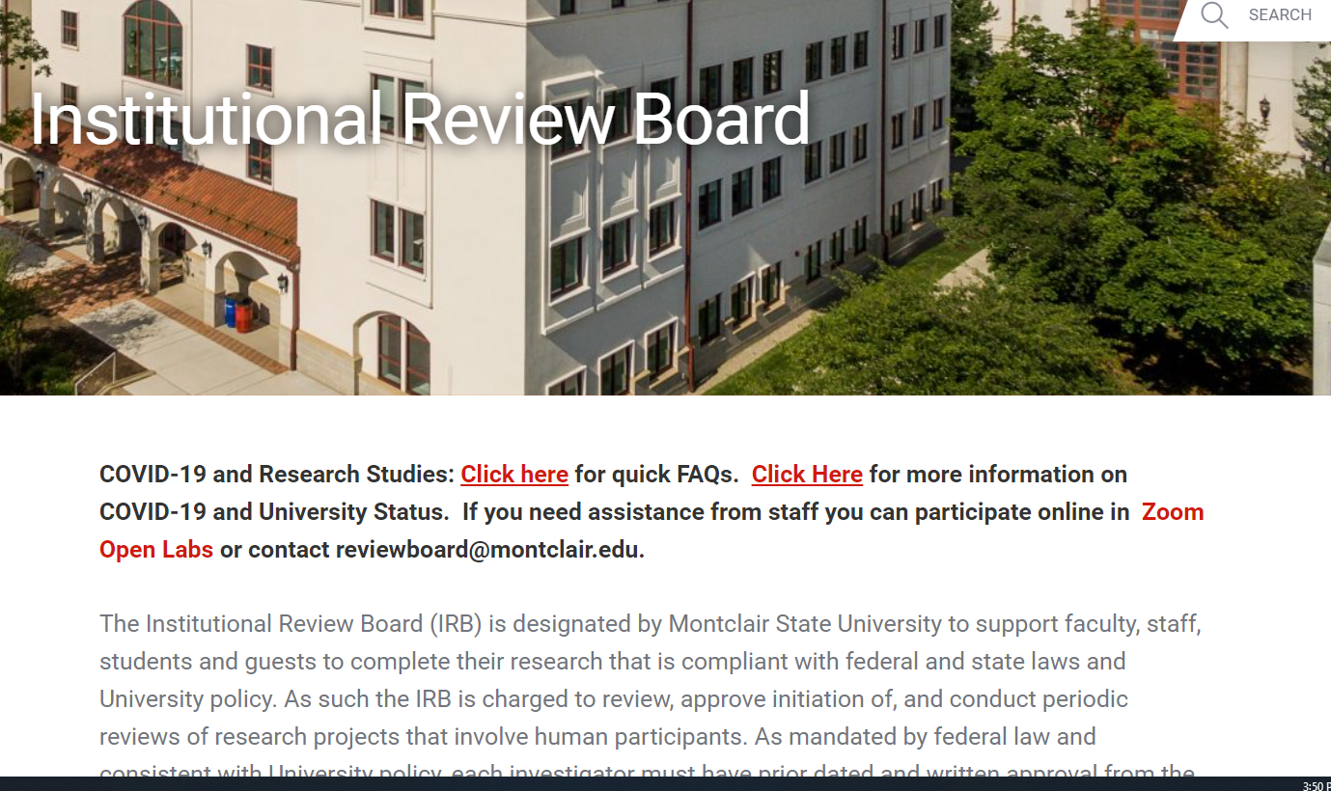
HUMAN SUBJECTS PROTECTION
IRB
NEW FACULTY PRESENTATION

Slide 9
IRB Mission
To support faculty, staff, students, and guests to complete their research that is compliant with federal and state laws and University policy. As such the IRB is charged to review, approve initiation of, and conduct periodic reviews of research projects that involve human participants.

Slide 10
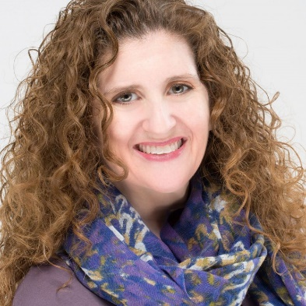
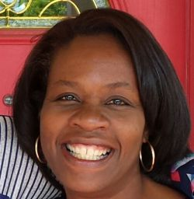
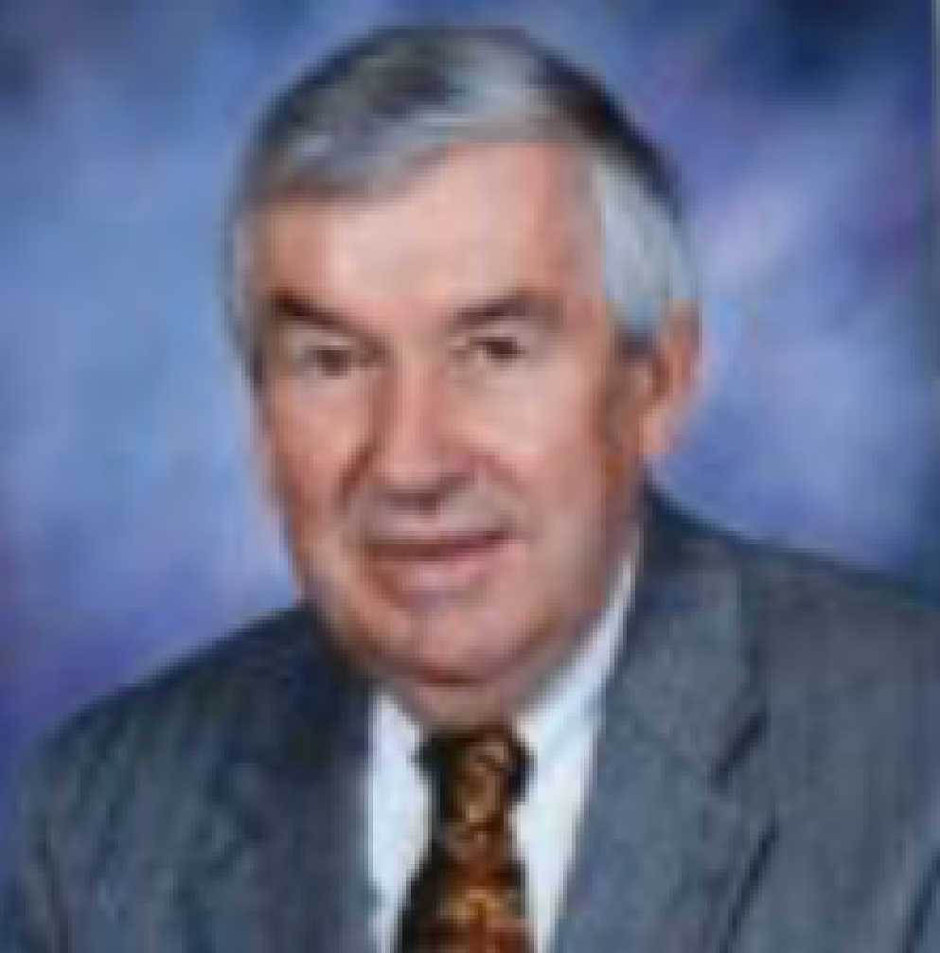

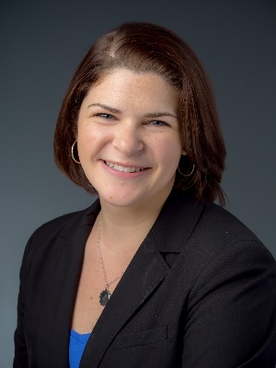
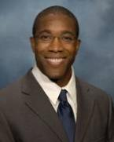
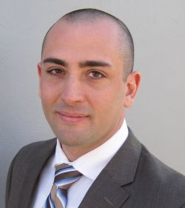
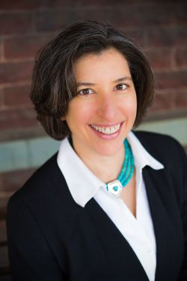
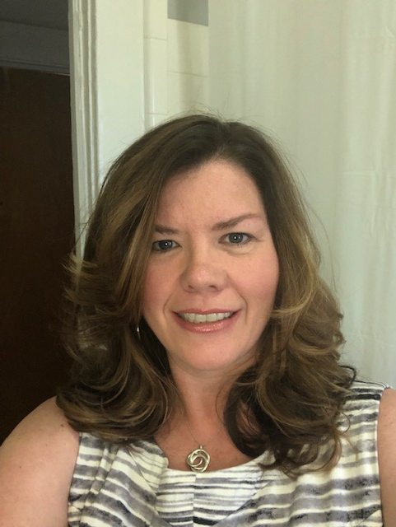
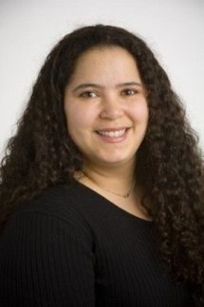
IRB BOARD
10 Faculty /Staff and
1 community member
10
Notes:
10

Slide 11
Definition of Human Subjects Research
Human subject means a living individual about whom an investigator conducting research obtains:
1) data through intervention or interaction with the individual or
2) identifiable private information
Research is defined as systematic investigation that is hypothesis driven with the intent to develop knowledge that can be generalized.

Slide 12
Not sure if what you’re doing is Human Subjects Research?
Submit a Research Determination Form (RDF) available in Cayuse IRB
Call or email the IRB for further clarification
IRB Chair or designated member will get back to you within 3-5 business days to determine if you need to submit an IRB application.

Slide 13
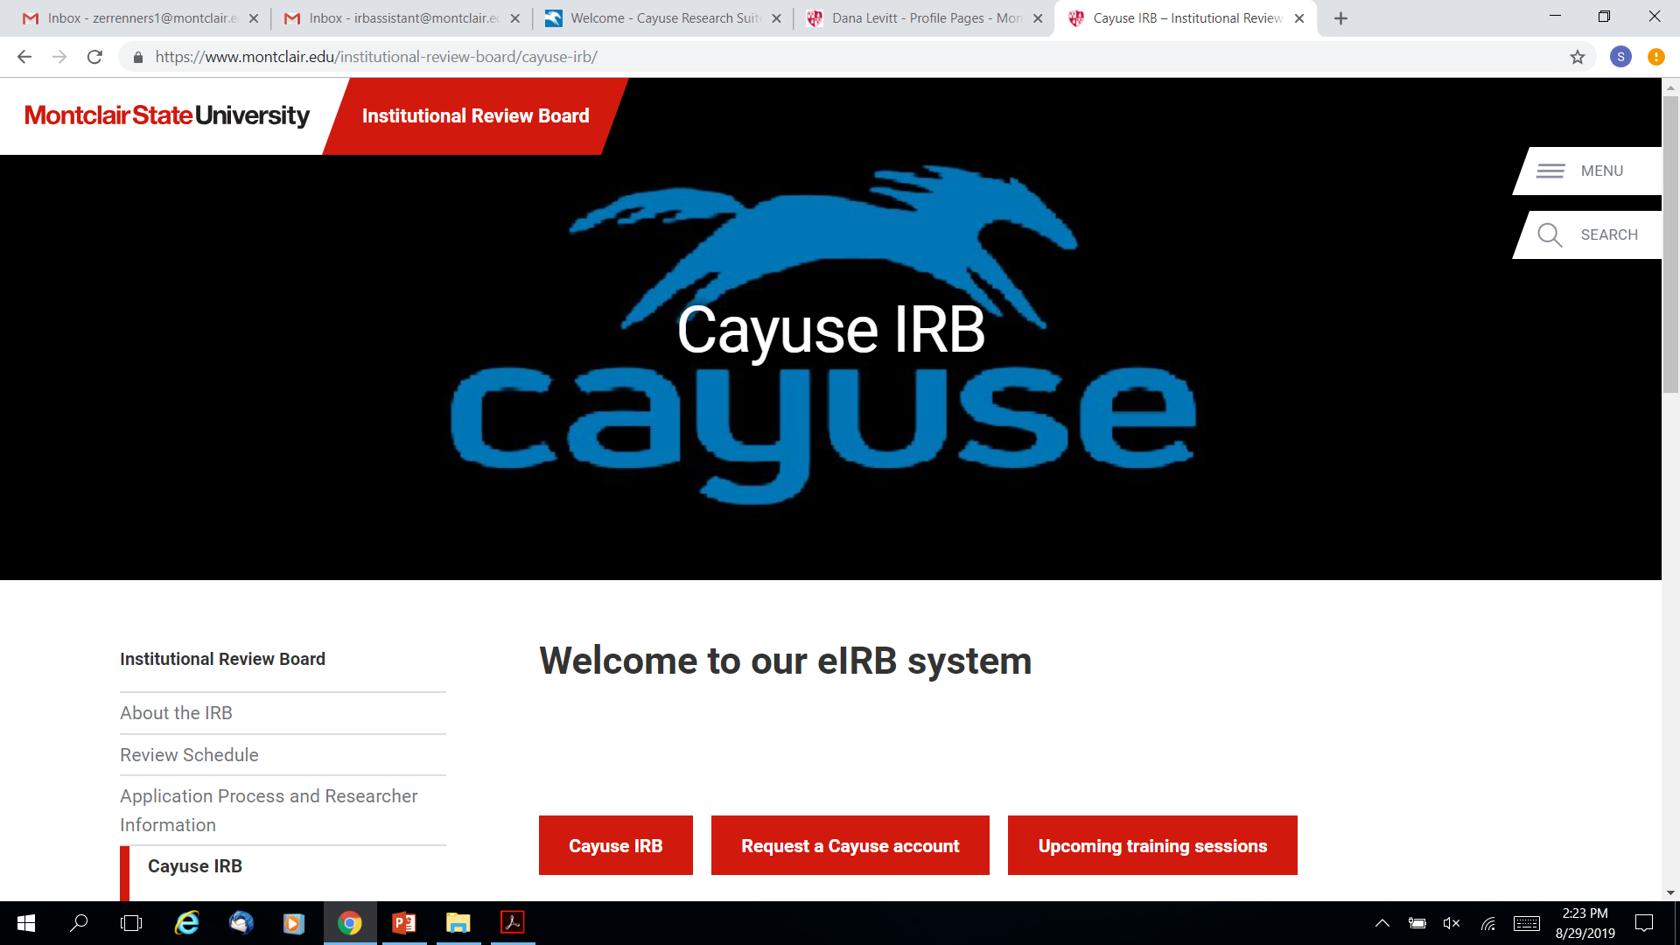

Slide 14
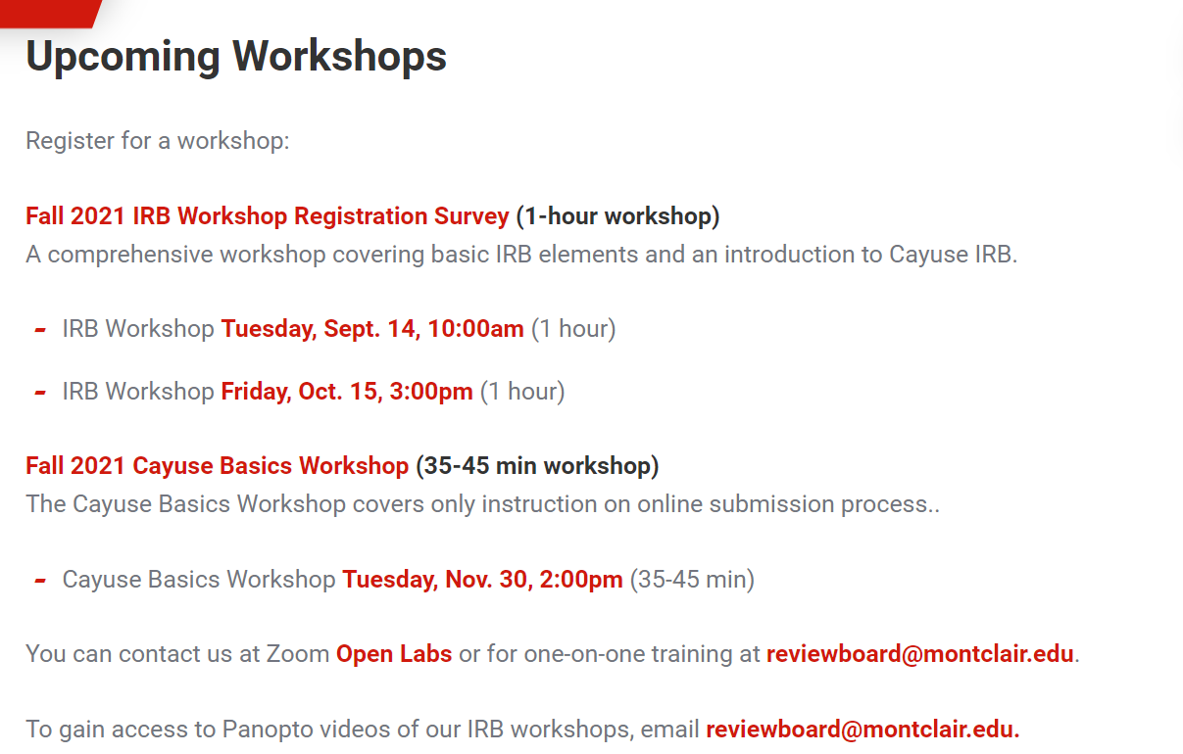
CAYUSE IRB TRAINING

Slide 15
CITI Training
MSU requires that all faculty, staff, students, and visitors who conduct research that involves human participants must complete a training program on the protection of human participants
  Est. time 2-4 hours (not in one sitting)
  Valid for 3 years
  Citiprogram.org

Slide 16
Transferring Research Activity to MSU
If you have an active approval at another institution you MAY need to apply with MSU IRB
If you are still publishing on the data and may have to revisit data you MAY need to apply with MSU IRB
If applying, include all previous approval letters and documentation with your full submission
Briefly describe your research activities conducted at your previous institution in the body of your email to reviewboard@montclair.edu

Slide 17
Understanding Faculty Sponsorship
FS is affirming research design and implementation by signing application
FS should provide training and oversight of student in conducting research
A FS should be a permanent faculty member (adjunct faculty and faculty from other universities cannot sponsor a student)
FSs must not only support a student’s application but the entire implementation of their research activity.
In Cayuse the FS will be the PI and the student will be the primary contact.

Slide 18
Ask for Help
Email us
Call us
Zoom Open Labs
Staff availability for meetings
  M-F 8:30-4:30
Visit our FAQs

Slide 19
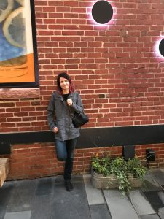
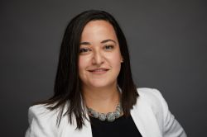
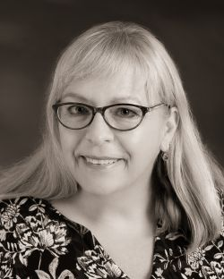
IRB Staff
Amy Krenzer, CIP, Senior IRB Coordinator
Hila Berger, MPH, CIP, CHC, Research Compliance Officer
Sabrina Jung, Compliance Coordinator

Slide 20
Contact Information for IRB and Research Compliance
Senior Human Research Protection Analyst:: Amy Krenzer
  reviewboard@Montclair.edu
  Ext. 7583
Compliance Coordinator: Sabrina Jung
  jungsa@montclair.edu
  Ext. 3021
Director, Research Compliance: Hila Berger
  bergerh@Montclair.edu
  Ext. 7781
IRB Chair: Dana Heller Levitt
  levittd@Montclair.edu
Research Compliance/IRB Office: GRAD 333
Website: Montclair.edu/irb

Slide 21
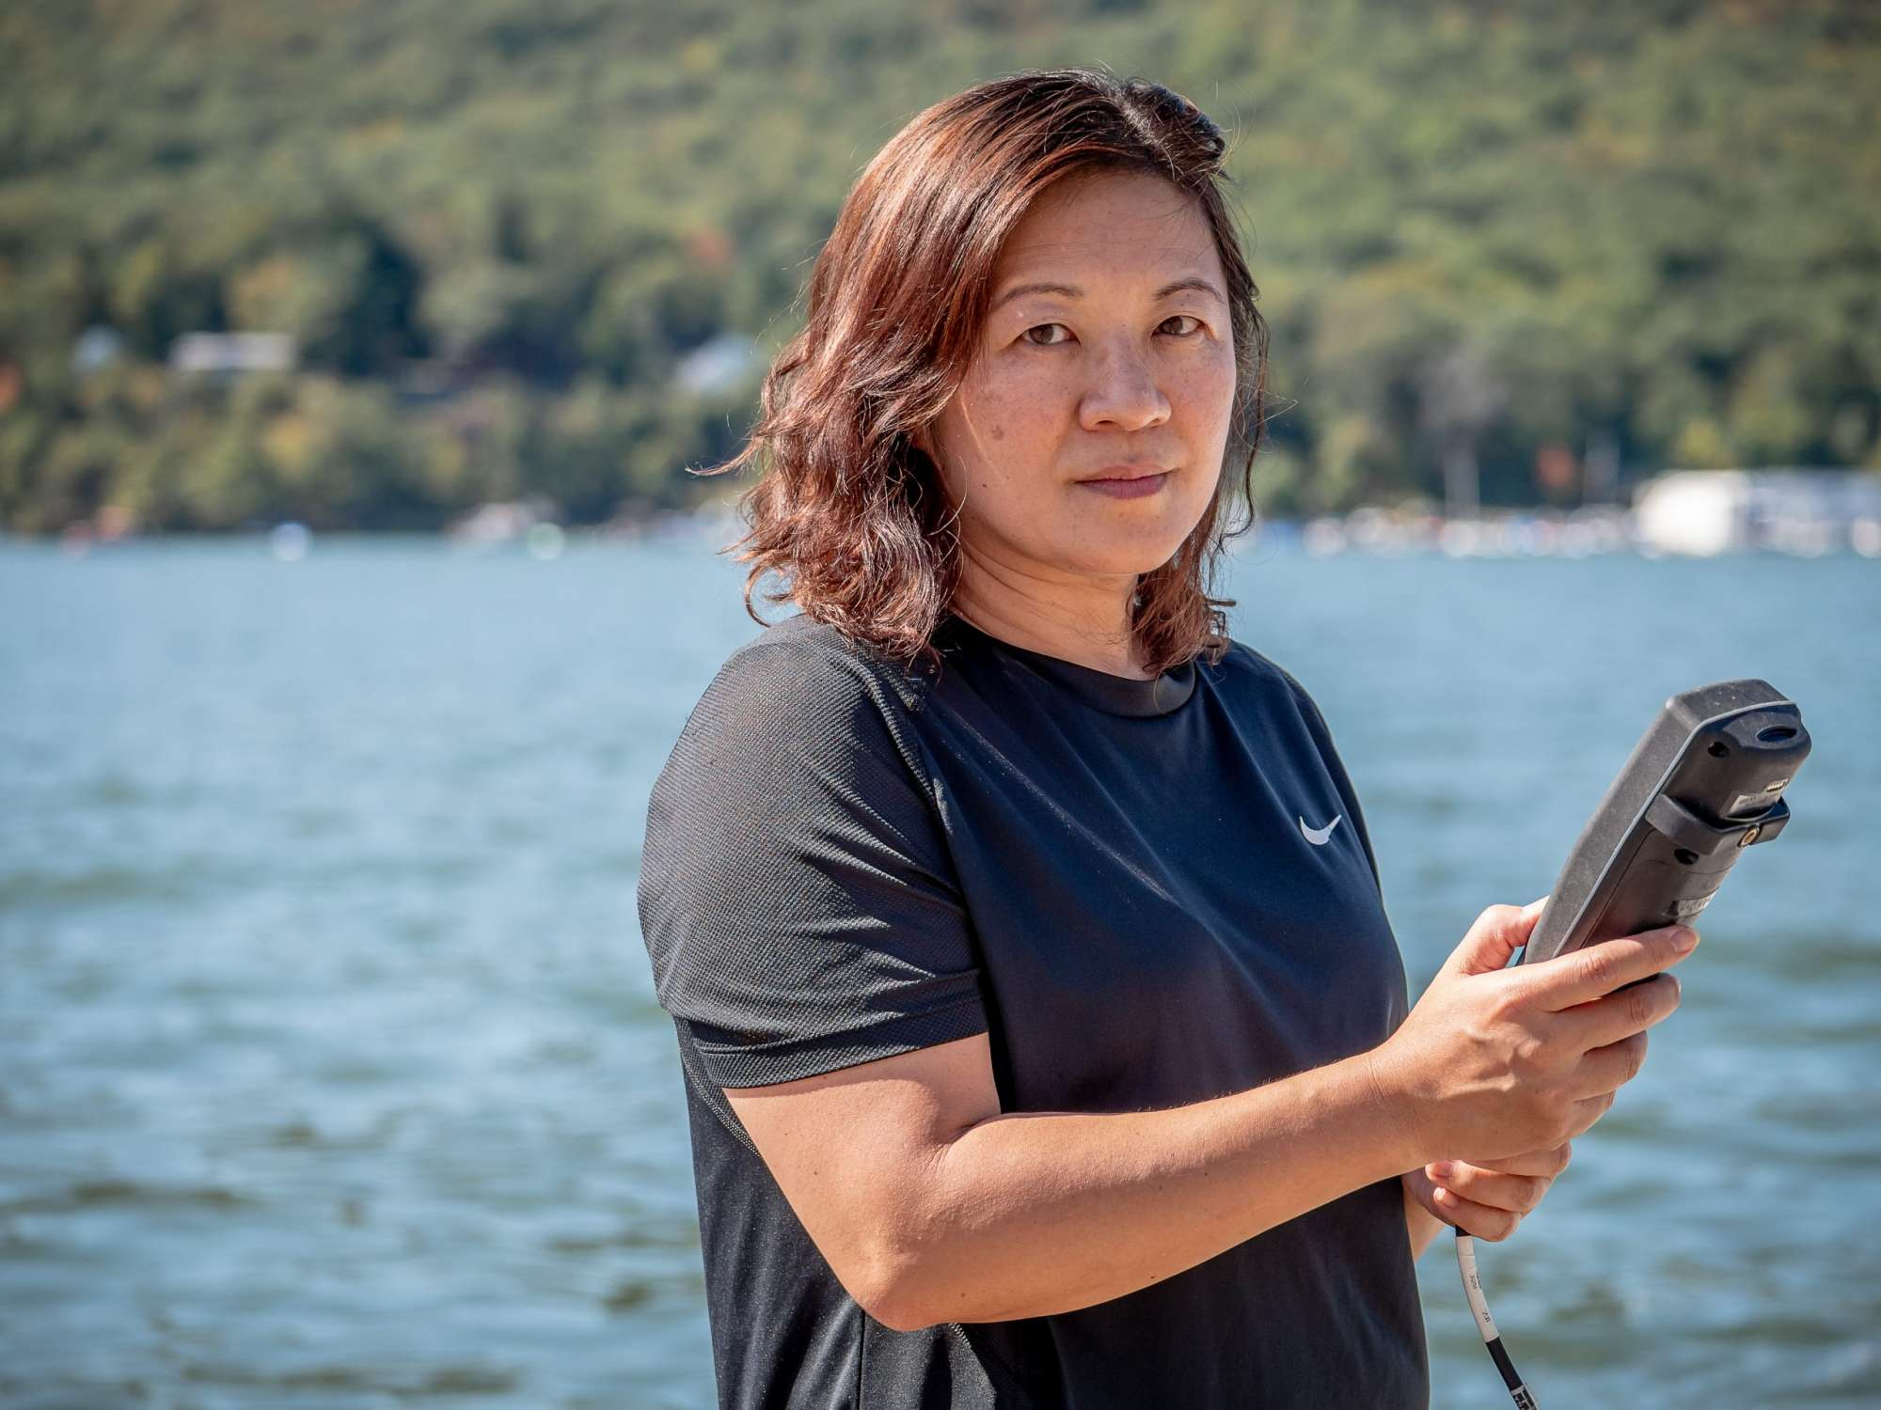
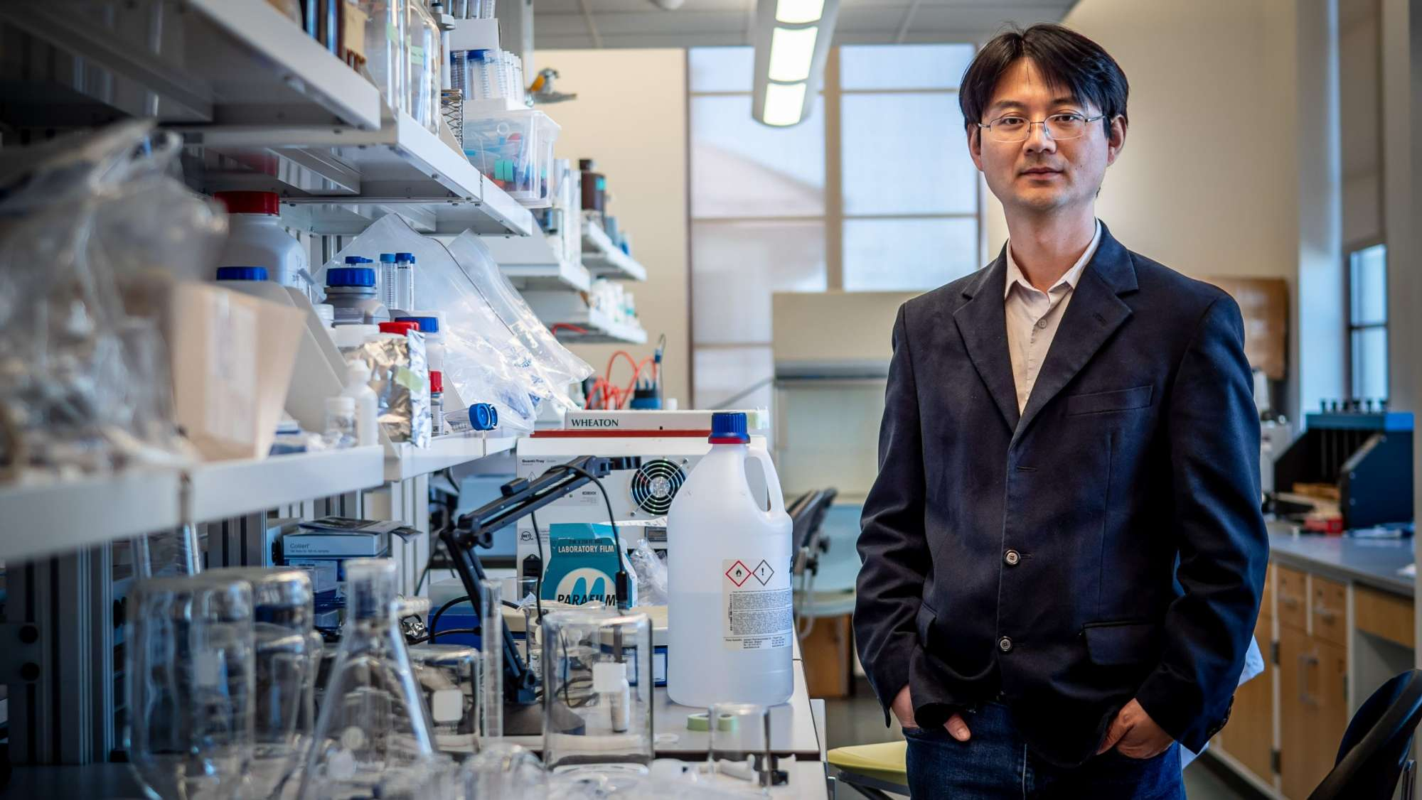

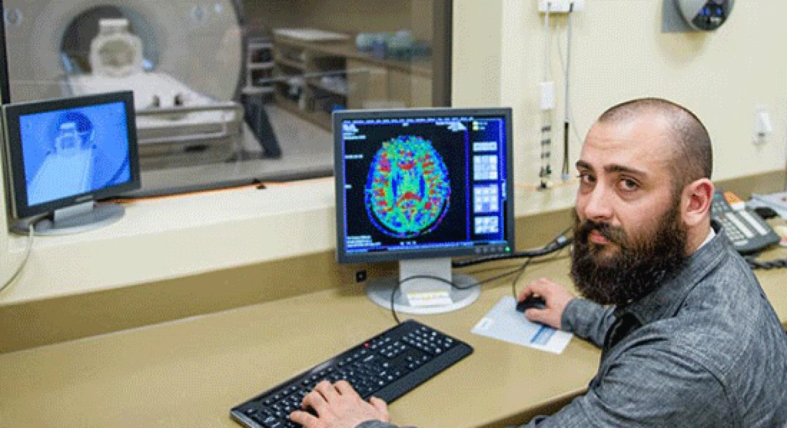

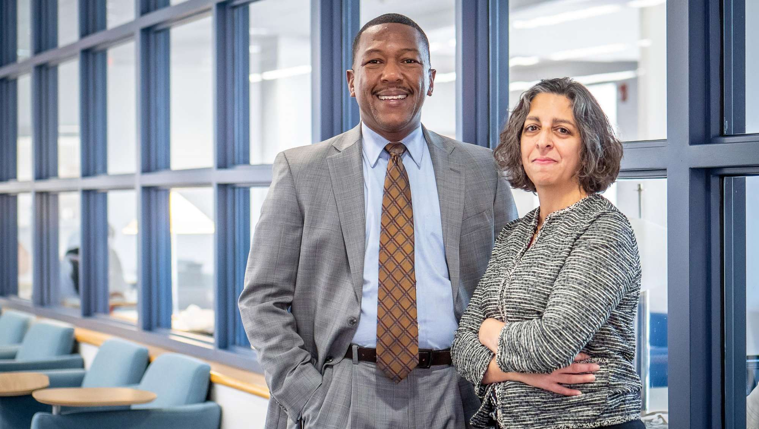

Office of Sponsored Programs
Montclair State University
New Faculty Workshop - September 27, 2021

Slide 22
Your OSP Staff
Ted Russo, Director
Catherine Bruno, Post-Award Officer
Kate Dorsett, Post-Award Officer
Amanda Lopez, Junior Pre-Award Specialist
Dana Natale, Pre-Award Services Manager
Sam Wolverton, Pre-Award and Outreach Specialist
The School of Nursing and The Graduate School 415 ▪ x4128
osp@montclair.edu ▪ www.montclair.edu/osp
twitter.com/ORSP_MSU

Slide 23
College of Education and Human Services
Mark Heimerdinger, Grants Coordinator
  University Hall, Room 2191
  Office Phone Number ext. 4459
  April Serfass, Post Award Facilitator
  University Hall, Room 3132
  Office Phone Number ext. 3072

Slide 24
College of Science and Mathematics
Gloria Rodriguez, Grants and Contracts Specialist
Center for Environmental & Life Sciences, Room 206G
Office Phone Number ext. 5120

Slide 25
E-Systems that support Research at MSU
CAYUSE RESEARCH SUITE:
  Cayuse SP- Internal Proposal Routing, Approval, Reporting and Proposal and Award Repository
  CAYUSE 424- Direct Submission to Grants.Gov
  CAYUSE IRB-Human Subjects Protocols
PIVOT: Search for funding opportunities
InfoReady: Internal Awards and Limited Submission Competitions
CITI: Online Training for Researchers, Student RA’s
Workday: Financial management of awarded grants
Notes:
25

Slide 26

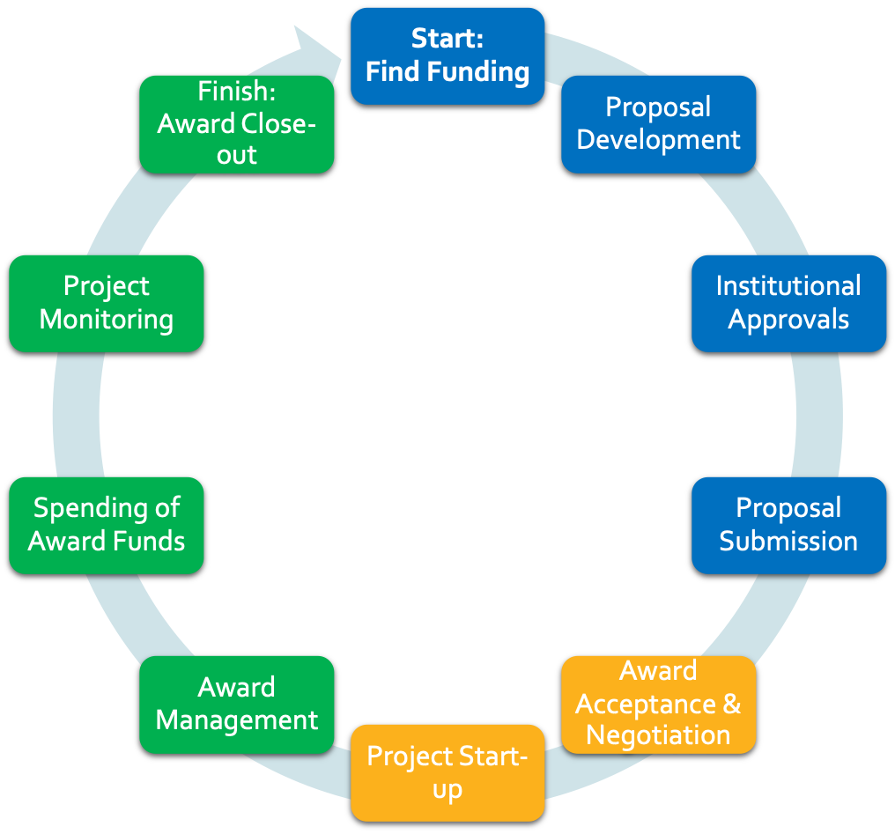



The Grant Lifecycle

Slide 27
Proposal Development Services
Montclair State University OSP
PRE-AWARD
Notes:
27

Slide 28
Pre-Award: Seeking External Funding
Proposal Development Team (Dana, Sam, and Amanda) can assist you in applying for grants:
OSP Web resources (funding opportunities, templates, narratives, proposal development)
Meetings, advising, interpreting (reviews, for example)
Assistance with planning for compliance issues (human/animal subjects, conflicts of interest, intellectual property)
Reviewing drafts of narratives & budgets
Submitting final proposal (planning re-submissions)
Notes:
28

Slide 29
Pre-Award: Finding the Funding
Pivot https://pivot.proquest.com
A global, multi-disciplinary database
  Over $63 Billion in funding opportunities
  More than 3 million profiles from around the world
Suggests potential funding opportunities for you based on your Pivot profile
New opportunities matching saved searches are emailed weekly
Faculty profile is searchable by other users for potential collaboration
Gives you one place to manage and track funding of interest
Grant Resource Center (GRC): Federal funding opportunities and sample Proposals (contact OSP for log-in information)
Funding Opportunities Listserv
Once a week, federal and non-federal opportunities
More links at https://www.montclair.edu/orsp/find-funding/

Slide 30
Pre-Award: Approvals & Submissions
Proposal Certification and Approval
  Prior to submission, proposals must be certified by PI/Co’I’s, and approved by Chair and Dean in CAYUSE SP
Submission to Sponsor/Agency
  In m0st cases, an OSP Authorized Organizational Representative (AOR) will be responsible for submission
  NSF submissions are through Research.Gov
  NIH, and other Grants.Gov submissions are via CAYUSE 424
  OSP Deadline Policy: https://www.montclair.edu/sponsored-programs/proposal-submission/

Slide 31
Award Management Services
Montclair State University OSP
POST-AWARD
Non-Financial
Notes:
31

Slide 32
Post-Award: Award Management
(Non-Financial)
Award Set-Up
  Award packet
Sponsor Prior Approvals: some examples
  No-cost Extensions
  Addition of a subaward
  Change in Key Personnel
Non-Financial Reporting
Notes:
32

Slide 33
Award Management Services
Montclair State University OSP
POST-AWARD
Financial
Notes:
33

Slide 34
Post-Award: Your Grant Accounting Staff
Trisha Sardesai, Director
Christine Singh, Grants Manager
Darryl Rivera, Grants Accountant
Jay Wolk, Grants Accountant
Open position- Grants Accountant
Bill Jones, Grants Coordinator- ON LEAVE
The Grants Accounting office reports to Finance and Treasury (Controller’s office)
The School of Nursing and The Graduate School, 4th Floor
https://www.montclair.edu/finance-and-treasury/university-controller/grant-accounting/

Slide 35
Post-Award: Your Grant Accounting Staff
Award Set-Up in financial workday system
Expense Approvals for all sponsored projects
Accounting & Compliance for all sponsored projects
Financial reporting for all sponsors, including cost share
Assistance with processing summer pay, course release, supplemental pay etc.
Distribution of IDC and reconciling revenue
Coordinating with IT/HR/Procurement for grant related matters
Timely closeouts and overall sponsored award management in partnership with the PI

Slide 36
Montclair State University OSP
INTERNAL AWARDS
Notes:
36

Slide 37
MSU Internal Awards
What are Internal Awards?
  Separately Budgeted Research
  Student Faculty Scholarship
  Summer Grant Proposal Development
  Faculty Research Mentoring Program
  Internal Awards Process

Slide 38
QUESTIONS?

