Slide 1
Leading Short-Term Education Abroad Programs
Wendy Gilbert-Simon, Student Mobility Coordinator, International Academic Initiatives
Chelsey Watts, Interim Director, International Academic Initiatives
James Adkins, Study Abroad Association

Slide 2

Workshop Agenda:
Why study abroad?
Benefits of a Faculty-led Program
Models of faculty-led programs
Step-by-step process and timeline
Elements of a strong study abroad course proposal
Role of a program leader
Faculty leader remuneration
Partnering with IAI
Partnering with SAA
Q and A

Slide 3
WHY STUDY ABROAD?
Benefits for Students:
Transformative Experience – Supports strategic plan
Study abroad offers many benefits:
  Opportunity to see a different part of the world in its context.
  Personal enrichment, growth and independence.
  Deeper cultural awareness beyond films, media and the evening news.
  Fresh perspectives and ways of thinking about the world.
  Academic credit.
  Linguistic immersion from beginner to advanced levels.
  Experience that is prized by employers in a wide variety of fields.
Notes:
Preaching to the choir!
Supported by Montclair State Project SOAR Pillar One: Fostering Student Transformation (Objective 1.1e, Objective 1.3 b,c, & f). These objectives state the common community goal of achieving high-impact experiences for students in national and international programs and to deliver “curricular and co-curricular experiences that require teamwork, leadership, problem-solving and decision making, cultural competence, and creative thinking.”
Through study abroad students meet new people and enrich themselves in new ways, developing skills and confidence they carry throughout their lives.
Students who study abroad find that by living and learning in a new environment their academic, personal and even professional horizons open up in ways they may not have imagined.
IIE estimates that about 10.9 percent of all undergraduate students -- and 16 percent of those earning bachelor’s degrees -- study abroad at some point in their undergraduate careers.

Slide 4
Types of Study Abroad/Study Away
Exchange through Partner Universities
  MSU currently has formal exchange agreements with 21 partners in 16 countries.
Affiliated Programs
  MSU has formal agreements with several established study abroad program providers, offering hundreds of different programs around the world.
National Student Exchange
  MSU students can study out of state at 160+ member institutions across the US and Canada for a semester or year, pay MSU tuition and earn credit toward their degree.
Faculty-led Short Term Programs
  Each year, the Office of International Academic Initiatives works with faculty to develop and support a growing number of short term faculty led study abroad programs.

Slide 5
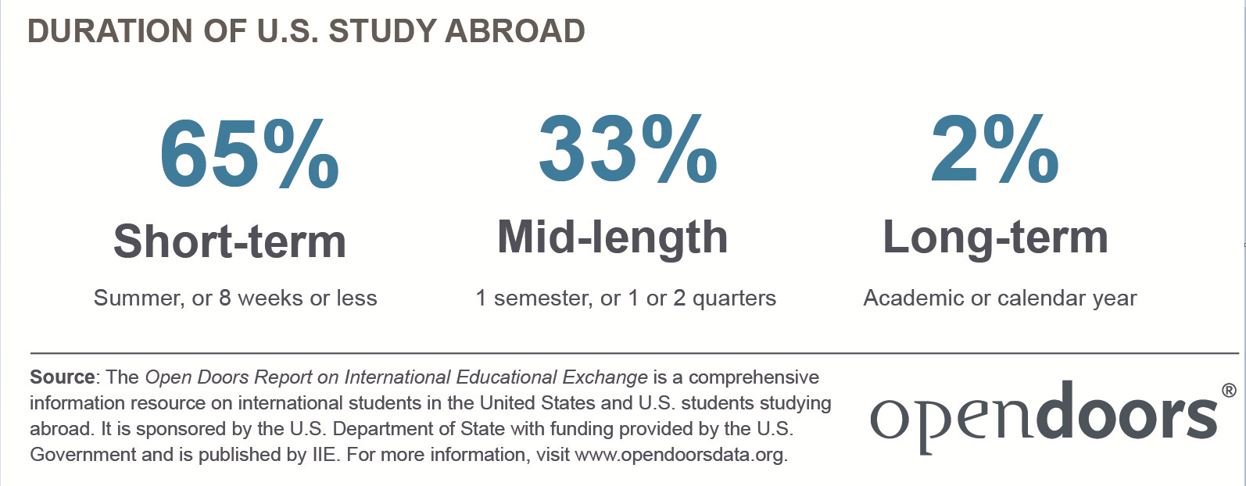
Short Term Programs vs Long Term Programs
Notes:
MSU: 76% short-term, 23% Mid-length (one semester) 1% academic year

Slide 6
Why Faculty Led Programs Appeal to Students
These unique opportunities provide high-impact learning experiences.
Nationwide, most popular type of study abroad and growing.
Attractive option for students
  Shorter time means less conflicts with part-time jobs
  Shorter time means less conflicts with family responsibilities
  Affordable options- group rates for airfare, hotels, guides, etc.
  Montclair State courses and credit, making academic progress
  Traveling with a known and trusted faculty member
  Traveling with a faculty member alleviates student and parental concerns about solo travel
  Traveling with a faculty member allows students expert insights on location, history, amenities

Slide 7
Why Leading a Program Is Appealing to Faculty
  Opportunity to provide expert insights on location, history, amenities
  Adapt and expand existing course syllabi
  Expand international connections for research
  Foster stronger relationships with students
  Travel to new or familiar destinations
Notes:
---- Now that you know why, how?

Slide 8
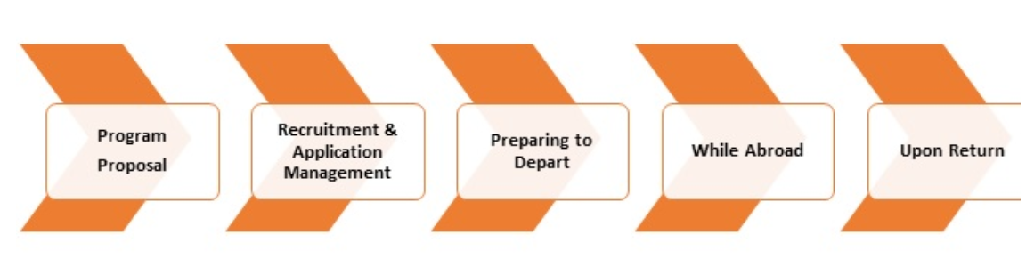
THE FIVE PHASES OF DESIGNING AND IMPLEMENTING A FACULTY-LED PROGRAM

Slide 9

TYPES OF FACULTY LED PROGRAMS
Exploration Seminar (Spring Break, Winter or Summer)
a stand-alone course offered during spring break (one credit) or winter (1-3 credits)
typically between 7-14 days of travel
single city or region to ensure students have the best opportunity to explore the location and the subject material and to keep the program cost efficient.
limited opportunities for independent student or faculty travel.
Two leaders unless approved by IAI.

Slide 10
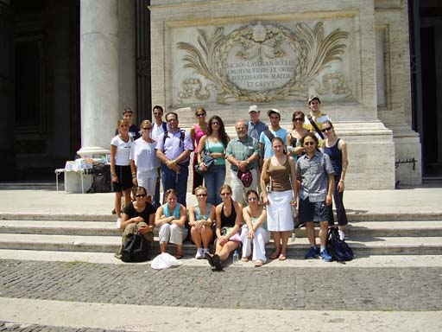
TYPES OF FACULTY LED PROGRAMS
Global+ Embedded Program (Spring, Winter or Summer)
embedded in a three credit spring semester, winter or summer session course.
travel component occurs during either spring break, or for a short period during winter or summer session
approximately 7-14 days.
limited opportunities for independent
student or faculty travel.
Two leaders unless approved by IAI

Slide 11

TYPES OF FACULTY LED PROGRAMS
Summer School Abroad
faculty guided immersion program
approximately 3-8 weeks, three or six-credit
often located on the campus or facility of an international partner
significant classroom instruction complemented by cultural experiences and excursions.
students and faculty have the opportunity outside of class time for independent travel and exploration.
option for single leader depending on in-country support.

Slide 12
What does a Program Leader Do?
Faculty leaders have a wide range of responsibilities and roles. They don many hats throughout the various stages, from proposal to preparation and implementation.
Before departure:
Envision how a course can be enhanced by international immersion
Develop an outline (abstract): what, where, when, who
Work with IE to conceive itinerary
Recruit Students (IAI and/or SAA will provide marketing materials)
Interview applicants
Participate in pre-departure orientations
While Abroad:
Teach course and facilitate activities
Manage daily group dynamics
Serve as crisis manager and liaison to MSU for any emergency
After Return:
Participate in a reflective activity with students (hopefully built into course design)
Provide feedback to IAI
Notes:
Envision
Teach
Assess

Slide 13
International Academic Initiatives is your partner throughout!
General:
Develop policies, processes, guidelines, risk management protocols and external partnerships
Before departure:
Guide and advise faculty on program development
Review proposals across disciplines and destinations, identify opportunities for collaborations
Work with external partners (eg SAA, travel agents) to develop detailed itineraries
Develop program budgets, collect student payments, pay vendors
Develop marketing materials (or SAA will provide marketing materials)
Build, collect and review applications for eligibility
Lead pre-departure orientations
While Abroad:
Serve as primary contact for any emergencies
After Return:
Review feedback for improvements
Notes:
SAA may do some admin (itineraries, budget, marketing materials)

Slide 14
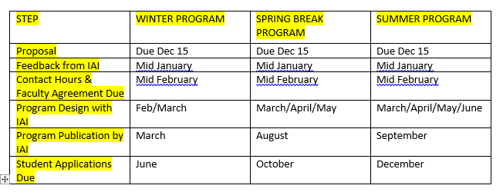
PROGRAM PROPOSAL TIMELINE
Notes:
Timeline starts early to allow development of program details and budget, and then recruitment of students
Two Steps –Proposal and program development
Proposals must be approved by the Department Chair(s) and College Dean(s) before submission to the Office of International Academic Initiatives.
If a proposal is approved by IAI, then a tentative itinerary must be developed, in collaboration with IAI staff.
Note: Programs that were approved AY2021-2021 but cancelled may submit a copy of previously approved proposal but must indicate any changes and attach a new Program Approval form signed by Chairs and Deans.

Slide 15
CONSIDERATIONS FOR PROPOSAL REVIEW
Risk Management (travel advisories, on-the-ground support, etc.)
Support within the college/department
Feasibility:
  Affordability
  Target student population
  Complexity of logistics
Academic Framework
Faculty Leader Eligibility
IAI capacity
Notes:
IAI has limited capacity and our primary concern is safety and quality control. Depending how many proposals are received, IE may seek to defer some programs to a future year. In making such decisions, IE may reach out chairs or deans to determine the priorities for fac-led programs in the college.

Slide 16
Risk Management
Health, safety, and security are the number one priorities in program development, implementation, and management.
Programs must ensure safe, clean, and hospitable student housing
Co- or extra-curricular activities must offer responsible health, safety, and security measures.
Facilities and infrastructure must provide a safe environment and accommodate students of varying needs and abilities.
Notes:
Confirm that your proposed destination does not have a U.S. Department of State Travel Warning (Level 3 or 4) or CDC Travel Health Warning (Level 3) at this time.

Slide 17
Academic Support
It is the intention of the Office of International Academic Initiatives to support programs that academic chairs and deans have determined are well integrated into the objectives of the college and department.
Notes:
Programs are evaluated and approved at each stage – Abstract and Full- by the Chair and Dean.

Slide 18
Academic Content and Integrity
Destination is integral to academic content
Comparable academic rigor to on campus course
Meet learning outcomes not met by an existing study abroad program
Credit hour equivalency to on campus programs
Curriculum supports the program goals and leverages the unique learning opportunities offered by the international context
Pre-program, on-site, and post-program offerings support the continuity of student learning and development and provide opportunities for intercultural learning and growth
Notes:
The destination is integral to the academic content and provides meaningful interaction with the host country and people.
Chair and deans discussion should be primary consideration of faculty before proposing
All participants must be enrolled in credit-bearing course(s)
Educational objectives remain central to program design and management

Slide 19
Program Design and Financial Feasibility
When designing programs faculty should ensure programs are accessible, affordable and attractive. Programs should be:
Integrated into the curriculum and preferably meet major/minor, or general education requirements.
Balance the learning goals of the program with the cost of travel.
Meet the needs of a large enough group of students to run.
Student enrollment
  Target 15-24 students for two leader programs
  Summer School Abroad – minimum 10 students per leader.
IAI is responsible for setting program budgets and determining the final program cost to students.
Notes:
Student enrollment and available pool: rule of thumb 10% of current students available and interested for that particular program and time period.

Slide 20
Faculty Leader Eligibility
Faculty must be full-time tenured, or tenure-track faculty. Instructional Specialists will also be eligible if their contract allows.
Faculty who are on sabbatical may not lead any program during the entire term of the sabbatical.
Adjunct faculty are not eligible to serve as program leaders or second leaders.
Full-time non-teaching staff may serve as second leaders.

Slide 21
FACULTY LEADER REMUNERATION
Teaching Salary
Spring Semester: Salary is paid to the faculty member through the faculty member’s department.
Summer or Winter Session: Faculty are paid by Summer/Winter Sessions according to the established teaching rates.
A second faculty leader or administrator who is not teaching a course will not be paid a teaching salary for the program.
Notes:
Spring semester:
The spring course should fall within the faculty’s base salary teaching load for the semester with no additional salary. If a course exceeds the faculty’s maximum teaching load, the faculty must be approved and paid a temporary service stipend by the faculty member’s department. IE will not cover the cost of an additional stipend.

Slide 22
Faculty Leader Remuneration, cont.
Expenses of Program
All costs of the program are covered, typically including:
  Roundtrip airfare
  Housing in a single room or similar, depending on location
  Local transportation included in the student program
  Airport transfers
  Enrollment fee for travel assistance policy
  Group meals included in the student program
  International phone service

Slide 23
Faculty Leader Remuneration, cont.
Expense Reimbursement
Faculty leaders will be reimbursed for meals and incidental expenses during the program, in accordance with University guidelines.
Amount varies in accordance with the length of the program.
Notes:
Details as per Faculty Leader Agreement:
For trips 3 weeks or less - faculty will be reimbursed 100% of the federally approved per diem rate, without receipts, in accordance with MSU travel regulations.
For trips greater than 3 weeks- faculty will be reimbursed 100% of the federally approved per diem rate for the first 2 weeks of the program and then 60% of the federally approved per diem for remainder of the time in country, without receipts, in accordance with MSU travel regulations.
Meals included in the program (e.g. group meals, airline meals) will reduce the daily per diem rate.

Slide 24

PARTNER ORGANIZATIONS
MSU has partnered with a custom faculty-led program provider who can assist with designing and delivering programs.
Visit the Study Abroad Association website to view sample itineraries.
SAA programs are fully customizable to meet you academic needs.
SAA handle all the logistics and provide an in-country manager and support for the duration of your program.
Can offer programs in 30+ countries.
SAA does not have a sole source contract so we can consider other organizations if they are better able to meet the academic needs of the program
Notes:
James to discuss their approach to program development, their staff on the ground, their expertise…. James to discuss how they work with MSU, maybe one or two sample programs

Slide 25
WHAT TO DO NEXT
Visit IAI’s website to explore proposal process
Talk to your Chair and colleagues in your department
Explore the Study Abroad Association website
Explore your professional networks
Schedule a meeting with IAI to discuss your idea (Wendy or Chelsey)

Slide 26
CURRICULUM RESOURCES
The Forum on Education Abroad
  The Education Abroad Digital Resource Center
  The Curriculum Toolbox
Montclair State University is a member so you can request access to their web resources.
https://forumea.org/resources/curriculum/curriculum-resources/
Notes:
Questions?

