Slide 1
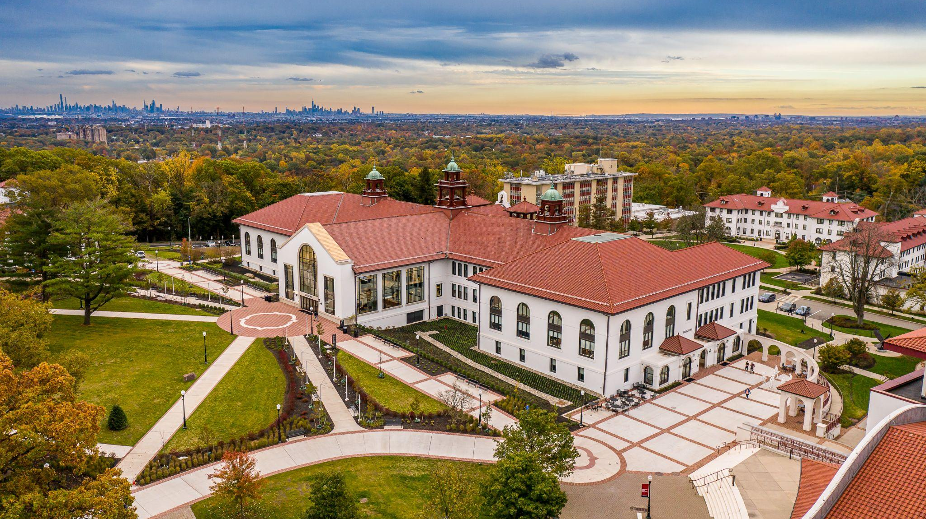

Board of Trustees
2023-2024 Tuition and Fees Hearing
March 31, 2023
Notes:
According to the latest IPEDS Data Feedback Report, our students of color graduation rates do not exceed the average of the 11 other NJ public universities (but our Pell students do). This pertains to the entering cohort of 2015.
We are #7 in the nation on USNWR’s “graduation rate performance” statistic. In other words, students at Montclair far exceed the graduation rate (+18 percentage points) of similar students attending similar institutions
For the last several years, Essex County has supplied about 18% of our headcount enrollment.
Green Teams: clients have included many significant Essex County organizations, including City of Newark, Newark Community Food System, Prudential, and PSEG (as you know, both those companies are headquartered in Newark)
Feliciano Center for Entrepreneurship and Innovation assists Essex residents in starting their own businesses, with an emphasis on women and people of color.
The New Jersey Center for Water Science and Technology focuses on environmental issues of importance to Essex County, and runs a summer program to introduce school children to environmental science at field locations in Essex County, including the lower Passaic River and Newark Bay.

Slide 2




EDUCATIONAL ACCESS & EQUITY
“Red Hawk Rising” partnership in Newark trains students to return and teach in the city, cited by US DOE as a national model
Mentoring early-career teachers to help retain them
Supporting network of Essex & Northern NJ school districts
PUBLIC SERVICE TO SUPPORT COMMUNITIES
Nursing partnership with West Orange Health Department, Speech and Hearing clinics, child care
NextGen Service Corps, Bonner, Americorps
Support for entrepreneurs, government, non-profits
STUDENT SUCCESS
#21 in the nation on Social Mobility (USNWR)
Montclair undergraduate students dramatically exceed experts’
predicted graduation rates (#5 nationally)
21,744 alumni and 3,700 students live or work in Essex County
MEGA initiative focuses on attainment gap for men of color
HANDS-ON LEARNING
Green Teams work with companies, civic groups
Undergraduate research opportunities promotes academic and career success
Professional level training by doing (e.g., media, arts, finance)
TUITION AND FEES HEARING 2023-2024

Slide 3
Excellence earns recognition
#21 in Social Mobility
U.S. News &
World Report, 2023
One of “America’s Top Colleges”
Forbes, 2022
A Top Producer of Minority Graduates
Diverse: Issues in Higher Education
Top 100 Colleges & Universities for Hispanics
Hispanic Outlook on Education
Best of the Best for LGBTQ students
Campus Pride
Top 100 Public Research University
U.S. News & World Report
One of the Best Colleges for Your Money
Money, 2022
Among “America’s Best Bang for the Buck” Colleges
Washington Monthly, 2022
No. 38 Online Master’s Degree Programs in Business
Princeton Review
Top 100 online degree programs in business and information technology
U.S. News & World Report, 2021
#2 Master’s in Public Health and #2 Best Education Schools in New Jersey
U.S. News & World Report, 2023
Fulbright Hispanic-Serving Institution Leader for second year in a row
U.S. Dept. of State, 2022
One of America’s greenest campuses
The Princeton Review Guide to Green Colleges, 2022
Top 10 Online Master’s Programs in Education
U.S. News & World Report, 2023
TUITION AND FEES HEARING 2023-2024

Slide 4
Tuition and Fees Approval Process
Governor’s Budget Address
President’s Leadership Council
Tuition & Fees Hearing
Propose FY2024 general and fringe benefit appropriations
Provide opportunity for input from students and public
New Jersey State Legislature
Approve state appropriations and financial aid support
President’s Leadership Council
Consider input from Hearing
Montclair Board of Trustees
Propose range of tuition and fees increases based on projected revenue, enrollment, and budget requests
Review and approve tuition and fee request
Propose student financial aid
May also establish tuition and fee increase guidelines
Approve tuition and fee request
Review legislative budget outcomes
TUITION AND FEES HEARING 2023-2024

Slide 5
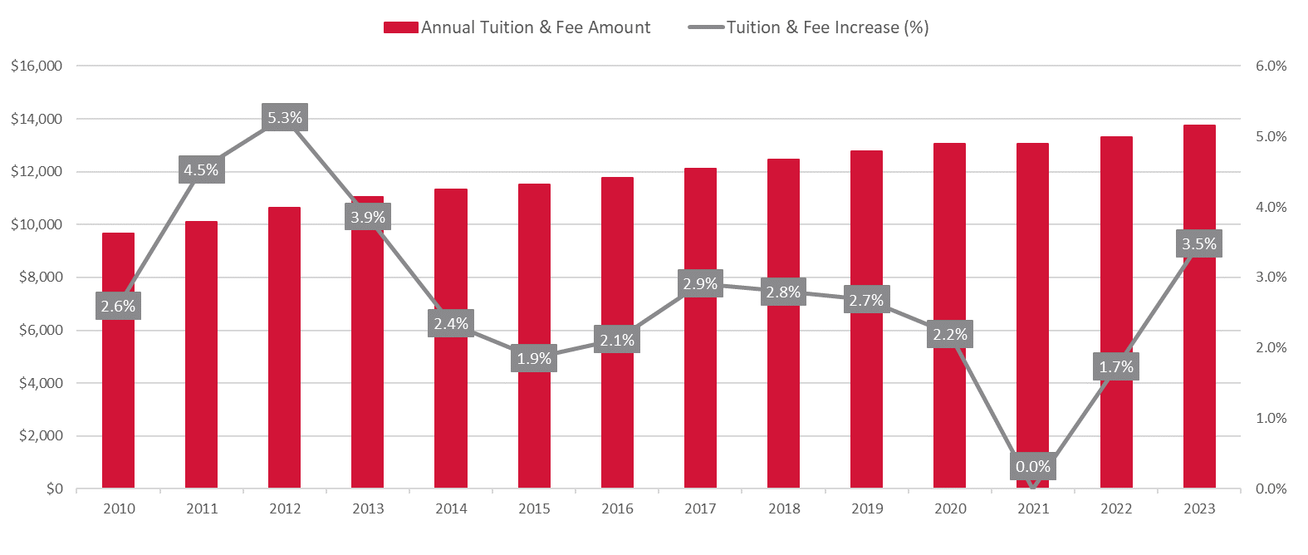
Montclair has a history of low annual adjustments for undergraduate tuition
Full-time Tuition and Fees for New Resident Undergraduate Students (FY 2010 – FY 2023)
TUITION AND FEES HEARING 2023-2024
4
TUITION AND FEES HEARING 2022-2023
Notes:
NR updated 2/10/23

Slide 6
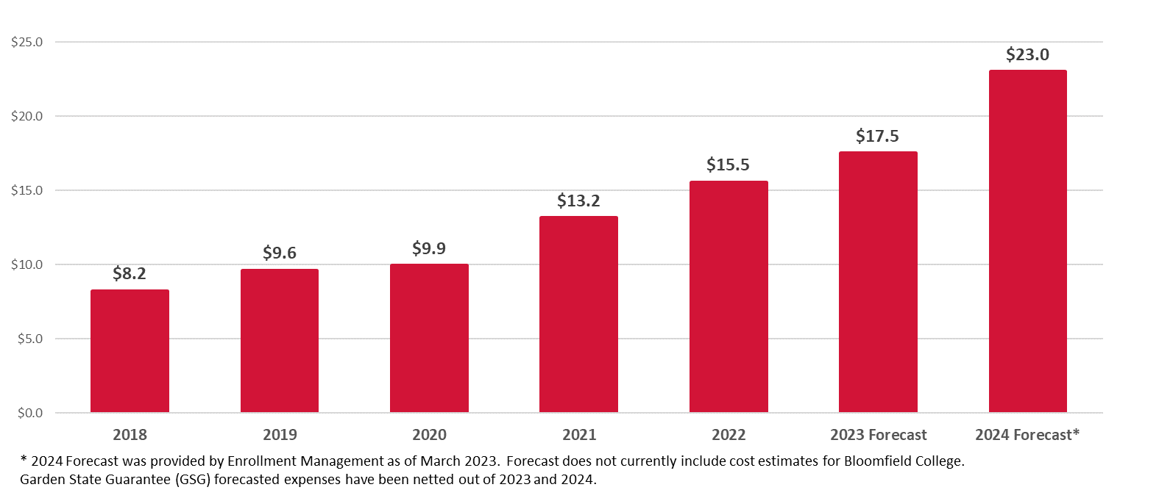
Montclair is committed to higher education access and affordability
by increasing investments in gift aid
Institutional Scholarship Aid in Millions (FY 2018 – FY 2024)
TUITION AND FEES HEARING 2023-2024
5
TUITION AND FEES HEARING 2022-2023
Notes:
NR updated 2/13/23

Slide 7
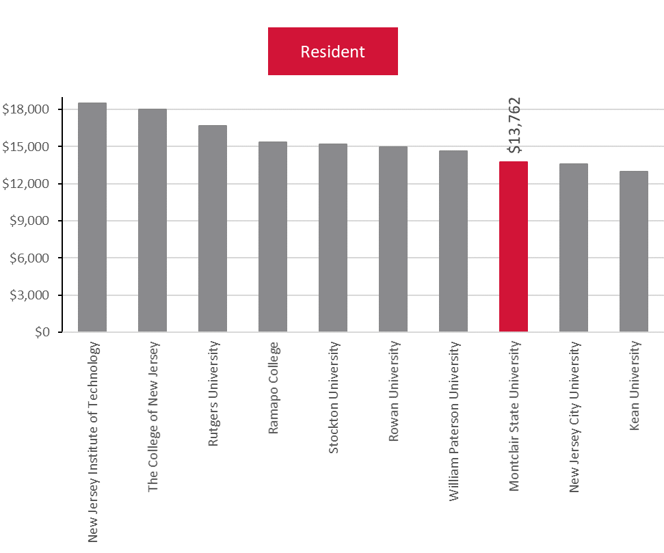
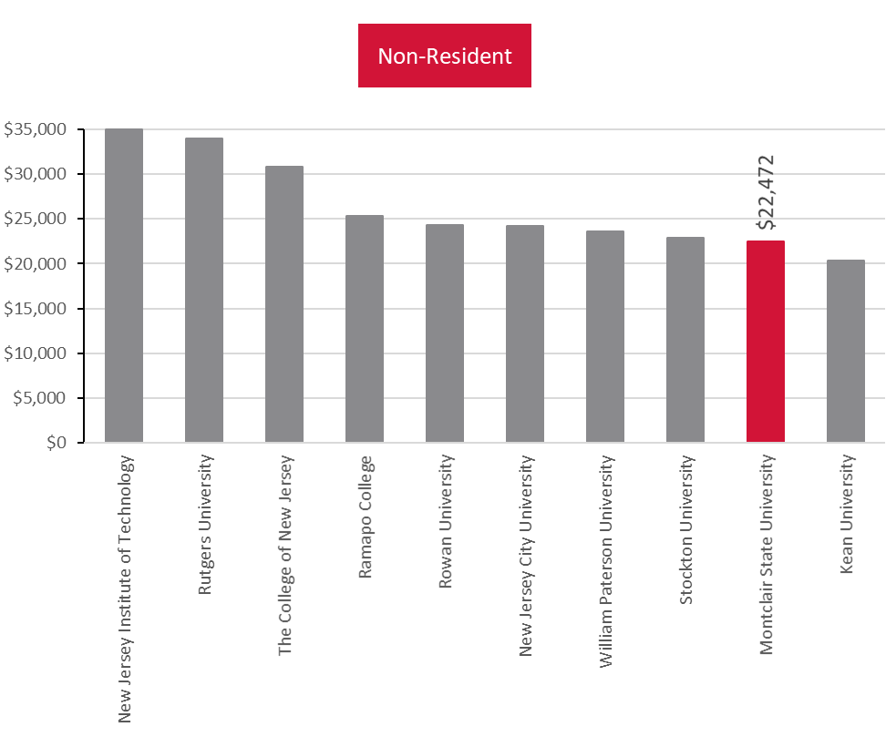
Montclair undergraduate tuition and fees remain low across resident and non-resident
student groups compared to its New Jersey public peers
Full-time Tuition and Fees for Undergraduate Students (AY2022-2023)
TUITION AND FEES HEARING 2023-2024
6
TUITION AND FEES HEARING 2022-2023
Notes:
NR updated 2/10/23

Slide 8
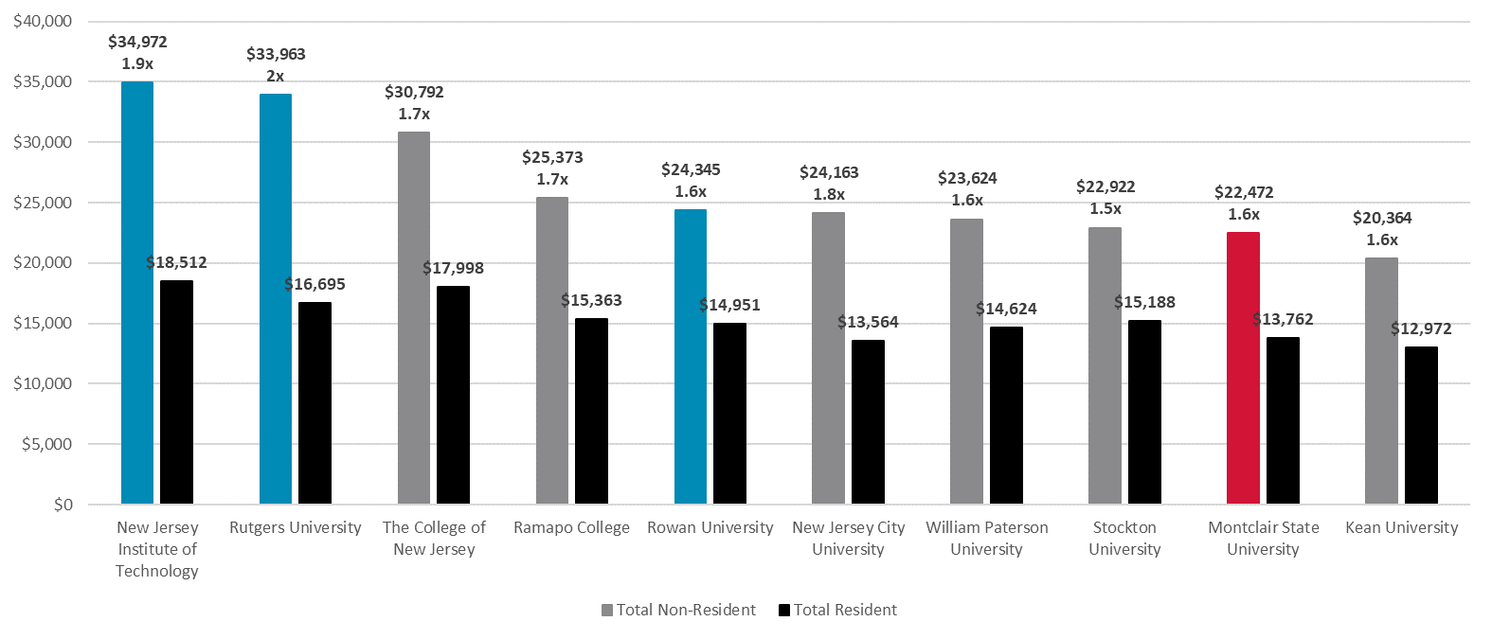
Montclair has low tuition and fee rates and a low differential between resident and
non-resident rates compared to its New Jersey public peers
Full-time Tuition and Fees for Undergraduate Students (AY2022-2023)
TUITION AND FEES HEARING 2023-2024
7
TUITION AND FEES HEARING 2022-2023
Notes:
NR updated 2/10/23

Slide 9
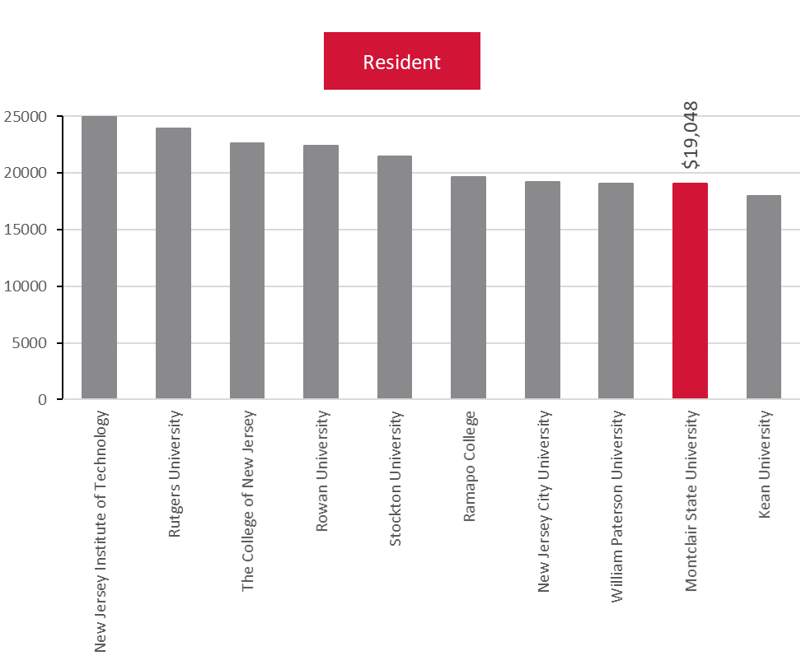
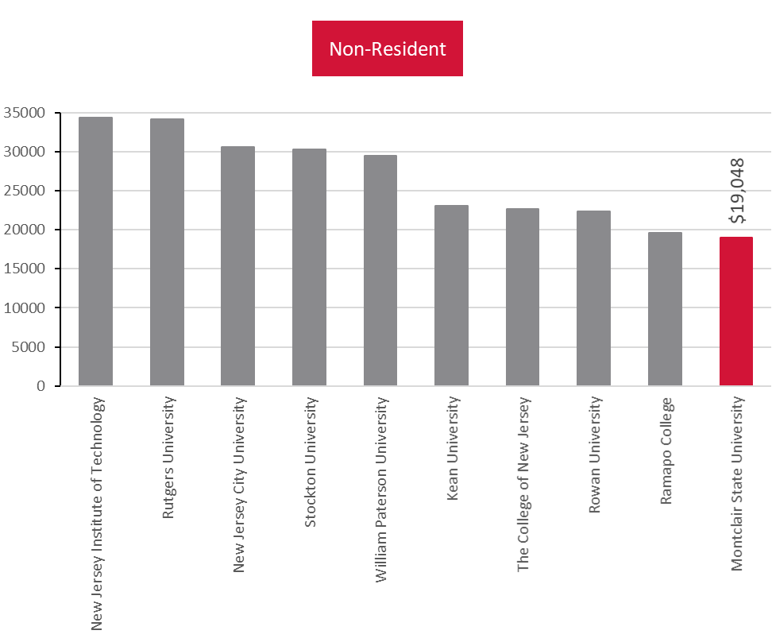
Montclair graduate tuition and fees are second lowest for resident and lowest for non-
resident student groups compared to its New Jersey public peers
Full-time Tuition and Fees for Graduate Students (AY2022-2023)
TUITION AND FEES HEARING 2023-2024
8
TUITION AND FEES HEARING 2022-2023
Notes:
NR updated 2/10/23

Slide 10
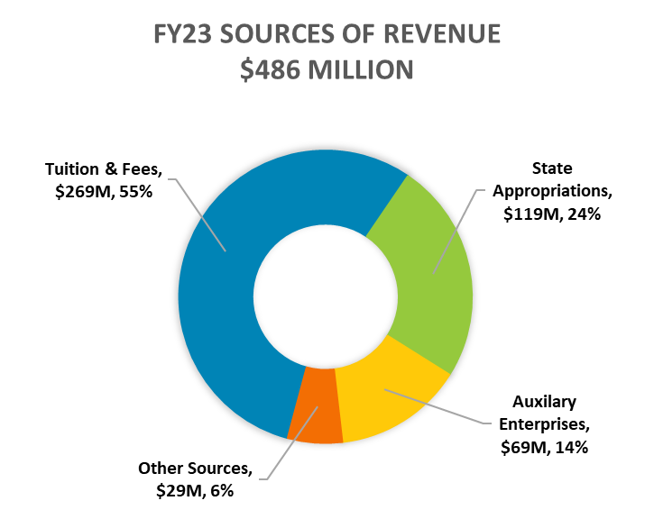
Tuition and Fees make up more than half of Montclair’s Total Sources of Revenue
Sources of Revenue (FY 2023 Budget, $486 Million)
TUITION AND FEES HEARING 2023-2024
9
TUITION AND FEES HEARING 2022-2023
Notes:
NR updated 2/10/23

Slide 11
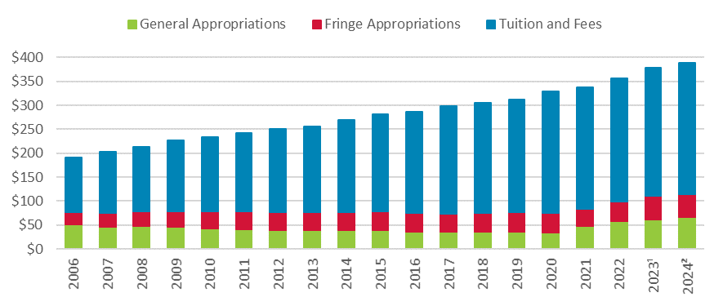
Despite recent years of increased state support, general operating appropriations has only
increased by 31% while Tuition and Fee revenue has increased by 141% since FY 2006
State Appropriations and Tuition & Fees Revenue in Millions (FY 2006 – FY 2024)
1. Montclair Fiscal Year 2023 Budget
2. State of New Jersey Proposed Fiscal Year 2024 Budget.
3. General Appropriations includes base appropriations and the Outcomes-based Allocation. Garden State Guarantee (GSG) Appropriations were netted out of 2022 and 2023.
TUITION AND FEES HEARING 2023-2024
10
Notes:
As of slide update on 2/13/23 =
2023 = MSU FY23 Orig Bud.
2024 = State of NJ Proposed FY24 Budget with Gen Appr = FY23 Base + $4.875m for BC. Fringe is flat.

Slide 12
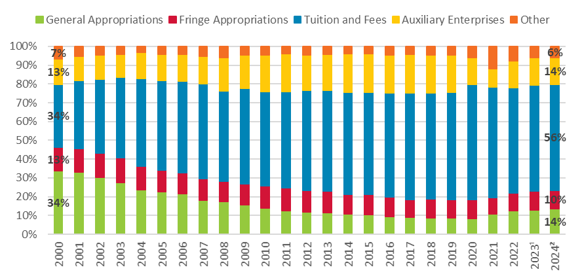
General operating appropriations as a share of total revenue has decreased by
more than half in the last two decades
Revenue Source as a Percentage of Total Revenue (FY 2000 – FY 2024)
1. Montclair Fiscal Year 2023 Budget
2. State of New Jersey Proposed Fiscal Year 2024 Budget.
3. General Appropriations includes base appropriations and the Outcomes-based Allocation. Garden State Guarantee (GSG) Appropriations were netted out of 2022 and 2023.
4. Other includes – Investment Income, Educational Sales & Services, and other revenue sources.
TUITION AND FEES HEARING 2023-2024
11
Notes:
As of slide update on 2/13/23 =
2023 = MSU FY23 Orig Bud.
2024 = State of NJ Proposed FY24 Budget with Gen Appr = FY23 Base + $4.875m for BC. Fringe is flat.

Slide 13
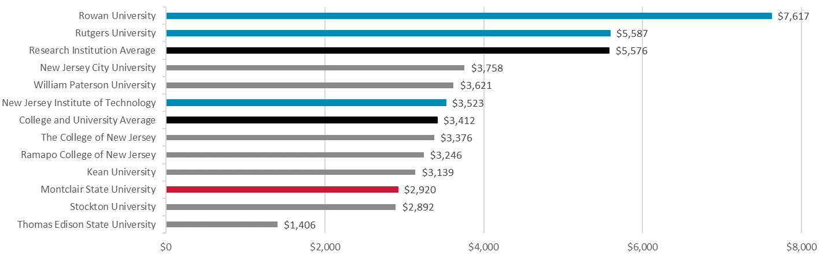
Montclair students are underfunded by almost 50% compared to their New Jersey public research
peers, and by almost 15% compared to the other four-year New Jersey senior public peers
FY 2024 Proposed “Base” General State Appropriations² per 12-month Student FTE (2020-21)
Source(s) and notes:
1. Integrated Postsecondary Education Data System (IPEDS)
2. State of New Jersey Proposed Fiscal Year 2024 Budget. “Base” General State Appropriations is General State Appropriations less Outcomes-Based Allocation.
3. Averages exclude Montclair.
TUITION AND FEES HEARING 2023-2024
12
TUITION AND FEES HEARING 2022-2023

Slide 14
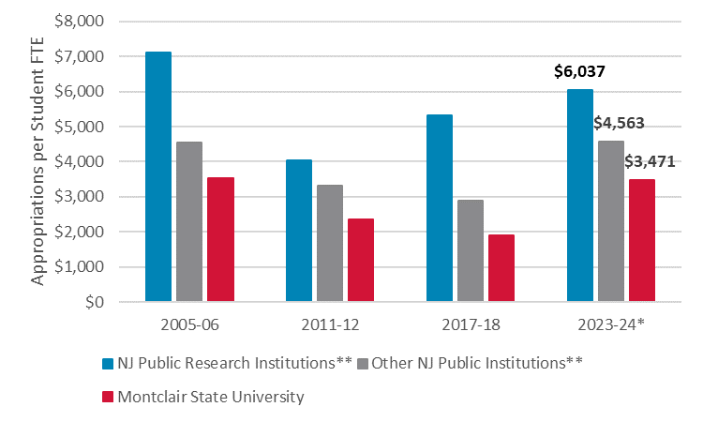
Montclair students have remained underfunded over the past two decades
General State Appropriations per 12-month Student FTE (2020-21)
Source: Integrated Postsecondary Education Data System (IPEDS)
* State of New Jersey Proposed Fiscal Year 2024 Budget
** Excludes Montclair and Thomas Edison
TUITION AND FEES HEARING 2023-2024
13
TUITION AND FEES HEARING 2022-2023

Slide 15
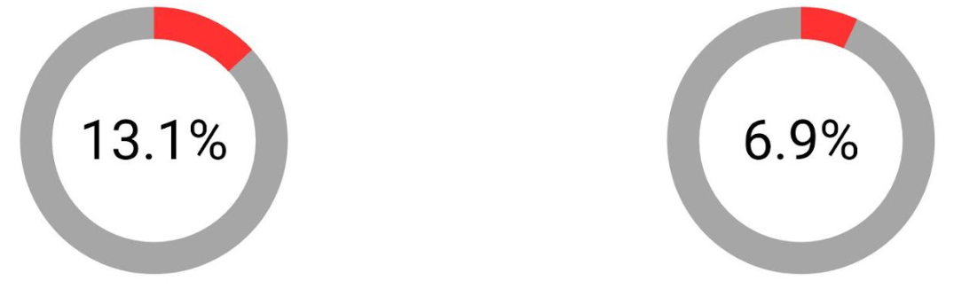
FY24 proposed base appropriation funding for Montclair trails Outcomes-Based Allocations
Montclair State University Share of State Outcomes-Based Allocation
Montclair State University Share of Total State Base Appropriation Funding
Montclair earns 13.1% of the State’s total Outcomes-Based Allocation pool
but only 6.9% of total State Base Appropriations
Source: State of New Jersey Proposed Fiscal Year 2024 Budget. “Base” General State Appropriations is General State Appropriations less Outcomes-Based Allocation.
TUITION AND FEES HEARING 2023-2024
14

Slide 16







Montclair has the highest Student to State-authorized Position* ratio
7 : 1
NJ Research
Average
(Excl. Montclair)
State-authorized Position
9 : 1
NJ Average (Excl. Montclair)
For each State-authorized position, the University is rebated the cost of health and pension benefits
Every 100 State-authorized Positions are worth approximately $3 million to the University
14 : 1
Montclair
Sources:
1. Integrated Postsecondary Education Data System (IPEDS): 2020-21 12-month FTE Enrollment
2. State of New Jersey Proposed Fiscal Year 2024 Budget: FY 2024 State Authorized Positions
* Fringe benefit appropriations are based on the number of state-authorized positions
TUITION AND FEES HEARING 2023-2024
15

Slide 17
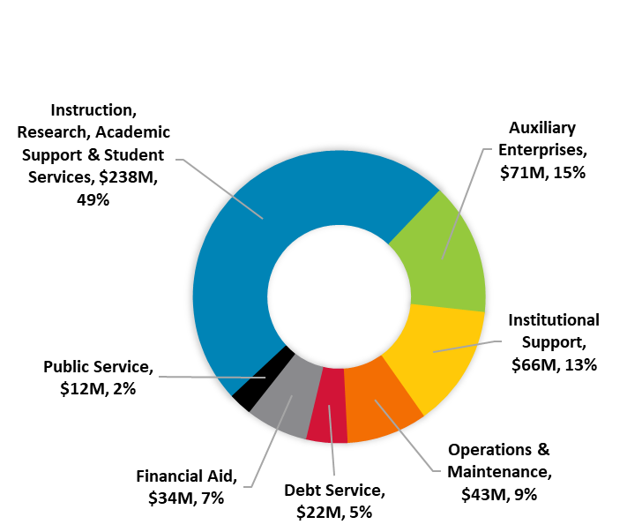
One-half of Montclair’s operating revenue supports Instruction, Research, Academic Support
and Student Services; two-thirds funds employee salaries and benefits
Uses of Revenue (FY 2023 Budget, $486 Million)
FY23 USES OF REVENUE
(NACUBO)
FY23 USES OF REVENUE
(Natural Account)
TUITION AND FEES HEARING 2023-2024
16
TUITION AND FEES HEARING 2022-2023
Notes:
NR updated 2/13/23
Discrepancy? $485,590 BOT Report vs $485,558 Adaptive

Slide 18
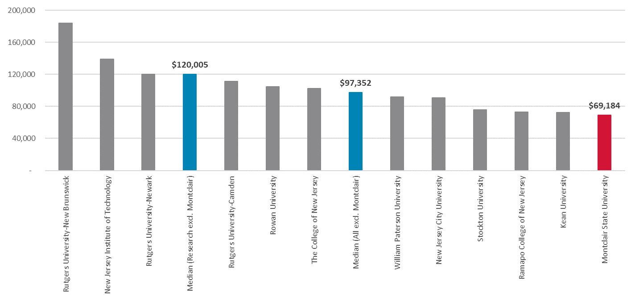
Montclair expends the least resources per degree awarded than its New Jersey senior public peers
Total NACUBO Functional Expenses* per Degree Awarded (FY 2021)
Source: Integrated Postsecondary Education Data System (IPEDS). Median excludes Montclair.
* Total Expenses exclude Auxiliary enterprises, Hospital services, and Independent operations.
TUITION AND FEES HEARING 2023-2024
17
TUITION AND FEES HEARING 2022-2023
Notes:
NR updated 2/13/23

Slide 19

STRATEGIC INITIATIVES
Academic and Professional Success for Diverse Student Body
Maintain principles of accessibility and excellence for all students
Enhance student advising programs & academic coaching
Improve retention and graduation rates
Launch new efforts for career services and experiential learning
Research and Innovation
Engage in solutions-focused research
Broaden and deepen research infrastructure
Provide hands on research opportunities for both graduate and undergraduate students
Increase research grants awarded from federal, state and local private sponsors
Partnership and Public Service
Increase partnerships with government, businesses, schools, health care providers, non-profits and civic organizations
Advance economic development and educational outcomes
Montclair Unbound
Implement innovative flexible models of learning – programs that give students the ability to learn how, when and where it works best for them
Create new online graduate degrees, programs that combine in-person and online learning, and programs that are offered entirely off campus
Human Capital & Talent
Attract and retain high-quality faculty & staff
Design and deploy professional development programs
Fundraising
Secure external resources (Hinchliffe and Paterson)
TUITION AND FEES HEARING 2023-2024
TUITION AND FEES HEARING 2022-2023

Slide 20

Innovative New Academic Programs
FY 2024 BUDGET PRIORITIES
Maintain Affordability and Excellence
Continue to increase support for Presidential Scholarships and other institutional aid.
Recruit Highly Qualified New Faculty
35 New tenure-track positions approved for fall 2023
Employee Salary Increases
Fund collective bargaining increases for union positions and salary increases for non-aligned positions (estimated $8.5 million).
Fund Inflationary Cost Increases
Costs have increased due to high inflation.
Address State Funding Inequities
Work with State Legislature to secure additional state support for Bloomfield College of Montclair State University.
Continue to identify operating efficiencies to address ongoing underfunding of Montclair relative to its peers.
Continue to Launch Innovative New Academic Programs
Complete launch of College for Community Health and College for Education and Engaged Learning.
Expand Montclair Unbound and continue to invest in new academic initiatives.
Maintain Campus Infrastructure at a High Level
Do not defer maintenance
TUITION AND FEES HEARING 2023-2024
TUITION AND FEES HEARING 2022-2023

Slide 21

Innovative New Academic Programs
INNOVATIVE NEW ACADEMIC PROGRAMS
Recently Launched
Masters in Human Resource Analytics
Masters in Digital Marketing Analytics
Bachelors in Animation and Visual Effects (VFX)
Bachelors in Recording Arts and Production
2023-2024 New Programs
Expected Fall 2023
BS in Business Analytics
Minor in Neuroscience
Bachelors in Applied Studies
Selected Examples in Development for 2024
BS in Cybersecurity
BS in Neuroscience
MA in Media Management (Online)
DNP (Doctor of Nursing Practice)
Several new Montclair Unbound offerings
TUITION AND FEES HEARING 2023-2024
TUITION AND FEES HEARING 2022-2023

Slide 22
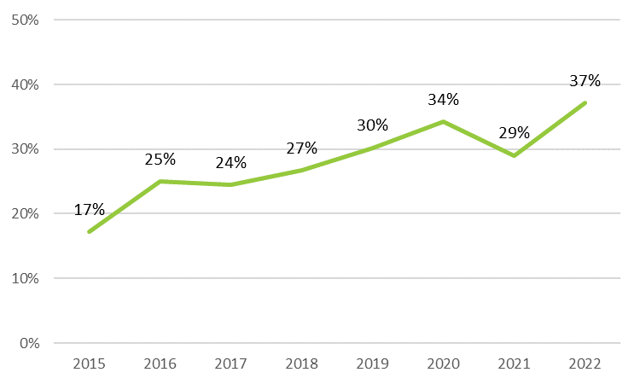
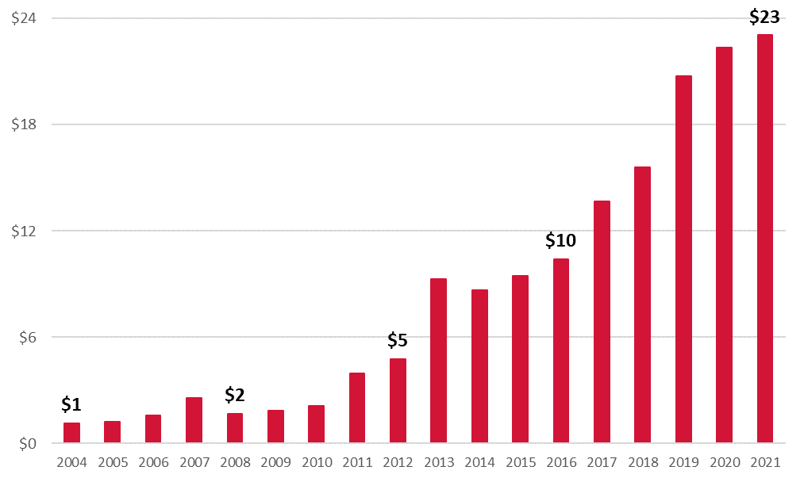
Montclair’s research award success rate and growth in research expenditures has more than doubled since 2015
Award Success Rate by dollar volume (FY 2015 – FY 2022)
Research Expenditures in Millions (FY 2004 – FY 2021)
Source: Office of Sponsored Programs, Montclair State University (Annual Reports)
Source: Integrated Postsecondary Education Data System (IPEDS)
TUITION AND FEES HEARING 2023-2024
21
TUITION AND FEES HEARING 2022-2023

Slide 23
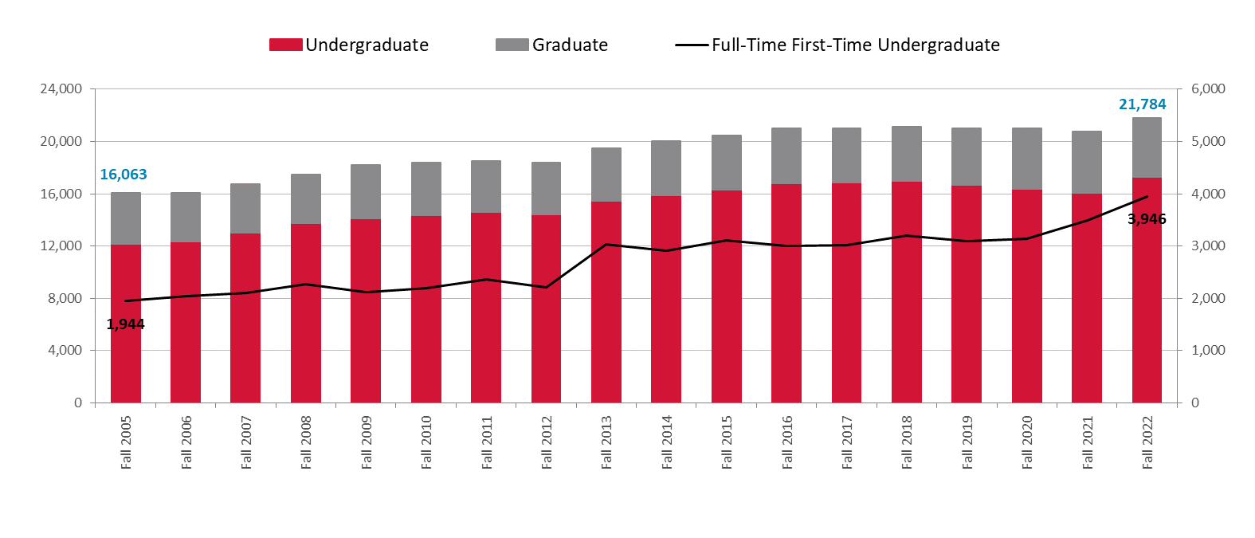
The University has enrolled its largest freshman classes in the past two years
Total Undergraduate and Graduate Enrollment (Fall 2005 – Fall 2022)
TUITION AND FEES HEARING 2023-2024
22
TUITION AND FEES HEARING 2022-2023
Notes:
NR updated 2/10/23

Slide 24


AY2022-2023 Tuition & Fees Rates
Undergraduate Full-Time (Per Semester) | Resident | Non-Resident
Tuition | $6,378 | $10,733
Fees | $503 | $503
Tuition and Fees | $6,881 | $11,236
AY2023-2024 Proposed Tuition & Fees Rate Increase
Undergraduate Full-Time (Per Semester) | 2022-23 Tuition & Fees | Proposed Percent Change | Proposed Amount Change
Resident | $6,881 | 2% to 5% | $138 - $344
Non-Resident | $11,236 | 2% to 5% | $225 - $562
TUITION AND FEES HEARING 2023-2024
23
TUITION AND FEES HEARING 2022-2023
Notes:
NR updated 2/10/23

Slide 25
Questions?
TUITION AND FEES HEARING 2023-2024
24
TUITION AND FEES HEARING 2022-2023

