Slide 1
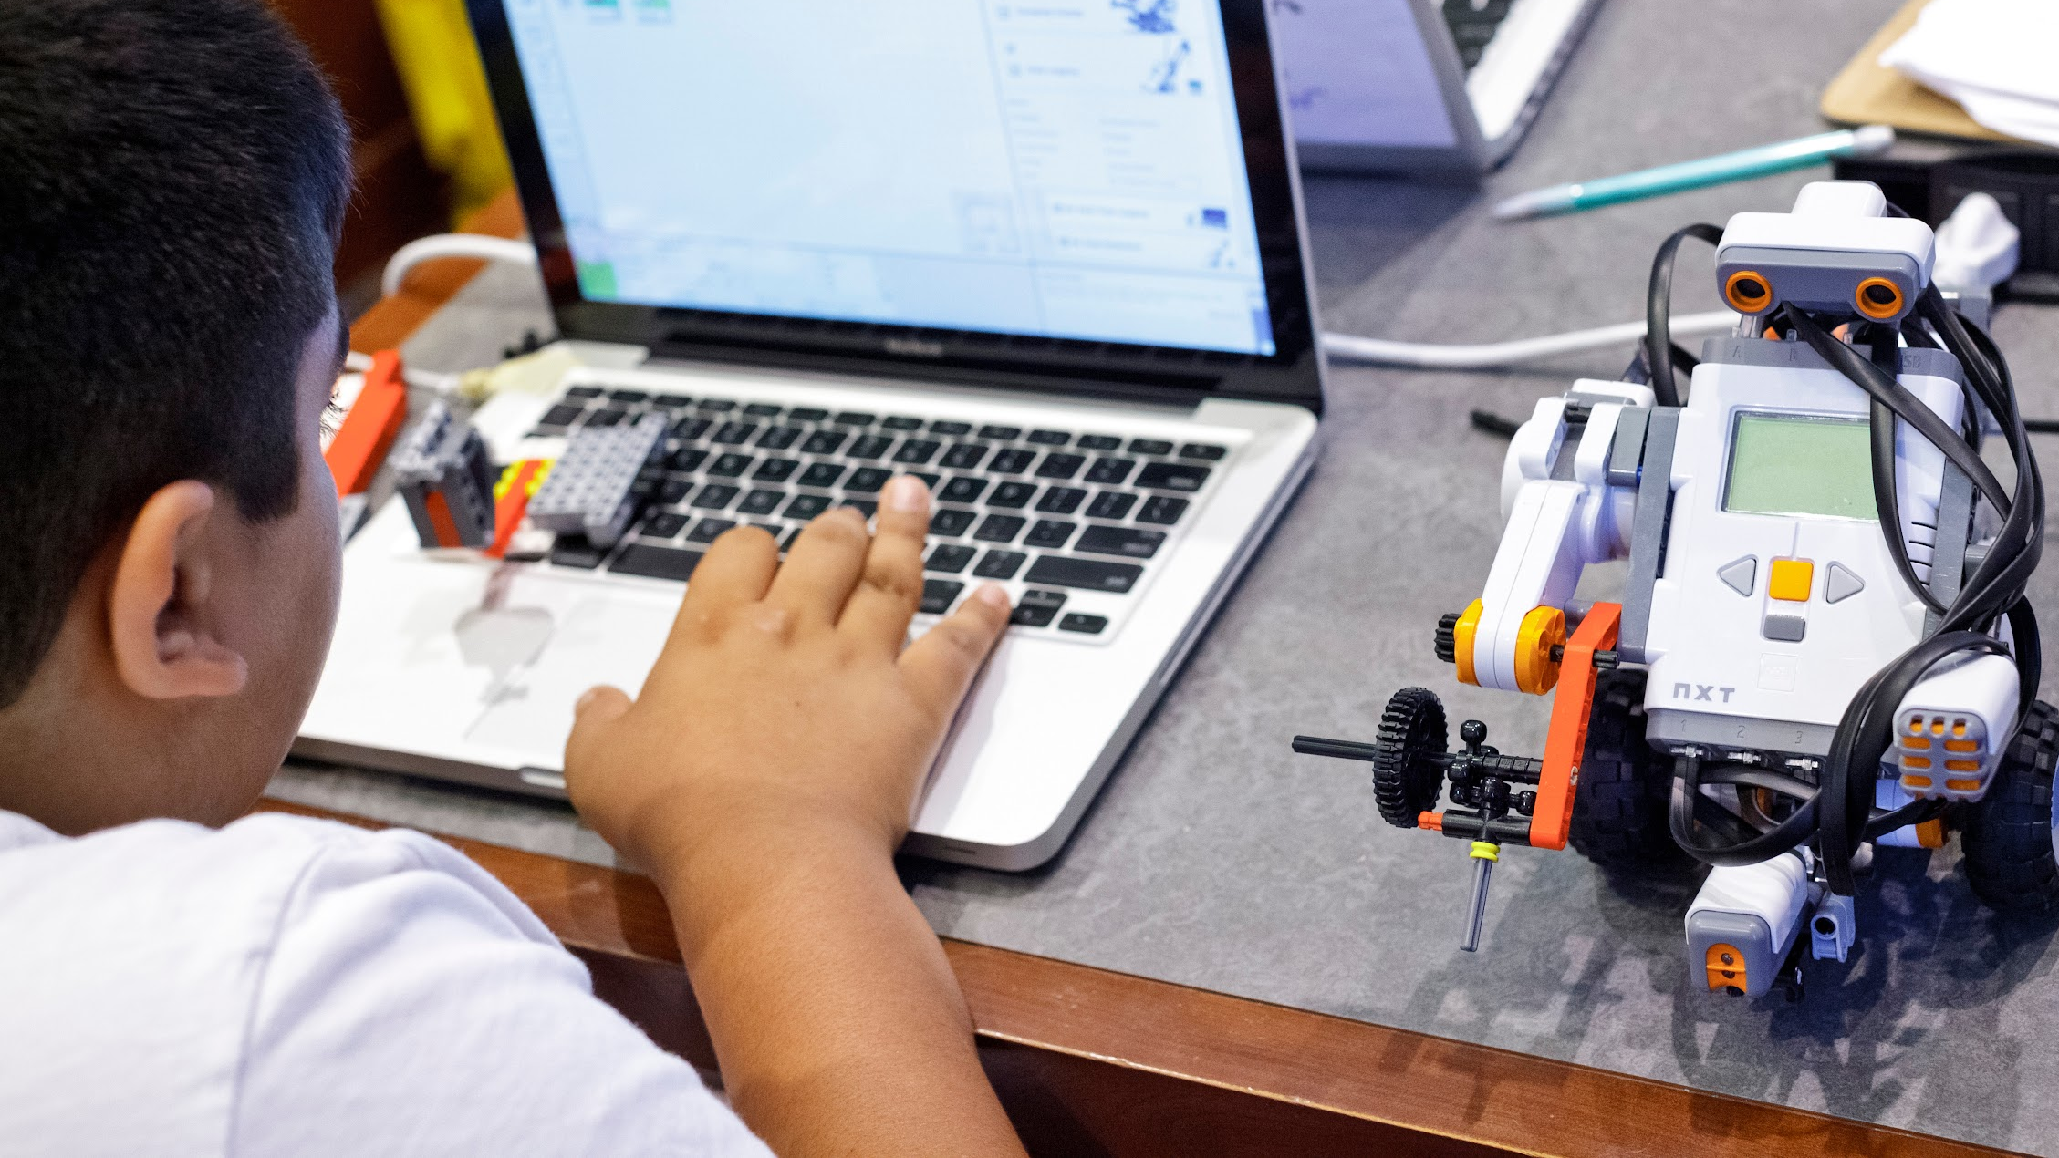

COMPUTER SCIENCE FOR EVERYONE, EVERYWHERE
7/14/22
PD
Orientation
NJDOE Standards 22E00178
NJDOE Hub 22E00173

Slide 2
RECAP
GOTS | NEEDS
Critical thinking unplugged activity Decomposition and pattern recognition Computational thinking has 4 steps Makes me want to enroll in the K12 CS cert Make clear connections with CT Importance of differentiating assignments How to integrate CT into subjects CT deals with processes and topics in each subject | Make and take resources ford CS Sample lesson More examples of how to include CS on a daily basis for our students Projection of activities before going into sessions? Activities
Computer Science for Everyone, Everywhere (CSEE)

Slide 3

Welcome!
Today’s Agenda: Computer Science Primer
What is Computer Science?
Vocabulary - How is Computer Science, Computers and Technology related?
How does a computer work?
What is a computer system?
What is the relationship between hardware and software?
What is a network?
What is an algorithm?
What is data analysis?
What is a cultural impact of technology?
Computer Science for Everyone, Everywhere (CSEE)

Slide 4
Computer Science Definition
What is Computer Science?
Computer Science is the study of the generation, storage, transportation, and manipulation of data.
In the classification of sciences, computer science is a FORMAL SCIENCE - a science like how mathematics and physics are defined as a science.
Other types of science: Natural Science, Social Science, Applied Science and Interdisciplinary science.
Computer Science for Everyone, Everywhere (CSEE)

Slide 5
Data
So if data is so central to computing, what is data?
Data is “something” that holds meaning for the human-user that the computer will do an action on. Note - there is no truth value on this other than the importance to the user. it is often the codes used to represent those somethings to a user.
Data can be interpreted into Information. Information is the meaning the user imposes on the data.
Information can be analyzed for Knowledge. Knowledge is the observable patterns within the information that we can measure with a level of confidence.
Knowledge that we can apply reliably is Wisdom (we don’t often talk about that ;-) )
Computer Science for Everyone, Everywhere (CSEE)

Slide 6
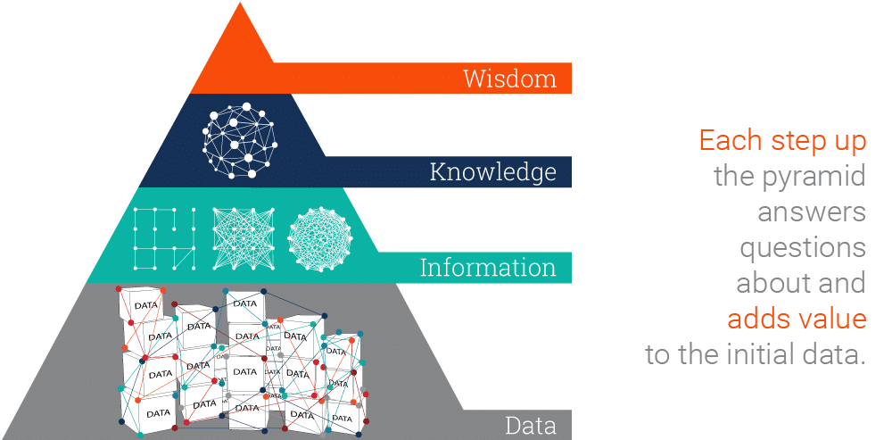
Data
Computer Science for Everyone, Everywhere (CSEE)

Slide 7
Exercise: Understanding Data from the Computer’s Perspective - 7 minutes
In your groups:
Create a short message you will give to another table (three words or less)
Create a scheme to represent your letters and spaces. You can only represent your letters with two symbols. You can repeat the symbols in any sequence you want. You may not use dots or dashes or any numbers.
Create a piece of paper that gives each letter and its representation
Give your message to a neighboring table and see if they can guess your message using you representation sheet.
Computer Science for Everyone, Everywhere (CSEE)

Slide 8
Debrief
What did we observe from this exercise?
Could you communicate?
Was it easy or hard?
Why would we want to communicate this way?
Computer Science for Everyone, Everywhere (CSEE)

Slide 9
Computers and Electricity: Perfect together!
The first computer is generally considered to be the abacus. It was a manual computer that allowed for rapid calculations.
Next came mechanical computers - computers that used simple machines to do the computations (Hollerinth’s tabulating machine).
With the turn of the 20th century - data is exploding and everyone wants to do computations quicker - especially the military.
Electricity offered a way to work very fast - theoretically at a speed close to light.
However, there are problems - namely electricity and reliability.
Computer Science for Everyone, Everywhere (CSEE)

Slide 10
Electricity and computers…
Electricity is a natural force. It is a force of motion that allows for the transport of atoms of matter.
Math: I can use numbers to represent letters and other numbers. The idea is we could use levels of electricity to represent the concepts of 0-9 and then match up our decimal number system to represent letters and numbers.
We can do this but …. to have 10 levels to represent each number, the computer needed to have 10 different volts levels to represent numbers.
The electrical network is like a river system - it has surges and drop offs. Therefore, the computers were very sensitive to this and were getting “fried”.
Computer Science for Everyone, Everywhere (CSEE)

Slide 11
Back to the drawing board and Math to the rescue!
A Decimal Computer was just not practical. However, we could still work with the concept of power on and power off!
Math also had a ton of work on number systems - that is a number system with bases other than 10. And the cool thing was there are clear rules on how to convert numbers from one system to another.
If we assign presence of voltage (on) the concept of “1” and absence of voltage (power off) the concept of zero, we then had a math system to help us design ways to process the electricity with 100% reliability - Binary math!
To this day, everything on the modern computer at its most very basic level uses binary math. The circuits of the computer do approximately 100 math options, 20 of which are used frequently.
Computer Science for Everyone, Everywhere (CSEE)

Slide 12
Data and Binary
All data must be able to be mapped onto the binary number system. This type of data is called discrete data.
We can do a lot of representation with this - most text can be represented this way. Pictures used binary values to represent the presence of certain colors in a picture element or pixel. We can record sound waves and the play rapid pictures with sound over them to make movies.
Some things cannot be represented by the computer. For example - a computer cannot represent a circle completely - only an approximation of it. Any data is difficult.
Computer Science for Everyone, Everywhere (CSEE)

Slide 13
Bits, Bytes and Data Storage
Binary Digit: Bit - this is our ones and zeros.
Byte: 8 bits equal 1 byte. I can store 256 different values with 1 Byte. With 2 Bytes working together, I can store 65,536 values. One byte lets me represent all English characters (ASCII). Two bytes lets me represent all other alphabets except languages like Mandarin. Even those, the major characters can be represented (Unicode).
In working with powers of two, every time you add a bit, you are doubling the amount of data that you can store or work with.
Computer Science for Everyone, Everywhere (CSEE)

Slide 14
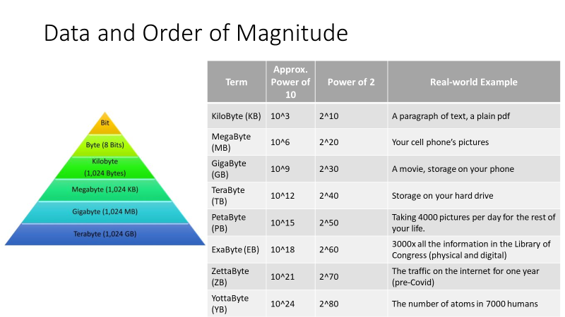
Computer Science for Everyone, Everywhere (CSEE)

Slide 15
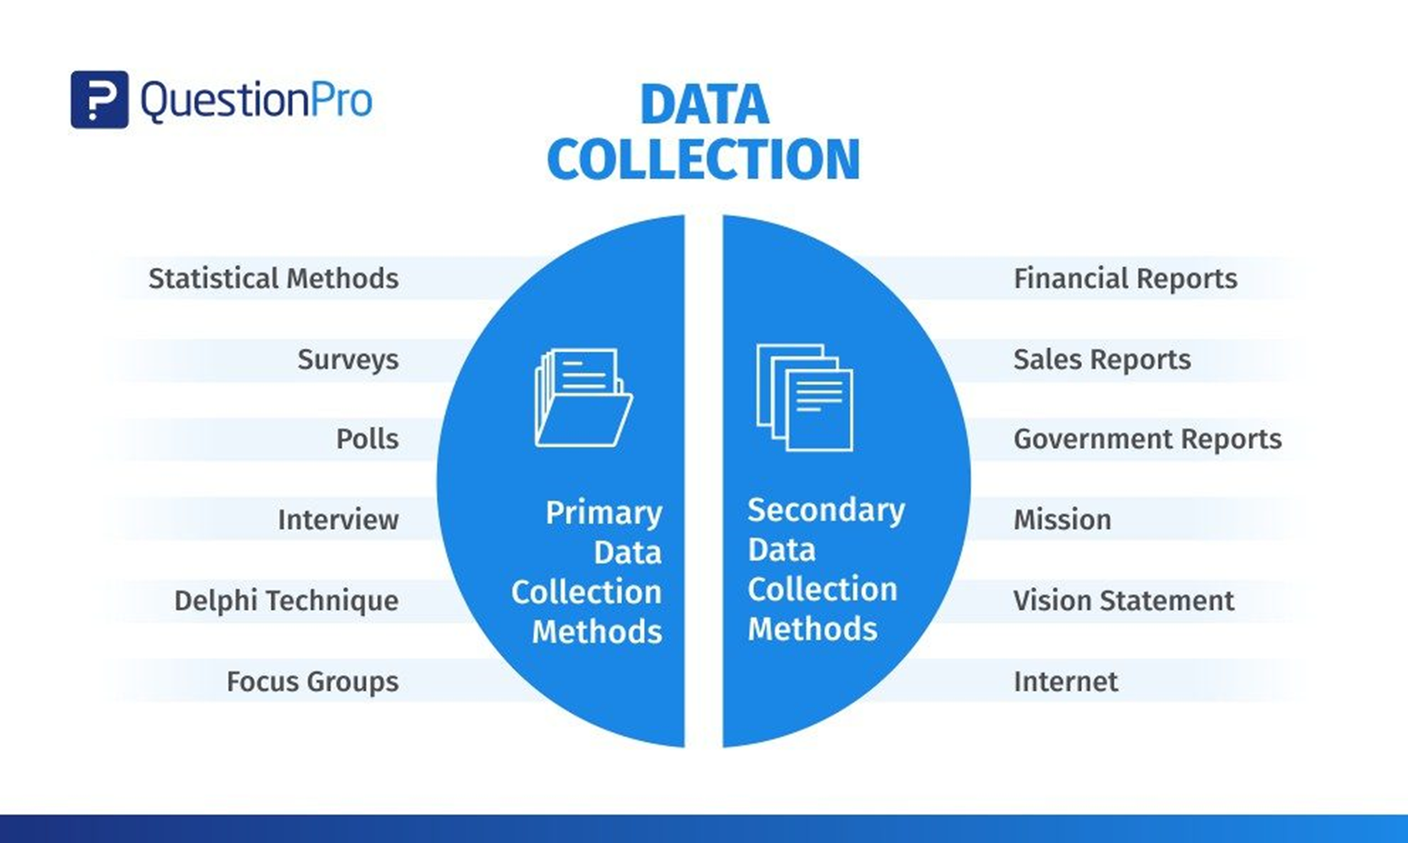
How is data collected
Computer Science for Everyone, Everywhere (CSEE)

Slide 16
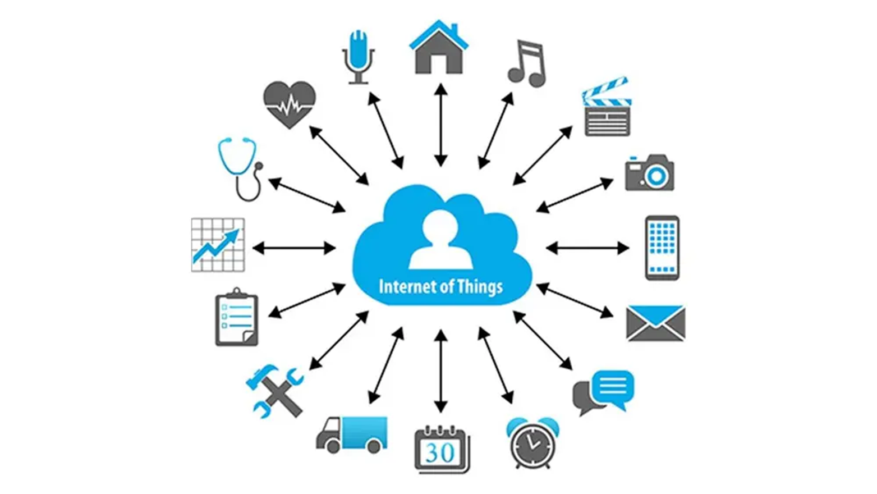
How is data collected
Computer Science for Everyone, Everywhere (CSEE)

Slide 17
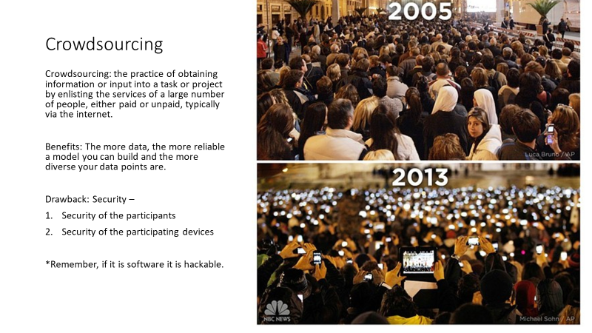

Slide 18
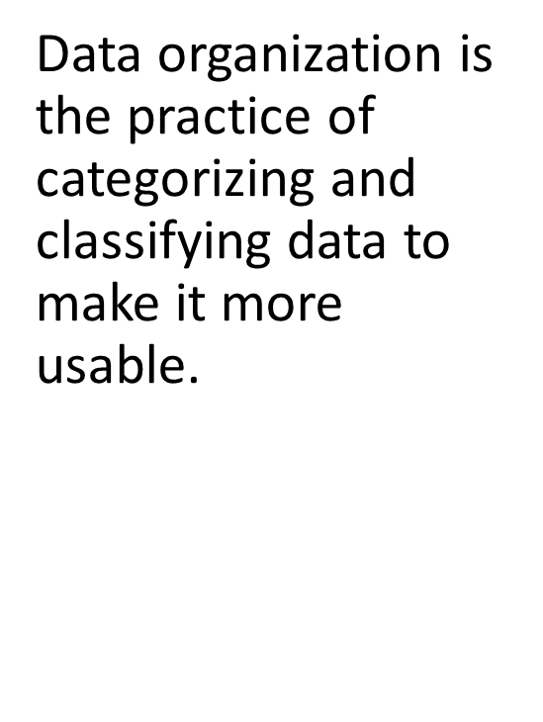
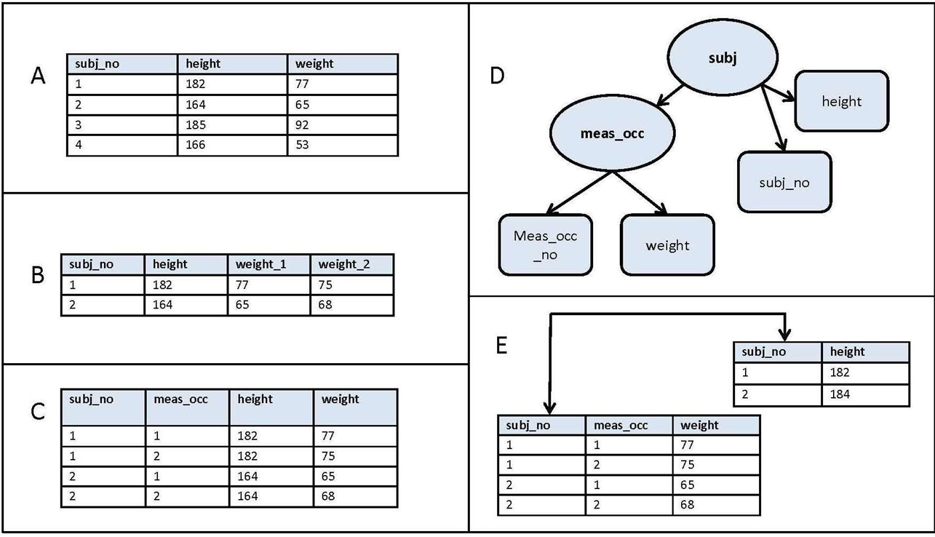
How is data organized?
Computer Science for Everyone, Everywhere (CSEE)

Slide 19
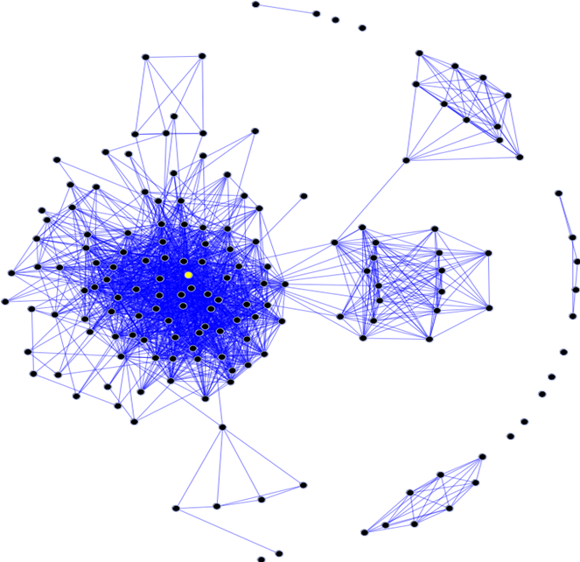
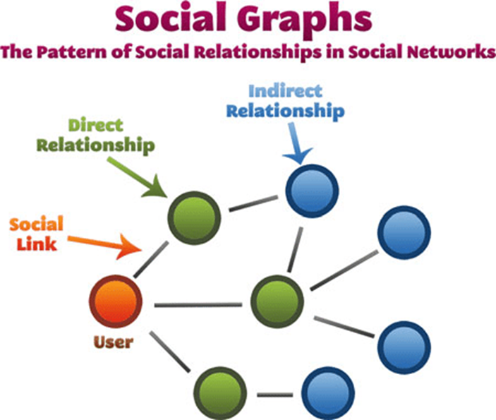
How is data collected
•Often, besides the actual information the data represents, how data interact with each other is also important. Social Media is an example of this concept.
Computer Science for Everyone, Everywhere (CSEE)

Slide 20
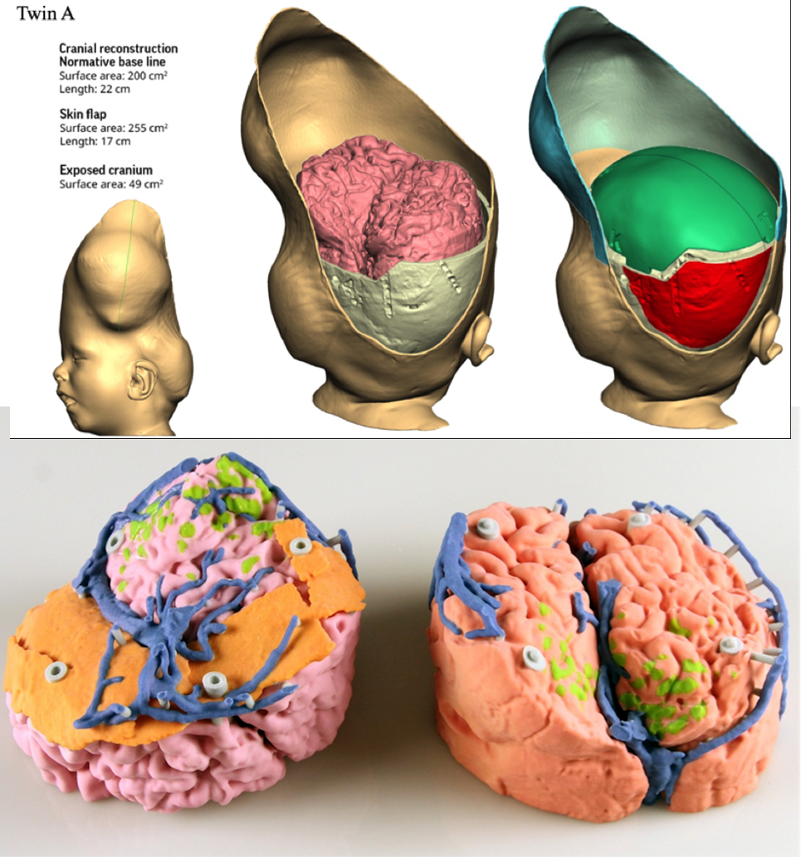
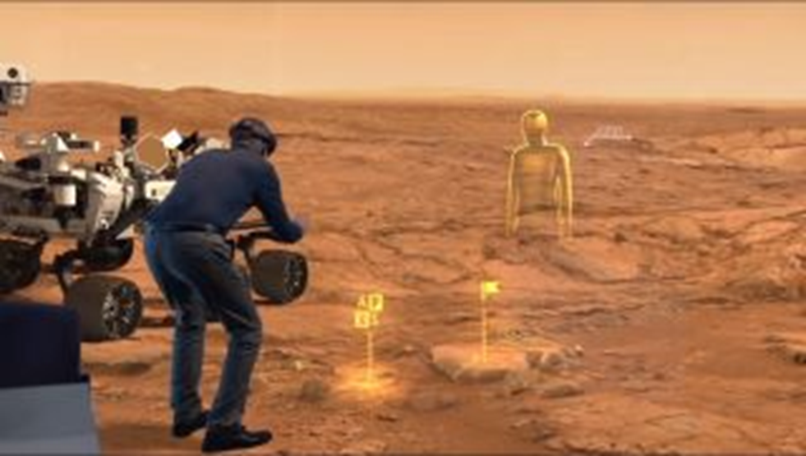
How is data visualized?
Computer Science for Everyone, Everywhere (CSEE)

Slide 21


Computer Systems
How do they talk to each other?
How does the computer know what to do?
Computer Science for Everyone, Everywhere (CSEE)

Slide 22
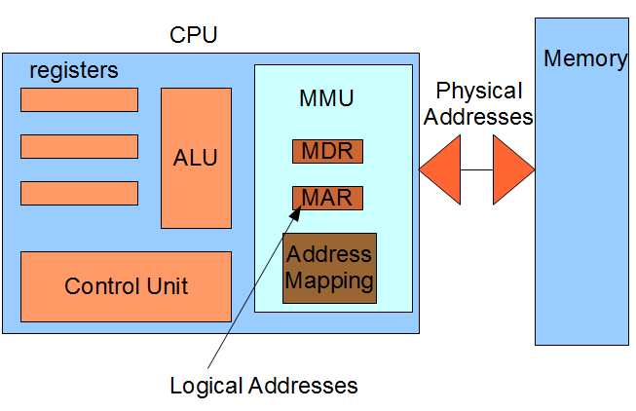
The Central Processing Unit: The Brains of the Computer
Computer Science for Everyone, Everywhere (CSEE)

Slide 23
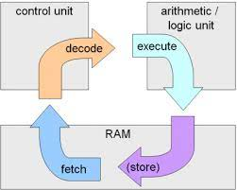
Machine Cycle
Computer Science for Everyone, Everywhere (CSEE)

Slide 24
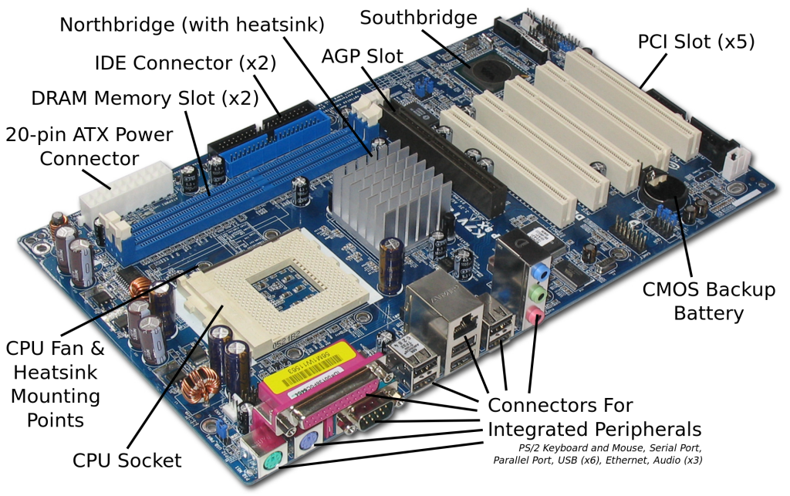
Motherboard and integrating with additional hardware
Computer Science for Everyone, Everywhere (CSEE)

Slide 25

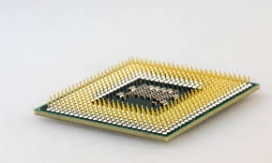
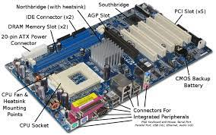
Hardware and Software Together - General Computer
The CPU does the “math” to create the actions”
The hard drive holds our programs. When we want to use the program, it is loaded into memory and run on the CPU.
The Motherboard holds the CPU and connects it to other devices like memory, hard drive USB - peripherals.
Computer Science for Everyone, Everywhere (CSEE)

Slide 26
Software
Software is a set of programs that are used to help the computer complete a task.
Computers use to have their programs “hard coded” into them - that is if you wanted to change the program, you had to change the physical hardware.
Now, software lets a mass produce general purpose computers and then use software to do different things with them.
Software interfaces for the human user so that the user gets an experience that they expect, but the actions or directions the user wants to perform are translated by software into the 1’s and 0’s the computer needs to run a task.
All software reduces its actions down to about 20 mathematical actions on the Arithmetic Logic Unit.
Programming is a component of creating software.
Computer Science for Everyone, Everywhere (CSEE)

Slide 27
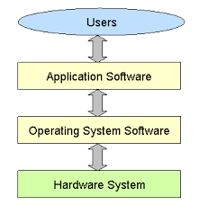
Hardware and Software Together
The program that does the thing I want to do.
The Program that manages all
of the Computer’s resources
Computer Science for Everyone, Everywhere (CSEE)

Slide 28
Troubleshooting
First - don’t panic. Seriously. Every teacher who taught in covid and most students are not experts in troubleshooting basic problems on the computer. You got this.
Make a checklist for yourself and run through it:
Check all of your wires - did something fall off or out of place?
Check your internet connection - it's often not you!
If software is not running properly - close it - this works for a traditional computer and your phone.
If it is still malfunctioning, turn off the computer - wait a good 20 seconds, and turn it back on.
Computer Science for Everyone, Everywhere (CSEE)

Slide 29
Troubleshooting - When do I need help?
Sometimes the problem can’t be fixed this way. Here are some clues:
If the computer is slowing down: This usually means the computer is having storage issues:
Close some applications!
Reboot
If this isn’t working, check to see if your hard drive is too full - you probably need at least 4 Gigabytes of Storage.
Does your computer have enough memory? - if no, get more
What is your bus speed? - if no, you are buying a new computer.
If I get a odd thing on my monitor
If possible, use an HDMI or USB cord to connect to another monitor - like your smart tv. See if it works fine that way.
If I get a black or blue screen - there may be a serious problem. Try to make sure your back up the computer - then try to run a diagnostic. If it persists, you may need to do more research or get help.
Computer Science for Everyone, Everywhere (CSEE)

Slide 30
Exercise: The Human Computer
Divide into four groups - each group go to a break out room.
Designate one person as “Data” - they get to go wait and get coffee - they need to leave now before we read the rest!!! Note - you must be happy with being blindfolded with a paper mask.
Computer Science for Everyone, Everywhere (CSEE)

Slide 31
The Human Computer
We are designing an obstacle course “Data” will be going through blindfolded!
Designate one person as the “Controller” - the controller will be responsible for reading our directions to “Data”
Designate one person as the “Clock” - the clock will use a timer to tell controller when they can do their next step.
Designate two people to be the “Registers” Call them Register 1 and Register 2 - they, with the controller, clock and buses, are going to write down on a piece of paper the steps to get through the obstacle course safely. Put one step on one piece of paper so that you have multiple pieces of paper that give the direction through the obstacle course.
Once done writing the steps, Register 1 should hold Step 1, Register 2 will hold Step 2.
Computer Science for Everyone, Everywhere (CSEE)

Slide 32
The Human Computer
Designate one person to be “Cache” - Cache will hold the steps from the registers that have not been done yet. The registers can only hold one step - Register 1 the next step and Register 2 the step after. Cache will hold the remained of the steps.
Designate two people to be the “Bus” - Bus 1 and Bus 2. Bus 1 will take a step in order from the register to the control unit and then Bus 2 will take a step from cache to Register 2. The registers can hold only one step at a time. Register 1 should hold the first step, Register 2 the second step. When we are ready to run - Bus 1 will take the step to the controller, the controller will read the direction. Register 2 gives their instruction to Register 1. Bus 2 will get the next instruction from Cache and give it to Register 2.
Computer Science for Everyone, Everywhere (CSEE)

Slide 33
Human Computer
Everyone else - “Gates”:
Create and obstacle course with anything you have in the room including people. Every person who is a gate has to be an obstacle in the course. You should have 3 moving elements to your obstacle course.
Gates and the controller, registers, clock, bus and cache will work together to create the steps.
Once complete, controller gets data from the food lounge.
Outside of your breakout room, put mask over Data’s eyes.
Lead data into the room to be ready to run the obstacle course.
Computer Science for Everyone, Everywhere (CSEE)

Slide 34
The Obstacle Course
Design your obstacle course quickly - Registers, Controller, Clock and Cache - work on written directions to go through the course.
Starting Positions:
Data: Blindfolded at the beginning of the course.
Controller: Waiting for first instruction
Clock: Has timer primed - will call out Next at 0 seconds, 20 second, 40 seconds, etc.
Register 1 - Holding the first direction
Register 2 - Holding the second direction
Bus 1 - Standing next register 1 waiting to transport the direction.
Bus 2 - Standing next to Cache waiting to transport direction 3 to Register 2.
Cache - holding all of the remaining directions in order, ready to give direction 3 to bus.
Gates - ready to do their obstacle course thing to Data.
Computer Science for Everyone, Everywhere (CSEE)

Slide 35
The Human Computer
Once the course is ready, the Controller should go, blindfold “Data” with a mask and come back to the room. Note, you cannot touch Data - you can only give them verbal commands once at the obstacle course. You can mask them just outside the room.
Once inside the room, clock uses the timer - every 20 seconds - that it is okay to go. You have that time period to complete 1 and only 1 step. If you miss your call out to start a step, everyone has to wait until the next call out to begin. Bus 1 will deliver Step 1 to Controller. Controller reads out Step 1 to Data, Data then does Step 1. While this is going on Bus 1 goes to Register 1 to get the next step to give to Controller. Register 2 gives Register 1 the next step. Bus 2 gets the next step from Cache. It transport Step 3 to Register 2.
At the next call out from the clock, Bus 1 transports direction 2 to controller and controller reads it out.
Repeat these steps until Data completes the obstacle course.
Computer Science for Everyone, Everywhere (CSEE)

Slide 36
Debrief
What are our observations from this activity?
Collaboration,
Being organized,
Need to communicate effectively, be precise
Trial and error
Input to produce sequential/desired output
Form and function
(How) Were you able to get organized?
Understand/decompose the problem,
Using vocabulary
Did you ever miss a clock call out? If so why?
Adjusted the time, shortened.
What moving parts were going on during each “clock cycle”?
Bus 1 and 2
Computer Science for Everyone, Everywhere (CSEE)

Slide 37
Debrief
Which helped more the CPU or Exercise: Exercise
Could be taught w/ exercise first, then explain the CPU and Machine cycle.
(How) Were you able to get organized?
Understand/decompose the problem,
Using vocabulary
Did you ever miss a clock call out? If so why?
Adjusted the time, shortened.
What moving parts were going on during each “clock cycle”?
Bus 1 and 2
Computer Science for Everyone, Everywhere (CSEE)

Slide 38
SMALL GROUP WORK
Which CS standards align to this activity?
What is the knowledge, patterns of reasoning, skills, and products of this activity?
How would you modify it for diverse learners in your classroom?
Computer Science for Everyone, Everywhere (CSEE)

