Slide 1
K-2 Computer Science Education Primer
Katherine G. Herbert, Ph.D.
Director, Montclair Computer Science Education Hub
Sumi Hagiwara, Ph.D.
Director, Montclair Computer Science for Everyone Everywhere Program.

Slide 2
Introduction

Slide 3
Schedule - Tentative (we may run over on sections but we will be out by 3:00pm)
9:00am-9:05am - Welcome
9:05am - 9:15am - NJDOE Required Data Collection
9:20am - 9:30am - Icebreaker
9:30am - 10:30am Basics of Computer Science
10:20am - 10:30am - Break
10:30am - 11:15 am - Computer Systems
11:15am - 12:00 am - Networks and the Internet
11:45am - 12:30pm - Working Lunch - Reflections on the CS and Impacts of Computing
12:30pm - 1:15pm - Data and Analysis
1:15pm - 2:40pm - Algorithms and Programming - special with Kibo
2:40pm - 3:00pm - Debrief

Slide 4
Community of Learners
Styles we adopt in this session …
We are friendly and hopefully building friendship - please welcome people - especially singletons who you do not know to your table and feel free to use first names.
We are Inclusive and try to design for UDL.
We are Positive - everyone has a voice, perspective and contribution to give.
We try to Laugh - this is a long day with a lot of content we may not have ever seen before so we are going to try to have fun.
We Accept there is no one authority or expert in the room - everyone has human moments and we support each other through them.
We are Safe - personal stories should stay here unless you have the express permission of the person.

Slide 5
Today will be …
Jammed - packed
Fun
Address Some of Your Questions
Inspire New Questions
Frustrate You - In a Good Way
Be a “Springboard” for you to Explore the Standards

Slide 6
Today will not be …
Complete and exhaustive and you will have a perfect understanding of everything computing by the end of these lessons

Slide 7
Data Collection
Please Please Please fill out your Pre-Survey Data
Places to get the Pre-Survey Data:
Best: Your District Content Management Systems like Genesis, LinkIt!, or other places where you grade and get student information.
Better: New Jersey School District Performance Reports
https://rc.doe.state.nj.us/
Okay and Acceptable: National Center for Education Statistics IPEDS
https://nces.ed.gov/ipeds

Slide 8
Icebreaker - My CS Emoji
Draw two pictures - one on each side of your piece of paper.
Happy Emoji - Side one - tell us something you love about computers or computer science. - Can be a picture, words - anyway you express yourself
Grumpy/Sad Emoji - Side two - tell us something that stresses you about computers or computer science (makes your feel grumpy or sad)

Slide 9


Debrief
HAPPY
GRUMPY/SAD

Slide 10
Theme for K-2 Computer Science Education
When we look at CS for K-2, like a lot of K-2 Education, it is about identifying things that we see in everyday life and trying to put the formal words (terminology) to the things we see.
It is also about trying to observe the patterns we are encountering.
When considering the standards for K-2, a lot of the standard is identifying things and finding patterns:
Vocabulary
How do we use things?
What problems do we encounter?
How can we fix these problems?
What am I feeling, and how can I work through those feelings to find solutions?
With K-2, keep it short, simple, as kinesthetic as possible (make them move and use sensory oriented techniques), help them to identify their emotions and work through them, and try to have fun.

Slide 11
Computer Science
an Overview for K-2 Teachers

Slide 12
Computer Science Definition
What is Computer Science?
Computer Science is the study of the generation, storage, transportation, and manipulation of data.
In the classification of sciences, computer science is a FORMAL SCIENCE - a science like how mathematics and physics are defined as a science.
Other types of sciences besides Formal Sciences: Natural Science, Social Science, Applied Science and Interdisciplinary sciences.
Computational Thinking is part of the mindset for Computer Science and helps us with problem solving.
Computer Science for Everyone, Everywhere (CSEE)

Slide 13
Data
So if data is so central to computing, what is data?
Data is “something” that holds meaning for the human-user that the computer will do an action on. Note - there is no truth value on this other than the importance to the user. it is often the codes used to represent those somethings to a user.
Data can be interpreted into Information. Information is the meaning the user imposes on the data.
Information can be analyzed for Knowledge. Knowledge is the observable patterns within the information that we can measure with a level of confidence.
Knowledge that we can apply reliably is Wisdom (we don’t often talk about that ;-) )

Slide 14
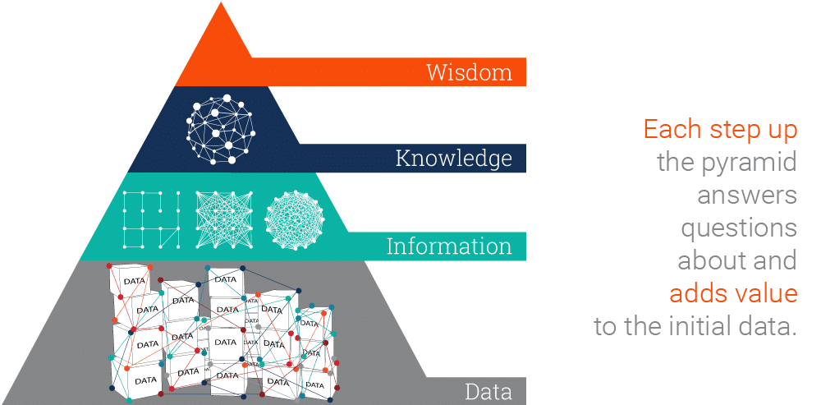
Data
Image source: https://www.ontotext.com/knowledgehub/fundamentals/dikw-pyramid/

Slide 15
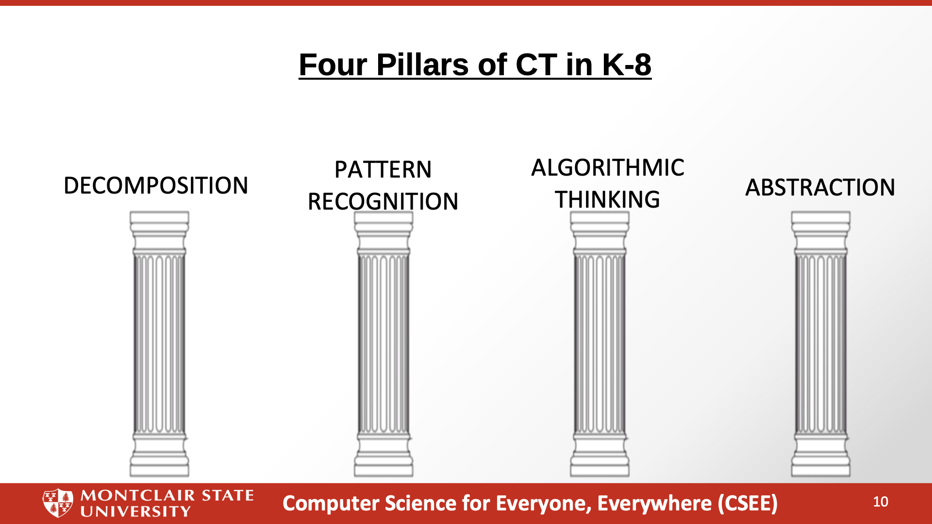

Slide 16
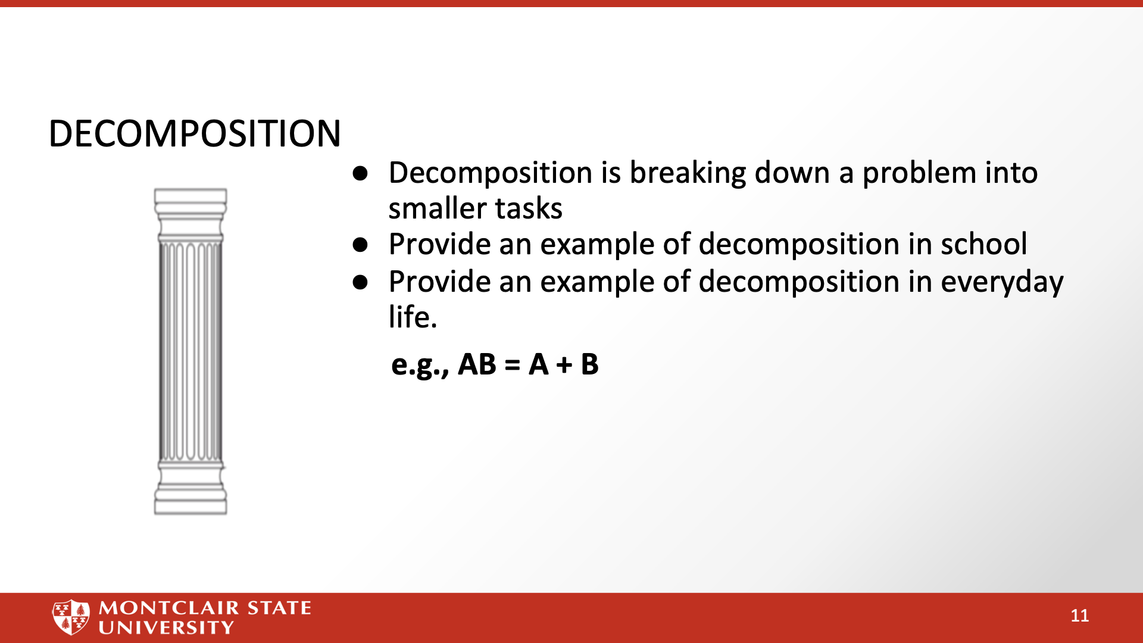

Slide 17
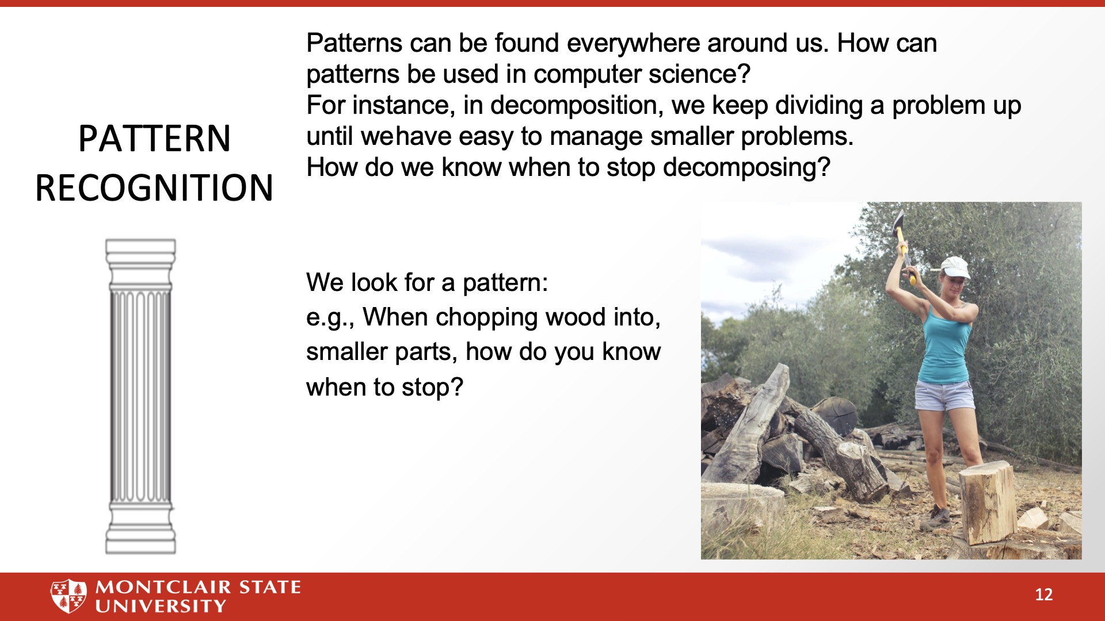

Slide 18
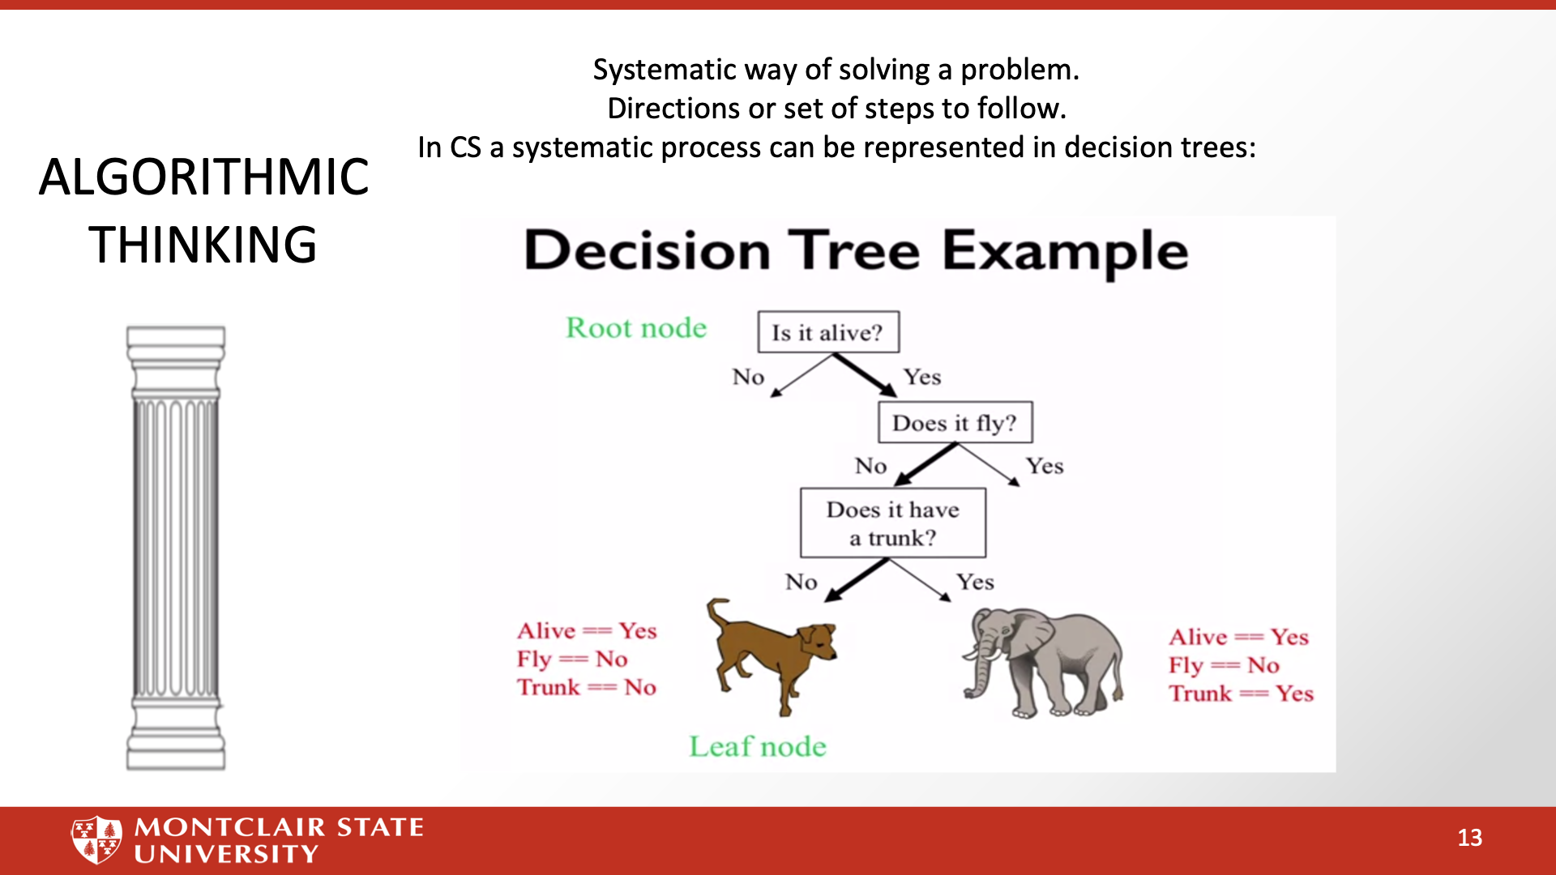

Slide 19
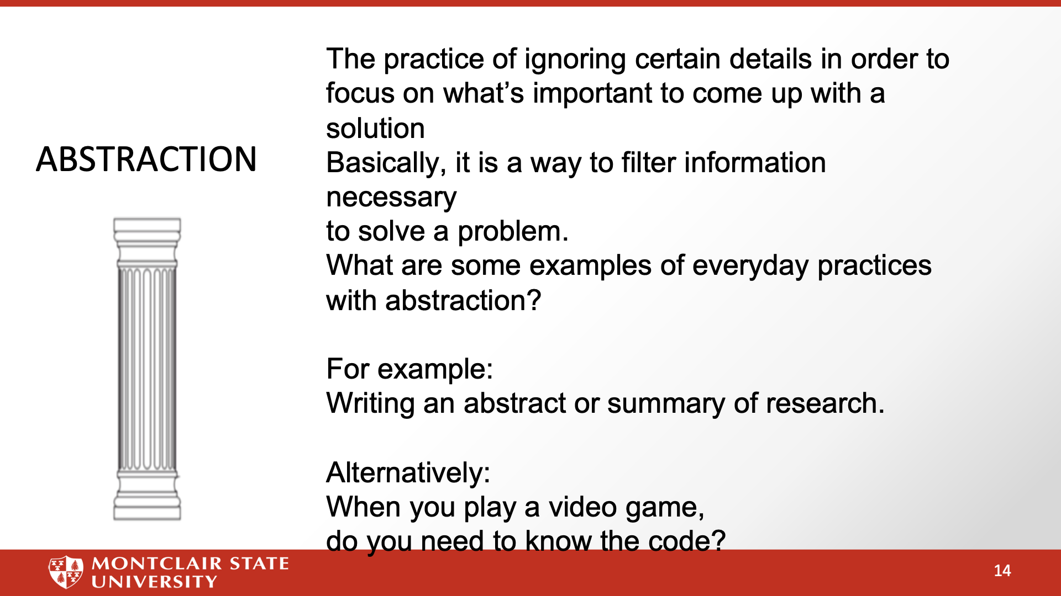

Slide 20
Computer Science and the Standards - what are we trying to accomplish ..
New Jersey has nearly 16,000 tech business establishments. The tech sector accounts for an estimated $56 billion of the state's economy, or 9.6% of total economic output. It is the ninth highest dollar value contribution among the 50 states and the District of Columbia. (I like to call us the Silicon Shore …)
New Jersey is generating 17,000 jobs in tech a month, while only 17% of NJ High Schoolers are considered proficient in CS.
New Jersey Universities only generate about 3,000 graduates a year - no where near the growth the state needs.
Computer Science is the fastest growing science field that can give students access to lucrative career paths and lifetime skills. However, computer science is more than just a one-course experience. It needs to be integrated into children’s learning
Citations: https://njbmagazine.com/njb-news-now/strong-decade-of-growth-for-nj-technology-industry/

Slide 21
Why K-2 Students
We often get feedback of why K-2?
Computer Science isn’t doing things on the computer - even professional computer scientists don’t spend as much time on the computer as people think.
Computer Science is the intersection of a lot of disciplines - Math, Engineering, Physics, Logic and Philosophy - and applied to almost every other domain … Understanding it and developing skills over time will help students to have a better understanding.
Kindergarteners are coming in not knowing their ABCs - but knowing how to use TikTok. We have to be prepared for Generation AI.

Slide 22
Computer Systems

Slide 23
NJ SLS CS Standard - In a Nutshell
By the end of Grade 2
• Individuals use computing devices to perform a variety of tasks accurately and quickly. Computing devices interpret and follow the instructions they are given literally.
• A computing system is composed of software and hardware.
• Describing a problem is the first step toward finding a solution when computing systems do not work as expected.

Slide 24
What does that mean to us?
Let's look at all the ways our kindergarteners are already exposed to computers before coming to elementary school - kids are dealing with computers almost every minute of every day
Computing will become more and more ubiquitous - we need to help students be a part of this world.

Slide 25
Computer Systems Standard
Core Idea | Performance Expectations
Individuals use computing devices to perform a variety of tasks accurately and quickly. Computing devices interpret and follow the instructions they are given literally. | 8.1.2.CS.1: Select and operate computing devices that perform a variety of tasks accurately and quickly based on user needs and preferences.
A computing system is composed of software and hardware. | 8.1.2.CS.2: Explain the functions of common software and hardware components of computing systems.
Describing a problem is the first step toward finding a solution when computing systems do not work as expected. | 8.1.2.CS.3: Describe basic hardware and software problems using accurate terminology.

Slide 26
Perspective
Computer Systems

Slide 27

Computers and Electricity: Perfect together!
The first computer is generally considered to be the abacus. It was a manual computer that allowed for rapid calculations.
Next came mechanical computers - computers that used simple machines to do the computations (Hollerinth’s tabulating machine).
With the turn of the 20th century - data is exploding and everyone wants to do computations quicker - especially the military.
Electricity offered a way to work very fast - theoretically at a speed close to light.
However, there are problems - namely electricity and reliability.
Computer Science for Everyone, Everywhere (CSEE)

Slide 28
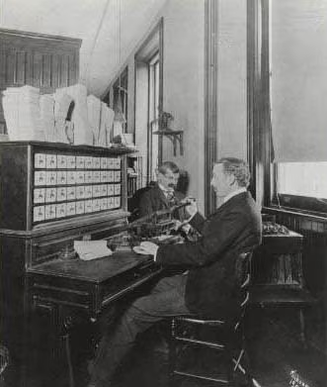
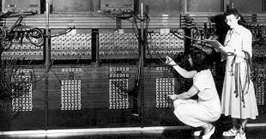
Hollerinth Machine ENIAC

Slide 29
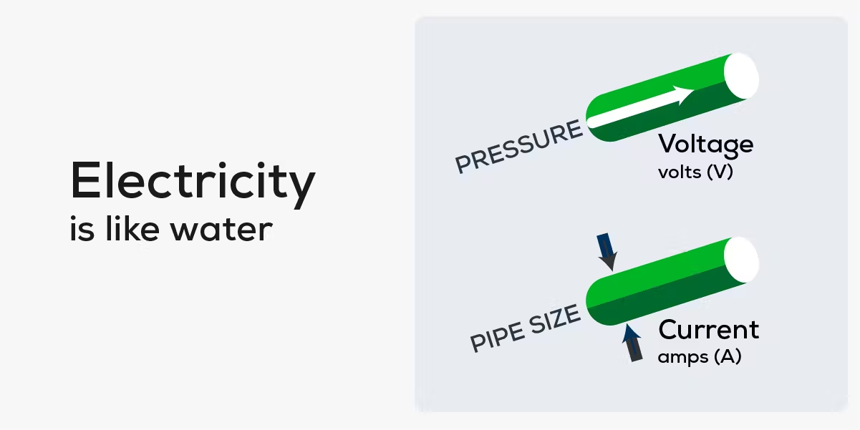

Electricity and computers…
https://palmetto.com/learning-center/blog/understanding-solar-power-electricity-terms-volts-amps-watts
https://www.thegeekpub.com/243163/what-is-resistance-ohms-electricity-basics/
Computer Science for Everyone, Everywhere (CSEE)

Slide 30
Back to the drawing board and Math to the rescue!
A Decimal Computer was just not practical. However, we could still work with the concept of power on and power off!
Math also had a ton of work on number systems - that is a number system with bases other than 10. And the cool thing was there are clear rules on how to convert numbers from one system to another.
If we assign presence of voltage (on) the concept of “1” and absence of voltage (power off) the concept of zero, we then had a math system to help us design ways to process the electricity with 100% reliability - Binary math!
To this day, everything on the modern computer at its most very basic level uses binary math. The circuits of the computer do approximately 100 math options, 20 of which are used frequently.

Slide 31
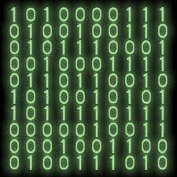
Data and Binary
All data must be able to be mapped onto the binary number system. This type of data is called discrete data.
We can do a lot of representation with this - most text can be represented this way. Pictures used binary values to represent the presence of certain colors in a picture element or pixel. We can record sound waves and the play rapid pictures with sound over them to make movies.
Some things cannot be represented by the computer. For example - a computer cannot represent a circle completely - only an approximation of it.

Slide 32


Computer Systems
How do they talk to each other?
How does the computer know what to do?

Slide 33
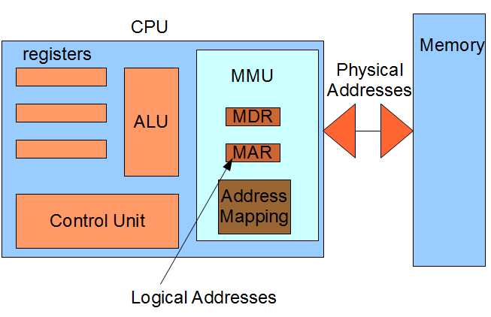
The Central Processing Unit: The Brains of the Computer
Computer Science for Everyone, Everywhere (CSEE)

Slide 34
The Central Processing Unit: The Brains of the Computer
The ALU is responsible for carrying out the arithmetic and logical operations of the CPU. It consists of an arithmetic logic unit (which performs arithmetic and logical operations) and a set of registers (which store data and instructions).
The control unit is responsible for fetching, decoding, and executing instructions. It also controls the flow of data between the various components of the CPU.
The registers are used to store data and instructions. There are four types of registers: general-purpose, floating-point, control, and status. General-purpose registers can be used for any purpose. floating point registers are used for storing floating-point numbers. Control registers or unit contain control signals that tell the various components of the CPU what to do. Status registers contain information about the current state of the CPU.
Computer Science for Everyone, Everywhere (CSEE)

Slide 35
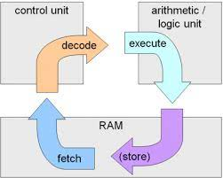
Machine Cycle
Computer Science for Everyone, Everywhere (CSEE)

Slide 36
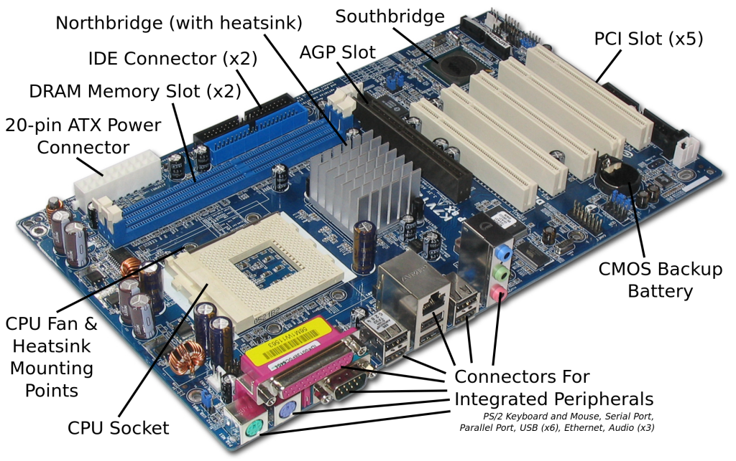
Motherboard and integrating with additional hardware
Computer Science for Everyone, Everywhere (CSEE)

Slide 37
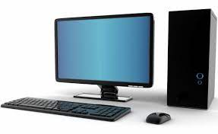
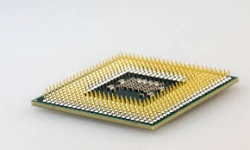
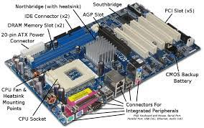
Hardware and Software Together - General Computer
The CPU does the “math” to create the actions”
The hard drive holds our programs. When we want to use the program, it is loaded into memory and run on the CPU.
The Motherboard holds the CPU and connects it to other devices like memory, hard drive USB - peripherals.
Computer Science for Everyone, Everywhere (CSEE)

Slide 38
Software
Software is a set of programs that are used to help the computer complete a task.
Computers use to have their programs “hard coded” into them - that is if you wanted to change the program, you had to change the physical hardware.
Now, software lets a mass produce general purpose computers and then use software to do different things with them.
Software interfaces for the human user so that the user gets an experience that they expect, but the actions or directions the user wants to perform are translated by software into the 1’s and 0’s the computer needs to run a task.
All software reduces its actions down to about 20 mathematical actions on the Arithmetic Logic Unit.
Programming is a component of creating software.
Computer Science for Everyone, Everywhere (CSEE)

Slide 39
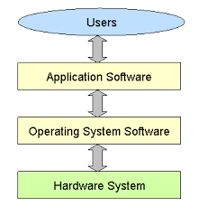
Hardware and Software Together
The program that does the thing I want to do.
The Program that manages all
of the Computer’s resources
Computer Science for Everyone, Everywhere (CSEE)

Slide 40
Troubleshooting
First - don’t panic. Seriously. Every teacher who taught in covid and most students are not experts in troubleshooting basic problems on the computer. You got this.
Make a checklist for yourself and run through it:
Check all of your wires - did something fall off or out of place?
Check your internet connection - it's often not you!
If software is not running properly - close it - this works for a traditional computer and your phone.
If it is still malfunctioning, turn off the computer - wait a good 20 seconds, and turn it back on.
Computer Science for Everyone, Everywhere (CSEE)

Slide 41
Troubleshooting - When do I need help?
Sometimes the problem can’t be fixed this way. Here are some clues:
If the computer is slowing down: This usually means the computer is having storage issues:
Close some applications!
Reboot
If this isn’t working, check to see if your hard drive is too full - you probably need at least 4 Gigabytes of Storage.
Does your computer have enough memory? - if no, get more
What is your bus speed? - if no, you are buying a new computer.
If I get a odd thing on my monitor
If possible, use an HDMI or USB cord to connect to another monitor - like your smart tv. See if it works fine that way.
If I get a black or blue screen - there may be a serious problem. Try to make sure your back up the computer - then try to run a diagnostic. If it persists, you may need to do more research or get help.
Computer Science for Everyone, Everywhere (CSEE)

Slide 42
Brainstorming
8.1.2.CS.1: Select and operate computing devices that perform a variety of tasks accurately and quickly based on user needs and preferences.
Issues:
8.1.2.CS.2: Explain the functions of common software and hardware components of computing systems.
Issues:
8.1.2.CS.3: Describe basic hardware and software problems using accurate terminology.
Issues:

Slide 43
Working Smart - Is there any overlap with this work and other work I am doing?

Slide 44
As a teacher, what knowledge do I need to feel confident in teaching Computer Systems?

Slide 45
Lesson 1 - What is a Computer?
Many children today are interacting with computers and they don’t even realize it.
Gen Xer Computer: classical desktop/laptop computer
Generation AI Computer:
A stuffed Dog named Violet or Scout
Amazon Echo
Their TV Set
Their Family Car
Digital Road Signs - Times Square Billboards
Phone
Watch
Gaming System
So What is a Computer?

Slide 46
Lesson 1: Identify a Computer
Collect some computing devices Or Pictures of Computing Devices - the weirder the better - and ask students - is this a computer or is it not.
A Computer will have:
Some processing element
Will take in data in some form and do something with that data

Slide 47
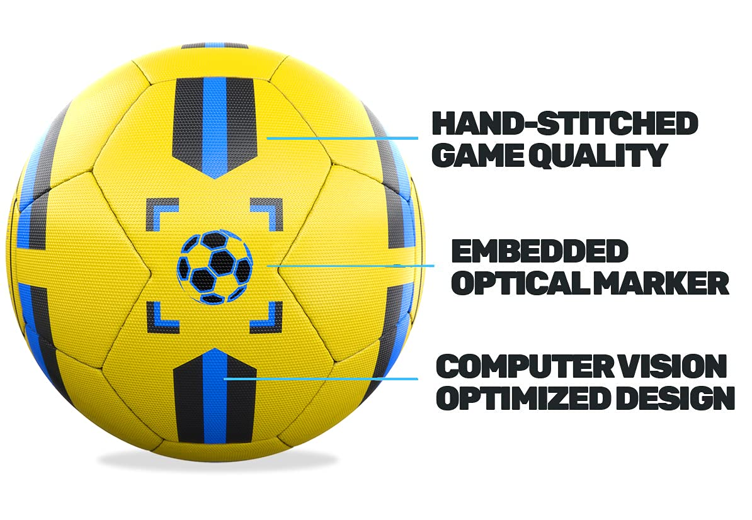
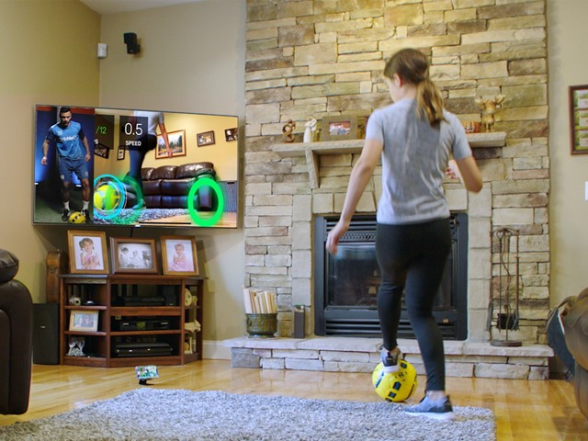
Lesson 1: Computer or Not a Computer?

Slide 48
Lesson 1 Identifying a Computer
Have students discuss what they observe are the things that make something a computer.
Note - there are computers that are not driven by electricity - a calculator or an abacus are computers.

Slide 49
Lesson 1: Identifying a Computer
Video Lesson: “What is a Computer” https://www.youtube.com/watch?v=RmbFJq2jADY
Hub Lesson for K-2:
Computer Systems: https://drive.google.com/drive/folders/1m6uCWHWwdqGCeQ7CYr2wsgD6YPT92D3Z?usp=share_link

Slide 50
Lesson 2 - Make your Own Computer
Teacher Guide:
https://drive.google.com/file/d/1jFhZ71fsOFAS1EDAeHDdURcg4_FVl3o2/view
This lesson has students “make” their own computer with art supplies.
Resources for Instruction:
https://www.helloruby.com/play/2
Video to explain lesson:
https://www.youtube.com/watch?v=Pih_5TlpngY

Slide 51
Lesson 2 - Build your computer …
Work with your table mates to try to make the computer.
Note we aren’t going to finish it but you can get a good start on it.
This is an excellent project to help student with vocabulary and understanding the parts of the computer. You can adapt this to include more parts for older students.

Slide 52
How does lesson address the Standard:
Core Idea | Performance Expectations | Make my own computing Lesson
Individuals use computing devices to perform a variety of tasks accurately and quickly. Computing devices interpret and follow the instructions they are given literally. | 8.1.2.CS.1: Select and operate computing devices that perform a variety of tasks accurately and quickly based on user needs and preferences. | By building our computer, we can discuss the hardware and software issues. In this discussion and through discussion tasks this computer can do.
A computing system is composed of software and hardware. | 8.1.2.CS.2: Explain the functions of common software and hardware components of computing systems. | Software and hardware help each other run. By “building the hardware”, you can discuss how hardware needs software and software needs hardware
Describing a problem is the first step toward finding a solution when computing systems do not work as expected. | 8.1.2.CS.3: Describe basic hardware and software problems using accurate terminology. | Through building the computer, you can identify parts of the computer and discuss definitions

Slide 53
Further Resources
Lesson: Human Computer
https://www.educationworld.com/a_tech/tech/tech195.shtml
https://www.azed.gov/sites/default/files/2019/09/Kindergarten%20CS%20Lessons.pdf?id=5d72d0e91dcb251298c0faa2
https://www.sfusd.edu/learning/curriculum/elementary-school/computer-science/k-2-computer-science-curriculum

Slide 54
Networks an the Internet

Slide 55
Networks - why learn them
There are two major issues at play with network and why students need to learn them:
Students need to be able to understand how to connect their devices to the network.
Students need to learn how to protect both their data and their devices from any on-line security issues.

Slide 56
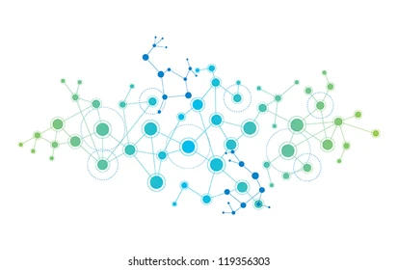
What is a network?
A connection between two or more computers so that they can share:
Data
Communication
Printing
Files
Other resources
A Network is Modeled as:
Line represents a connection
A Circle (vertex, node) represents a “thing” we are connecting - a computer, a website, etc.

Slide 57
NJ SLS CS Standard - In a Nutshell
By the end of Grade 2
Computer networks can be used to connect individuals to other individuals, places, information, and ideas. The Internet enables individuals to connect with others worldwide.
Connecting devices to a network or the Internet provides great benefits, but care must be taken to use authentication measures, such as strong passwords, to protect devices and information from unauthorized access.

Slide 58
What does that mean to us?
Hub:
Kids as young as 5 are connecting with their grandparents through zoom while playing with their Nintendo Switches, as their teachers post their grades to Genesis, while their parents are emailing and managing family life on a google calendar - Networks are a part of everyday life.
Security:
Kids are also dealing with Security at a younger age - we have to help them understand security concerns.

Slide 59
Teenagers and the Economics of Hacking
In 2017, families with members under the age of 20 lost $8.7 million in hacking schemes.
In 2021, families in this same demographic lost $101 million.
The United States is the primary target for most international hacking.
New Jersey is in the top 10 states for being targeted in hacking or malicious attacks.
*Source: FBI Internet Crimes Complaint Center https://www.ic3.gov/Media/PDF/AnnualReport/2021_IC3Report.pdf

Slide 60
NJSLS - CS Standards
Core Idea | Performance Expectations
Computer networks can be used to connect individuals to other individuals, places, information, and ideas. The Internet enables individuals to connect with others worldwide. | • 8.1.2.NI.1: Model and describe how individuals use computers to connect to other individuals, places, information, and ideas through a network. • 8.1.2.NI.2: Describe how the Internet enables individuals to connect with others worldwide.
Connecting devices to a network or the Internet provides great benefits, but care must be taken to use authentication measures, such as strong passwords, to protect devices and information from unauthorized access. | • 8.1.2.NI.3: Create a password that secures access to a device. Explain why it is important to create unique passwords that are not shared with others. • 8.1.2.NI.4: Explain why access to devices need to be secured.

Slide 61
Perspective - Networks and the Internet

Slide 62
Activity (Lesson): Send my friend Niraj in California
Problem - I want to sent the dictionary to my friend Niraj in California. I do not have to include the hard bound cover.
Constraints: You are only allowed to send the physical dictionary that I am showing you in plain, letter envelopes. You have an unlimited number of envelopes to do this, but you must use the letter size envelope.
How do you send the dictionary?
Computer Science for Everyone, Everywhere (CSEE)

Slide 63
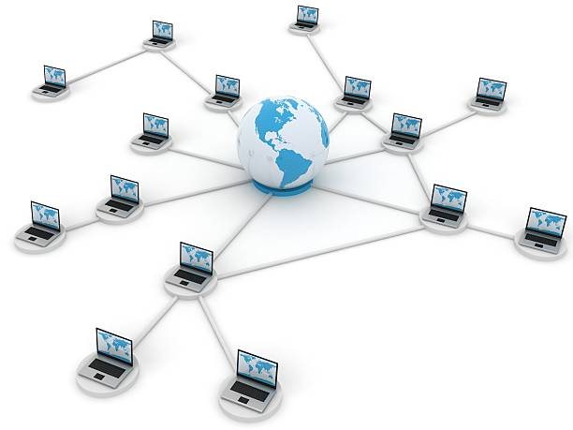
Data Communications
Data Communication or Networks is the study of the transport of data between two computing devices.
Essentially, how can we get computers to talk to each other and communicate?
Computer Science for Everyone, Everywhere (CSEE)

Slide 64
Networks - How are the Computers Connected
Your personal computer/tablet/phone connect to a network in one of two ways - either through a wired connection or a wireless connection.
Wired Connection: A wired connection is just that - a connection with wires! The first connections were like the old style phone lines - copper wire that was wrapped and insulated and then bound together.
Essentially for all media, they have to transports some form of the ones and the zeros. Copper wire could do this but we would lose data in the process - this is called signal degradation.
Fiber Optic cable came along and had better properties for sending a signal. Instead of using electricity, we use light pulses that follow a very thin glass wire that has some flexibility in it. We are now truly moving closer to the speed of light.
Wireless uses the properties of radio waves to send a signal. However, your need to be in “line of sight” of a router, tower, satellite. Signal has a lot of problems going through cinderblock, the hills of NJ, and is susceptible to outages when there is solar flare activity.
Computer Science for Everyone, Everywhere (CSEE)

Slide 65
Networks
A network is a connection between two or more computers that either share resources or what to communicate with each other.
Networks are described by a few features:
Topology - How is the network physically laid out?
Scope
Personal Area Network (short-range - earbud with your phone and smart watch)
Local Area Network (building/campus)
Metropolitan Area Network (community)
Wide Area Network (greater distances)
How is it connected: wired (bus) or wireless
Computer Science for Everyone, Everywhere (CSEE)

Slide 66
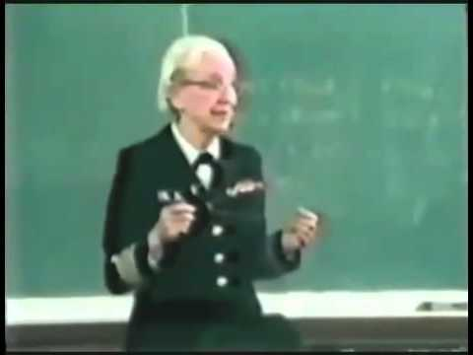
Networks - Speeds
Network speeds are managed in bits per second - we measure how many ones and zeros we can send in a second
When we talked about data last week, we talked about how we record data in Bytes.
Network speeds are measured in how many 1s and 0s I can send, not how many Bytes i send.
Most US homes have about 50 Megabits per second, or Mbps.
The average zoom/Google Hangout call is about 4 Mbps
Grace Hopper and the Nanosecond:
Computer Science for Everyone, Everywhere (CSEE)

Slide 67
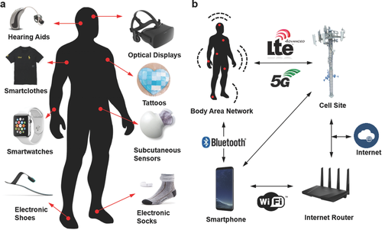
Example of Wearable
Wearable are taking the world by storm. Students will need to be able to navigate this world to understand their comfort levels and how to socialize and cope with this world.
Image Source: https://onlinelibrary.wiley.com/doi/full/10.1002/adma.201706910?_utm_campaign=mention57529&_utm_medium=inline&_utm_content=lnk241316896300&_utm_source=xakep

Slide 68
Brainstorming
• 8.1.2.NI.1: Model and describe how individuals use computers to connect to other individuals, places, information, and ideas through a network.
Issues:
• 8.1.2.NI.2: Describe how the Internet enables individuals to connect with others worldwide.
Issues:
8.1.2.NI.3: Create a password that secures access to a device. Explain why it is important to create unique passwords that are not shared with others.
Issues:
• 8.1.2.NI.4: Explain why access to devices need to be secured.
Issues:

Slide 69
Working Smart - Is there any overlap with this work and other work I am doing?

Slide 70
As a teacher, what knowledge do I need to feel confident in teaching Networks and the Internet?

Slide 71
Lesson 1 - Understanding Connections - Wireless and Wired - Motivation for Teachers - Beacons of Gondor
https://www.youtube.com/watch?v=i6LGJ7evrAg

Slide 72
Debrief - Why are the Beacons of Gondor a Network?

Slide 73
Lesson 1 - Building a Network Like the Beacons of Gondor
Supplies: Flashlights, String, scissors, index cards and paperclips
Part 1A - Wireless Networks
At your table - give everyone a flashlight.
Pair Up - Try to answer Yes/No questions with just the flashlight.
Next - try to create a chain of people like the Beacons of Gondor - how can you?
You want to send a message using your flashlights - How? Come up with a Scheme to do so

Slide 74
Lesson 1A - Debrief
Pro | Cons | What concept does this address in Computing?

Slide 75
Lesson 1B - Wired Network
Lets redo this - but now with String.
You have string on the table.
Pretend that each person at the table is a computer. Create a connection between at least two computers using your “Wire” which is the string.
How do you think the computers communicate?

Slide 76
Lesson 1B
Pick one person as your message sender, pick one person as your message receiver.
Sender: Write a sentence that is 5 words long - write each word - and only each word - on a index card. Do not tell your receiver what the message is. Shuffle the cards and “send” the cards over your wire to your receiver.
Receiver: Rebuild the message without any help or directions. Check with the sender.

Slide 77
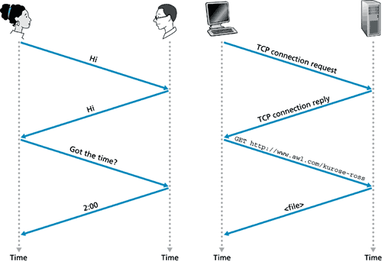
Protocols
Protocols are the system of rules by which communication happens.
Humans have protocols in their communication.
Computers use protocols to communicate with each other.

Slide 78
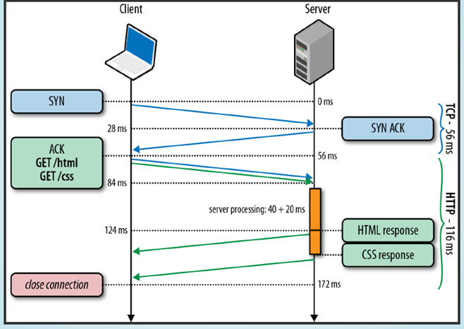
HTTP Protocol

Slide 79
Lesson 1 Debrief - Question: What were the differences between Wired and Wireless?
Wired Network Observation | My Home or School Network | Wireless Network Observation | My Cellphone | Computer Concept it is Matching

Slide 80
Lesson 1 Debrief
What do you observe about sending the message?
How did you send it across the network?
Did you give any vocal directions about how to send the message?
Did you give any body language clues about how to send the message?
What do you observe about receiving the message?
Did the cards have any clues about what order the words should have been in?
Would a little more directions help you in putting the message together?
How much did you rely on your ELA skills to understand how to put the message together?
Which network was easier to interrupt?
Which network was it easier to see the messages other people were sending at other tables?

Slide 81
Lesson 2: Hack the Classroom
Lets admit it - kids love to get into things they aren’t supposed to …
We have things organized in our classroom and no one is supposed to touch but… We organize our classroom in part for security.
How can we equate our classroom organization with our passwords …
And have the kids Hack the Classroom …

Slide 82
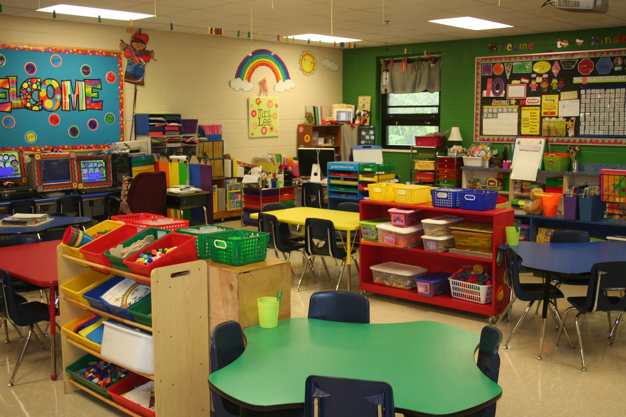
Typical Kindergarten Classroom

Slide 83
How things are stored in the classroom
Storage | How Secure is it (or how can i hack it) | Why does it have that security level? | What concept of Passwords does this represent
On the kids desk
On a shelf
On a shelf in a bin with a lid
In a closet
In a closet with a lock
On the teachers desk
Locked in desk
On A shelf higher than 4 ft.

Slide 84
NJSLS - CS Standards
Core Idea | Performance Expectations | How does the Lesson Address the Standard
Computer networks can be used to connect individuals to other individuals, places, information, and ideas. The Internet enables individuals to connect with others worldwide. | • 8.1.2.NI.1: Model and describe how individuals use computers to connect to other individuals, places, information, and ideas through a network. • 8.1.2.NI.2: Describe how the Internet enables individuals to connect with others worldwide. | Wireless and Wired mimics how the Internet works. Our zoom calls, emails, connections go over these connections. We learned how wireless works and wired. Messages have to use a protocol and a transmission means to send messages
Connecting devices to a network or the Internet provides great benefits, but care must be taken to use authentication measures, such as strong passwords, to protect devices and information from unauthorized access. | • 8.1.2.NI.3: Create a password that secures access to a device. Explain why it is important to create unique passwords that are not shared with others. • 8.1.2.NI.4: Explain why access to devices need to be secured. | Everything in our world has a security value - some things we worry about, other things not so much. We have to protect the things that are important to us with security.

Slide 85
Further Resources
https://beinternetawesome.withgoogle.com/en_us/
https://www.commonsense.org/education/articles/23-great-lesson-plans-for-internet-safety
https://kids.britannica.com/kids/article/Internet/353293

Slide 86
Impacts of Computing

Slide 87
NJ SLS CS Standard for Impacts of Computing - In a Nutshell
By the end of Grade 2
Computing technology has positively and negatively changed the way individuals live and work (e.g., entertainment, communication, productivity tools).

Slide 88
What does that mean to us?
Kids today are experiencing the world in an extremely different way than even the generation 10 years ago.
They are constantly in contact with others
Life is facilitated by technology - they barely know what commercials, cliffhangers and must see TV is!
Those who have trouble accessing technology are experiencing larger access gaps

Slide 89
Impacts of Computing
Core Idea | Performance Expectations
Computing technology has positively and negatively changed the way individuals live and work (e.g., entertainment, communication, productivity tools). | 8.1.2.IC.1: Compare how individuals live and work before and after the implementation of new computing technology.

Slide 90
Perspective - Computers and Society

Slide 91
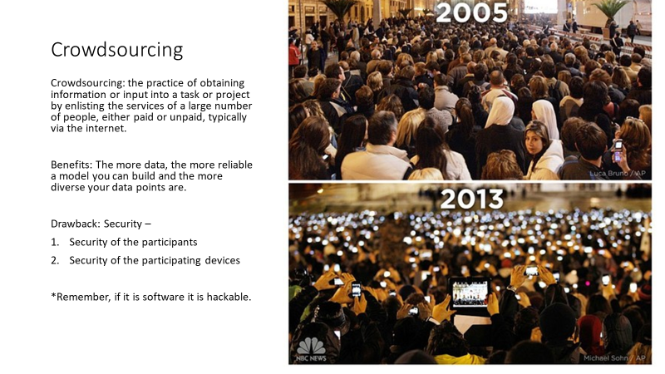

Slide 92
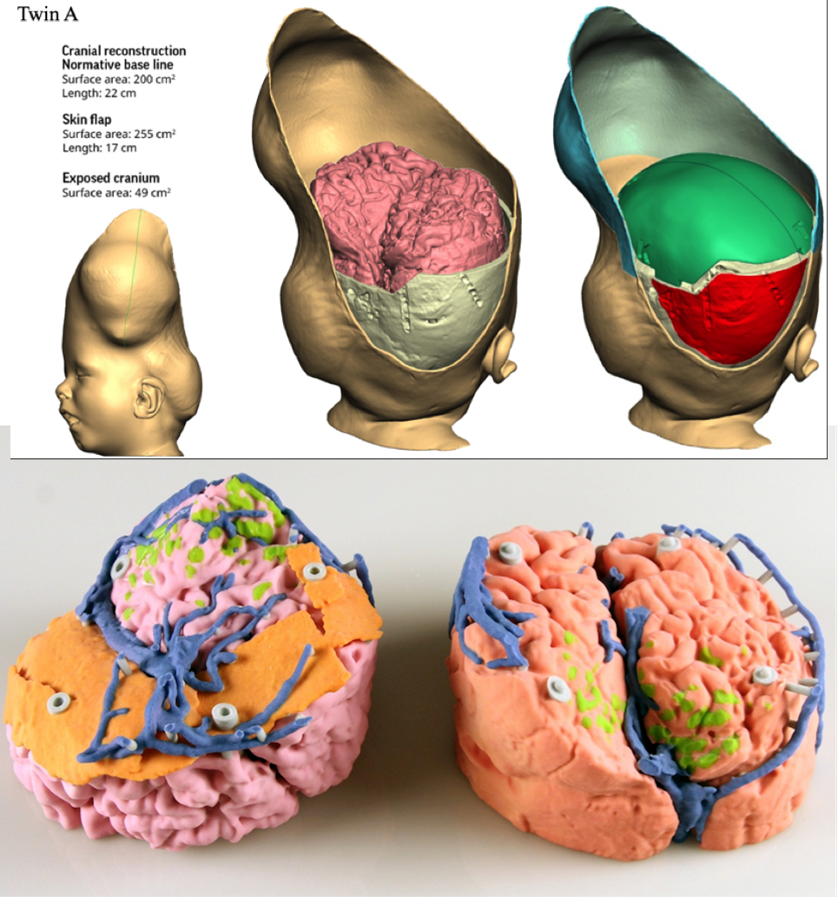
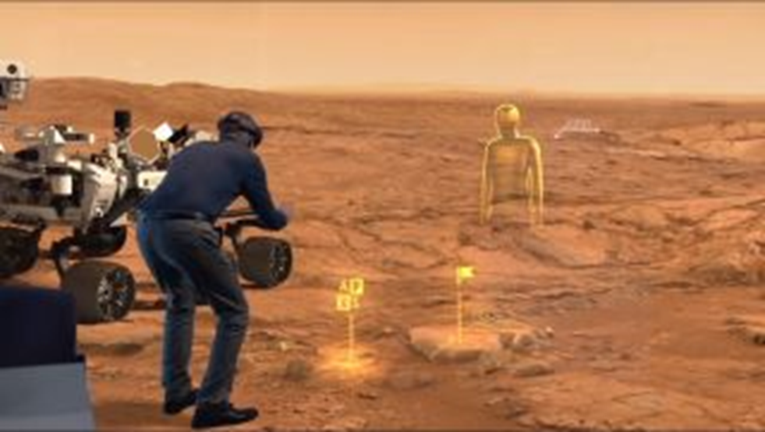
How is data visualized?
Computer Science for Everyone, Everywhere (CSEE)

Slide 93
AI and Life Changing Tools
ChatGPT - write a paper on computer science education …
ChatGPT - if you have a hypothetical patient with these symptoms, what illness do you think they have
ChatGPT - translate this sentence from English to Spanish: Can I help you?
ChatGPT - Generate a knitting pattern for me …
More at: Epic ChatGPT Fails: https://www.buzzfeed.com/andyneuenschwander/chatgpt-ai-fails-funny

Slide 94
Brainstorming
8.1.2.IC.1: Compare how individuals live and work before and after the implementation of new computing technology.
Issues:

Slide 95
Working Smart - Is there any overlap with this work and other work I am doing?

Slide 96
As a teacher, what knowledge do I need to feel confident in teaching Impacts of Computing?

Slide 97
Lesson 1: Impacts of Computing ART CRAWL !!!!
Divide every table into two groups of two.
Each Table Picks One Technology:
SmartPhone, Video Calls, Virtual Reality, Video Games, Internet, Miniaturized Computer Parts, Digital Pictures, Streaming Video, Online Shopping, Ring Doorbells and Smart Home Devices
Team A: Create a poster of on how your table’s technology impacts life right now
Team B: Create a poster of how life was like before your technology
Do these Posters on the Large Sticky Notes - do while eating lunch - we will debrief in 15 minutes.

Slide 98
Debrief
Technology | Life Before Tech | Life After Tech | Observations

Slide 99
Impacts of Computing
Core Idea | Performance Expectations | Lesson Plan
Computing technology has positively and negatively changed the way individuals live and work (e.g., entertainment, communication, productivity tools). | 8.1.2.IC.1: Compare how individuals live and work before and after the implementation of new computing technology. | Art Crawl Lets students get creative and display their understanding of Life Before a Technology and After A Technology The Debriefing part - or any critical reflection - helps them to learn about the technology

Slide 100
Further Resources
https://www.create-learn.us/blog/history-of-computers-for-kids/
https://kids.britannica.com/kids/article/computer/352990
https://bedtimehistorystories.com/the-history-of-computer-science-for-kids/

Slide 101
Data and Analysis

Slide 102
Exercise
Given a baggy of legos
Do something with them … in 5 minutes

Slide 103
Debrief
What did you do?

Slide 104
NJ SLS CS Standard - In a Nutshell
By the end of Grade 2
Individuals collect, use, and display data about individuals and the world around them.
Computers store data that can be retrieved later. Data can be copied, stored in multiple locations, and retrieved.
Data can be used to make predictions about the world.

Slide 105
What does that mean to us?
In many ways the Data Standard is the hardest of the standards. While it is with the best of intentions we want to help students learn the skills they need to analyze data properly, these skills can often be misinterpreted for other motives.
The important points in the Data Standard with K-2 is introducing them to concepts. Help them uncover the beautiful world of data and have them learn about their role in data generation.

Slide 106
K-2 Data Sciences Expectation
Core Idea | Performance Expectations
Individuals collect, use, and display data about individuals and the world around them. | 8.1.2.DA.1: Collect and present data, including climate change data, in various visual formats. Computers store data that can be retrieved later
Data can be copied, stored in multiple locations, and retrieved. | 8.1.2.DA.2: Store, copy, search, retrieve, modify, and delete data using a computing device.
Data can be used to make predictions about the world. | 8.1.2.DA.3: Identify and describe patterns in data visualizations. 8.1.2.DA.4: Make predictions based on data using charts or graphs.

Slide 107
Perspective
Data Sciences, Data and Analysis

Slide 108
Data and Binary
All data must be able to be mapped onto the binary number system. This type of data is called discrete data.
We can do a lot of representation with this - most text can be represented this way. Pictures used binary values to represent the presence of certain colors in a picture element or pixel. We can record sound waves and the play rapid pictures with sound over them to make movies.
Some things cannot be represented by the computer. For example - a computer cannot represent a circle completely - only an approximation of it.
Computer Science for Everyone, Everywhere (CSEE)

Slide 109
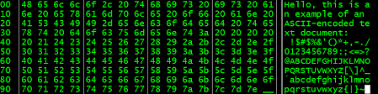
Data and Binary
Computer Science for Everyone, Everywhere (CSEE)

Slide 110
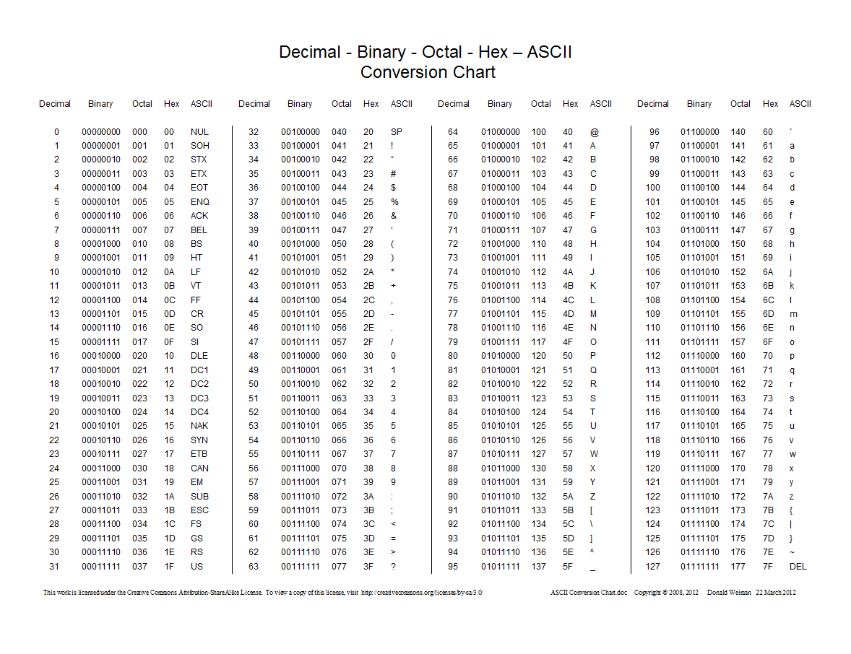
Data and Binary
Computer Science for Everyone, Everywhere (CSEE)

Slide 111
Bits, Bytes and Data Storage
Binary Digit: Bit - this is our ones and zeros.
Byte: 8 bits equal 1 byte. I can store 256 different values with 1 Byte. With 2 Bytes working together, I can store 65,536 values. One byte lets me represent all English characters (ASCII). Two bytes lets me represent all other alphabets except languages like Mandarin. Even those, the major characters can be represented (Unicode).
In working with powers of two, every time you add a bit, you are doubling the amount of data that you can store or work with.
Computer Science for Everyone, Everywhere (CSEE)

Slide 112
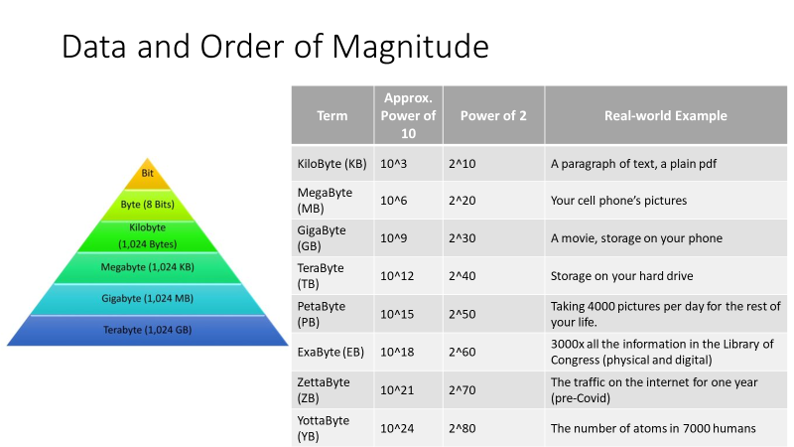
Computer Science for Everyone, Everywhere (CSEE)

Slide 113
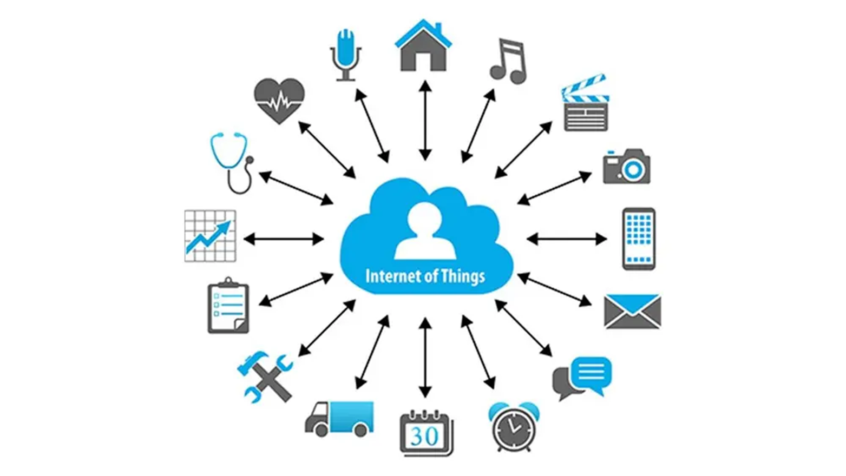
How is data collected
Computer Science for Everyone, Everywhere (CSEE)

Slide 114
US 2020 Election visualization on NPR
Look at this visualization: https://www.npr.org/sections/live-updates-2020-election-results
Note: This is not a statement about who won the election, just how the information is visualized.
What visualization are you most used to?
What visualization do you feel is most representative of the data?

Slide 115
Data Dashboards
Covid -19 Dashboards:
NY Times: https://www.nytimes.com/interactive/2021/us/covid-cases.html
University of Washington: https://covid19.healthdata.org/global?view=cumulative-deaths&tab=trend

Slide 116
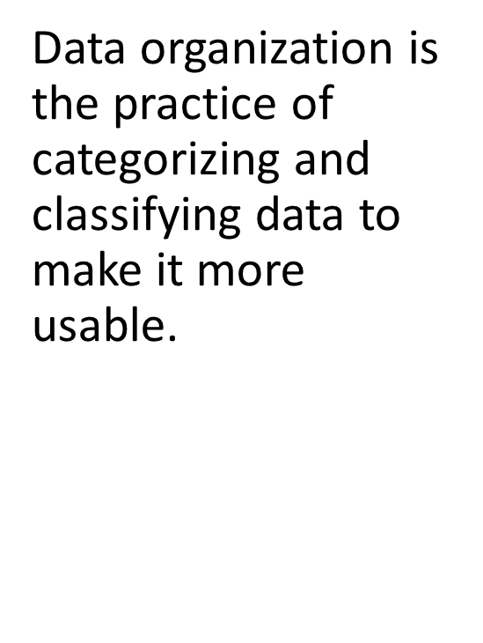
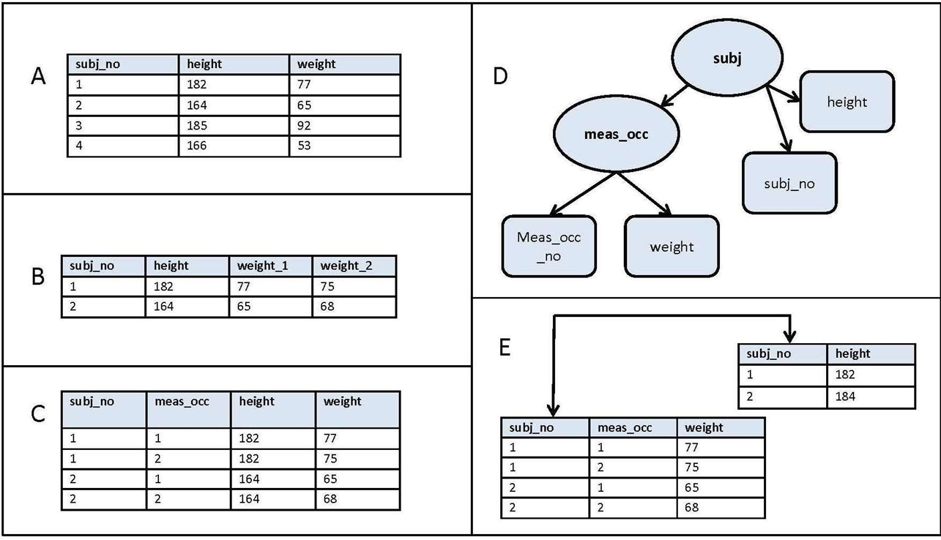
How is data organized?
Computer Science for Everyone, Everywhere (CSEE)

Slide 117
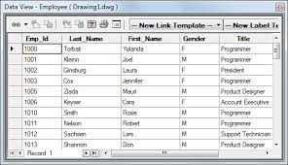
How is data organized? - Tables
Computer Science for Everyone, Everywhere (CSEE)

Slide 118
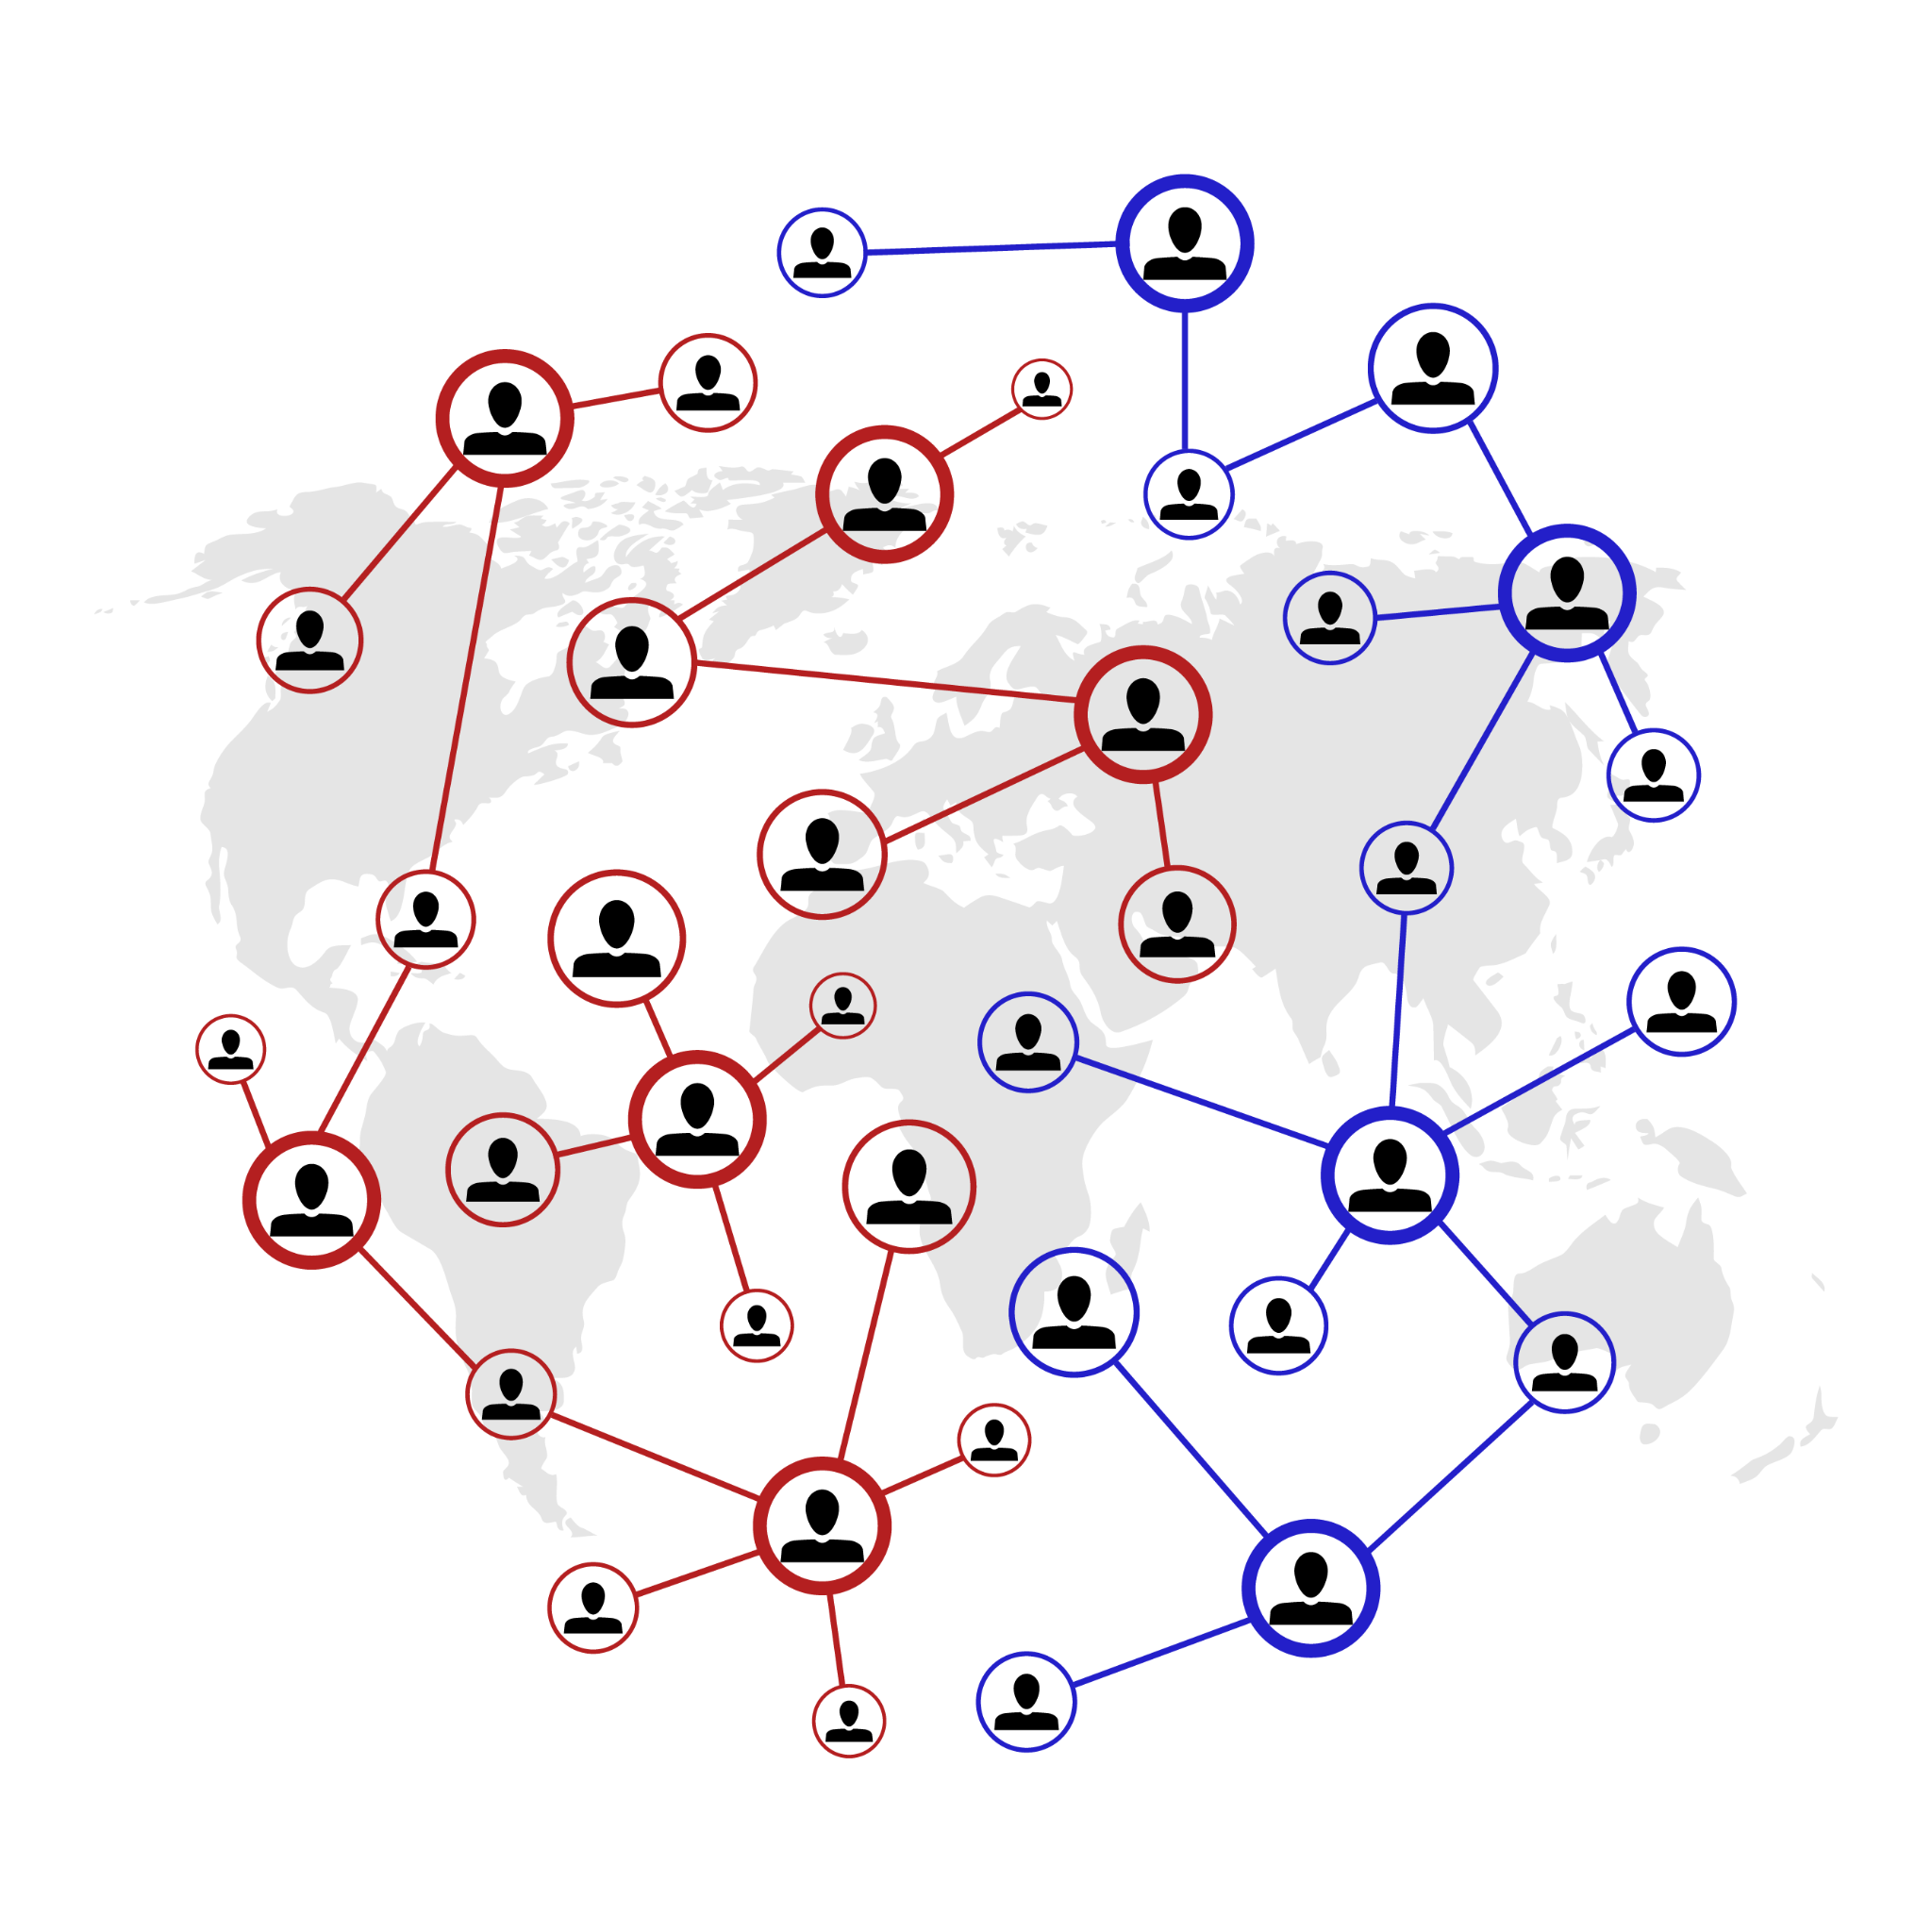
How is data organized? - Graphs or Network
Computer Science for Everyone, Everywhere (CSEE)

Slide 119
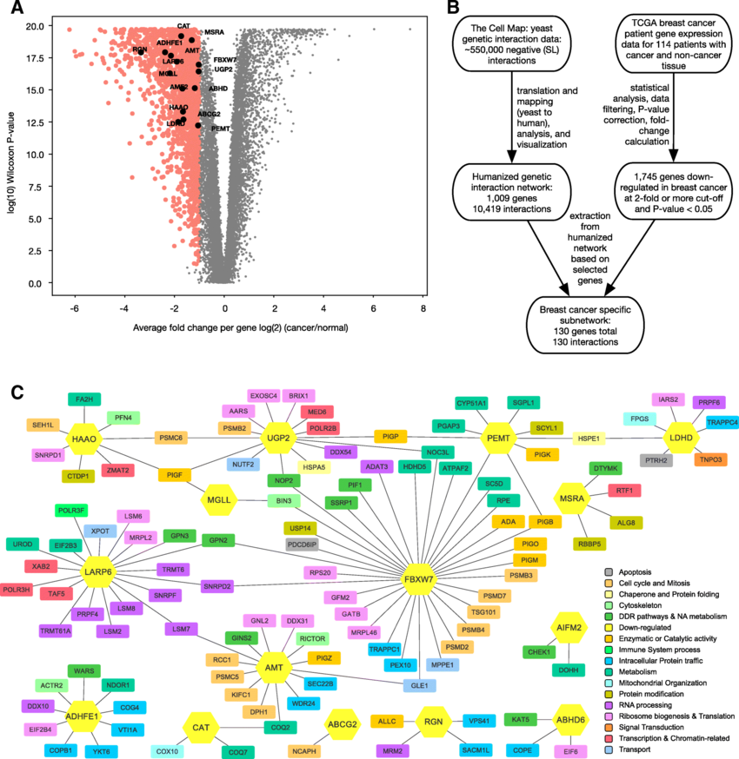
How is data organized?
- Graphs or Network
Computer Science for Everyone, Everywhere (CSEE)

Slide 120
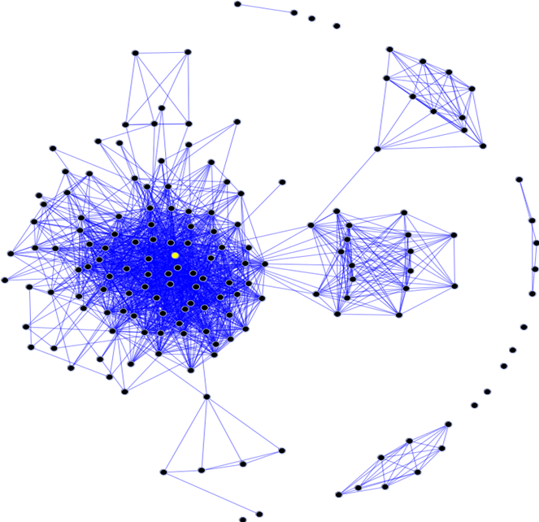
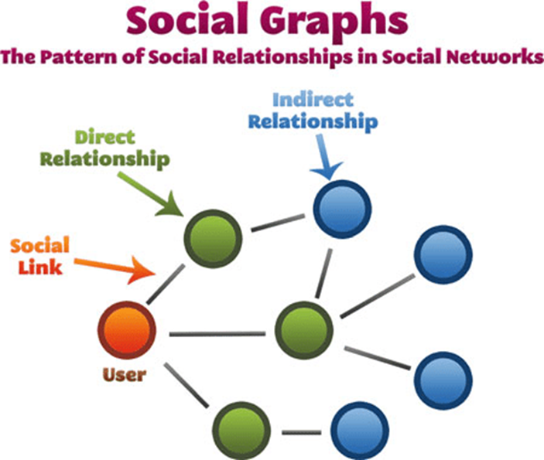
How is data collected
•Often, besides the actual information the data represents, how data interact with each other is also important. Social Media is an example of this concept.
Computer Science for Everyone, Everywhere (CSEE)

Slide 121
Brainstorming
8.1.2.DA.1: Collect and present data, including climate change data, in various visual formats. Computers store data that can be retrieved later
Issues:
8.1.2.DA.2: Store, copy, search, retrieve, modify, and delete data using a computing device.
Issues:
8.1.2.DA.3: Identify and describe patterns in data visualizations.
Issues:
8.1.2.DA.4: Make predictions based on data using charts or graphs.
Issues:

Slide 122
Working Smart - Is there any overlap with this work and other work I am doing?

Slide 123
As a teacher, what knowledge do I need to feel confident in teaching Data & Analysis?

Slide 124
Lesson 1: Kids as Data Generators
As a part of the standard, we have to help students: Store, copy, search, retrieve, modify, and delete data using a computing device.
This is not the easiest of tasks, especially when you may only have ChromeBooks at your disposal
Simple exercise:
Have the kids create 3 different Google Documents (or whatever they have access to) - the content can be on anything. One document should be okay to delete
Then, do these tasks:
STORE: Give the document a name: Store - point out on some machines we have to click on Save.
COPY: Make a Copy of the Document
RETRIEVE: Close out of Google Drive, then reopen and have them find the document. Debrief of how this process worked.
MODIFY: Open an Existing Document, put more information in it.
DELETE: Delete the file you decided to delete - have them try to find it after deletion.

Slide 125
Lesson 2: Kids as Data Generators
Pick an aspect of the environment for kids to observe over a period of time:
Weather (I did this), Growth of a Plant, and record aspects of the data.
Weather: Temperature, sky conditions, air conditions…
Plant: Have the students plant plants. Put the plants in different places in the room (including a closet that keeps the door closed). Record information about growth. You can also have sets you water and do not water.

Slide 126
Lesson: Kids as Data Generators
The idea with this standard is not to teach kids to make standard charts. Its to help them use their creativity to model what they learned in this exercise.
You can have them put their data into Google Sheets and then use a chart.
Another idea is use a tool like abcya.com to do picture art:
Lesson Plan: https://docs.google.com/document/d/1aFFIFQgLRQTRPUMMgPQ54FRPEx1sXjlQNM53EGKv6d0/edit

Slide 127
Lesson 2: Kids as Data Generator
Help them then connect to the larger world through an on-line Dashboard system.
Google Trends: https://trends.google.com/trends/
For Example - have student use Google Trends to see about weather changes.
Look at the maps, and regions, and dates - find patterns. See if you can figure out the patterns.
Once you identify patterns - see if you can predict something about the patterns (for example, is there always a spike in weather searches around hurricanes).

Slide 128
K-2 Data Sciences Expectations
Core Idea | Performance Expectations | Lessons
Individuals collect, use, and display data about individuals and the world around them. | 8.1.2.DA.1: Collect and present data, including climate change data, in various visual formats. Computers store data that can be retrieved later | Creating the Picture to represent their understanding of climate data and doing the climate Observations
Data can be copied, stored in multiple locations, and retrieved. | 8.1.2.DA.2: Store, copy, search, retrieve, modify, and delete data using a computing device. | Google Docs Exercise
Data can be used to make predictions about the world. | 8.1.2.DA.3: Identify and describe patterns in data visualizations. 8.1.2.DA.4: Make predictions based on data using charts or graphs. | Google Trends

Slide 129
Further Resources
NASA’s Kid’s Climate Change site: https://climatekids.nasa.gov/kids-guide-to-climate-change/
NOAA’s Kids’ Climate Change site: https://oceanservice.noaa.gov/kids/
Octonaut Science: https://oceanexplorer.noaa.gov/octonauts/

Slide 130
Algorithms and
Computer Programming

Slide 131
Exercise
What do you do the same every single day?
Why do you do it the same way?
What goal do you reach or how do you complete a task with it?

Slide 132
Algorithms and Programming
What is an Algorithm?
Informally: An Algorithm is a step by step process by which we complete a task.
Formal definition: An algorithm is an ordered set of unambiguous, executable steps that defines a terminating process
What is Programming?
Programming is a representation of an algorithm into a form that the computer can understand.
How are they related?
Computer scientists develop algorithms and test them through math to solve problems. Then we use programming languages to develop software based on those algorithms.

Slide 133
NJ SLS CS Standard - In a Nutshell
By the end of Grade 2
• Individuals use computing devices to perform a variety of tasks accurately and quickly. Computing devices interpret and follow the instructions they are given literally.
• A computing system is composed of software and hardware.
• Describing a problem is the first step toward finding a solution when computing systems do not work as expected.

Slide 134
What does that mean to us?
The standard asks that we get students to the point where they understand the purpose of a loop - not necessarily program it well, but understand its purpose and do a simple loop.
Core ideas in this standard are:
How do we represent our ideas for a program?
How do we work with data?
How do we do a simple program?

Slide 135
Algorithms and Programming
Core Idea | Performance Expectations
Individuals develop and follow directions as part of daily life. A sequence of steps can be expressed as an algorithm that a computer can process. | 8.1.2.AP.1: Model daily processes by creating and following algorithms to complete tasks.
Real world information can be stored and manipulated in programs as data (e.g., numbers, words, colors, images). | 8.1.2.AP.2: Model the way programs store and manipulate data by using numbers or other symbols to represent information.
Computers follow precise sequences of steps that automate tasks. | 8.1.2.AP.3: Create programs with sequences and simple loops to accomplish tasks.
Complex tasks can be broken down into simpler instructions, some of which can be broken down even further. | 8.1.2.AP.4: Break down a task into a sequence of steps.
People work together to develop programs for a purpose, such as expressing ideas or addressing problems. The development of a program involves identifying a sequence of events, goals, and expected outcomes, and addressing errors (when necessary). | • 8.1.2.AP.5: Describe a program’s sequence of events, goals, and expected outcomes. 8.1.2.AP.6: Debug errors in an algorithm or program that includes sequences and simple loops.

Slide 136
Perspective
Algorithms and Programming

Slide 137
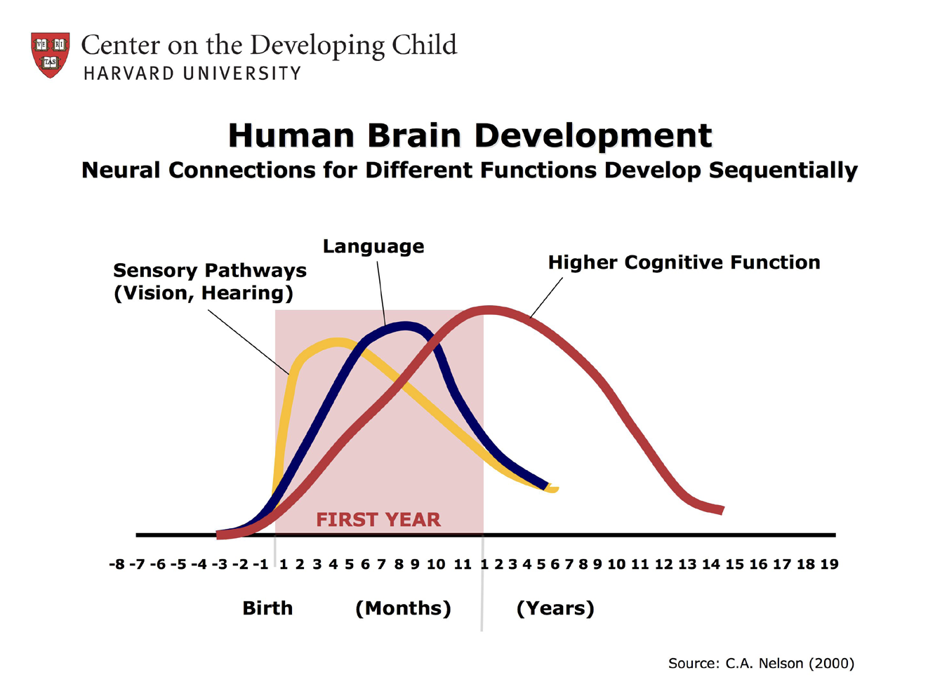
Conjecture 1: Build CS Learning through Language and Literacy
CS as visual and verbal
Brain development starts with early and rapid proliferation of neural networks formation.
Development starts with sensory pathways like those for basic vision and hearing, followed by early language skills and higher cognitive functions.
Neural connections proliferate and prune in a prescribed order, with later, more complex brain circuits built upon earlier, simpler circuits.
Montclair Computer Science Education Hub

Slide 138
Conjecture 2: Build CS Learning as Dual-Language
Exposure to dual-language input in the brain
Kuhl, Tsaio, and Liu (2022) found that infants pick up distributional frequency patterns in ambient speech, whether they experience them during short-term laboratory experiments or over months in natural settings. During early development, ambient speech informs phonetic perception, helping infants transition from their "universal" state of perception at birth to their "native" state of phonetic listening at the end of the first year.
Snow and Hoefnagel-Hohle (1978) showed that English speakers learning Dutch in Holland over a one-year period learned it most efficiently and quickly if they were between 12–15 years old, rather than younger or older.
Montclair Computer Science Education Hub

Slide 139
Conjecture 3: Practice and Socialization
Brain activation enhanced through social interaction, oral/verbal communication, consistent practice
Lack of verbal stimulation and other aspects of stress and chaos that increase anxiety can impair verbal ability and cognitive function.
Children require brain activation through social interaction and a social setting with a human to trigger computation skills to learn from exposure to language.
Montclair Computer Science Education Hub

Slide 140
If, Then
IF language and literacy are essential to the development of fluency in young children and are predictors of educational success later in life.
IF when learning through multiple means of representation (visual, auditory, kinesthetic), young children may be able to develop their literacy skills, coding/programming skills.
IF computer science requires individuals to talk about what they’re doing and thinking (LENA)
IF students comment on what they’re doing or looking at. (LENA)
IF computer science activities are collaborative, take turn, follow, lead.
IF computer science activities expects failure and mistakes to learn from.
Montclair Computer Science Education Hub

Slide 141
If, Then
THEN young children may have higher educational success later in life.
THEN young children may be able to develop their literacy skills, coding/programming skills.
THEN young children improve how they talk about what they’re doing and thinking (LENA)
THEN students can improve how they comment on what they’re doing or looking at. (LENA)
THEN students learn to become collaborative, take turns, follow, lead.
THEN students learn failure and mistakes are normed and can learn from.
Montclair Computer Science Education Hub

Slide 142
Algorithms, Programming and Why all the fuss?
What is an Algorithm?
Informally: An Algorithm is a step by step process by which we complete a task.
Formal definition: An algorithm is an ordered set of unambiguous, executable steps that defines a terminating process
What is Programming?
Programming is a representation of an algorithm into a form that the computer can understand.
How are they related?
Computer scientists develop algorithms and test them through math to solve problems. Then we use programming languages to develop software based on those algorithms.
Montclair Computer Science Education Hub

Slide 143
The Anatomy of an Algorithm
An algorithms definition is deceptively simple: A step-by-step process by which we complete a task. There are many important elements to this definition!
Formal definition: An algorithm is an ordered set of unambiguous, executable steps that defines a terminating process
What is important:
It is ordered
It is step-by-step and its very clear steps
It is possible for the computer to do those steps
There is a clear way the algorithm ends
There is a result at the end of the algorithm
Montclair Computer Science Education Hub

Slide 144
Algorithms: It has order!
The key design factor for algorithms is that it has order.
Why is order important?
Often a step is dependent upon a previous step. We need to follow the direction like a path or recipe.
Is everything ordered on a computer?
Not everything in computing requires order - in fact, for many things to work they have to unordered or even random. This is one of the reasons why we say clearly it must be ordered.
Montclair Computer Science Education Hub

Slide 145
Algorithms: It is step-by-step!
Related to ordered, there must be clear, precise steps that are followed in the algorithm. This is often the hardest part of algorithms because often the “math proof” lets you describe the concept every openly, but the programming implementation does not allow that.
We often start with a “high level” concept, then refine until we get to pseudo-code (notation that uses many common programming techniques). We usually work on about three versions of the algorithm, using problem solving techniques to get us to code.
Montclair Computer Science Education Hub

Slide 146
Algorithms: Three Versions
Working on algorithms is like writing a paper - and using a similar process for writing a paper helps.
Brainstorming
Begin with crafting a clear statement of what you want the algorithm to do. Include the following components: what is your input, what is your output, how does the algorithm end and describe in plain language how you want to go about getting to your end state/final output. Note - this should be in PLAIN LANGUAGE
Revision
You take your brainstorming and organize it. You begin to identify programming concepts that can implement your ideas.
Sometimes you need multiple revisions at this phase.
Your last revision should be in a good place where you know the code you need to use.
Translation: Translate the Revision into any programming language.
Montclair Computer Science Education Hub

Slide 147
Algorithms: Version Example - Brainstorming
Our problem is to create an adding program. It will add two numbers, return a result and then ask the user if they want to add something else.
Brainstorming:
I think about the program …
I am adding two numbers, so I will need to input two numbers and save those somewhere. Then I have to add them. Then I have to tell the user the result. Then I have to see if they want to do it again.
Considerations:
How am I getting the two numbers that I am adding? Are they typing it in or am I using a Graphical User Interface (windows, something they touch) to get the info?
Montclair Computer Science Education Hub

Slide 148
Algorithms: Version Example - Revision 1
Brainstorm:
I am adding two numbers, so I will need to input two numbers and save those somewhere. Then I have to add them. Then I have to tell the user the result.
Revision 1
Montclair Computer Science Education Hub

Slide 149
Algorithms: Version Example - Translation phase
Revision 1 - with more details
Get two numbers from user typing in number on the keyboard
Get first number through an input statement
Assign my result to variable number1
Get second number from an input statement
Assignment my result to variable number2
I save them in a container that holds data -> variables
This work was done in the above steps.
Add numbers and save in the result
Create a result variable to hold the value of the addition.
Add number and number 2 - save the addition value in variable result
Print out the result for the user
Use an output statement to the print out result
Pseudo-code (looks like code but independent of language)
number 1 = 0
number1 = input(““Please enter your first number to be added: “)
number 2 = 0
number2 = input(““Please enter your second number to be added: “)
result = 0
result = number1 + number2
print(“Your result is “ + result)
Montclair Computer Science Education Hub

Slide 150
Algorithms: Techniques for development
We use three basic techniques to develop our algorithms:
Top-down approach
Top-down is what we did in the previous example. We start with a High-level idea and we revise it, breaking it into smaller parts until we can visible see the coding elements needed to create the program.
Top-down approach uses a concept called step-wise refinement. This means you do multiple versions of your outline, breaking up each bullet point again and again until your bullet points can be easily translatable into code.
We often use the Divide and Conquer Technique in Top Down - breaking the problem into smaller, more manageable pieces.
Montclair Computer Science Education Hub

Slide 151
Algorithms: Techniques for development
Bottom Up Approach:
Design a problem that you want to address with an algorithm
Then look at problems similar to it.
Use the pieces from other programs to build out your solution.
Bottom up is an engineering technique where you have goal x and supplies y, how do you get to your goal?
Combination of the two approaches
The reality is we use both approaches often together to get a robust solution.
Trying to look at problems from different points of view often help us with understanding where problems are in our logic.
Montclair Computer Science Education Hub

Slide 152
Algorithms: A computer can complete the task
Computers work in binary: yes and no, one and zero, true and false.
The computer isn’t good with “loose instructions” or instructions that are indefinite.
It is impossible for the computer to do the following instruction:
When you are done enjoying the sunset, do this step.
Therefore the instruction must be able to end.
Montclair Computer Science Education Hub

Slide 153
Algorithms: It Ends
It must end. When try to design with infinity with caution.
For the most part, the only place that we work with the program being allowed to run infinitely are systems programs - the operating system, the computer security features, etc.
These programs work on the idea that they run infinitely until an “interrupt” event occurs. We assume a lot of interrupts will happen.
These programs are then ended either by an interrupt or the user turning off the devise.
Montclair Computer Science Education Hub

Slide 154
Algorithms: There is a result at the end
The purpose of the algorithm is to manipulate the data in some way - therefore by the time the algorithm ends - something should have happened with the data.
Examples:
Something was stored
Something was printed or reported to the user
A value changed
A value was visualized in a cool way
A set of values were analyzed
etc…
Montclair Computer Science Education Hub

Slide 155
Brainstorming
8.1.2.AP.1: Model daily processes by creating and following algorithms to complete tasks.
Issues:
8.1.2.AP.2: Model the way programs store and manipulate data by using numbers or other symbols to represent information.
Issues:
8.1.2.AP.3: Create programs with sequences and simple loops to accomplish tasks.
Issues:
8.1.2.AP.4: Break down a task into a sequence of steps.
Issues:
• 8.1.2.AP.5: Describe a program’s sequence of events, goals, and expected outcomes.
Issues:
8.1.2.AP.6: Debug errors in an algorithm or program that includes sequences and simple loops.
Issues:

Slide 156
Working Smart - Is there any overlap with this work and other work I am doing?

Slide 157
As a teacher, what knowledge do I need to feel confident in teaching Computer Systems?

Slide 158
Simple Lessons

Slide 159
Unplugged Activities
1. Pattern Recognition: Getting loopy
Activity: https://code.org/curriculum/course1/12/Teacher#Activity1
chrome-extension://efaidnbmnnnibpcajpcglclefindmkaj/https://code.org/curriculum/course1/12/Activity12-GettingLoopy.pdf
2. Unplugged: Cup stacking
Activity: chrome-extension://efaidnbmnnnibpcajpcglclefindmkaj/https://active-living.ucalgary.ca/sites/default/files/teams/1/Coding%20Cups%20-%20MIM.pdf
Video for teachers: https://youtu.be/7zXtn8CoJ-w
3
Computer Science Education Hub

Slide 160
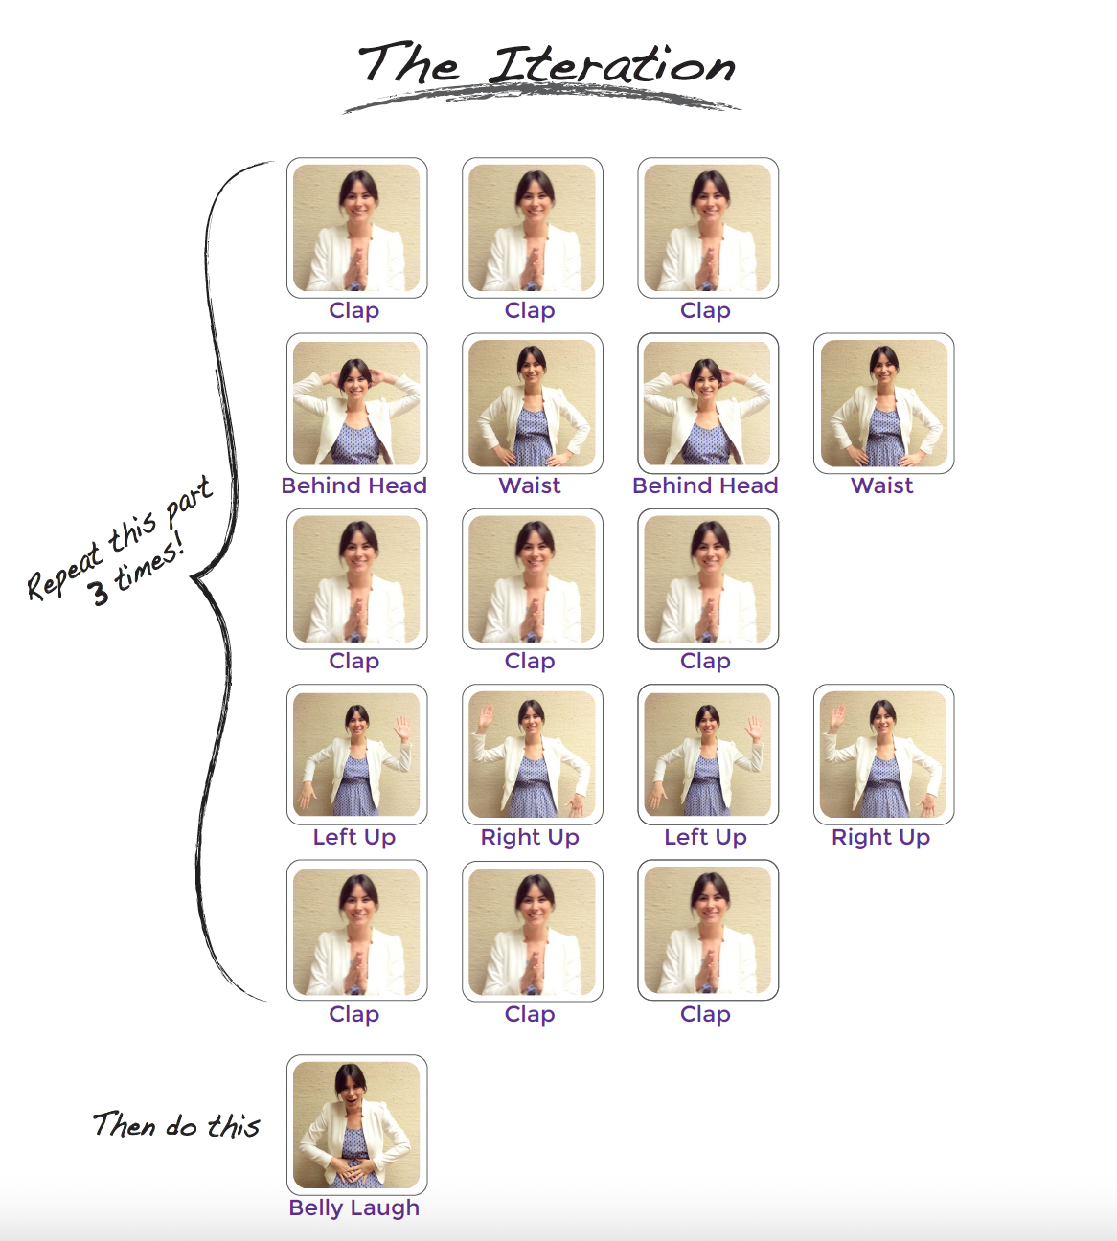
GETTING LOOPY
Resource: code.org
Vocabulary:
Loop - Say it with me: Loop
The action of doing something over and over again
Interdisciplinary:
ISTE Standards (formerly NETS)
CSTA K-12 Computer Science Standards
NGSS Science and Engineering Practices
NJ SLS Math, Language Arts

Slide 161
GETTING LOOPY:
VOLUNTEER TO
CREATE YOUR LOOP and ITERATION
Variation:
Go Noodle
https://app.gonoodle.com/activities/meow-moo-moo?sp=search&sn=search&st=video%20versions&sid=471

Slide 162
CUP STACK
Our language (code)
= Pick up stack
= Set bottom cup down
= Move ½ cup width forward
= Move ½ cup width backward
= Flip cup over
Computer Science for Everyone, Everywhere (CSEE)

Slide 163
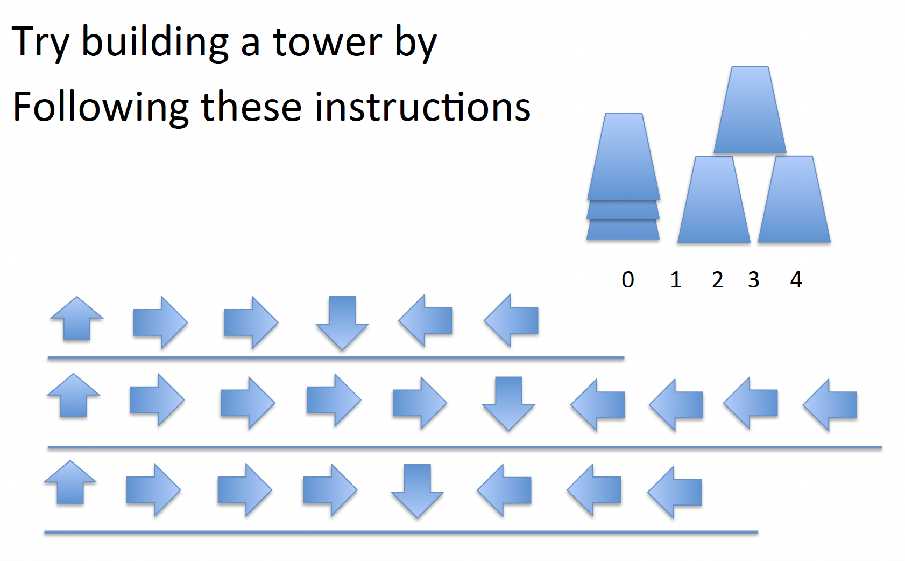
CUP STACK
position of cup = 0 1 2
Computer Science for Everyone, Everywhere (CSEE)

Slide 164
Kibo Robots

Slide 165
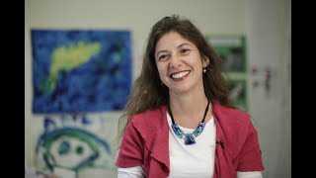
KIBO ROBOTS
Montclair Computer Science Education Hub

Slide 166
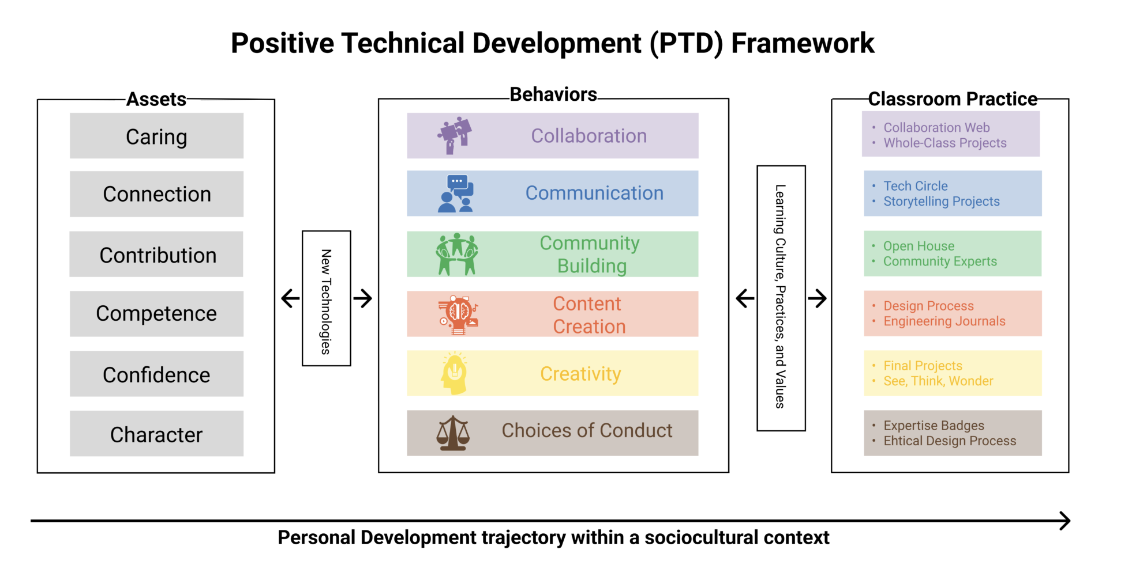
Montclair Computer Science Education Hub
Notes:
As a theoretical framework, PTD proposes six positive behaviors (six C’s) that should be supported by educational programs that use new educational technologies, such as KIBO robotics and ScratchJr. These are: content creation, creativity, communication, collaboration, community building and choices of conduct.

Slide 167
Research-based Practice: Kibo for Early Childhood Computer Science Education
Improved Sequencing Ability in Early Childhood PreK-Gr2 students’ performance on standard assessments of sequencing ability improved from 20-35% after an 8-week robotics and coding curriculum with KIBO.
Improved Computational Thinking with Concrete Tools Children using KIBO performed 27% better on computational thinking than children using screen-based tools.
Counteracting Harmful Gender-Based STEM Stereotypes After a KIBO curriculum, 2/3 of girls expressed an interest in engineering careers – a rate equal to boys. Girls who completed a 6-week KIBO curriculum were equally capable as boys at building and programming.
Positive Impact on Underrepresented Groups in STEM Fields Studies also demonstrate successful mastery of programming and computational thinking skills by disadvantaged students in underperforming schools.
Montclair Computer Science Education Hub

Slide 168
KIBO LESSON DEMO
Coding as Another Language:
https://sites.bc.edu/codingasanotherlanguage/curricula/kibo-curricula/
Montclair Computer Science Education Hub

Slide 169
Debrief (in small groups, record answers on poster paper)
What works in this activity if you were to teach it?
What doesn’t work?
What considerations need to be made in advance?
How would you modify it for your class?
Takeaways?
Montclair Computer Science Education Hub

Slide 170
Vocabulary: Algorithms and Programming
Syntax: Meaning variable: Capitalized, variables store a number. set: Sets a VARIABLE equal to a number. input: Input a number to be stored in a VARIABLE. calculate: Performs mathematical operations. +, -, *, /, = : Add, subtract, multiply, divide, equals. <, <= : Less than, less than or equal to. >, >= : Greater than, greater than or equal to. | display: Prints information to the screen. if: If a condition is true, run its block of code. Otherwise, skip the block of code. else if: See if. Follows if statement and checks if a different condition is true. start loop: Begins a repeating block of code. repeat x times: Repeats a loop x times. end loop: Stops repeating a block of code.
Montclair Computer Science Education Hub

Slide 171
Algorithms and Programming
Core Idea | Performance Expectations | Lesson
Individuals develop and follow directions as part of daily life. A sequence of steps can be expressed as an algorithm that a computer can process. | 8.1.2.AP.1: Model daily processes by creating and following algorithms to complete tasks. | Identify things that we do the same every day, Kibo
Real world information can be stored and manipulated in programs as data (e.g., numbers, words, colors, images). | 8.1.2.AP.2: Model the way programs store and manipulate data by using numbers or other symbols to represent information. | Lego Organizer, Kibo
Computers follow precise sequences of steps that automate tasks. | 8.1.2.AP.3: Create programs with sequences and simple loops to accomplish tasks. | Get Loopy, Kibo
Complex tasks can be broken down into simpler instructions, some of which can be broken down even further. | 8.1.2.AP.4: Break down a task into a sequence of steps. | Solo Cups, Kibo
People work together to develop programs for a purpose, such as expressing ideas or addressing problems. The development of a program involves identifying a sequence of events, goals, and expected outcomes, and addressing errors (when necessary). | • 8.1.2.AP.5: Describe a program’s sequence of events, goals, and expected outcomes. 8.1.2.AP.6: Debug errors in an algorithm or program that includes sequences and simple loops. | All of the lessons - this is integrated into them and why the mindfulness is important.

Slide 172
Further Resources
https://code.org/educate/curriculum/elementary-school
K-2 Loops https://www.youtube.com/watch?v=74bDpGQcp1o

Slide 173
Conclusions
This was a boot camp experience! You will need time to decompress.
Try to integrate one idea from a lesson you learned today in your teaching - then email us at k12csed@montclair.edu and tell us how it went - better yet - take pics and video and send them to us or tag us on social media.
Thank you so much to everyone for coming today and supporting this project.
Please fill out our Post-PD survey

