Slide 1
Computing Systems
NJSLS 8.1.2
Prepared By: Mrs. Angela Nash, MSID
Prepared For: Montclair State University
CS HUB
August 2023

Slide 2
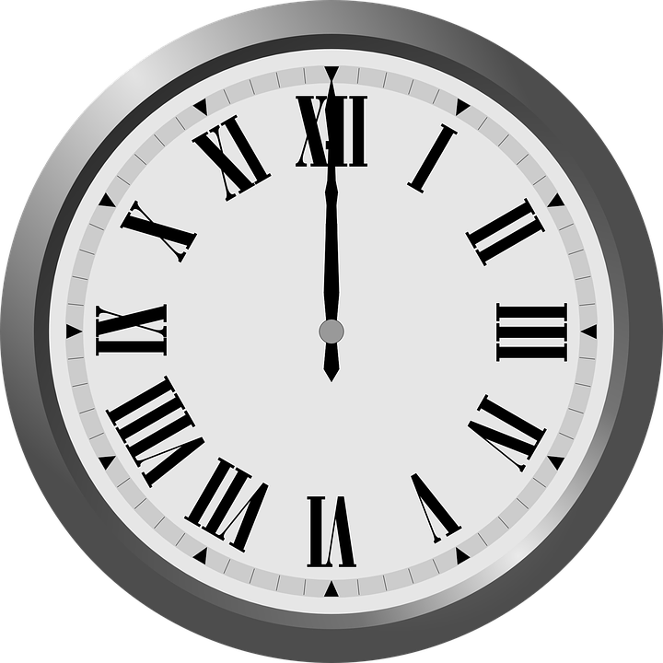
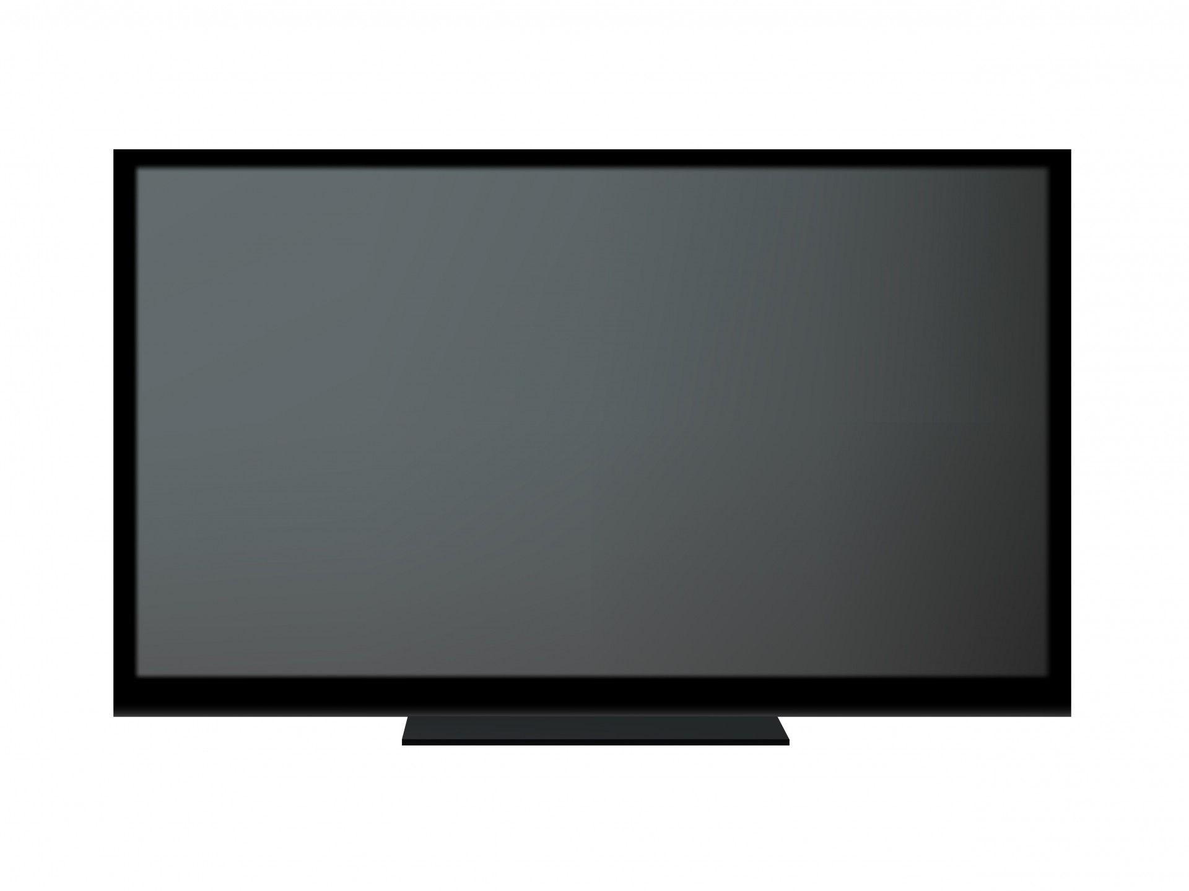
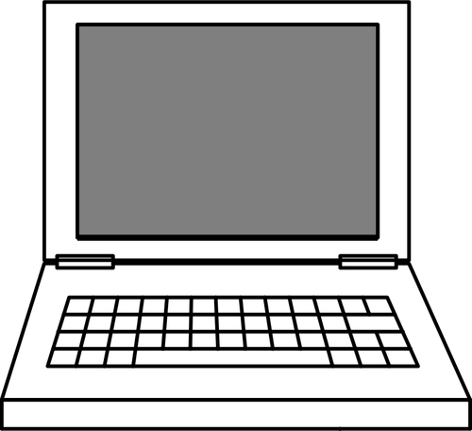




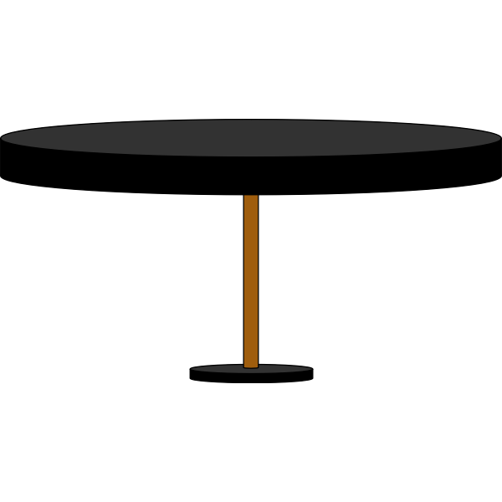
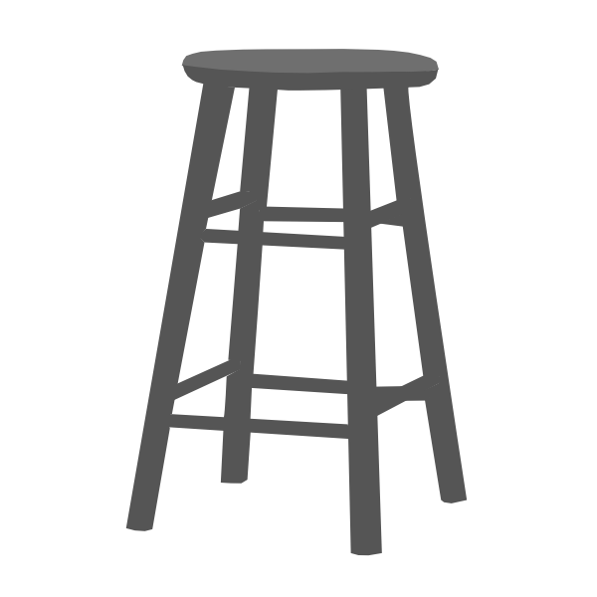

New Jersey Student Learning Standards
Core Concept: Computing Systems
People interact with a wide variety of computing devices that collect, store, analyze, and act upon information in ways that can affect human capabilities both positively and negatively. The physical components (hardware) and instructions (software) that make up a computing system communicate and process information in digital form.
Computing Systems
8.1.2.CS.1: Select and operate computing devices that perform a variety of tasks accurately and quickly based on user needs and preferences.
8.1.2.CS.2: Identify common computing devices and external hardware in different environments by name
Topics
Computing Systems
Types of Computing Systems
Computer Hardware
Computer Software
Resources
Grading Policy
Paper
Exit Ticket
Rubric
Supplies
Notes:
This is the base that can be changed.

Slide 3
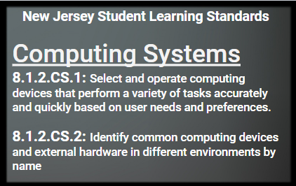

Slide 4
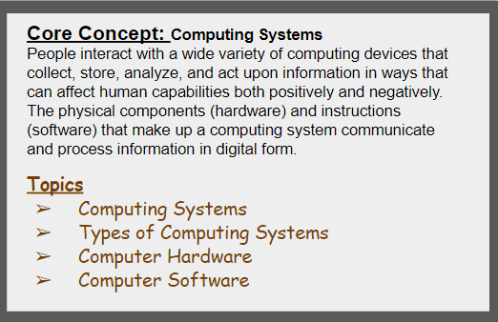

Slide 5
Part 1 Computing Systems

Slide 6
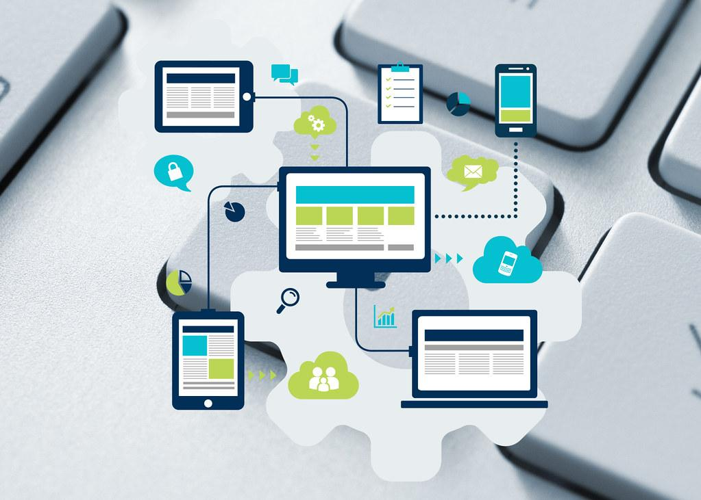
1. What is a computing system?
People interact with a wide variety of computing devices.

Slide 7
What is a computing device?

Slide 8
1. What is a computing device?
A computing system is an arrangement of hardware and software to perform a computing task to process, store, transmit, and manage data.

Slide 9
What types of computing devices do you use in everyday life?

Slide 10
Everyday computing devices include….
Smart phone
Laptop
Desktop
Printer
Tablet
Screen
Modem
Router
Scanner

Slide 11
1. Types of computing device?
We use different types of computing systems or devices:
stationary devices
mobile devices
wearable devices

Slide 12
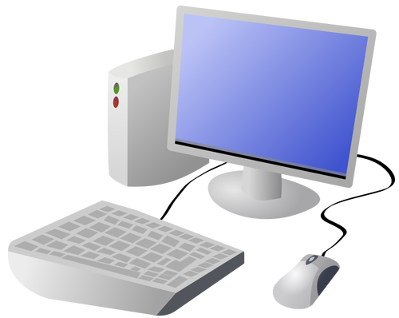
1a. Stationary devices
Devices are located in one place, like a desktop computer. You go to the device when you need to use it.

Slide 13
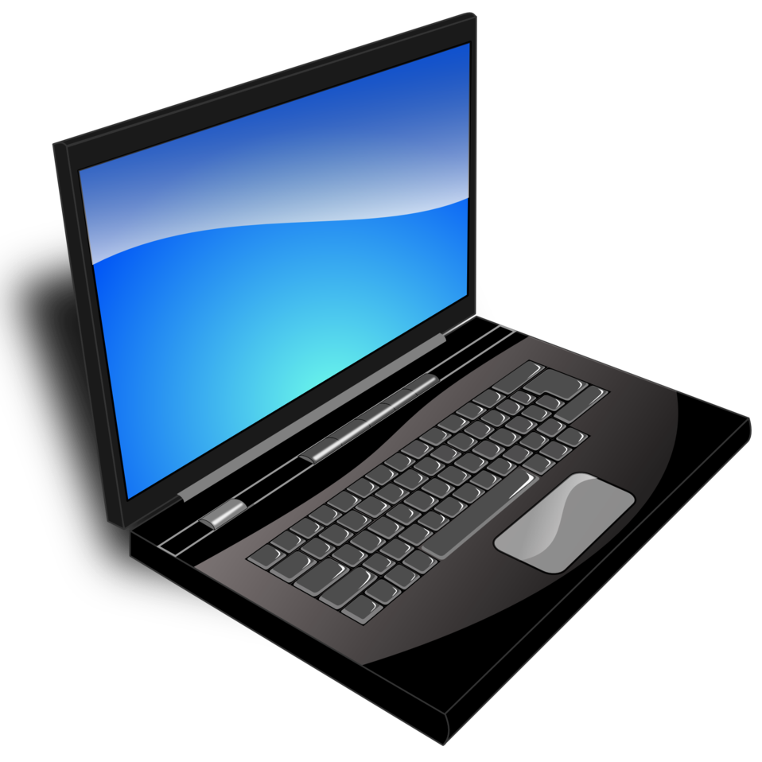
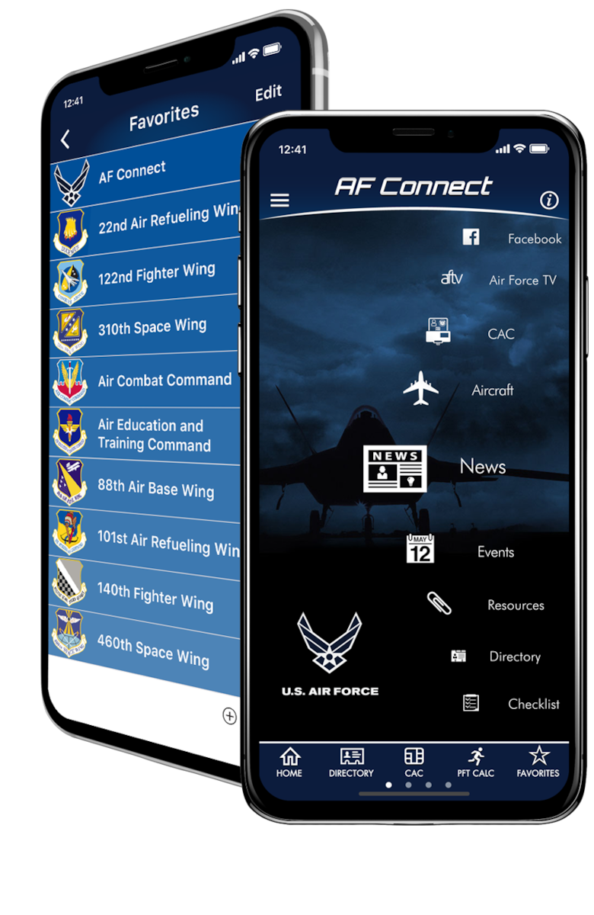

1b. Mobile Devices
Devices can be taken with you from place to place like a laptop, tablet and smartphone.

Slide 14
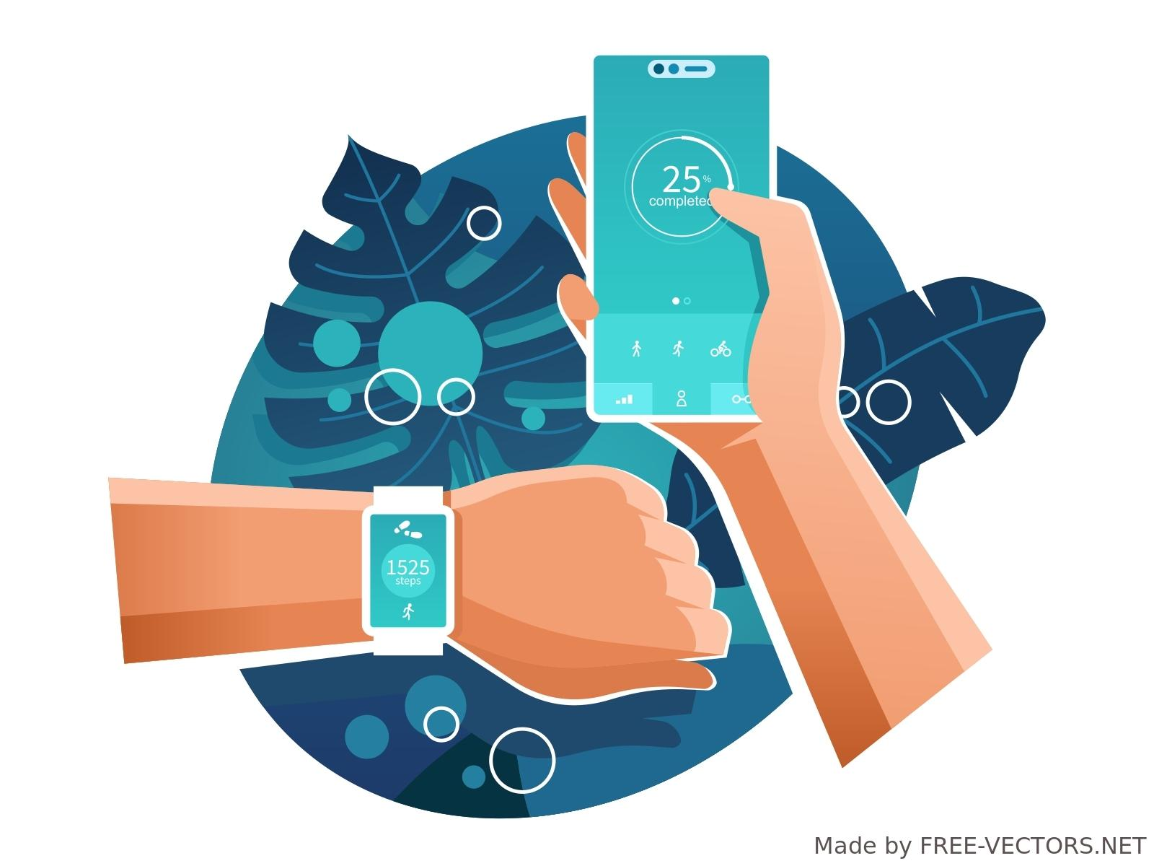
1c. Wearable Devices
A kind of mobile device that is worn on the human body, like a watch connected to a smartphone, fitness tracker, or wearable camera.

Slide 15
What types of computing devices do you use in everyday life?

Slide 16
Everyday computing devices include….
Smart phone
Laptop
Desktop
Printer
Tablet
Screen
Modem
Router
Scanner

Slide 17
1. Types of computing device?
We use different types of computing systems or devices:
stationary devices
mobile devices
wearable devices

Slide 18
1a. Stationary devices
Devices are located in one place, like a desktop computer. You go to the device when you need to use it.

Slide 19
1b. Mobile Devices
Devices can be taken with you from place to place like a laptop, tablet and smartphone.

Slide 20
1c. Wearable Devices
A kind of mobile device that is worn on the human body, like a watch connected to a smartphone, fitness tracker, or wearable camera.

Slide 21
2. What is a computing system?
Some of the information we give is good and
some is not good.
Some information
is helpful and
some is not helpful.

Slide 22
Review Questions

Slide 23
Question 1. What is a computing device?

Slide 24
Question 1. What is a computing device?
Answer→ Computing devices collect, store, analyze, and
act upon data
we input.

Slide 25
Question 2. What is the difference between a stationary device, mobile device, and wearable device?

Slide 26
Question 2. What is the difference between a stationary device, mobile device and wearable device?
Answer→ Stationary devices stay in one place, mobile devices are light enough to carry with you where ever you go, and wearable devices are worn on the body.

Slide 27
Computing systems all need hardware and software to work!

Slide 28
Question 3. Computing devices need both hardware and software to work properly?

Slide 29
Question 3. Computing systems need both hardware and software to work properly?
Answer→ True! Hardware and software are necessary to do work. The combination make up a computing system to process, store, transmit, and manage data to do work.

Slide 30
Part 2 Computer Hardware

Slide 31
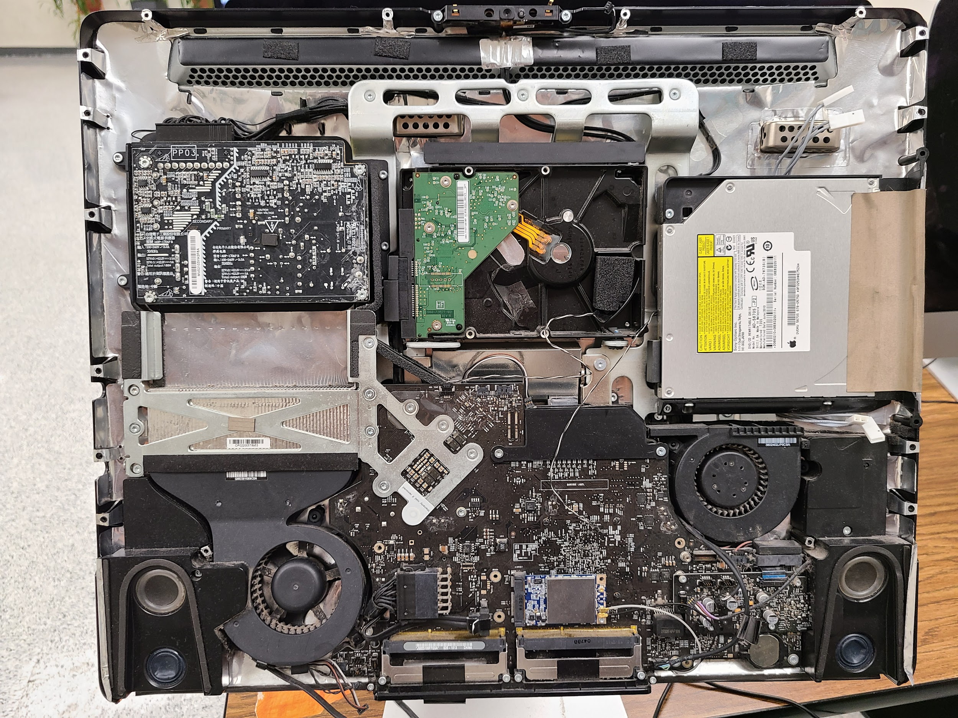
1. Computer Hardware
Computer hardware refers to the physical (touchable) parts and related devices that make up a computer systems.

Slide 32
Computer Hardware
Computers are made of internal and external components (parts).

Slide 33
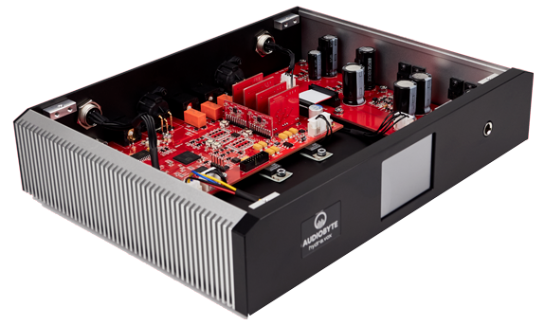
2. Internal Hardware
Internal hardware is the equipment or devices that are inside the computer.

Slide 34
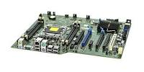
2.1 Motherboard
The motherboard is a computer's central communications backbone connectivity point, through which all components and external peripherals connect.

Slide 35
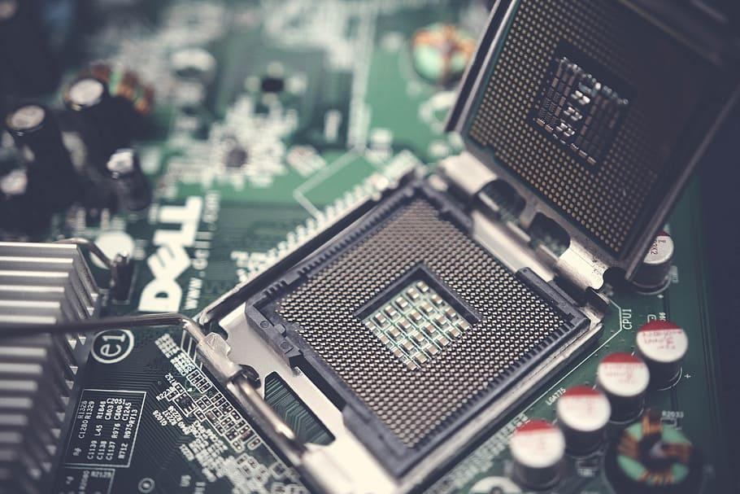
2.2 Central Processing Unit (CPU)
The Central Processing Unit (CPU) is the primary component of a computer that acts as its “control center.” The CPU runs the machine's operating system and apps.

Slide 36
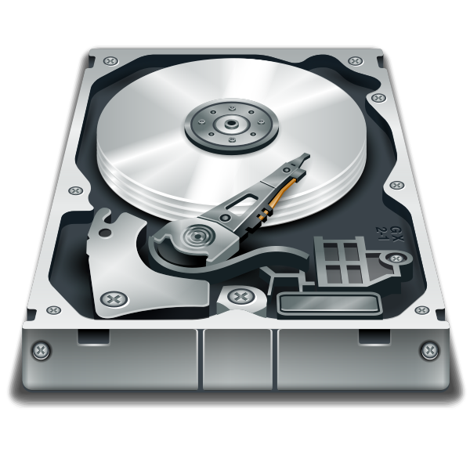
2.3 Hard Drive
A hard drive or hard disk drive (HDD) is a type of data storage device that is used in laptops and desktop computers. It retains stored data even when your device is off.

Slide 37
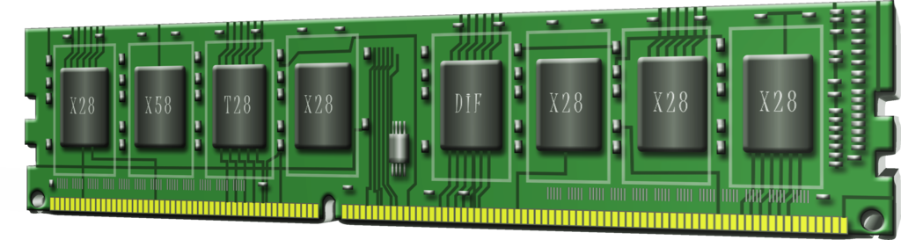
2.4 Computer Memory
Memory is the electronic holding place for the instructions and data or information the computer needs to reach quickly. It's where information is stored for immediate use.

Slide 38
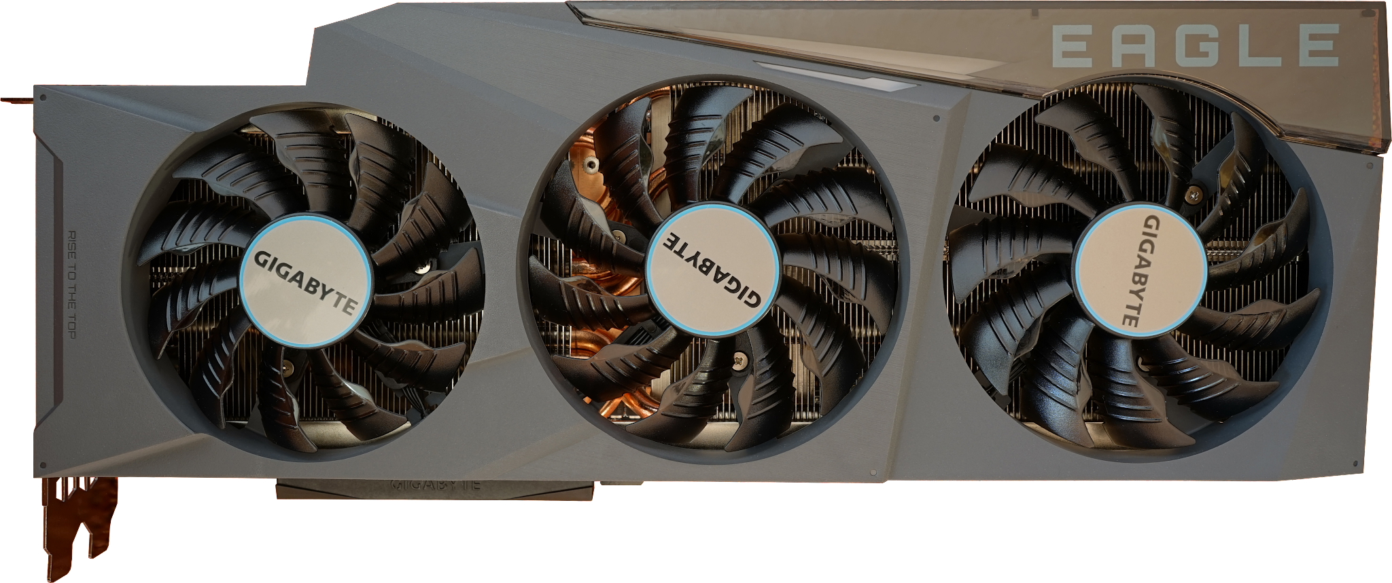
2.5 Computer Fan
A computer fan is any fan inside, or attached to, a computer case used for active cooling.

Slide 39
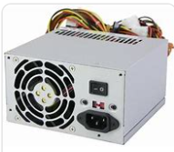
2.6 Power Supply
A power supply unit (PSU) converts mains AC to low-voltage regulated DC power for the internal components of a computer.

Slide 40
Review Questions

Slide 41
Question 4. Where is internal computer hardware located?

Slide 42
Question 4. Where is internal computer hardware located?
Answer→ Internal computer hardware is located inside the computer.

Slide 43
3. External Hardware
External hardware refers to devices that are attached to a computer. They are also called peripheral or I/O (input/output) devices.

Slide 44
3. External Hardware
There are two types of external hardware.
Input Devices
Output Devices
I/O Devices

Slide 45
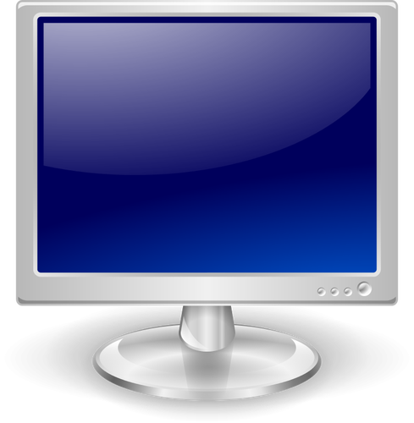
3. External Hardware “I/O Devices”
Output devices allow you to retrieve, see or hear results.
Input devices get data into the computer.

Slide 46
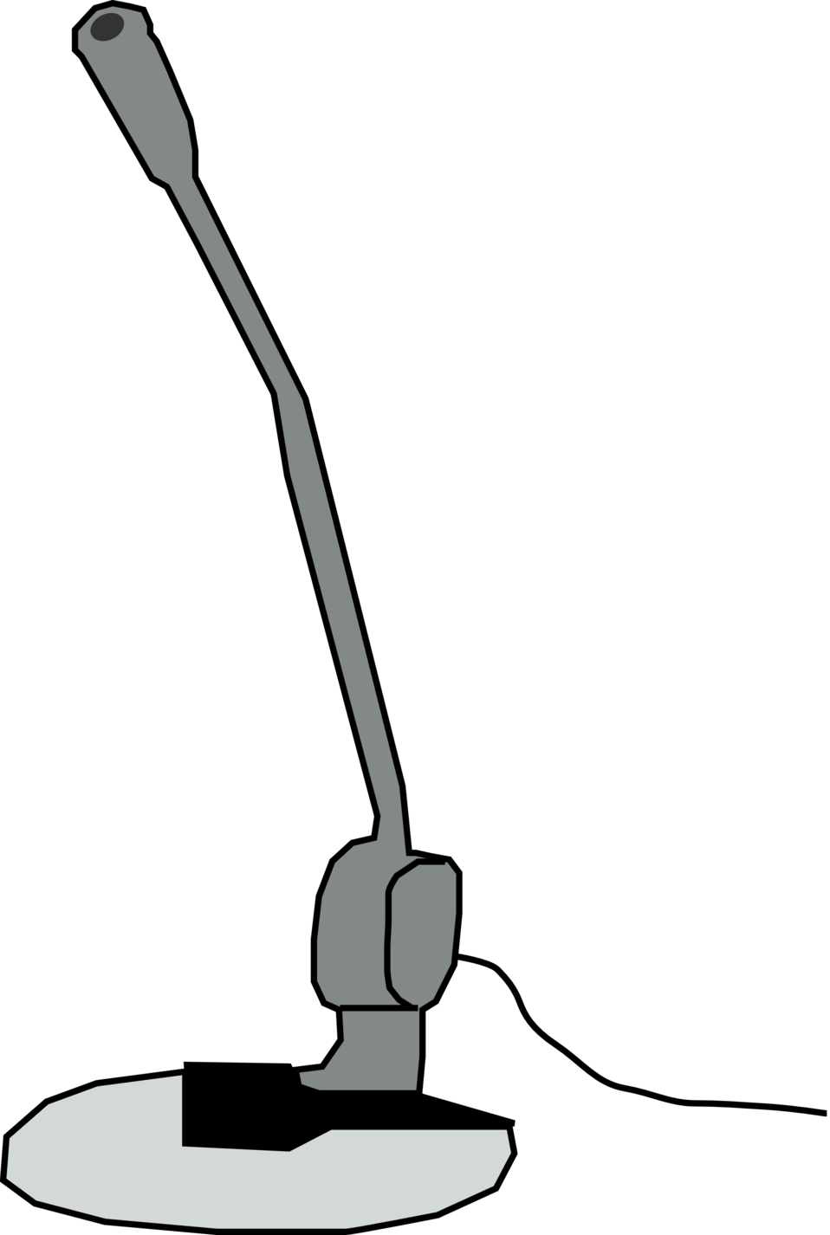
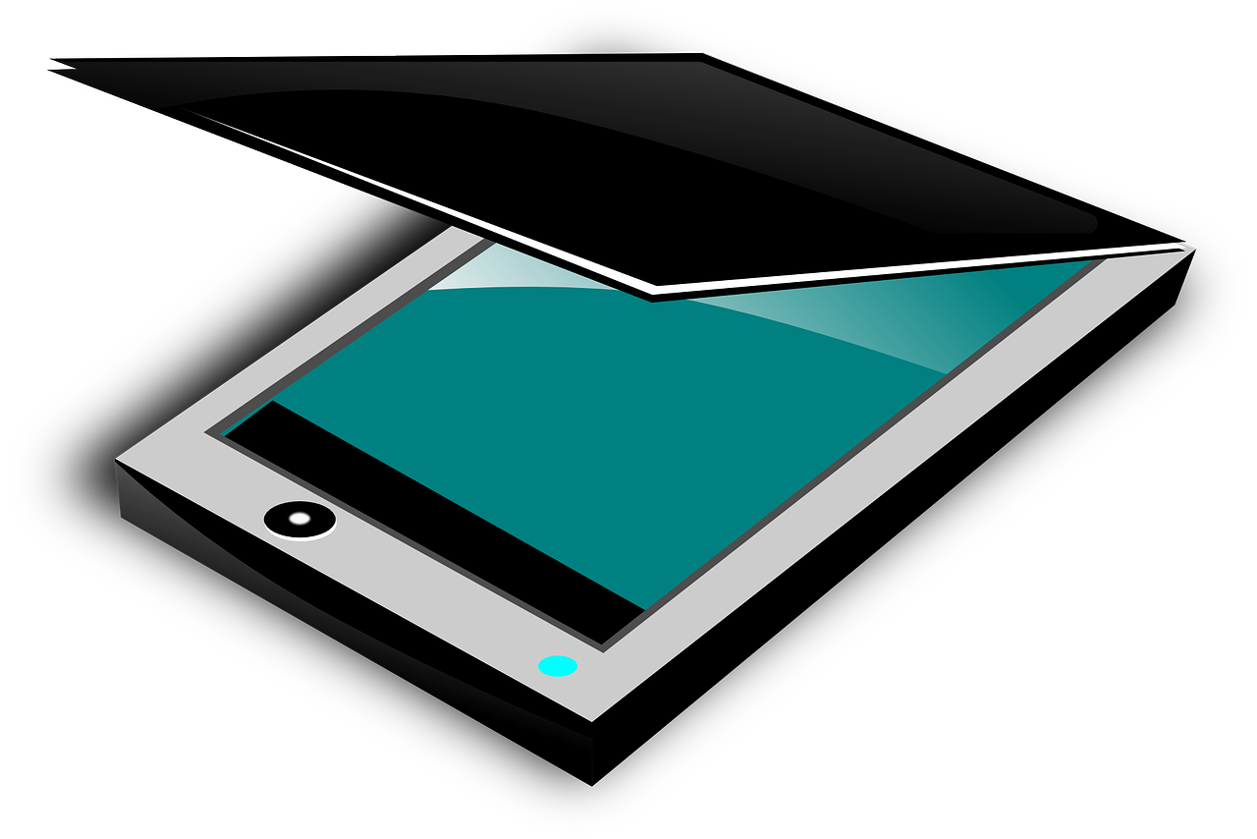
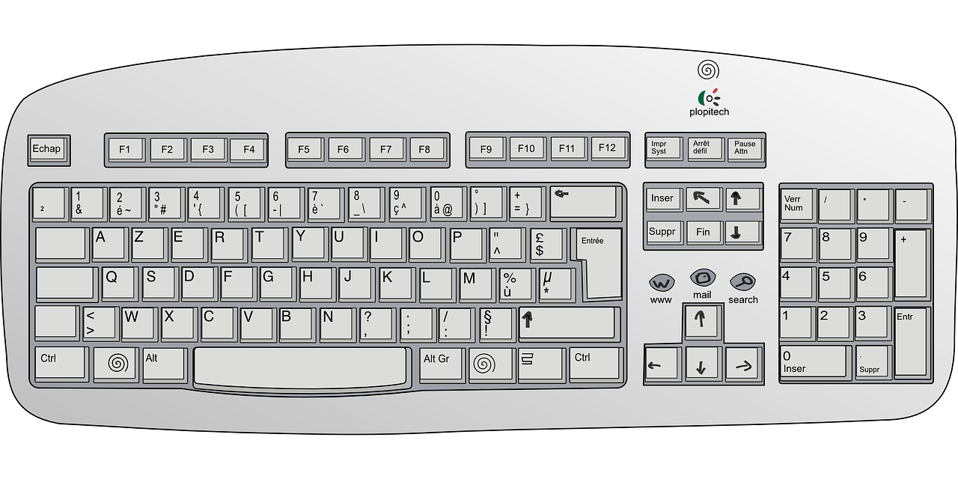
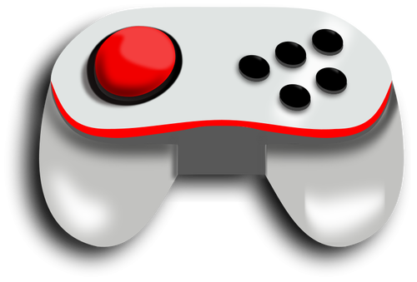
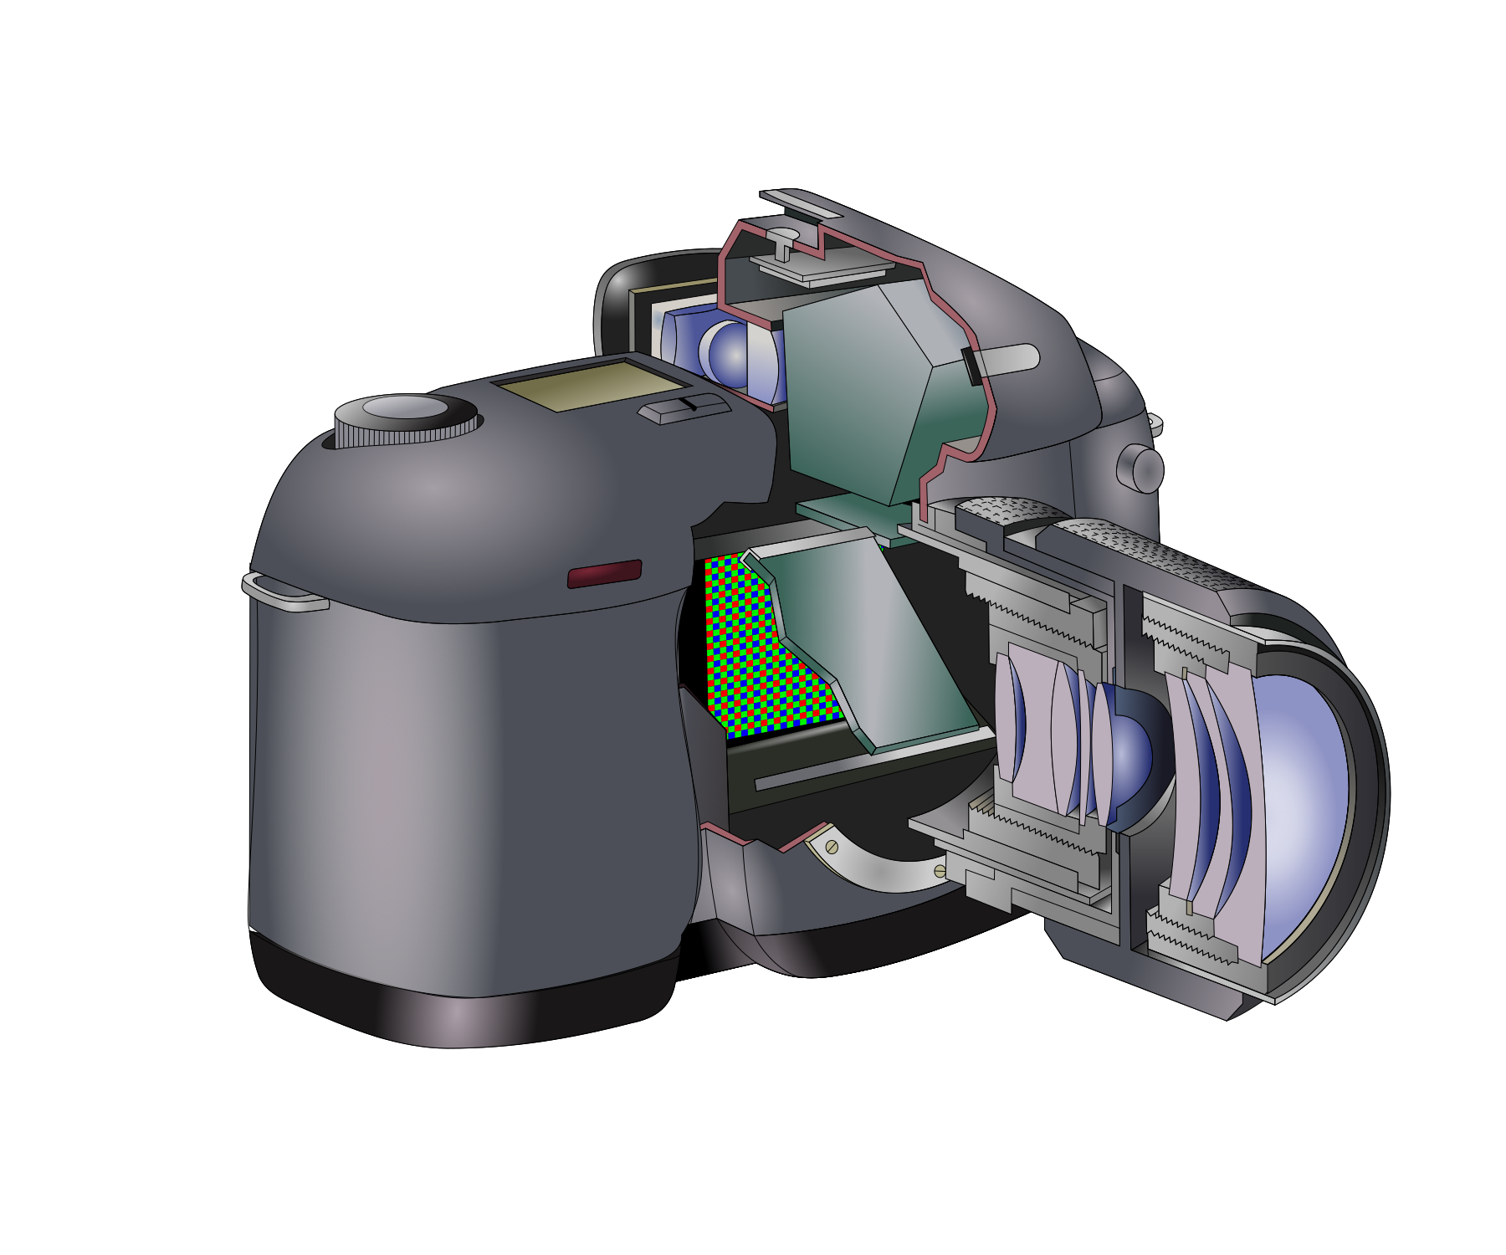
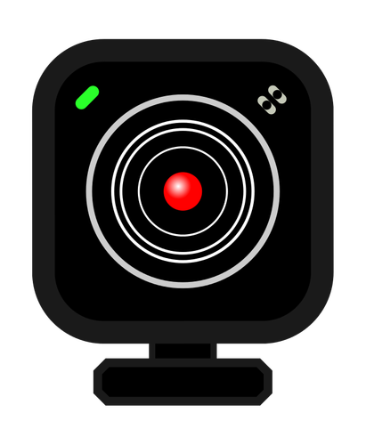

3a. Input Devices
An input device is any device that lets you get data into to a computer. Some examples are:
Keyboard
Mouse
Joysticks
Microphone
Scanners
Digital cameras, and
Webcams

Slide 47
Review Questions

Slide 48
Question 5. External computer hardware is also called what?

Slide 49
Question 5. External computer hardware is also called what?
Answer→ External hardware is also called peripheral or I/O (input/output) devices.

Slide 50
Question 6.
What is the meaning of I/O ?

Slide 51
Question 6. What does I/O stand for?
Answer→ Input/Output devices

Slide 52

Part 2A The Computer Keyboard

Slide 53
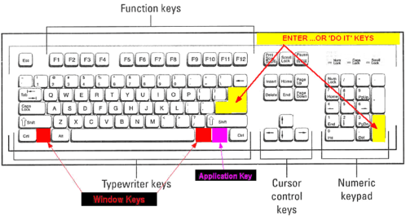

Slide 54
1
2
3
The picture above shows a typical keyboard. It’s design is more than 30 years old. It has not changed because we are use to it! All keyboards look similar to the ones used in this presentation.
The keyboard is divided in three basic sections→
Main keyboard or Typewriter keys
Cursor Control Keys and
Numeric keypad.
See sections 1,2, and 3 above. We will examine each section closer.

Slide 55
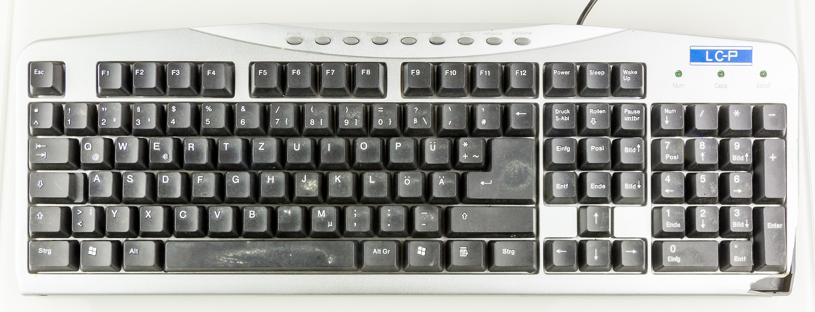
At the top of your keyboard are keys that begin with the letter F. They are called Function keys because each performs a specific tasks, like printing a document or boldfacing text. People used these keys alot before the mouse was invented.

Slide 56
Underneath the Function keys are keys that contain a symbol (on top) and number (at bottom). In order to type the symbol on top you must hold the Shift key down then press the symbol. For example to type the dollar sign $ you would press Shift then 4.

Slide 57
Underneath the symbol/number keys are Capital letters. When you type, the letters displayed on your screen are lowercase.
Caps Lock key which located on the left side is used when you want to type all capital letters.
The Shift key is used when you want to type one letter in a word capital like the beginning of sentence or proper noun.

Slide 58
Enter
There is an Enter key in the main area of the keyboard and on the Numeric keypad. We use the Enter key as follows:
As a hard return to force the cursor to move down to the next line.
Press the Enter key twice to get a blank line in between paragraphs or lines in your document.

Slide 59
Space Bar key
The long key at the bottom is called the Space Bar key. It is used to add a space. Please note the following:
You insert 1 space between words.
You insert 1 space at the end of an endmark (. , ?).

Slide 60
Cursor Control Keys
Before the mouse was invented, Cursor Control Keys were used to navigate or move throughout a document, insert space or delete text. Arrow keys were used to move throughout a document and as gaming controls.

Slide 61
Numeric Keypad
The Numeric keypad is located on the right side of your screen. Some keys have words, some have numbers with words or directional arrows, while others contain math symbols. The Numeric keypad serves the following two functions:
It serve as cursor controls.
It functions as a calculator to type numbers and basic equations.
In order to use the Numeric keypad as a calculator you must press the NumLock key located toward the top. A green or white light will usually appear indicating that the insert number feature is on. To use it as a Cursor Control just deselect the same key.

Slide 62
Review Questions

Slide 63
Question 7. What are the keys with an F followed by a number called? What do they do?

Slide 64
Question 7. What are the keys with an F followed by a number called?
Answer→ They are called Functions keys because they perform a task like printing or boldfacing text.

Slide 65
Question 8. What key would you press to type all capital letters?

Slide 66
Question 8. What key would you press to type all capital letters?
Answer: Caps Lock key

Slide 67
Question 9. What key do you press to put a space in between words?

Slide 68
Question 9. What key do you press to put 1 space in between words?
Answer→ The Space bar puts one blank space between words.

Slide 69
Question 10. What key do you press to type the first letter of a word capital?

Slide 70
Question 10. What key do you press to type the first letter of a word capital?
Answer→ You press and hold the Shift key then the letter you want to capitalize.

Slide 71
Question 11. What keys do you press to type the following 5%?

Slide 72
Question 11. What keys do you press to type the following → 5%
Answer→ Press 5 then Shift+5

Slide 73
Question 12. What would you press to force the cursor to go to the beginning of the next line?

Slide 74
Question 12. What would you press to force the cursor to go to the beginning of the next line?
Answer→ You press the Enter key

Slide 75


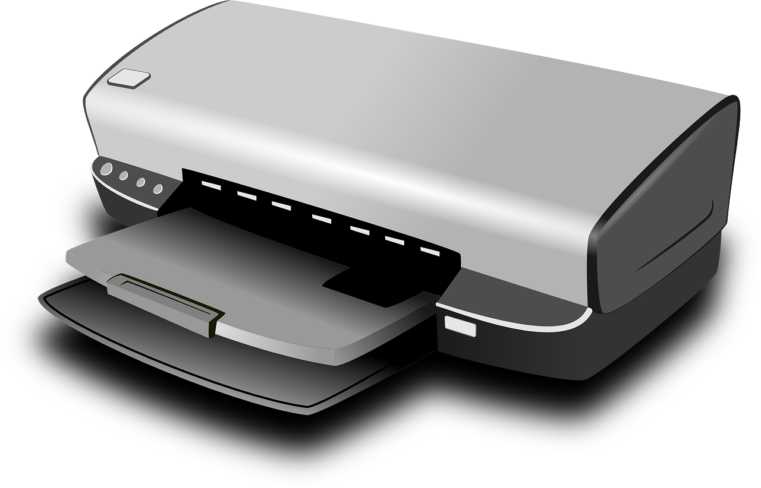
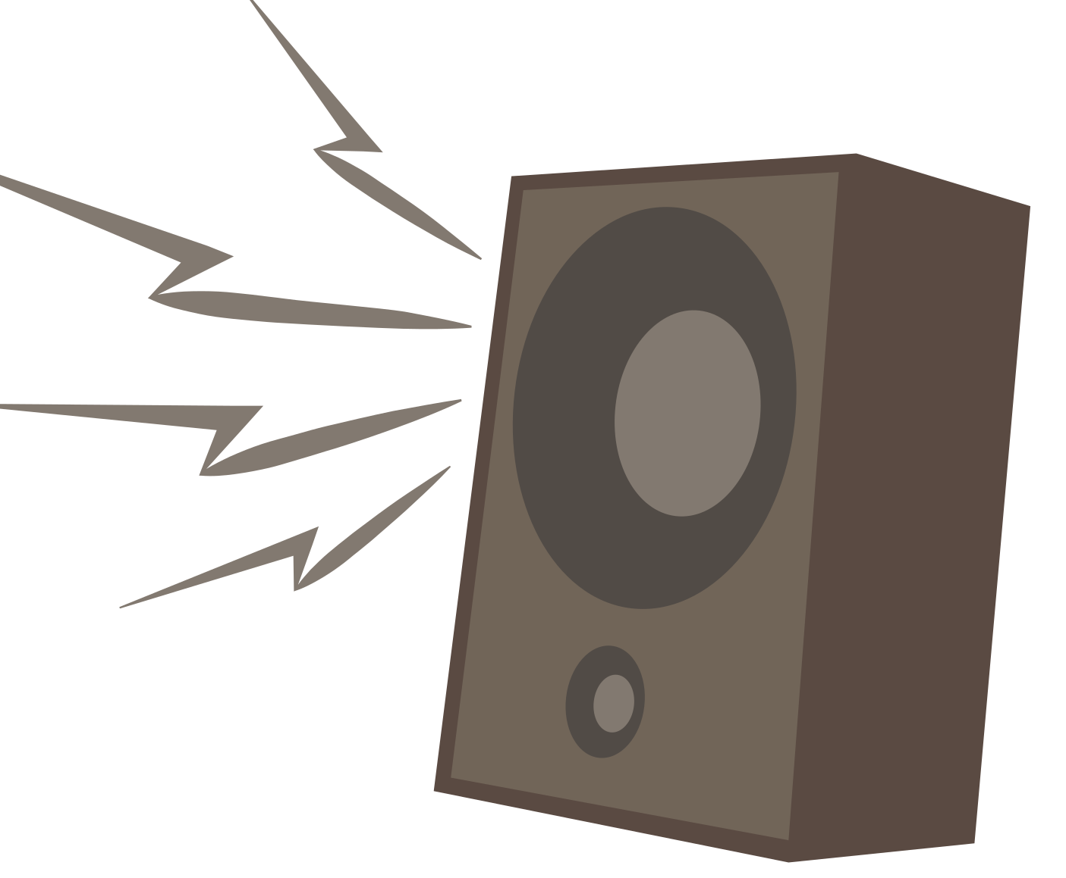
3b.Output Devices
Any device that outputs information from a computer is called an output device. They allow you to retrieve data. Some examples are:
Monitors
Printers,
Speakers,
Headphones,
Projectors

Slide 76
Review Questions

Slide 77
Question 13. What is an output device?

Slide 78
Question 13. What is the job of output devices?
Answer→ An output device allows you to access (“get”) data from the computer.

Slide 79
Hardware Recap!
Hardware refers to the physical components (parts) and related devices that make up a computer systems.
A computer can have internal hardware and external hardware.
Internal hardware are devices that are inside the computer.
External hardware are devices that are outside the computer.
External hardware is commonly called peripheral devices.
I/O stands for Input/Output.
I/O devices are attached to a computer.
An input device like a keyboard allows users to get information into the computer systems.
Output devices like a screen, allow you to get information out of the computer.
You need both hardware and software for your computer system to work!

Slide 80
Part 3 Computer Software

Slide 81
3. What is software?
Software is a program commonly defined as a set of instructions, or a set of modules or procedures, that allow for a certain type of computer operation.

Slide 82
3a. What are software programs called?
software
software application
apps

Slide 83
3b. Types of Software Programs
System Software
Applications Software
Control and coordinate the procedures and functions of computer hardware.
Programs created to complete specific tasks.

Slide 84
3b.1 Types of Software Programs
System Software
Applications Software
Control and coordinate the procedures and functions of computer hardware.
Programs created to complete specific tasks.
Content Access software
Web browsers
Operatioperatng system
Firmware
Graphic
software
Spreadsheets
Device Drivers
Database software
Education software
Multimedia Software
Translator
Utility
Word processors
Information Software
Presentation

Slide 85
3b.2 System Software
Control and coordinate the procedures and functions of computer hardware.
Operating system
Device Drivers
Translator
Utility
Firmware
Harnesses communication between hardware, system programs, and other applications.
Enables device communication with the OS and other programs.
Translates programming languages to low-level machine codes.
Ensures optimum functionality of devices and applications.
Enables device control and identification.

Slide 86
3b.3 Applications Software
Web browsers
Word processors
Programs created to complete specific tasks
Applications Software
Presentation
Spreadsheets
Education software
Database software
Multimedia Software
Content Access software
Information Softwares
Graphic software

Slide 87
3b.4 Apps often used at school.
Presentation
Word processors
Web browsers
Apps Like MS Powerpoint and Google Slides that allow visual presentations of information in the form of slides that incorporate text, charts, tables, audio, video, and animation.
Apps that facilitate easy surfing of the internet like Microsoft Edge and Chrome.
Apps like MS Word and Google Docs that enable document production like letters, essays, book reports, and research papers.
Education software
Spreadsheets
Apps like Typing.com and Flocabulary that are designed for learning and tutorials.
Apps like MS Excel and Google Sheets that enable the representation of data in tabular form (columns & rows) which can be analyzed and shown as charts and graphs.

Slide 88
Computer Software Recap
Computer Software refers to programs that manage the computer and perform tasks for you.
The two categories of software are System Software and Applications Software Programs (or apps).
System Software manages the computer system.
Applications Programs or apps are used to complete specific tasks.
The five types of applications programs typically used at school are:
Browser Programs like Internet Explorer and Chrome help make our online experiences easy.
Word processing programs like MS Word and Google Docs that help us create documents like essays, reports, letters, resumes, brochures, flyers, etc.
Spreadsheet programs like MS Excel and Google Sheets that are used to create lists and data tables that can be converted into charts and graphs..
Presentation Programs like MS Powerpoint and Google Slides that enable use to present information by combining text, sounds, video, and images.
Educational Software like typing programs and reading programs that help us learn and improve a skill.
You need both hardware and software to have a functioning computer.

Slide 89
Links to work cited
Computer Hardware
Input and Output Devices
Types of Software Programs
Different Types of Applications Software
I/O Devices

