Slide 1
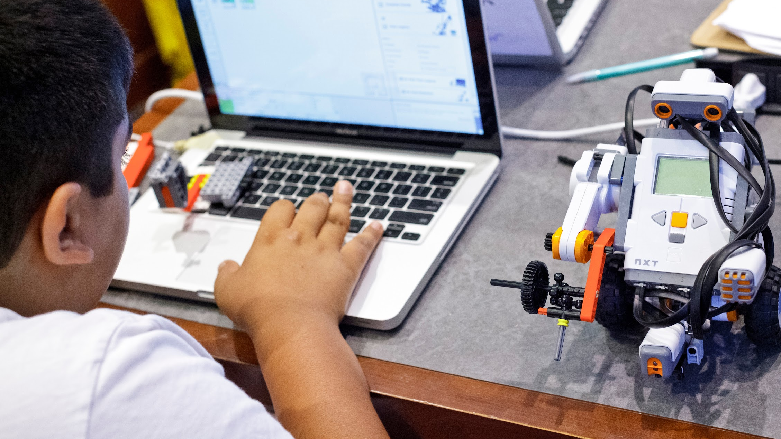
COMPUTER SCIENCE FOR EVERYONE, EVERYWHERE
8/22/23
Introduction to Computer Science Education
NJDOE Standards 22E00178
NJDOE Hub 22E00173

Slide 2
Today’s Agenda
Welcome to the Computer Science for Everyone, Everywhere (CSEE) Program
Congratulations on taking this important step in computer science education - knowing the CS standards and expectations for CS education at your school/district.
SURVEYS SHOULD BE COMPLETED TODAY:
ATTITUDE (w/ NYU)
CONSENT
HR
PRE-PD SURVEY
Computer Science for Everyone, Everywhere (CSEE)
Notes:
SUMI

Slide 3
Daily Schedule 8/22, 23, 24
8:30 - 9:00 Breakfast
9:00 - 10:00 PD
10:00 - 10:15 Break
10:15 - 11:15 PD/Breakout groups
11:15 - 12:15 Working lunch
12:15 - 2:00 Breakout Group: Lesson
Demonstration and Debrief
Computer Science for Everyone, Everywhere (CSEE)
Notes:
SUMI

Slide 4
Objectives for our PD Session 1
Create a community of learners
Tell the story of why CS in K-12
Envision CS education that centers on students
Unpack the NJ Computer Science Standards
Distinguish between different components of the NJCSS
Align NJCSS to pre-existing work
Computer Science for Everyone, Everywhere (CSEE)
Notes:
SUMI

Slide 5
What is computer science?
ⓘ
Click Present with Slido or install our Chrome extension to activate this poll while presenting.
Notes:
📣 This is Slido interaction slide, please don't delete it. ✅ Click on 'Present with Slido' and the poll will launch automatically when you get to this slide.

Slide 6
ICE BREAKER: Complete the following statement
“HOW I FEEL ABOUT TEACHING COMPUTER SCIENCE...”
At your table, work together to elaborate on this statement using one
of the methods listed below.
Plan: 20 mins.
a) write a poem
b) draw a picture
c) tell a story
d) interpretive dance
Computer Science for Everyone, Everywhere (CSEE)
Notes:
SUMI

Slide 7
How is the icebreaker activity relevant to computer science education?
mix of emotions
activity - out of comfort zone, like CS
starts with everyone having different ways to interact, share information, data/explore data, and learning from the discovery
follow the process
creativity
array of talent, feeling the same, really don’t know the reach, there is not end
Computer Science for Everyone, Everywhere (CSEE)
Notes:
SUMI

Slide 8
STORYTELLING
Computer Science for Everyone, Everywhere (CSEE)

Slide 9
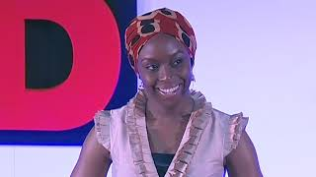
Why is story relevant in CS education?
Computer Science for Everyone, Everywhere (CSEE)

Slide 10
Why is story relevant in this PD for CS education?
CS is a relatively new field in K-12 education
You are authoring the future of CS education in NJ
Computer Science for Everyone, Everywhere (CSEE)

Slide 11
Why is story relevant in this PD for CS education?
CS is a relatively new field in K-12 education
You are authoring the future of CS education in NJ
Computer Science for Everyone, Everywhere (CSEE)

Slide 12
Single story
diversity of backgrounds do not make it a single story
people often have a perception of computer science, people who can do CS without understandings CS bc of a preconceived notion of CS; not taking the time to learn and understand. Learning and discovery in the re-read of things. not about the answers, the questions that drive us.
non-tested subjects have a single story - in between space, assign homework or not
anything that is new, we build off a narrative the pre-existed; change perception of the concepts.
difference between challenge and validation; challenge self to see other side.

Slide 13
What “story” will you author about CS education in your students’ lives?
Center on students and their lived experiences
Universally designed for inclusive and equitable learning
Constructionism: “learning by making” is personal, social, and cultural
Computer Science for Everyone, Everywhere (CSEE)
Notes:
In the early 1980s (that is in the era before the appearance of mass-produced personal computers), the mathematician Seymour Papert envisioned that one day, all children would have a personal portable computer that would fit their small hands and enable them to concretize and individualize their own education (Papert, 1980, 1985).
Focuses on children constructing their learning.
Papert emphasized children’s agency in making choice, thinking independently and seeking answers via discovery learning and share four key learning principles: cognitive challenge, children’s agency, discovery learning, and child-led learning.
Papert: “[C]onstructionism – shares Constructivism’s connotation to learning as building knowledge structures irrespective of the circumstances of learning. It then adds the idea that this happens in a context where the learner is consciously engaged in constructing a public entity whether it’s a sand castle on the beach or a theory of
the universe that can be shared with others”.

Slide 14
What is computer science?
What computer science is NOT: Computer
Internet
Software
Programs
Video games
Computer science is:
We use CS the most in our everyday life
Problem-solving, logic, analyzing
Application
Programming, coding (tool to do CS)
Impact on society
Data (base level - foundation)
Computer Science for Everyone, Everywhere (CSEE)
Notes:
Lincoln

Slide 15
MSU CS EDUCATION PRINCIPLES
COMPUTATIONAL THINKING
PROBLEM SOLVING
COMMUNICATING
COLLABORATING
PROCESS
CONCEPTS
STUDENT
• COMPUTING SYSTEMS (CS)
• NETWORKS/INTERNET(NI)
• IMPACTS OF COMPUTING (IC)
• DATA AND ANALYSIS (DA)
• ALGORITHMS-PROGRAMMING (AP)
INNOVATION
RENAISSANCE: CREATE, IMAGINE POSSIBILITIES
DIGITAL CITIZENRY
EQUITABLE, RESPONSIBLE
POLICY
SHAPES SOCIETY AND CULTURE
CONSEQUENTIAL
Computer Science for Everyone, Everywhere (CSEE)
Notes:
Lincoln

Slide 16
MSU CS EDUCATION FRAMEWORK
COMMUNITY
CURRICULUM
POLICY
STUDENT
PROFESSIONAL DEVELOPMENT
ACCESS
FAMILY
AFTER-SCHOOL/
SUMMER
Computer Science for Everyone, Everywhere (CSEE)
Notes:
Lincoln

Slide 17
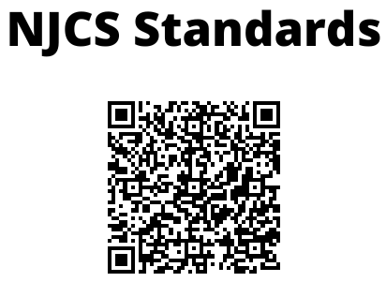
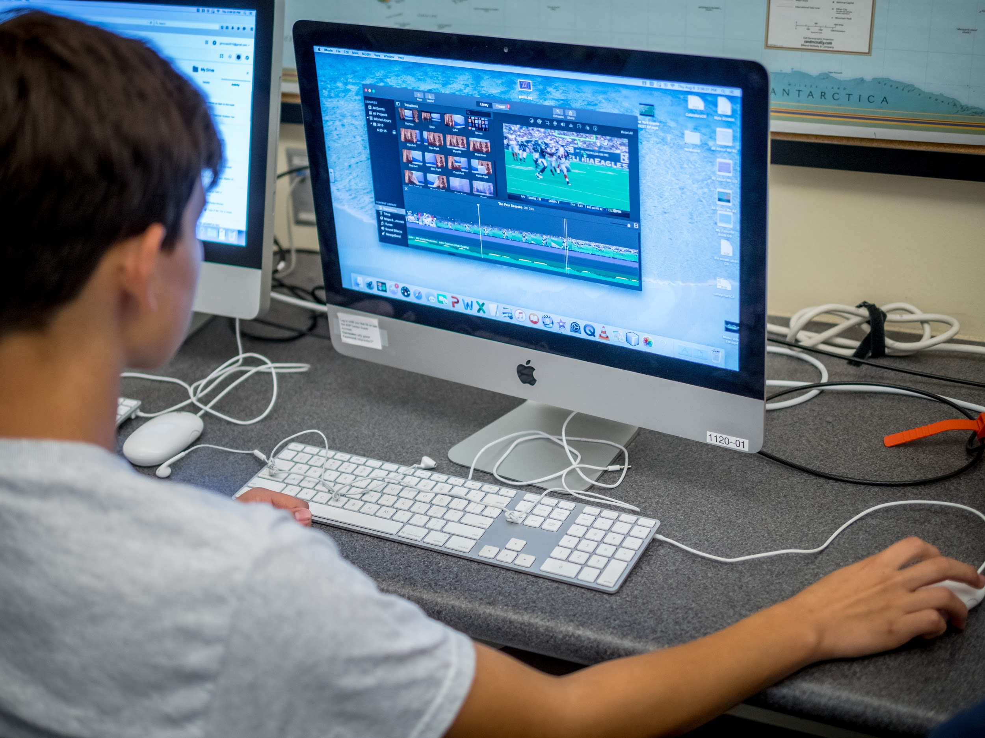
NEW STUDENT ORIENTATION | K-12 COMPUTER SCIENCE TEACHING
Notes:
PRINT OUT COPIES OF QR CODE

Slide 18
Changes to the Standards
Note: 8.1 Educational Technology of the 2014 NJSLS – Technology have been expanded and integrated across multiple disciplinary concepts in the 2020 NJSLS – Career Readiness, Life Literacies, and Key Skills standard 9.4.
Note: Computer Science and Design Thinking Practices (pages 13-15)
Process skills and practices
Computational Thinking (CT)
Computer Science for Everyone, Everywhere (CSEE)

Slide 19
Navigating the NJ Computer Science Standards
•Standard 8.1 Computer Science/Computer Science, previously a strand entitled ‘Computational Thinking: Programming’ in standard 8.2 of the 2014 NJSLS-Technology, outlines a comprehensive set of concepts and skills, such as data and analysis, algorithms and programming, and computing systems. (pages 4-7)
•Standard 8.2 Design Thinking. This standard, previously standard 8.2 Technology Education of the 2014 NJSLS – Technology, outlines the technological design concepts and skills essential for technological and engineering literacy. The new framework design, detailed previously, includes Engineering Design, Ethics and Culture, and the Effects of Technology on the Natural world among the disciplinary concepts.
Computer Science for Everyone, Everywhere (CSEE)

Slide 20
Navigating the Standards
Page 3 and 16
Performance Expectations are the studs and serve as the framework for what students should know and be able to do.
The Disciplinary Concepts and Core Ideas are the joists and play an integral role in the framing by making connections among the performance expectations. Core ideas help to prioritize the important ideas and core processes that are central to a discipline and have lasting value beyond the classroom.
The Practices are the roof and represent two key ideas. Positioned as the top of the house, they represent the apex of learning. The goal is for students to internalize the practices (habits of mind) and be able to apply them to new situations outside the school environment. The practices span across all aspects of the standards and are an integral part of K-12 students’ learning of the disciplines.
Computer Science for Everyone, Everywhere (CSEE)

Slide 21
Navigating the Standards
Disciplinary Concepts:
• Computing Systems (CS)
• Networks and the Internet (NI)
• Impacts of Computing (IC)
• Data & Analysis (DA)
• Algorithms & Programming (AP)
8.1 2 NI 1
Standard End grade Disciplinary Performance
Number Concept Expectation
CS Standards for K-8 on pages 20-29.
Computer Science for Everyone, Everywhere (CSEE)

Slide 22
UNPACKING THE STANDARDS
Lead Faculty
K2 Minsun/Lincoln
3-5 Sumi
6-8 Vaibhav/Angela
9-12 Kathy
Computer Science for Everyone, Everywhere (CSEE)
Notes:
PRINT PAGES SPECIFIC TO GRADE BANDS FOR SMALL GROUP

Slide 23
UNPACK THE STANDARDS
https://docs.google.com/document/d/1kBtRUDatRGgHnnphpVjfbzc7xA444nHOKpaKukckcG4/edit
Review Impacts of Computing for your grade band
Follow Unpacking the Standards
Unpack using chart paper to record notes
Debrief
Computer Science for Everyone, Everywhere (CSEE)
Notes:
PRINT PAGES SPECIFIC TO GRADE BANDS FOR SMALL GROUP

Slide 24
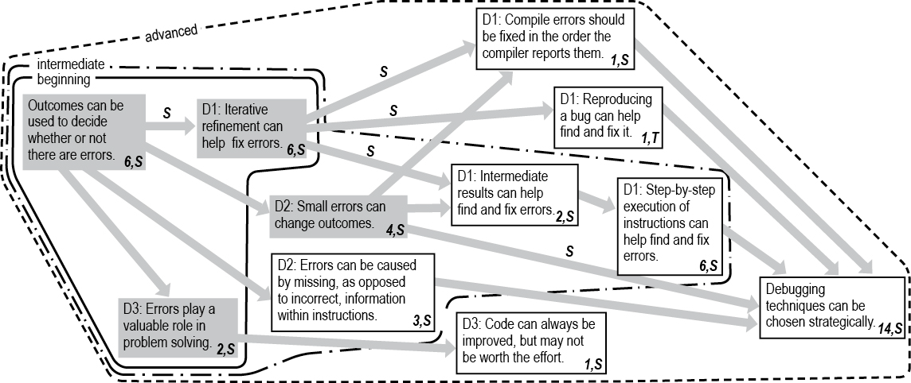
Activity: Debugging
Kathryn M. Rich, Carla Strickland, T. Andrew Binkowski, and Diana Franklin. 2019. A K-8 Debugging Learning Trajectory Derived from Research Literature. In Proceedings of the 50th ACM Technical Symposium on Computer Science Education (SIGCSE '19). Association for Computing Machinery, New York, NY, USA, 745–751.
Computer Science for Everyone, Everywhere (CSEE)

Slide 25
Activity: Debugging
When students or adults engage in a process of inquiry that is self-chosen, is personally motivating, and has meaningful implications, they can lose themselves in the inquiry process.
Inquiry becomes play.
Baker, M., Daliva,G.S. (2018, November). Inquiry is play: Playful participatory research.
Retrieved from https://www.naeyc.org/resources/pubs/yc/nov2018/inquiry-is-play-playful-participatory-research
Computer Science for Everyone, Everywhere (CSEE)

Slide 26
Activity: Debugging
Being in a relaxed and playful state of mind, we were eager to share ideas and feedback with each other; we experienced playful learning when the documentation we shared offered windows into each other’s classrooms, providing a common reference point for generative and supportive dialogue.
Baker, M. & Daliva,G.S. (2018)
Computer Science for Everyone, Everywhere (CSEE)

Slide 27
WHAT PLAYFUL LEARNING LOOKS LIKE and FEELS LIKE: Choice, Wonder, Delight

Slide 28
DEBUGGING ACTIVITY:
THE HOOK or ANTICIPATORY SET
ENGAGE a learner (WONDER): https://youtu.be/UAG_FBZJVJ8
Have you seen a robot? How does a robot know how to move?
This can lead to a conversation about programming?
Definitions:
Algorithm - A precise sequence of instructions that can be executed by a computer
Bug - Part of a program that does not work correctly.
Debugging - Finding and fixing problems in an algorithm or program.
Program - An algorithm that has been coded into something that can be run by a machine.
Another video option: https://www.youtube.com/watch?v=QdQL11uWWcI&t=47s

Slide 29
PLAY: CUP STACKING GAME (or MY ROBOTIC FRIEND from Code.org)
https://studio.code.org/s/pre-express-2018/stage/6/puzzle/1
How can you create this model of three cups:
Start with a stack of three cups.
Code:
↑: pick up cup (approx. 1 foot/12 inches)
↓: put down cup
→: forward (right, 1/2 cup width)
←: backward (left, 1/2 cup width)

Slide 30
Handy Rules: Students = Programmers
Up means that the cup automatically goes up 12 inches
Down means that it automatically goes down until it lands on something
The hand automatically returns to cup stack after setting down a cup
Forward means the robot moves one step (1/2 cup width) forward
Backward means the robot moves one step (1/2 cup width) Backward
Note: Students may not use backward at this age unless they want to build the cup stacks in reverse (which is also okay)
Programmers are not allowed to talk when the robot is working. This includes blurting out answers or pointing out when the robot has done something wrong
Programmers should raise their hand if they see a bug

Slide 31
HOW TO MAKE A ROBOT CREATE YOUR STACK OF CUPS?
PROGRAM IT- Answer key

Slide 32
Discussion questions
What strategy was used to find and fix errors?
What types of errors did you identify?
What is the role of errors in problem solving?

Slide 33
ASSESSMENT for Students
Journal Prompts:
Draw your own stack of cups that you would like to see a robot build.
Can you create a program for that cup stack?
OTHERS:
1. Create a program for your partner (robot). Try to create each other’s design.
2. Write the program in reverse (unstack the cups).

Slide 34
GOTS/NEEDS Poster
Connect with Us
Computer Science for Everyone, Everywhere (CSEE)

Slide 35
Expectations for the the PD series
Dates:
8/23 UDL and CS Teaching and Learning, Standard: Impacts of Computing
8/24 CS Primer, Standard: Computing Systems
Computer Science for Everyone, Everywhere (CSEE)
Notes:
SUMI

Slide 36
Introduction to the MSU Team
Sumi Hagiwara hagiwara@montclair.edu
Kathy Herbert herbertk@montclair.edu
Minsun Shin shinm@montclair.edu
Vaibhav Anu anuv@montclair.edu
Lincoln Lawrence l.lawrence@eastorange.k12.nj.us
Angela Willliams-Nash a.nash@eastorange.k12.nj.us
Rebecca Goldstein goldsteinr@montclair.edu
Amy DeFelice defelicea@montclair.edu
Stefan Robila robilas@montclair.edu
Rui Li lir@montclair.edu
Jessica Miller millerjess@montclair.edu
Computer Science for Everyone, Everywhere (CSEE)
Notes:
Move to the last slide

Slide 37
Connect with Us
Computer Science for Everyone, Everywhere (CSEE)

