Slide 1
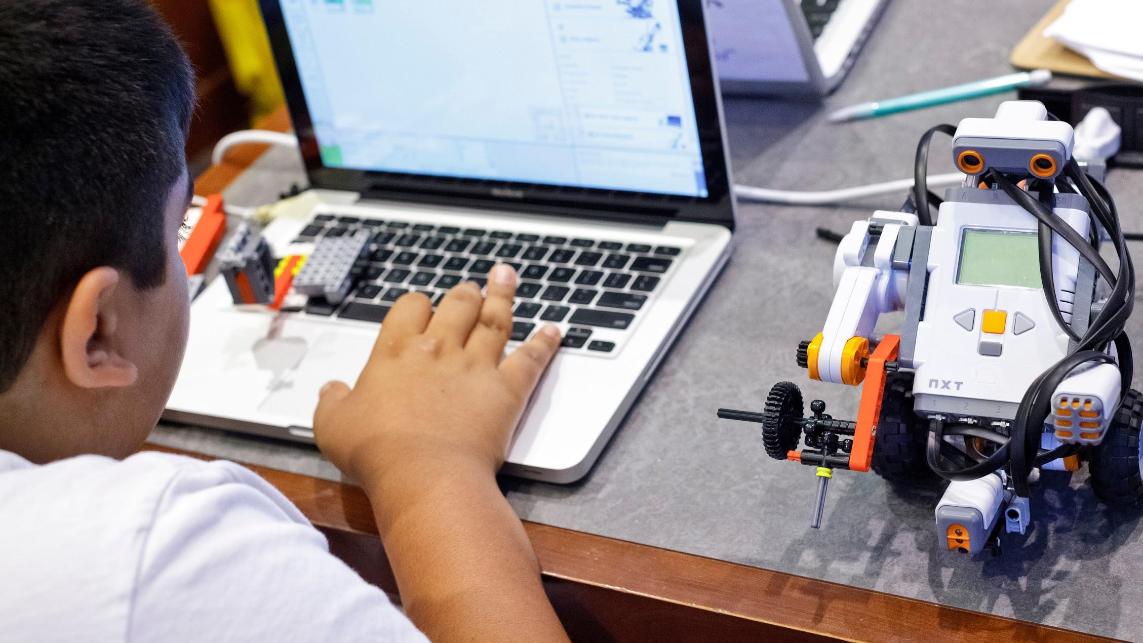
Computational Thinking
Dr. Katherine Herbert
ONLINE

Slide 2
Module 4: Pattern Recognition

Slide 3
Decomposition and Pattern Recognition
In the last lecture we talked about Decomposition.
Decomposition is the process of dividing a problem up into more manageable smaller problems whose solutions can be integrated later to address the original problem.
In decomposition, we have to keep dividing a problem up until we have easy to manage problems that correspond to simple solutions that we know.
Therefore, how do we know when to stop?
TLRN 500 SUMMER 2021

Slide 4
Pattern Recognition
Pattern Recognition is the understanding of the common tools and pieces we can use in computing to then “match them up” with the smaller problems we are generating in decomposition.
We can look at three types of pattern recognition
Common programming constructs
Common techniques used in a certain style of problem solving
Design Patterns for Software Engineering
TLRN 500 SUMMER 2021

Slide 5
Common Programming Constructs
Often, a new programmer learns their first skills in pattern recognition through learning programming constructs.
Programming constructs are standard techniques used in popular programming languages to build solutions.
When a student is first learning a language, it is extremely overwhelming. Programming takes most students out of their “comfort zones”. Understanding the basic programming constructs can help students understand programming and then adapt to other languages.
TLRN 500 SUMMER 2021

Slide 6
Common Programming Constructs
Input and Output
Variables
Assignment Statements
Conditionals
Iteration
Container constructs (arrays and lists)
Methods, procedures and functions
User Defined Types
TLRN 500 SUMMER 2021

Slide 7
Input and Output
It is Used when you need to communicate with your user.
Input – you obtain data
Output – you display or save data
It is used for human-computer interactions.
It is also used when you need to obtain data that might come from:
A “data stream” like twitter
A database
A file
Another source that is not necessarily someone typing in info
TLRN 500 SUMMER 2021

Slide 8
Variables
Variables are data holders – they use an easy to remember name to represent a place in memory.
Variables usually have a type:
Integer – short or long
Decimal – float, double precision or specialized extremely large decimals
Character
String
Boolean
Arrays or Lists (discussed later)
Methods, Procedures and Functions
User-defined types (objects)
Variables can also be “constants”, where the intent is to assign the value once then leave it alone.
Variables help with abstraction and consistency.
TLRN 500 SUMMER 2021

Slide 9
Assignment Statements
We use an assignment statement when we want to change the value of a variable.
When you are decomposing your problem, often change or “movement” happens in the program when your program does an action on the data. Assignment Statements are how you cause an action on the data.
TLRN 500 SUMMER 2021

Slide 10
Conditionals
Traditionally called the “if statements” or “case statements”. There are three major types of these.
Classic, basic if statement
If-Else statement
Multiway branching
We use them when we want to enable choices in a program or if we want to categorize our actions, where if one set of data happens, we do one action, while another data occurs we do a different action.
TLRN 500 SUMMER 2021

Slide 11
Iteration
Iteration is when we use a loop structure to do actions. The while loop is the basic loop and the for loop is a special case of the while loop.
We use iteration when:
We want to use the same code multiple times
We are waiting for an event to occur and we do a set of actions while we wait.
TLRN 500 SUMMER 2021

Slide 12
Container Constructs (arrays, lists, hashes)
Often, we will want to apply our program to a bunch of data of the same type or are related to each other in some way. We often refer to this as a set of data.
Containers such as arrays or lists let us treat a set of variables as one unit. This makes it easier to use with loops or with methods.
Implementation of arrays and lists can vary from programming language to programming language. If you use such a construct, you will want to pay attention to the implementation details.
TLRN 500 SUMMER 2021

Slide 13
Methods, Procedures and Functions
Often, a group of code we author will have a particular purpose.
Consider, for example, the concept of average. We know what it is and we would want to use it again and again.
A method, procedure or function lets us group this code together for reuse. We need to let the programmer know how to send it data and what data it sends back, but otherwise the programmer doesn’t worry about the details of the implementation after the first use.
Different languages use different words to describe methods. Procedure is often reserved for methods that return a void value.
TLRN 500 SUMMER 2021

Slide 14
Data Types and User-Defined Types
A data type is data and actions associated with that data. For example, Integer consists of positive and negative whole numbers and 0. The actions we can do to Integer are addition, subtraction, multiplication, division, modulo, print or get the value, and assign an integer to a variable (set a value).
Users can create their own data types. That is what classes are in an object oriented language. You have a data section (usually a number of variables that break down into the simple data types) and then actions you can do on that data.
TLRN 500 SUMMER 2021

Slide 15
User-Defined Types, Classes and Objects
In programming, there are four generally agreed upon styles of programming – Imperative, Object Oriented, Declarative and Functional.
Imperative and Object-Oriented are the two that are used most frequently.
Imperative style is when you make a list of steps and the computer runs through the list step by step.
Object Oriented style tries to mimic the real world. Take for example a pen. How to you know what to do with a pen? We need to create code that gives the user every possible thing they can do with the pen.
TLRN 500 SUMMER 2021

Slide 16
User-Defined Types
User-Defined Types give us further powerful tools to program. We often identify the following as a part of User-defined types:
Encapsulation – grouping everything together for ease of use
Inheritance – repurposing existing code for a highly similar purpose but extending that code with new functionality. Think clock vs alarm clock.
Polymorphism – having code that “does the same thing in concept”, but is implemented differently for certain types of problems. Think of the concept of geometric area of a planar figure. We understand the concept of area but it is implemented differently for a square vs a circle vs a triangle.
TLRN 500 SUMMER 2021

Slide 17
Common Techniques Used to Solve Problems
As programming skills develop, there are a number of problem solving techniques used to help solve problems.
Example: Not knowing how much data to expect
Answer: Use a loop that will keep doing the work until there is no more data.
Example: Its impossible to specify a certain condition
Answer: Is it easier to specify what you don’t want? If so, do that, then take the opposite of it or the data that doesn’t fulfill that condition (the not of it) – double negation.
TLRN 500 SUMMER 2021

Slide 18
Design Patterns
Professional programmers use the concepts of software engineering to help design software.
Software can consist of hundreds of smaller programs or programming units that work together to create the software.
Having all of these programs work together is Software Engineering – this is a recognized engineering discipline like mechanical or civil engineering at adheres to engineering principals.
Overwhelmingly in this field, they use Design Patterns to define their programs. Design patterns are recognized, frequently used techniques to address commonly occurring problems in programming.
TLRN 500 SUMMER 2021

Slide 19
Design Patterns
Examples of situations that use Design Patterns:
Creation: Instantiation of data or program instance.
Adapters: get one program to talk to another program
Facades: makes sure the result of a program conforms to a “look and feel” of the software.
Iterators: group together “stuff” – data, program results, etc – and then apply additional programming to those things.
Specification: Make sure the Business Logic and the Programming Logic concur (can be done in documentation).
Concurrency: When multiple parts of the program are working in different parts of the processor, it manages how we orchestrate that and combine the results.
TLRN 500 SUMMER 2021

