Slide 1


AP
The New Jersey Student Learning Standards
Computer Science & Design Thinking
8.1.5
Algorithms & Programming
8.1.5

Slide 2
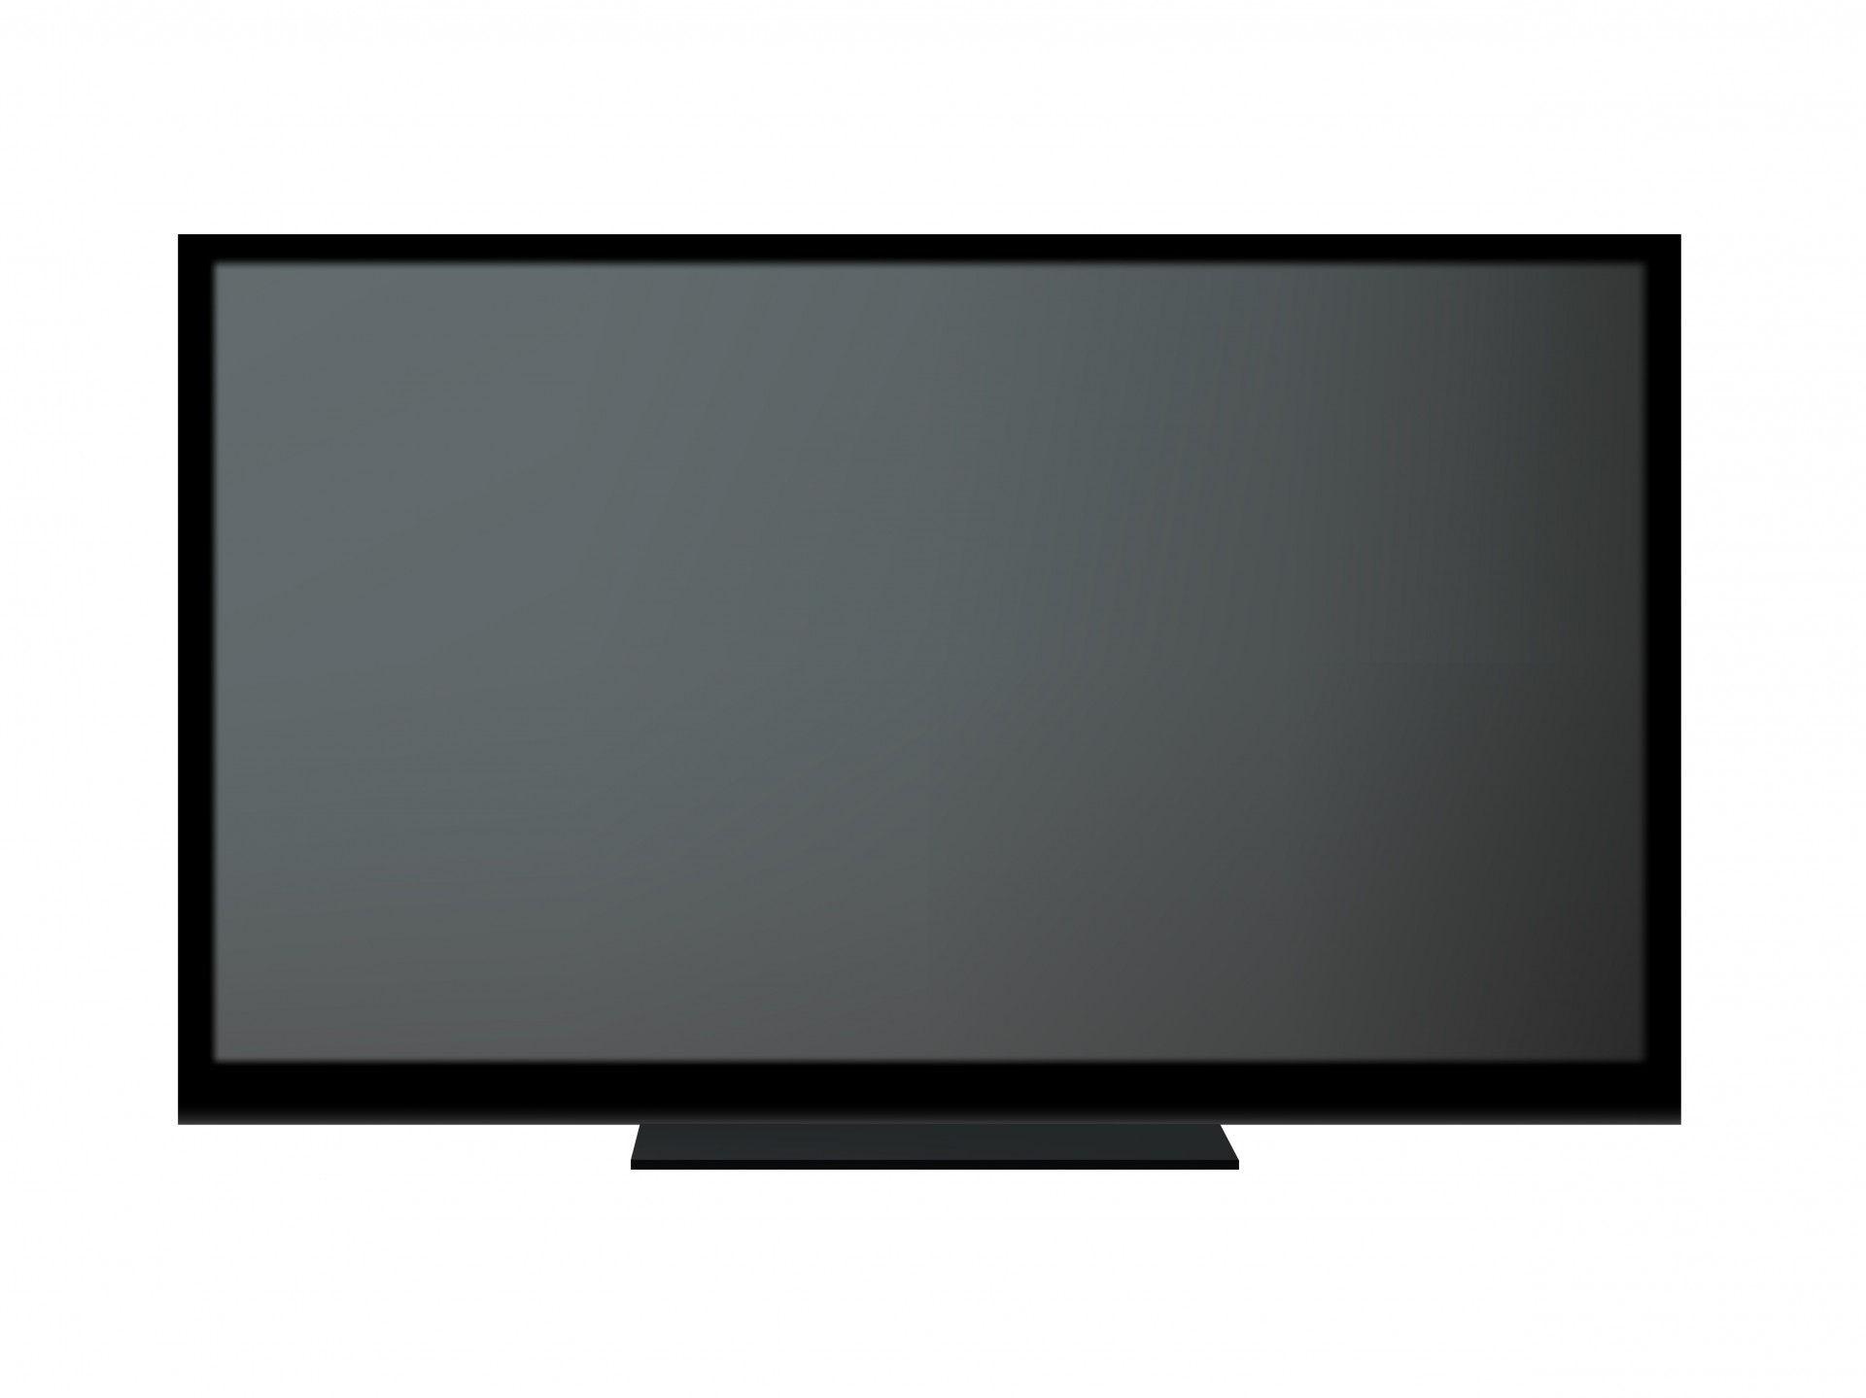
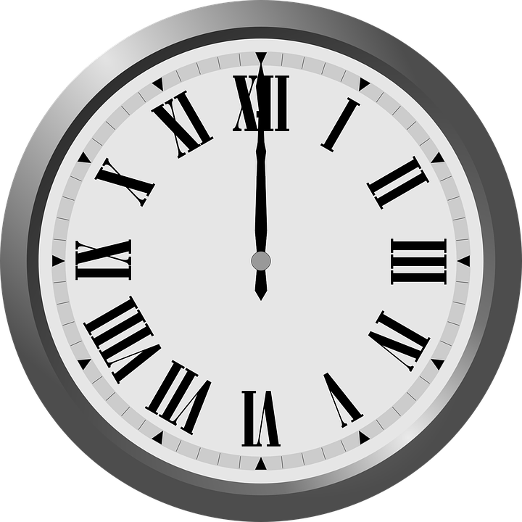
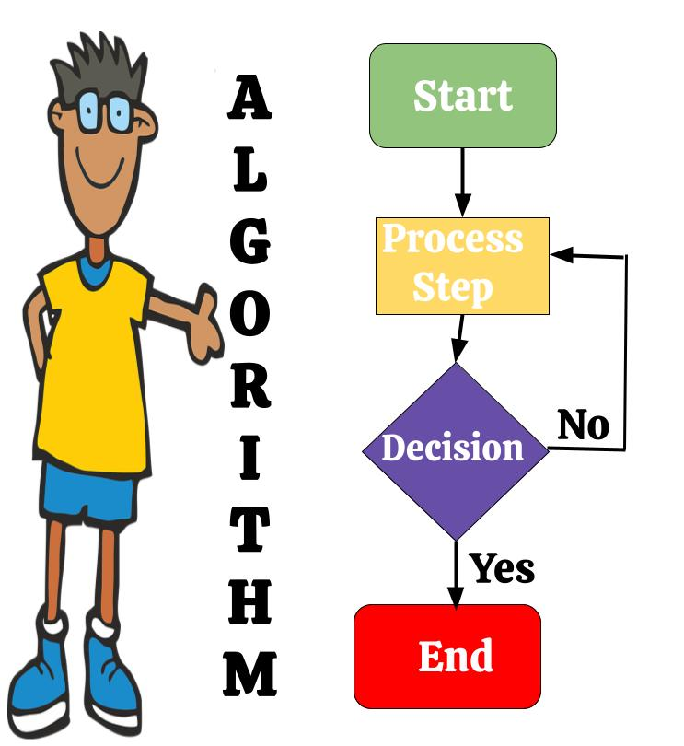




New Jersey Student Learning Standards
AP
Technology:
8.1.5.AP.1: Compare and refine multiple algorithms for the same task and determine which is the most appropriate.
8.1.5.AP.2: Create programs that use clearly named variables to store and modify data.
8.1.5.AP.3: Create programs that include sequences, events, loops, and conditionals.
8.1.5.AP.4: Break down problems into smaller, manageable sub-problems to facilitate program development.
8.1.5.AP.5: Modify, remix, or incorporate pieces of existing programs into one’s own work to add additional features or create a new program.
8.1.5

Slide 3
I
AP
Core Concept 8.1.5 Algorithms & Programming
An algorithm is a sequence of steps designed to accomplish a specific task. Algorithms are translated into programs, or code, to provide instructions for computing devices. Algorithms and programming control all computing systems, empowering people to communicate with the world in new ways and solve compelling problems.
8.1.5

Slide 4
AP
Topics Covered
Communication Between Humans
Algorithms
Control Structures
Pseudocode
Decomposition
Debugging
Data Types
Variables
Programming
Computer Programming
Works Cited
8.1.5

Slide 5
AP
Communication
Between Humans
8.1.5

Slide 6

AP
Communication Between Humans
People have always created methods to communicate in nonverbal ways. People create codes with pictures and symbols to share secret messages!
↪↻↾←⍇╅┆┗☨♽⛕⛤☡✆⛦⛚⛓⛮
8.1.5

Slide 7

AP
Communication Between Humans
People use flashlights in the dark to send and receive secret messages!
8.1.5

Slide 8

AP
Communication Between Humans
Fire and smoke signals have been used share secret messages!
8.1.5

Slide 9
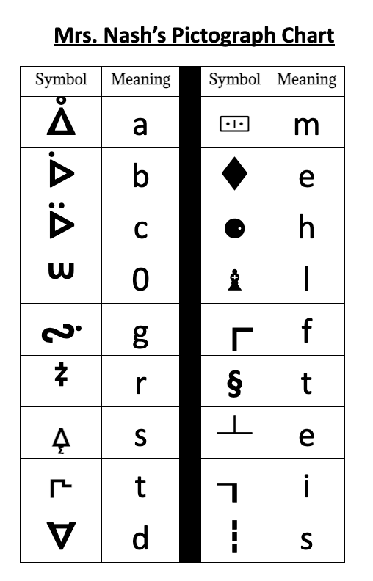
Writing Algorithms
AP
People create and use pictographs to represent letters or words in order to share secret messages.
8.1.5
Notes:
Have students write the word “code” using the pictograph chart.

Slide 10
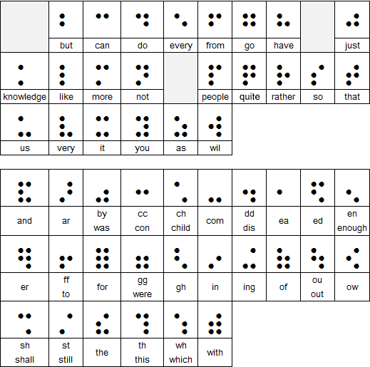
AP
Communication Between Humans
Braille is a reading and writing system for blind and vision impaired people, made up of raised dots that can be 'read' by touch.
8.1.5
Notes:
Try to get and show an actual passage in braille so students can see and touch it.

Slide 11
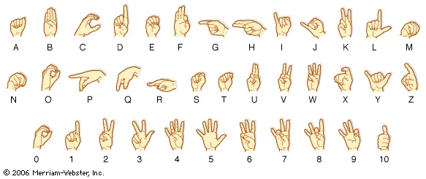
AP
Communication Between Humans
Sign language is used by people who are deaf. The gestures or symbols in sign language are organized in a linguistic way. Each individual gesture is called a sign.
8.1.5
Notes:
Have students sign the word “Hello”.

Slide 12
AP
Communication Between Humans
Sign language Each sign has three distinct parts:
  the handshape,
  the position of the hands, and
  the movement of the hands.
American Sign Language (ASL) is used most in our country. Other countries have their own sign language.
8.1.5

Slide 13
AP
Communication Between Humans
Again, people have always found ways to communicate nonverbally!
8.1.5

Slide 14
AP
Algorithms
8.1.5

Slide 15

What Is An Algorithm?
AP
List three tasks or things you do everyday?
8.1.5
Notes:
Note to teacher: After a few minutes have students share their list. Write ideas on the smartboard.

Slide 16
What Is An Algorithm?
AP
Examples of Daily Tasks
getting ready for school
brushing teeth
tying sneaker strings
travelling to or from school
school day
structure of a class
participating in clean-up time
8.1.5

Slide 17
What Is An Algorithm?
AP
Take one item from your list and write the steps you use to complete that task.
8.1.5
Notes:
From the completed list discuss how we usually complete task the same way every time. Have students write the steps for one of their tasks. Have several students share with class.

Slide 18
What Is An Algorithm?
AP
Task Name:
Write the steps in the space below.
8.1.5
Notes:
From the completed list discuss how we usually complete task the same way every time. Have students write the steps for one of their tasks. Have several students share with class.

Slide 19


What Is An Algorithm?
AP
Congratulations! You have just created your first algorithm!
8.1.5

Slide 20

What Is An Algorithm?
AP
Sooooo!
What is an algorithm?
8.1.5

Slide 21

What Is An Algorithm?
AP
An algorithm is a recipe book! In the recipe book, you have list the step by step instructions on how to make your favorite sandwich.
The sequence is the specific order instruction of your instructions.
8.1.5

Slide 22
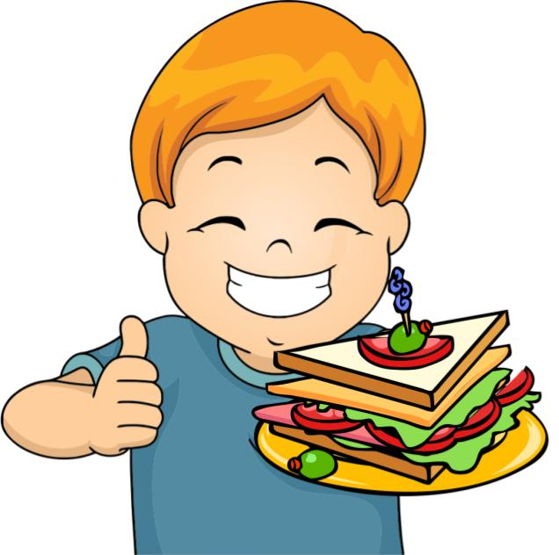
What Is An Algorithm?
AP
In fact, the instructions are so good, that anyone who follows the recipe can make the same, exact sandwich!
8.1.5

Slide 23

What Is An Algorithm?
AP
A computer algorithm is like a set of
instructions that tell
the computer what to
do!
8.1.5

Slide 24
What Is An Algorithm?
AP
So, just like your recipe book tells you how to make a sandwich, a computer algorithm is a
list of step by step
instructions that a computer
program follows in order to
complete a task (run a program).
8.1.5

Slide 25

What Is An Algorithm?
AP
Remember, in order for your algorithm to work you must use provide, clear, precise and efficient steps!
STEP …
STEP 4
8.1.5
STEP 3
STEP 2
STEP 1

Slide 26
AP
Control Structures
8.1.8

Slide 27
Control Structures
AP
Control structures allow you to change the flow of execution in your code. They enable you to make decisions, repeat blocks of code, and perform different actions based on conditions.
8.1.8

Slide 28
Control Structures
AP
The three primary control structures we will discuss are:
Sequential Structure
Selection Structure (Conditional Statements)
Repetition Structure (Loops)
8.1.8

Slide 29
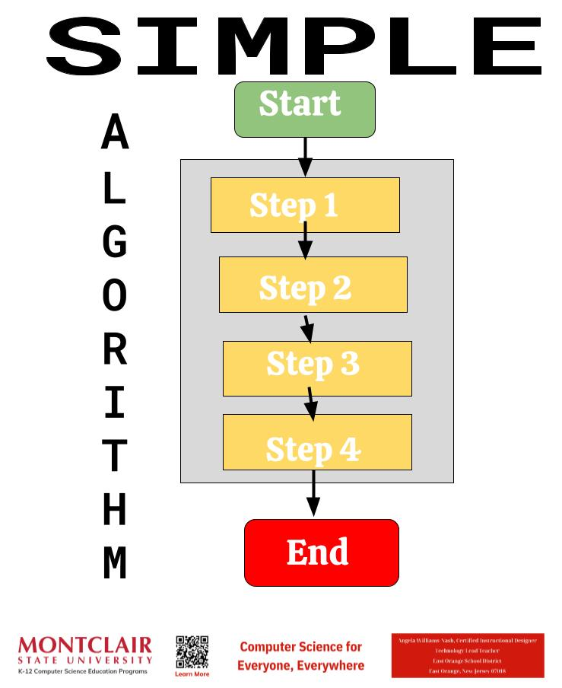
Control Structures
AP
Sequential Structure
This is the default structure or simple algorithm where statements are executed one after the other in the order they appear in the code.
8.1.8
Notes:
From the completed list discuss how we usually complete task the same way every time. Have students write the steps for one of their tasks. Have several students share with class.

Slide 30
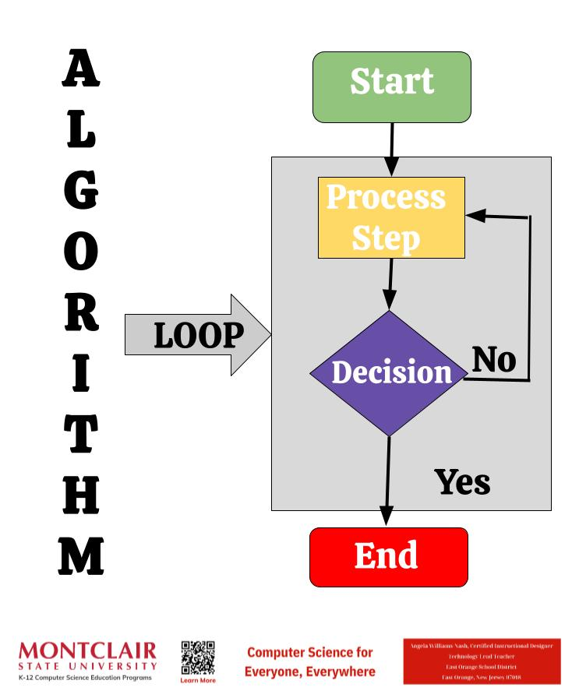
Control Structures
AP
Selection Structure (Conditional Statements)
These structures allow you to execute different blocks of code based on certain conditions.
8.1.8

Slide 31
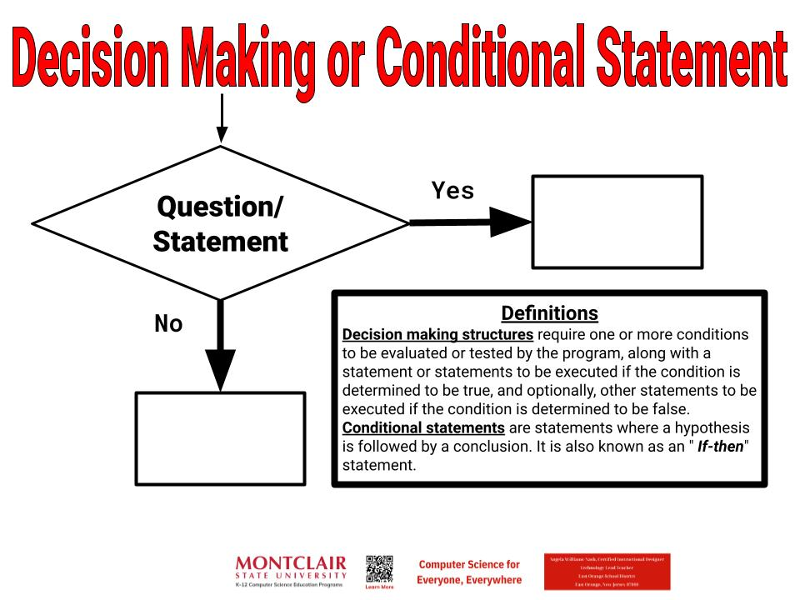
Control Structures
AP
Decision Making or Conditional Statements allow selection, making different things happen based on different conditions. You use this process everyday to make decisions.
8.1.8

Slide 32
Control Structures
AP
Repetition Structure (Loops)
These structures allow you to repeat a block of code multiple times until a certain condition is met. The main types of loops include:
for loop: It executes a block of code a specified number of times.
while loop: It repeats a block of code as long as a specified condition is true.
do-while loop: Similar to a while loop, but it guarantees that the block of code is executed at least once before the condition is checked.
8.1.8

Slide 33
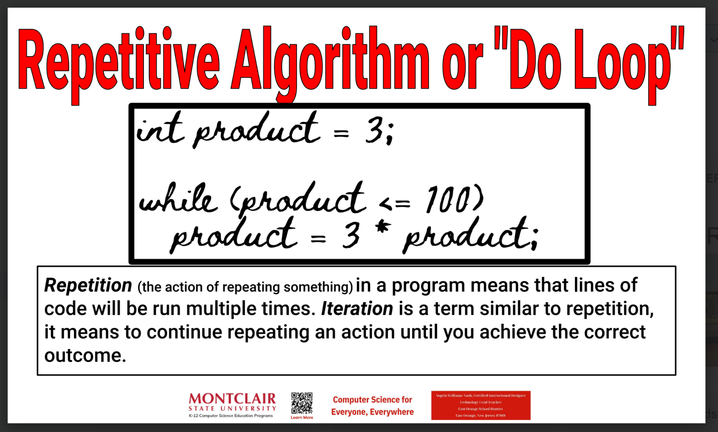
Control Structures
AP
Repetitive Algorithms requires a program to run until a condition is met.
8.1.8

Slide 34
Control Structures
AP
Control structures are fundamental in programming because they enable the creation of algorithms and programs that respond to different situations and inputs. They are essential for building logic and enabling your programs to perform complex tasks.
8.1.8

Slide 35
AP
Pseudocode
8.1.8

Slide 36
AP
What Is Pseudocode?
Sooooo!
What is pseudocode
8.1.8

Slide 37
What Is Pseudocode?
AP
Imagine you have to explain to a friend how to make a sandwich without using any specific language, just simple steps. That's kind of
what pseudocode is like.
8.1.8

Slide 38
What Is Pseudocode?
AP
Pseudocode is a way to write down the steps of a computer program in simple, easy to understand steps, without a programming language. It's like writing down the recipe for a computer to follow.
8.1.8

Slide 39
What Is Pseudocode?
AP
People use pseudocode to create and assess an algorithm before coding. It a way to break down what you want the computer to do into simple steps that anyone can understand, even if they don't know a particular programming language.
8.1.8

Slide 40
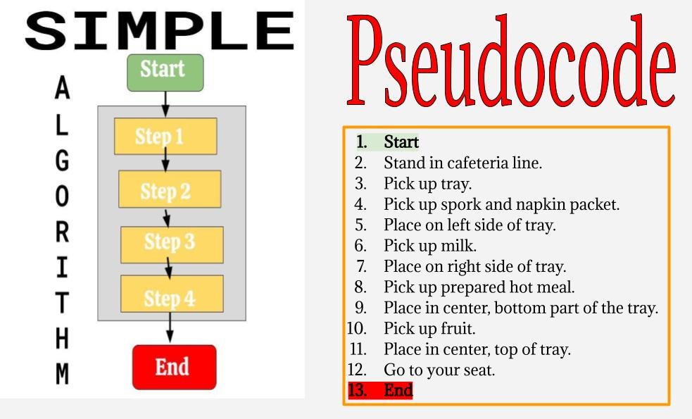
What Is Pseudocode?
AP
8.1.8
Notes:
From the completed list discuss how we usually complete task the same way every time. Have students write the steps for one of their tasks. Have several students share with class.

Slide 41
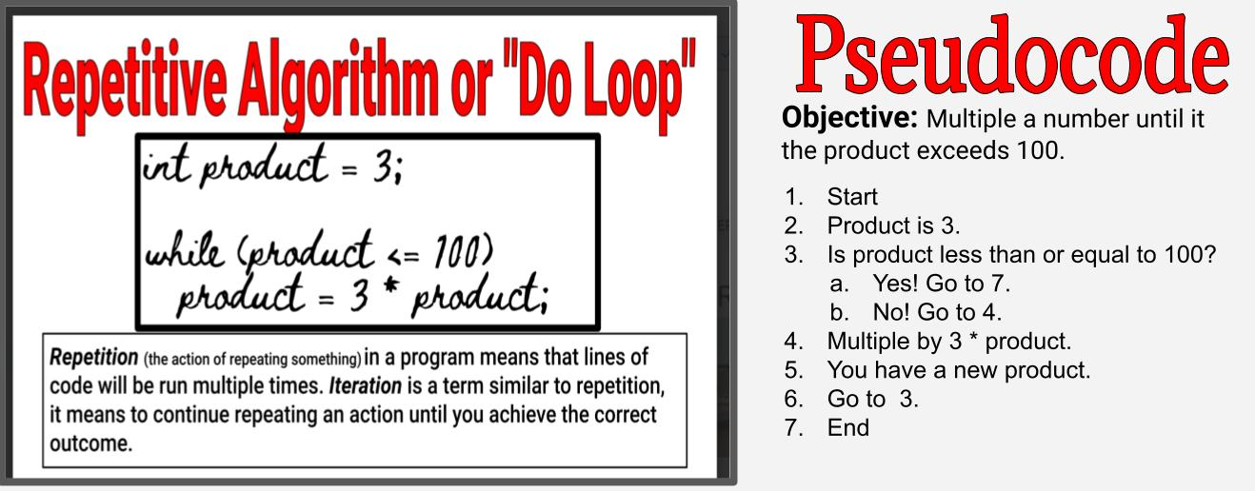
What Is Pseudocode?
AP
8.1.8
Notes:
Have students work in teams to develop an algorithm. Pick several teams to use theirs on the rest of the class.

Slide 42
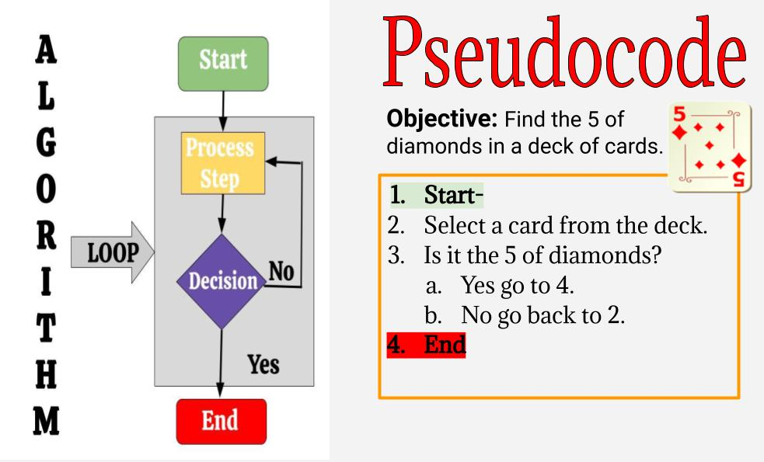
What Is Pseudocode?
AP
8.1.8
Notes:
From the completed list discuss how we usually complete task the same way every time. Have students write the steps for one of their tasks. Have several students share with class.

Slide 43
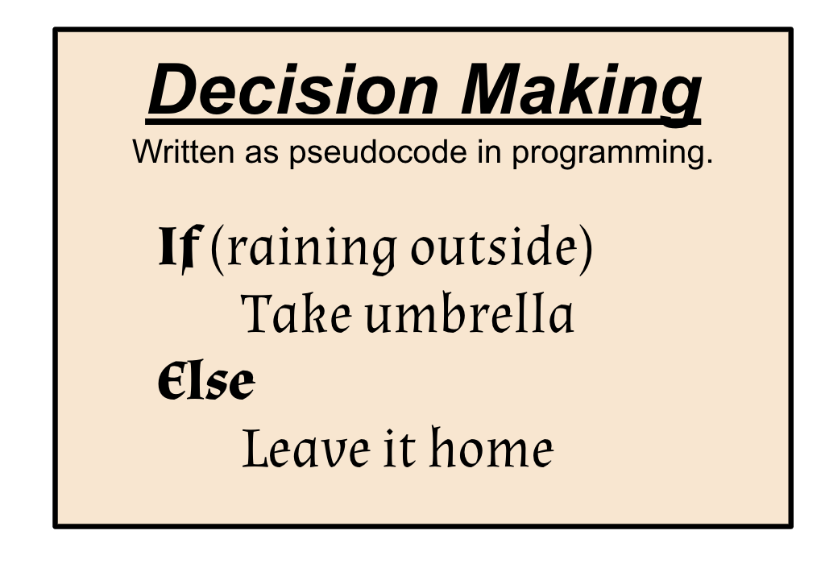
What Is Pseudocode?
AP
Decision Making or Conditional Statements allow selection, making different things happen based on different conditions. You use this process everyday to make decisions.
Pseudocode
8.1.5

Slide 44
What Is Pseudocode?
AP
Use pseudocode to write a dance algorithm that makes your human robot dance. Remember to use loops and conditional statements to make it more efficient.
Dance Algorithm
8.1.8
Notes:
Have students work in teams to develop an algorithm. Pick several teams to use theirs on the rest of the class.

Slide 45
AP
Decomposition
8.1.8

Slide 46
What is Decomposition?
AP
Sometimes, computer programmers come across big, complex problems to solve. In this case, programmers will decompose or break down a problem or task into smaller, more manageable parts.
8.1.8
Notes:
From the completed list discuss how we usually complete task the same way every time. Have students write the steps for one of their tasks. Have several students share with class.

Slide 47
What is Decomposition?
AP
This commonly used approach in software development will:
a) simplify the design,
b) simplify implementation, and
c) simplify maintenance.
8.1.8
Notes:
From the completed list discuss how we usually complete task the same way every time. Have students write the steps for one of their tasks. Have several students share with class.

Slide 48
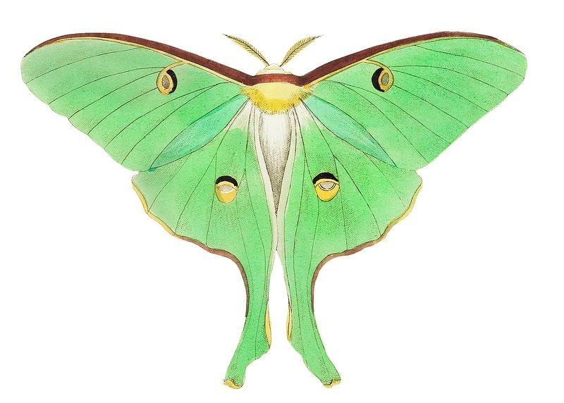
AP
Debugging
8.1.5

Slide 49
Debugging
AP
Debugging is the process of finding and fixing errors. A bug is present anytime your program does not function as expected.
8.1.5
Notes:
Have students come up with a third option. For example a triangle for Yes and a circle for No.

Slide 50
Debugging
AP
Errors stop your program from working correctly. Possible errors could be:
Logic - testing for being to hot when you meant to test for being too cold.
Sequence - steps are in the wrong order.
Spelling mistakes
8.1.5
Notes:
Have students come up with a third option. For example a triangle for Yes and a circle for No.

Slide 51
AP
Data Types
8.1.8

Slide 52
AP
Data Types
In programming, data types define the type of data that can be stored and manipulated by a program. The specific data types available can vary depending on the programming language. We will discuss some common data types found in many programming languages.
8.1.8

Slide 53
AP
Data Types
Integer (int)
Integers are whole numbers without any decimal points. The numbers can be positive or negative.
Integers | Not Integers
24 | 3/4
-67 | 24.89
15 | -6.9
8.1.8

Slide 54
AP
Data Types
Floating-point (float)
Float are numbers with decimal points.
Integers | Float
24 | 7.6
-67 | 24.89
15 | -125.9
8.1.8

Slide 55
AP
Data Types
Boolean (bool)
A boolean is a binary, data type with two possible values:
True (1) or False (0);
Yes (1) or No (0); or
On (1) or Off (0).
8.1.8

Slide 56
AP
Data Types
Character (char)
Represents a single character, like upper or lowercase letters and symbols. The table provides a few examples.
Character (char)
d
E
y
?
$
%
8.1.8

Slide 57
AP
Data Types
String
Represents a sequence of characters. Examples include
"hello",
"goodbye",
"4321".
8.1.8

Slide 58
AP
Variables
8.1.8

Slide 59
What are Variables?
AP
In computer science, variables are named storage locations used to store data that can vary or change during the execution of a program.
8.1.8

Slide 60
What are Variables?
AP
These data can represent various types of information such as
numbers,
characters,
strings, or
complex data structures.
Variables allow programmers to manipulate and work with data in their programs.
8.1.8

Slide 61
AP
Programming
8.1.5

Slide 62
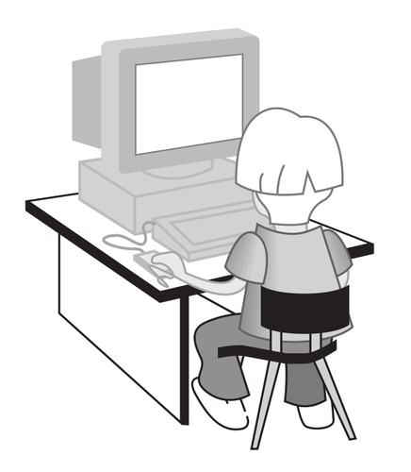
Programming
AP
Let’s look at the way people communicate with computers!
8.1.5
Notes:
Have students come up with a third option. For example a triangle for Yes and a circle for No.

Slide 63
Programming
AP
Programs store and manipulate data by using numbers or other symbols to represent information. Let’s go through a few examples.
8.1.5
Notes:
From the completed list discuss how we usually complete task the same way every time. Have students write the steps for one of their tasks. Have several students share with class.

Slide 64
Programming
AP
Human-Computer Communication
ASCII (American Standard Code for Information Interchange) is the most common character encoding format for text data in computers and on the internet.
8.1.5
Notes:
Have students come up with a third option. For example a triangle for Yes and a circle for No.

Slide 65
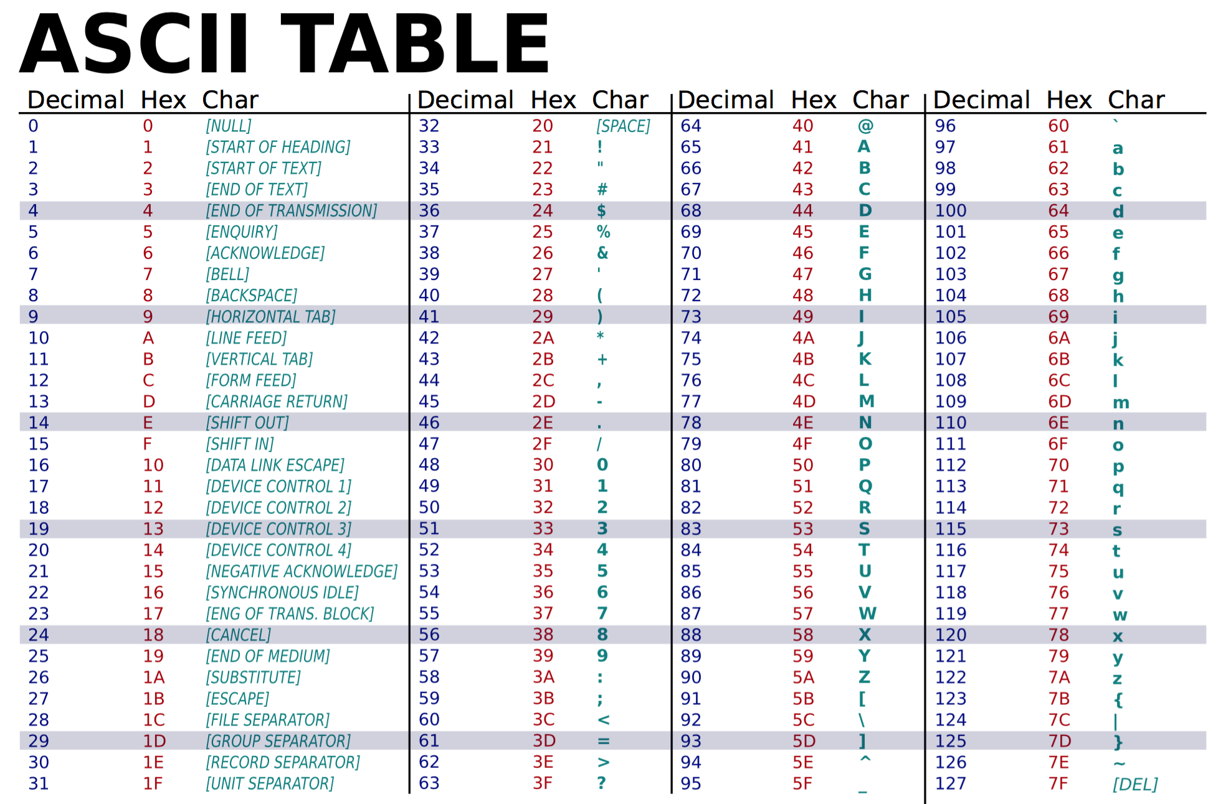
Programming
AP
8.1.5
Notes:
Have students come up with a third option. For example a triangle for Yes and a circle for No.

Slide 66
Programming
AP
Human-Computer Communication
Binary code is one type of coding that uses only 0 and 1 to represent letters, numbers, and symbols. It is called binary code because it’s made of only two symbols. The “bi” in binary means two!
8.1.5
Notes:
Have students come up with a third option. For example a triangle for Yes and a circle for No.

Slide 67
Programming
AP
Human-Computer Communication
The hardware of computers has only two electrical states, on or off. These can be represented by
0 or zero (off), or
1 or one (on).
8.1.5
Notes:
Have students come up with a third option. For example a triangle for Yes and a circle for No.

Slide 68
Programming
AP
Human-Computer Communication
Letters, numbers, and symbols are translated to eight-character binary numbers (0 and 1) as you work with them through the software on your computer.
8.1.5
Notes:
Have students come up with a third option. For example a triangle for Yes and a circle for No.

Slide 69
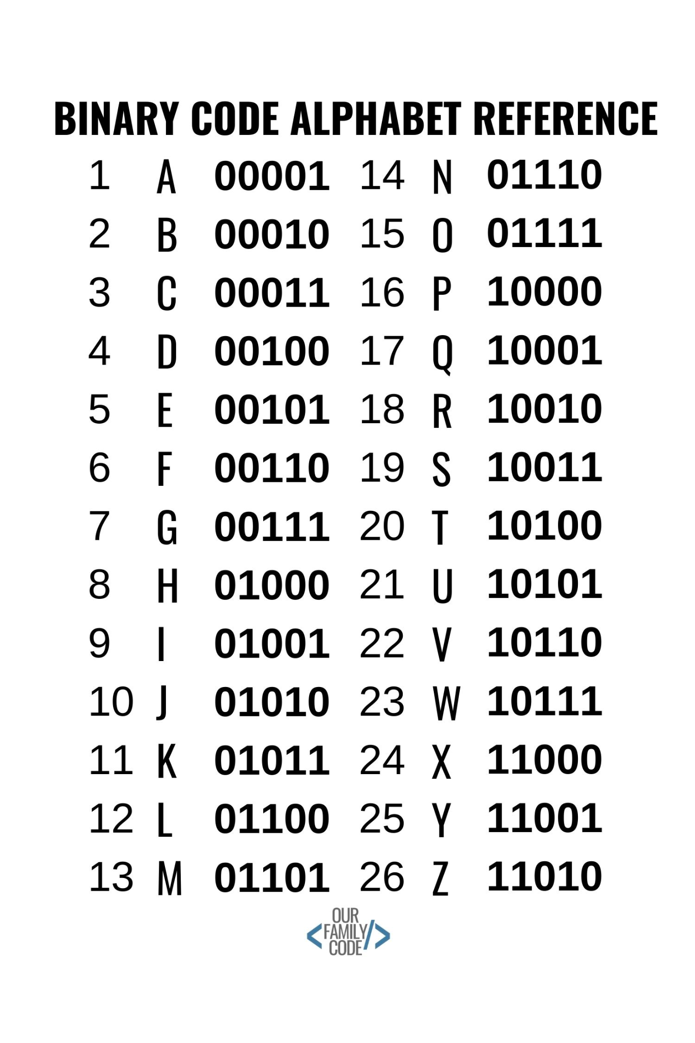
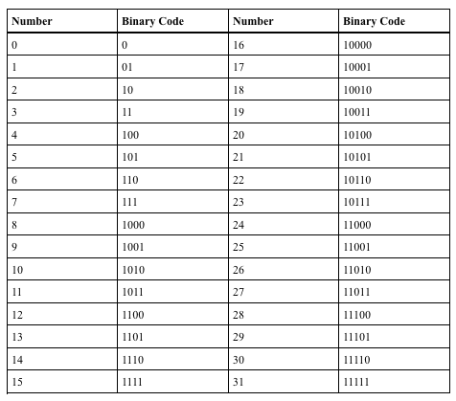
Programming
AP
Human-Computer Communication
8.1.5
Notes:
Have students come up with a third option. For example a triangle for Yes and a circle for No.

Slide 70
Programming
AP
Human-Computer Communication
Unicode provides a unique number. This means that text can be shared and displayed across different systems without loss of information or character corruption.
8.1.5
Notes:
Have students come up with a third option. For example a triangle for Yes and a circle for No.

Slide 71
Programming
AP
Human-Computer Communication
Unicode assigns each character a unique code point. Look at the example below:
"A" is U+0041
8.1.5
Notes:
Have students come up with a third option. For example a triangle for Yes and a circle for No.

Slide 72
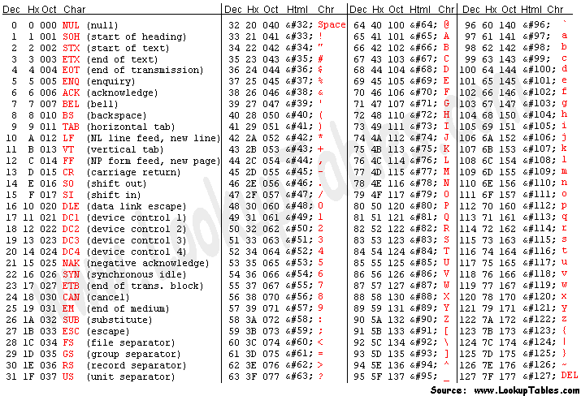
Programming
AP
Human-Computer Communication
8.1.5
Notes:
Have students come up with a third option. For example a triangle for Yes and a circle for No.

Slide 73
Programming
AP
Human-Computer Communication
Unicode supports over a million code points, which can represent characters from various scripts, symbols, emoji, and more.
8.1.5
Notes:
Have students come up with a third option. For example a triangle for Yes and a circle for No.

Slide 74
Programming
AP
Human-Computer Communication
One of the key advantages of Unicode is its universality and inclusivity, allowing for the representation of text in numerous languages and scripts, including those that are not traditionally supported by older encoding standards like ASCII.
8.1.5
Notes:
Have students come up with a third option. For example a triangle for Yes and a circle for No.

Slide 75
Programming
AP
Human-Computer Communication
This makes Unicode very important for multilingual computing, internationalization, and globalization of software and content.
8.1.5
Notes:
Have students come up with a third option. For example a triangle for Yes and a circle for No.

Slide 76
AP
Computer
Programming
8.1.5

Slide 77
Computer Programming
AP
What is Computer Programming?
Imagine you have a big box of colorful building blocks. Each block is like a little instruction for the computer to follow. When you put these blocks together in a certain order, they tell the computer what to do, just like when you follow the steps to build a tower with your blocks.
8.1.5
Notes:
Have students come up with a third option. For example a triangle for Yes and a circle for No.

Slide 78
Computer Programming
AP
What is Computer Programming?
Now, these blocks are special because they're made for the computer. They tell it how to do things like play a game, draw a picture, or even talk to other computers far away. When you press a button on the computer or a tablet, it follows the instructions from these blocks to do what you want, like open a game or show a video.
8.1.5
Notes:
Have students come up with a third option. For example a triangle for Yes and a circle for No.

Slide 79
Computer Programming
AP
What is Computer Programming?
So, computer programs are like sets of instructions that tell the computer what to do, just like you use instructions to build something with your building blocks!
// Function to collect numbers from the user
function collectNumbers() {
let numbers = [];
for (let i = 1; i <= 4; i++) {
let input = prompt("Enter number " + i + ":");
let number = parseFloat(input);
if (!isNaN(number)) {
numbers.push(number);
} else {
alert("Invalid input. Please enter a valid number.");
return null;
}
}
return numbers;
}
// Function to calculate sum of numbers
function calculateSum(numbers) {
let sum = 0;
for (let number of numbers) {
sum += number;
}
return sum;
}
// Function to calculate average of numbers
function calculateAverage(numbers) {
let sum = calculateSum(numbers);
return sum / numbers.length;
}
// Main function
function main() {
let numbers = collectNumbers();
if (numbers !== null) {
let sum = calculateSum(numbers);
let average = calculateAverage(numbers);
alert("Sum: " + sum + "\nAverage: " + average);
}
}
// Call the main function
main();
8.1.5
Notes:
Have students come up with a third option. For example a triangle for Yes and a circle for No.

Slide 80
AP
Works Cited
OpenAI. 2024. ChatGPT (2023) Algorithms & Programming. Retrieved from https://www.openai.com/
What is Braille?
What is Sign Language?
What is ASCII?
What is Binary Code?
8.1.5

