Slide 1


D
A
The New Jersey Student Learning Standards
Computer Science & Design Thinking
8.1.5
Data & Analysis
8.1.5

Slide 2


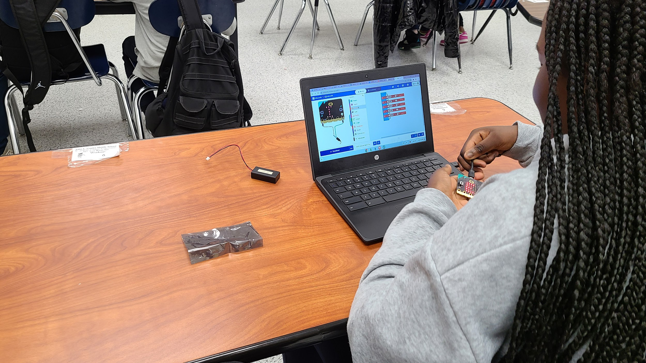




New Jersey Student Learning Standards
D
A
Technology:
8.1.5.DA.1: Collect, organize, and display data in order to highlight relationships or support a claim. The type of data being stored affects the storage requirements.
8.1.5.DA.2: Compare the amount of storage space required for different types of data.
8.1.5.DA.3: Organize and present collected data visually to communicate insights gained from different views of the data.
8.1.5.DA.4: Organize and present climate change data visually to highlight relationships or support a claim.
8.1.5.DA.5: Propose cause and effect relationships, predict outcomes, or communicate ideas using data.
8.1.5

Slide 3
I
D
A
Core Concept 8.1.5 Data & Analysis
Computing systems exist to process data. The amount of digital data generated in the world is rapidly expanding, so the need to process data effectively is increasingly important. Data is collected and stored so that it can be analyzed to better understand the world and make more accurate predictions.
8.1.5

Slide 4
D
A
Topics Covered
Data Collection, Storage, Analysis & Display
Climate Change
Extreme Weather
Pollution
Student Challenge
Works Cited
8.1.5

Slide 5
D
A
Data
Collection, Storage, Analysis & Display
8.1.5

Slide 6
D
A
Data Collection
People collect data about other people and the world around them. People collect data in different ways depending on what information they need and the material or resources available to them.
8.1.5

Slide 7
D
A
Data Collection
Here are six common methods used by students like you:
Surveys and Questionnaires
Observation
Interviews
Experiments
Focus Groups
Secondary Data Analysis
Sensor
8.1.5

Slide 8
D
A
Data Collection
Surveys and Questionnaires
These collection methods involve asking people questions either in person, over the phone, through mail, or online. Surveys can be structured (with fixed-choice answers) or unstructured (open-ended questions).
8.1.5

Slide 9
D
A
Data Collection
Secondary Data Analysis
Researchers analyze data that has already been collected by others. This could include government data, organizational records, academic studies, or publicly available datasets.
8.1.5

Slide 10
D
A
Data Collection
Observation
Data collectors can observe or look at people or phenomena directly.
8.1.5

Slide 11
D
A
Data Collection
Interviews
Similar to surveys, interviews involve asking people questions and recording their anwer. Interviews are often more in-depth and allow for follow-up questions.
8.1.5

Slide 12
D
A
Data Collection
Experiments
In controlled settings, researchers manipulate variables to observe the effects on outcomes. This method is common in psychology, medicine, and the natural sciences.
8.1.5

Slide 13
D
A
Data Collection
Focus Groups
A group of people is brought together to discuss a particular topic under the guidance of a moderator. This method is often used in market research to understand consumer opinions and preferences.
8.1.5

Slide 14
D
A
Data Collection
Sensor Data
With advancements in technology, various sensors can collect data automatically. This includes data from smartphones, fitness trackers, environmental sensors, and more.
8.1.5

Slide 15
D
A
Data Collection
Each method has its good parts and not so good parts. Sometimes data collectors use several methods together in order to get data that is detailed and reliable.
8.1.5

Slide 16
D
A
Data Storage
After data is collected it is stored in a safe place until you are ready to use it. Data can be stored in various ways based on the type and amount.
8.1.5

Slide 17
D
A
Data Storage
The five methods we will review are:
Databases
File Systems
Cloud Storage
Storage Area Network (SAN)
External Hard Drives and Flash Drives
8.1.5

Slide 18
D
A
Data Storage
Databases
Databases are collections of data that are organized in a way that allows for efficient storage, retrieval, and manipulation.
8.1.5

Slide 19
D
A
Data Storage
File Systems
Data can be stored in files on disk drives. File systems organize data into directories and files and provide mechanisms for reading, writing, and managing data.
8.1.5

Slide 20
D
A
Data Storage
Cloud Storage
Cloud storage services like Google Cloud Storage and Dropbox provide allow users to store and access data from anywhere.
8.1.5

Slide 21
D
A
Data Storage
Storage Area Network (SAN)
SAN is a dedicated network that provides access to consolidated, block-level storage. Block-level storage is a type of data storage where data is stored and retrieved in fixed-sized blocks or chunks.
8.1.5

Slide 22
D
A
Data Storage
External Hard Drives and Flash Drives
Data can be stored on external hard disk drives (HDDs) or solid-state drives (SSDs) connected to a computer via USB or other interfaces.
8.1.5

Slide 23
D
A
Data Storage
Each storage method has its advantages and limitations. Most organizations use a combination of storage technologies to meet their data storage needs effectively.
8.1.5

Slide 24
D
A
Data Analysis
Data analysis involves the process of inspecting, transforming, and modeling data with the goal of discovering useful information, informing conclusions, and supporting decision-making.
8.1.5

Slide 25
D
A
Data Analysis
We look at tables, charts, and graphs to find meaning in the data. The goal is to find patterns so that we can make predictions. A prediction is a really good guess.
8.1.5

Slide 26
D
A
Data Displays
Spreadsheet programs are a type of software applications program used to organize, analyze, and change and display data.
8.1.5

Slide 27
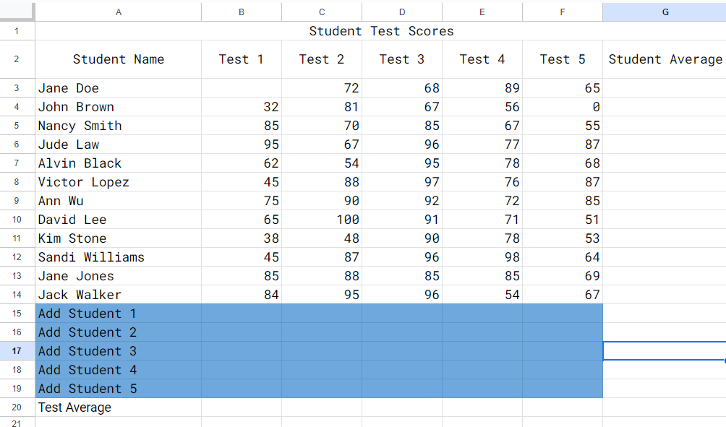
D
A
Data Displays
Two popular spreadsheet programs used in school
are Microsoft Excel
and Google Sheets.
8.1.5

Slide 28
D
A
Data Displays
People use a spreadsheet for the following.
Create, order, and sort lists in table form.
Perform math calculations.
Convert a data table into a chart or graph.
8.1.5

Slide 29
D
A
Data Displays
Data Displays
Spreadsheets can create visual representations of data through charts and graphs. This allows users to visualize trends, patterns, and relationships within the data more easily. Let’s look at visualizations!
8.1.5

Slide 30
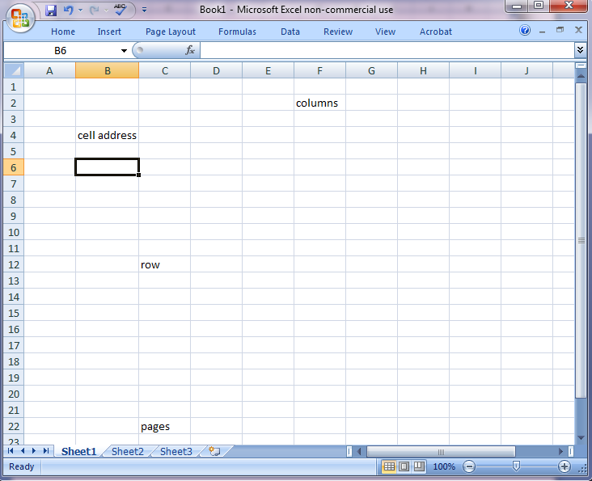
D
A
Data Displays
Spreadsheets arrange data in rows and columns. The intersection, where a column and row meet is called a cell. Each cell can contain text, numbers, formulas, or functions.
8.1.5

Slide 31
D
A
Data Displays
Each column is labeled with a capital letter.
Every row is labeled with a number.
Every page in a spreadsheet is called a sheet.
8.1.5

Slide 32
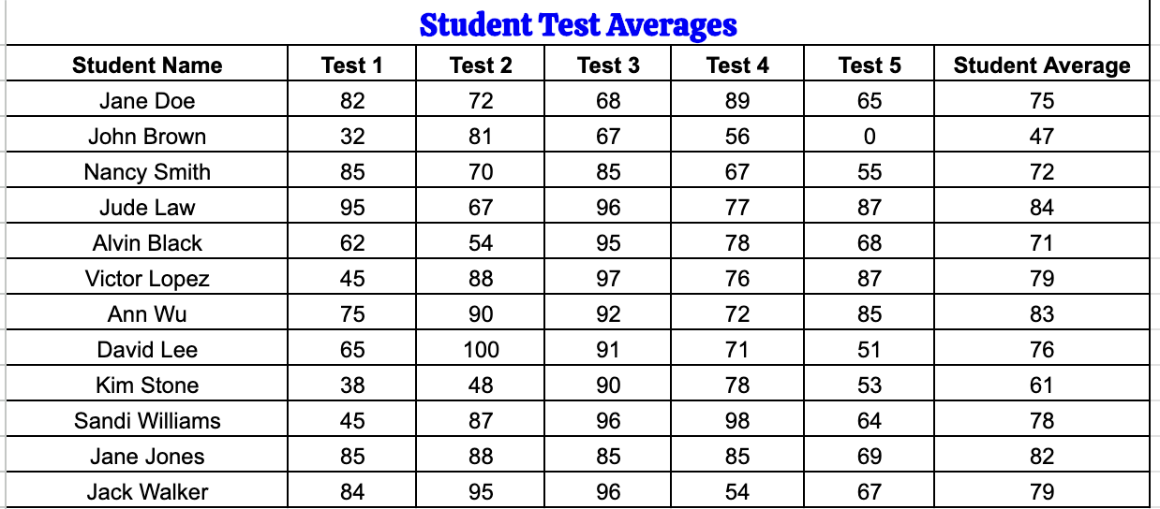
D
A
Data Displays
Here is a spreadsheet that contains data on student test scores. It is a tabular form.
8.1.5

Slide 33
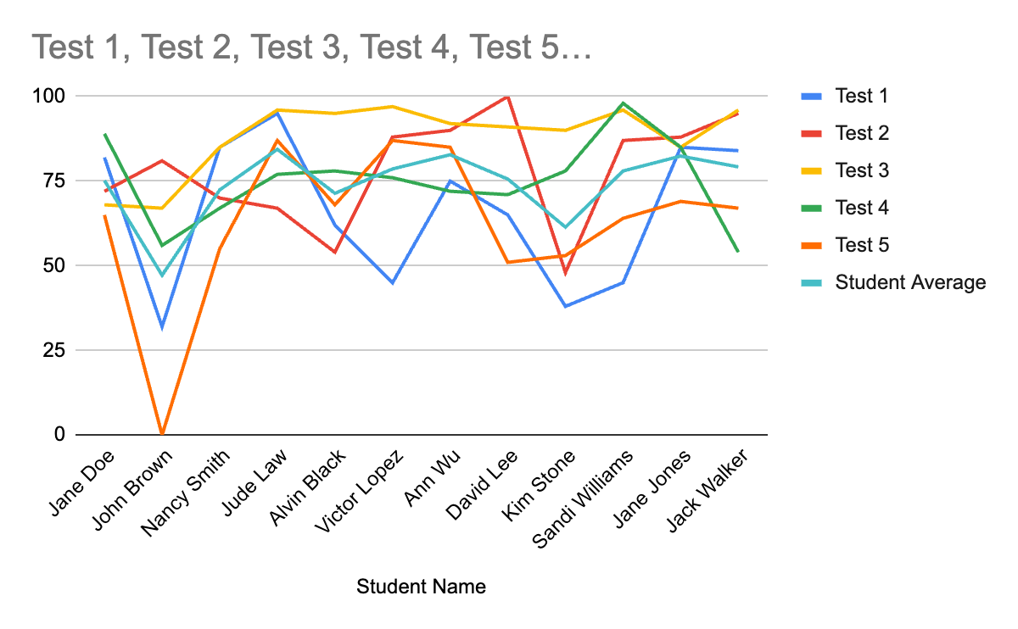
D
A
Data Displays
8.1.5
Here is the same data shown as a line chart.

Slide 34
D
A
Data Displays
When examining line charts, look for the following line behaviors:
Increase is when the line goes up.
Decrease is when the line goes down.
Steady state is when the line stays the same.
8.1.5

Slide 35
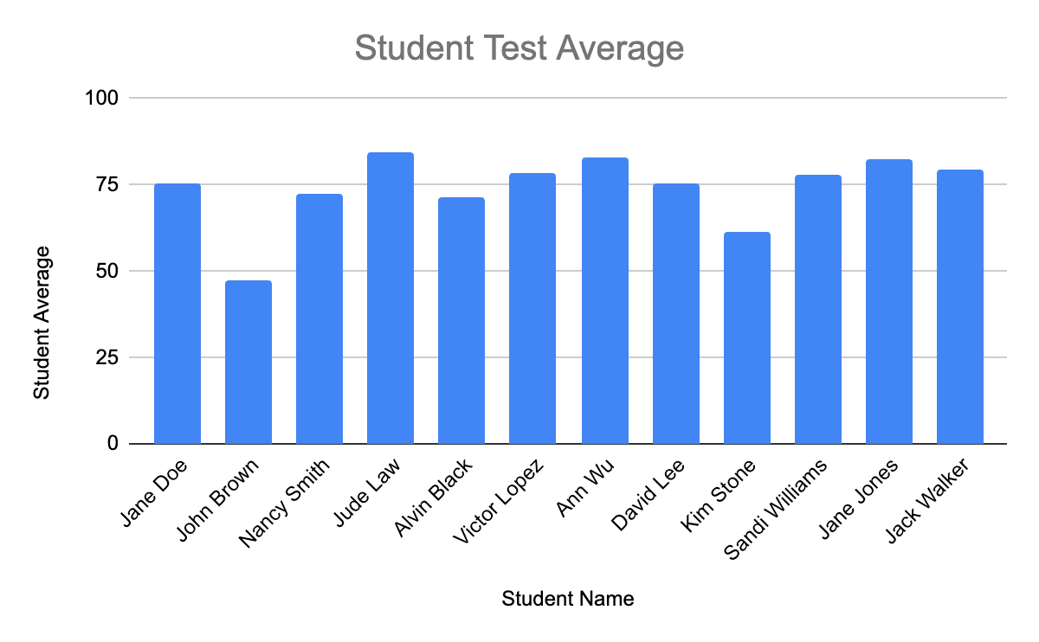
D
A
Data Display
Here is the student average column shown as a bar chart.
8.1.5

Slide 36
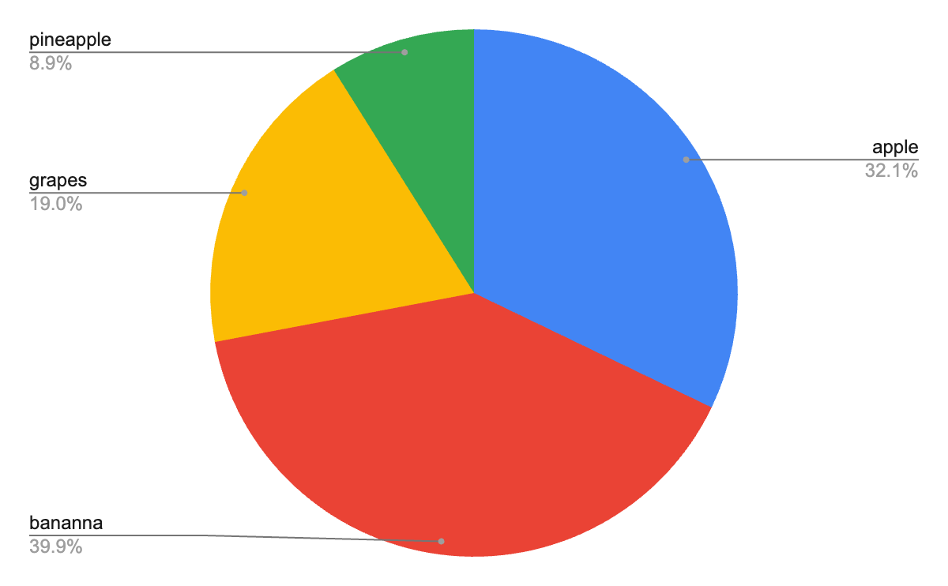
D
A
Data Display
Favorite Fruit
apple | 54
banana | 67
grapes | 32
pineapple | 15
8.1.5
Here is survey data from the table shown as a pie chart.

Slide 37
D
A
Climate Change
8.1.5

Slide 38
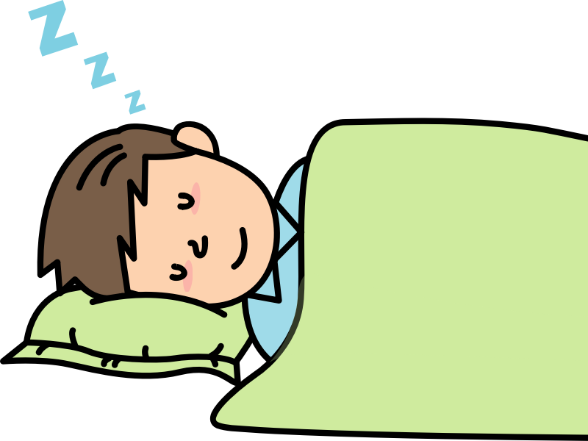
What is Climate Change?
D
A
Let’s suppose you are sleeping and your caregiver comes in and places a lot of extra blankets on you. At first you are OK but over time you get warmer and warmer. You get so hot that you feel as though you are burning up and all you want to do it push the blankets off you to release the heat
and cool down!
8.1.5

Slide 39
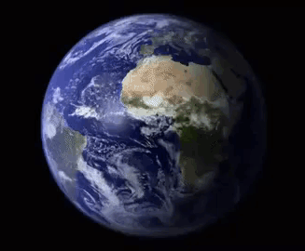
What is Climate Change?
D
A
Surrounding the Earth is a big layer that acts as a blanket covering our planet. We call it our atmosphere. The atmosphere is made up of gases like carbon dioxide,
methane, and water vapor,
which helps keep our planet
warm, just like a blanket
keeps you warm at night.
8.1.5

Slide 40
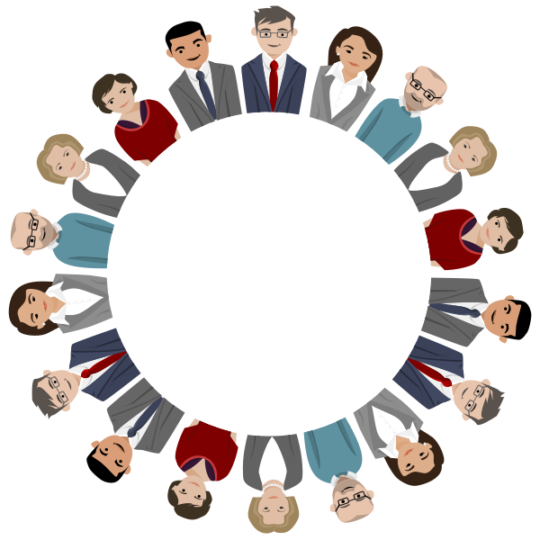
What is Climate Change?
D
A
Over time, people all around the world have been doing things that add extra blankets to our planet.
8.1.5

Slide 41

What is Climate Change?
D
A
Human activities like
burning coal, oil, and gas for energy,
reducing the size of our forest, and
industrialization (manufacturing)
have released extra gases into
the air. The effect is like adding
extra blankets. This has made the
Earth warmer than it should be.
8.1.5

Slide 42
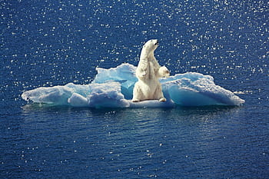

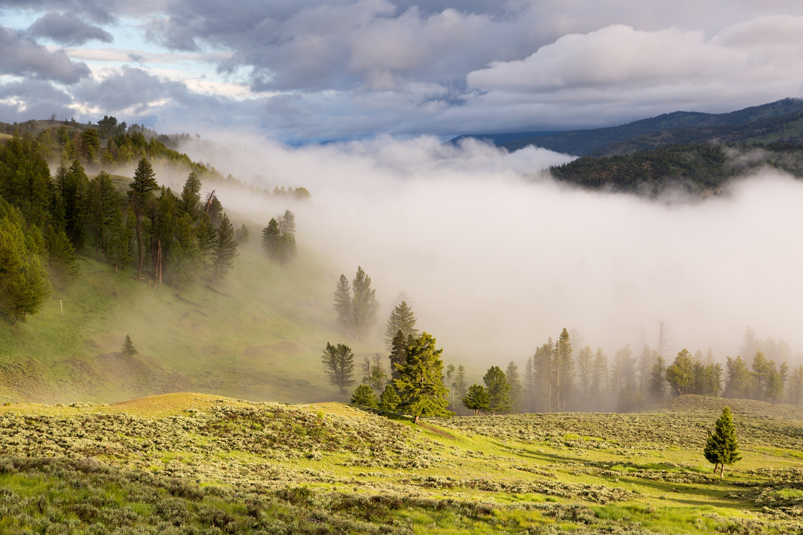
What is Climate Change?
D
A
As our Earth gets warmer, all sorts of problems begin to happen. Look at the example below.
Melting ice at North and South Pole.
Sea level rises.
Pollution and extreme weather.
8.1.5

Slide 43
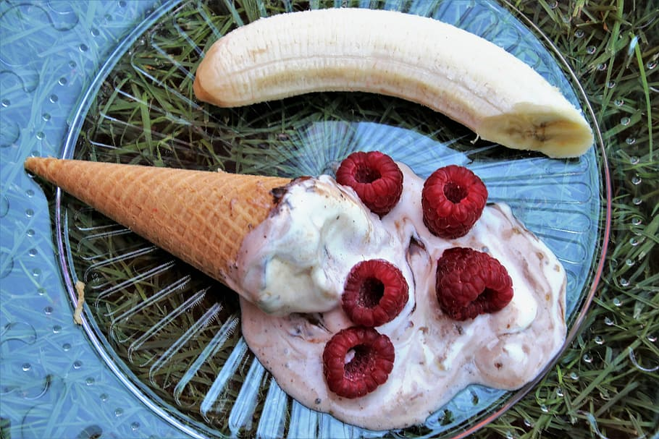
What is Climate Change?
D
A
Think of it like leaving a bowl of ice cream outside on a summer day. Your ice cream melts after a while, it loses it taste and no matter what you do, it does not taste the same anymore.
8.1.5

Slide 44
What is Climate Change?
D
A
And so! Climate change is the permanent change in the Earth’s weather pattern caused by human activity. It adversely impacts all living things and can result in:
rising temperatures,
sea level rise,
extreme weather events,
shifts in ecosystems, and
disruptions to agriculture, and
problems with local economies.
8.1.5

Slide 45
What is Climate Change?
D
A
Climate change causes Global warming, the long-term increase in Earth's average surface temperature, primarily due to human activities that release greenhouse gases into the atmosphere. These greenhouse gases, trap heat from the sun in the Earth's atmosphere, leading to a warming.
8.1.5

Slide 46
D
A
Extreme Weather
8.1.5

Slide 47
What is Extreme Weather?
D
A
The word extreme means reaching the maximum or highest amount. Extreme weather refers to severe or unusual weather events that are very different from is expected for a town, state, country or time of year.
8.1.5

Slide 48
What is Extreme Weather?
D
A
These events often involve extreme temperatures, precipitation, wind speeds, or other weather conditions. Examples of extreme weather events include:
Heatwaves
Cold snaps
Heavy rainfall
Droughts
Hurricanes, typhoons, and cyclones
Tornadoes
Thunderstorms
8.1.5

Slide 49
What is Extreme Weather?
D
A
Heatwaves
Prolonged periods of unusually high temperatures, often accompanied by high humidity, which can pose health risks and lead to heat-related illnesses and deaths.
8.1.5

Slide 50
What is Extreme Weather?
D
A
Cold Snaps
Sudden and severe drops in temperature, resulting in freezing conditions, frost, and sometimes blizzards or ice storms.
8.1.5

Slide 51
What is Extreme Weather?
D
A
Heavy Rainfall
Intense and prolonged periods of rain leading to flooding, landslides, and waterlogged infrastructure.
8.1.5

Slide 52
What is Extreme Weather?
D
A
Droughts
Extended periods of abnormally low rainfall, resulting in water shortages, crop failures, and ecological stress.
8.1.5

Slide 53
What is Extreme Weather?
D
A
Hurricanes, typhoons, and cyclones: Powerful tropical storms characterized by strong winds, heavy rainfall, and storm surges, which can cause widespread devastation and loss of life.
8.1.5

Slide 54
What is Extreme Weather?
D
A
Tornadoes
Violently rotating columns of air that extend from thunderstorms to the ground, capable of causing severe damage to buildings and infrastructure in their path.
8.1.5

Slide 55
What is Extreme Weather?
D
A
Thunderstorms
Storms characterized by lightning, thunder, heavy rain, and sometimes hail or strong winds, which can result in localized flooding, property damage, and power outages.
8.1.5

Slide 56
What is Extreme Weather?
D
A
Extreme weather events are associated with climate change, as rising global temperatures can lead to changes in weather patterns, increased frequency and intensity of extreme events, and changes to regional climates. Managing and mitigating the impacts of extreme weather require preparedness, resilience, and effective disaster response strategies at the local, national, and global levels.
8.1.5

Slide 57
D
A
Pollution
8.1.5

Slide 58

D
A
What is Pollution?
Pollution is when something harmful is added to the environment that is harmful or has a poisonous effect. Pollutants can make humans, wildlife, trees, and even our food sources unhealthy or sick.
8.1.5

Slide 59
D
A
What is Pollution?
Pollution can be grouped based on where it comes from, its impact, and the environment it affects. Some of the main types of pollution:
1. Air Pollution
2. Water Pollution
3. Soil Pollution
4. Noise Pollution
5. Light Pollution
6. Thermal Pollution
7. Plastic Pollution
8. e-Waste Pollution
8.1.5

Slide 60
D
A
What is Pollution?
Air Pollution
This type of pollution occurs when harmful substances, such as gases, particulate matter, and chemicals, are released into the air. Common sources include vehicle emissions, industrial activities, and burning of fossil fuels like coal oil and methane gas. Air pollution can lead to respiratory problems, cardiovascular diseases, and environmental damage.
8.1.5

Slide 61
D
A
What is Pollution?
Water Pollution
Water pollution occurs when contaminants, such as chemicals, sewage, and waste, enter bodies of water like rivers, lakes, and oceans. Sources of water pollution include industrial discharge, agricultural runoff, and improper waste disposal. Water pollution can harm aquatic ecosystems, affect drinking water quality, and pose risks to human health.
8.1.5

Slide 62
D
A
What is Pollution?
Soil Pollution
Soil pollution occurs when contaminants, such as heavy metals, pesticides, and industrial chemicals, accumulate in the soil. This can result from activities like improper waste disposal, agricultural practices, and industrial activities. Soil pollution can degrade soil quality, harm plants and animals, and affect food safety.
8.1.5

Slide 63
D
A
What is Pollution?
Noise Pollution
Noise pollution refers to excessive or disruptive noise that interferes with normal activities and causes discomfort or harm to humans and animals. Sources of noise pollution include transportation, industrial machinery, construction activities, and urbanization. Exposure to long periods of high noise levels can lead to hearing loss, stress, and other health problems.
8.1.5

Slide 64
D
A
What is Pollution?
Light Pollution
Light pollution occurs when artificial light sources, such as streetlights and billboards, disrupt natural light cycles and cause excessive brightness at night. This can affect wildlife behavior, disrupt ecosystems, and interfere with astronomical observations. Light pollution can also contribute to energy waste and affect human health and sleep patterns.
8.1.5

Slide 65
D
A
What is Pollution?
Thermal Pollution
Thermal pollution refers to the excessive heat released into water bodies from industrial processes, power plants, and urban runoff. This can disrupt aquatic ecosystems, decrease oxygen levels in water, and harm aquatic organisms.
8.1.5

Slide 66
D
A
What is Pollution?
Plastic Pollution
Plastic pollution occurs when plastic materials accumulate in the environment, particularly in oceans, rivers, and landfills. This can harm wildlife, marine ecosystems, and human health. Plastic pollution also contributes to environmental degradation and the spread of microplastics throughout the food chain.
8.1.5

Slide 67
D
A
What is Pollution?
E-waste Pollution
E-waste is short for electronic waste. E-waste pollution occurs when discarded electronic devices (old computers, laptops, mobile phones, televisions) or appliances (refrigerators, washers, dryers) are thrown in dumps, landfills or incinerated (burned). This is a significant environmental concern due to the toxic materials like lead, mercury, cadmium, and hazardous chemicals. such as brominated flame retardants. Improper disposal of e-waste can lead to the release of these harmful substances into the environment, contaminating soil, water, and air, and posing risks to human health and ecosystems.
8.1.5

Slide 68
D
A
What is Pollution?
These are some of the main types of pollution, each with its own sources, impacts, and challenges.
8.1.5

Slide 69
D
A
Student Challenge
8.1.5

Slide 70
D
A
Climate Change Project
Each of us can positively contribute to making our environment a better place. You will participate in a climate change project. We will use the scientific method to study a problem, collect data, recommend solutions and present our findings.
8.1.5

Slide 71
Works Cited
D
A
Gore, Al (2007) An Inconvenient Truth: The Crisis of Global Warming. Penguin Books Ltd.
OpenAI. (Year). ChatGPT [Computer software]. Retrieved from https://www.openai.com/chatgpt
8.1.5

