Slide 1
AP
The New Jersey Student Learning Standards
Computer Science & Design Thinking
8.1.8
Algorithms & Programming
8.1.8

Slide 2
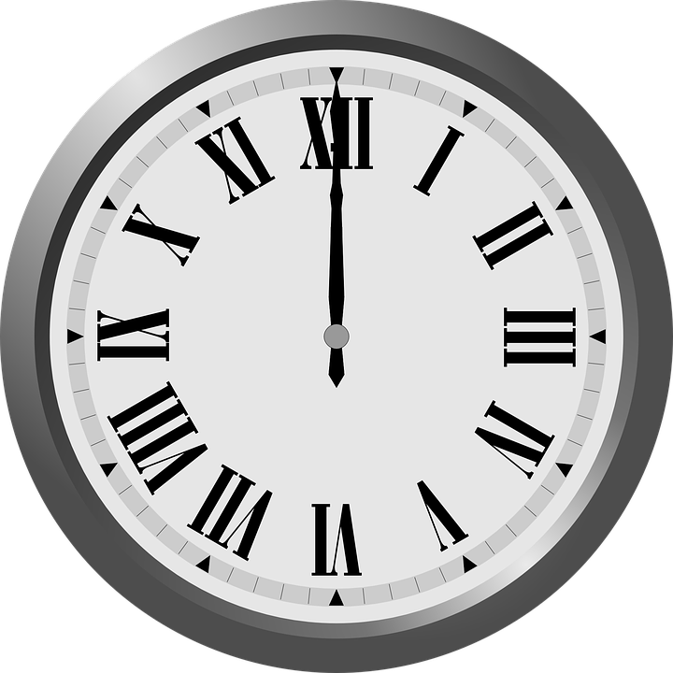
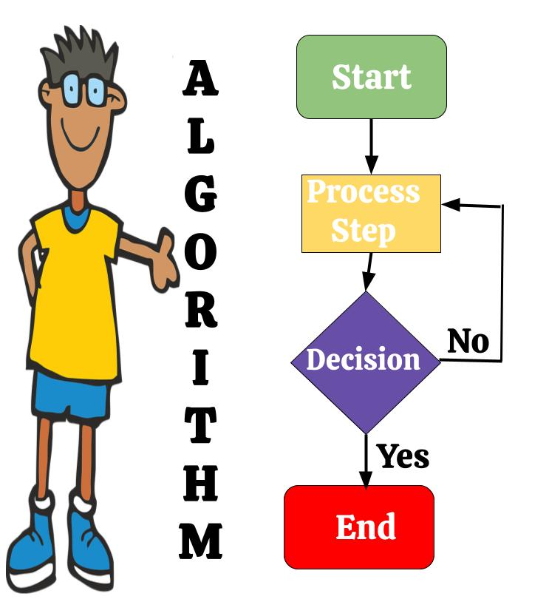
New Jersey Student Learning Standards
AP
Technology:
8.1.8.AP.1: Design and illustrate algorithms that solve complex problems using flowcharts and/or pseudocode.
8.1.8.AP.2: Create clearly named variables that represent different data types and perform operations on their values.
8.1.8.AP.3: Design and iteratively develop programs that combine control structures, including nested loops and compound conditionals.
8.1.8.AP.4: Decompose problems and subproblems into parts to facilitate the design, implementation, and review of programs.
8.1.8.AP.5: Create procedures with parameters to organize code and make it easier to reuse.
8.1.8.AP.6: Refine a solution that meets users’ needs by incorporating feedback from team members and users.
8.1.8.AP.7: Design programs, incorporating existing code, media, and libraries, and give attribution.
8.1.8.AP.8: Systematically test and refine programs using a range of test cases and users. 8.1.8.AP.9: Document programs in order to make them easier to follow, test, and debug.
8.1.8

Slide 3
I
AP
Core Concept 8.1.8 Algorithms & Programming
An algorithm is a sequence of steps designed to accomplish a specific task. Algorithms are translated into programs, or code, to provide instructions for computing devices. Algorithms and programming control all computing systems, empowering people to communicate with the world in new ways and solve compelling problems.
8.1.8

Slide 4
AP
Topics Covered
Pre Planning
Algorithms
Control Structures
Pseudocode
Flowchart
Decomposition
Debugging
Programming
Data Types
Variables
Computer Programming
Works Cited
8.1.8

Slide 5
AP
Pre Planning
8.1.8

Slide 6
AP
Pre Planning Programs
Computer programmers use algorithms or pseudocode and flowcharts to map how they want their program to work. This saves time and money because they can:
Decompose or break complex problems down into more manageable parts.
Debug, or fix problems that might occur before actually coding.
Allow non-programmers to view and evaluate the program without having to know anything about coding.
8.1.8

Slide 7
AP
Pre Planning Programs
Algorithms Vs. Flowcharts
An algorithm is a step-by-step summary of the procedure, while on the other hand, a flowchart illustrates the steps of a program graphically. Let’s examine both!
8.1.8
Notes:
From the completed list discuss how we usually complete task the same way every time. Have students write the steps for one of their tasks. Have several students share with class.

Slide 8
AP
Pre Planning Programs
Attribution is the act of giving credit to a person or source for using their material. As you develop your program and incorporate or use existing code, media, and libraries; make sure you provide attribution.
8.1.8
Notes:
From the completed list discuss how we usually complete task the same way every time. Have students write the steps for one of their tasks. Have several students share with class.

Slide 9
AP
Algorithms
8.1.8

Slide 10
What Is An Algorithm?
AP
List three tasks or things you do everyday?
8.1.8
Notes:
Note to teacher: After a few minutes have students share their list. Write ideas on the smartboard.

Slide 11
What Is An Algorithm?
AP
Examples of Daily Tasks
Getting ready for school.
Brushing teeth.
Tying sneaker strings.
Travelling to or from school.
School day.
Structure of a class.
Participating in clean-up time.
8.1.8

Slide 12
What Is An Algorithm?
AP
Take one item from your list and write the steps you use to complete that task.
8.1.8
Notes:
From the completed list discuss how we usually complete task the same way every time. Have students write the steps for one of their tasks. Have several students share with class.

Slide 13
What Is An Algorithm?
AP
Congratulations! You have just created your first algorithm!
8.1.8

Slide 14
What Is An Algorithm?
AP
Sooooo!
What is an algorithm?
8.1.8

Slide 15
What Is An Algorithm?
AP
An algorithm is a recipe book! In the recipe book, you have list the step by step instructions on how to make your favorite sandwich.
The sequence is the specific order instruction of your instructions.
8.1.8

Slide 16
What Is An Algorithm?
AP
In fact, the instructions are so good, that anyone who follows the recipe can make the same, exact sandwich!
8.1.8

Slide 17
What Is An Algorithm?
AP
A computer algorithm is like a set of
instructions that tell
the computer what to
do!
8.1.8

Slide 18
What Is An Algorithm?
AP
So, just like your recipe book tells you how to make a sandwich, a computer algorithm is a
list of step by step
instructions that a computer
program follows in order to
complete a task (run a program).
8.1.8

Slide 19
What Is An Algorithm?
AP
Remember, in order for your algorithm to work you must use provide, clear, precise and efficient steps!
STEP …
STEP 4
8.1.8
STEP 3
STEP 2
STEP 1

Slide 20
AP
Control Structures
8.1.8

Slide 21
Control Structures
AP
Control structures allow you to change the flow of execution in your code. They enable you to make decisions, repeat blocks of code, and perform different actions based on conditions.
8.1.8

Slide 22
Control Structures
AP
The three primary control structures we will discuss are:
Sequential Structure
Selection Structure (Conditional Statements)
Repetition Structure (Loops)
8.1.8

Slide 23
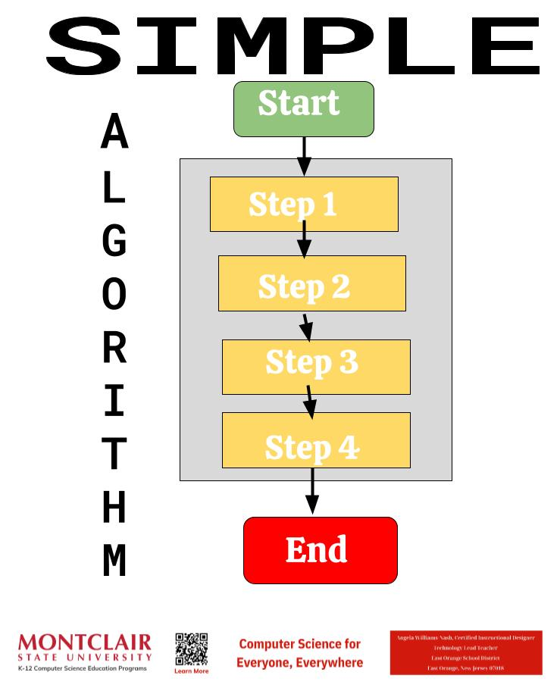
Control Structures
AP
Sequential Structure
This is the default structure or simple algorithm where statements are executed one after the other in the order they appear in the code.
8.1.8
Notes:
From the completed list discuss how we usually complete task the same way every time. Have students write the steps for one of their tasks. Have several students share with class.

Slide 24
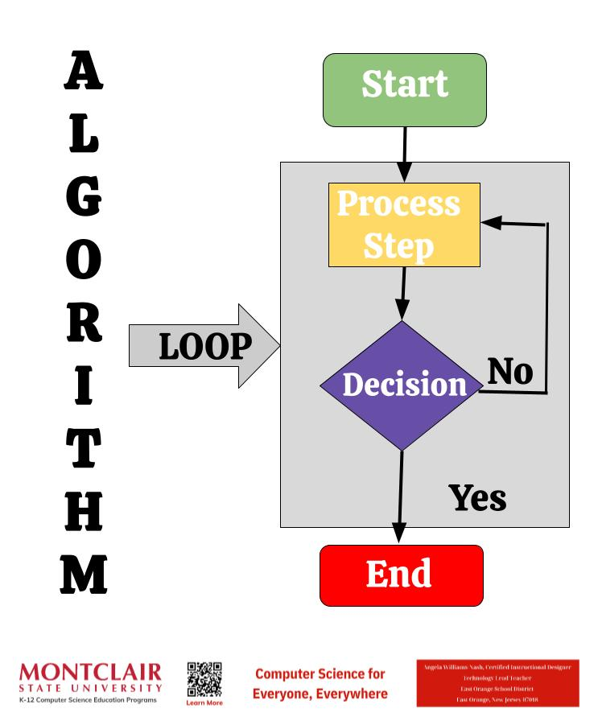
Control Structures
AP
Selection Structure (Conditional Statements)
These structures allow you to execute different blocks of code based on certain conditions.
8.1.8

Slide 25
Control Structures
AP
The most common conditional statements are:
if statement: It allows you to execute a block of code if a specified condition is true.
if-else statement: It allows you to execute one block of code if the condition is true and another block if the condition is false.
nested if-else statement: You can have if-else statements inside other if-else statements, enabling more complex condition checks.
8.1.8

Slide 26
Control Structures
AP
Selection Sort works by repeatedly finding the minimum element from the unsorted portion of the list and moving it to the beginning. It maintains two sublists: one sorted and one unsorted.
Ascending Order A to Z sorts alphabetically or from lowest to highest.
Descending Order Z to A sorts alphabetically backwards from Z to A and from highest to lowest.
8.1.8

Slide 27
Control Structures
AP
Decision Making or Conditional Statements allow selection, making different things happen based on different conditions. You use this process everyday to make decisions.
8.1.8

Slide 28
Control Structures
AP
Compound Conditionals or Compound Boolean Expressions involve combining multiple conditions using logical operators like `and`, `or`, and `not`.
8.1.8

Slide 29
Control Structures
AP
Repetition Structure (Loops)
These structures allow you to repeat a block of code multiple times until a certain condition is met. The main types of loops include:
for loop: It executes a block of code a specified number of times.
while loop: It repeats a block of code as long as a specified condition is true.
do-while loop: Similar to a while loop, but it guarantees that the block of code is executed at least once before the condition is checked.
8.1.8

Slide 30
Control Structures
AP
Repetitive Algorithms requires a program to run until a condition is met.
8.1.8

Slide 31
Control Structures
AP
Nested Loop contains an outer and inner condition. The inner loop executes completely for each iteration of the outer loop, resulting in a total of 9 pairs of values being printed.
8.1.8

Slide 32
Control Structures
AP
Control structures are fundamental in programming because they enable the creation of algorithms and programs that respond to different situations and inputs. They are essential for building logic and enabling your programs to perform complex tasks.
8.1.8

Slide 33
AP
Pseudocode
8.1.8

Slide 34
AP
What Is Pseudocode?
Sooooo!
What is pseudocode
8.1.8

Slide 35
What Is Pseudocode?
AP
Imagine you have to explain to a friend how to make a sandwich without using any specific language, just simple steps. That's kind of
what pseudocode is like.
8.1.8

Slide 36
What Is Pseudocode?
AP
Pseudocode is a way to write down the steps of a computer program in simple, easy to understand steps, without a programming language. It's like writing down the recipe for a computer to follow.
8.1.8

Slide 37
What Is Pseudocode?
AP
People use pseudocode to create and assess an algorithm before coding. It a way to break down what you want the computer to do into simple steps that anyone can understand, even if they don't know a particular programming language.
8.1.8

Slide 38
What Is Pseudocode?
AP
8.1.8
Notes:
From the completed list discuss how we usually complete task the same way every time. Have students write the steps for one of their tasks. Have several students share with class.

Slide 39
What Is Pseudocode?
AP
8.1.8
Notes:
Have students work in teams to develop an algorithm. Pick several teams to use theirs on the rest of the class.

Slide 40
What Is Pseudocode?
AP
8.1.8
Notes:
From the completed list discuss how we usually complete task the same way every time. Have students write the steps for one of their tasks. Have several students share with class.

Slide 41
What Is Pseudocode?
AP
Pseudocode
8.1.8
Notes:
From the completed list discuss how we usually complete task the same way every time. Have students write the steps for one of their tasks. Have several students share with class.

Slide 42
What Is Pseudocode?
AP
Use pseudocode to write a dance algorithm that makes your human robot dance. Remember to use loops and conditional statements to make it more efficient.
Dance Algorithm
8.1.8
Notes:
Have students work in teams to develop an algorithm. Pick several teams to use theirs on the rest of the class.

Slide 43
AP
Flowchart
8.1.8

Slide 44
What Is A Flowchart?
AP
A flowchart to a visualization tool programmers use when creating new applications. It helps the programmer and non-programmers understand the process, workflow or algorithm. Geometric shapes are used to represent steps and arrows show the directional flow.
8.1.8
Notes:
From the completed list discuss how we usually complete task the same way every time. Have students write the steps for one of their tasks. Have several students share with class.

Slide 45
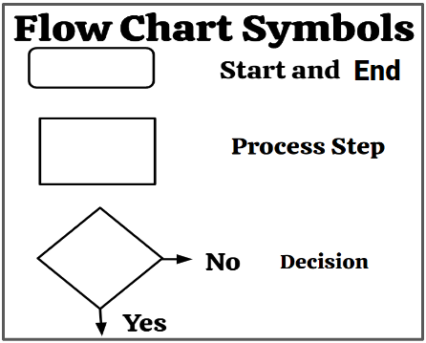
AP
What Is A Flowchart?
Sometime you may see the Start symbol colored in green and the End symbol in red.
The Decision symbol might have True and False.
8.1.8
Notes:
From the completed list discuss how we usually complete task the same way every time. Have students write the steps for one of their tasks. Have several students share with class.

Slide 46
What Is A Flowchart?
AP
8.1.8
Notes:
From the completed list discuss how we usually complete task the same way every time. Have students write the steps for one of their tasks. Have several students share with class.

Slide 47
What Is A Flowchart?
AP
Create a flowchart that will enable your human robot to move from one place in the classroom to another. Remember to use loops and conditional statements to make it more efficient.
Dance Algorithm
8.1.8
Notes:
Have students work in teams to develop an algorithm. Pick several teams to use theirs on the rest of the class.

Slide 48
AP
Decomposition
8.1.8

Slide 49
What is Decomposition?
AP
Sometimes, computer programmers come across big, complex problems to solve. In this case, programmers will decompose or break down a problem or task into smaller, more manageable parts.
8.1.8
Notes:
From the completed list discuss how we usually complete task the same way every time. Have students write the steps for one of their tasks. Have several students share with class.

Slide 50
What is Decomposition?
AP
This commonly used approach in software development will:
a) simplify the design,
b) simplify implementation, and
c) simplify maintenance.
Some benefits of decomposition are discussed on the following slides.
8.1.8
Notes:
From the completed list discuss how we usually complete task the same way every time. Have students write the steps for one of their tasks. Have several students share with class.

Slide 51
What is Decomposition?
AP
Simplify Complexity
Large problems can be daunting to tackle all at once. Decomposition breaks them down into smaller, more manageable sub-problems that are easier to understand and solve.
8.1.8
Notes:
From the completed list discuss how we usually complete task the same way every time. Have students write the steps for one of their tasks. Have several students share with class.

Slide 52
What is Decomposition?
AP
Modularize Code
Breaking a problem into smaller parts, allows each part to be implemented separately. This modular approach promotes code reuse, maintainability, and makes it easier to collaborate on development tasks.
8.1.8
Notes:
From the completed list discuss how we usually complete task the same way every time. Have students write the steps for one of their tasks. Have several students share with class.

Slide 53
What is Decomposition?
AP
Encapsulate Complexity
Each part encapsulates a specific functionality or responsibility, hiding its internal details from the rest of the program. This helps in managing complexity and makes the codebase easy to understand.
8.1.8
Notes:
From the completed list discuss how we usually complete task the same way every time. Have students write the steps for one of their tasks. Have several students share with class.

Slide 54
What is Decomposition?
AP
Improve Readability
Decomposing a problem often results in more readable and understandable code. Each part can focus on a specific aspect of the problem, making it easier for other developers to comprehend.
8.1.8
Notes:
From the completed list discuss how we usually complete task the same way every time. Have students write the steps for one of their tasks. Have several students share with class.

Slide 55
What is Decomposition?
AP
Facilitate Testing
Smaller, modular components are easier to test. Unit tests can be written for individual modules, allowing for more thorough and targeted testing of the software.
8.1.8
Notes:
From the completed list discuss how we usually complete task the same way every time. Have students write the steps for one of their tasks. Have several students share with class.

Slide 56
What is Decomposition?
AP
Enable Parallel Development
Decomposition allows different parts of a system to be developed independently by different teams or individuals at the same time.
8.1.8
Notes:
From the completed list discuss how we usually complete task the same way every time. Have students write the steps for one of their tasks. Have several students share with class.

Slide 57
What is Decomposition?
AP
Overall, decomposition is a fundamental technique in computer programming that helps manage complexity, promote code reuse, and facilitate collaboration in software development projects.
8.1.8
Notes:
From the completed list discuss how we usually complete task the same way every time. Have students write the steps for one of their tasks. Have several students share with class.

Slide 58
AP
Debugging
8.1.8

Slide 59
Debugging
AP
Debugging is the process of finding and fixing errors or "bugs," in software code. It's an essential skill for developers, as even small errors can cause significant issues in the functionality of a program.
8.1.8
Notes:
Have students come up with a third option. For example a triangle for Yes and a circle for No.

Slide 60
Debugging
AP
Possible errors could be:
Logic - testing for being to hot when you meant to test for being too cold.
Sequence - steps are in the wrong order.
Spelling mistakes.
8.1.8
Notes:
Have students come up with a third option. For example a triangle for Yes and a circle for No.

Slide 61
Debugging
AP
Debugging can be a time-consuming process, especially for complex issues.
8.1.8
Notes:
Have students come up with a third option. For example a triangle for Yes and a circle for No.

Slide 62
Debugging
AP
Patience, persistence, and attention to detail are key attributes of successful debuggers.
8.1.8
Notes:
Have students come up with a third option. For example a triangle for Yes and a circle for No.

Slide 63
Debugging
AP
Debugging your dance algorithm. Were there any parts that confused your human robot? Go through and clarify, DEBUG confusing steps.
Dance Algorithm Revision#2
DEBUGGING
8.1.8
Notes:
Have students work in teams to develop an algorithm. Pick several teams to use theirs on the rest of the class.

Slide 64
AP
Programming
8.1.8

Slide 65
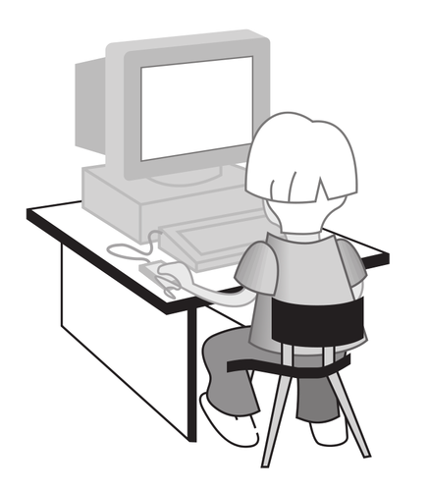
Programming
AP
Programs store and manipulate data by using numbers or other symbols to represent information. Let’s go through a few examples.
8.1.8
Notes:
From the completed list discuss how we usually complete task the same way every time. Have students write the steps for one of their tasks. Have several students share with class.

Slide 66
Programming
AP
Human-Computer Communication
ASCII (American Standard Code for Information Interchange) is the most common character encoding format for text data in computers and on the internet.
8.1.8
Notes:
Have students come up with a third option. For example a triangle for Yes and a circle for No.

Slide 67
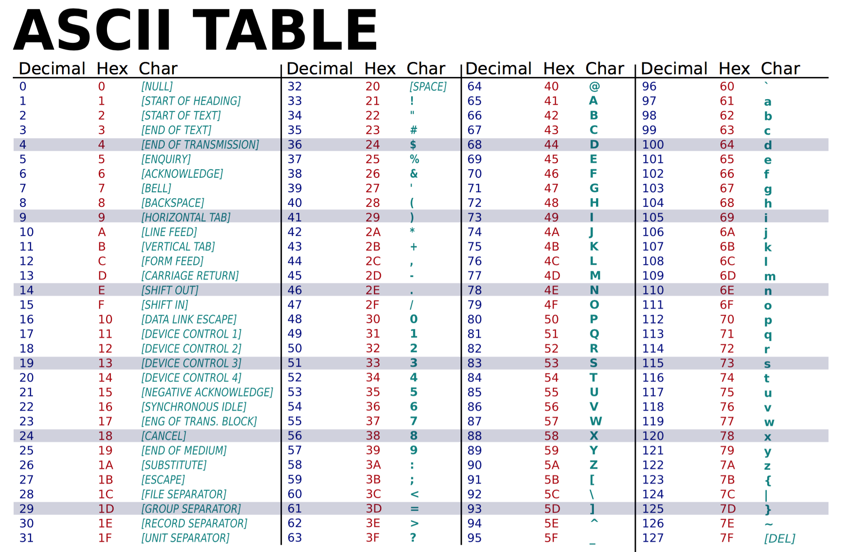
Programming
AP
8.1.8
Notes:
Have students come up with a third option. For example a triangle for Yes and a circle for No.

Slide 68
Programming
AP
Human-Computer Communication
Binary code is one type of coding that uses only 0 and 1 to represent letters, numbers, and symbols. It is called binary code because it’s made of only two symbols. The “bi” in binary means two!
8.1.8
Notes:
Have students come up with a third option. For example a triangle for Yes and a circle for No.

Slide 69
Programming
AP
Human-Computer Communication
The hardware of computers has only two electrical states, on or off. These can be represented by
0 or zero (off), or
1 or one (on).
8.1.8
Notes:
Have students come up with a third option. For example a triangle for Yes and a circle for No.

Slide 70
Programming
AP
Human-Computer Communication
Letters, numbers, and symbols are translated to eight-character binary numbers (0 and 1) as you work with them through the software on your computer.
8.1.8
Notes:
Have students come up with a third option. For example a triangle for Yes and a circle for No.

Slide 71
Programming
AP
Byte is equal to 8 bits.
Illustrations as Bytes
A | 01000001
n | 01101110
2 | 00110010
? | 00111111
8.1.8
Notes:
Have students come up with a third option. For example a triangle for Yes and a circle for No.

Slide 72
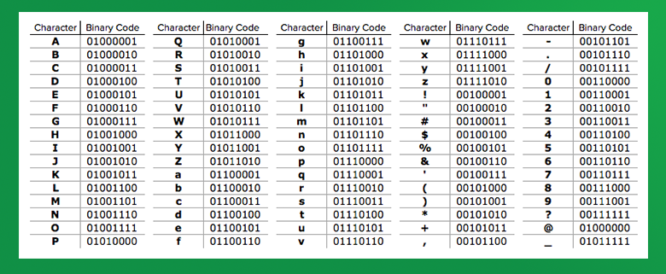
Programming
AP
Use the chart below to write your first name in binary code.
8.1.8
Notes:
Have students come up with a third option. For example a triangle for Yes and a circle for No.

Slide 73
Programming
AP
Human-Computer Communication
Unicode provides a unique number. This means that text can be shared and displayed across different systems without loss of information or character corruption.
8.1.8
Notes:
Have students come up with a third option. For example a triangle for Yes and a circle for No.

Slide 74
Programming
AP
Human-Computer Communication
Unicode assigns each character a unique code point. Look at the example below:
"A" is U+0041
8.1.8
Notes:
Have students come up with a third option. For example a triangle for Yes and a circle for No.

Slide 75
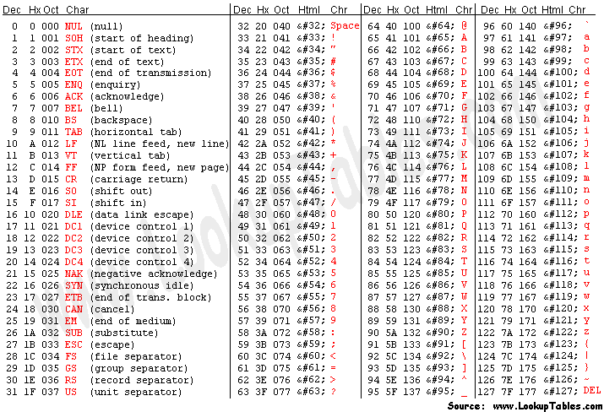
Programming
AP
Human-Computer Communication
8.1.8
Notes:
Have students come up with a third option. For example a triangle for Yes and a circle for No.

Slide 76
Programming
AP
Human-Computer Communication
Unicode supports over a million code points, which can represent characters from various scripts, symbols, emoji, and more.
8.1.8
Notes:
Have students come up with a third option. For example a triangle for Yes and a circle for No.

Slide 77
Programming
AP
Human-Computer Communication
One of the key advantages of Unicode is its universality and inclusivity, allowing for the representation of text in numerous languages and scripts, including those that are not traditionally supported by older encoding standards like ASCII.
8.1.8
Notes:
Have students come up with a third option. For example a triangle for Yes and a circle for No.

Slide 78
Programming
AP
Human-Computer Communication
This makes Unicode very important for multilingual computing, internationalization, and globalization of software and content.
8.1.8
Notes:
Have students come up with a third option. For example a triangle for Yes and a circle for No.

Slide 79
AP
Data Types
8.1.8

Slide 80
AP
Data Types
In programming, data types define the type of data that can be stored and manipulated by a program. The specific data types available can vary depending on the programming language. We will discuss some common data types found in many programming languages.
8.1.8

Slide 81
AP
Data Types
Integer (int)
Integers are whole numbers without any decimal points. The numbers can be positive or negative.
Integers | Not Integers
24 | 3/4
-67 | 24.89
15 | -6.9
8.1.8

Slide 82
AP
Data Types
Floating-point (float)
Float are numbers with decimal points.
Integers | Float
24 | 7.6
-67 | 24.89
15 | -125.9
8.1.8

Slide 83
AP
Data Types
Boolean (bool)
A boolean is a binary, data type with two possible values:
True (1) or False (0);
Yes (1) or No (0); or
On (1) or Off (0).
8.1.8

Slide 84
AP
Data Types
Character (char)
Represents a single character, like upper or lowercase letters and symbols. The table provides a few examples.
Character (char)
d
E
y
?
$
%
8.1.8

Slide 85
AP
Data Types
String
Represents a sequence of characters. Examples include
"hello",
"goodbye",
"4321".
8.1.8

Slide 86
AP
Data Types
Array
Represents a collection of elements of the same data type, accessed by index. Arrays can be one-dimensional, multi-dimensional, or jagged.
8.1.8

Slide 87
AP
Data Types
Tuple
Describes an ordered set of values that store multiple data types. For instance, “(2.0, 3.4, 5.0)” is an example of a 3-tuple containing the three numerical objects listed by commas inside the parenthesis.
8.1.8

Slide 88
AP
Data Types
Set
Represents an unordered collection of unique elements. Sets do not allow duplicate elements.
8.1.8

Slide 89
AP
Data Types
These are some basic, common, data types. The programming language you use will have many more data types or variations of these basic types. Additionally, some languages support user-defined data types, allowing programmers to create custom data types tailored to their specific needs.
8.1.8

Slide 90
AP
Variables
8.1.8

Slide 91
What are Variables?
AP
In computer science, variables are named storage locations used to store data that can vary or change during the execution of a program.
8.1.8

Slide 92
What are Variables?
AP
These data can represent various types of information such as
numbers,
characters,
strings, or
complex data structures.
Variables allow programmers to manipulate and work with data in their programs.
8.1.8

Slide 93
What are Variables?
AP
Name
Each variable has a unique identifier, known as its name, which is used to refer to it within the program's code. Variable names typically follow certain rules and conventions depending on the programming language being used.
8.1.8

Slide 94
What are Variables?
AP
Data Type
Variables are associated with a particular data type, which defines the kind of data that can be stored in them and the operations that can be performed on that data. Common data types include integers, floating-point numbers, characters, strings, and boolean values, among others.
8.1.8

Slide 95
What are Variables?
AP
Value
Variables hold a value, which can be assigned or changed during the execution of a program. The value stored in a variable can be retrieved and manipulated as needed.
8.1.8

Slide 96
What are Variables?
AP
Scope
Variables have a scope that defines where in the program they can be accessed. The scope of a variable is determined by where it is declared within the code. Local variables are accessible only within the block of code in which they are declared, while global variables are accessible throughout the entire program.
8.1.8

Slide 97
What are Variables?
AP
Lifetime
The lifetime of a variable refers to the duration for which it exists in memory. Variables can be created (initialized) and destroyed (deallocated) at specific points during program execution. Local variables typically have a shorter lifetime, while global variables may persist for the entire duration of the program's execution.
8.1.8

Slide 98
What are Variables?
AP
Variables play a very important role in programming, allowing developers to write flexible and dynamic code that can handle different data inputs and perform various computations and operations.
8.1.8

Slide 99
AP
Computer Programming
8.1.8

Slide 100
Computer Programming
AP
What is Computer Programming?
Imagine you have a big box of colorful building blocks. Each block is like a little instruction for the computer to follow. When you put these blocks together in a certain order, they tell the computer what to do, just like when you follow the steps to build a tower with your blocks.
8.1.8
Notes:
Have students come up with a third option. For example a triangle for Yes and a circle for No.

Slide 101
Computer Programming
AP
What is Computer Programming?
Now, these blocks are special because they're made for the computer. They tell it how to do things like play a game, draw a picture, or even talk to other computers far away. When you press a button on the computer or a tablet, it follows the instructions from these blocks to do what you want, like open a game or show a video.
8.1.8
Notes:
Have students come up with a third option. For example a triangle for Yes and a circle for No.

Slide 102
Computer Programming
AP
What is Computer Programming?
So, computer programs are like sets of instructions that tell the computer what to do, just like you use instructions to build something with your building blocks!
// Function to collect numbers from the user
function collectNumbers() {
let numbers = [];
for (let i = 1; i <= 4; i++) {
let input = prompt("Enter number " + i + ":");
let number = parseFloat(input);
if (!isNaN(number)) {
numbers.push(number);
} else {
alert("Invalid input. Please enter a valid number.");
return null;
}
}
return numbers;
}
// Function to calculate sum of numbers
function calculateSum(numbers) {
let sum = 0;
for (let number of numbers) {
sum += number;
}
return sum;
}
// Function to calculate average of numbers
function calculateAverage(numbers) {
let sum = calculateSum(numbers);
return sum / numbers.length;
}
// Main function
function main() {
let numbers = collectNumbers();
if (numbers !== null) {
let sum = calculateSum(numbers);
let average = calculateAverage(numbers);
alert("Sum: " + sum + "\nAverage: " + average);
}
}
// Call the main function
main();
8.1.8
Notes:
Have students come up with a third option. For example a triangle for Yes and a circle for No.

Slide 103
Works Cited
AP
OpenAI. 2024. ChatGPT (2023) Algorithms & Programming. Retrieved from https://www.openai.com/
What is ASCII?
What is Binary Code?
The Difference Between ASCII and Unicode
Multi-dimensional Array
Capterra Glossary
Science Friday Binary Code
8.1.8

