Slide 1
D
A
The New Jersey Student Learning Standards
Computer Science & Design Thinking
8.1.8
Data & Analysis
8.1.8

Slide 2
New Jersey Student Learning Standards
D
A
Technology
8.1.8.DA.1: Organize and transform data collected using computational tools to make it usable for a specific purpose.
8.1.8.DA.2: Explain the difference between how the computer stores data as bits and how the data is displayed.
8.1.8.DA.3: Identify the appropriate tool to access data based on its file format.
8.1.8.DA.4: Transform data to remove errors and improve the accuracy of the data for analysis
8.1.8.DA.5: Test, analyze, and refine computational models.
8.1.8.DA.6: Analyze climate change computational models and propose refinements.
8.1.8

Slide 3
I
D
A
Core Concept 8.1.8 Data & Analysis
Computing systems exist to process data. The amount of digital data generated in the world is rapidly expanding, so the need to process data effectively is increasingly important. Data is collected and stored so that it can be analyzed to better understand the world and make more accurate predictions.
8.1.8

Slide 4
D
A
Topics Covered
Data Collection, Storage, Analysis & Display
Data Storage & Screen Display
Data Analysis
Data Cleaning
Climate Change
Pollution
Extreme Weather
Spreadsheets
Student Challenge
Works Cited
8.1.8

Slide 5
D
A
Data
Collection, Storage, Analysis & Display
8.1.8

Slide 6
D
A
Data Collection
People collect data about other people and the world around them. People collect data in different ways depending on what information they need and the material or resources available to them.
8.1.8

Slide 7
D
A
Data Collection
Here are six common methods used by students like you:
Surveys and Questionnaires
Observation
Interviews
Experiments
Focus Groups
Secondary Data Analysis
Sensor
Social Media Monitoring
Case Studies
Ethnography
8.1.8

Slide 8
D
A
Data Collection
Secondary Data Analysis
Researchers analyze data that has already been collected by others. This could include government data, organizational records, academic studies, or publicly available datasets.
8.1.8

Slide 9
D
A
Data Collection
Surveys and Questionnaires
These collection methods involve asking people questions either in person, over the phone, through mail, or online. Surveys can be structured (with fixed-choice answers) or unstructured (open-ended questions).
8.1.8

Slide 10
D
A
Data Collection
Observation
Data collectors can observe or look at people or phenomena directly.
8.1.8

Slide 11
D
A
Data Collection
Interviews
Similar to surveys, interviews involve asking people questions and recording their anwer. Interviews are often more in-depth and allow for follow-up questions.
8.1.8

Slide 12
D
A
Data Collection
Experiments
In controlled settings, researchers manipulate variables to observe the effects on outcomes. This method is common in psychology, medicine, and the natural sciences.
8.1.8

Slide 13
D
A
Data Collection
Focus Groups
A group of people is brought together to discuss a particular topic under the guidance of a moderator. This method is often used in market research to understand consumer opinions and preferences.
8.1.8

Slide 14
D
A
Data Collection
Sensor Data
With advancements in technology, various sensors can collect data automatically. This includes data from smartphones, fitness trackers, environmental sensors, and more.
8.1.8

Slide 15
D
A
Data Collection
Social Media Monitoring
Researchers analyze data from social media platforms to understand trends, opinions, and behaviors of individuals or groups.
8.1.8

Slide 16
D
A
Data Collection
Case Studies
Researchers deeply investigate a particular case or situation to understand its complexities and dynamics.
8.1.8

Slide 17
D
A
Data Collection
Ethnography
Researchers immerse themselves in a particular culture or community for an extended period to understand its practices, beliefs, and behaviors.
8.1.8

Slide 18
D
A
Data Collection
Each method has its good parts and not so good parts. Sometimes data collectors use several methods together in order to get data that is detailed and reliable.
8.1.8

Slide 19
D
A
Data Storage
After data is collected it is stored in a safe place until you are ready to use it. Data can be stored in various ways based on the type and amount.
8.1.8

Slide 20
D
A
Data Storage
We will examine the storage methods listed below:
Databases
File Systems
Cloud Storage
Storage Area Network (SAN)
External Hard Drives and Flash Drives
Object Storage
Tape Storage
8.1.8

Slide 21
D
A
Data Storage
Databases
Databases are collections of data that are organized in a way that allows for efficient storage, retrieval, and manipulation.
8.1.8

Slide 22
D
A
Data Storage
File Systems
Data can be stored in files on disk drives. File systems organize data into directories and files and provide mechanisms for reading, writing, and managing data.
8.1.8

Slide 23
D
A
Data Storage
Cloud Storage
Cloud storage services like Google Cloud Storage and Dropbox provide allow users to store and access data from anywhere.
8.1.8

Slide 24
D
A
Data Storage
Storage Area Network (SAN)
SAN is a dedicated network that provides access to consolidated, block-level storage. Block-level storage is a type of data storage where data is stored and retrieved in fixed-sized blocks or chunks.
8.1.8

Slide 25
D
A
Data Storage
External Hard Drives and Flash Drives
Data can be stored on external hard disk drives (HDDs) or solid-state drives (SSDs) connected to a computer via USB or other interfaces.
8.1.8

Slide 26
D
A
Data Storage
Object Storage
Object storage is a type of storage infrastructure that manages data as objects rather than files or blocks. Each object typically includes the data itself, metadata, and a unique identifier. Examples of object storage systems include Amazon S3 and Google Cloud Storage.
8.1.8

Slide 27
D
A
Data Storage
Tape Storage
Tape storage involves storing data on magnetic tapes, which offer high capacity and low cost per gigabyte compared to disk storage. Tape storage is often used for long-term archival purposes due to its durability and low energy consumption.
8.1.8

Slide 28
D
A
Data Storage
Each storage method has its advantages and limitations. Most organizations use a combination of storage technologies to meet their data storage needs effectively.
8.1.8

Slide 29
D
A
Data Storage & Screen Display
8.1.8

Slide 30
D
A
Data As Bits & Screen Display
The difference between how a computer stores data as bits and how the data is displayed lies in the representation and interpretation of information.
8.1.8

Slide 31
D
A
Data As Bits & Screen Display
Data Storage as Bits
Inside a computer's memory, data is stored in the form of binary digits, commonly referred to as bits.
8.1.8

Slide 32
D
A
Data As Bits & Screen Display
Data Storage as Bits
Groups of bits are used to represent more complex data types. For example, a byte consists of 8 bits and can represent values from 0 to 255 (2^8 possible combinations).
8.1.8

Slide 33
D
A
Data As Bits & Screen Display
Data Storage as Bits
Computers use various storage devices such as RAM (Random Access Memory) and hard drives to store data in binary form.
Information in its binary form is abstract and not understandable by humans.
8.1.8

Slide 34
D
A
Data As Bits & Screen Display
Data Display
Data is displayed to users in a human-readable format through various output devices such as monitors, printers, speakers, etc..
8.1.8

Slide 35
D
A
Data As Bits & Screen Display
Data Display
To make data understandable to humans, it needs to be converted from its binary representation to a format that can be interpreted visually, audibly, or otherwise.
8.1.8

Slide 36
D
A
Data As Bits & Screen Display
Data Display
This conversion process involves interpreting the binary data according to predefined rules and conventions. For example:Text data is typically represented using character encoding schemes like ASCII or Unicode, where each character is mapped to a specific binary code.
8.1.8

Slide 37
D
A
Data As Bits & Screen Display
Data Display ASCII
ASCII (American Standard Code for Information Interchange) data represents text characters using a 8-bit binary code. Each character is assigned a unique numeric value, allowing computers to store and manipulate textual data. Here's an example of how ASCII data might look:
01000001 01000010 01000011 01000100 01000101
8.1.8

Slide 38
D
A
Data As Bits & Screen Display
Data Display ASCII
This binary sequence represents the ASCII characters 'A', 'B', 'C', 'D', and 'E', respectively. Here's how it breaks down:
- 'A' corresponds to the binary sequence: 01000001
- 'B' corresponds to the binary sequence: 01000010
- 'C' corresponds to the binary sequence: 01000011
- 'D' corresponds to the binary sequence: 01000100
- 'E' corresponds to the binary sequence: 01000101
8.1.8

Slide 39
D
A
Data As Bits & Screen Display
Data Display ASCII
When this binary data is interpreted according to the ASCII encoding standard, it translates to the characters 'A', 'B', 'C', 'D', and 'E'. Keep in mind that this is just a small example, and ASCII data can represent a wide range of characters including letters, numbers, punctuation marks, and control characters.
8.1.8

Slide 40
D
A
Data As Bits & Screen Display
Data Display as Unicode
Unicode is a character encoding standard that aims to represent every character from every language and script in the world. Unlike ASCII, which uses 8 bits to represent characters, Unicode typically uses 16 bits or more, allowing for a much broader range of characters to be represented.
8.1.8

Slide 41
D
A
Data As Bits & Screen Display
Data Display as Unicode
Here's an example of Unicode data:
U+0041 U+0042 U+0043 U+0044 U+0045
In this example:
- U+0041 represents the Unicode code point for the character 'A'.
- U+0042 represents the Unicode code point for the character 'B'.
- U+0043 represents the Unicode code point for the character 'C'.
- U+0044 represents the Unicode code point for the character 'D'.
- U+0045 represents the Unicode code point for the character 'E'.
8.1.8

Slide 42
D
A
Data As Bits & Screen Display
Data Display as Unicode
Each Unicode code point uniquely identifies a character, and it can be represented in various formats, including hexadecimal or decimal notation. The 'U+' prefix indicates that the following characters represent Unicode code points.
8.1.8

Slide 43
D
A
Data As Bits & Screen Display
Data Display as Unicode
Unicode supports a vast range of characters beyond those found in ASCII, including characters from various writing systems, symbols, emojis, and special characters used in different languages and contexts.
8.1.8

Slide 44
D
A
Data Analysis
8.1.8

Slide 45
D
A
Data Analysis
Data analysis involves the process of inspecting, transforming, and modeling data with the goal of discovering useful information, informing conclusions, and supporting decision-making.
8.1.8

Slide 46
D
A
Data Analysis
We look at tables, charts, and graphs to find meaning in the data. The goal is to find patterns so that we can make predictions. A prediction is a really good guess.
8.1.8

Slide 47
D
A
Data Cleaning
8.1.8

Slide 48
D
A
Data Cleaning
Data cleaning, also known as data cleansing or data scrubbing, is the process of detecting and correcting errors, inconsistencies, and inaccuracies in a dataset to improve its quality, reliability, and usability for analysis or other purposes.
8.1.8

Slide 49
D
A
Data Cleaning
Data cleaning is an important step in the data preparation pipeline and is essential for ensuring that analytical results are accurate and reliable.
8.1.8

Slide 50
D
A
Data Cleaning
Here are some common tasks involved in data cleaning:
Handling Missing Values
Removing Duplicates
Standardizing Data
Correcting Errors
Addressing Data Integrity Issues
8.1.8

Slide 51
D
A
Data Cleaning
Handling Missing Values
Identify and handle missing values in the dataset. This may involve imputing missing values using statistical methods (e.g., mean, median, mode), filling missing values with default values, or removing records with missing values.
8.1.8

Slide 52
D
A
Data Cleaning
Removing Duplicates
Identify and remove duplicate records or entries in the dataset. Duplicate data can skew analysis results and lead to incorrect conclusions.
8.1.8

Slide 53
D
A
Data Cleaning
Standardizing Data
Standardize data formats, units, and representations to ensure consistency across the dataset. For example, convert date and time formats to a standard format, normalize numerical values, and ensure consistent naming conventions for categorical variables.
8.1.8

Slide 54
D
A
Data Cleaning
Correcting Errors
Identify and correct errors in the dataset, such as typos, spelling mistakes, and incorrect values. This may involve manual inspection, data validation rules, or automated algorithms for error detection and correction.
8.1.8

Slide 55
D
A
Data Cleaning
Addressing Data Integrity Issues
Ensure data integrity by enforcing referential integrity constraints, primary key constraints, and other integrity constraints in relational databases. This helps maintain the consistency and accuracy of data across different tables or datasets.
8.1.8

Slide 56
D
A
Data Cleaning
Overall, data cleaning is a continuous process that requires careful attention to detail. Effective data cleaning practices are essential for producing high-quality, reliable, and actionable insights from data analysis.
8.1.8

Slide 57
D
A
Climate Change
8.1.8

Slide 58
What is Climate Change?
D
A
Let’s suppose you are sleeping and your caregiver comes in and places a lot of extra blankets on you. At first you are OK but over time you get warmer and warmer. You get so hot that you feel as though you are burning up and all you want to do it push the blankets off you to release the heat
and cool down!
8.1.8

Slide 59
What is Climate Change?
D
A
Surrounding the Earth is a big layer that acts as a blanket covering our planet. We call it our atmosphere. The atmosphere is made up of gases like carbon dioxide,
methane, and water vapor,
which helps keep our planet
warm, just like a blanket
keeps you warm at night.
8.1.8

Slide 60
What is Climate Change?
D
A
Over time, people all around the world have been doing things that add extra blankets to our planet.
8.1.8

Slide 61
What is Climate Change?
D
A
Human activities like
burning coal, oil, and gas for energy,
reducing the size of our forest, and
industrialization (manufacturing)
have released extra gases into
the air. The effect is like adding
extra blankets. This has made the
Earth warmer than it should be.
8.1.8

Slide 62
What is Climate Change?
D
A
As our Earth gets warmer, all sorts of problems begin to happen. Look at the example below.
Melting ice at North and South Pole.
Sea level rises.
Pollution and extreme weather.
8.1.8

Slide 63
What is Climate Change?
D
A
Think of it like leaving a bowl of ice cream outside on a summer day. Your ice cream melts after a while, it loses it taste and no matter what you do, it does not taste the same anymore.
8.1.8

Slide 64
What is Climate Change?
D
A
And so! Climate change is the permanent change in the Earth’s weather pattern caused by human activity. It adversely impacts all living things and can result in:
rising temperatures,
sea level rise,
extreme weather events,
shifts in ecosystems, and
disruptions to agriculture, and
problems with local economies.
8.1.8

Slide 65
What is Climate Change?
D
A
Climate change causes Global warming, the long-term increase in Earth's average surface temperature, primarily due to human activities that release greenhouse gases into the atmosphere. These greenhouse gases, trap heat from the sun in the Earth's atmosphere, leading to a warming.
8.1.8

Slide 66
D
A
Pollution
8.1.8

Slide 67
D
A
What is Pollution?
Pollution is when something harmful is added to the environment that is harmful or has a poisonous effect. Pollutants can make humans, wildlife, trees, and even our food sources unhealthy or sick.
8.1.8

Slide 68
D
A
What is Pollution?
Pollution can be grouped based on where it comes from, its impact, and the environment it affects. Some of the main types of pollution:
1. Air Pollution
2. Water Pollution
3. Soil Pollution
4. Noise Pollution
5. Light Pollution
6. Thermal Pollution
7. Plastic Pollution
8. e-Waste Pollution
8.1.8

Slide 69
D
A
What is Pollution?
Air Pollution
This type of pollution occurs when harmful substances, such as gases, particulate matter, and chemicals, are released into the air. Common sources include vehicle emissions, industrial activities, and burning of fossil fuels like coal oil and methane gas. Air pollution can lead to respiratory problems, cardiovascular diseases, and environmental damage.
8.1.8

Slide 70
D
A
What is Pollution?
Water Pollution
Water pollution occurs when contaminants, such as chemicals, sewage, and waste, enter bodies of water like rivers, lakes, and oceans. Sources of water pollution include industrial discharge, agricultural runoff, and improper waste disposal. Water pollution can harm aquatic ecosystems, affect drinking water quality, and pose risks to human health.
8.1.8

Slide 71
D
A
What is Pollution?
Soil Pollution
Soil pollution occurs when contaminants, such as heavy metals, pesticides, and industrial chemicals, accumulate in the soil. This can result from activities like improper waste disposal, agricultural practices, and industrial activities. Soil pollution can degrade soil quality, harm plants and animals, and affect food safety.
8.1.8

Slide 72
D
A
What is Pollution?
Noise Pollution
Noise pollution refers to excessive or disruptive noise that interferes with normal activities and causes discomfort or harm to humans and animals. Sources of noise pollution include transportation, industrial machinery, construction activities, and urbanization. Exposure to long periods of high noise levels can lead to hearing loss, stress, and other health problems.
8.1.8

Slide 73
D
A
What is Pollution?
Light Pollution
Light pollution occurs when artificial light sources, such as streetlights and billboards, disrupt natural light cycles and cause excessive brightness at night. This can affect wildlife behavior, disrupt ecosystems, and interfere with astronomical observations. Light pollution can also contribute to energy waste and affect human health and sleep patterns.
8.1.8

Slide 74
D
A
What is Pollution?
Thermal Pollution
Thermal pollution refers to the excessive heat released into water bodies from industrial processes, power plants, and urban runoff. This can disrupt aquatic ecosystems, decrease oxygen levels in water, and harm aquatic organisms.
8.1.8

Slide 75
D
A
What is Pollution?
Plastic Pollution
Plastic pollution occurs when plastic materials accumulate in the environment, particularly in oceans, rivers, and landfills. This can harm wildlife, marine ecosystems, and human health. Plastic pollution also contributes to environmental degradation and the spread of microplastics throughout the food chain.
8.1.8

Slide 76
D
A
What is Pollution?
E-waste Pollution
E-waste is short for electronic waste. E-waste pollution occurs when discarded electronic devices (old computers, laptops, mobile phones, televisions) or appliances (refrigerators, washers, dryers) are thrown in dumps, landfills or incinerated (burned). This is a significant environmental concern due to the toxic materials like lead, mercury, cadmium, and hazardous chemicals. such as brominated flame retardants. Improper disposal of e-waste can lead to the release of these harmful substances into the environment, contaminating soil, water, and air, and posing risks to human health and ecosystems.
8.1.8

Slide 77
D
A
What is Pollution?
These are some of the main types of pollution, each with its own sources, impacts, and challenges.
8.1.8

Slide 78
D
A
Extreme Weather
8.1.8

Slide 79
What is Extreme Weather?
D
A
The word extreme means reaching the maximum or highest amount. Extreme weather refers to severe or unusual weather events that are very different from is expected for a town, state, country or time of year.
8.1.8

Slide 80
What is Extreme Weather?
D
A
These events often involve extreme temperatures, precipitation, wind speeds, or other weather conditions. Examples of extreme weather events include:
Heatwaves
Cold snaps
Heavy rainfall
Droughts
Hurricanes, typhoons, and cyclones
Tornadoes
Thunderstorms
8.1.8

Slide 81
What is Extreme Weather?
D
A
Heatwaves
Prolonged periods of unusually high temperatures, often accompanied by high humidity, which can pose health risks and lead to heat-related illnesses and deaths.
8.1.8

Slide 82
What is Extreme Weather?
D
A
Cold Snaps
Sudden and severe drops in temperature, resulting in freezing conditions, frost, and sometimes blizzards or ice storms.
8.1.8

Slide 83
What is Extreme Weather?
D
A
Heavy Rainfall
Intense and prolonged periods of rain leading to flooding, landslides, and waterlogged infrastructure.
8.1.8

Slide 84
What is Extreme Weather?
D
A
Droughts
Extended periods of abnormally low rainfall, resulting in water shortages, crop failures, and ecological stress.
8.1.8

Slide 85
What is Extreme Weather?
D
A
Hurricanes, typhoons, and cyclones: Powerful tropical storms characterized by strong winds, heavy rainfall, and storm surges, which can cause widespread devastation and loss of life.
8.1.8

Slide 86
What is Extreme Weather?
D
A
Tornadoes
Violently rotating columns of air that extend from thunderstorms to the ground, capable of causing severe damage to buildings and infrastructure in their path.
8.1.8

Slide 87
What is Extreme Weather?
D
A
Thunderstorms
Storms characterized by lightning, thunder, heavy rain, and sometimes hail or strong winds, which can result in localized flooding, property damage, and power outages.
8.1.8

Slide 88
What is Extreme Weather?
D
A
Extreme weather events are associated with climate change, as rising global temperatures can lead to changes in weather patterns, increased frequency and intensity of extreme events, and changes to regional climates. Managing and mitigating the impacts of extreme weather require preparedness, resilience, and effective disaster response strategies at the local, national, and global levels.
8.1.8

Slide 89
D
A
Spreadsheets
8.1.8

Slide 90
D
A
Spreadsheets
Spreadsheet programs are a type of software applications program used to organize, analyze, and change and display data.
8.1.8

Slide 91
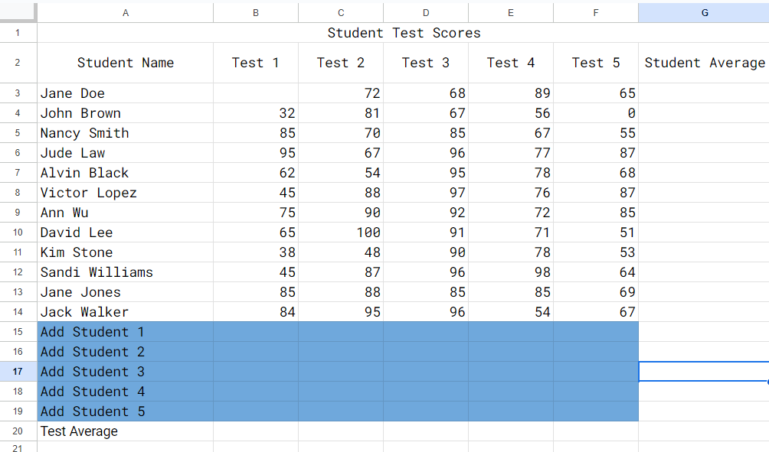
D
A
Spreadsheets
Two popular spreadsheet programs used in school
are Microsoft Excel
and Google Sheets.
8.1.8

Slide 92
D
A
Spreadsheets
Spreadsheets are commonly used for various purposes, including:
Data Entry and Organization
Data Analysis
Financial Management
Project Management
Data Visualization
Collaboration
8.1.8

Slide 93
D
A
Spreadsheets
Data Entry and Organization
Spreadsheets provide a structured way to input and organize data. Users can input data into cells manually or import data from external sources such as databases or other files.
8.1.8

Slide 94
D
A
Spreadsheets
Data Analysis
Spreadsheets offer a wide range of built-in functions and tools for analyzing data. Users can perform calculations, generate summaries, create charts and graphs, and apply statistical functions to analyze the data within the spreadsheet.
8.1.8

Slide 95
D
A
Spreadsheets
Financial Management
Spreadsheets are widely used for financial tasks such as budgeting, expense tracking, forecasting, and financial modeling. They can perform complex calculations related to taxes, investments, loans, and accounting.
8.1.8

Slide 96
D
A
Spreadsheets
Project Management
Spreadsheets can be used for project planning, scheduling, tracking tasks, managing resources, and creating Gantt charts. Project managers often use spreadsheets to keep track of project timelines, milestones, and budgets.
8.1.8

Slide 97
D
A
Spreadsheets
Data Visualization
Spreadsheets can create visual representations of data through charts and graphs. This allows users to visualize trends, patterns, and relationships within the data more easily.
8.1.8

Slide 98
D
A
Spreadsheets
Collaboration
Many spreadsheet applications support collaboration features, allowing multiple users to work on the same spreadsheet simultaneously. Users can share, edit, and comment on spreadsheets in real-time, facilitating teamwork and communication.
8.1.8

Slide 99
D
A
Spreadsheets
Data Displays
Spreadsheets can create visual representations of data through charts and graphs. This allows users to visualize trends, patterns, and relationships within the data more easily. Let’s look at visualizations!
8.1.8

Slide 100
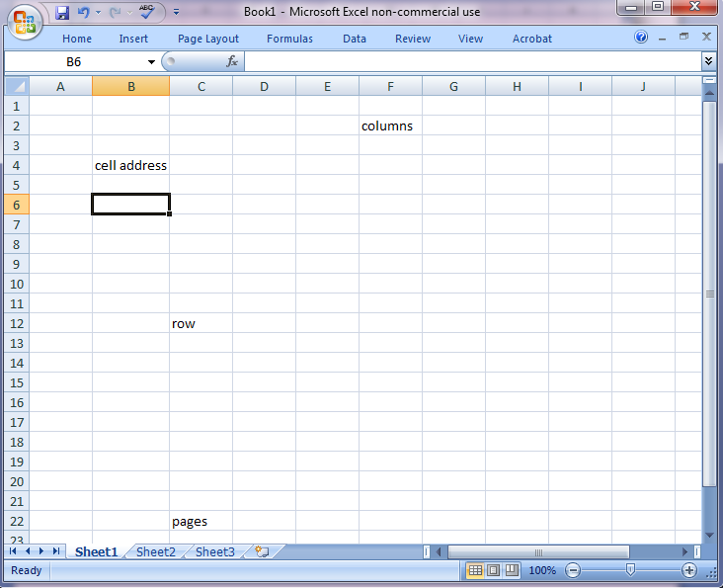
D
A
Spreadsheets
Each column is labeled with a capital letter.
Every row is labeled with a number.
Every page in a spreadsheet is called a sheet.
8.1.8

Slide 101
D
A
Spreadsheets
Spreadsheets arrange data in rows and columns. The intersection, where a column and row meet is called a cell. Each cell can contain text, numbers, formulas, or functions.
8.1.8

Slide 102
D
A
Spreadsheets
Each cell has a unique name which is its column heading (capital letter) followed by the row heading (number). The circled cell is named B6.
8.1.8

Slide 103
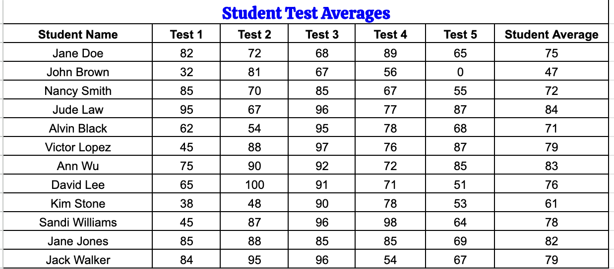
D
A
Spreadsheets
Here is a spreadsheet that contains data on student test scores. It is a tabular form.
8.1.8

Slide 104
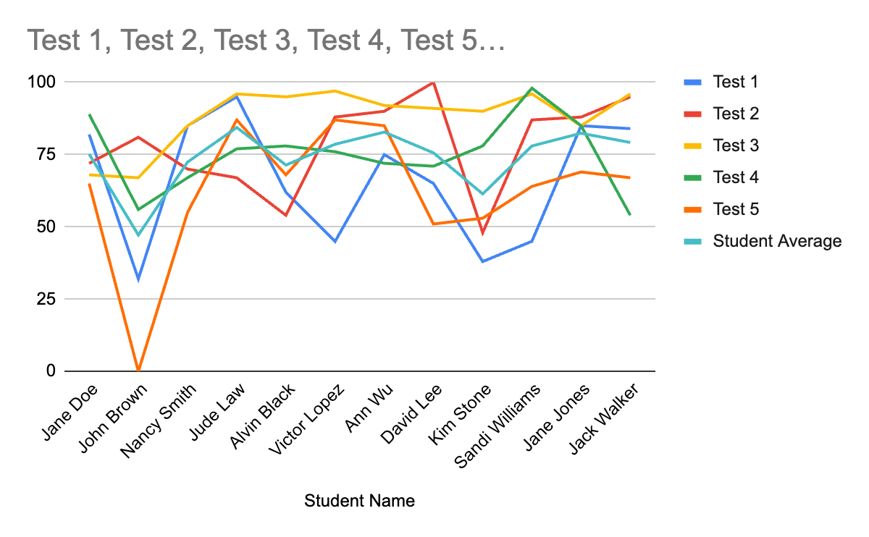
D
A
Spreadsheets
8.1.8
Here is the same data shown as a line chart.

Slide 105
D
A
Spreadsheets
When examining line charts, look for the following line behaviors:
Increase is when the line goes up.
Decrease is when the line goes down.
Steady state is when the line stays the same.
8.1.8

Slide 106
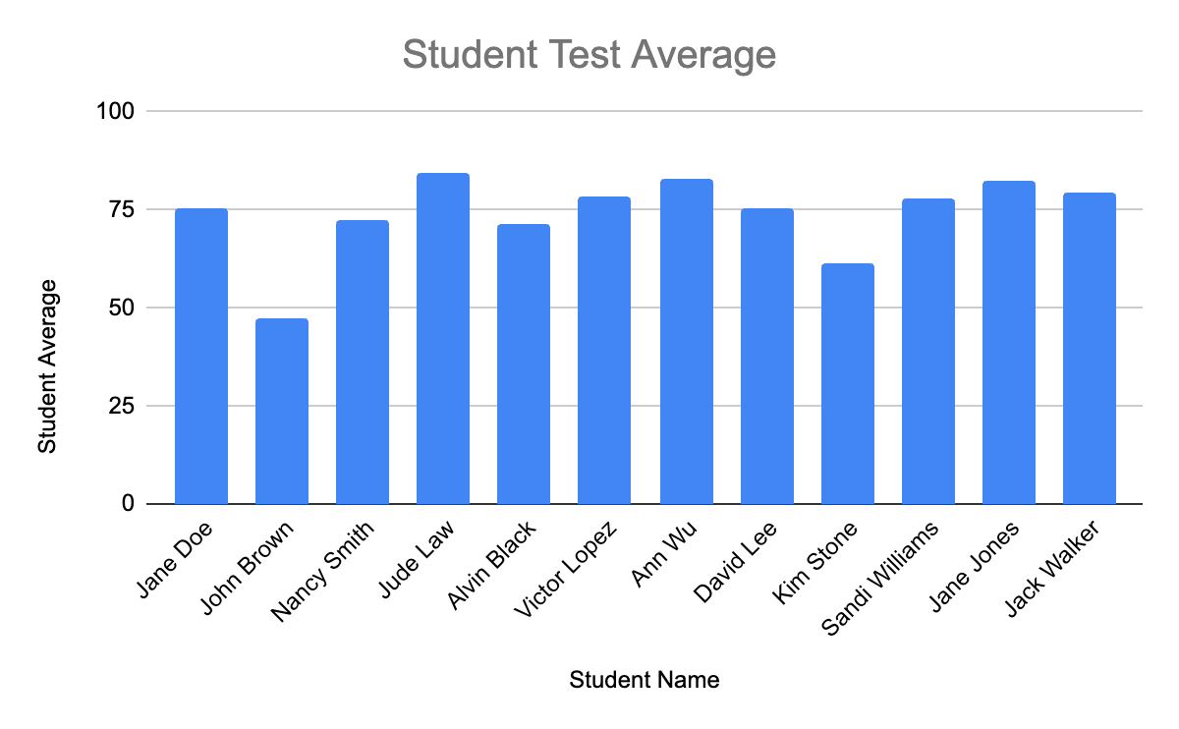
D
A
Spreadsheets
Here is the student average column shown as a bar chart.
8.1.8

Slide 107
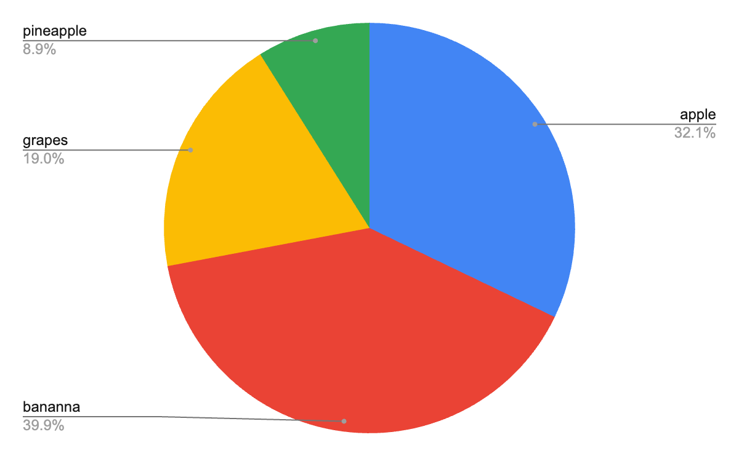
D
A
Spreadsheets
Favorite Fruit
apple | 54
banana | 67
grapes | 32
pineapple | 15
8.1.8
Here is survey data from the table shown as a pie chart.

Slide 108
D
A
Spreadsheets Formulas
Spreadsheet programs include lots of math and analytical formulas and functions that are used to evaluate data to make predictions. Formulas and functions are categorized.
8.1.8

Slide 109
D
A
Spreadsheets Formulas
We will examine the following common formulas and functions:
Sum
Average
Maximum
Minimum
Mode
Count
If
Forecast
8.1.8

Slide 110
D
A
Spreadsheets Formulas
SUM
The SUM formula adds up the values in a range of cells. We use the word SUM not add! It's often used to calculate totals, subtotals, or to simply add up a list of numbers.
Example:=SUM(A1:A10)
This formula adds up the values in cells A1 through A10.
8.1.8

Slide 111
D
A
Spreadsheets Formulas
AVERAGE
The AVERAGE formula calculates the arithmetic mean of a range of cells, providing the average value of the selected data points.
Example: =AVERAGE(B1:B10)
This formula calculates the average of the values in cells B1 through B10.
8.1.8

Slide 112
D
A
Spreadsheets Formulas
Maximum
The Max formula looks through a range of cells, and provides the largest number.
Example: =Max(A4:D20)
This formula returns the largest number in cells A4 through D20.
8.1.8

Slide 113
D
A
Spreadsheets Formulas
Minimum
The Min formula looks through a range of cells, and provides the smallest number.
Example: =Min(A1:F20)
This formula returns the largest number in cells A1 through F20.
8.1.8

Slide 114
D
A
Spreadsheets Formulas
Mode
The Mode formula looks through a range of cells, and provides the number that appears most often.
Example: =Mode(A1:G35)
This formula returns the number that appears most often in cells A1 through G35.
8.1.8

Slide 115
D
A
Spreadsheets Formulas
Count
The Count formula looks through a range of cells, and provides the number of numbers or number of objects in the list.
Example: =Count(A1:B20)
This formula returns the number of numbers or objects in cells A1 through B20.
8.1.8

Slide 116
Spreadsheets Formulas
D
A
IF
The IF formula performs a logical test and returns one value if the test evaluates to TRUE and another value if the test evaluates to FALSE. It's useful for conditional calculations or formatting.
Example: =IF(A1>10, "Yes", "No")
This formula checks if the value in cell A1 is greater than 10. If true, it returns "Yes"; otherwise, it returns "No".
8.1.8

Slide 117
D
A
Spreadsheets Formulas
Forecast is a function used to calculate the expected value of a future observation based on historical data. You can forecast one value of multiple future values. For one future value
FORECAST(A17, B:2:B16, A2:A16)
Where, A17 represents the future value you want to forecast, B2:B16 is historical data, and A2:A16 are the corresponding dates or time periods.
8.1.8

Slide 118
D
A
Spreadsheets Formulas
These are just a few examples of common spreadsheet formulas in Microsoft Excel and Google Sheets. A wide range of built-in functions for performing various calculations, manipulations, and analyses on data. Familiarizing oneself with these functions can greatly enhance productivity and efficiency in working with spreadsheets.
8.1.8

Slide 119
D
A
Student Challenge
8.1.8

Slide 120
D
A
Climate Change Project
Each of us can positively contribute to making our environment a better place. You will complete a project on some aspect of climate change. We will use the scientific method to study the problem, collect data, recommend solutions and present our findings.
8.1.8

Slide 121
Works Cited
D
A
Gore, Al (2007) An Inconvenient Truth: The Crisis of Global Warming. Penguin Books Ltd.
OpenAI. (Year). ChatGPT [Computer software]. Retrieved from https://www.openai.com/chatgpt
How to Use Google Sheets
8.1.8

