Slide 1
NI
The New Jersey Student Learning Standards
Computer Science & Design Thinking
8.1.8 Networks
& The Internet
8.1.8

Slide 2
New Jersey Student Learning Standards
NI
Technology:
8.1.8.IN.1: Model how information is broken down into smaller pieces, transmitted as addressed packets through multiple devices over networks and the Internet, and reassembled at the destination.
8.1.8.NI.2: Model the role of protocols in transmitting data across networks and the Internet and how they enable secure and errorless communication.
8.1.8.NI.3: Explain how network security depends on a combination of hardware, software, and practices that control access to data and systems.
8.1.8.NI.4: Explain how new security measures have been created in response to key malware events.
8.1.8

Slide 3
I
NI
Core Concept 8.1.8 Networks & The Internet
Computing devices typically do not operate in isolation. Networks connect computing devices to share information and resources and are an increasingly integral part of computing. Networks and communication systems provide greater connectivity in the computing world. Protocols, packets, and addressing are the key components for reliable delivery of information across networks.
8.1.8

Slide 4
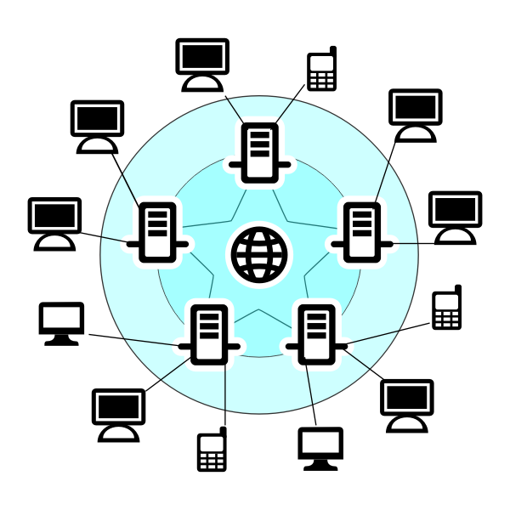
NI
Topics Covered
Computer Data
Computer Network
Types of Computer Networks
Network Protocols
Packets
Addressing
Routers
Servers
Malware
Network Security
Works Cited
8.1.8

Slide 5
NI
Computer Data
8.1.8

Slide 6
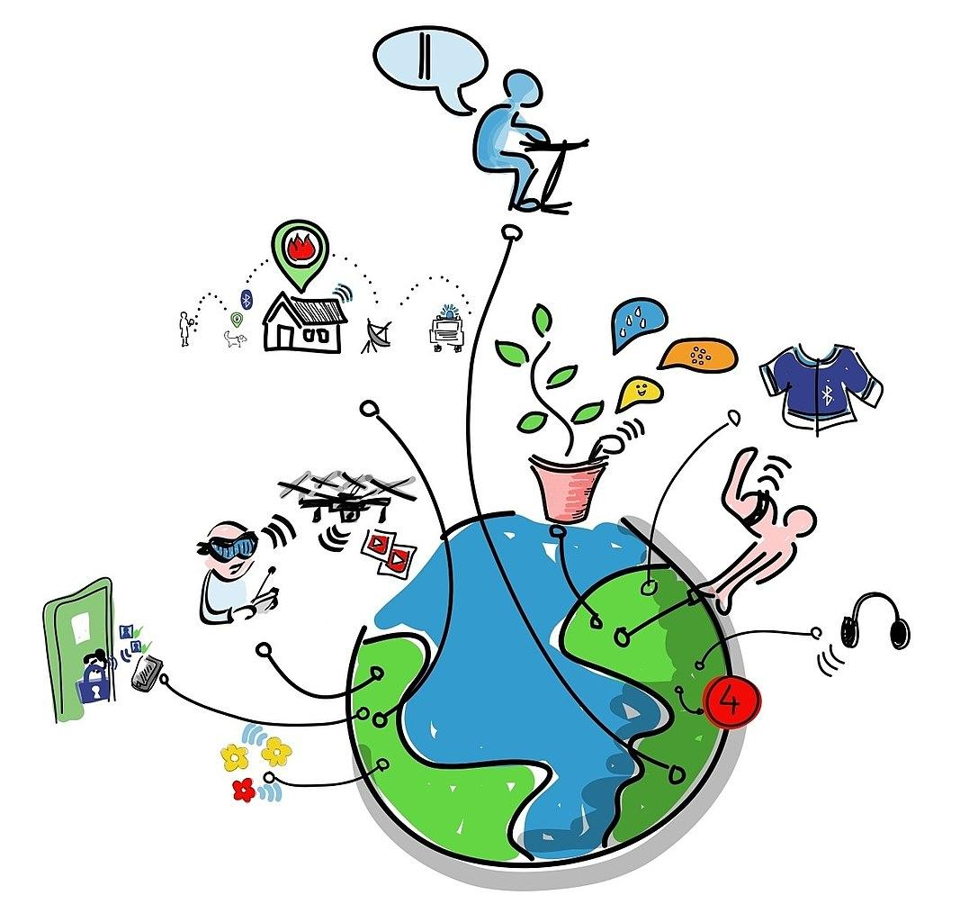
NI
Computer Data
Data is the information you send and receive over the Internet.
8.1.8

Slide 7
Computer Data
NI
Question:
What types of data do you send or receive over the internet?
8.1.8

Slide 8
Computer Data
NI
Answer:
Data includes pictures, drawings, images, sounds, and text like notes, letters, essays and book reports.
8.1.8

Slide 9
NI
Computer Networks
8.1.8

Slide 10
NI
What is a Computer Network
Imagine you have a bunch of friends. You all like to talk to each other and share your games. Your friends live in different houses and in different towns. Think of the houses that your friends live in as computers. Think about the roads you travel to get to their houses as connections.
8.1.8

Slide 11
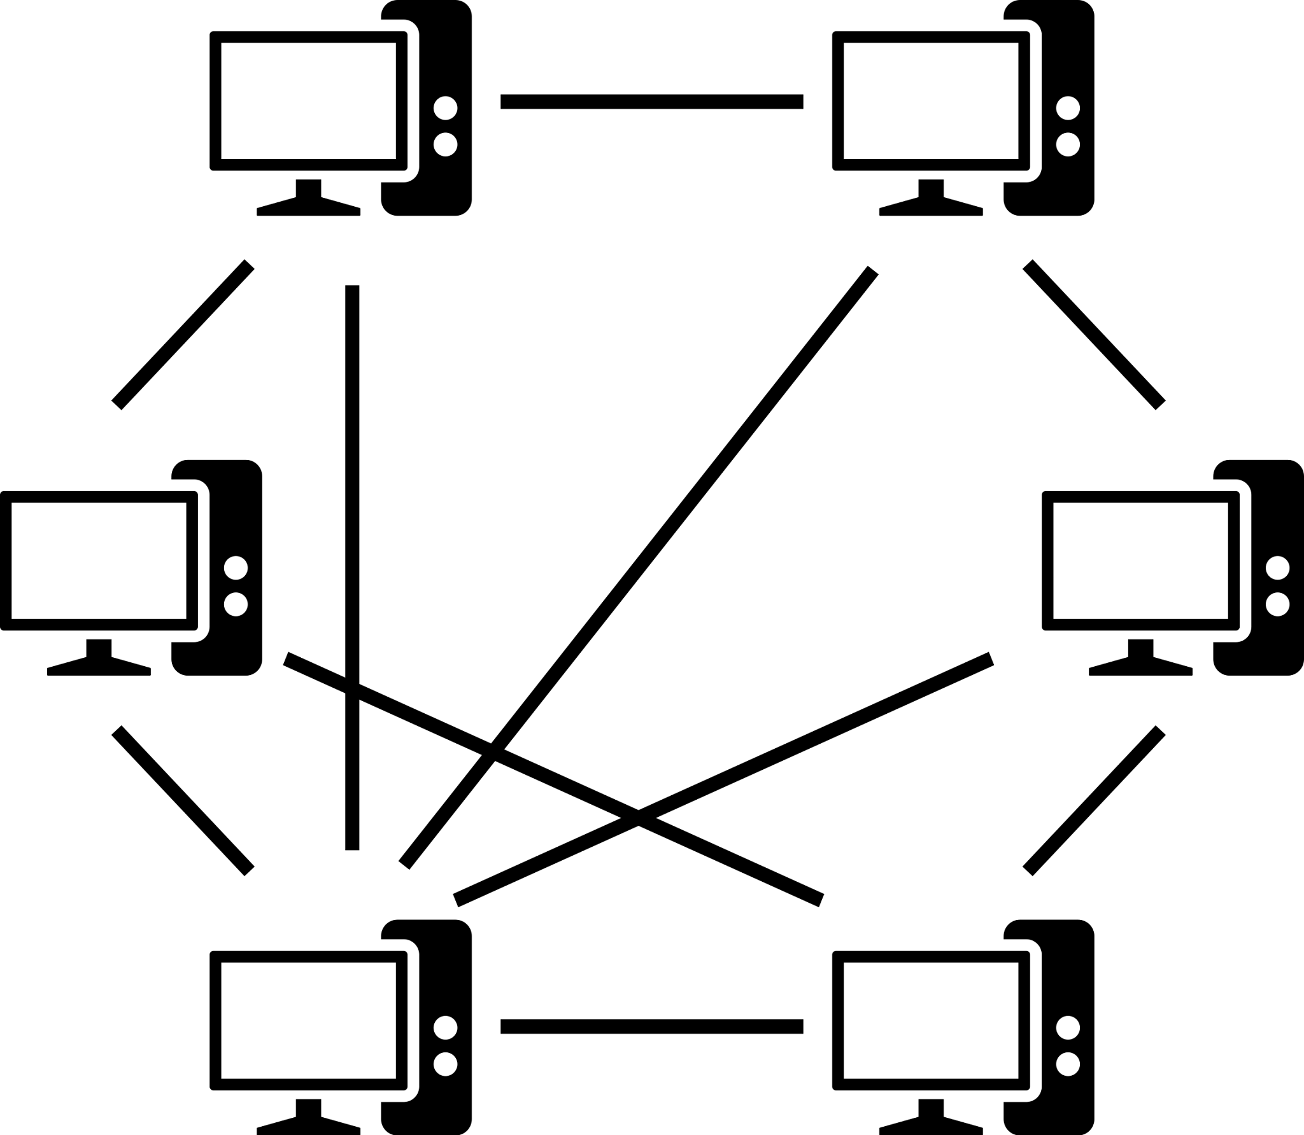
NI
What is a Computer Network
A computer network is like a big map that shows all the roads (connections) between the houses (computers).
8.1.8

Slide 12
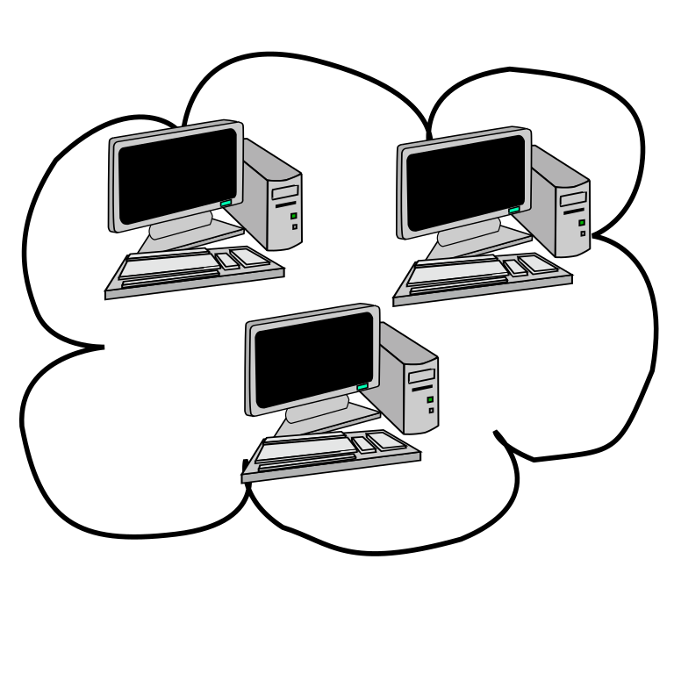
NI
What is a Computer Network
When your friends want to hangout or play a game, they use these roads (connections) to send messages back and forth between the houses (computers). Computers pass information to each other through network connections.
8.1.8

Slide 13
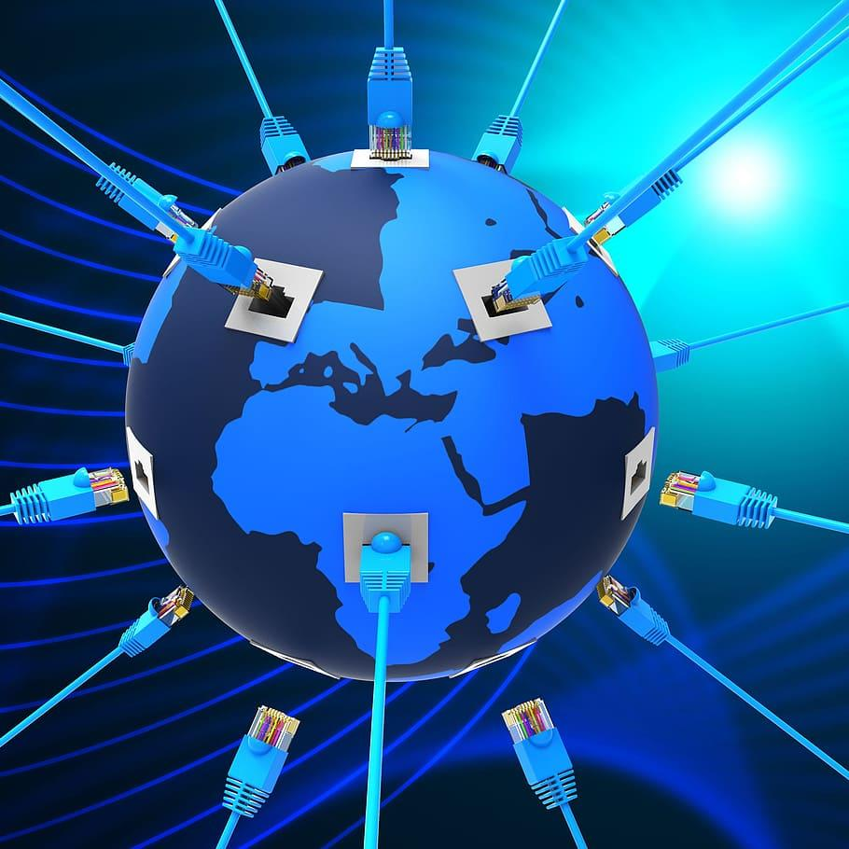
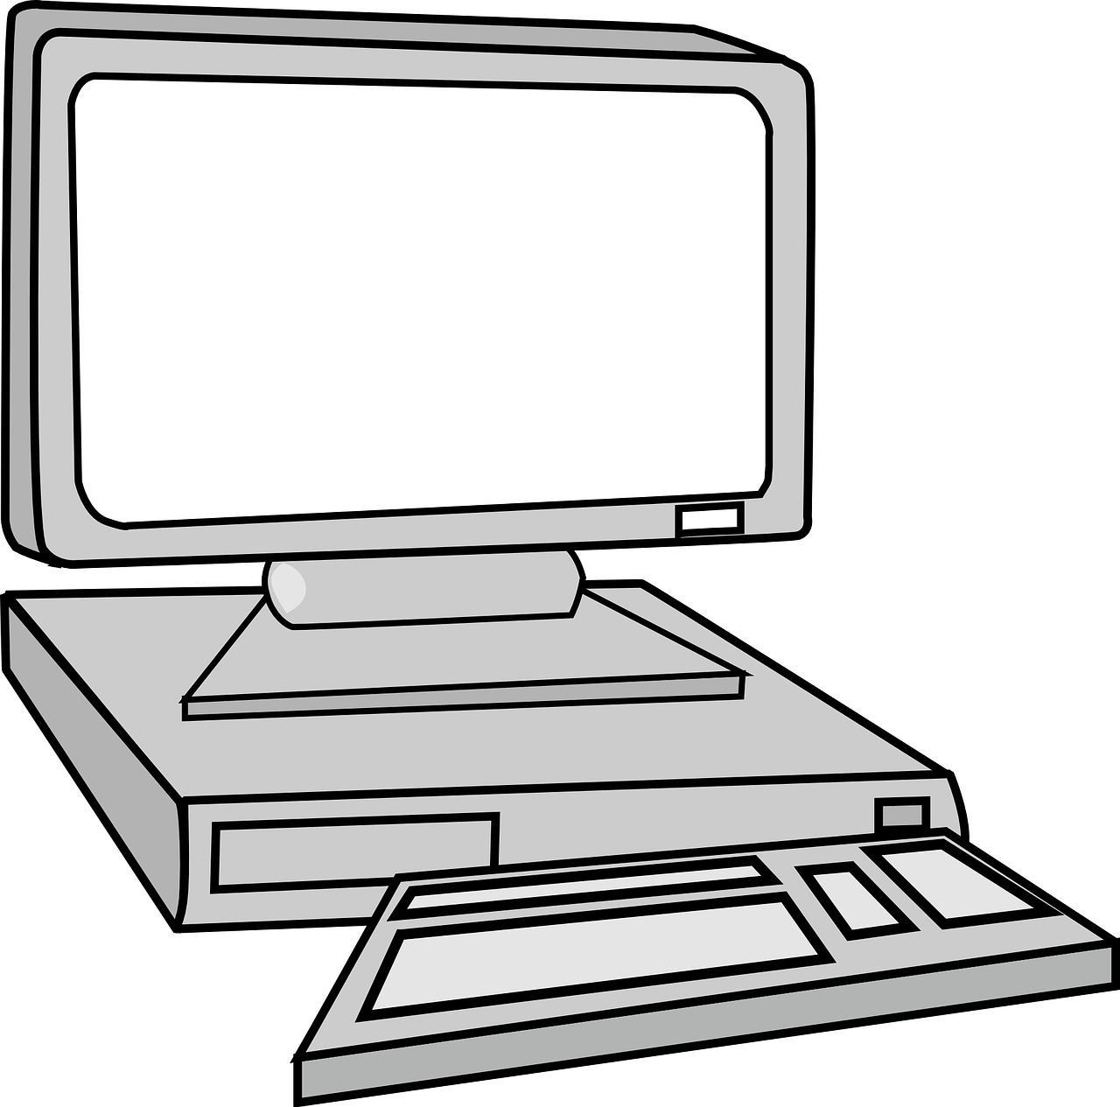
NI
What is a Computer Network
The more roads (connections) there are and the faster they are, the quicker your friends can share and play together! That's what computer networks do—they help computers talk and share stuff with each other, no matter where they are!
8.1.8

Slide 14
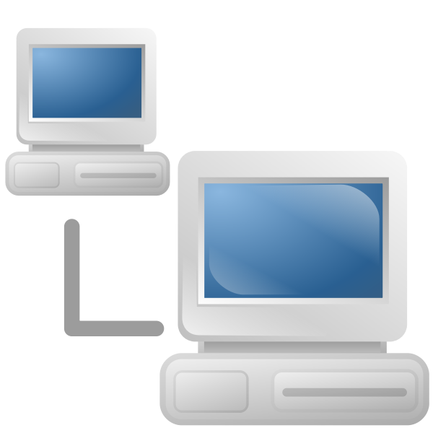
NI
What is a Computer Network
A computer network has lots of devices that are connected via wires or wireless to communicate with one another to share information and resources.
8.1.8

Slide 15
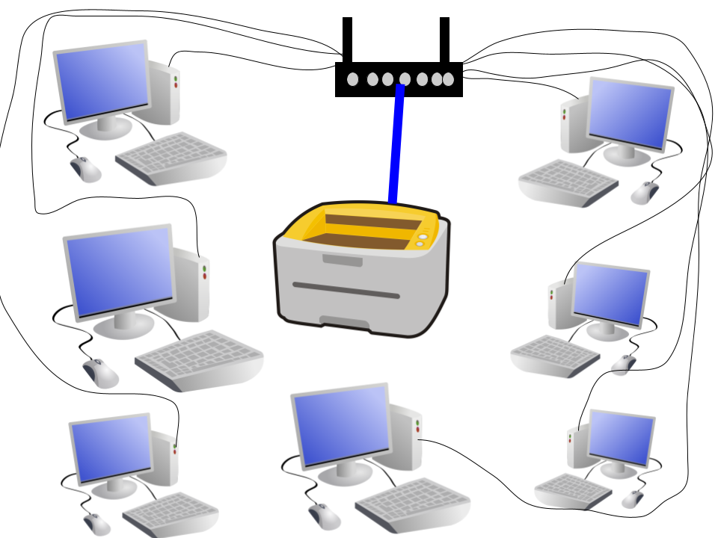
NI
What is a Computer Network
Traditional computer networks have desktop computers connect to printers.
8.1.8

Slide 16
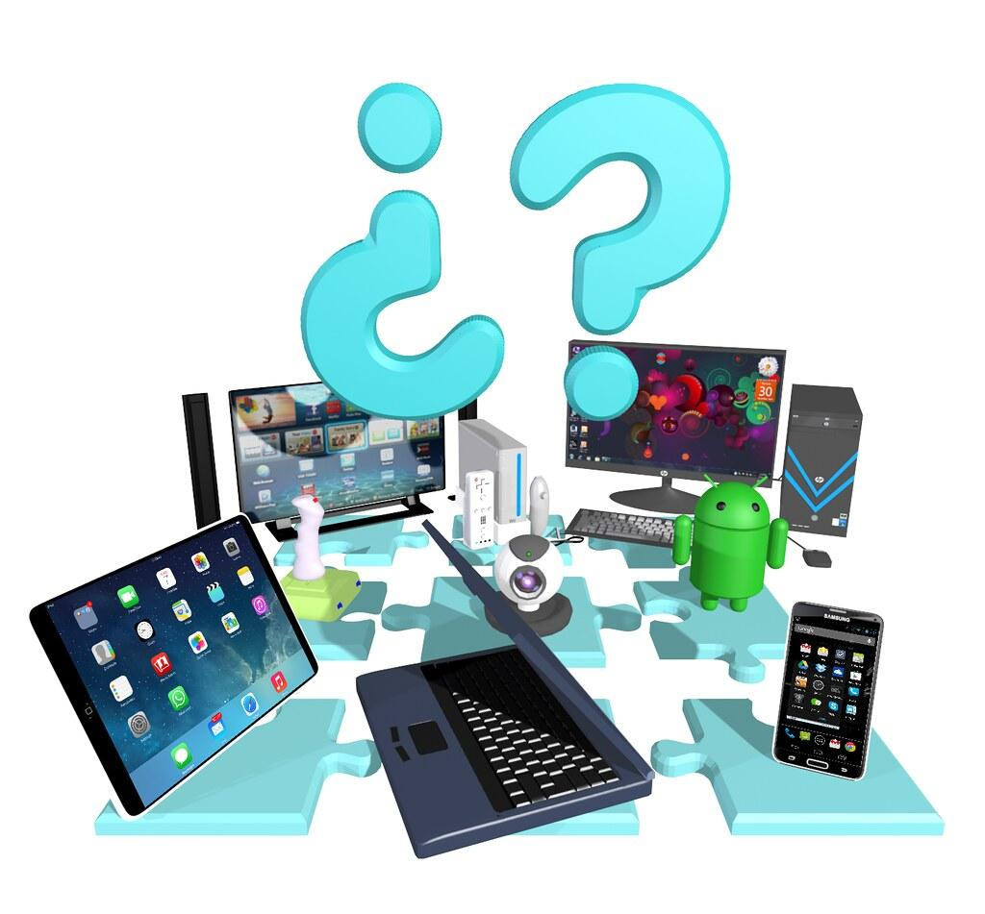
NI
What is a Computer Network
Modern computer networks include a lot of different devices like laptops, tablets, smart phones, smart TVs and other electronics.
8.1.8

Slide 17
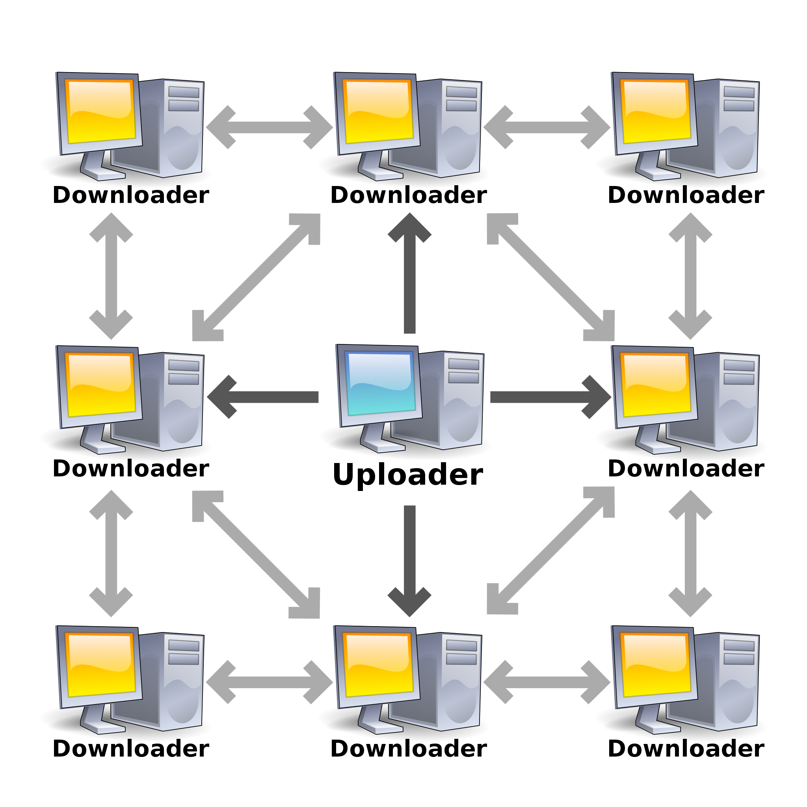
NI
What is a Computer Network
Computer networks come in different sizes. Some are very small like the one in a classroom that connects all computers to one printer. And some are very large. The Internet is the largest computer network in the world!
8.1.8

Slide 18
NI
What is a Computer Network
Remember, computer networks are used to connect individuals to other individuals, places, information, and ideas. And the Internet is the largest computer network in the world!
8.1.8

Slide 19
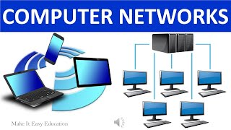
NI
What is a Computer Network
8.1.8

Slide 20
NI
Types of Computer Networks
8.1.8

Slide 21
Types of Computer Networks
NI
Computer networks are grouped based on their size, scope, and structure. Each type has its own characteristics and applications. Some of the most common types of computer networks are reviewed in this section.
8.1.8

Slide 22
Types of Computer Networks
NI
Local Area Network (LAN) covers a small geographic area, such as a single building or a group of buildings. These type of networks typically used for connecting devices like computers, printers, and servers within an organization.
8.1.8

Slide 23
Types of Computer Networks
NI
Wireless Local Area Network (WLAN) use wireless communication technology (such as Wi-Fi) to connect devices within a limited area. WLANs are commonly found in homes, offices, airports, and cafes.
8.1.8

Slide 24
Types of Computer Networks
NI
Wide Area Network (WAN) covers a large geographic area, connecting multiple LANs and other networks together. They are often used to connect offices in different cities or countries, utilizing leased lines or satellite links.
8.1.8

Slide 25
Types of Computer Networks
NI
Metropolitan Area Network (MAN) covers a larger geographical area than a LAN but smaller than WANs. They are used to interconnect various local networks within a metropolitan area, like spanning a city.
8.1.8

Slide 26
Types of Computer Networks
NI
Personal Area Network (PAN) are used for connecting devices within the immediate vicinity of a user, typically within a range of a few feet. Examples include Bluetooth connections between a smartphone and a headset or a computer and a mouse.
8.1.8

Slide 27
Types of Computer Networks
NI
Campus Area Network (CAN) interconnect LANs within a limited geographical area, such as a college campus or corporate campus.
8.1.8

Slide 28
Types of Computer Networks
NI
Storage Area Network (SAN) are specialized networks designed to provide block-level storage to servers. They are used in data centers to connect servers to storage devices such as disk arrays and tape libraries.
8.1.8

Slide 29
Types of Computer Networks
NI
Virtual Private Network (VPN) create secure, encrypted connections over a public network (typically the internet), enabling remote users to access a private network as if they were directly connected to it.
8.1.8

Slide 30
Types of Computer Networks
NI
These are some of the common types of computer networks, each with its own characteristics and applications.
Local Area Network (LAN) covers a small geographic area, such as a single building or group of buildings.
Wireless LAN (WLAN) use wireless communication technology (such as Wi-Fi) to connect devices within a limited area.
Wide Area Network (WAN) spans a large geographic area, connecting multiple LANs and other networks together.
Metropolitan Area Network (MAN) covers a larger geographical area than LANs but smaller than WANs, typically spanning a city.
Personal Area Network (PAN) are used for connecting devices within the immediate vicinity of a user, typically within a range of a few meters.
Campus Area Network (CAN) connect LANs within a limited geographical area, such as a university campus or corporate campus.
Storage Area Network (SAN) are specialized networks designed to provide block-level storage to servers.
Virtual Private Network (VPN) create secure, encrypted connections over a public network (typically the internet), enabling remote users to access a private network as if they were directly connected to it.
8.1.8

Slide 31
Types of Computer Networks
NI
Network Types
Click on the link above to view the video.
8.1.8

Slide 32
NI
Network Protocols
8.1.8

Slide 33
NI
What is a Network Protocol?
Network protocols are a set of rules and conventions that control how data is transmitted and received over a computer network.
8.1.8

Slide 34
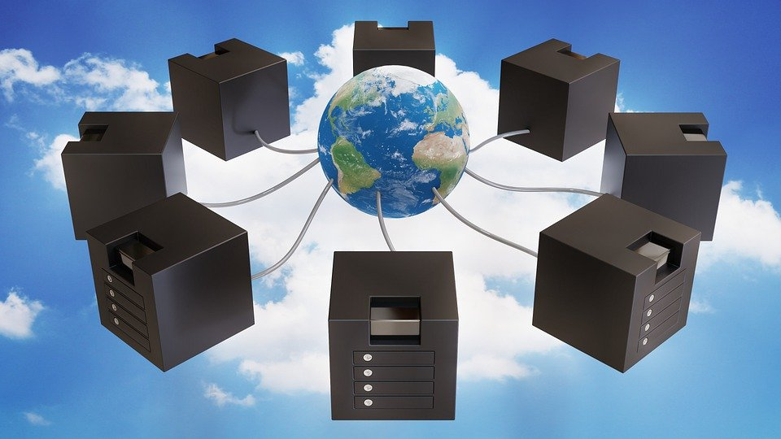
NI
What is a Network Protocol?
There are different types of protocols for the different types of jobs or tasks needed to make the Internet work.
8.1.8

Slide 35
NI
What is a Network Protocol?
Protocols dictate various aspects of network communication, including
addressing,
data formatting,
error detection and correction,
and routing.
We will review some key components and functions of network protocols.
8.1.8

Slide 36
NI
What is a Network Protocol?
Addressing protocols define how devices on a network are identified and addressed. A unique IP addresses to assigned to each device, enabling data packets to be routed to their intended destinations.
8.1.8

Slide 37
NI
What is a Network Protocol?
Data Formatting Protocols specify how data is formatted for transmission over the network. This includes rules for organizing data into packets or frames, as well as specifying the structure of headers and trailers attached to each packet for routing and error detection.
8.1.8

Slide 38
NI
What is a Network Protocol?
Error Detection and Correction Network Protocols include mechanisms for detecting and, in some cases, correcting errors that may occur during data transmission.
8.1.8

Slide 39
NI
What is a Network Protocol?
Routing Protocols determine how data packets are routed through the network from the source to the destination. This involves determining the best path for data transmission based on factors like network congestion, latency, and reliability.
8.1.8

Slide 40
NI
What is a Network Protocol?
Flow Control Protocols regulate the flow of data between devices to prevent congestion and ensure efficient transmission. Flow control mechanisms control the rate at which data is sent and received, adjusting transmission speeds based on network conditions and the capabilities of the receiving device.
8.1.8

Slide 41
NI
What is a Network Protocol?
Session Management Protocols include features for establishing, maintaining, and terminating communication sessions between devices.
8.1.8

Slide 42
NI
What is a Network Protocol?
Security Protocols include security features to protect data from unauthorized access, interception, and tampering. Encryption protocols like Secure Sockets Layer (SSL) and Transport Layer Security (TLS) are commonly used to secure transmitted data.
8.1.8

Slide 43
NI
Examples
Internet Protocol (IP) is based on internet addresses and is used for sending and receiving messages on the Internet.
Transmission Control Protocol (TCP) is a connection protocol that makes sure data reaches its destination error free.
Simple Mail Transfer Protocol (SMTP) is used for sending emails within the same network and between different networks.
Hypertext Transfer Protocol (HTTP) is used to browse the Internet and download material.
File Transfer Protocol (FTP) is used to allow users to work from a remote server.
Secure Sockets Layer (SSL) and Transport Layer Security (TLS) are commonly used to secure transmitted data.
8.1.8

Slide 44
NI
Network Protocols: Why Do We Need Them
Click the link above to view the video.
8.1.8

Slide 45
NI
Packets
8.1.8

Slide 46
NI
Packets
When data like an image or video is sent from one device to another across a network, it is broken down into smaller, manageable chunks or segments.
8.1.8

Slide 47
NI
Packets
Each segment is placed into its own container which is called a packet by the Internet Protocol (IP). There are two versions of IP: version 4 and version 6. We will talk more about these later.
8.1.8

Slide 48
NI
Packets
Packets enable the efficient and reliable communication between devices across networks.
8.1.8

Slide 49
NI
Packets
These packets contain not only the actual data being transmitted but also additional information necessary for successful delivery. Look at the image below.
8.1.8

Slide 50
NI
Packets
IP Header contains the following:
Source address-computer requesting the information
Destination address-where the device containing the requested information is located.
Type- the network protocol being used.
Data or payload is the file, image, sound being sent.
8.1.8

Slide 51
NI
Packets
The three key components of every packets are:
Header
Payload
Trailer (optional)
8.1.8

Slide 52
NI
Packets
HEADER
The header is the portion of the packet that contains control information necessary for routing and managing the packet as it travels through the network. This information typically includes:
Source and destination addresses: Identifiers indicating where the packet originated and where it is intended to be delivered.
Sequence numbers: Used to ensure that packets are received and reassembled in the correct order.
Protocol information: Specifies which network protocol the packet is using (e.g., TCP, UDP, IP).
Error checking information: Checksums or other error detection codes used to verify the integrity of the packet during transmission.
8.1.8

Slide 53
NI
Packets
PAYLOAD
The payload is the actual data being transmitted, such as a piece of a file, a web page, an email message, or a video stream. The payload can vary in size depending on the application and the network protocol being used.
8.1.8

Slide 54
NI
Packets
TRAILER
The trailer is an optional section of the packet that contains additional control information, such as error detection codes or padding to ensure that the packet meets a minimum size requirement.
Not all packets include a trailer, and its presence depends on the specific network protocol being used.
8.1.8

Slide 55
NI
Packets
Packets are transmitted across the network independently of one another. This means that each packet can take different paths and arrive at their destination out of order.
8.1.8

Slide 56
NI
Packets
However, the header of each packet contains information that allows routers and other networking devices to route and reassemble the packets correctly.
8.1.8

Slide 57
NI
Packets
Upon reaching their destination, packets are reassembled into their original order and combined to reconstruct the original data.
8.1.8

Slide 58
NI
Packets
Overall, packets are essential building blocks of network communication, allowing data to be efficiently transmitted and routed across complex networks while ensuring reliability and integrity.
8.1.8

Slide 59
NI
A Packets Tale
Click the link above to view the video.
8.1.8

Slide 60
NI
Addressing
8.1.8

Slide 61
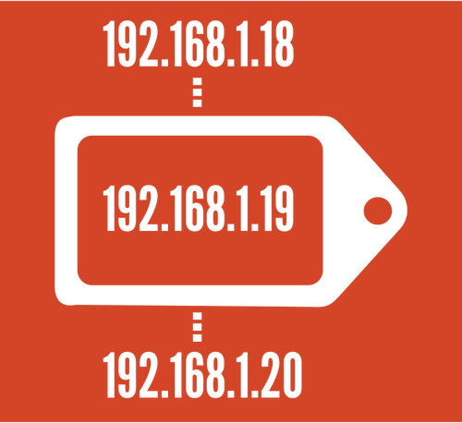
Addressing
NI
IP is short for Internet Protocol. IP addresses are numerical labels assigned to devices connected to a computer network that uses the Internet Protocol for communication.
8.1.8

Slide 62
Addressing
NI
These addresses serve two primary purposes:
identifying devices on a network, and
enabling the routing of data packets to their destinations.
8.1.8

Slide 63
Internet Delivery System
Addressing
NI
The IP address is a set of three sets of up to 3 digits separated by a period. For example:
12.93.415
Let’s look at the two versions of IP Addresses!
8.1.8

Slide 64
Addressing
NI
Unique Identification
Every device connected to a network, such as computers, servers, smartphones, routers, and IoT devices, must have a unique IP address. This uniqueness ensures that each device can be identified and addressed individually within the network.
8.1.8

Slide 65
Addressing
NI
IPv4 and IPv6
There are two main versions of IP addresses:
IPv4 (Internet Protocol version 4), and
IPv6 (Internet Protocol version 6).
8.1.8

Slide 66
Addressing
NI
IPv4
IPv4 addresses are 32-bit numbers written in a dotted-decimal format (e.g., 128.168.3.211).
They have a limited address space, which has led to IPv6 adoption.
8.1.8

Slide 67
Addressing
NI
IPv6
IPv6 addresses are 128-bit numbers written in hexadecimal notation (e.g., 2001:0db8:85a3:0000:0000:8a2e:0370:7334), providing a much larger pool of addresses to accommodate the growing number of devices connected to the Internet.
8.1.8

Slide 68
Addressing
NI
Hierarchical Structure
IP addresses are structured hierarchically, consisting of network and host portions. In IPv4, the network portion identifies the network to which a device belongs, while the host portion identifies the specific device within that network. In IPv6, the first 64 bits typically represent the network portion, and the remaining 64 bits represent the host portion.
8.1.8

Slide 69
Addressing
NI
Public and Private IP Addresses
IP addresses can be classified as public or private.
Public IP addresses are globally routable and used to identify devices on the public Internet.
Private IP addresses are reserved for use within private networks and are not routable on the public Internet. Instead, network address translation (NAT) is used to translate private IP addresses into public IP addresses for communication over the Internet.
8.1.8

Slide 70
Addressing
NI
Dynamic and Static IP Addresses
IP addresses can be dynamically assigned by a DHCP (Dynamic Host Configuration Protocol) server or statically configured by a network administrator.
Dynamic IP addresses are assigned temporarily and may change over time, while static IP addresses remain constant and are manually configured.
8.1.8

Slide 71
Addressing
NI
Subnetting
Subnetting involves dividing a larger IP address space into smaller subnetworks to improve network efficiency and manageability. Subnet masks are used to define the boundary between the network and host portions of an IP address.
8.1.8

Slide 72
Addressing
NI
In conclusion, IP addresses are fundamental components of computer networking. They provide a means of identifying and addressing devices on a network and facilitating communication between them. IP addresses play a crucial role in enabling the Internet and other networked systems to function effectively.
8.1.8

Slide 73
Internet Delivery System
Addressing
NI
You do not have to know, use or remember an IP address. Instead you will use the domain name which is the website name like:
YouTube.com
8.1.8

Slide 74
Addressing
NI
What Is an IP Address?
Click the link above to view the video.
8.1.8

Slide 75
NI
Routers
8.1.8

Slide 76
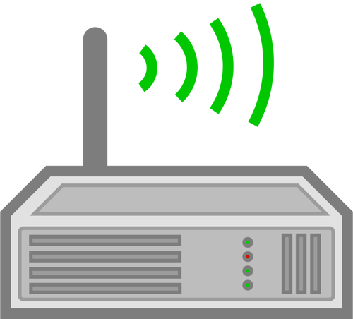
Routers
NI
A router is the device that transmits data between different networks. The data goes to a server, which is the computer that fulfills the request. The request takes many paths to get to the computer that holds the information.
8.1.8

Slide 77
Routers
NI
Once the data is retrieved, the server uses many routes to get the information back to your computer.
8.1.8

Slide 78
NI
Server
8.1.8

Slide 79
Server
NI
A computer server is a specialized computer system designed to provide
services,
resources, or
data
to other computers or clients over a network.
8.1.8

Slide 80
Server
NI
Servers are configured to optimize…
reliability to perform consistently well,
performance to carry out or complete their task or function, and
scalability to change the size or scope of the assigned task or function.
8.1.8

Slide 81
Server
NI
Servers run continuously without interruption to provide services like…
hosting websites,
managing databases,
storing files,
running applications, and more.
Servers come in different forms and serve various purposes. Some common servera are discussed on the following slide.
8.1.8

Slide 82
Server
NI
Web Servers
These servers host websites and web applications, responding to requests from clients (web browsers) by delivering web pages, files, or data.
8.1.8

Slide 83
Server
NI
File Servers
File servers store and manage files that can be accessed and shared by users or other devices on a network, providing a centralized storage solution.
8.1.8

Slide 84
Server
NI
Database Servers
These servers manage databases, storing and organizing data in a structured manner, and handling requests to retrieve or manipulate that data.
8.1.8

Slide 85
Server
NI
Email Servers
Email servers handle the sending, receiving, and storage of email messages, allowing users to access their emails through email clients like Outlook or web-based interfaces.
8.1.8

Slide 86
Server
NI
Application Servers
Application servers provide a runtime environment for running and managing software applications, often used in enterprise environments for business applications.
8.1.8

Slide 87
Server
NI
Game Servers
Game servers host online multiplayer games, managing connections, handling game logic, and coordinating interactions between players.
8.1.8

Slide 88
Server
NI
Servers typically run server operating systems (such as Linux or Windows Server) and may be housed in data centers or server rooms with special environmental controls for temperature, humidity, and security.
8.1.8

Slide 89
Server
NI
Servers can range from small-scale servers used in home networks to large-scale enterprise servers powering critical business operations or serving millions of users on the internet.
8.1.8

Slide 90
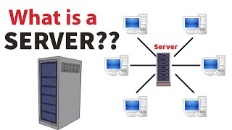
Server
NI
8.1.8
Click the button to start the video.

Slide 91
NI
Malware
8.1.8

Slide 92
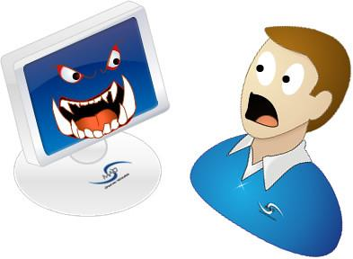
Malware
NI
The word Malware comes from the words malicious software. It is term used to describe a host of computer programs created by criminals that try to steal or damage your data and just mess up your network operation.
8.1.8

Slide 93
Malware
NI
The three main types of malware:
Virus,
Worms, and
Trojan horse.
We will learn about each type
of malware on the following
slides.
8.1.8

Slide 94
Malware
NI
Virus
Viruses are malicious software attached to another program to execute a particular action on a computer. Viruses normally require the intervention of humans in order to spread themselves. They are commonly
eceived as attachments to emails
or as files stored on USB memory
sticks.
8.1.8

Slide 95
Malware
NI
Worms
Worms self-contained malware programs that attack a computer and try to exploit a specific security ‘hole’ or vulnerability in a software program installed on it. Once they have successfully attacked the vulnerability, the worm copies its program across the
network to attack other devices on
the network.
8.1.8

Slide 96
Malware
NI
Trojan Horse
They are similar in operation to a worm, except it is disguised to look like a useful software program that you may want to install on your computer. Once installed, it will act as if it is normal software, but will be secretly
carrying out some criminal activity.
8.1.8

Slide 97
Malware
NI
Trojan Horse
The secret criminal activity might be logging the keys you are typing in an attempt to copy your passwords. Trojans are normally capable of transmitting the information they steal to interested criminals via your network connection to the Internet.
8.1.8

Slide 98
NI
Malware
Below are some ways to protect your device from malware.
Do not open unfamiliar mail.
Install virus protection software.
Keep all virus protection software up to date.
8.1.8

Slide 99
NI
Network Security
8.1.8

Slide 100
Network Security
NI
Network security refers to the set of measures and practices designed to protect your computer network and the data transmitted over it from unauthorized
access, misuse, modification,
or disruption. It protects from malware!
8.1.8

Slide 101
Network Security
NI
Network security encompasses various technologies, policies, and procedures aimed at safeguarding the confidentiality, integrity,
and availability of network resources.
8.1.8

Slide 102
Network Security
NI
Firewalls are network security devices that monitor and control incoming and outgoing network traffic based on predetermined security rules.
8.1.8

Slide 103
Network Security
NI
Firewalls act as a barrier between trusted internal networks and untrusted external networks (such as the internet), filtering traffic to prevent unauthorized access
and malicious activities.
8.1.8

Slide 104
Network Security
NI
Intrusion Detection Systems (IDS) and Intrusion Prevention Systems (IPS) are security tools that monitor network traffic for signs of suspicious or malicious activity. IDS passively analyze network traffic and generate alerts when potential threats are detected, while IPS can actively block or prevent malicious traffic based on predefined rules.
8.1.8

Slide 105
Network Security
NI
Virtual Private Networks (VPNs) create secure, encrypted connections over a public network (typically the internet), allowing users to access private networks and resources remotely. VPNs provide confidentiality and privacy by encrypting data transmitted over the network, protecting it from interception and eavesdropping.
8.1.8

Slide 106
Network Security
NI
Authentication and Access Control Authentication mechanisms, such as usernames, passwords, biometrics, and multi-factor authentication (MFA), verify the identity of users and devices attempting to access network resources. Access control policies define who is allowed to access specific resources and
what actions they can perform once authenticated.
8.1.8

Slide 107
Network Security
NI
Encryption converts data into an unreadable format using cryptographic algorithms, making it unintelligible to unauthorized parties. Transport Layer Security (TLS) and Secure Sockets Layer (SSL) are commonly used
protocols for encrypting data transmitted
over networks, ensuring confidentiality
and integrity.
8.1.8

Slide 108
Network Security
NI
Network Segmentation involves dividing a network into smaller, isolated segments or subnetworks to reduce the attack surface and contain potential security breaches. Segmentation helps prevent lateral movement by attackers and limits the impact of security incidents.
8.1.8

Slide 109
Network Security
NI
Patch Management involves regularly updating and applying security patches to network devices, operating systems, software, and firmware to address known vulnerabilities and security weaknesses. Patching helps mitigate the risk of exploitation by attackers and ensures that network infrastructure remains secure.
8.1.8

Slide 110
Network Security
NI
Patch Management involves regularly updating and applying security patches to network devices, operating systems, software, and firmware to address known vulnerabilities and security weaknesses. Patching helps mitigate the risk of exploitation by attackers and ensures that network infrastructure remains secure.
8.1.8

Slide 111
Network Security
NI
Security Auditing and Monitoring allow regular security auditing and monitoring activities, including log analysis, network scanning, and vulnerability assessments, help identify security gaps, detect suspicious activities, and ensure compliance with security policies and regulations.
8.1.8

Slide 112
Network Security
NI
Incident Response and Disaster Recovery plans outline procedures for responding to security incidents, such as data breaches, cyberattacks, and network compromises. Disaster recovery plans establish processes for restoring network operations and recovering data in the event of a
security incident or natural disaster.
8.1.8

Slide 113
Network Security
NI
Security Awareness Training is the education of users and employees about security best practices, phishing awareness, password hygiene, and social engineering tactics is essential for building a security-aware culture and minimizing the risk of human error and insider threats.
8.1.8

Slide 114
Network Security
NI
Overall, network security is a multifaceted discipline that requires a combination of technical controls, organizational policies, and user awareness to effectively mitigate security risks and protect sensitive information from unauthorized access and cyber threats.
8.1.8

Slide 115
NI
Works Cited
Data & Networks
TechTerms.com
Algorithms
Introduction to Computer Networks
RBC Cyber Security - Powerful Passwords
A Packet’s Tale
OpenAI. (2023-2024). ChatGPT (3.5)
8.1.8

