Slide 1
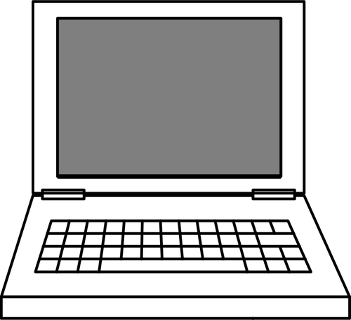

I
C
The New Jersey Student Learning Standards
Computer Science & Design Thinking
8.1.5 Impacts of Computing
8.1.5

Slide 2


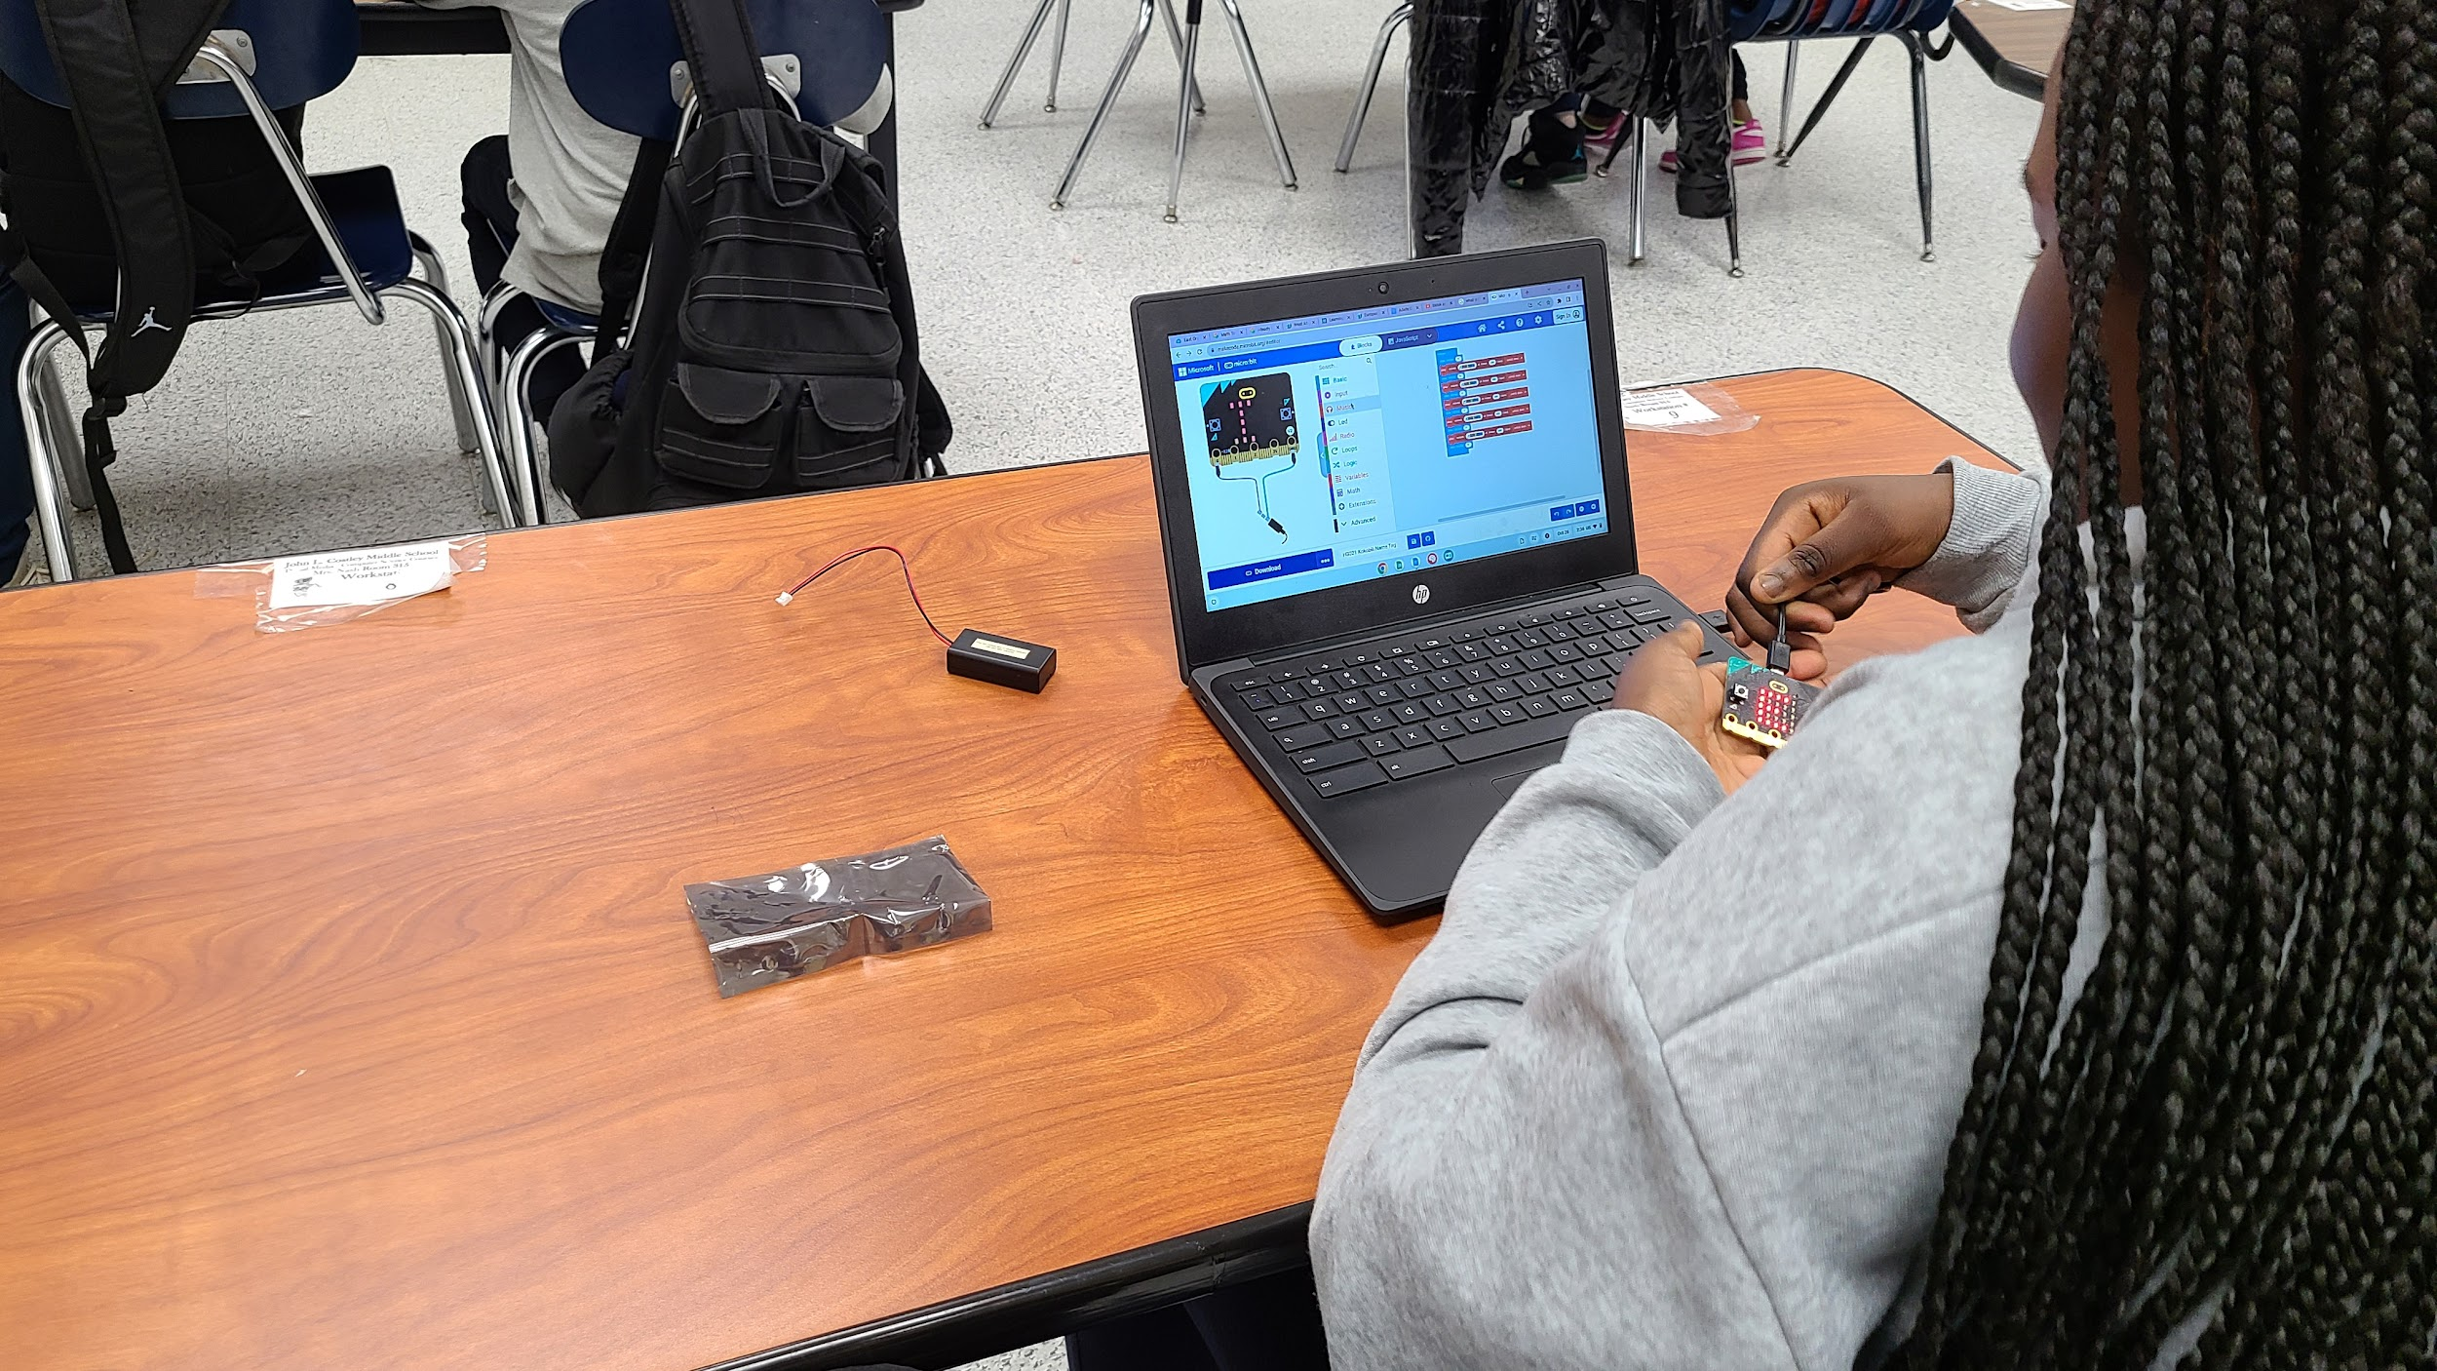




New Jersey Student Learning Standards
I
C
Technology
8.1.5.IC.1: Identify computing technologies that have impacted how individuals live and work and describe the factors that influenced the changes.
8.1.5.IC.2: Identify possible ways to improve the accessibility and usability of computing technologies to address the diverse needs and wants of users.
8.1.5

Slide 3
I
C
Core Concept 8.1.5 Impacts of Computing
Computing affects many aspects of the world in both positive and negative ways. These impacts can be felt at local, national, and global level. Individuals and communities influence computing through their behaviors, cultural interactions, and social interactions. In turn, computing influences new cultural practices.
8.1.5

Slide 4
I
C
Topics Covered
What is a Computer
What is Computer Science
What is a Computing System
Common Computing Devices
Types of Computing Devices
How Computing Devices Impact People
Technologies That Impact Human Lives
Physical Impacts on Humans
Emotional Impacts on Human
8.1.5

Slide 5
I
C
What is a Computer?
8.1.5

Slide 6
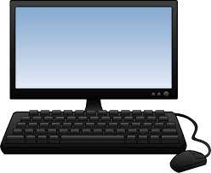
I
C
What is a Computer?
A computer is an electronic device that
collects,
analyzes (or study), and
acts upon
information we give it.
8.1.5
Page 6

Slide 7
I
C
What is Computer Science?
8.1.5

Slide 8
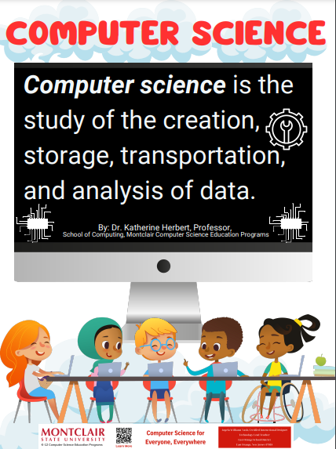
I
C
8.1.5

Slide 9
I
C
What is a Computing System?
8.1.5

Slide 10
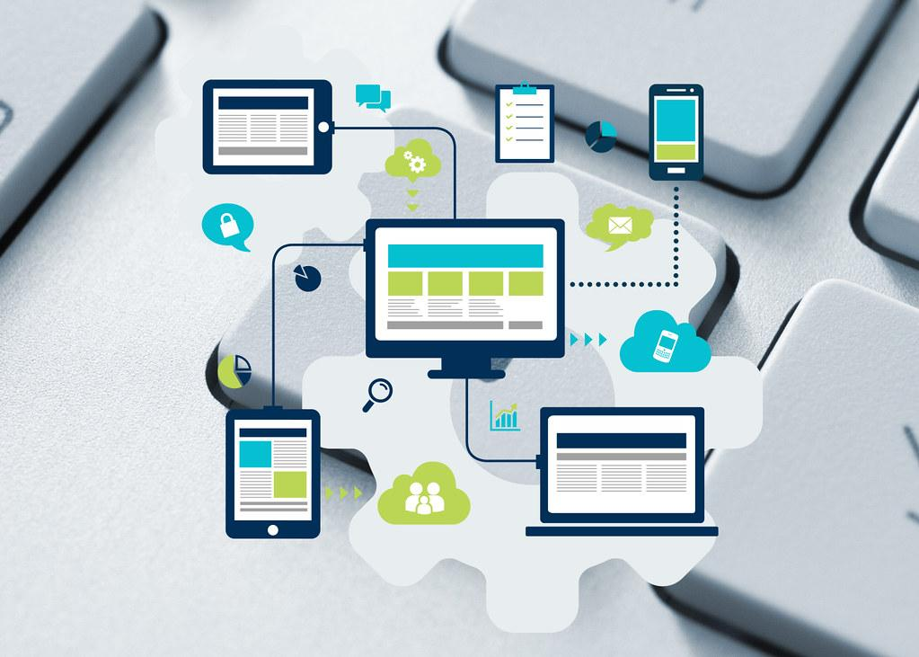
What is a Computing System?
I
C
A computing system is an arrangement (or layout) of hardware and software to
perform a computing task.
8.1.5

Slide 11
I
C
Common Computing Devices
8.1.5

Slide 12

I
C
Question:
Can you name
a computing device that people use everyday?
?
?
?
?
8.1.5

Slide 13

Answer: Below is a list of common computing devices that you use at school and home.
I
C
Desktop
Laptop
Tablet
Smart TVs
Smart phone
Smartwatch
E-readers
Fitness Trackers
8.1.5

Slide 14
I
C
Types of Computing Devices
8.1.5

Slide 15
Types of Computing Devices
I
C
We use three different types of Impacts of Computing or devices:
stationary devices stay in one place, like a desktop computer.
mobile devices go with you wherever you go, like a laptop, tablet and smartphone in your bookbag.
wearable devices are a special type of mobile device that is worn on the body, like a watch connected to a smartphone or fitness tracker.
8.1.5

Slide 16
I
C
How Computing Devices
Impact People
8.1.5

Slide 17
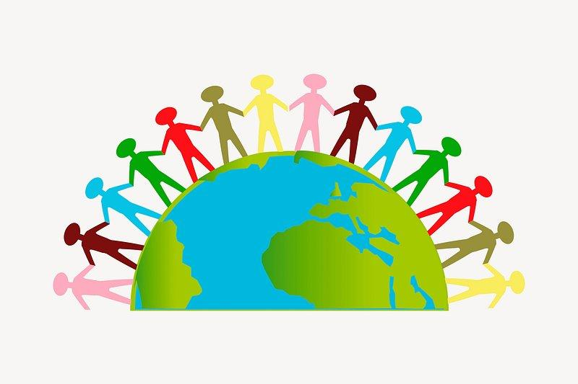
How Computing Devices Impact People
IC
A community is a social group of any size whose members reside in a specific locality, share government, and often have a common cultural and historical heritage.
8.1.5

Slide 18
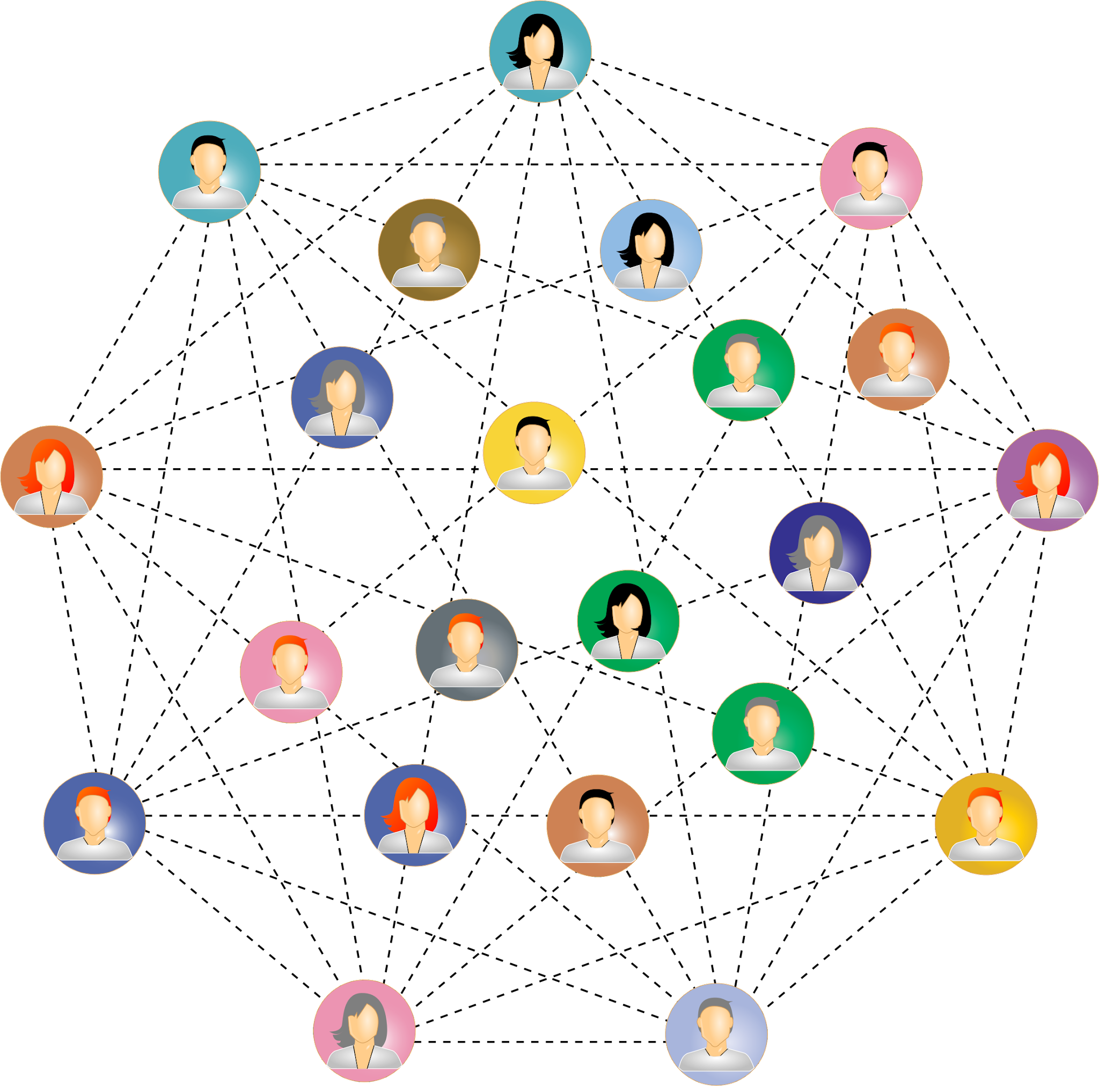
How Computing Devices Impact People
IC
Computing devices have a big impact on people in a community in good ways and in bad ways.
8.1.5

Slide 19

How Computing Devices Impact People
IC
Thanks for calling Sweetpea! Have a great day at school!
A good impact is one that makes the person, family and community better.
A good impact would be using your cell phone to call your parent to let them know you arrived at school safely.
8.1.5

Slide 20
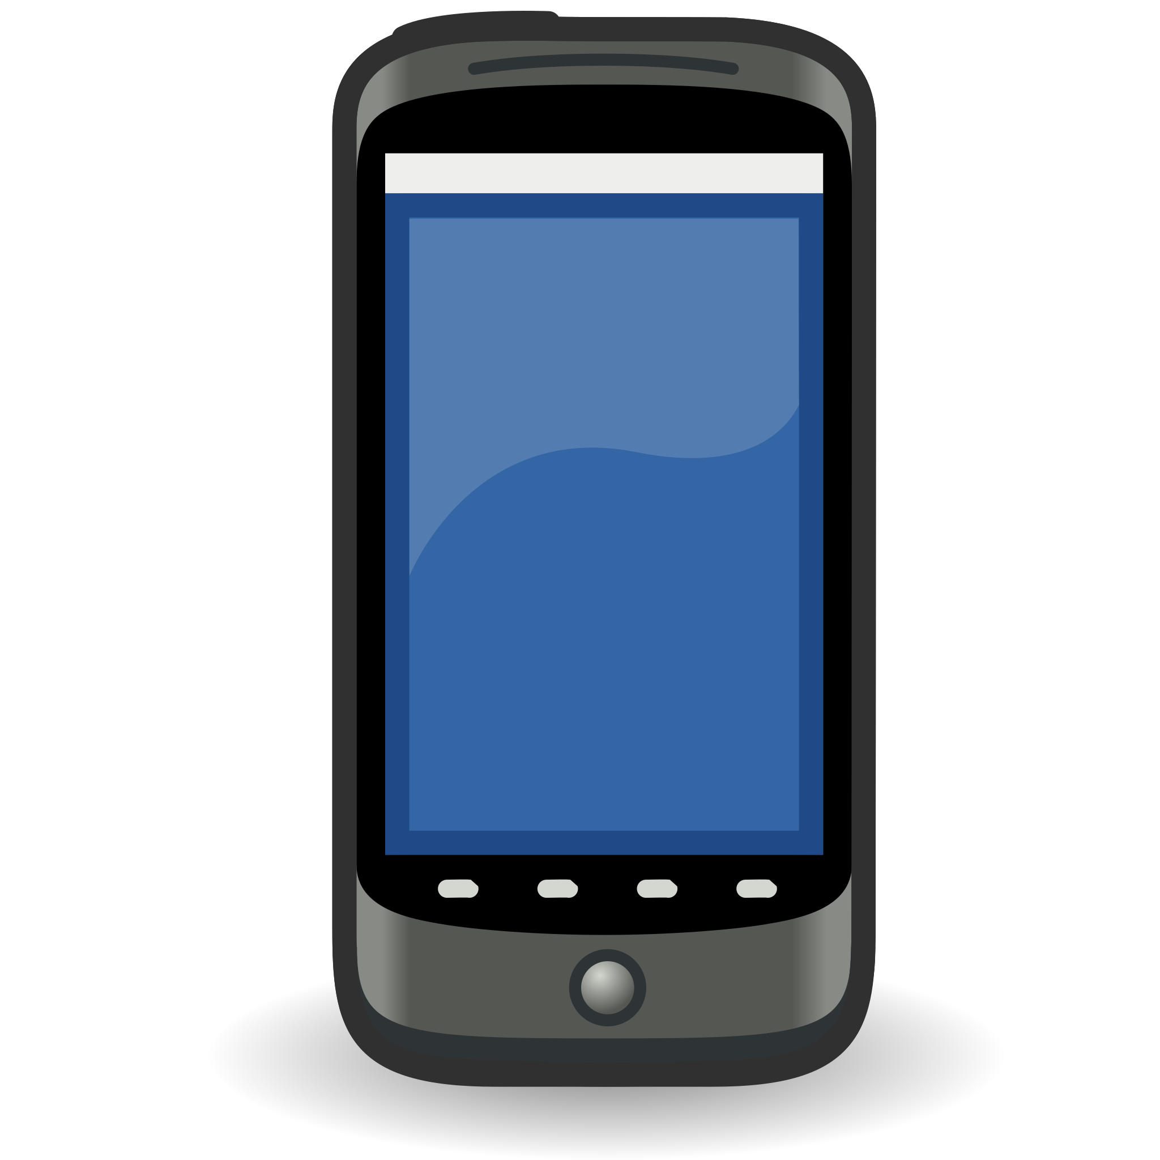
How Computing Devices Impact People
IC
A bad impact is one that makes a you feel bad or that causes a person, family, or community to feel bad.
A bad impact would be sending or receiving a mean text message.
Hey! Ur dress is cheap and you look like a turtle in it!
8.1.5

Slide 21

How Computing Devices Impact People
IC
Computing devices impact every part of modern life.
communication
shopping
education
work
entertainment
healthcare
social interaction
creative expression
personal organization
8.1.5
access to information

Slide 22
I
C
Technologies That Have
Impacted Peoples Lives
8.1.5

Slide 23
Technologies That Have Impacted People
IC
Algorithm is a process or set of rules to be followed in order to complete a task, operation, or solve a problem.
8.1.2

Slide 24
Technologies That Have Impacted People
IC
Computing technologies have significantly impacted many parts of the daily life of how people live and work. Several key technologies have proven to be driving forces in these changes, influenced by a combination of factors including
technological innovation,
societal needs,
economic forces, and
cultural shifts.
Factors driving their adoption include advances in algorithms and computing power, the mass collection of data, and the need for automation and efficiency in various domains.Some examples are provided.
8.1.2

Slide 25
Technologies That Have Impacted People
IC
Internet and World Wide Web: The internet or World Wide Web has been the most transformative technological developments in recent history. It has revolutionized communication, commerce, entertainment, and information access.
Factors influencing its impact include advancements in networking technologies, the need for global connectivity, and the rise of digital communication and commerce.
8.1.2

Slide 26
Technologies That Have Impacted People
IC
Smartphones and Mobile Computing: Smartphones and mobile computing devices have reshaped how people interact with information and each other. These devices have become necessary tools for communication, productivity, entertainment, and even healthcare.
Factors driving their adoption include advances in mobile hardware, software ecosystems, and the demand for on-the-go connectivity.
8.1.2

Slide 27
Technologies That Have Impacted People
IC
Cloud Computing: Cloud computing has transformed the way individuals and businesses store, process, and access data and applications compared to traditional on-premises IT infrastructure. It offers…
Scalability- the capacity to be changed in size or scale.
Flexibility-the ability to changed (stretched) without breaking or losing its shape.
Cost-efficiency- does not include extraneous charges or fees.
Factors driving its adoption include the need for scalable computing resources, cost savings, and the rise of remote work and collaboration.
8.1.2

Slide 28
Technologies That Have Impacted People
IC
Social Media Platforms: Social media platforms have become an integral part of many people's personal and professional lives. They influence communication, marketing, and societal dynamics. Social media has changed how people
connect,
share information, and
express themselves online.
Factors contributing to their impact include the desire for social interaction, technological advancements in networking and user interfaces, and the rise of digital advertising.
8.1.2

Slide 29
Technologies That Have Impacted People
IC
Artificial Intelligence and Machine Learning: AI and machine learning technologies are increasingly being integrated into various applications and services, automating tasks, personalizing experiences, and driving insights from data.
Factors driving their adoption include advances in algorithms and computing power, the proliferation of data, and the need for automation and efficiency in various domains.
8.1.2

Slide 30
Technologies That Have Impacted People
IC
Internet of Things (IoT): The IoT refers to the interconnected network of devices embedded with sensors and actuators, enabling them to collect and exchange data. IoT technologies have applications in areas such as:
smart homes,
healthcare,
transportation, and
manufacturing.
IoT benefits automation, efficiency, and enhanced decision-making.
Factors influencing its adoption include advances in sensor technology, connectivity standards, and the demand for data-driven insights and automation.
8.1.2

Slide 31
Technologies That Have Impacted People
IC
Blockchain Technology: Blockchain technology, best known as the underlying technology behind cryptocurrencies like Bitcoin, has broader applications beyond finance, including supply chain management, voting systems, and digital identity verification.
Factors driving its adoption include the need for secure and transparent transactions, decentralization, and trust in digital systems.
8.1.2

Slide 32
Technologies That Have Impacted People
IC
Overall, computing technologies impact innovation, market demand, regulatory frameworks, and societal trends. These changes collectively contribute to significant changes in how individuals live and work.
8.1.2

Slide 33
I
C
Computing Technologies
Physical & Emotional Impacts
8.1.5

Slide 34
Physical Impacts of Technology on Humans
IC
Technology has brought about a variety of negative, physical changes in lives of people. Let’s examine three physical changes.
sedentary lifestyle
eye strain and vision problems
sleep disruptions
8.1.2

Slide 35
Physical Impacts of Technology on Humans
IC
Sedentary Lifestyle: Increased use of technology, especially devices like computers, smartphones, and television, has contributed to a more sedentary lifestyle for many people.
Extended periods of sitting and decreased physical activity can lead to health issues such as obesity, cardiovascular problems, and musculoskeletal disorders.
8.1.2

Slide 36
Physical Impacts of Technology on Humans
IC
Eye Strain and Vision Problems:
Staring at screens for prolonged periods can cause eye strain, dry eyes, and blurred vision. This is made worse by the number of digital screens used everyday at school and at home.
8.1.2

Slide 37
Physical Impacts of Technology on Humans
IC
Sleep Disruptions: Exposure to the blue light emitted by screens, especially before bedtime, can disrupt sleep patterns and contribute to insomnia or poor sleep quality. This is really bad if you use of smartphones and tablets as bedtime entertainment devices.
8.1.2

Slide 38
Emotional Impacts of Technology on Humans
IC
Technology has brought about a variety of negative, emotional changes in lives of people. Let’s examine three emotional changes.
social isolation
fear of missing out (FOMO)
cyberbullying and online harassment
8.1.2

Slide 39
Emotional Impacts of Technology on Humans
IC
Social Isolation: Using technology a lot, especially social media, can contribute to feelings of social isolation and loneliness.
Online interaction does not always provide the same level of emotional fulfillment as face-to-face interactions.
8.1.2

Slide 40
Emotional Impacts of Technology on Humans
IC
Fear of Missing Out (FOMO): Social media and constant connectivity can cause feelings of FOMO. People become anxious or feel inadequate when comparing their real lives to the curated and often idealized versions of someone else’s online life.
8.1.2

Slide 41
Emotional Impacts of Technology on Humans
IC
Cyberbullying and Online Harassment: The anonymity and distance afforded by technology can cause cyberbullying and online harassment, leading to emotional distress, anxiety, and depression in victims.
8.1.2

Slide 42
Emotional Impacts of Technology on Humans
IC
Overall, while technology offers numerous benefits and conveniences, it's essential to be mindful of its potential impact on both physical health and emotional well-being and to strive for a healthy balance in its usage.
8.1.2

Slide 43

Impact of Computing Devices
I
C
Positive & Negative
On the next slide, work with a partner to select a computing device. Research positive and negative impacts and then fill out the chart.Be prepared to report out on your findings.
8.1.5

Slide 44
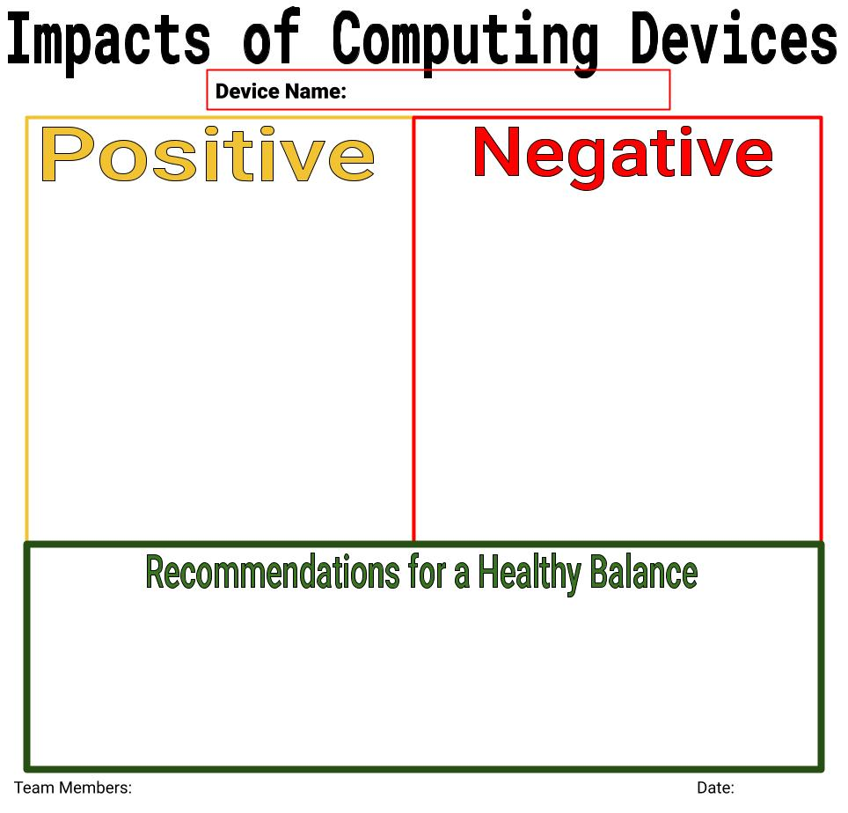
I
C
8.1.5

Slide 45
Resources
I
C
Kucuk, Turgay (2023) Technology Integrated Teaching and Its Positive and Negative Impacts on Education. International Journal of Social Sciences & Educational Studies, 10 (1). pp. 46-55.
Positive and Negative Impacts of Technology
OpenAI. (2023-2024). ChatGPT (3.5)
TechTerms.com
Impacts of Social Media
8.1.5

