Slide 1
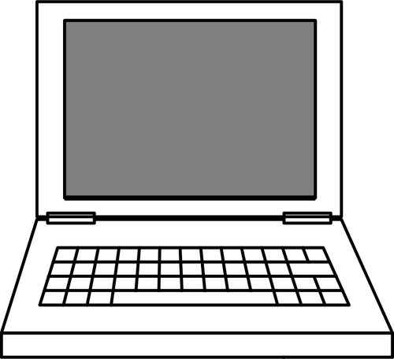
C
S
The New Jersey Student Learning Standards
Computer Science & Design Thinking
8.1.8 Computing Systems
8.1.8

Slide 2
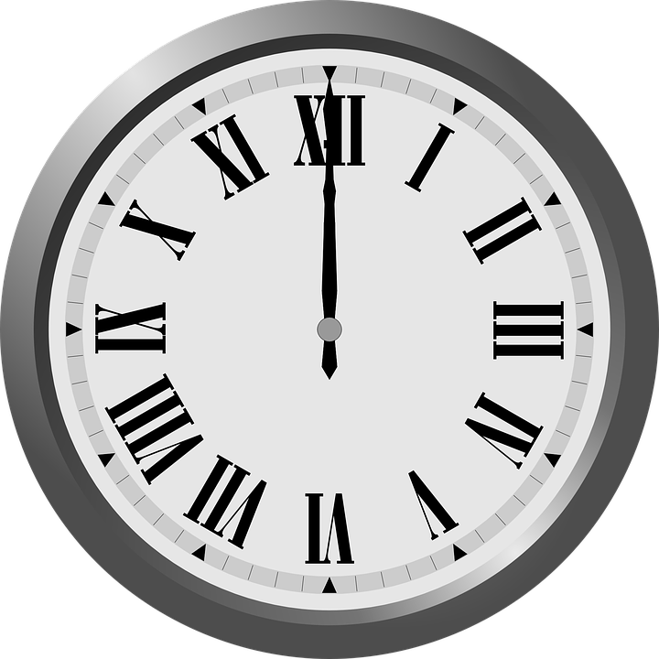
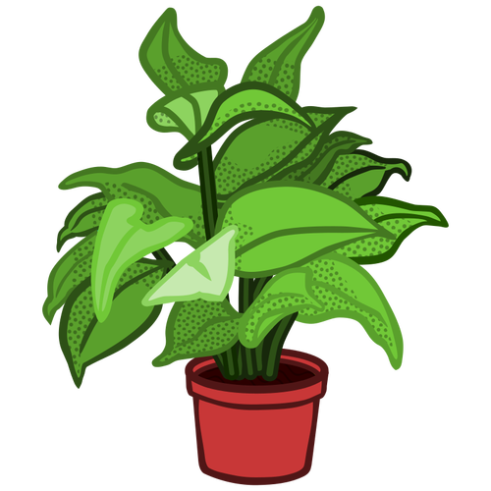
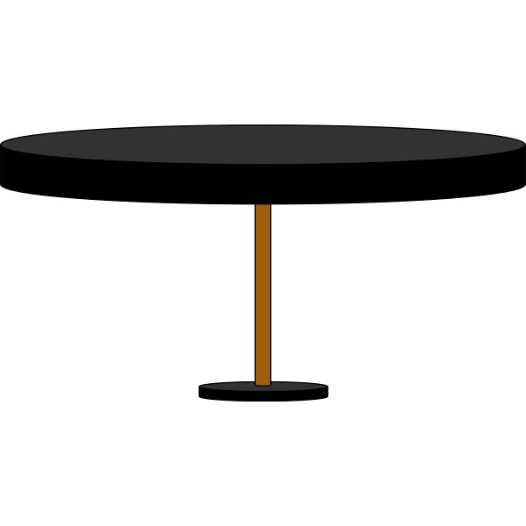
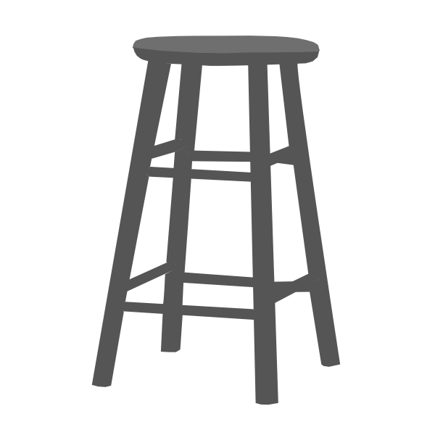
New Jersey Student Learning Standards
C
S
Technology
8.1.8.CS.1: Recommend improvements to computing devices in order to improve the ways users interact with the devices
8.1.8.CS.2: Design a system that combines hardware and software components to process data.
8.1.8.CS.3: Justify design decisions and explain potential system trade-offs
Troubleshooting a problem is more effective when knowledge of the specific device along with a systematic process is used to identify the source of a problem.
8.1.8.CS4: Systematically apply troubleshooting strategies to identify and resolve hardware and software problems in computing systems
8.1.8

Slide 3
C
S
Core Concept 8.1.8 Computing Systems
People interact daily with a wide variety of computing devices that collect, store, analyze and act upon information in ways that can positively or negatively affect people.
The hardware and software that make up a computing system communicate and process information in digital form.
8.1.8

Slide 4
C
S
Topics Covered
What is a Computer
What is Computer Science
Computing Systems
Computer Hardware
Internal Hardware
External Hardware - I/O Devices
Computer Software
System Software
Applications Software Programs
Computer Instruction Cycle
Troubleshooting
Basic Problems
8.1.8

Slide 5
C
S
What is a Computer?
8.1.8

Slide 6
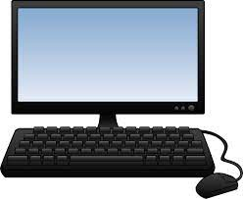
C
S
What is a Computer?
A computer is an electronic device that
collects,
analyzes (or study), and
acts upon
information we give it.
8.1.8
Page 6

Slide 7
C
S
What is Computer Science?
8.1.8

Slide 8
C
S
8.1.8

Slide 9
C
S
Computing Systems
8.1.8

Slide 10
C
S
Computing Systems
What is a Computing System?
The Internet of Things (IoT)
Categories of Computing Systems
Types of Computing Devices
8.1.8

Slide 11
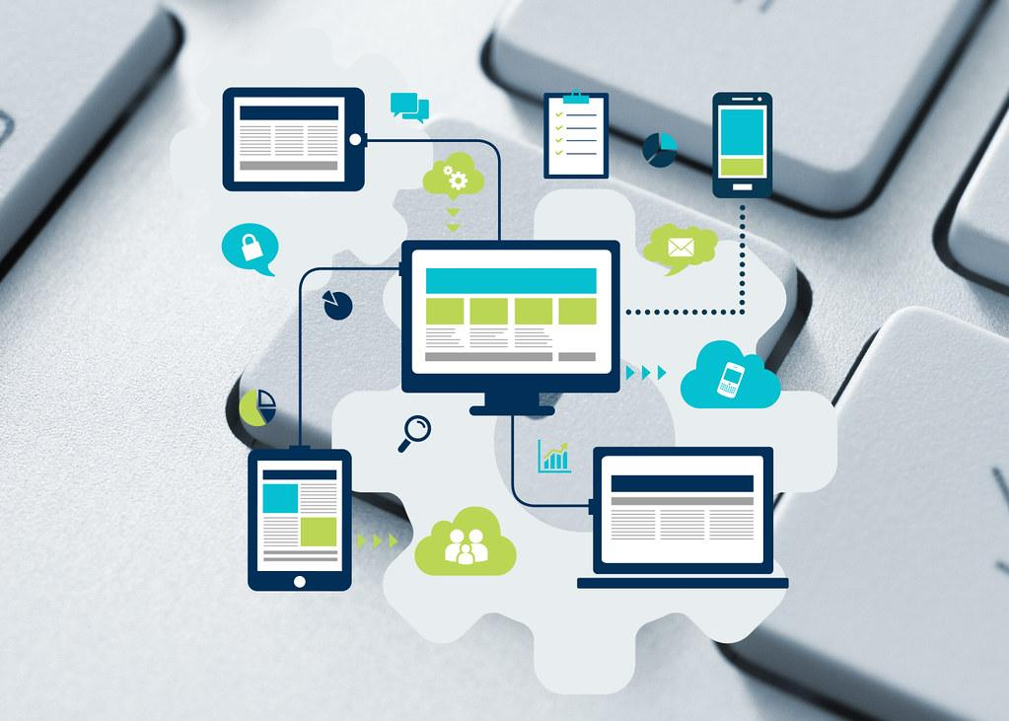
What is a Computing System?
C
S
A computing system is the layout of hardware and software programs that work together to perform various tasks.
8.1.8

Slide 12
C
S
Question:
Can you name
a computing device that is used in school or at home everyday?
?
?
?
?
8.1.8

Slide 13
Answer: Here are some computing devices you might use in school or at home everyday!
C
S
Desktop
Laptop
Tablet
Smart phone
Smart TVs
Smartwatch
Fitness Trackers
E-readers
8.1.8

Slide 14
C
S
There are additional computing devices that work behind the scenes at home, school and businesses. For now, we want to add one more computing device called IoT Devices.
8.1.8

Slide 15
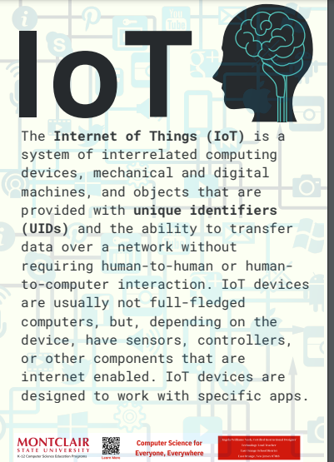
C
S
Internet of Things
interrelated
unique identifiers
Transfer data over network without human-to-human or human-to-computer interaction.
8.1.8
Sensors, controllers, and other internet enabled components.

Slide 16
C
S
Categories of Computing Devices
The three main categories of computing systems or devices are:
stationary devices
mobile devices
wearable devices
8.1.8

Slide 17
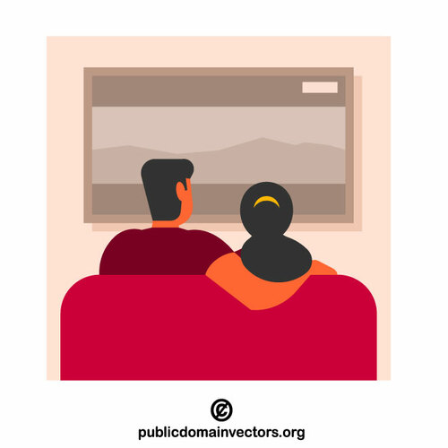
Categories of Computing Devices
C
S
Stationary devices stay in one place, like a desktop computer. You go to the device when you need to use it.
8.1.8

Slide 18
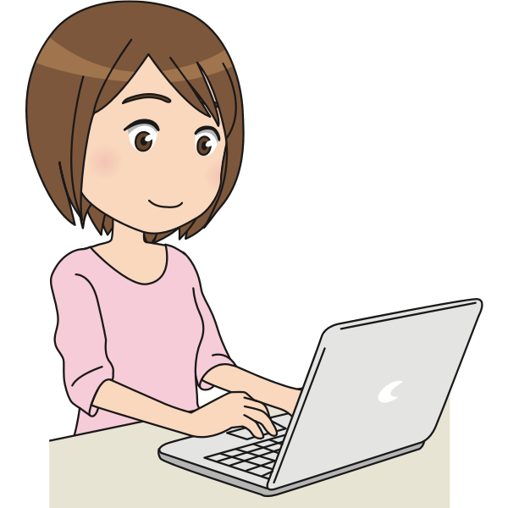
Categories of Computing Devices
C
S
2. Mobile devices go with you from place to place like a laptop, tablet and smartphone in your bookbag.
8.1.8

Slide 19
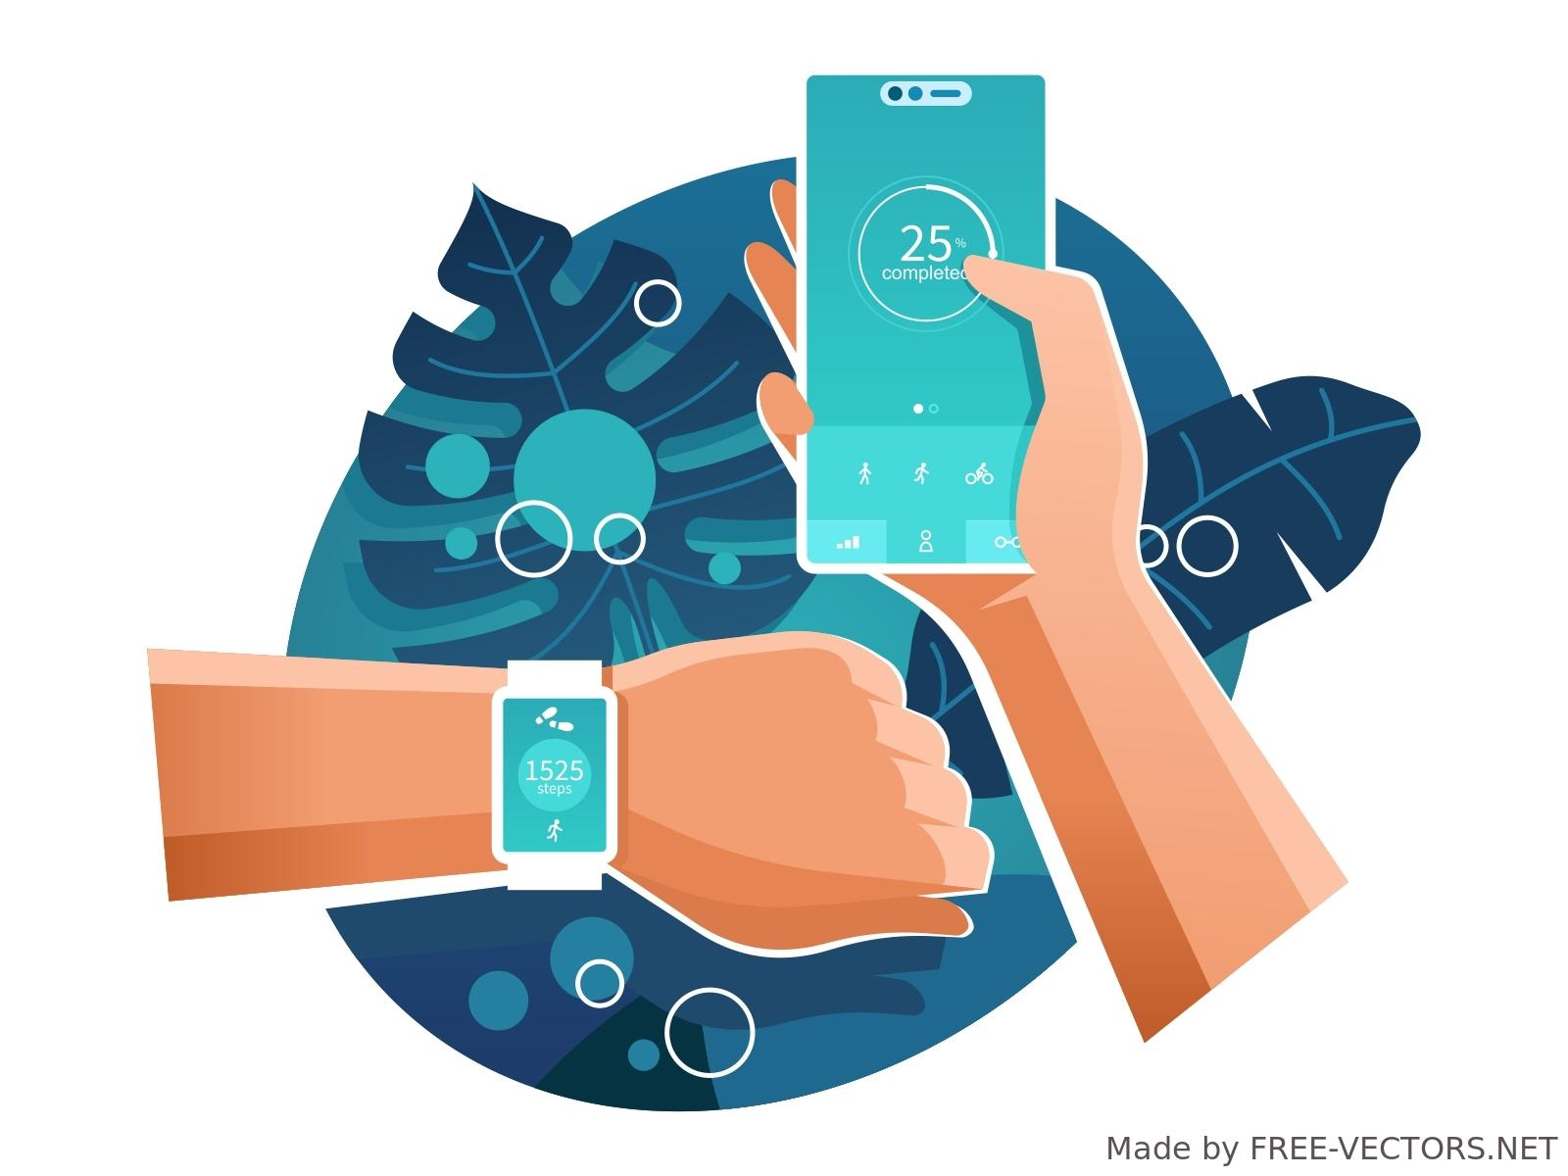
Categories of Computing Devices
C
S
3. Wearable devices are worn on the human body, like a watch connected to a smartphone or fitness tracker.
8.1.8

Slide 20
Question: Can you put each device in its proper place!
C
S
Stationary devices | Mobile Devices | Wearable Devices
8.1.8
Fitness Trackers
Smart TVs
E-readers
Laptop
Smart phone
Smartwatch
Tablet
Desktop

Slide 21
Answer: Can you put each device in its proper place!
C
S
Stationary devices | Mobile Devices | Wearable Devices
Desktop
E-readers
Fitness Trackers
Smart TVs
Laptop
Smartwatch
Smart phone
Tablet
8.1.8

Slide 22
C
S
Computer Hardware
8.1.8

Slide 23
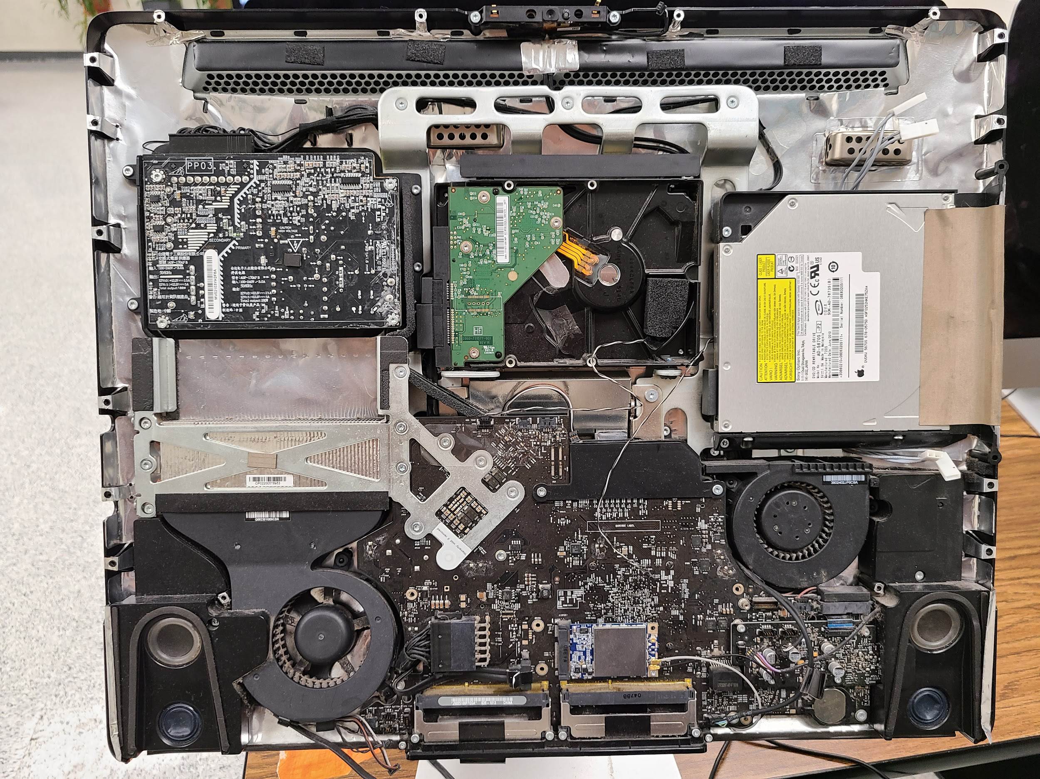
Computer Hardware
C
S
Computer hardware refers to the physical (touchable) parts and related devices that make up a computer systems.
8.1.8

Slide 24
Computer Hardware
C
S
Internal hardware is located inside a computer are often referred to as components, while external hardware are located outside a computer and are usually called peripheral devices or peripherals.
8.1.8

Slide 25
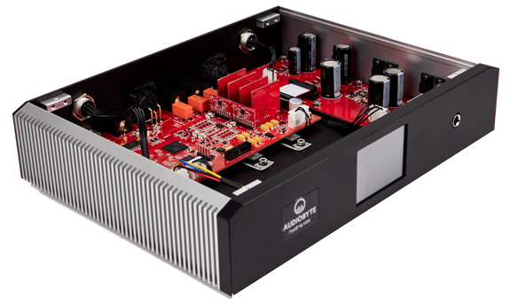
Internal Computer Hardware
C
S
Motherboard
Central Processing Unit (CPU)
Memory (ROM and RAM)
Storage Devices
Peripheral Component Interconnect (PCI)
Power Supply Unit (PSU)
Cooling Fans
8.1.8

Slide 26
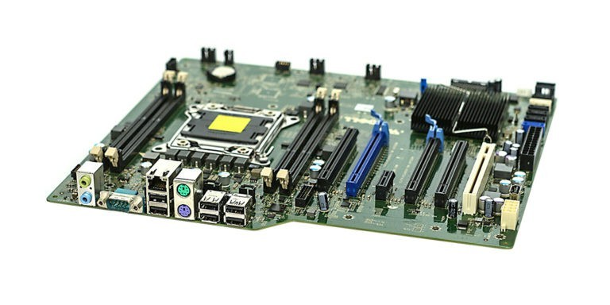
Internal Computer Hardware
C
S
The motherboard is the main circuit board. It houses the CPU, memory, and other essential components. It provides the electrical connections between the various hardware components.
8.1.8

Slide 27
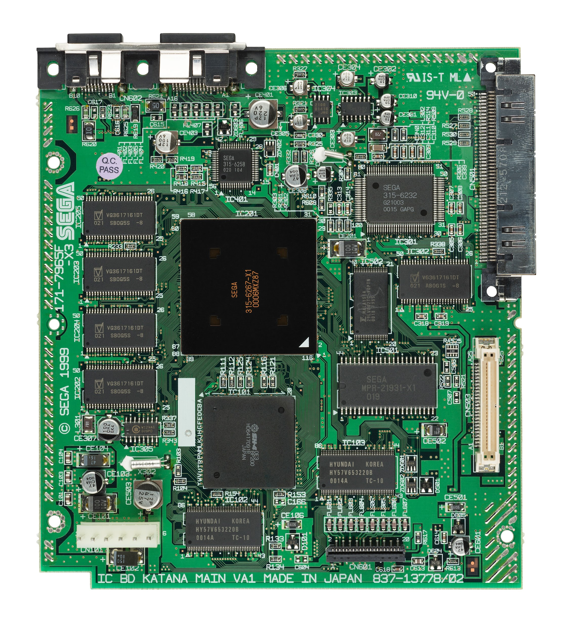
Internal Hardware - Motherboard
C
S
The motherboard is also known as the mainboard or logic board. If you ever open your computer, the biggest piece of silicon you see is the motherboard.
8.1.8

Slide 28
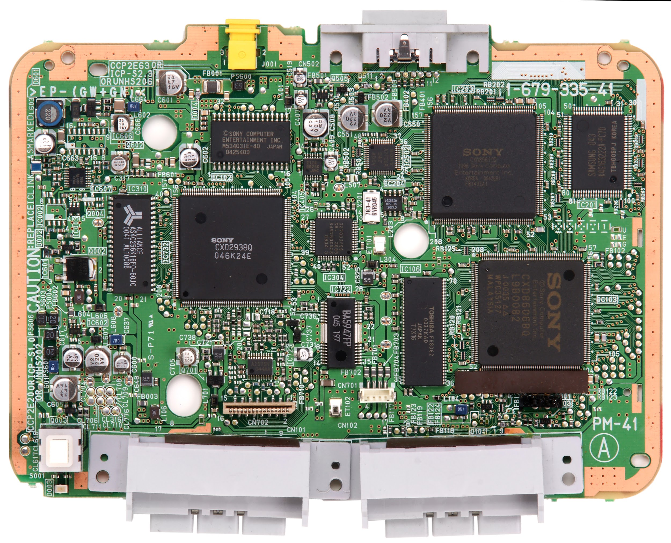
Internal Hardware - Motherboard
C
S
Basically, the motherboard is what makes everything in your computer work together.
8.1.8

Slide 29
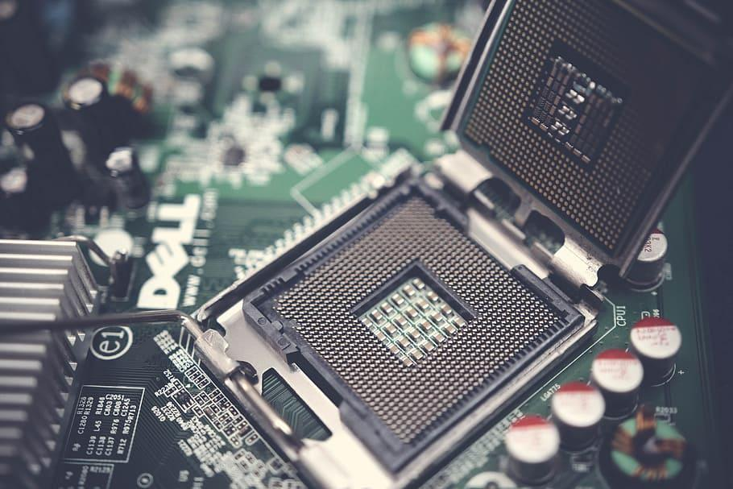
Internal Computer Hardware
C
S
The Central Processing Unit (CPU) is often referred to as the brains of a computer. It is the primary component of a computer that processes instructions.
8.1.8

Slide 30
Internal Hardware - CPU
C
S
The CPU performs arithmetic and logic operations and coordinates the activities of the other hardware components.
8.1.8

Slide 31
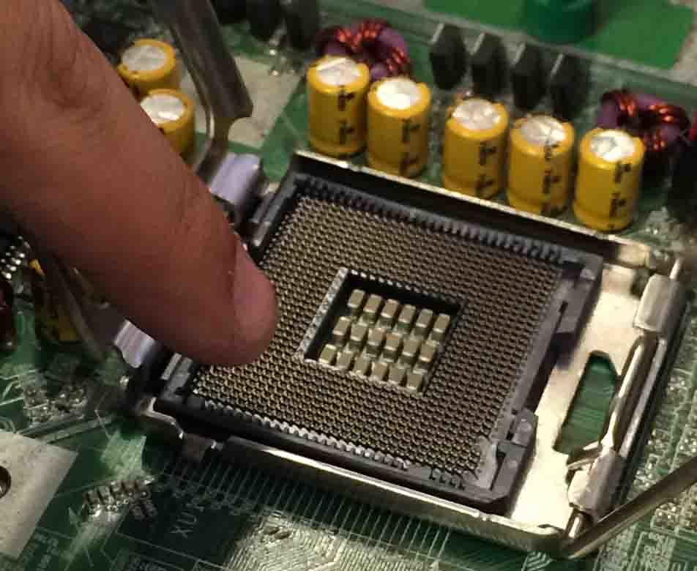
Internal Hardware - CPU
C
S
The CPU…
Runs the operating system.
Runs applications programs.
Constantly receives input from the user and active software programs.
Processes data.
Produces output for storage or for display on your screen.
8.1.8

Slide 32
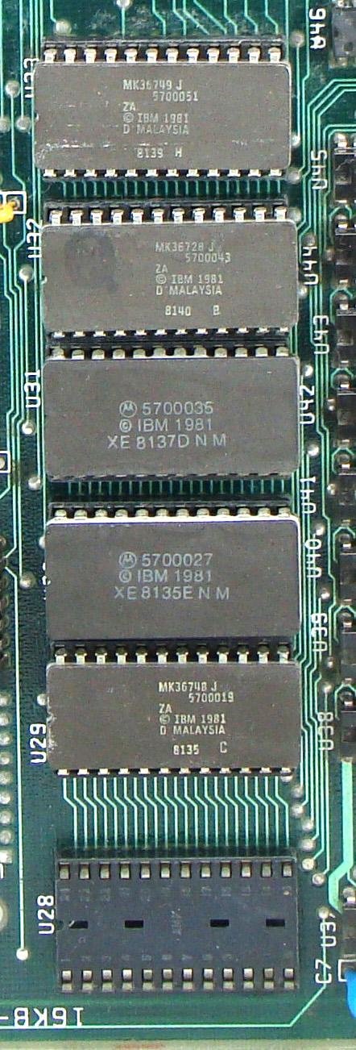
Internal Hardware - Memory
C
S
Computer memory refers to the physical devices or components used to store and retrieve data.The two main types of memory are:
ROM-Read Only Memory
RAM-Random Access Memory
8.1.8

Slide 33
Internal Hardware - ROM
C
S
ROM stands for "Read-Only Memory." ROM is a type of non-volatile memory that is used primarily in the storage of firmware and system software in electronic devices.
8.1.8

Slide 34
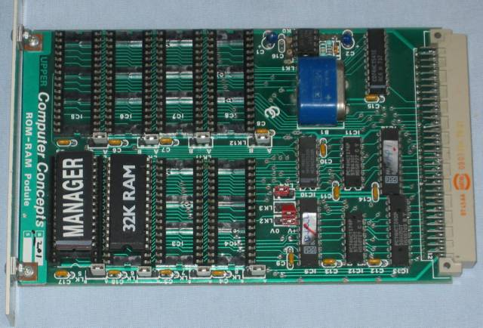
Internal Hardware - RAM
C
S
RAM stands for "Random Access Memory” is a common hardware component.
8.1.8

Slide 35
Internal Hardware - RAM
C
S
RAM or system memory is considered "volatile" memory. It only stores data while a device is turned on. When the device is powered down, data stored in the RAM is erased.
8.1.8

Slide 36
Internal Hardware - RAM
C
S
The amount of RAM in a device determines how much memory the operating system and applications can use.
8.1.8

Slide 37
Internal Hardware - RAM
C
S
Insufficient (not enough) RAM, can cause a noticeable slowdown in your computer system. Adding RAM or buying a device with more RAM is one of the best ways to improve the performance of your device.
8.1.8

Slide 38
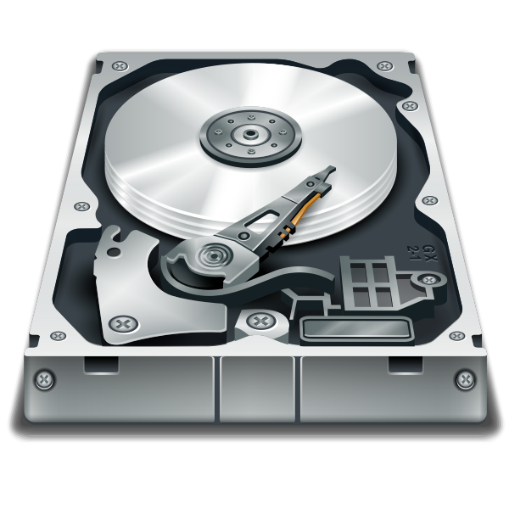
Internal Hardware-Storage Devices
C
S
Storage devices like hard disk drives (HDD), solid-state drives (SSD) or other storage media; store data and programs even when your device is off.
8.1.8

Slide 39
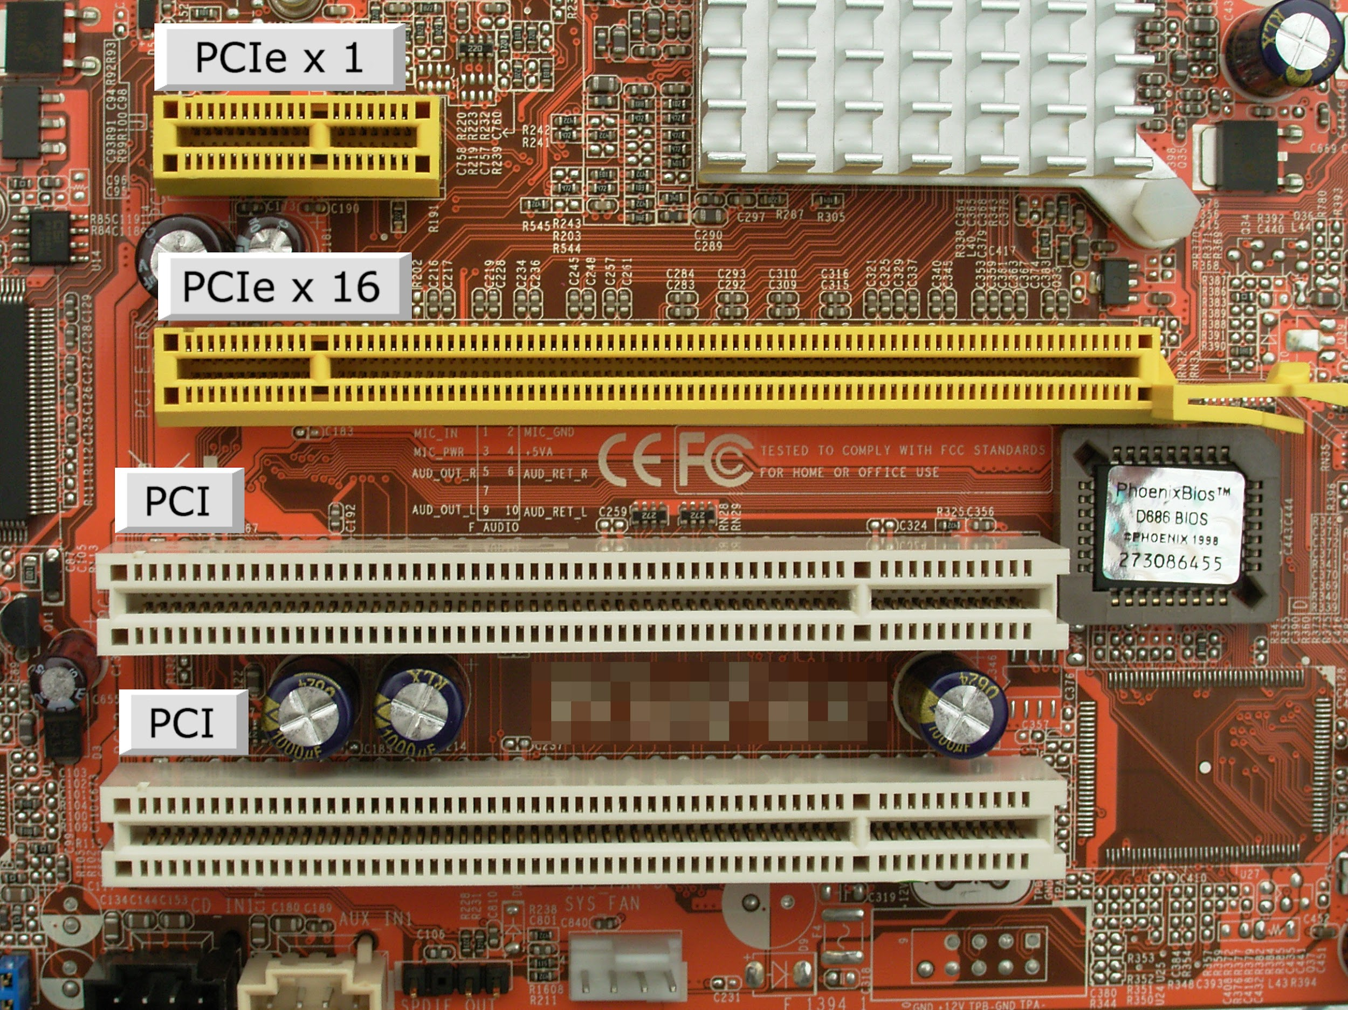
Internal Hardware - PCI
C
S
PCI stands for "Peripheral Component Interconnect." It is used to connect peripheral devices (like a mouse) to the computer’s motherboard.
8.1.8

Slide 40
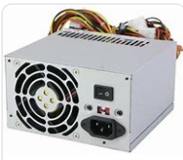
Internal Hardware - PSU
C
S
The power supply unit (PSU) provides electricity to components in the device.
8.1.8

Slide 41
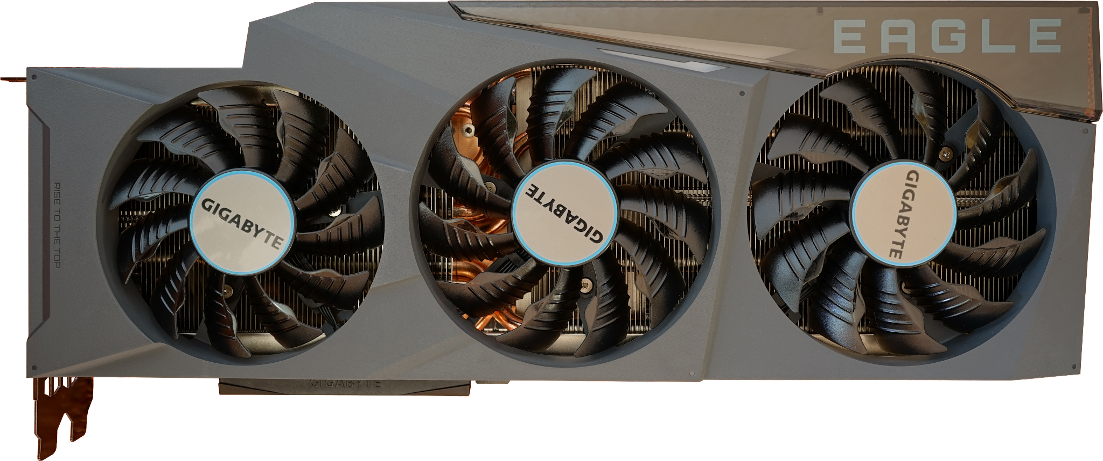
Internal Computer Hardware
C
S
A computer fan is used to cool down the insides.
8.1.8

Slide 42
C
S
External Computer Hardware
Wired and Wireless Devices
I/O Devices
Input Devices
Output Devices
8.1.8

Slide 43
External Computer Hardware
C
S
External hardware refers to devices that are attached to a computer system.
8.1.8

Slide 44
External Computer Hardware
C
S
Wired vs Wireless
Some devices are wired, they connect to a computer with a cord.
Some devices are wireless, they connect to a computer by transmitting a signal.
8.1.8

Slide 45
External Computer Hardware
C
S
I/O Devices
External devices are also called peripheral or I/O (Input/Output) Devices.
8.1.8

Slide 46
External Computer Hardware
C
S
I/O (Input/Output) Devices
Input devices get data into the computer.
Output devices allow you to retrieve, see or hear results.
8.1.8

Slide 47
External Computer Hardware
C
S
Input Devices
mouse
keyboard
joystick
microphone
digital camera
webcams
8.1.8

Slide 48
External Computer Hardware
C
S
Output Devices
monitors
speakers
headphones
printers
projectors
8.1.8

Slide 49
C
S
Computer Software
8.1.8

Slide 50
Names for programs.
Definition of software.
Main types of programs.
System Software
Operating Software
Applications Software
Computer Software Programs
C
S
8.1.8

Slide 51
Other names are software programs?
Computer Software Programs
C
S
Names for Software
software;
software application; or
apps
8.1.8

Slide 52
Computer Software Programs
C
S
Definition of Software
Software program or app, is a set of instructions that allow the computer to perform an operation or task.
8.1.8

Slide 53
Computer Software Programs
C
S
Categories of Software
Software program are categorized or grouped according to the type of tasks they perform. The three main ones we use are:
System Software
Operating Software
Drivers
Applications Software
8.1.8

Slide 54
Computer Software Programs
C
S
System Software
System software are programs that control and coordinate the procedures and functions of computer hardware. Some examples are below.
System Software
File Management Tools | Operating Systems | Device Drivers | Firmware | Utilities | Compilers and Interpreters
8.1.8

Slide 55
Computer Software Programs
C
S
System Software
File management software refers to programs and tools designed to efficiently facilitate the organization, manipulation, and storage of files and folders on a computer or network.
8.1.8

Slide 56
Computer Software Programs
C
S
System Software
Operating System (OS) manages hardware and provides services for computer programs. It acts as an intermediary between users and the computer hardware.
8.1.8

Slide 57
Computer Software Programs
C
S
System Software
Device drivers are specialized programs that allow the operating system to communicate with and control specific hardware devices like printers, graphics cards, or storage devices.
8.1.8

Slide 58
Computer Software Programs
C
S
System Software
Utilities are programs that perform a specific task, usually related to managing system resources, optimizing performance, or providing maintenance.
8.1.8

Slide 59
Computer Software Programs
C
S
System Software
Firmware is software embedded in hardware devices, providing low-level control for the device.
8.1.8

Slide 60
Computer Software Programs
C
S
System Software
Compilers and Interpreters are tools that translate high-level programming code into machine code or execute it directly.
8.1.8

Slide 61
Computer Software Programs
C
S
System Software
Compilers translate the entire code before execution.
Interpreters execute code line by line.
8.1.8

Slide 62
Computer Software Programs
C
S
Apps
Application Software or app (for short) are programs designed to work with the end user (YOU) to complete specific task(s). Some examples are provided below.
8.1.8

Slide 63
Computer Software Programs
C
S
Apps
Categories of APPs
Word Processors | Spreadsheet Programs | Presentation Programs | Web Browsers
Educational Programs | Email Clients | Video Editing Software | Audio Editing Soware
Antivirus Software |  | Graphics Design Software
8.1.8

Slide 64
Applications Software Programs
C
S
There are many categories of applications programs. We will focus on the four main types you use in school.
8.1.8

Slide 65
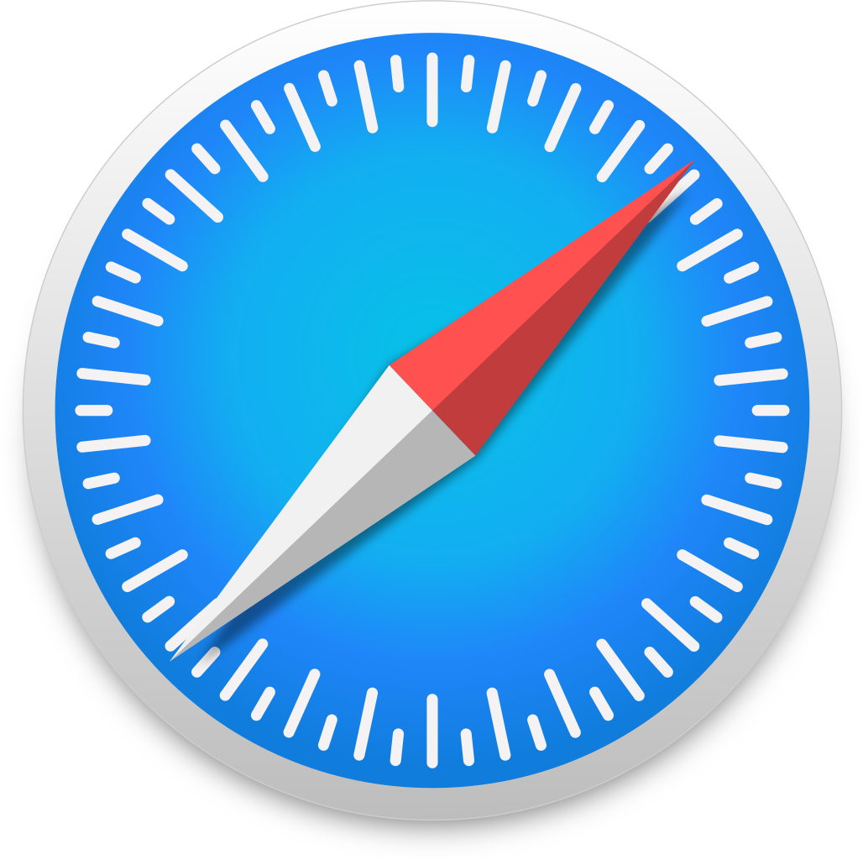
C
S
Applications Software often used in school.
Web browsers
Chrome
Safari
Apps that facilitate easy access and surfing on the internet.
8.1.8
Internet Explorer

Slide 66
C
S
Applications Software often used in school.
Document Production
Apps like MS Word and Google Docs that enable document production like book reports and essays.
8.1.8

Slide 67
C
S
Applications Software often used in school.
Spreadsheet Programs
Apps like MS Excel and Google Sheets are used to organize, analyze, and store data (numeric and text) in a tables. The tables can be changed into charts and graphs.
8.1.8

Slide 68
C
S
Applications Software often used in school.
Presentation
Apps like MS Powerpoint and Google Slides allow the visual presentation of information in the form of slides that can contain text, charts, tables, audio, video, and animation.
8.1.8

Slide 69
Applications Software often used in school.
C
S
Education Software
flocabulary.com
Educational software apps are designed for learning and practice!
ixl.com
8.1.8
typing.com

Slide 70
C
S
Forming A Computer System
8.1.8

Slide 71
The Fetch-Execute Cycle
C
S
The fetch-execution cycle is also known
as the instruction cycle. It is the basic operational method of a device that includes:
Information (data) is received by the computer.
A determination is made on what to do with the data.
The Central Process Unit (CPU) continuously cycles through the the fetch-execute cycle.
8.1.8

Slide 72
The Fetch-Execute Cycle
C
S
The Central Process Unit (CPU) cycles through the following steps:
Fetch. The CPU collects an instruction and prepares it for decoding.
Decode. The decoder in the control unit works out (decodes) what to do with the instruction.
Execute. The Arithmetic Logic Unit (ALU) then executes decoded instructions.
Store. Send and write the results back into main memory.
8.1.8

Slide 73
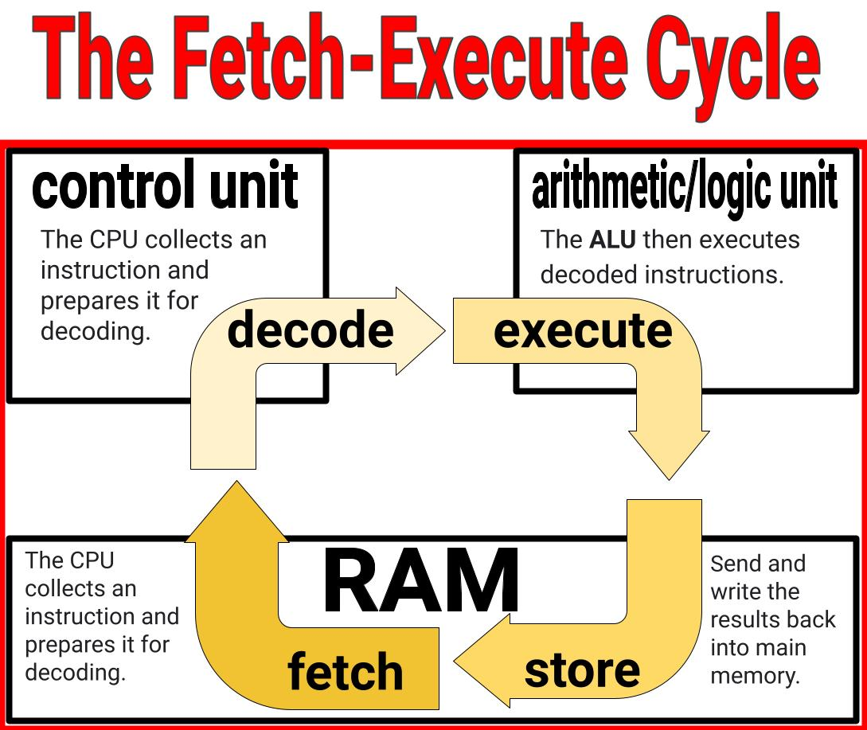
C
S
8.1.8

Slide 74
C
S
Troubleshooting
8.1.8

Slide 75
C
S
Troubleshooting
Sometimes things go wrong with a computing device. The key is not to worry! Find a trusted adult to help you! Here are some things you and a trusted adult can do.
8.1.8

Slide 76
C
S
Troubleshooting
Troubleshooting is the process of diagnosing the sources of a problem (hardware or software) then working toward solving or fixing the problem. Start with the most general possible problem and then narrow it down to a specific issue.
8.1.8

Slide 77
Troubleshooting Strategies For Grades 3-5
C
S
DON’T
PANIC!!
8.1.8

Slide 78
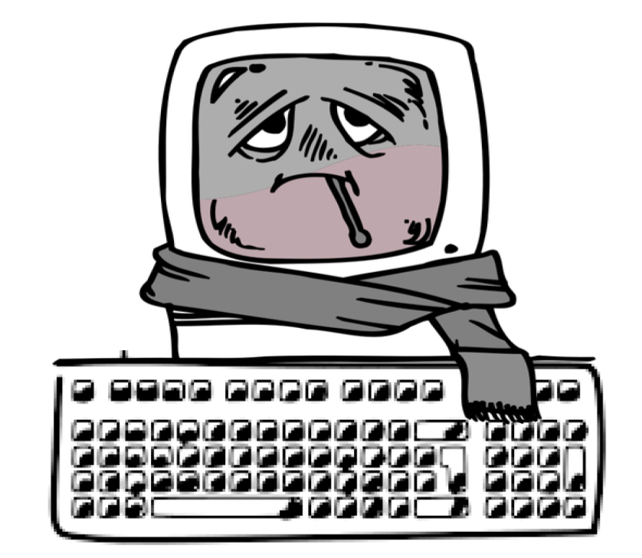
Troubleshooting Strategies For Grades 3-5
C
S
Isolation
Check for Updates
Backup Data
Built-in Diagnostic Tools
System Restore
8.1.8
Seek Professional Help

Slide 79
Troubleshooting Strategies For Grades 3-5
C
S
Operating System Errors
Software Compatibility Issues
Application Crashes
Driver Problems
8.1.8
Malware & Viruses

Slide 80
Troubleshooting Strategies For Grades 3-5
C
S
Hardware Malfunctions
Peripheral Issues
Overheating
8.1.8
Network Connectivity Problems

Slide 81
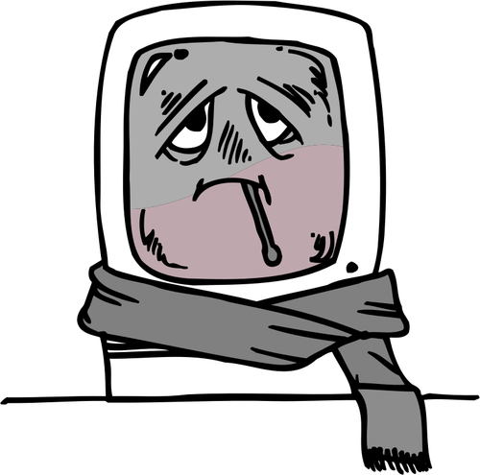
For Middle Schoolers
C
S
8.1.8

Slide 82
Resources
C
S
The Journey Inside Microprocessors
Fetch-Execute Cycle
Computer Hardware
Types of Software Programs
Different Types of Applications Software
I/O Devices
OpenAI. (2023-2024). ChatGPT (3.5)
TechTerms.com
HP What Are Computer Drivers
8.1.8

