Slide 1
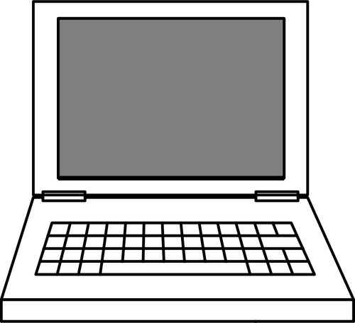
I
C
The New Jersey Student Learning Standards
Computer Science & Design Thinking
8.1.8 Impacts of Computing
8.1.8

Slide 2
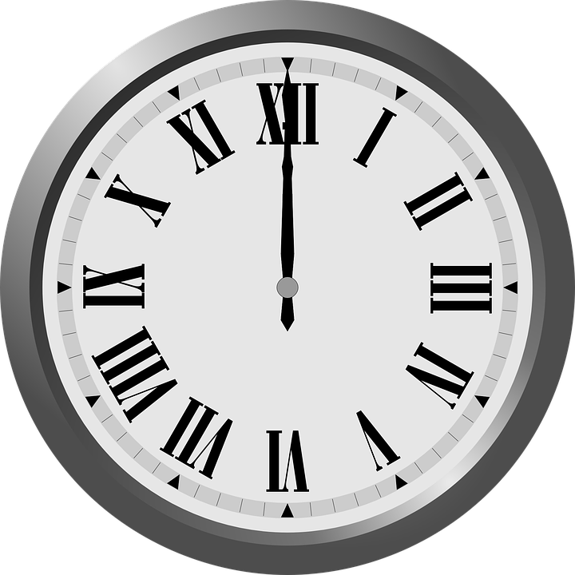
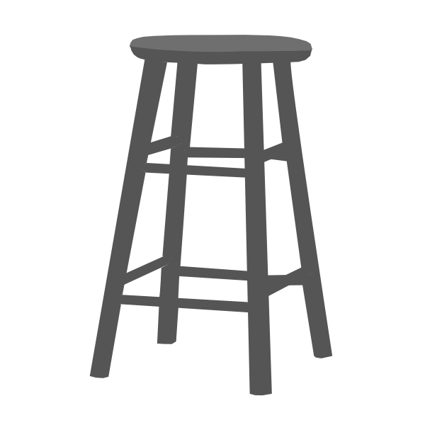
New Jersey Student Learning Standards
I
C
Technology
8.1.8.IC.1: Compare the trade-offs associated with computing technologies that affect an individual's everyday activities and career options.
8.1.8.IC.2: Describe issues of bias and accessibility in the design of existing technologies.
8.1.8

Slide 3
I
C
Core Concept 8.1.8 Impacts of Computing
Computing affects people of the world in both positive and negative. These impacts can be found at the local, national, and global levels.
Individuals and communities influence computing through their behaviors, cultural interaction, and social interactions. In turn, computing brings new cultural practices.
8.1.8

Slide 4
I
C
Topics Covered
What is a Computer
What is Computer Science
What is a Computing System
Common Computing Devices
Types of Computing Devices
How Computing Devices Impact People
Technologies That Impact Human Lives
Physical Impacts
Emotional Impacts
Trade-offs Associated With Technology
Issues of Bias
Student Activity No.1
8.1.8

Slide 5
I
C
What is a Computer?
8.1.8

Slide 6
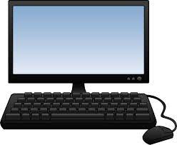
I
C
What is a Computer?
A computer is an electronic device that
collects,
analyzes (or study), and
acts upon
information we give it.
8.1.8
Page 6

Slide 7
I
C
What is Computer Science?
8.1.8

Slide 8
I
C
8.1.8

Slide 9
I
C
What is a Computing System?
8.1.8

Slide 10
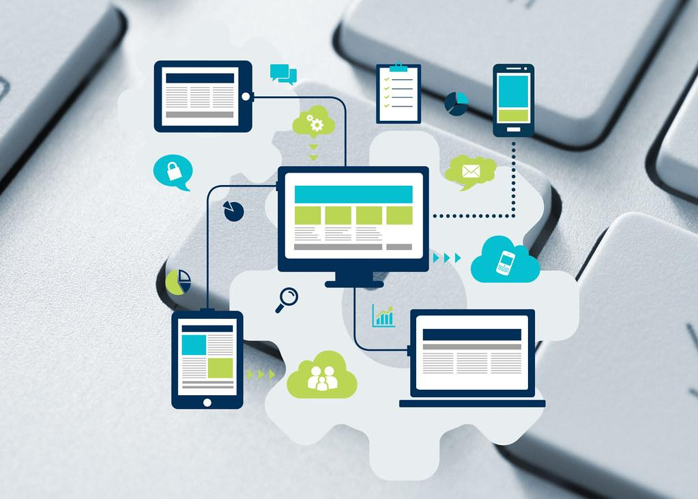
What is a Computing System?
I
C
A computing system is an arrangement (or layout) of hardware and software to
perform a computing task.
8.1.8

Slide 11
I
C
Common Computing Devices
8.1.8

Slide 12
I
C
Question:
Can you name
a computing device that people use everyday?
?
?
?
?
8.1.8

Slide 13
Answer: Below is a list of common computing devices that you use at school and home.
I
C
Desktop
Laptop
Tablet
Smart TVs
Smart phone
Smartwatch
E-readers
Fitness Trackers
8.1.8

Slide 14
I
C
Types of Computing Devices
8.1.8

Slide 15
Types of Computing Devices
I
C
We use three different types of Impacts of Computing or devices:
stationary devices stay in one place, like a desktop computer.
mobile devices go with you wherever you go, like a laptop, tablet and smartphone in your bookbag.
wearable devices are a special type of mobile device that is worn on the body, like a watch connected to a smartphone or fitness tracker.
8.1.8

Slide 16
I
C
How Computing Devices
Impact People
8.1.8

Slide 17
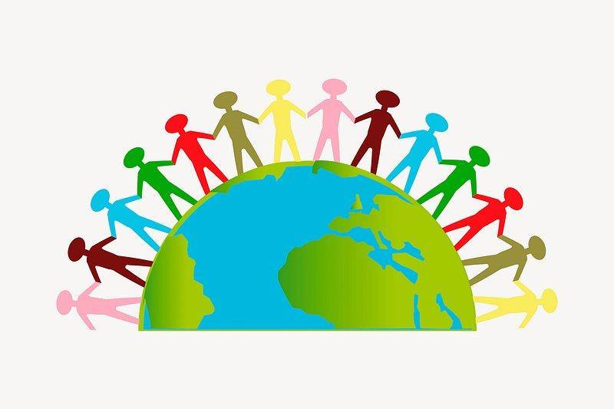
How Computing Devices Impact People
IC
A community is a social group of any size whose members reside in a specific locality, share government, and often have a common cultural and historical heritage.
8.1.8

Slide 18
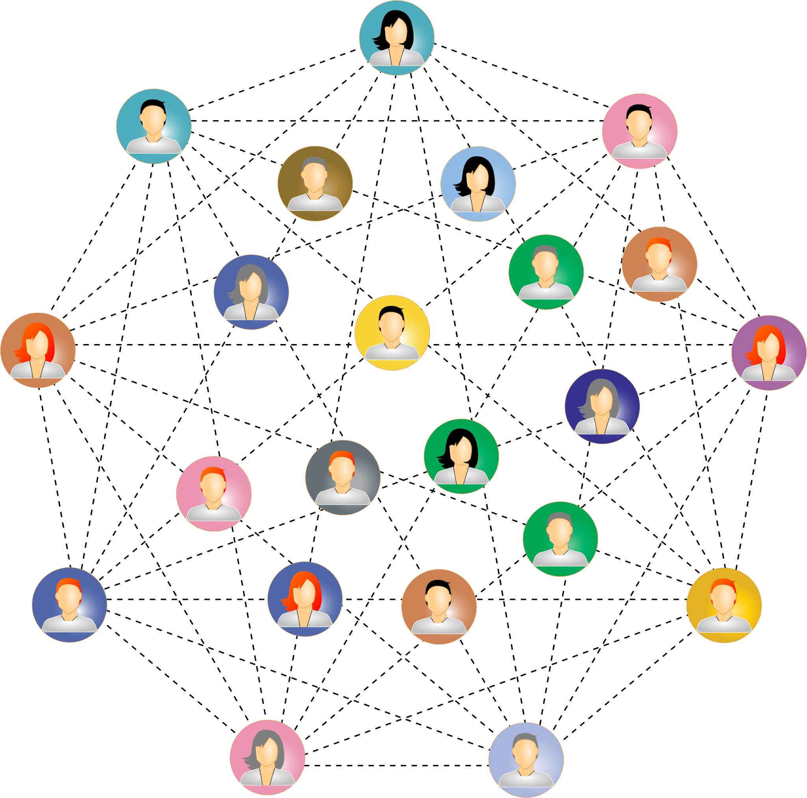
How Computing Devices Impact People
IC
Computing devices have a big impact on people in a community in good ways and in bad ways.
8.1.8

Slide 19
How Computing Devices Impact People
IC
Thanks for calling Sweetpea! Have a great day at school!
A good impact is one that makes the person, family and community better.
A good impact would be using your cell phone to call your parent to let them know you arrived at school safely.
8.1.8

Slide 20
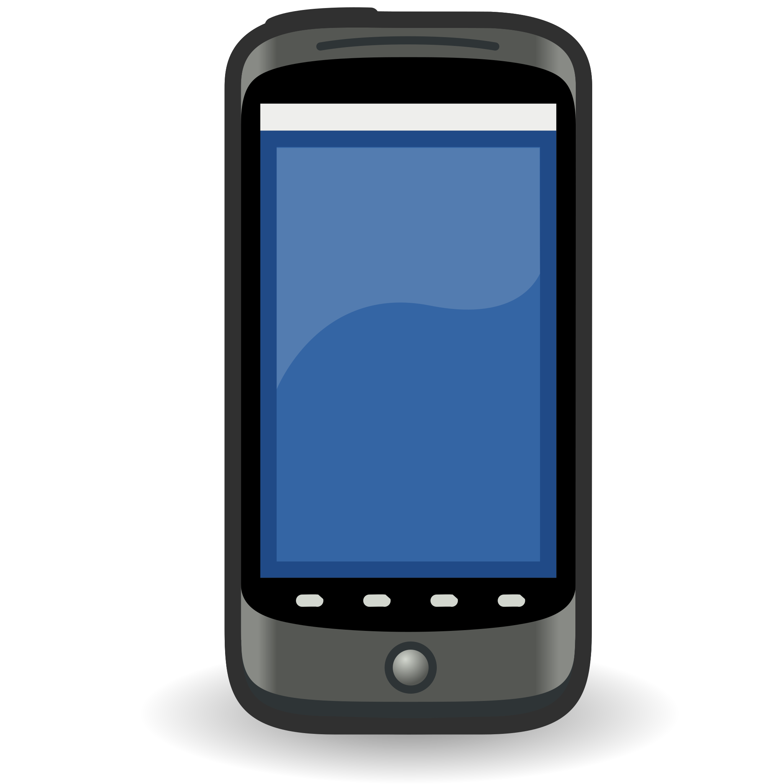
How Computing Devices Impact People
IC
A bad impact is one that makes a you feel bad or that causes a person, family, or community to feel bad.
A bad impact would be sending or receiving a mean text message.
Hey! Ur dress is cheap and you look like a turtle in it!
8.1.8

Slide 21
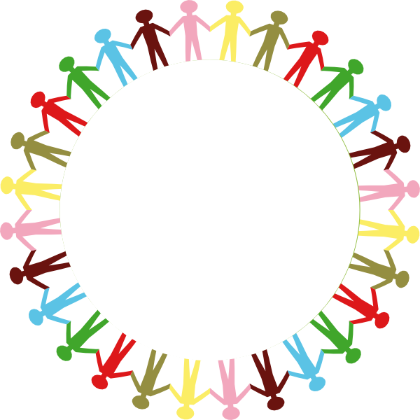
How Computing Devices Impact People
IC
Computing devices impact every part of modern life.
communication
shopping
education
work
entertainment
healthcare
social interaction
creative expression
personal organization
8.1.8
access to information

Slide 22
I
C
Technologies That Have
Impacted Peoples Lives
8.1.8

Slide 23
Technologies That Have Impacted People
IC
Algorithm is a process or set of rules to be followed in order to complete a task, operation, or solve a problem.
8.1.2

Slide 24
Technologies That Have Impacted People
IC
Computing technologies have significantly impacted many parts of the daily life of how people live and work. Several key technologies have proven to be driving forces in these changes, influenced by a combination of factors including
technological innovation,
societal needs,
economic forces, and
cultural shifts.
Factors driving their adoption include advances in algorithms and computing power, the mass collection of data, and the need for automation and efficiency in various domains.Some examples are provided.
8.1.2

Slide 25
Technologies That Have Impacted People
IC
Internet and World Wide Web: The internet or World Wide Web has been the most transformative technological developments in recent history. It has revolutionized communication, commerce, entertainment, and information access.
Factors influencing its impact include advancements in networking technologies, the need for global connectivity, and the rise of digital communication and commerce.
8.1.2

Slide 26
Technologies That Have Impacted People
IC
Smartphones and Mobile Computing: Smartphones and mobile computing devices have reshaped how people interact with information and each other. These devices have become necessary tools for communication, productivity, entertainment, and even healthcare.
Factors driving their adoption include advances in mobile hardware, software ecosystems, and the demand for on-the-go connectivity.
8.1.2

Slide 27
Technologies That Have Impacted People
IC
Cloud Computing: Cloud computing has transformed the way individuals and businesses store, process, and access data and applications compared to traditional on-premises IT infrastructure. It offers…
Scalability- the capacity to be changed in size or scale.
Flexibility-the ability to changed (stretched) without breaking or losing its shape.
Cost-efficiency- does not include extraneous charges or fees.
Factors driving its adoption include the need for scalable computing resources, cost savings, and the rise of remote work and collaboration.
8.1.2

Slide 28
Technologies That Have Impacted People
IC
Social Media Platforms: Social media platforms have become an integral part of many people's personal and professional lives. They influence communication, marketing, and societal dynamics. Social media has changed how people
connect,
share information, and
express themselves online.
Factors contributing to their impact include the desire for social interaction, technological advancements in networking and user interfaces, and the rise of digital advertising.
8.1.2

Slide 29
Technologies That Have Impacted People
IC
Artificial Intelligence and Machine Learning: AI and machine learning technologies are increasingly being integrated into various applications and services, automating tasks, personalizing experiences, and driving insights from data.
Factors driving their adoption include advances in algorithms and computing power, the proliferation of data, and the need for automation and efficiency in various domains.
8.1.2

Slide 30
Technologies That Have Impacted People
IC
Internet of Things (IoT): The IoT refers to the interconnected network of devices embedded with sensors and actuators, enabling them to collect and exchange data. IoT technologies have applications in areas such as:
smart homes,
healthcare,
transportation, and
manufacturing.
IoT benefits automation, efficiency, and enhanced decision-making.
Factors influencing its adoption include advances in sensor technology, connectivity standards, and the demand for data-driven insights and automation.
8.1.2

Slide 31
Technologies That Have Impacted People
IC
Blockchain Technology: Blockchain technology, best known as the underlying technology behind cryptocurrencies like Bitcoin, has broader applications beyond finance, including supply chain management, voting systems, and digital identity verification.
Factors driving its adoption include the need for secure and transparent transactions, decentralization, and trust in digital systems.
8.1.2

Slide 32
Technologies That Have Impacted People
IC
Overall, computing technologies impact innovation, market demand, regulatory frameworks, and societal trends. These changes collectively contribute to significant changes in how individuals live and work.
8.1.2

Slide 33
I
C
Computing Technologies
Physical & Emotional Impacts
8.1.8

Slide 34
Physical Impacts of Technology on Humans
IC
Technology has brought about a variety of negative, physical changes in lives of people. Let’s examine some bad physical changes.
8.1.2

Slide 35
Physical Impacts of Technology on Humans
IC
Sedentary Lifestyle: Increased use of technology, especially devices like computers, smartphones, and television, has contributed to a more sedentary lifestyle for many people.
Extended periods of sitting and decreased physical activity can lead to health issues such as obesity, cardiovascular problems, and musculoskeletal disorders.
8.1.2

Slide 36
Physical Impacts of Technology on Humans
IC
Eye Strain and Vision Problems:
Staring at screens for prolonged periods can cause eye strain, dry eyes, and blurred vision. This is made worse by the number of digital screens used everyday at school and at home.
8.1.2

Slide 37
Physical Impacts of Technology on Humans
IC
Repetitive Strain Injuries (RSI): Activities such as typing on keyboards or using a mouse extensively can lead to repetitive strain injuries like carpal tunnel syndrome, tendonitis, and other musculoskeletal disorders.
8.1.2

Slide 38
Physical Impacts of Technology on Humans
IC
Sleep Disruptions: Exposure to the blue light emitted by screens, especially before bedtime, can disrupt sleep patterns and contribute to insomnia or poor sleep quality. This is really bad if you use of smartphones and tablets as bedtime entertainment devices.
8.1.2

Slide 39
Physical Impacts of Technology on Humans
IC
Tech Neck and Posture Issues: Constantly looking down at smartphones and other handheld devices can lead to poor posture, neck strain, and back problems, commonly referred to as "tech neck."
8.1.2

Slide 40
Emotional Impacts of Technology on Humans
IC
Technology has brought about a variety of negative, emotional changes in lives of people. Let’s examine some emotional changes humans experience.
8.1.2

Slide 41
Physical Impacts of Technology on Humans
IC
Increased Connectivity: Technology has enabled people to stay connected with friends, family, and colleagues regardless of physical distance, leading to increased feelings of connectedness and support.
8.1.2

Slide 42
Emotional Impacts of Technology on Humans
IC
Social Isolation: Using technology a lot, especially social media, can contribute to feelings of social isolation and loneliness.
Online interaction does not always provide the same level of emotional fulfillment as face-to-face interactions.
8.1.2

Slide 43
Emotional Impacts of Technology on Humans
IC
Fear of Missing Out (FOMO): Social media and constant connectivity can cause feelings of FOMO. People become anxious or feel inadequate when comparing their real lives to the curated and often idealized versions of someone else’s online life.
8.1.2

Slide 44
Physical Impacts of Technology on Humans
IC
Information Overload: The constant exposure to large amounts of information from various digital sources can lead to feelings of overwhelm and stress, making it difficult for individuals to disconnect, relax, or make decisions.
8.1.2

Slide 45
Physical Impacts of Technology on Humans
IC
Digital Addiction: Excessive use of technology, particularly smartphones and social media, can lead to addictive behaviors and compulsive usage patterns, negatively impacting mental health and well-being.
8.1.2

Slide 46
Physical Impacts of Technology on Humans
IC
Decreased Attention Span: The rapid-fire nature of digital media consumption can contribute to decreased attention spans and an inability to focus on tasks for extended periods.
8.1.2

Slide 47
Emotional Impacts of Technology on Humans
IC
Cyberbullying and Online Harassment: The anonymity and distance afforded by technology can cause cyberbullying and online harassment, leading to emotional distress, anxiety, and depression in victims.
8.1.2

Slide 48
Emotional Impacts of Technology on Humans
IC
Overall, while technology offers numerous benefits and conveniences, it's essential to be mindful of its potential impact on both physical health and emotional well-being and to strive for a healthy balance in its usage.
8.1.2

Slide 49
I
C
Impacts of Technology
Student Activity
8.1.8

Slide 50
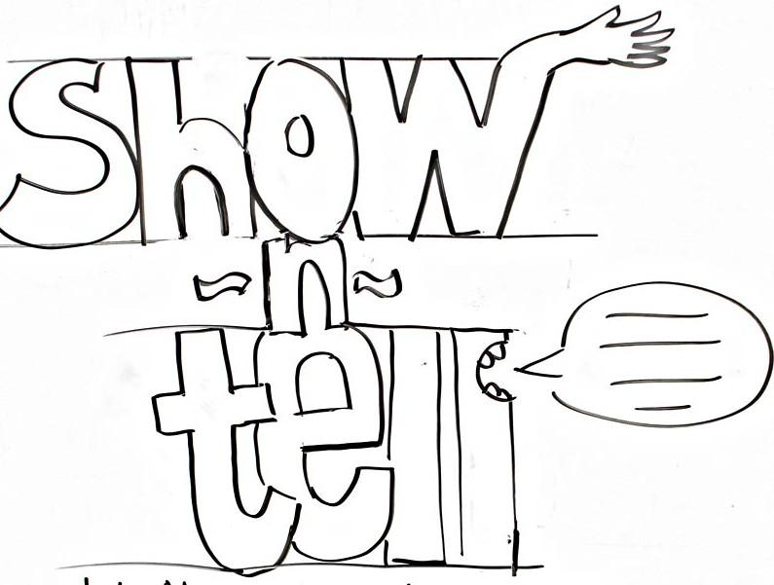
Impact of Computing Devices
I
C
Positive & Negative
On the next slide, work with a partner to select a computing device. Research positive and negative impacts and then fill out the chart.Be prepared to report out on your findings.
8.1.8

Slide 51
I
C
8.1.8

Slide 52
I
C
Tradeoffs
Associated with Technology
8.1.8

Slide 53
Associated Tradeoffs
IC
A trade-off is the ability to find a balance between two things you want. It's a compromise!
8.1.2

Slide 54
Associated Tradeoffs
IC
Computing technologies offer a number of benefits and conveniences, but they also come with trade-offs. Here are some common trade-offs associated with computing technologies.
8.1.2

Slide 55
Associated Tradeoffs
IC
Convenience vs. Privacy: Many computing technologies have convenience through features like personalized recommendations and targeted advertising, but often at the cost of privacy. Users may have to trade their personal data and privacy for access to these services.
8.1.2

Slide 56
Associated Tradeoffs
IC
Efficiency vs. Job Displacement: Automation and AI technologies can improve efficiency and productivity in various industries, but they may also lead to job displacement as certain tasks become automated, potentially leaving some workers unemployed or requiring them to retrain for new roles.
8.1.2

Slide 57
Associated Tradeoffs
IC
Global Connectivity vs. Digital Divide: The internet and mobile technologies enable global connectivity and access to information. Some people lack access to reliable internet infrastructure or devices, deepening existing inequalities.
8.1.2

Slide 58
Associated Tradeoffs
IC
Innovation vs. Security: Rapid technological innovation often outpaces efforts to secure systems and data adequately. This trade-off can result in cybersecurity threats, requiring ongoing investment in security measures and protocols.
8.1.2

Slide 59
Associated Tradeoffs
IC
Customization vs. Standardization: Computing technologies offer the ability to customize products and services to individual preferences, but this customization can lead to separation and compatibility issues, making it challenging to maintain interoperability across different platforms and devices.
8.1.2

Slide 60
Associated Tradeoffs
IC
Social Connectivity vs. Isolation: While social media and digital communication platforms facilitate connectivity and relationship-building, excessive use can lead to social isolation and a decline in face-to-face interactions, affecting mental health and well-being.
8.1.2

Slide 61
Associated Tradeoffs
IC
Data Access vs. Data Ownership: Cloud computing and online services provide easy access to data from anywhere. Users may relinquish ownership and control of their data to service providers, raising concerns about data privacy and sovereignty.
8.1.2

Slide 62
Associated Tradeoffs
IC
Speed vs. Accuracy: The ability to get faster computing speeds may come at the expense of accuracy or reliability. For example, in high-frequency trading, algorithms prioritize speed to execute trades quickly, sometimes at the cost of making errors or contributing to market instability.
8.1.2

Slide 63
Associated Tradeoffs
IC
Environmental Impact: The fast increase in computing technologies, especially data centers and energy-intensive devices, contributes to environmental concerns. Increased energy consumption, e-waste generation, and carbon emissions, are just a few trade-offs we face as we examine technological advancement and environmental sustainability.
8.1.2

Slide 64
Associated Tradeoffs
IC
Accessibility vs. Exclusion: While computing technologies have the potential to make information and services more accessible to diverse populations, there are still barriers to accessibility for people with disabilities, people in poverty stricken areas, and third world nations.
8.1.2

Slide 65
Associated Tradeoffs
IC
Navigating these trade-offs requires careful consideration of ethical, social, and economic factors to ensure that the benefits of computing technologies are maximized while mitigating their potential negative impacts.
8.1.2

Slide 66
I
C
Issues of Bias
8.1.8

Slide 67
I
C
WHAT IS BIAS?
Type your answer in the space below!
8.1.8

Slide 68
Answer: What is Bias?
I
C
Bias, a tendency to believe that some people, ideas, religions, schools, etc., are better than others which results in treating and judging others unfairly. Everyone has bias, it is part of human nature!
8.1.8

Slide 69
The Jim Crow Era
I
C
A quick look at the past before diving into the present & future.
8.1.8

Slide 70
The Jim Crow Era
I
C
Jim Crow Laws represented written, government sanctioned laws that codified a system of racial apartheid in the South beginning in the 1890s. The laws were designed to segregate and disenfranchise black people specifically and other groups (Chinese, Irish, Japanese, and Mexican laborers; and women).
8.1.8

Slide 71
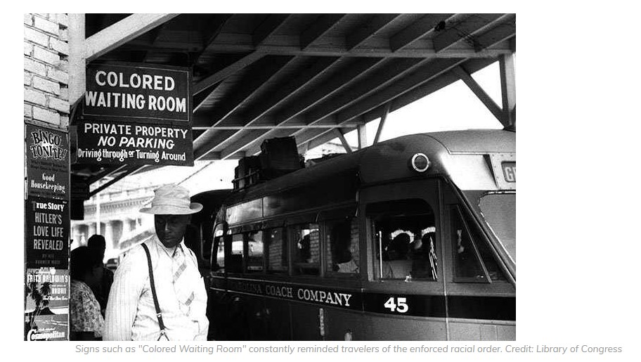
I
C
The Jim Crow Era
These laws affected every aspect of daily life:
Education
Healthcare
Housing
Voting
Recreation
Employment
Transportation
Incarceration
Marriage
8.1.8

Slide 72
I
C
The Jim Crow Era
While Jim Crow laws originated in southern institutions, codes related to racial discrimination and segregation in the North were also present in employment, education, and housing.
8.1.8

Slide 73
I
C
Machine Learning
8.1.8

Slide 74
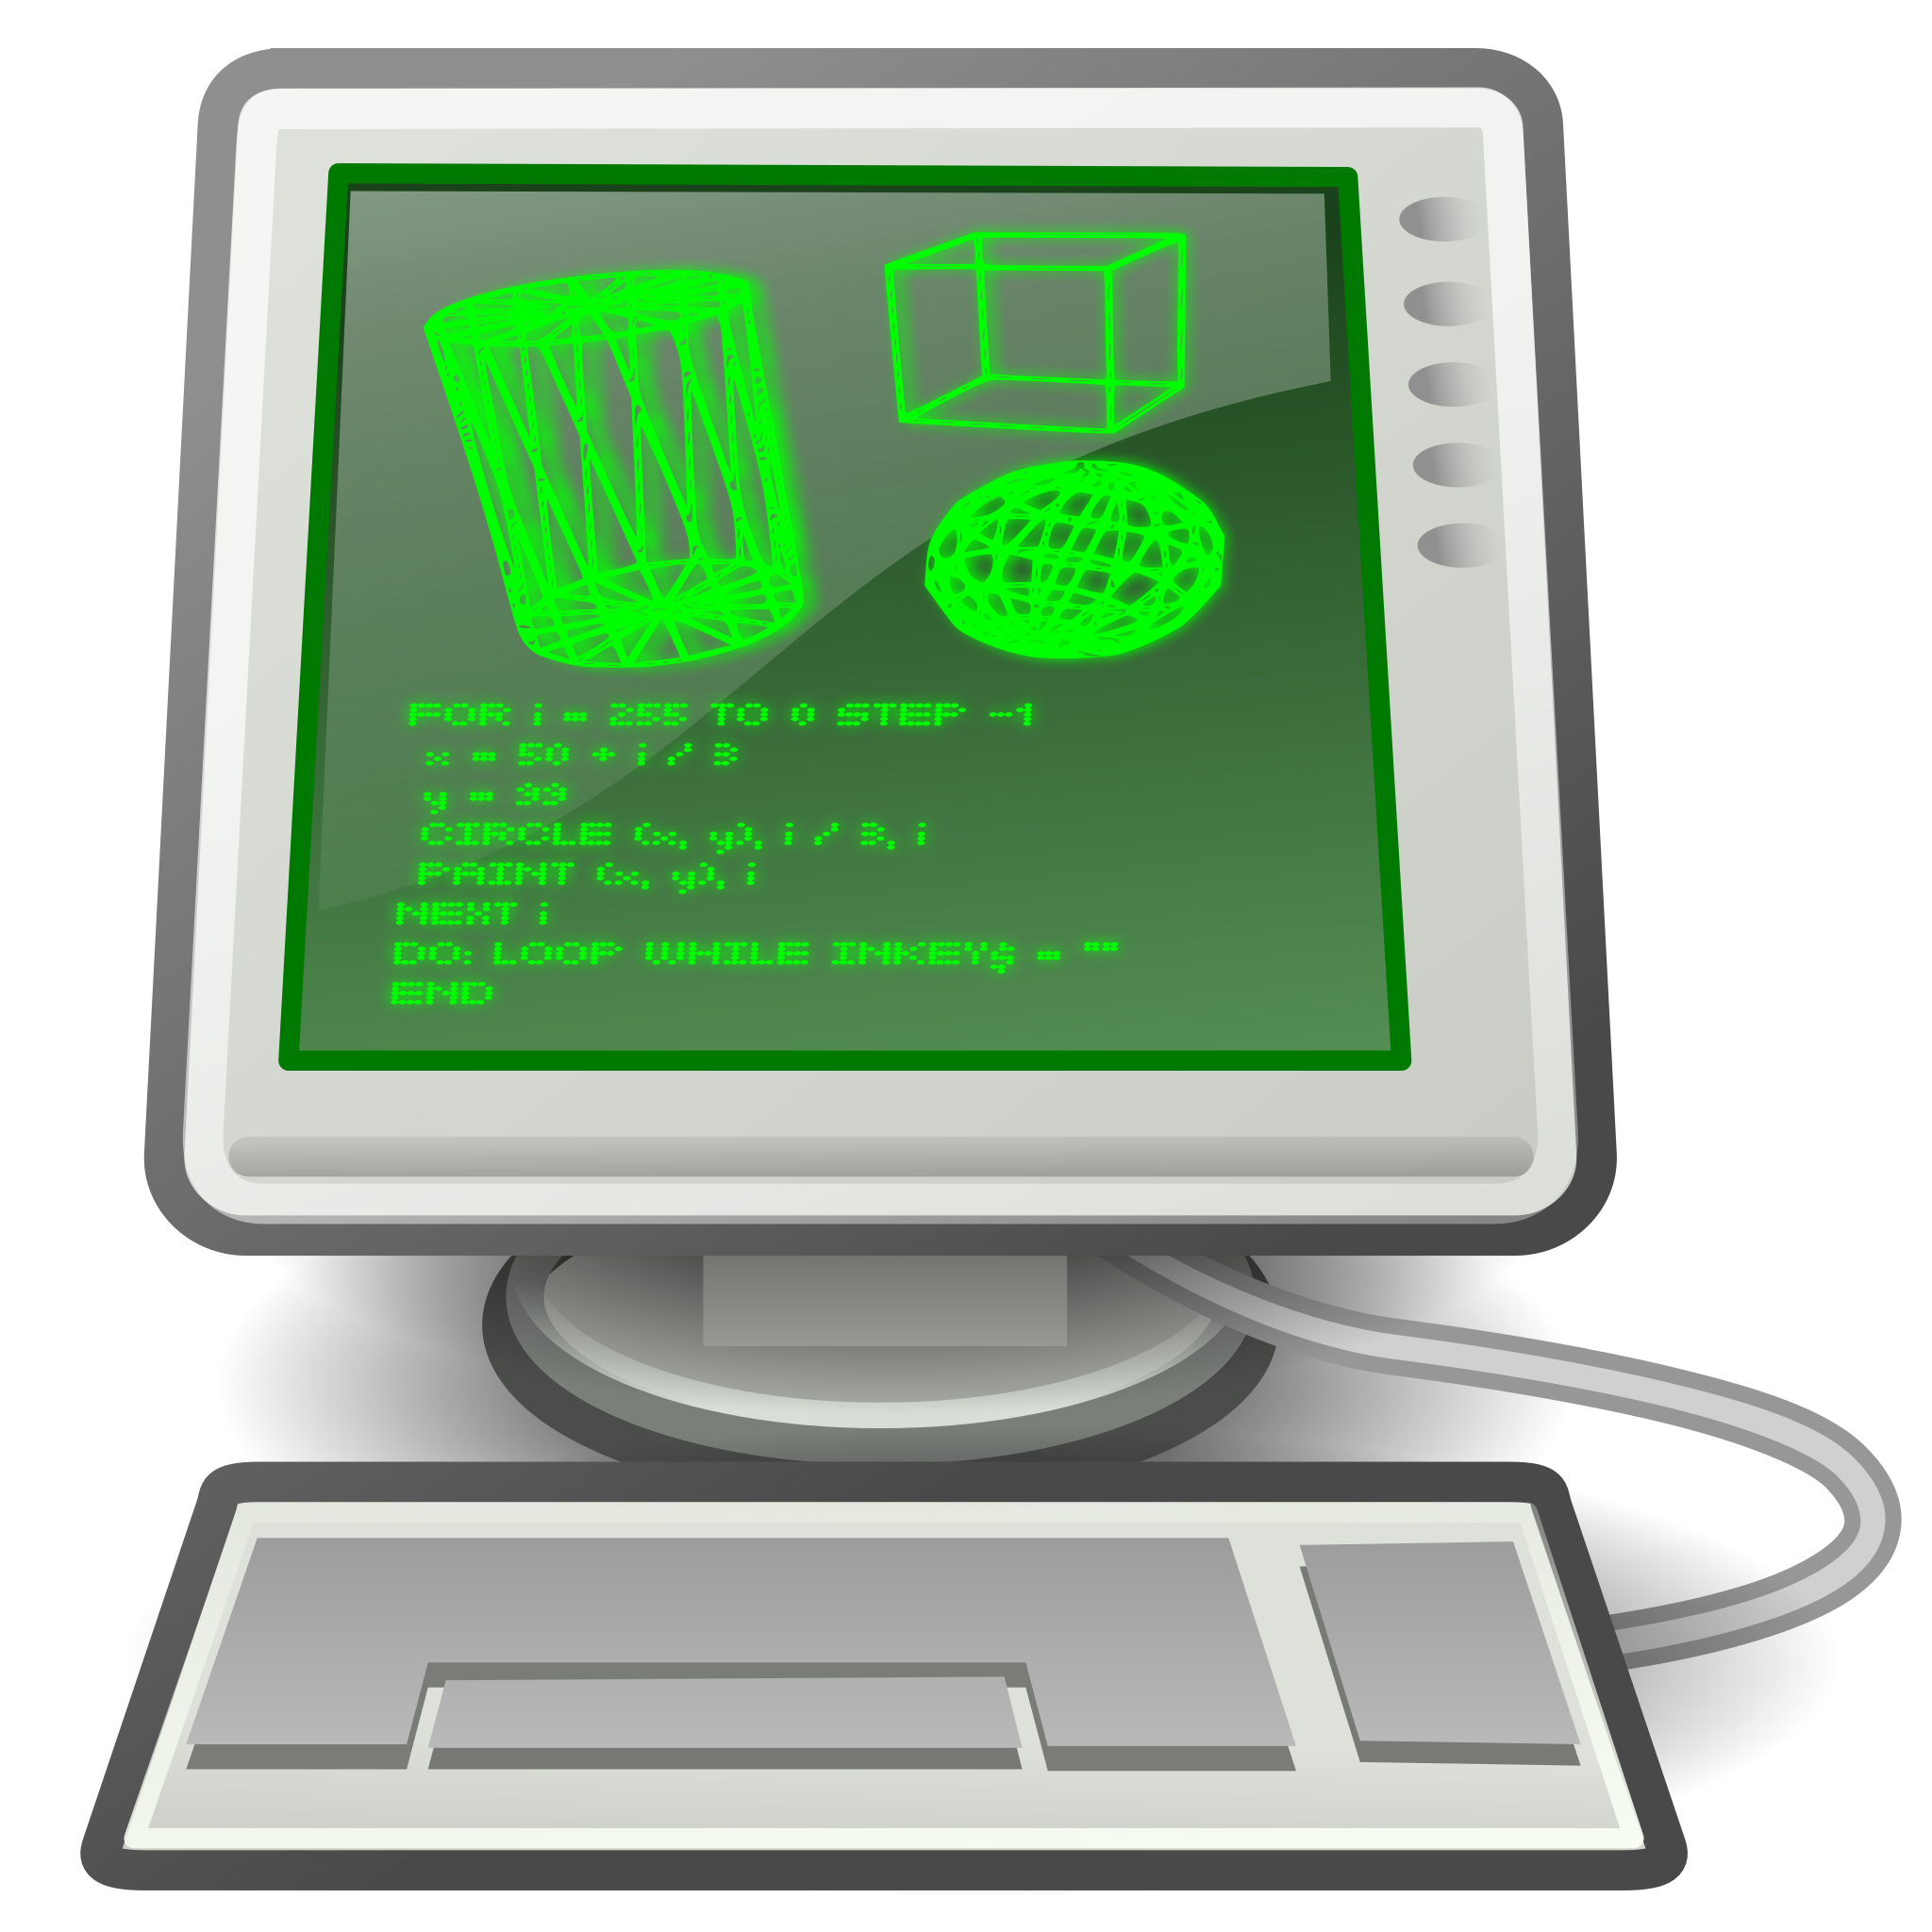
I
C
Machine Learning
In simple terms, machine learning is about teaching computers to learn from examples and make “smart” decisions on their own.
8.1.8

Slide 75
I
C
Machine Learning
Programmers provide lots of examples or “datasets” when creating computer programs. Let’s suppose you are writing a program that you want to be able to recognize a gorilla.
8.1.8

Slide 76
I
C
Machine Learning
Question: What do you think would happen if, as part of your examples of what a gorilla is, you added pictures of a white rabbit?
8.1.8

Slide 77
I
C
AI
Artificial Intelligence
8.1.8

Slide 78
AI or Artificial Intelligence refers to the simulation of human intelligence in machines that are programmed to think and learn like humans.
I
C
Artificial Intelligence
AI
8.1.8

Slide 79
AI is like having a digital helper that can understand and solve problems without being explicitly told what to do in every single situation. AI can learn from data and use that knowledge to handle different tasks.
I
C
Artificial Intelligence
AI
8.1.8

Slide 80
I
C
Data & Datasets
8.1.8

Slide 81
In computer programming, data refers to the information that is processed, stored, or transmitted by a computer. Data can represent a wide range of information, including numbers, text, images, sounds, and more.
What is Data?
I
C
8.1.8

Slide 82
A dataset is a structured collection of data organized and presented in a specific format. In computer science and machine learning, a dataset typically refers to a set of data points or observations that are related to each other.
What is Dataset?
I
C
8.1.8

Slide 83
These data points can represent information about
individuals,
objects,
events, or
other entities.
The data points are organized in a way that facilitates analysis and interpretation.
What is a Dataset?
I
C
8.1.8

Slide 84
I
C
What is a Coded Bias?
A broad definition of Coded Bias is the use of technologies that contain inherent prejudices and biases.
8.1.8

Slide 85
I
C
What is a Coded Bias?
Datasets created by humans contain biases that seep into algorithms and artificial intelligence (AI), are accepted by machine learning, disseminated and the perpetuated throughout the human-computer experience.
8.1.8

Slide 86
I
C
Meet Joy Buolamwini
Computer programs learn from the examples provided. It is the dataset that impacts the function of computer algorithms.
8.1.8

Slide 87
I
C
American Surveillance & Data Collection
In the USA surveillance and data collection are more geared toward three areas:
Policing
Employment
Advertising & Selling
8.1.8

Slide 88
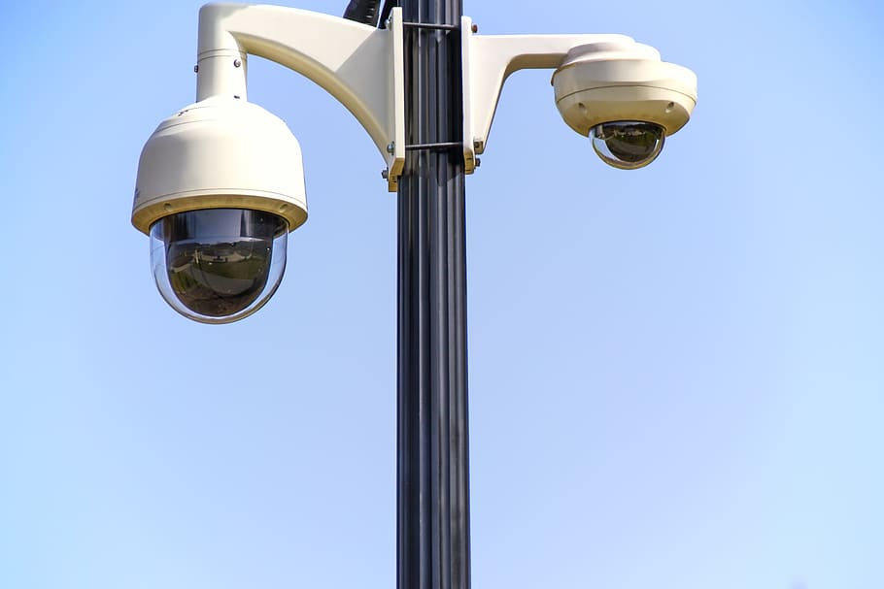
Policing
I
C
African Americans, people of color, and immigrant communities have always been under heightened surveillance by law enforcement and the US government. Technology has moved surveillance into less confrontational, inconspicuous places like cameras mounted overhead (out of sight).
8.1.8

Slide 89
Predictive Software Programs
I
C
Police departments all over the country use predictive programs like PredPol, HunchLab, and CompStat to evaluate the potential for criminal behavior so that resources can be allocated to “high crime area”.
8.1.8

Slide 90
Predictive Software Programs
I
C
In order for these programs to work, the developers feed them data. Most of the information comes from historical crime data and public records.
8.1.8

Slide 91
Predictive Software Programs
I
C
The problem is that the original dataset “information” is always skewed when it comes to police records. Poor, Black, and brown and immigrant communities have more negative encounters with police than white males in suburban environments.
8.1.8

Slide 92
Predictive Software Programs
I
C
The problem is that the original dataset “information” is always skewed when it comes to police records. Poor, Black, and brown and immigrant communities have more negative encounters with police than white males in suburban environments.
8.1.8

Slide 93
AI and Employment
I
C
AI is used by people and companies. AI helps people find job openings and the process of filling out online employment applications. Companies use AI to help match an applicants skills and experiences with the job requirements. It's like having a helper who looks at all the information and suggests which jobs might be a good fit for you.
8.1.8

Slide 94
AI and Employment
I
C
Programmers sometimes install bias in computer programs by placing more value on certain kinds of people. For example, there may be a preference for men over women or people that live in certain zip codes. This happens because the computer learns from the information it's given, and if that information isn't fair, then the choices it makes might not be fair either.
8.1.8

Slide 95
AI and Employment
I
C
Just like how we learn to be fair and include everyone when we pick teams, people who make computer programs have to be really careful to make sure they treat everyone equally. Programmers need to make sure the computer doesn't accidentally favor one group of people over another. It's important to teach the computer to be fair, just like it's important for us to be fair when we're playing games with our friends!
8.1.8

Slide 96
AI and Employment
I
C
Just like how we learn to be fair and include everyone when we pick teams, people who make computer programs have to be really careful to make sure they treat everyone equally. Programmers need to make sure the computer doesn't accidentally favor one group of people over another. It's important to teach the computer to be fair, just like it's important for us to be fair when we're playing games with our friends!
8.1.8

Slide 97
I
C
AI Bias in Employement
What type of information can AI obtain from your zip code?
Facts about people that live in my zip code.
How might your facts and circumstances impact employment of those that live in your zip code?
How might your facts and circumstances impact employment of those that do not live in your zip code?
8.1.8

Slide 98
I
C
AI in Sales & Markting
Sales and marketing companies use computer programs with AI to figure out what people might want to buy and then direct them toward that purchase. When you go online and look at toys or games, the website might remember what you looked at in the past. Then, it might suggest other toys or games that are similar to the ones you liked. That's AI at work! It's like a smart helper saying, "Hey, since you liked that toy, you might also like these!"
8.1.8

Slide 99
I
C
AI in Sales & Markting
Also, sometimes when you're watching videos or playing games online, you might see ads for toys or games. AI helps choose which ads to show you based on what it thinks you might be interested in. It's like having a friend who knows what you like and suggests cool stuff to you.
8.1.8

Slide 100
AI in Sales & Markting
I
C
Bias in AI for sales and marketing happens when the computer program is given a limited number of items to recommend. It's like if your friend only talked about one game all the time, and you never heard about all the other cool games out there.
To make sure AI is fair in sales and marketing, people have to teach the computer about lots of different toys and games, so it can suggest a variety of things to different kids. That way, everyone gets a chance to see all the cool stuff that's out there!
8.1.8

Slide 101
AI Bias in Sales & Marketing
I
C
What type of restaurants are in your zip code?
List the types of restaurants in your zip code.
How might your facts impact AI Tools like Siri and Alexa if you ask to suggest something to eat?
Do you think the reply is biased? Explain your rationale`.
8.1.8

Slide 102
I
C
Data Scientist
Data scientist comb through tons of information looking for patterns to help them create targeted, personalized, advertising.
8.1.8

Slide 103
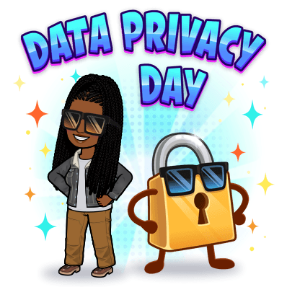
Final Thoughts
I
C
The degree to which you are personally impacted by AI decisions depends on your ethnicity, sex, zip code (socioeconomic status), and age.
Like everything else in America, the poorer and less educated you are, the worst you fair.
8.1.8

Slide 104
Final Thoughts
I
C
Be mindful of your personal data and how much of yourself you share online!
8.1.8

Slide 105
Suggested Reading
I
C
Movies/Videos
Coded Bias on Netflix directed by Shalini Kantayya
Coded Bias: A WTTW Community Conversation on YouTube
Books to read
Race After Technology by Ruha Benjamin
Weapons of Math Destruction by Cathy O’Neil
Algorithms of Oppression How Search Engines Reinforce Racism by Safiya Umoja Noble
Join
Algorithmic justice League
8.1.8

Slide 106
Works Cited
I
C
Kucuk, Turgay (2023) Technology Integrated Teaching and Its Positive and Negative Impacts on Education. International Journal of Social Sciences & Educational Studies, 10 (1). pp. 46-55.
Positive and Negative Impacts of Technology
OpenAI. (2023-2024). ChatGPT (3.5)
TechTerms.com
Impacts of Social Media
Big 5 Personality Test
Computer Science Algorithms
Algorithms
Biad Definition & Meaning
Jim Crow Laws Definition
Jim Crow Laws | American Experience | Official Site | PBS
China's Social Credit System
An Introduction to the Five Factor Model
Five Factor Model (pdf)
8.1.8

