Slide 1
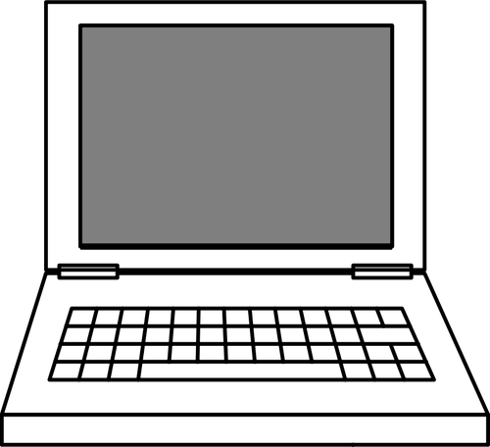

I
C
The New Jersey Student Learning Standards
Computer Science & Design Thinking
8.1.2 Impacts of Computing
8.1.2

Slide 2

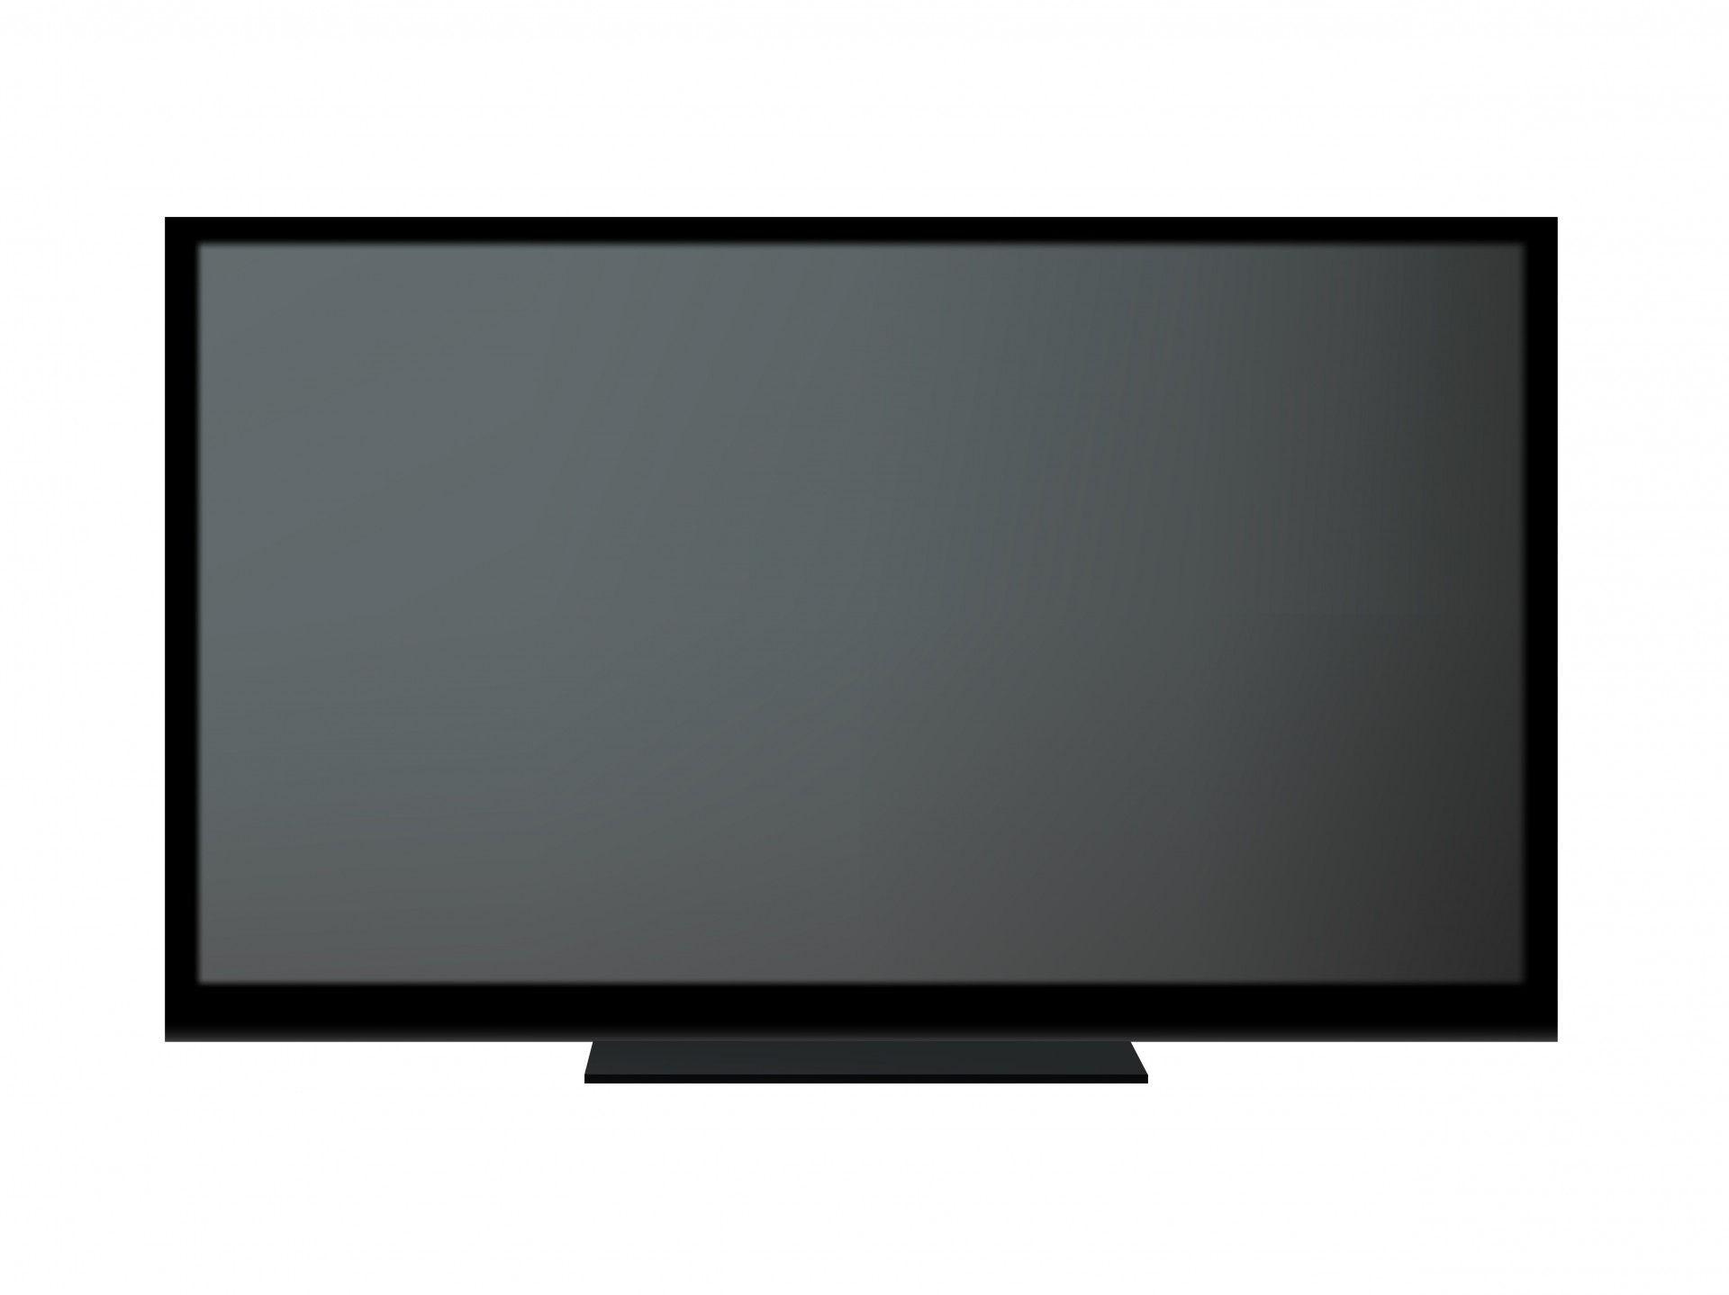
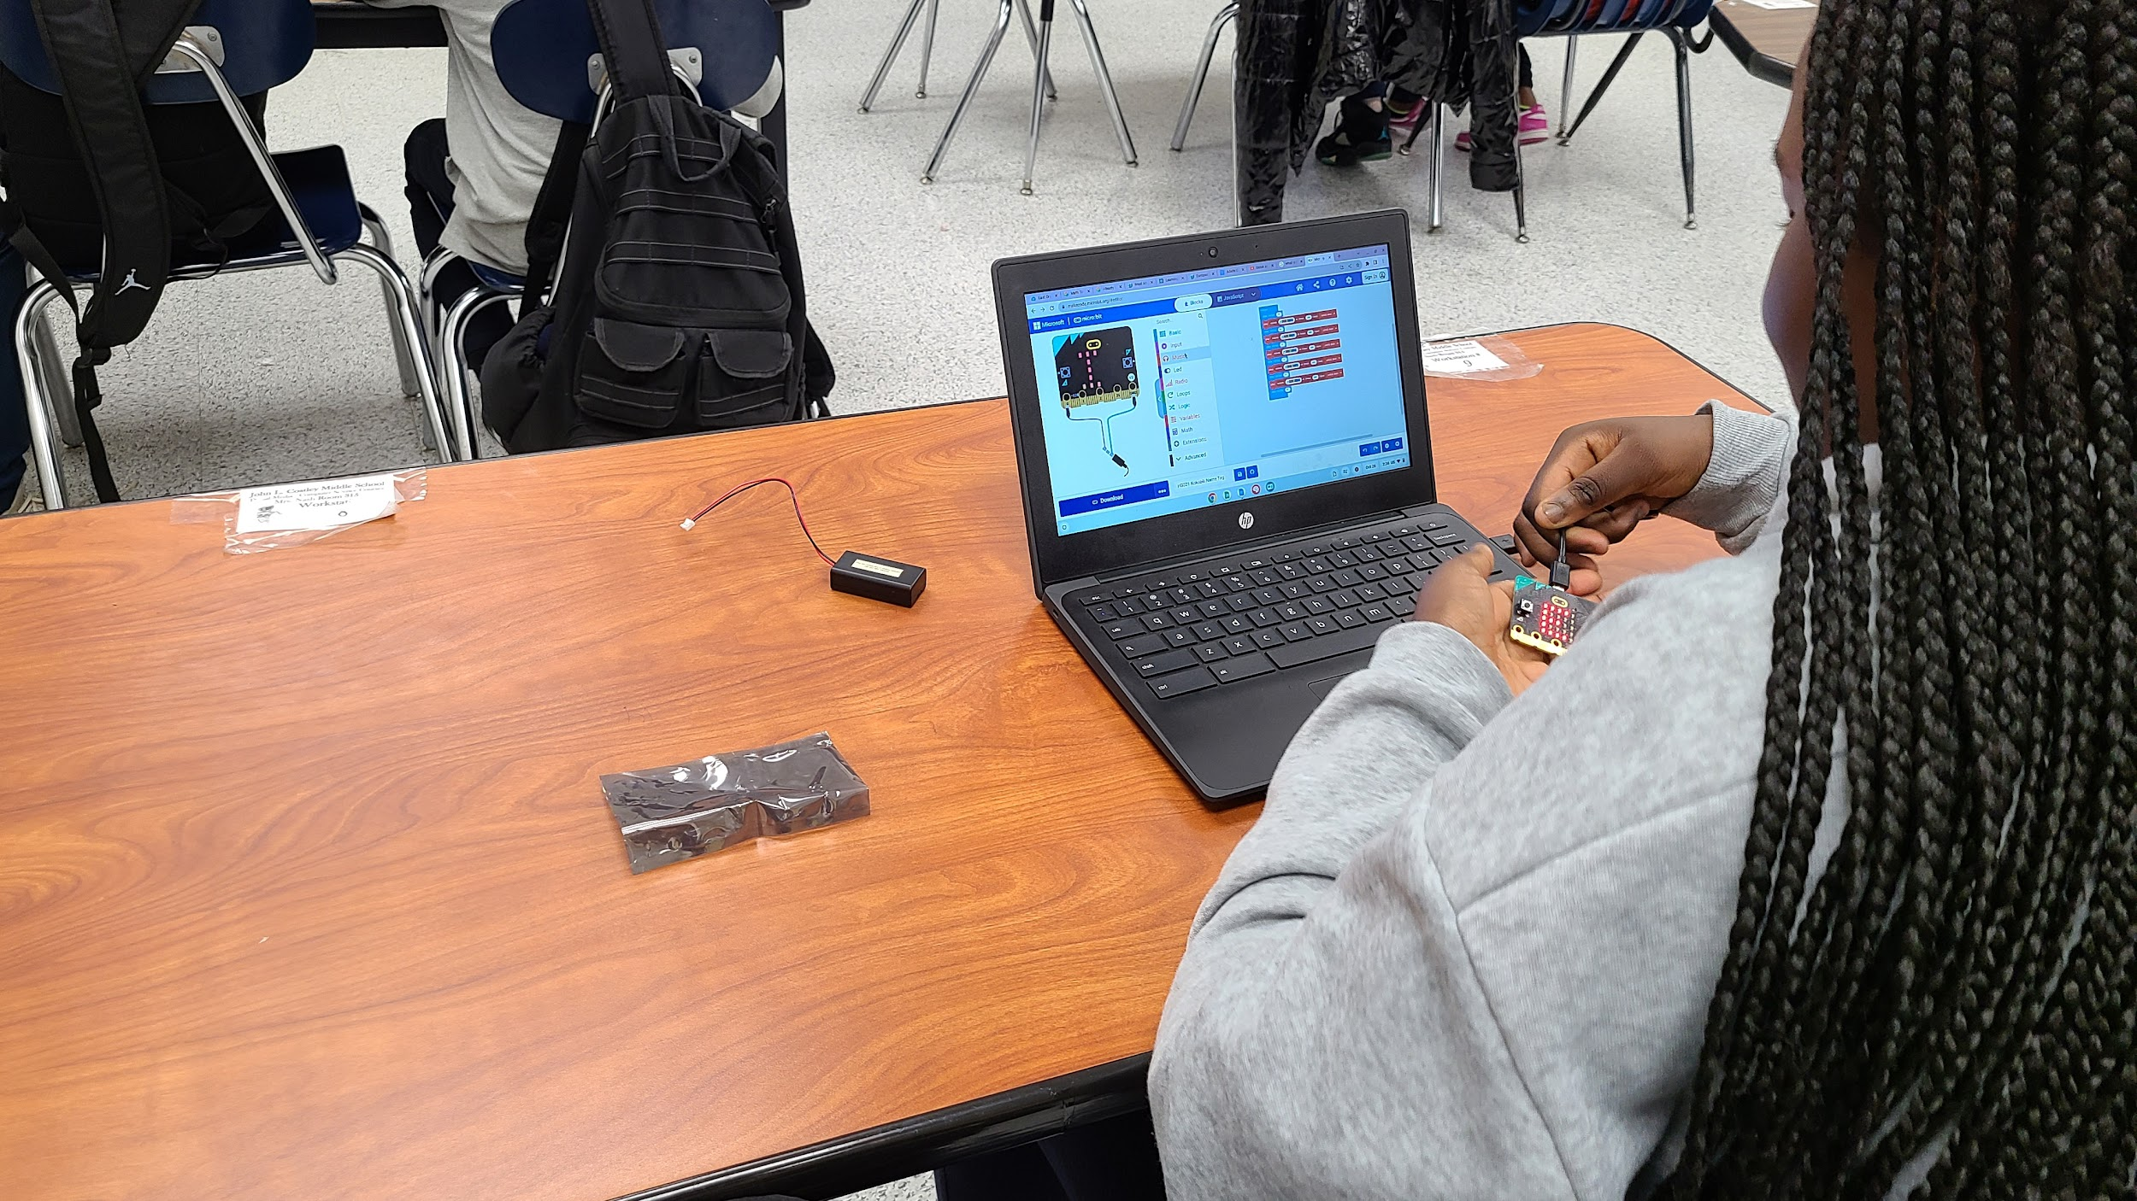

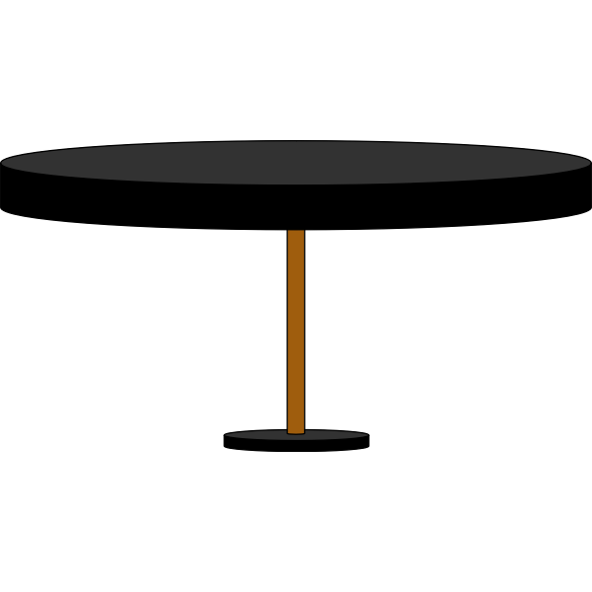


I
C
New Jersey Student Learning Standards
Technology
8.1.2.IC.1: Compare and contrast the impact of new computing technology in everyday life. Identify the pros and cons of computing technology, and how it impacts people and their communities.
8.1.2

Slide 3
I
C
Core Concept 8.1.2 Impacts of Computing
Computing affects many aspects of the world in both positive and negative ways at local, national, and global levels. Individuals and communities influence computing through their behaviors and cultural and social interactions, and, in turn, computing influences new cultural practices.
8.1.2

Slide 4
I
C
Topics Covered
What is a Computer
What is Computer Science
What is a Computing System
Common Computing Devices
Types of Computing Devices
How Computing Devices Impact People
8.1.2

Slide 5
I
C
What is a Computer?
8.1.2

Slide 6
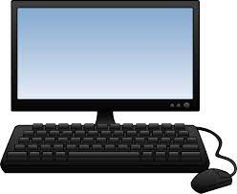
I
C
What is a Computer?
A computer is an electronic device that
collects,
analyzes (or study), and
acts upon
information we give it.
8.1.2
Page 6

Slide 7
I
C
What is Computer Science?
8.1.2

Slide 8
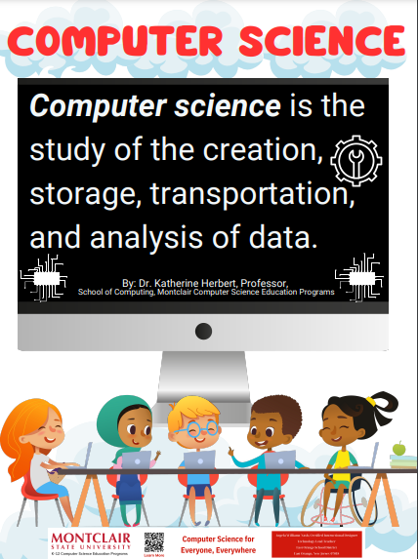
I
C
8.1.2

Slide 9
I
C
What is a Computing System?
8.1.2

Slide 10
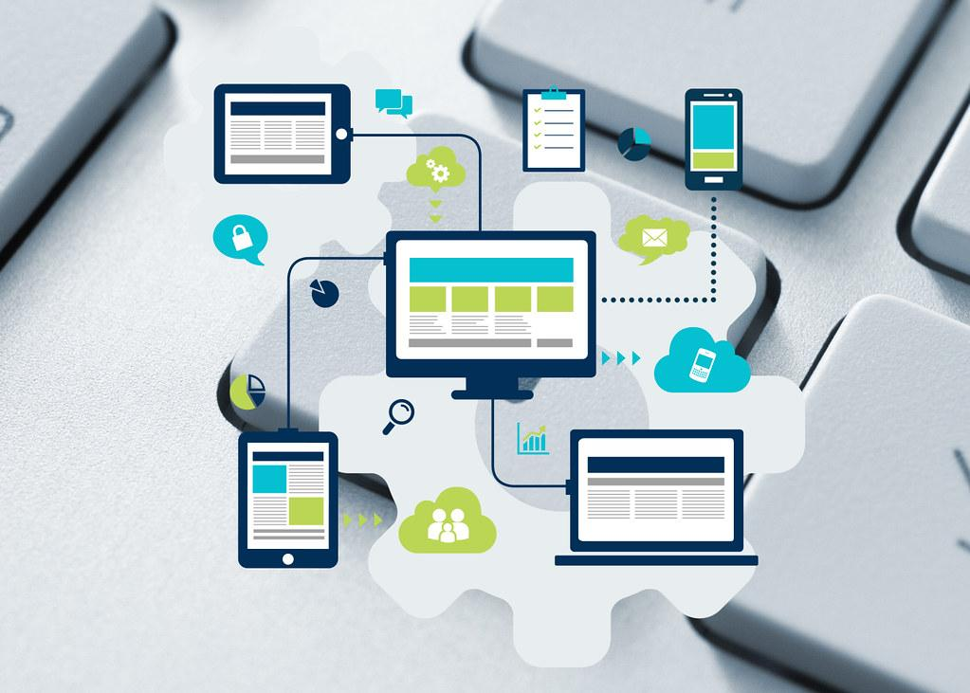
What is a Computing System?
I
C
A computing system is an arrangement (or layout) of hardware and software to
perform a computing task.
8.1.2

Slide 11
I
C
Common Computing Devices
8.1.2

Slide 12

I
C
Question:
Can you name
a computing device that people use everyday?
?
?
?
?
8.1.2

Slide 13
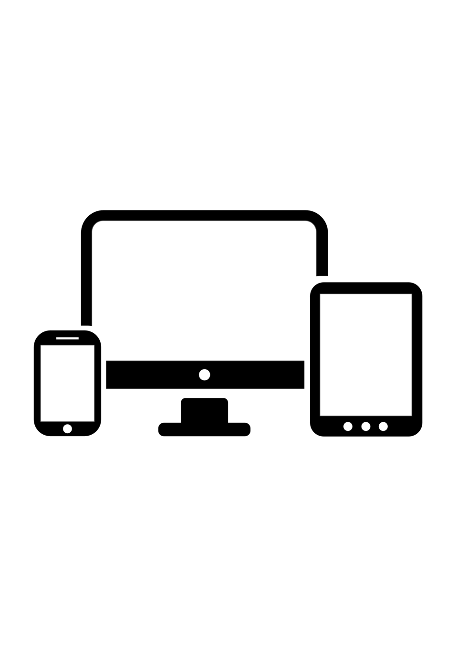
Answer: Below is a list of common computing devices that you use at school and home.
I
C
Desktop
Laptop
Tablet
Smart TVs
Smart phone
Smartwatch
E-readers
Fitness Trackers
8.1.2

Slide 14
I
C
Types of Computing Devices
8.1.2

Slide 15
Types of Computing Devices
I
C
We use three different types of Impacts of Computing or devices:
stationary devices
mobile devices
wearable devices
8.1.2

Slide 16

Types of Computing Devices
I
C
Stationary devices stay in one place, like a desktop computer. You go to the device when you need to use it.
8.1.2

Slide 17
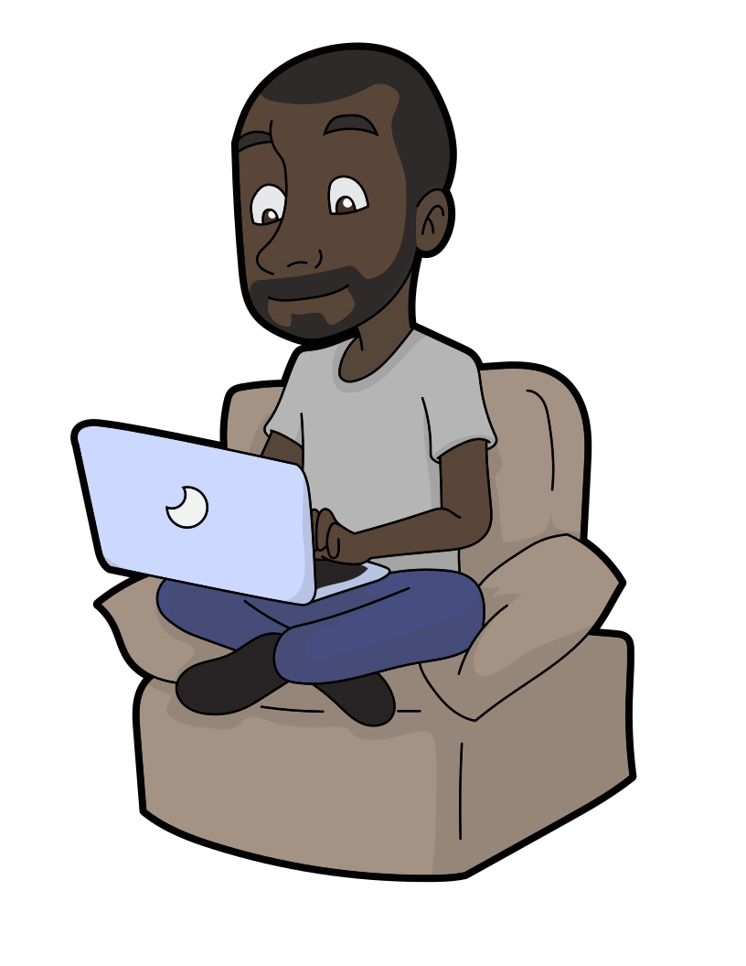
Types of Computing Devices
I
C
2. Mobile devices go with you from place to place like a laptop, tablet and smartphone in your bookbag.
8.1.2

Slide 18
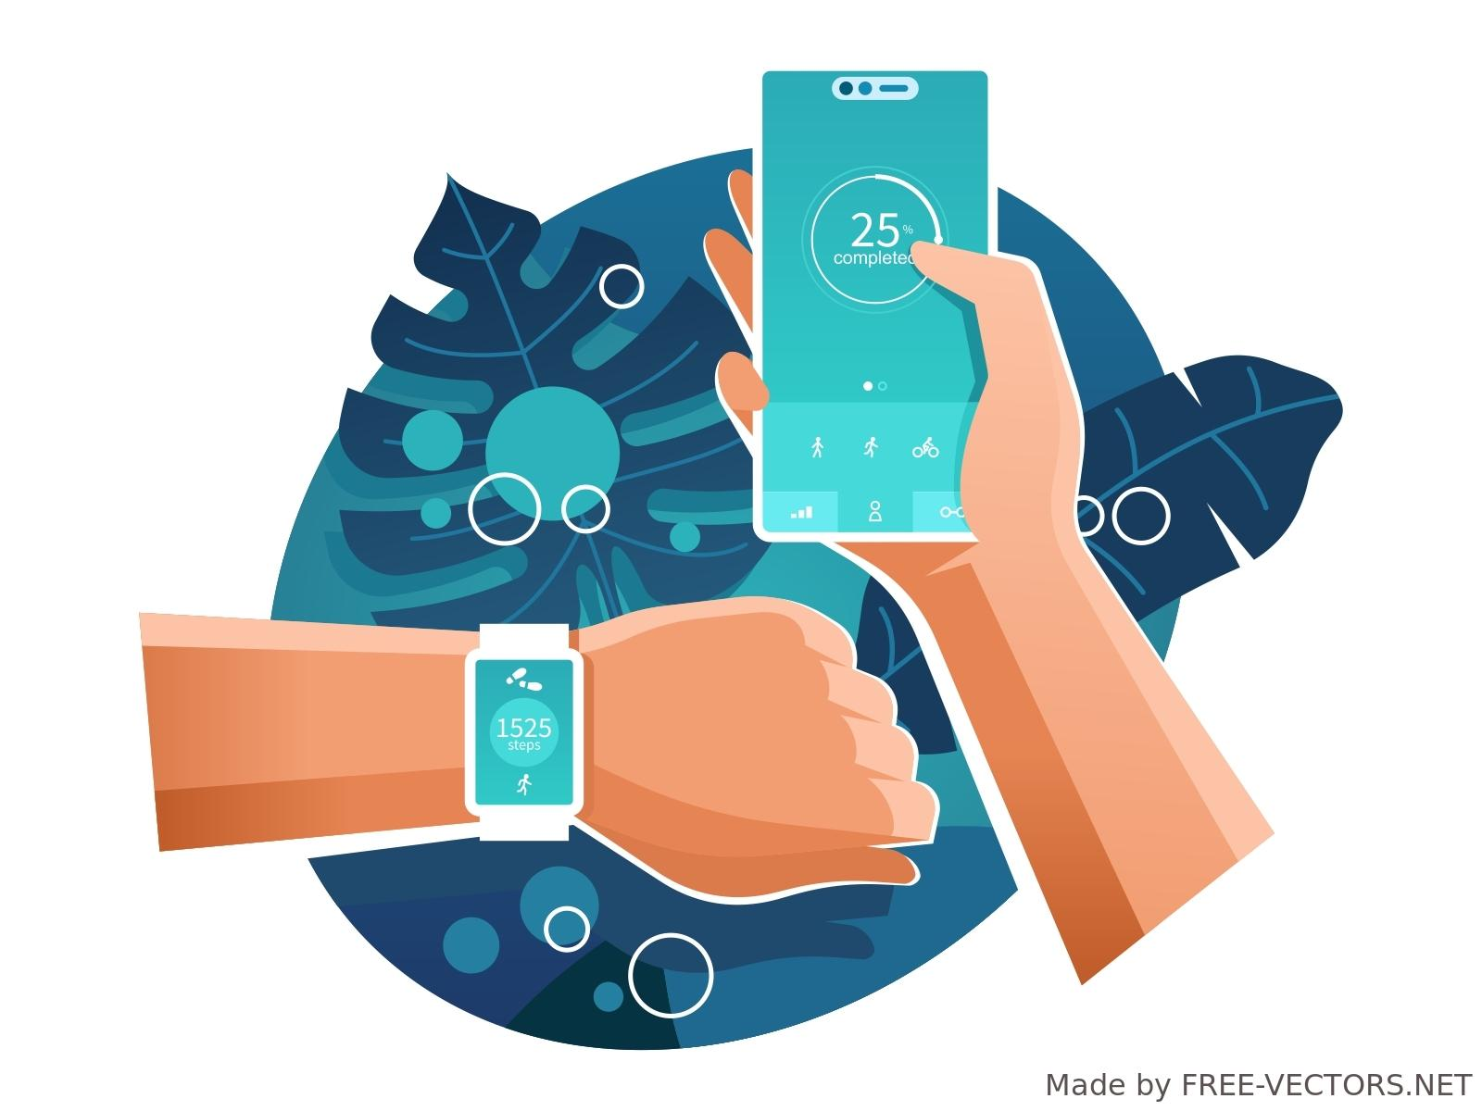
Types of Computing Devices
I
C
3. Wearable devices are worn on the human body, like a watch connected to a smartphone or fitness tracker.
8.1.2

Slide 19
I
C
How Computing Devices
Impact People
8.1.2

Slide 20
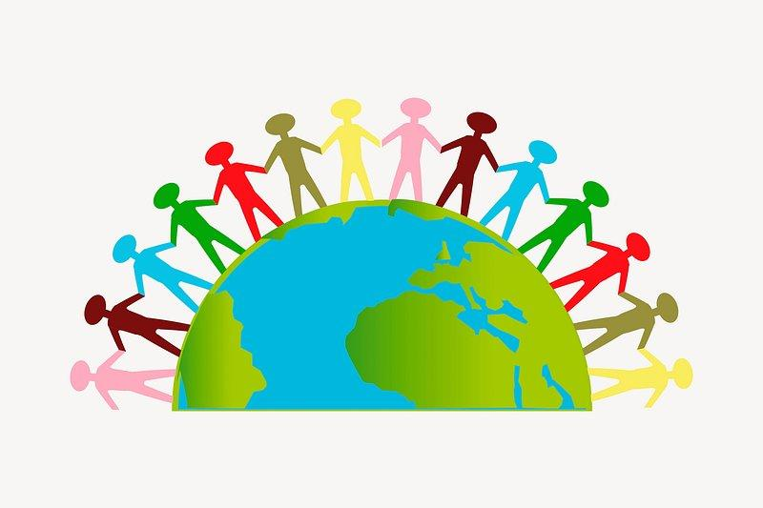
How Computing Devices Impact People
IC
A community is a social group of any size whose members reside in a specific locality, share government, and often have a common cultural and historical heritage.
8.1.2

Slide 21
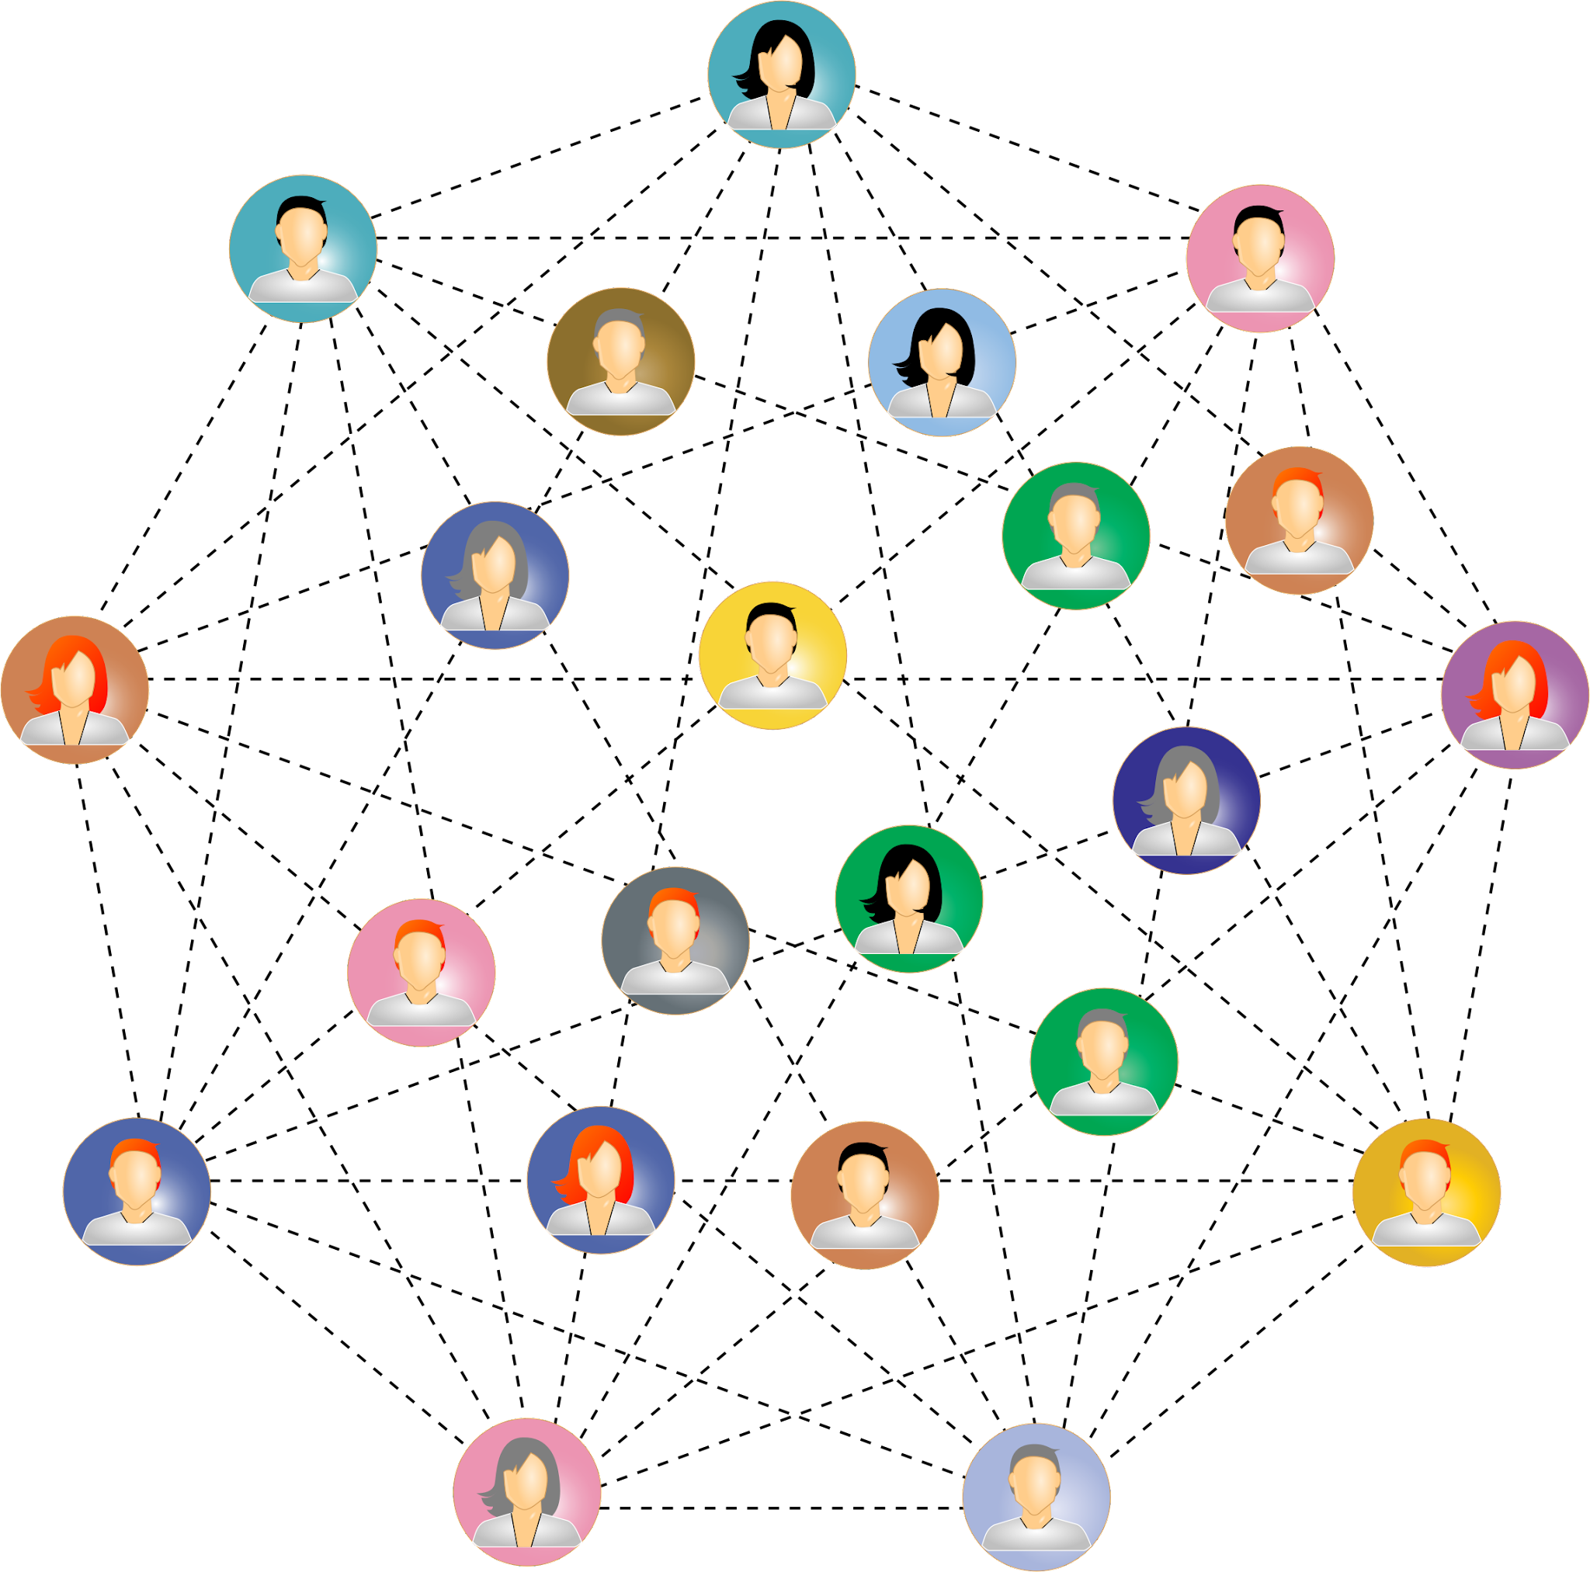
How Computing Devices Impact People
IC
Computing devices have a big impact on people in a community in good ways and in bad ways.
8.1.2

Slide 22

How Computing Devices Impact People
IC
Thanks for calling Sweetpea! Have a great day at school!
A good impact is one that makes the person, family and community better.
A good impact would be using your cell phone to call your parent to let them know you arrived at school safely.
8.1.2

Slide 23
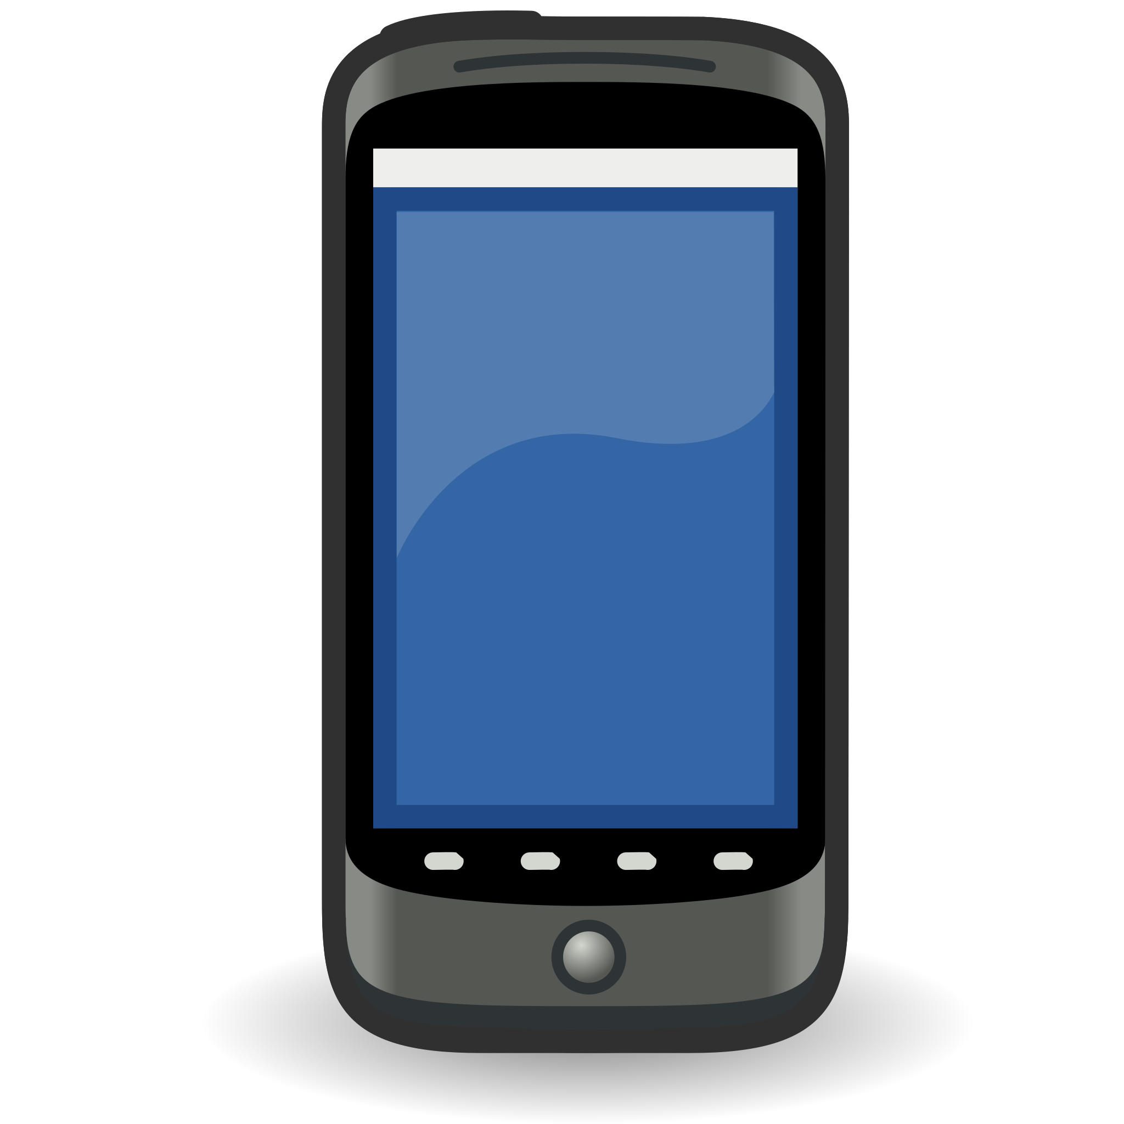
How Computing Devices Impact People
IC
A bad impact is one that hurts you or another person; or that makes your family or community feel or look bad.
A bad impact would be sending or receiving a mean text message.
Hey pig face! Why don’t you go back to the farm!
No one likes you!
Oink! Oink! Oink!
8.1.2

Slide 24
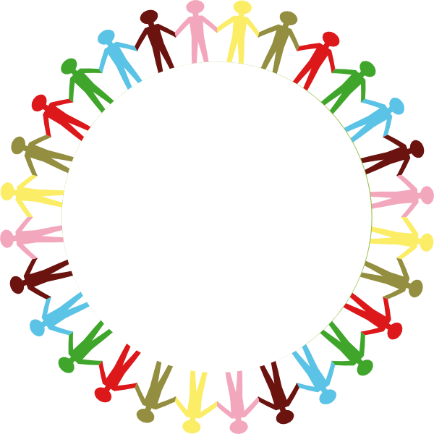
How Computing Devices Impact People
IC
Computing devices impact every part of modern life.
communication
shopping
education
work
entertainment
healthcare
social interaction
creative expression
personal organization
8.1.2
access to information

Slide 25
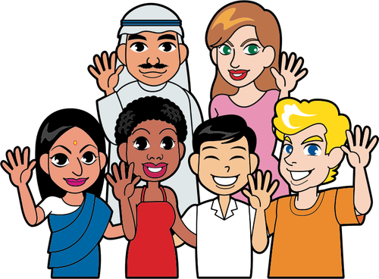
How Computing Devices Impact People
IC
We will investigate how one of the following areas impact modern life.
communication
education
entertainment
shopping
8.1.2

Slide 26
How Computing Devices Impact People
IC
Computing devices are used to communicate: Computing devices, particularly smartphones and computers, have revolutionized how people communicate.
email,
instant messaging,
social media platforms,
video conferencing, and
voice over Internet Protocol (VoIP)
These communication tools have made it have made it easier for people to stay connected across large distances
8.1.2

Slide 27

How Computing Devices Impact People
IC
Computing devices are used in education:
Teachers
  record attendance,
  grades
Students
  online learning
  practice a skill,
  find information,
  play games.
8.1.2

Slide 28
How Computing Devices Impact People
IC
Computing devices are used for entertainment.
streaming services for music, movies, and television shows to
video games and
interactive multimedia experiences.
These devices are important to how people get media because they offer a wide range of entertainment options.
8.1.2

Slide 29
How Computing Devices Impact People
IC
Computing devices have transformed shopping through E-commerce platforms.
Online marketplaces offer
convenience,
choice, and
lower prices compared to traditional brick-and-mortar stores.
Mobile payment systems
make it easier for people to make purchases
8.1.2

Slide 30

Positive Impact On People
I
C
Negative Impact On People
On the next slide, work with a partner to select a computing device. Research positive and negative impacts and then fill out the chart.Be prepared to report out on your findings.
8.1.2

Slide 31
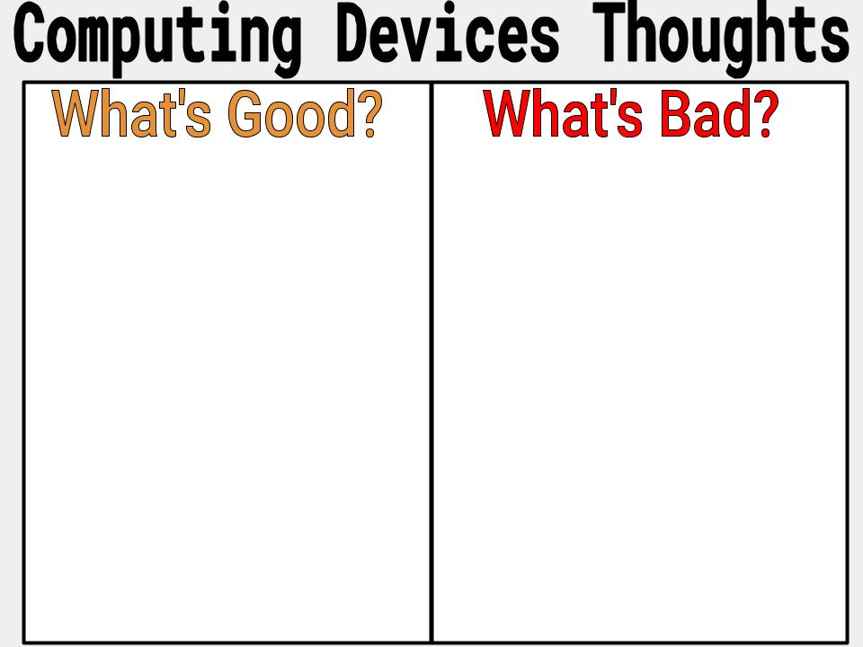
Team Members: Device Name:
I
C
8.1.2

Slide 32
Resources
C
S
Positive and Negative Impacts of Technology
OpenAI. (2023-2024). ChatGPT (3.5)
TechTerms.com
Impacts of Social Media
Kucuk, Turgay (2023) Technology Integrated Teaching and Its Positive and Negative Impacts on Education. International Journal of Social Sciences & Educational Studies, 10 (1). pp. 46-55.
8.1.2

