Slide 1
Grade 3-5
Computer Science Education Primer
Katherine G. Herbert, Ph.D.
Director, Montclair Computer Science Education Hub
Elliot Hu-Au
Assistant Professor, Montclair State University
Sumi Hagiwara, Ph.D.
Director, Montclair Computer Science for Everyone Everywhere Program.

Slide 2
Introduction

Slide 3
Schedule - Tentative (we may run over on sections but we will be out by 3:00pm)
9:00am - 9:05am - Welcome
9:05am - 9:15am - NJDOE Required Data Collection
9:20am - 9:30am - Icebreaker
9:30am - 10:30am - Basics of Computer Science
10:20am - 10:30am - Break
10:30am - 11:15am - Computer Systems
11:15am - 12:00am - Networks and the Internet
11:45am - 12:30pm - Working Lunch - Pedagogy and CS Education
12:30pm - 1:15pm - Data and Analysis
1:15pm - 2:30pm - Algorithms and Programming (please take break on your own during programming)
2:30pm - 3:00pm - Impacts of Computing and

Slide 4
Community of Learners
Styles we adopt in this session …
We are friendly and hopefully building friendship - please welcome people - especially singletons who you do not know to your table - and feel free to use first names.
We are Inclusive and try to design for UDL.
We are Positive - everyone has a voice, perspective and contribution to give.
We try to Laugh - this is a long day with a lot of content we may not have ever seen before so we are going to try to have fun.
We Accept there is no one authority or expert in the room - everyone has human moments and we support each other through them.
We are Safe - personal stories should stay here unless you have the express permission of the person.

Slide 5
Today will be …
Jammed - packed - while we will take short breaks please feel free to give yourself breaks as we go along.
Fun
Address Some of Your Questions
Inspire New Questions
Frustrate You - In a Good Way
Be a “Springboard” for you to Explore the Standards

Slide 6
Today will not be …
Complete and exhaustive and you will have a perfect understanding of everything computing by the end of these lessons
You will not have a complete understanding of CS or the Standards but you will be in a better position to begin your journey.

Slide 7
Data Collection
Please Please Please fill out your Pre-Survey Data
If you don’t … we will find you!!!
Places to get the Pre-Survey Data:
Best: Your District Content Management Systems like Genesis, LinkIt!, or other places where you grade and get student information.
Better: New Jersey School District Performance Reports
  https://rc.doe.state.nj.us/
Okay and Acceptable: National Center for Education Statistics IPEDS
  https://nces.ed.gov/ipeds

Slide 8
Icebreaker - My CS Emoji
Draw two pictures - one on each side of your piece of paper.
Happy Emoji - Side one - tell us something you love about computers or computer science. - Can be a picture, words - anyway you express yourself
Grumpy/Sad Emoji - Side two - tell us something that stresses you about computers or computer science (makes your feel grumpy or sad)

Slide 9


Debrief
HAPPY
I love being in contact with my kids
Connecting instantly
Excitement of students
Timeline of Photos and connection to friends and famiy
Al the new devices
Risk Taking
GRUMPY/SAD
EMAIL
Connecting instantly
New standards
When it doesn’t work
Expectations of CS teachers
Huge high stressor

Slide 10
Theme for 3-5 Computer Science Education
When we look at CS for 3-5, it is continuing on building on the 3-5 CS Education. K-2 it is about identifying things that we see in everyday life and trying to put the formal words (terminology) to the things we see. Grades 3-5 looks at trying to understand the whys of CS, while K-2 is about the whats..
It is about trying to observe the patterns we are encountering and apply them to other areas - a lot of abstraction.
When considering the standards for 3-5, a lot of the standard is identifying things and finding patterns:
Vocabulary
How do we use things? Why are they used in that way?
What problems do we encounter?
How can we fix these problems?
What am I feeling, and how can I work through those feelings to find solutions?
With 3-5, keep it short, simple, as kinesthetic as possible (make them move and use sensory oriented techniques), help them to identify their emotions and work through them, and try to have fun.

Slide 11
Computer Science
an Overview for 3-5 Teachers

Slide 12
Computer Science Definition
What is Computer Science?
Computer Science is the study of the generation, storage, transportation, and manipulation of data.
In the classification of sciences, computer science is a FORMAL SCIENCE - a science like how mathematics and physics are defined as a science.
Other types of sciences besides Formal Sciences: Natural Science, Social Science, Applied Science and Interdisciplinary Sciences.
Computational Thinking is part of the mindset for Computer Science and helps us with problem solving.
Computer Science for Everyone, Everywhere (CSEE)

Slide 13
Data
So if data is so central to computing, what is data?
Data is “something” that holds meaning for the human-user that the computer will do an action on. Note - there is no truth value on this other than the importance to the user. it is often the codes used to represent those somethings to a user.
Data can be interpreted into Information. Information is the meaning the user imposes on the data.
Information can be analyzed for Knowledge. Knowledge is the observable patterns within the information that we can measure with a level of confidence.
Knowledge that we can apply reliably is Wisdom (we don’t often talk about that ;-) )

Slide 14
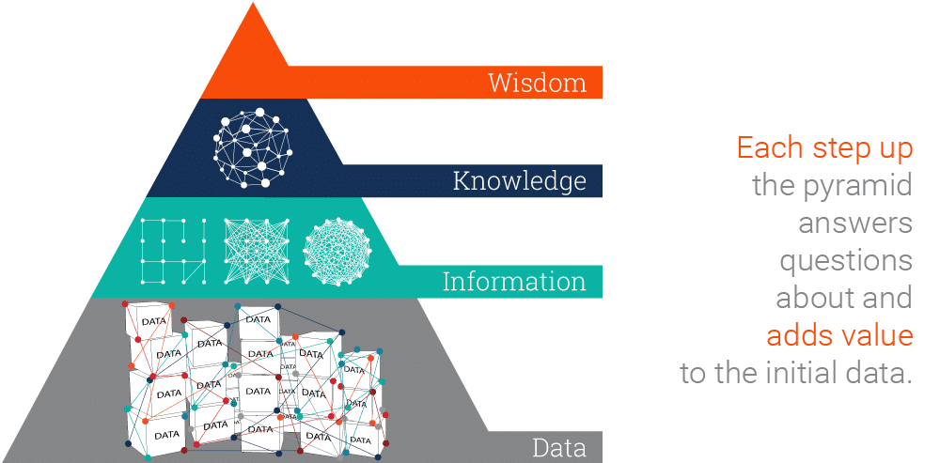
Data
Image source: https://www.ontotext.com/knowledgehub/fundamentals/dikw-pyramid/

Slide 15
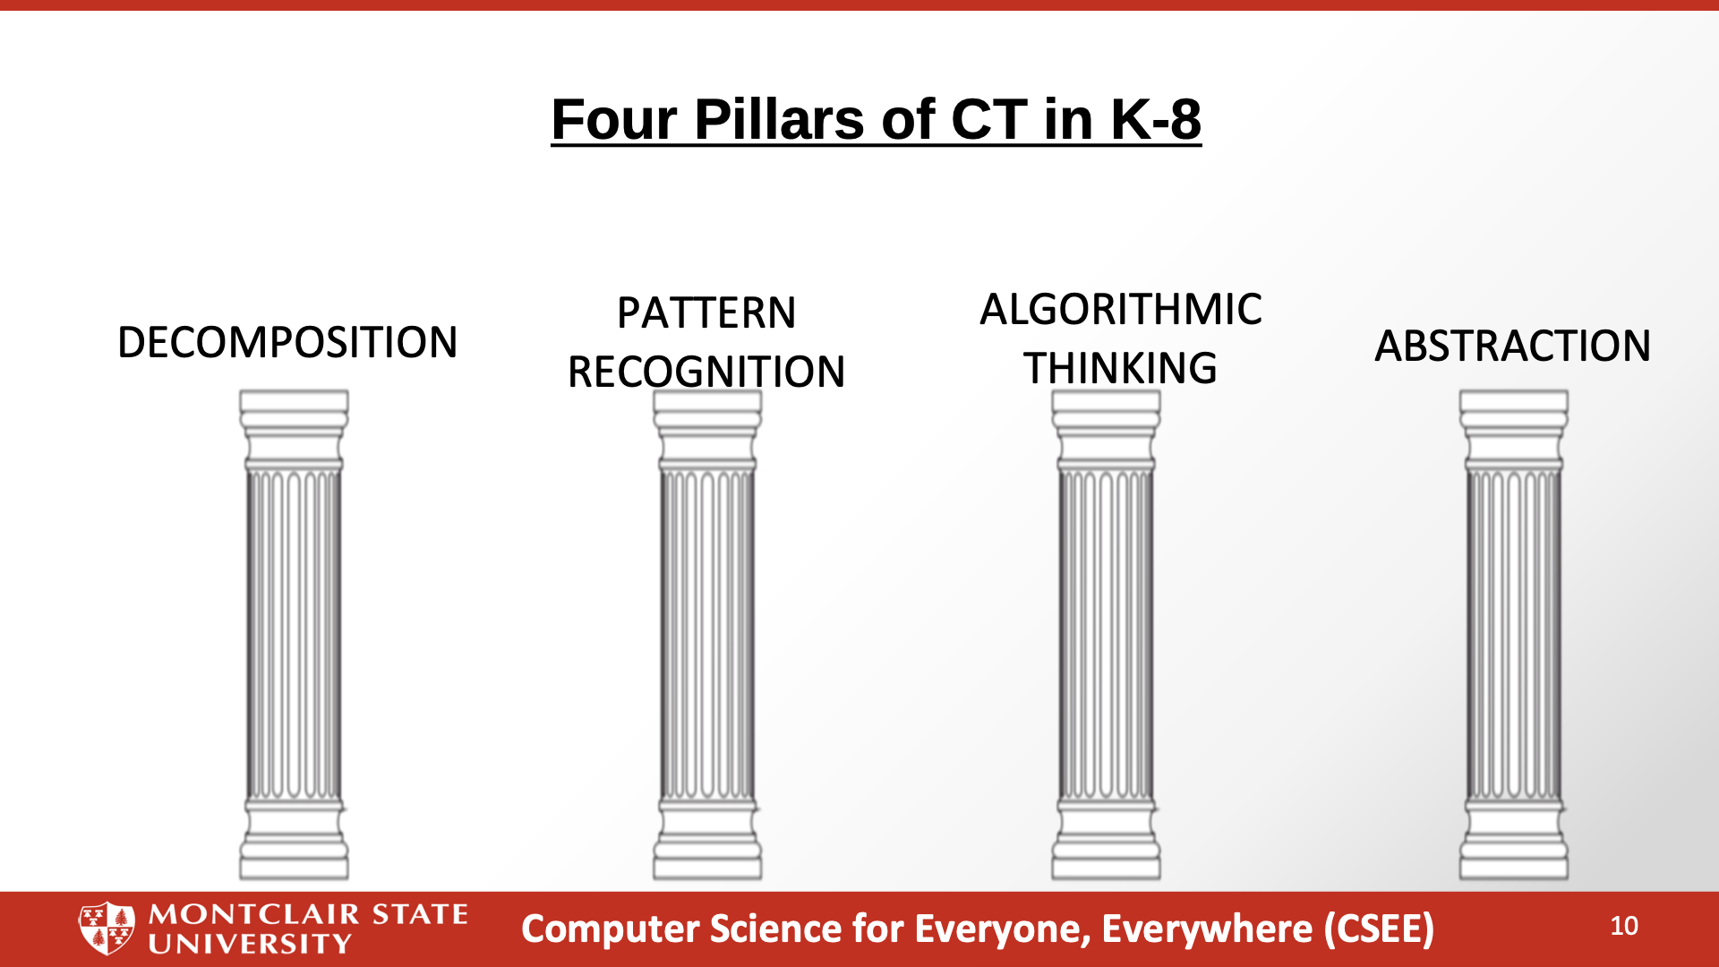

Slide 16
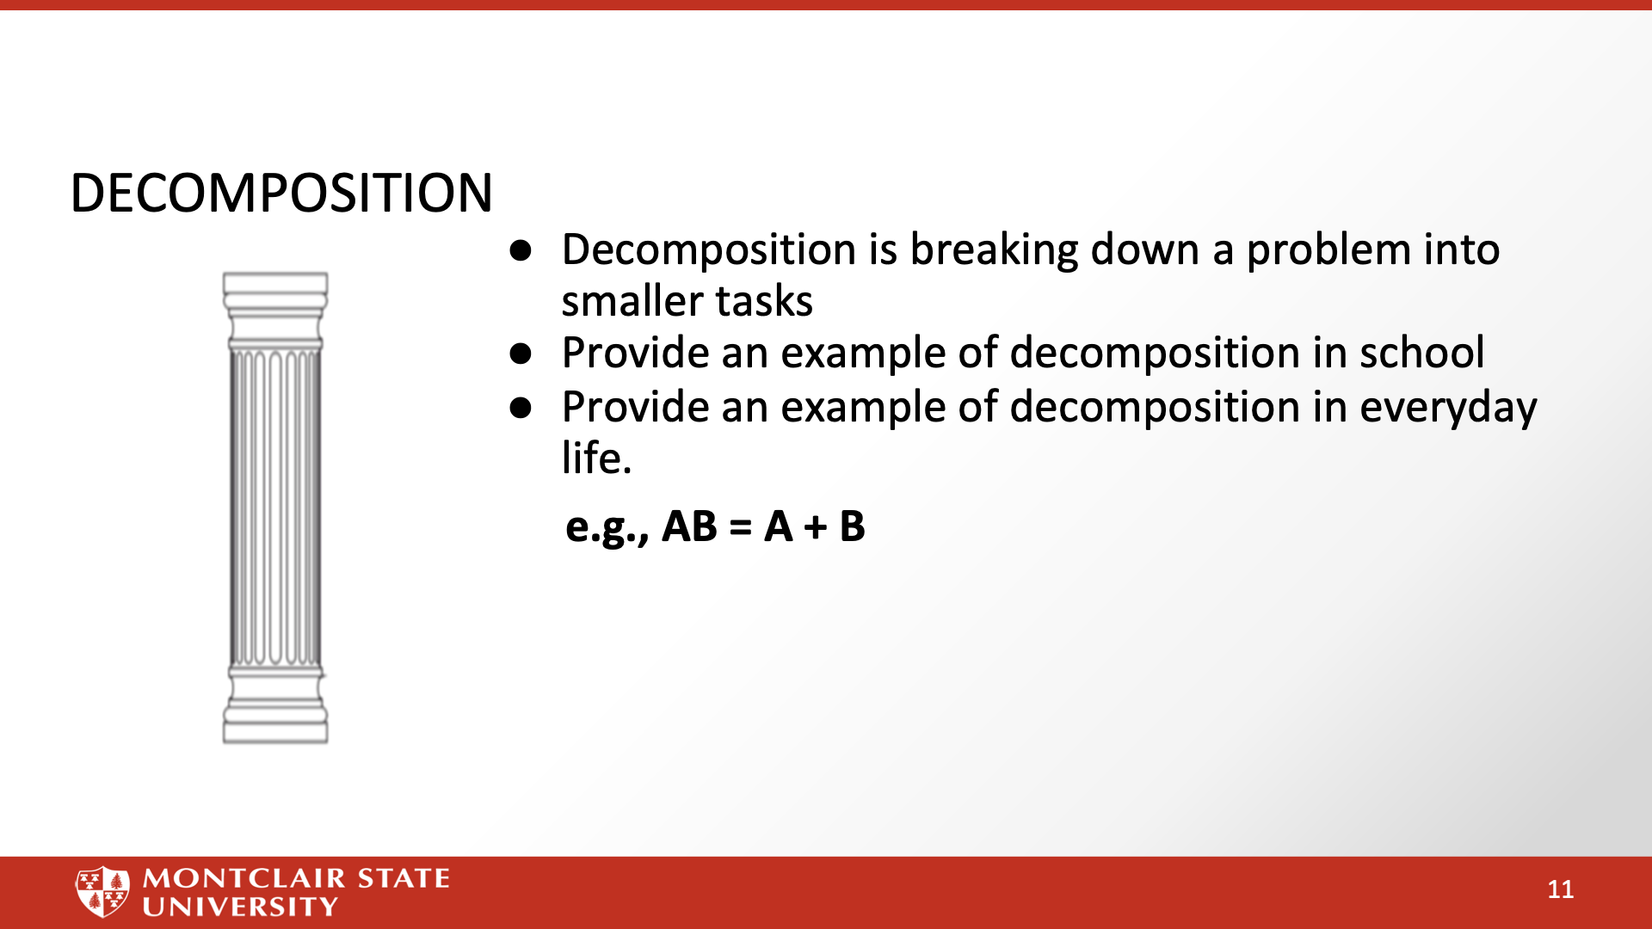

Slide 17
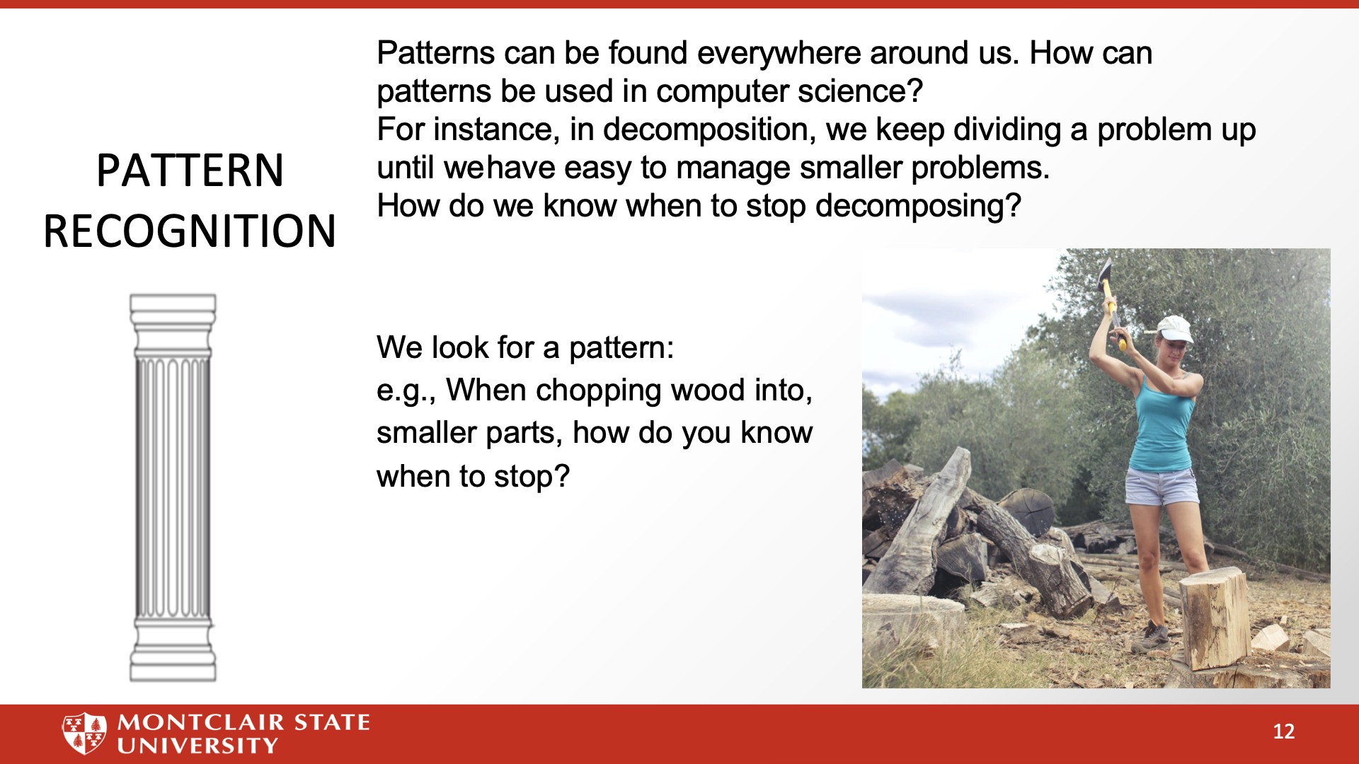

Slide 18
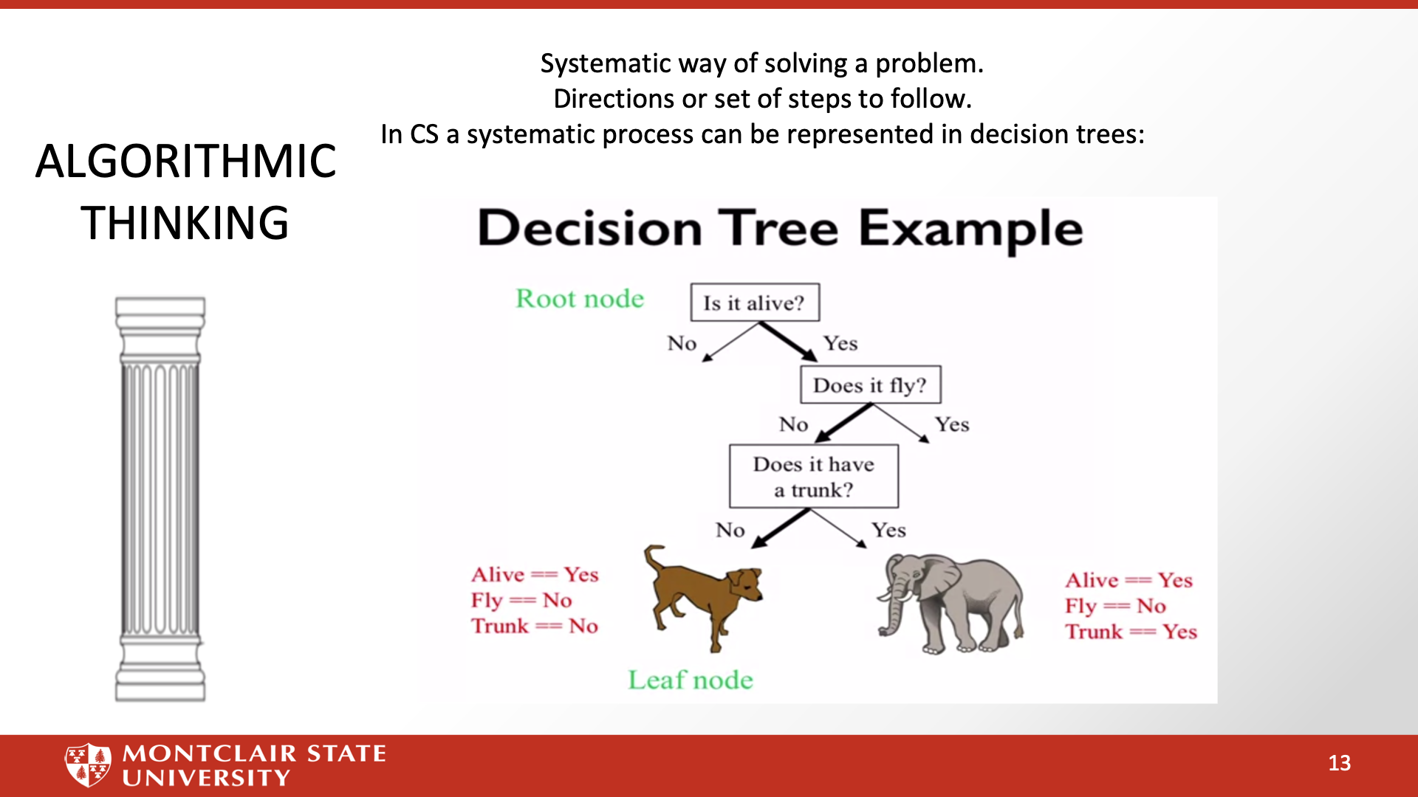

Slide 19
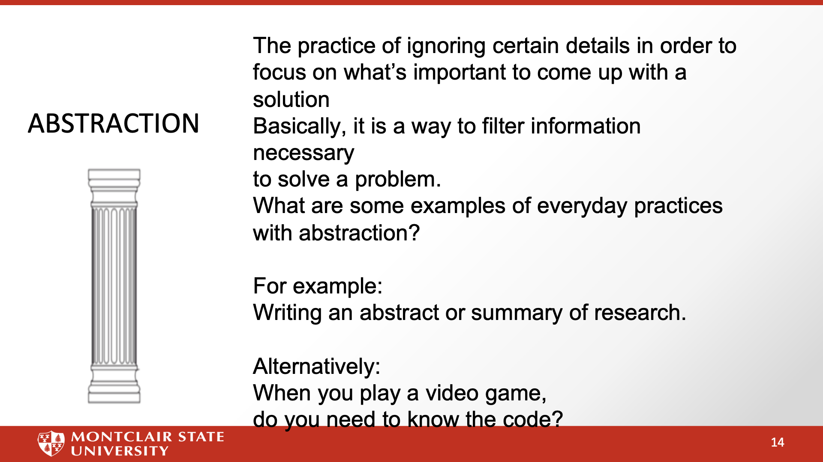

Slide 20
Computer Science and the Standards –
What are we trying to accomplish ..
New Jersey has nearly 16,000 tech business establishments. The tech sector accounts for an estimated $56 billion of the state's economy, or 9.6% of total economic output. It is the ninth highest dollar value contribution among the 50 states and the District of Columbia. (I like to call us the Silicon Shore …)
New Jersey is generating 17,000 jobs in tech a month, while only 17% of NJ High Schoolers are considered proficient in CS.
New Jersey Universities only generate about 3,000 graduates a year - no where near the growth the state needs.
Computer Science is the fastest growing science field that can give students access to lucrative career paths and lifetime skills. However, computer science is more than just a one-course experience. It needs to be integrated into children’s learning
Citations: https://njbmagazine.com/njb-news-now/strong-decade-of-growth-for-nj-technology-industry/

Slide 21
Why Grades 3-5 Students
We often get feedback of why students so young?
Computer Science isn’t doing things on the computer - even professional computer scientists don’t spend as much time on the computer as people think.
Computer Science is the intersection of a lot of disciplines - Math, Engineering, Physics, Logic and Philosophy - and applied to almost every other domain … Understanding it and developing skills over time will help students to have a better understanding.
Grades 3-5 are transitioning into being readers and being able to work independently. Children’s abilities vary widely in classes as well as their interested.
Grades 3-5 also see the emergence of various biases among students - We have to be very aware of the the social emotional learning components.

Slide 22
Computer Systems

Slide 23
NJ SLS CS Standard - In a Nutshell
By the end of Grade 5
• Computing devices may be connected to other devices to form a system as a way to extend their capabilities.
• Software and hardware work together as a system to accomplish tasks (e.g., sending, receiving, processing, and storing units of information).
• Shared features allow for common troubleshooting strategies that can be effective for many systems.

Slide 24
Computer Systems Standard
Core Idea | Performance Expectations
Computing devices may be connected to other devices to form a system as a way to extend their capabilities. | 8.1.5.CS.1: Model how computing devices connect to other components to form a system.
Software and hardware work together as a system to accomplish tasks (e.g., sending, receiving, processing, and storing units of information). | 8.1.5.CS.2: Model how computer software and hardware work together as a system to accomplish tasks.
Shared features allow for common troubleshooting strategies that can be effective for many systems. | 8.1.5.CS.3: Identify potential solutions for simple hardware and software problems using common troubleshooting strategies.

Slide 25
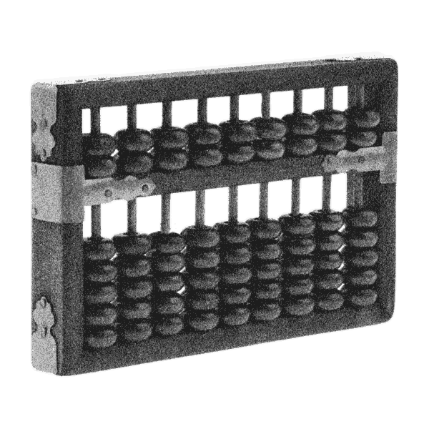

The First Computer
Computer Science for Everyone, Everywhere (CSEE)
Notes:
The first computer is generally considered to be the abacus. It was a manual computer that allowed for rapid calculations.

Slide 26
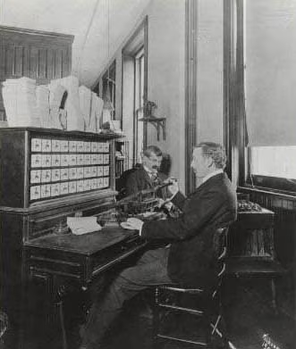
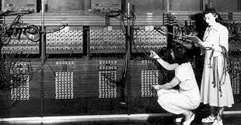
Hollerith Machine ENIAC
Notes:
Next came mechanical computers - computers that used simple machines to do the computations (Hollerith’s tabulating machine).
With the turn of the 20th century - data is exploding and everyone wants to do computations quicker - especially the military.

Slide 27
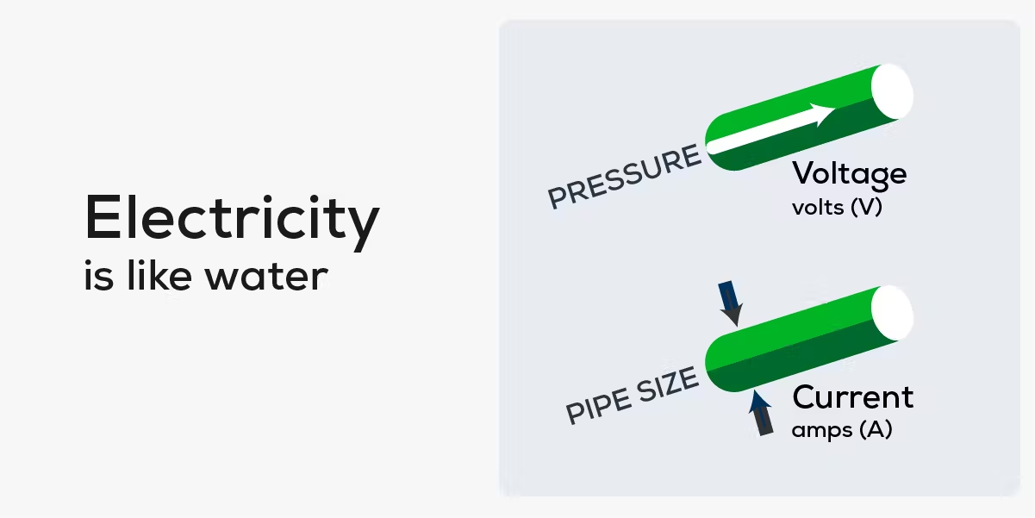

Electricity and computers…
https://palmetto.com/learning-center/blog/understanding-solar-power-electricity-terms-volts-amps-watts
https://www.thegeekpub.com/243163/what-is-resistance-ohms-electricity-basics/
Computer Science for Everyone, Everywhere (CSEE)
Notes:
Electricity offered a way to work very fast - theoretically at a speed close to light.
However, there are problems - namely electricity and reliability.

Slide 28
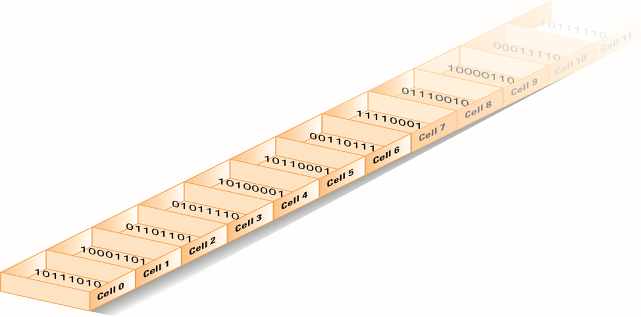
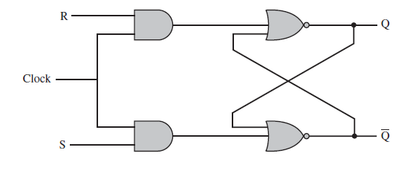
Computer memory - bits
Notes:
If we assign presence of voltage (on) the concept of “1” and absence of
voltage (power off) the concept of zero, we then had a math system to help us design ways to process the electricity with 100% reliability - Binary math!
To this day, everything on the modern computer at its most very basic level uses binary math. The circuits of the computer do approximately 100 math options, 20 of which are used frequently.

Slide 29
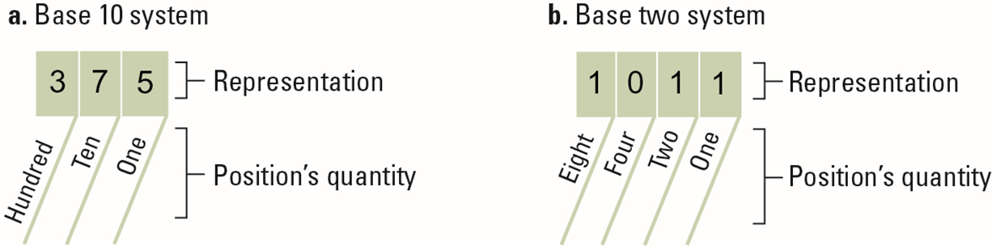
Counting by binary
Notes:
A Decimal Computer was just not practical. However, we could still work with the concept of power on and power off!
Math also had a ton of work on number systems - that is a number system with bases other than 10. And the cool thing was there are clear rules on how to convert numbers from one system to another.

Slide 30
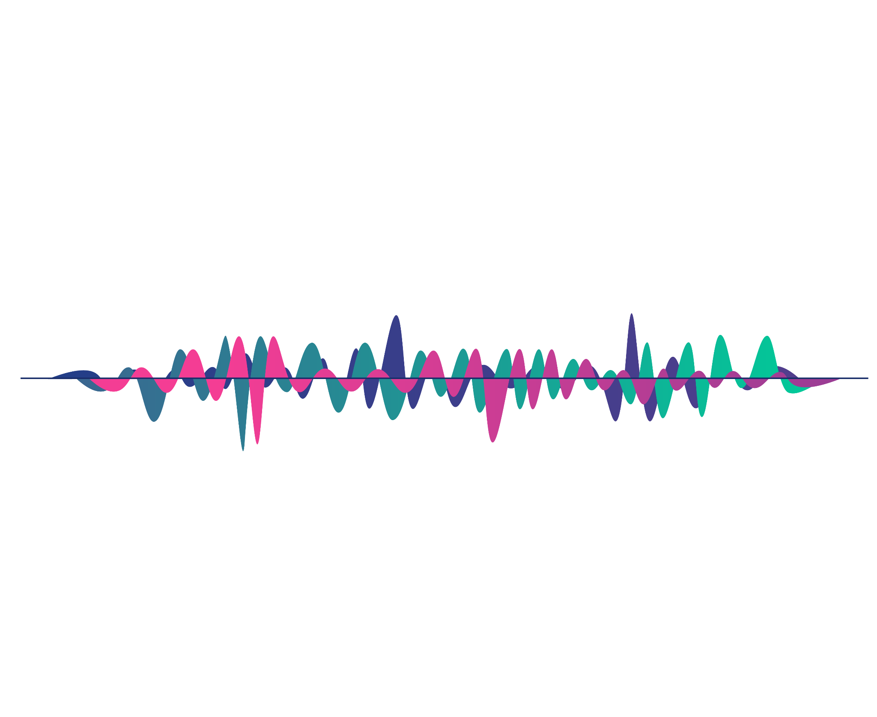

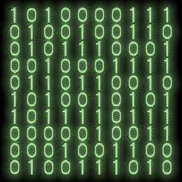
Data and Binary
Notes:
All data must be able to be mapped onto the binary number system. This type of data is called discrete data.
We can do a lot of representation with this - most text can be represented this way. Pictures used binary values to represent the presence of certain colors in a picture element or pixel. We can record sound waves and the play rapid pictures with sound over them to make movies.
Some things cannot be represented by the computer. For example - a computer cannot represent a circle completely - only an approximation of it.

Slide 31


Computer Systems
How do they talk to each other?
How does the computer know what to do?

Slide 32
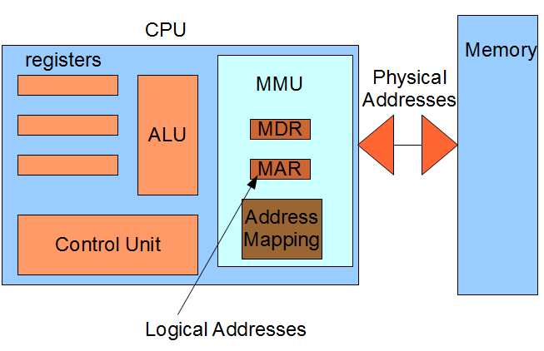
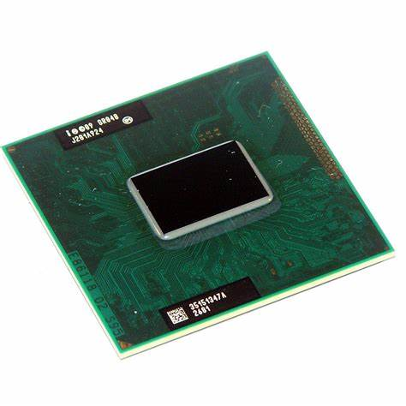
The Central Processing Unit: The Brains of the Computer
Computer Science for Everyone, Everywhere (CSEE)
Notes:
The ALU is responsible for carrying out the arithmetic and logical operations of the CPU. It consists of an arithmetic logic unit (which performs arithmetic and logical operations) and a set of registers (which store data and instructions).
The control unit is responsible for fetching, decoding, and executing instructions. It also controls the flow of data between the various components of the CPU.
The registers are used to store data and instructions. There are four types of registers: general-purpose, floating-point, control, and status. General-purpose registers can be used for any purpose. floating point registers are used for storing floating-point numbers. Control registers or unit contain control signals that tell the various components of the CPU what to do. Status registers contain information about the current state of the CPU.

Slide 33
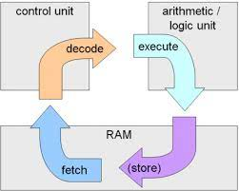
Machine Cycle
Computer Science for Everyone, Everywhere (CSEE)

Slide 34
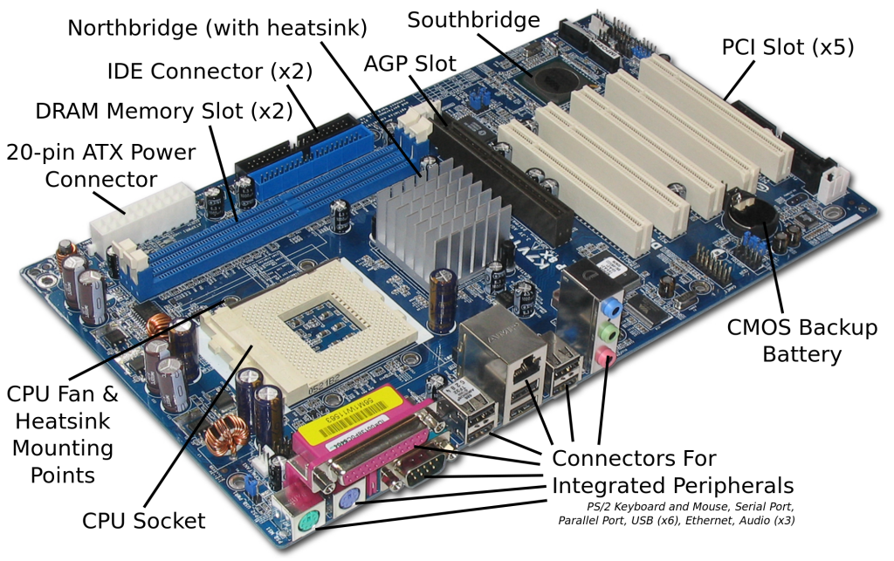
Motherboard and integrating with additional hardware
Computer Science for Everyone, Everywhere (CSEE)

Slide 35

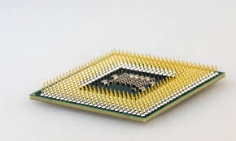
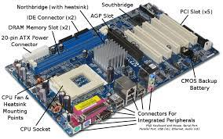
Hardware and Software Together - General Computer
The CPU does the “math” to create the actions”
The hard drive holds our programs. When we want to use the program, it is loaded into memory and run on the CPU.
The Motherboard holds the CPU and connects it to other devices like memory, hard drive USB - peripherals.
Computer Science for Everyone, Everywhere (CSEE)

Slide 36
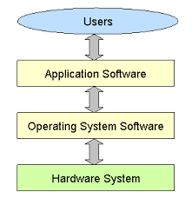
Hardware and Software Together
The program that does the thing I want to do.
The Program that manages all
of the Computer’s resources
Computer Science for Everyone, Everywhere (CSEE)
Notes:
Software is a set of programs that are used to help the computer complete a task.
Computers use to have their programs “hard coded” into them - that is if you wanted to change the program, you had to change the physical hardware.
Now, software lets a mass produce general purpose computers and then use software to do different things with them.
Software interfaces for the human user so that the user gets an experience that they expect, but the actions or directions the user wants to perform are translated by software into the 1’s and 0’s the computer needs to run a task.
All software reduces its actions down to about 20 mathematical actions on the Arithmetic Logic Unit.
Programming is a component of creating software.

Slide 37
Troubleshooting
First - don’t panic. Seriously. Every teacher who taught in covid and most students are not experts in troubleshooting basic problems on the computer. You got this.
Make a checklist for yourself and run through it:
Check all of your wires - did something fall off or out of place?
Check your internet connection - it's often not you!
If software is not running properly - close it - this works for a traditional computer and your phone.
If it is still malfunctioning, turn off the computer - wait a good 20 seconds, and turn it back on.
Computer Science for Everyone, Everywhere (CSEE)

Slide 38
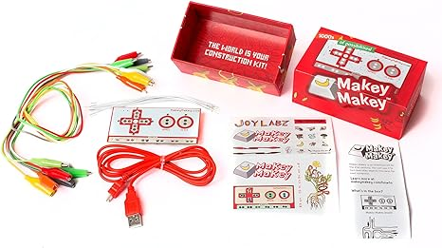
Connections for a Computer System
Computer Science for Everyone, Everywhere (CSEE)

Slide 39
Connections for a Computer System
https://makeymakey.com/pages/plug-and-play-makey-makey-apps
Or Google “makey makey plug and play”
8.1.5 Computer Systems Standard Core Ideas
Computing devices may be connected to other devices to form a system as a way to extend their capabilities.
Software and hardware work together as a system to accomplish tasks (e.g., sending, receiving, processing, and storing units of information).
Computer Science for Everyone, Everywhere (CSEE)

Slide 40
Troubleshooting - When do I need help?
Sometimes the problem can’t be fixed this way. Here are some clues:
If the computer is slowing down: This usually means the computer is having storage issues:
Close some applications!
Reboot
If this isn’t working, check to see if your hard drive is too full - you probably need at least 4 Gigabytes of Storage.
Does your computer have enough memory? - if no, get more
What is your bus speed? - if too slow, you are buying a new computer.
If I get a odd thing on my monitor
If possible, use an HDMI or USB cord to connect to another monitor - like your smart tv. See if it works fine that way.
If I get a black or blue screen - there may be a serious problem. Try to make sure your back up the computer - then try to run a diagnostic. If it persists, you may need to do more research or get help.
Computer Science for Everyone, Everywhere (CSEE)

Slide 41
Brainstorming
8.1.2.CS.1: Select and operate computing devices that perform a variety of tasks accurately and quickly based on user needs and preferences.
Issues:
8.1.2.CS.2: Explain the functions of common software and hardware components of computing systems.
Issues:
8.1.2.CS.3: Describe basic hardware and software problems using accurate terminology.
Issues:

Slide 42
Lesson 1 - What is a Computer and how can I connect to one?
Many children today are interacting with computers and they don’t even realize it.
Gen Xer Computer: classical desktop/laptop computer
Generation AI Computer:
A stuffed Dog named Violet or Scout
Amazon Echo
Their TV Set
Their Family Car
Digital Road Signs - Times Square Billboards
Phone
Watch
Gaming System
So What is a Computer?

Slide 43
Lesson 1: Identify a Computer
Collect some computing devices Or Pictures of Computing Devices - the weirder the better - and ask students - is this a computer or is it not.
A Computer will have:
Some processing element
Will take in data in some form and do something with that data

Slide 44
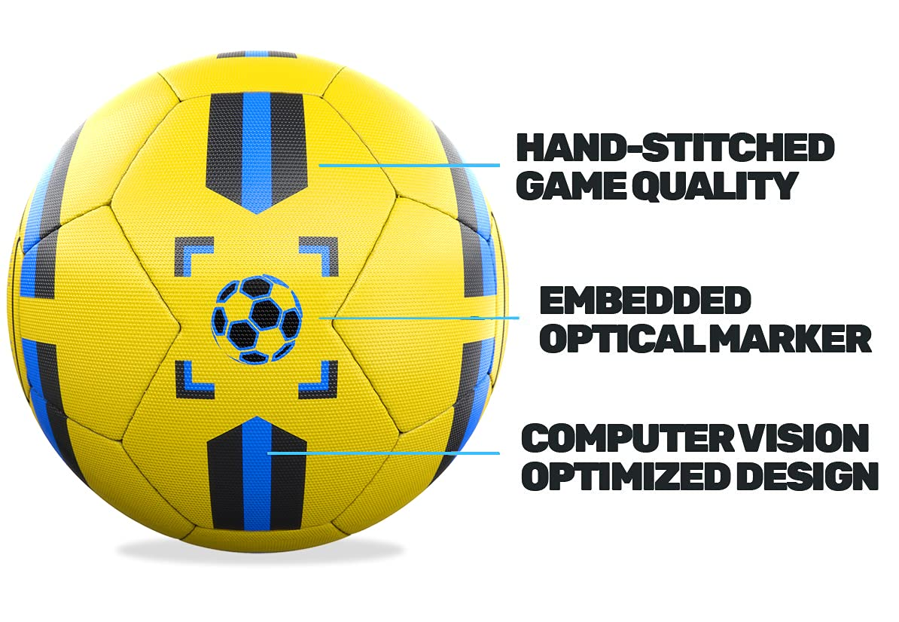
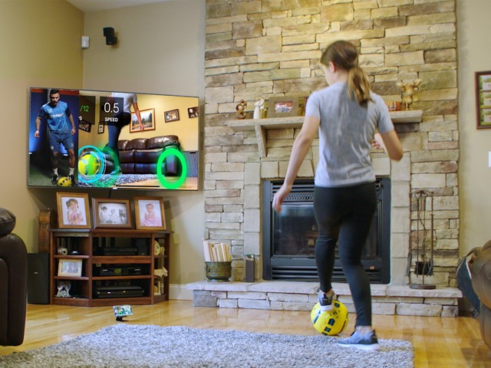
Lesson 1: Computer or Not a Computer?

Slide 45
Lesson 1: How do you connect?
First, identifying the computing device is important. However, next, it is important to understand the different ways to connect the device to make it work.
Gen Xer Computer: classical desktop/laptop computer - wires
Generation AI Computer:
A stuffed Dog named Violet or Scout - USB cable
Amazon Echo - wireless
Their TV Set - wired and wireless
Their Family Car - through the cigarette lighter
Digital Road Signs - Times Square Billboards - remote management software over the Internet
Phone - USB or Lightning Cable, Wifi, WIreless, Bluetooth
Watch - USB or Lightning Cable, Wifi, WIreless, Bluetooth
Gaming System - USB or Lightning Cable, Wifi, WIreless, Bluetooth
Mouse or keyboard - Bluetooth, USB, PS/2 Connector
Internet - Wireless, Wifi, Ethernet Cable.

Slide 46
Lesson 1 Identifying a Computer
Have students discuss what they observe are the things that make something a computer. Have students discuss challenges that they have encountered in connecting with the computer.
Note - there are computers that are not driven by electricity - a calculator or an abacus are computers.

Slide 47
Lesson 1: Identifying a Computer
Video Lesson: “What is a Computer” https://www.youtube.com/watch?v=RmbFJq2jADY
Hub Lessons:
Computer Systems: https://drive.google.com/drive/folders/1m6uCWHWwdqGCeQ7CYr2wsgD6YPT92D3Z?usp=share_link
3-5 Lessons:
What is a Computer? https://docs.google.com/document/d/1rXmSgml0L3UZY_X-ZgXjW2Kr2VTbxTBeNv3_nLQhE-8/edit
How does a Computer Work? https://docs.google.com/presentation/d/1DjqK6blkDJSJ6e94PFO804l1ar-2Ojr4ebtP4OIW040/edit#slide=id.p
Links from Code for Fun - https://www.codeforfun.com/LessonPlans/

Slide 48
Lesson 2 - Make your Own Computer
Teacher Guide:
https://drive.google.com/file/d/1jFhZ71fsOFAS1EDAeHDdURcg4_FVl3o2/view
This lesson has students “make” their own computer with art supplies.
Resources for Instruction:
https://www.helloruby.com/play/2
Video to explain lesson:
https://www.youtube.com/watch?v=Pih_5TlpngY

Slide 49
Computer Systems Standard
Core Idea | Performance Expectations | Lesson Ideas
Computing devices may be connected to other devices to form a system as a way to extend their capabilities. | 8.1.5.CS.1: Model how computing devices connect to other components to form a system. | Analyze how to connect various computing device - like TV - to a computer.
Software and hardware work together as a system to accomplish tasks (e.g., sending, receiving, processing, and storing units of information). | 8.1.5.CS.2: Model how computer software and hardware work together as a system to accomplish tasks. | Makey-Makey Lesson
Shared features allow for common troubleshooting strategies that can be effective for many systems. | 8.1.5.CS.3: Identify potential solutions for simple hardware and software problems using common troubleshooting strategies. Networks and | Understanding how security works in the classroom.

Slide 50
Further Resources
Lesson: Human Computer
https://www.educationworld.com/a_tech/tech/tech195.shtml
https://www.azed.gov/sites/default/files/2019/09/Kindergarten%20CS%20Lessons.pdf?id=5d72d0e91dcb251298c0faa2
https://www.sfusd.edu/learning/curriculum/elementary-school/computer-science/k-2-computer-science-curriculum

Slide 51
Break

Slide 52
Networks and the Internet

Slide 53
Networks - why learn them
There are two major issues at play with network and why students need to learn them:
Students need to be able to understand how to connect their devices to the network.
Students need to learn how to protect both their data and their devices from any on-line security issues.

Slide 54
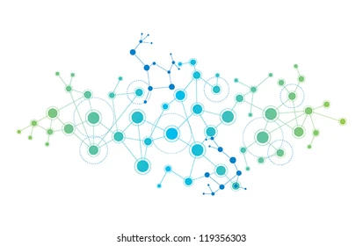
What is a network?
A connection between two or more computers so that they can share:
  Data
  Communication
  Printing
  Files
  Other resources
A Network is Modeled as:
  Line represents a connection
  A Circle (vertex, node) represents a “thing” we are connecting - a computer, a website, etc.

Slide 55
NJ SLS CS Standard - In a Nutshell
By the end of Grade 5
Information needs a physical or wireless path to travel to be sent and received.
Distinguishing between public and private information is important for safe and secure online interactions.
Information can be protected using various security measures (i.e., physical and digital).

Slide 56
What does that mean to us?
Hub:
Kids as young as 5 are connecting with their grandparents through zoom while playing with their Nintendo Switches, as their teachers post their grades to Genesis, while their parents are emailing and managing family life on a google calendar - Networks are a part of everyday life.
Security:
Kids are also dealing with Security at a younger age - we have to help them understand security concerns.

Slide 57
Teenagers and the Economics of Hacking
In 2017, families with members under the age of 20 lost $8.7 million in hacking schemes.
In 2021, families in this same demographic lost $101 million, in 2022 $210 million ($10 Billion National)
The United States is the primary target for most international hacking.
New Jersey is in the top 10 states for being targeted in hacking or malicious attacks.
*Source: FBI Internet Crimes Complaint Center https://www.ic3.gov/Media/PDF/AnnualReport/2021_IC3Report.pdf
/https://www.ic3.gov/Media/PDF/AnnualReport/2022_IC3Report.pdf

Slide 58
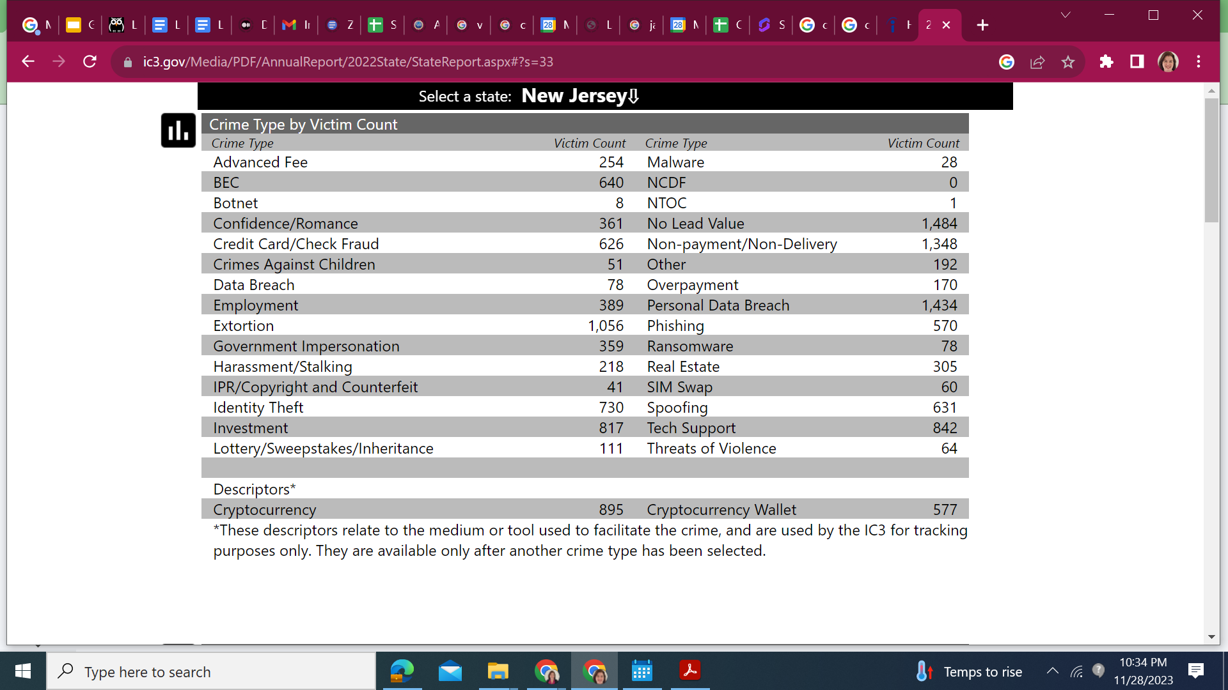
FBI 2022 Data - New Jersey

Slide 59
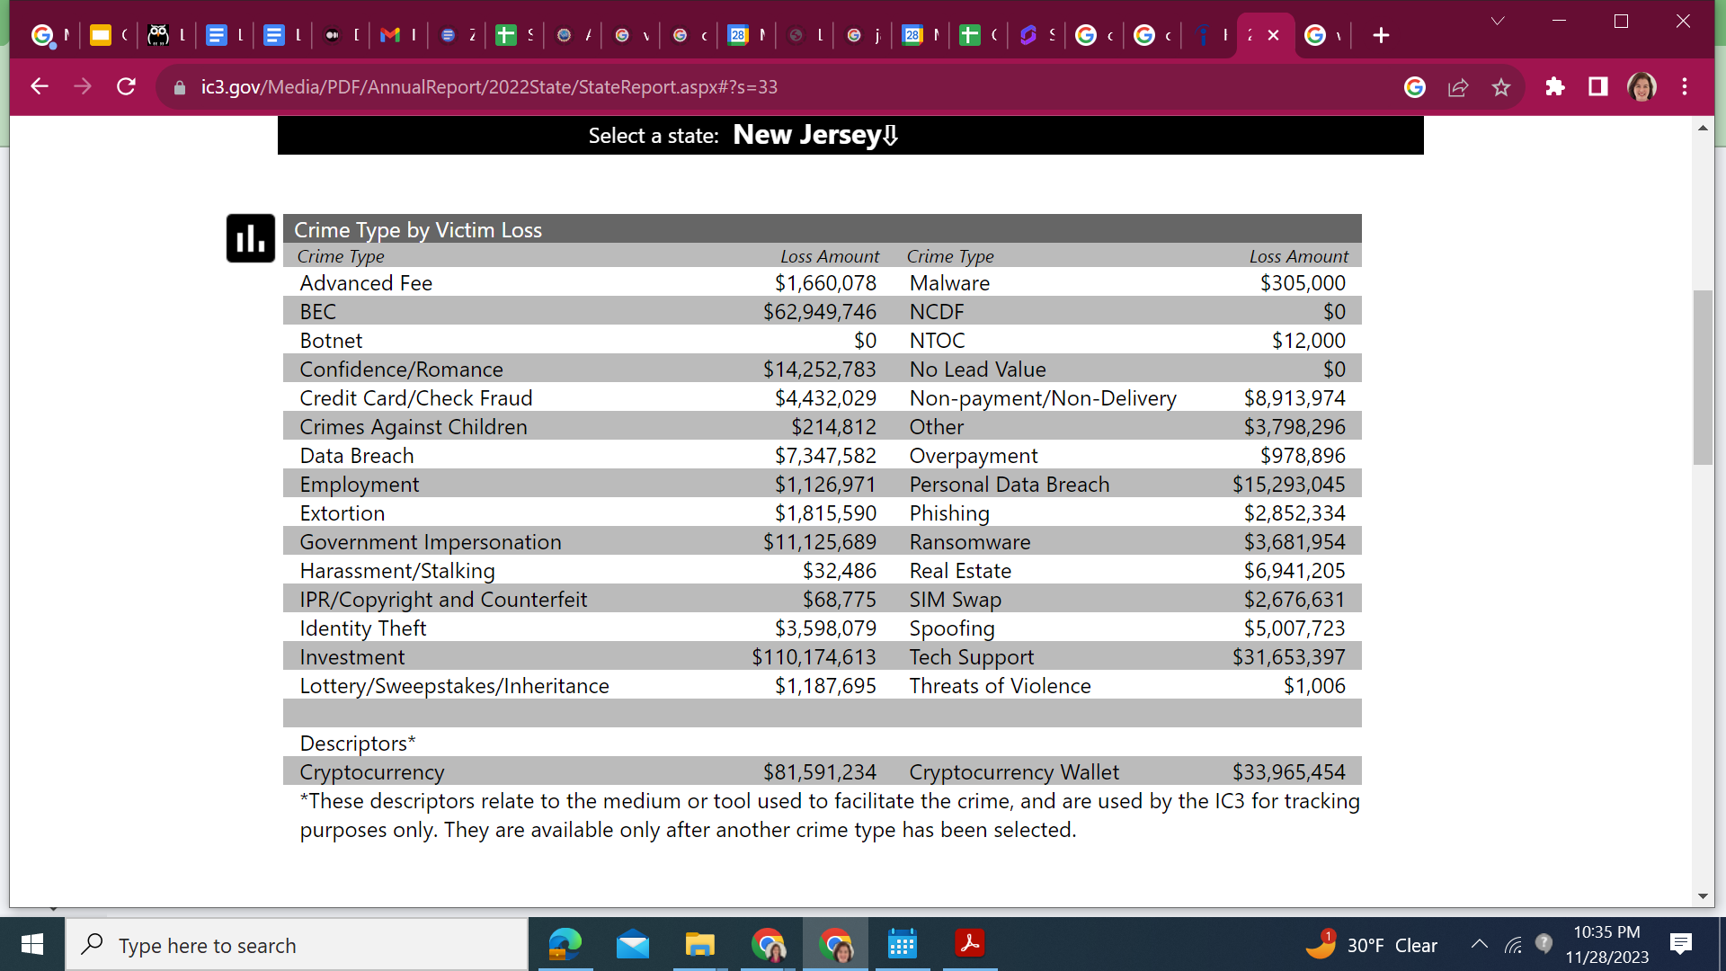

Slide 60
NJSLS - CS Standards
Core Idea | Performance Expectations
Information needs a physical or wireless path to travel to be sent and received. | 8.1.5.NI.1: Develop models that successfully transmit and receive information using both wired and wireless methods.
Distinguishing between public and private information is important for safe and secure online interactions. Information can be protected using various security measures (i.e., physical and digital). | 8.1.5.NI.2: Describe physical and digital security measures for protecting sensitive personal information.

Slide 61
Perspective - Networks and the Internet

Slide 62
Activity (Lesson): Send to my friend Niraj in California
Problem - I want to sent the dictionary to my friend Niraj in California. I do not have to include the hard bound cover.
Constraints: You are only allowed to send the physical dictionary that I am showing you in plain, letter envelopes. You have an unlimited number of envelopes to do this, but you must use the letter size envelope.
How do you send the dictionary?
Computer Science for Everyone, Everywhere (CSEE)

Slide 63
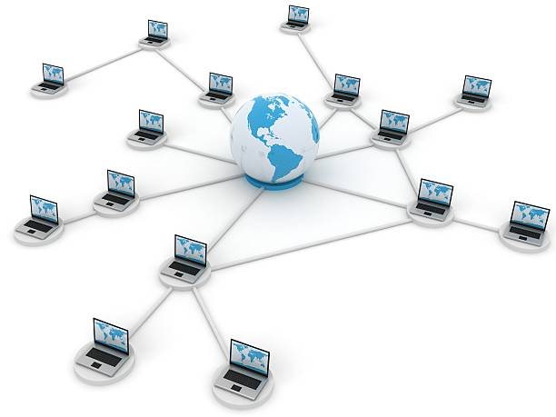
Data Communications
Data Communication or Networks is the study of the transport of data between two computing devices.
Essentially, how can we get computers to talk to each other and communicate?
Computer Science for Everyone, Everywhere (CSEE)
Notes:
A Packets Tale
https://youtu.be/ewrBalT_eBM?si=ZolPHQqNnCDPofsr

Slide 64
Networks - How are the Computers Connected
Your personal computer/tablet/phone connect to a network in one of two ways - either through a wired connection or a wireless connection.
Wired Connection: A wired connection is just that - a connection with wires! The first connections were like the old style phone lines - copper wire that was wrapped and insulated and then bound together.
Essentially for all media, they have to transports some form of the ones and the zeros. Copper wire could do this but we would lose data in the process - this is called signal degradation.
Fiber Optic cable came along and had better properties for sending a signal. Instead of using electricity, we use light pulses that follow a very thin glass wire that has some flexibility in it. We are now truly moving closer to the speed of light.
Wireless uses the properties of radio waves to send a signal. However, your need to be in “line of sight” of a router, tower, satellite. Signal has a lot of problems going through cinderblock, the hills of NJ, and is susceptible to outages when there is solar flare activity.
Computer Science for Everyone, Everywhere (CSEE)

Slide 65
Networks
A network is a connection between two or more computers that either share resources or what to communicate with each other.
Networks are described by a few features:
Topology - How is the network physically laid out?
Scope
  Personal Area Network (short-range - earbud with your phone and smart watch)
  Local Area Network (building/campus)
  Metropolitan Area Network (community)
  Wide Area Network (greater distances)
How is it connected: wired (bus) or wireless
Computer Science for Everyone, Everywhere (CSEE)

Slide 66
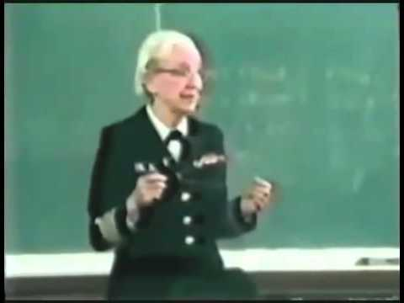
Networks - Speeds
Network speeds are managed in bits per second - we measure how many ones and zeros we can send in a second
When we talked about data last week, we talked about how we record data in Bytes.
Network speeds are measured in how many 1s and 0s I can send, not how many Bytes i send.
Most US homes have about 50 Megabits per second, or Mbps.
The average zoom/Google Hangout call is about 4 Mbps
Grace Hopper and the Nanosecond:
Computer Science for Everyone, Everywhere (CSEE)

Slide 67
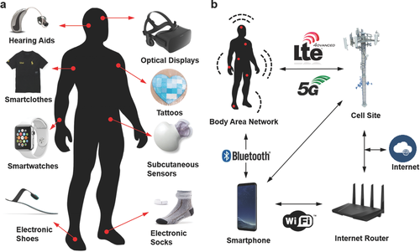
Example of Wearable
Wearable are taking the world by storm. Students will need to be able to navigate this world to understand their comfort levels and how to socialize and cope with this world.
Image Source: https://onlinelibrary.wiley.com/doi/full/10.1002/adma.201706910?_utm_campaign=mention57529&_utm_medium=inline&_utm_content=lnk241316896300&_utm_source=xakep

Slide 68
Brainstorming
• 8.1.2.NI.1: Model and describe how individuals use computers to connect to other individuals, places, information, and ideas through a network.
Issues:
How are we connecting?
• 8.1.2.NI.2: Describe how the Internet enables individuals to connect with others worldwide.
Issues:
Social connections
8.1.2.NI.3: Create a password that secures access to a device. Explain why it is important to create unique passwords that are not shared with others.
Issues:
• 8.1.2.NI.4: Explain why access to devices need to be secured.
Issues:

Slide 69
Lesson 1 - Understanding Connections - Wireless and Wired - Motivation for Teachers - Beacons of Gondor
https://www.youtube.com/watch?v=i6LGJ7evrAg

Slide 70
Debrief - Why are the Beacons of Gondor a Network?
Communicate very specific things - protocols
How fast was it? - quicker than horses
We needed the line of sight - message would have failed otherwise
Each station someone was ready - repeaters, network extenders
Security - no bugs or viruses because everyone can see

Slide 71
Lesson 1 - Building a Network Like the Beacons of Gondor
Supplies: Flashlights, String, scissors, index cards and paperclips
Part 1A - Wireless Networks
At your table - give everyone a flashlight.
Pair Up - Try to answer Yes/No questions with just the flashlight.
Next - try to create a chain of people like the Beacons of Gondor - how can you?
You want to send a message using your flashlights - How? Come up with a Scheme to do so

Slide 72
Beacons of Gondor - Evil Denathor Edition
Now while the Beacons are lit, the evil character Denathor does see that the beacons are lit and proceeds to do some things that are not so nice.
Look at the flashlight - how easy is it for people to intercept the message?
How can we keep the message private?
Notes:
Flashlight Code Sheets https://docs.google.com/document/d/120T8Lk6xesaUZuwNu9TSMCLdTdgvz9iAKfkws1vvAJA/edit?usp=sharing

Slide 73
Lesson 1A - Debrief
Pro | Cons | What concept does this address in Computing?

Slide 74
Lesson 1B - Wired Network
Let’s redo this - but now with String.
You have string on the table.
Pretend that each person at the table is a computer. Create a connection between at least two computers using your “Wire” which is the string.
How do you think the computers communicate?

Slide 75
Lesson 1B
Pick one person as your message sender, pick one person as your message receiver.
Sender: Write a sentence that is 5 words long - write each word - and only each word - on a index card. Do not tell your receiver what the message is. Shuffle the cards and “send” the cards over your wire to your receiver.
Receiver: Rebuild the message without any help or directions. Check with the sender.

Slide 76
Lesson 1B - Wired Network
Let’s redo this - but now with more connections
You have string on the table.
Pretend that each person at the table is a computer. Create a connection between every computer using your “Wire” which is the string.
How do you think the computers communicate? What problems do you think happen on this network?

Slide 77
Lesson 1B - Wired Network
Let’s redo this - but now with more connections
You have string on the table.
Pretend that each person at the table is a computer. Create a connection between every computer using your “Wire” which is the string.
How do you think the computers communicate? What problems do you think happen on this network?

Slide 78
Lesson 1B - Wired Network
Let’s redo this - but now with your own twist
Create your own layout for the network. It can be random (we call that ad hoc) or have a system to it. One rule - all computers must be reachable by every other computer.
How do you think the computers communicate? What problems do you think happen on this network?

Slide 79
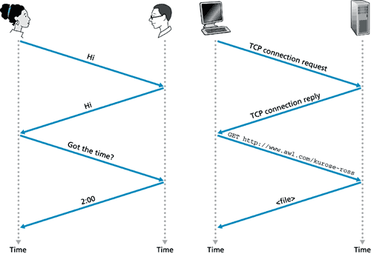
Protocols
Protocols are the system of rules by which communication happens.
Humans have protocols in their communication.
Computers use protocols to communicate with each other.

Slide 80
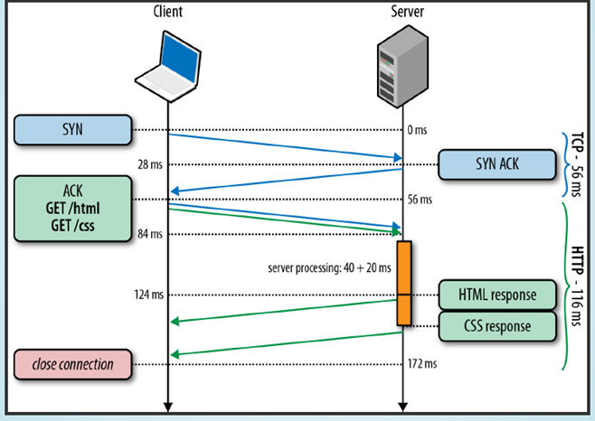
HTTP Protocol

Slide 81
Lesson 1 Debrief - Question: What were the differences between Wired and Wireless?
Wired Network Observation | My Home or School Network | Wireless Network Observation | My Cell Phone | Computer Concept it is Matching

Slide 82
Lesson 1 Debrief
What do you observe about sending the message?
  How did you send it across the network?
  Did you give any vocal directions about how to send the message?
  Did you give any body language clues about how to send the message?
What do you observe about receiving the message?
  Did the cards have any clues about what order the words should have been in?
Would a little more directions help you in putting the message together?
How much did you rely on your ELA skills to understand how to put the message together?
Which network was easier to interrupt?
Which network was it easier to see the messages other people were sending at other tables?

Slide 83
Lesson 2: Hack the Classroom
Let’s admit it - kids love to get into things they aren’t supposed to …
We have things organized in our classroom and no one is supposed to touch but… We organize our classroom in part for security.
How can we equate our classroom organization with our passwords …
And have the kids Hack the Classroom …

Slide 84
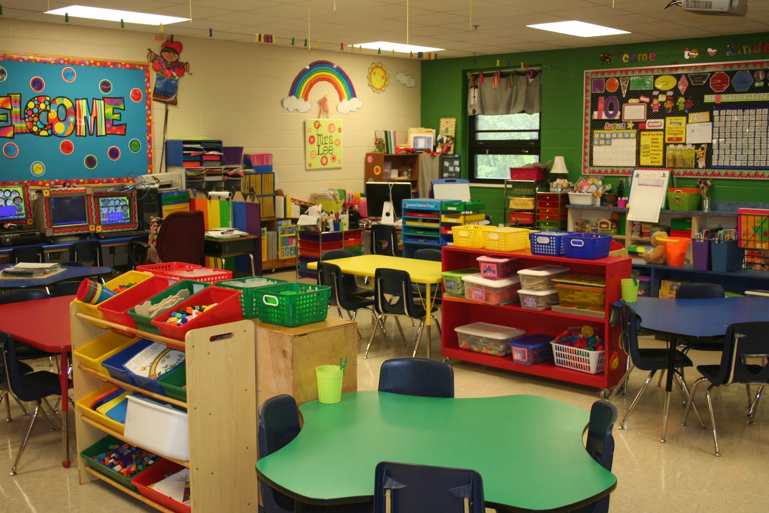
Typical Elementary Classroom

Slide 85
How things are stored in the classroom
Storage | How Secure is it (or how can i hack it) | Why does it have that security level? | What concept of Passwords does this represent
On the kid’s desk | Not at all | public | Not having a password
On a shelf | low | protected
On a shelf in a bin with a lid | medium
In a closet | medium
In a closet with a lock | high
On the teachers desk | medium
Locked in desk | high
On A shelf higher than 4 ft.

Slide 86
Synthesizing - Map my classroom or home
Have students then draw out what they understand about the classroom or their house. How do they identify secure areas and not secure areas?
https://kids.kiddle.co/Computer_security
https://beinternetawesome.withgoogle.com/en_us/

Slide 87
Homework - hack my house?

Slide 88
Hack My TikTok
{ "id": "7277986355668438314", "desc": "I hope they enjoy their new home \u2764\ufe0f #homereno #beforeandafter #construction We actually managed to completely renovate her house in 7 days \ud83d\ude33 Thanks @Emily Shaw and our construction team for making this happen!", "createTime": "1694538267", "scheduleTime": 0, "stats": { ** "diggCount": 2500000, "shareCount": 4346, "commentCount": 16800, "playCount": 16200000, "collectCount": "118252"** }, "nickname": "MrBeast", "authorId": "6614519312189947909", "authorSecId": "MS4wLjABAAAABKjQkOz_IIzXXzEAl_9LGsWhvK-gBnlczwRPXK8EmxAp6K3X0qiaP5_OEqmm0XwG", "avatarThumb": "https://p16-sign.tiktokcdn-us.com/tos-useast5-avt-0068-tx/54435a1ec165931f60f2a3872de74aa5~c5_100x100.jpeg?x-expires=1695236400&x-signature=FOzc8n8d8F6HCsXLKWIblmT5vcc%3D", "downloadSetting": 0, "authorPrivate": false, "capcutAnchorsOriginal": [], "capcutAnchors": [] }

Slide 89
NJSLS - CS Standards
Core Idea | Performance Expectations | Lesson Idea
Information needs a physical or wireless path to travel to be sent and received. | 8.1.5.NI.1: Develop models that successfully transmit and receive information using both wired and wireless methods. New | Beacons of Gondor, Creating your own Information Highway, Streams and Rivers
Distinguishing between public and private information is important for safe and secure online interactions. Information can be protected using various security measures (i.e., physical and digital). | 8.1.5.NI.2: Describe physical and digital security measures for protecting sensitive personal information. | Hack my Home, Hack Tiktok https://docs.google.com/document/d/1-SUVvAw1huSGFi0qEZScg1zxBLtlosEo_pqgjidkeY0/edit https://docs.google.com/presentation/d/1CFxbg-hWFY5VVrkaogcbxHSycAf8FEuu8a1HRazN39c/edit#slide=id.g70b115774c_0_0

Slide 90
Further Resources
https://beinternetawesome.withgoogle.com/en_us/
https://www.commonsense.org/education/articles/23-great-lesson-plans-for-internet-safety
https://kids.britannica.com/kids/article/Internet/353293

Slide 91
Pedagogy

Slide 92
Approaches to Teaching CS
Storytelling
Inter-/Trans-disciplinary
Universal Design for Learning

Slide 93
Approaches to Teaching CS
Storytelling
“coding is also reflective of the imaginative and narrative elements of fiction writing workshops.” (Burke & Kafai, 2010)
Demonstration of Language, Literacy, Equity, and Bilingual/Multilingual Students
https://nyuscholars.nyu.edu/files/80078129/Fall_2020_PiLa_CS_Telenovela_Classroom_Case_Study.pdf

Slide 94
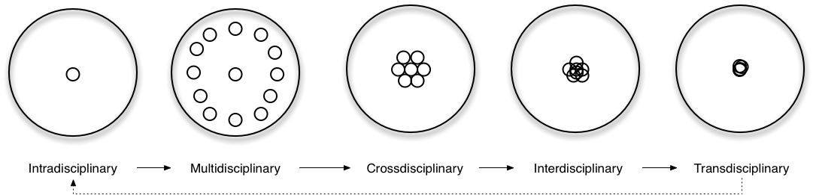
Approaches to Teaching CS
Inter-/Trans-disciplinary

Slide 95
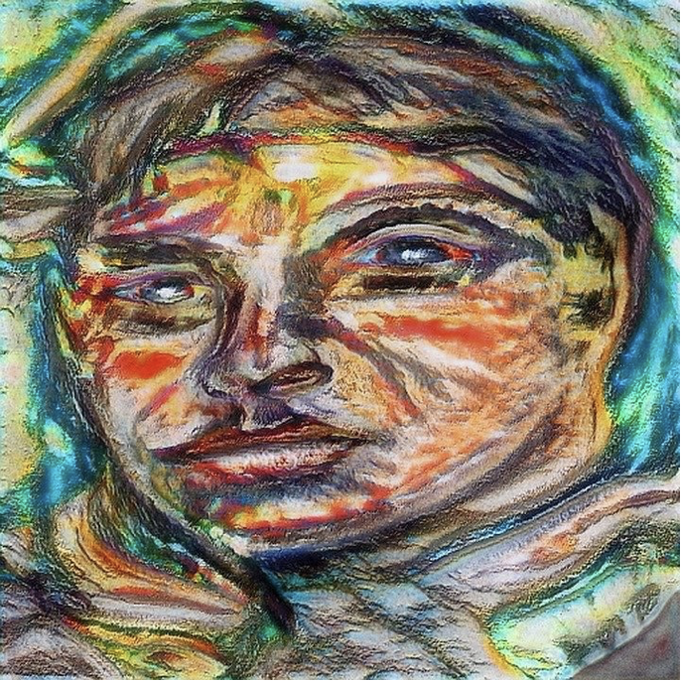
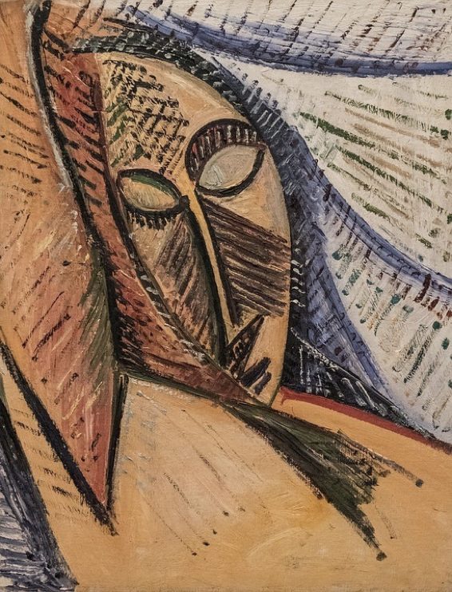
Abstraction and Art:
What is depicted in these Picasso paintings?

Slide 96
Language, Literacy, and CT
Integrate the idea of social network analysis with literary analysis and demonstrates how to integrate pgrahs (closed networks with nodes and edges) into mathematical abstractions coded as 2-dimensional arrays or data structures.
 | W | X | Y | Z
W |  | x
X | x |  | x | x
Y
Z
 | W | X | Y | Z
W | 0 | 1 | 0 | 0
X | 1 | 0 | 1 | 1
Y
Z
Y
W
X
Z
Grover, S. (2000). Computer science in K-12 an A to Z handbook on Teaching Programming. Edfinity.

Slide 97

What is Scratch? - 3 minutes
Notes:
ASK: What types of projects did you see in the video?
animations, games, stories, presentations, etc.

Slide 98
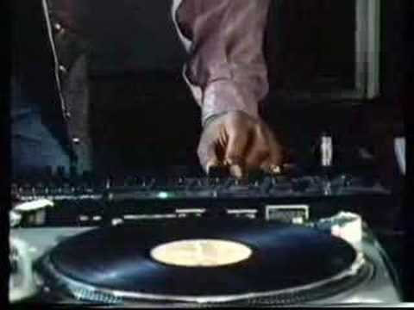
Impact of Computing
How do we impact computing technology positively/negatively?

Slide 99
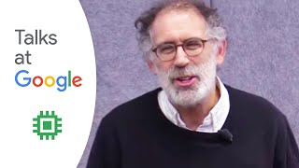
Scratch, Language, Math, and More
Notes:
Time: 19:10 - 20:50

Slide 100

Universal Design
for Learning (UDL)
Resources:
cast.org
https://udlguidelines.cast.org/
Computer Science for Everyone, Everywhere (CSEE)
Notes:
Move to the last slide

Slide 101
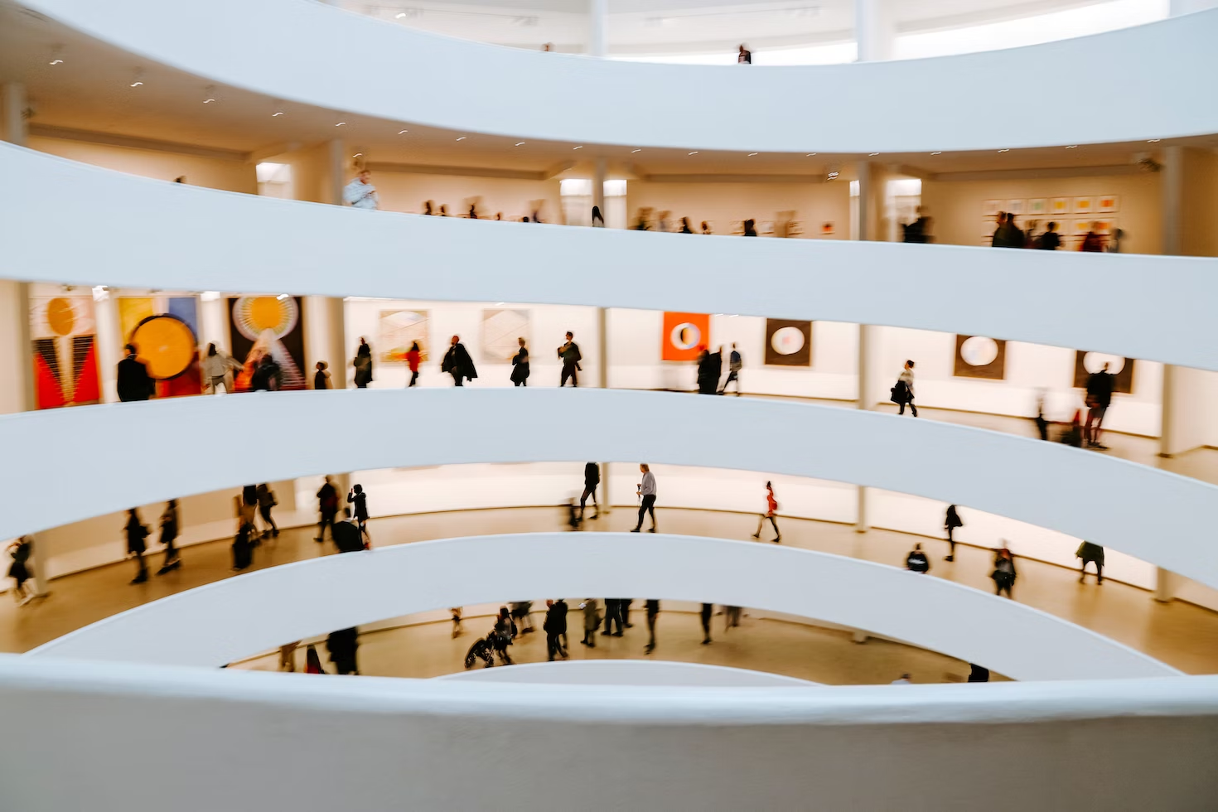
Foundations of UDL: Architecture
The Guggenheim Museum, NYC
Computer Science for Everyone, Everywhere (CSEE)

Slide 102
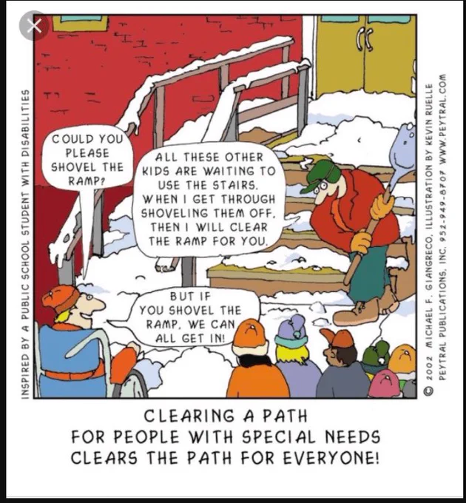
Computer Science for Everyone, Everywhere (CSEE)

Slide 103
UDL is…
“UDL is a framework that guides the shift from designing learning environments and lessons with potential barriers to designing barrier-free, instructionally rich learning environments and lessons” (Nelson, 2014, p. 2) --Scientifically valid framework
UDL provides a blueprint for creating instructional goals, methods, materials, and assessments that work for everyone--not a single, one-size-fits-all solution but rather flexible approaches that can be customized and adjusted for individual needs.
UDL involves helping all students succeed.
Computer Science for Everyone, Everywhere (CSEE)

Slide 104
What are the barriers?
Learning barriers are those elements of a lesson or the environment that prevent a learner from reaching the goal.
“barriers to learning are not, in fact, inherent in the capacities of learners, but instead arise in learners' interactions with inflexible educational goals, materials, methods, and assessments.”
(Dr. David Rose. Teaching Every Student in the Digital Age, p. vi)
A building barrier might be stairs;
a change made to the building might be _______________.
Computer Science for Everyone, Everywhere (CSEE)
Notes:
Move to the last slide

Slide 105
Learning barriers might be…
Removing barriers
Alphabet posters are hung on the narrowest wall because they visually look best there
Alphabet posters are hung on a spot where learners can see them easily (resource)
Learners are not motivated in math class. The goals are disconnected from their interests and experience.
The goal is rewritten to highlight an authentic application of the mathematical content to the real world.
Learners know that each day they need to come having read a chapter of the textbook and ready to take notes on that information.
Provide the reading materials in various formats (audio, digital, print) along with comprehension supports
Computer Science for Everyone, Everywhere (CSEE)

Slide 106
Data and Analysis

Slide 107
Exercise
Given a baggy of legos
Do something with them … in 5 minutes

Slide 108
Debrief
What did you do?

Slide 109
NJ SLS CS Standard - In a Nutshell
By the end of Grade 5
Data can be organized, displayed, and presented to highlight relationships
The type of data being stored affects the storage requirements.
Individuals can select, organize, and transform data into different visual representations and communicate insights gained from the data.
Many factors influence the accuracy of inferences and predictions.

Slide 110
What does that mean to us?
In many ways the Data Standard is the hardest of the standards. While it is with the best of intentions we want to help students learn the skills they need to analyze data properly, these skills can often be misinterpreted for other motives.
The important points in the Data Standard continuing with data concepts both from the 3-5 standard but also the math standard.
The important thing to remember with the data standard is that we are:
1 - Trying to help students understand the nature of data
2 - Begin to use some simple analysis and visualization tools
3 - Challenge students in why they are accepting the tools output

Slide 111
Grade 3-5 Data Sciences Expectation
Core Idea | Performance Expectations
Data can be organized, displayed, and presented to highlight relationships. | 8.1.5.DA.1: Collect, organize, and display data in order to highlight relationships or support a claim.
The type of data being stored affects the storage requirements. | 8.1.5.DA.2: Compare the amount of storage space required for different types of data.
Individuals can select, organize, and transform data into different visual representations and communicate insights gained from the data. | 8.1.5.DA.3: Organize and present collected data visually to communicate insights gained from different views of the data. • 8.1.5.DA.4: Organize and present climate change data visually to highlight relationships or support a claim.
Many factors influence the accuracy of inferences and predictions. | 8.1.5.DA.5: Propose cause and effect relationships, predict outcomes, or communicate ideas using data.

Slide 112
Perspective
Data Sciences, Data and Analysis

Slide 113
Data and Binary
All data must be able to be mapped onto the binary number system. This type of data is called discrete data.
We can do a lot of representation with this - most text can be represented this way. Pictures used binary values to represent the presence of certain colors in a picture element or pixel. We can record sound waves and the play rapid pictures with sound over them to make movies.
Some things cannot be represented by the computer. For example - a computer cannot represent a circle completely - only an approximation of it.
Computer Science for Everyone, Everywhere (CSEE)

Slide 114
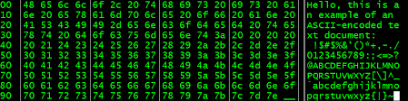
Data and Binary
Computer Science for Everyone, Everywhere (CSEE)

Slide 115
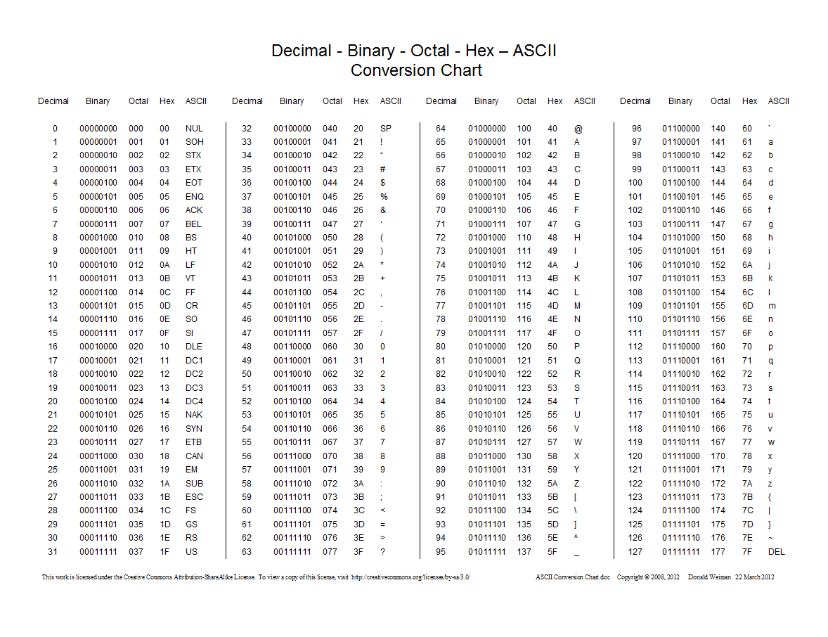
Data and Binary
Computer Science for Everyone, Everywhere (CSEE)

Slide 116
Bits, Bytes and Data Storage
Binary Digit: Bit - this is our ones and zeros.
Byte: 8 bits equal 1 byte. I can store 256 different values with 1 Byte. With 2 Bytes working together, I can store 65,536 values. One byte lets me represent all English characters (ASCII). Two bytes lets me represent all other alphabets except languages like Mandarin. Even those, the major characters can be represented (Unicode).
In working with powers of two, every time you add a bit, you are doubling the amount of data that you can store or work with.
Computer Science for Everyone, Everywhere (CSEE)

Slide 117
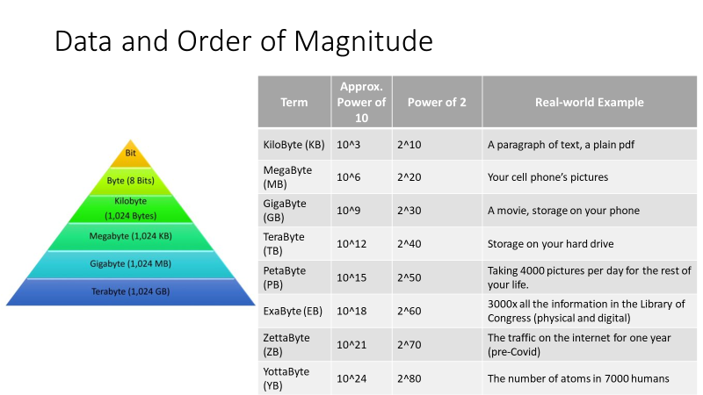
Computer Science for Everyone, Everywhere (CSEE)

Slide 118
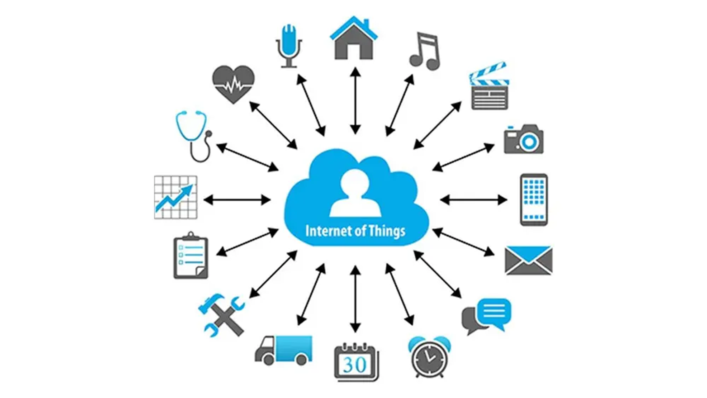
How is data collected
Computer Science for Everyone, Everywhere (CSEE)

Slide 119
US 2020 Election visualization on NPR
Look at this visualization: https://www.npr.org/sections/live-updates-2020-election-results
Note: This is not a statement about who won the election, just how the information is visualized.
What visualization are you most used to?
What visualization do you feel is most representative of the data?

Slide 120
Data Dashboards
Covid -19 Dashboards:
NY Times: https://www.nytimes.com/interactive/2021/us/covid-cases.html
University of Washington: https://covid19.healthdata.org/global?view=cumulative-deaths&tab=trend

Slide 121
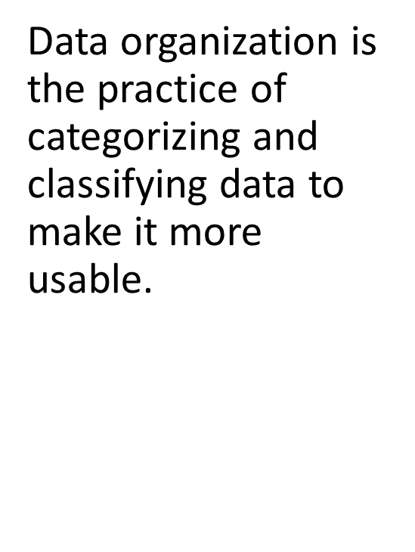
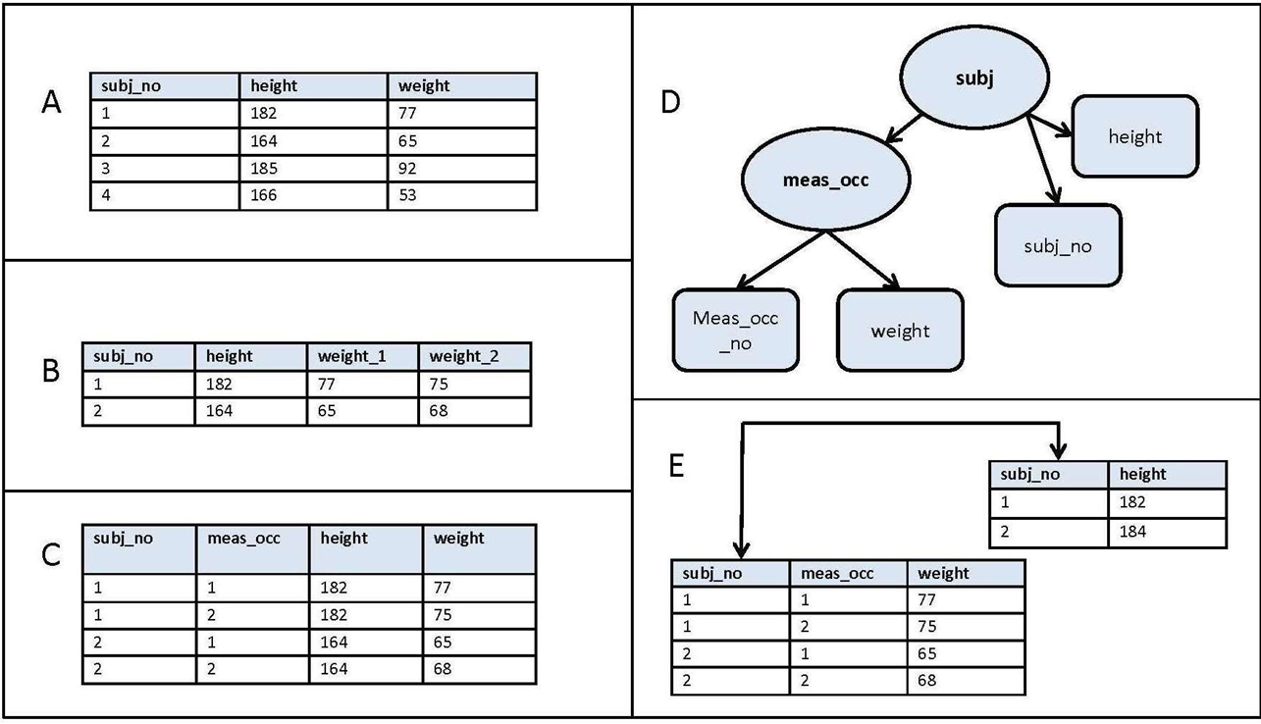
How is data organized?
Computer Science for Everyone, Everywhere (CSEE)

Slide 122
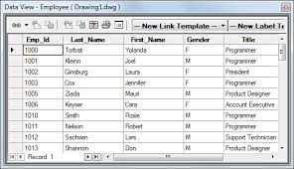
How is data organized? - Tables
Computer Science for Everyone, Everywhere (CSEE)

Slide 123
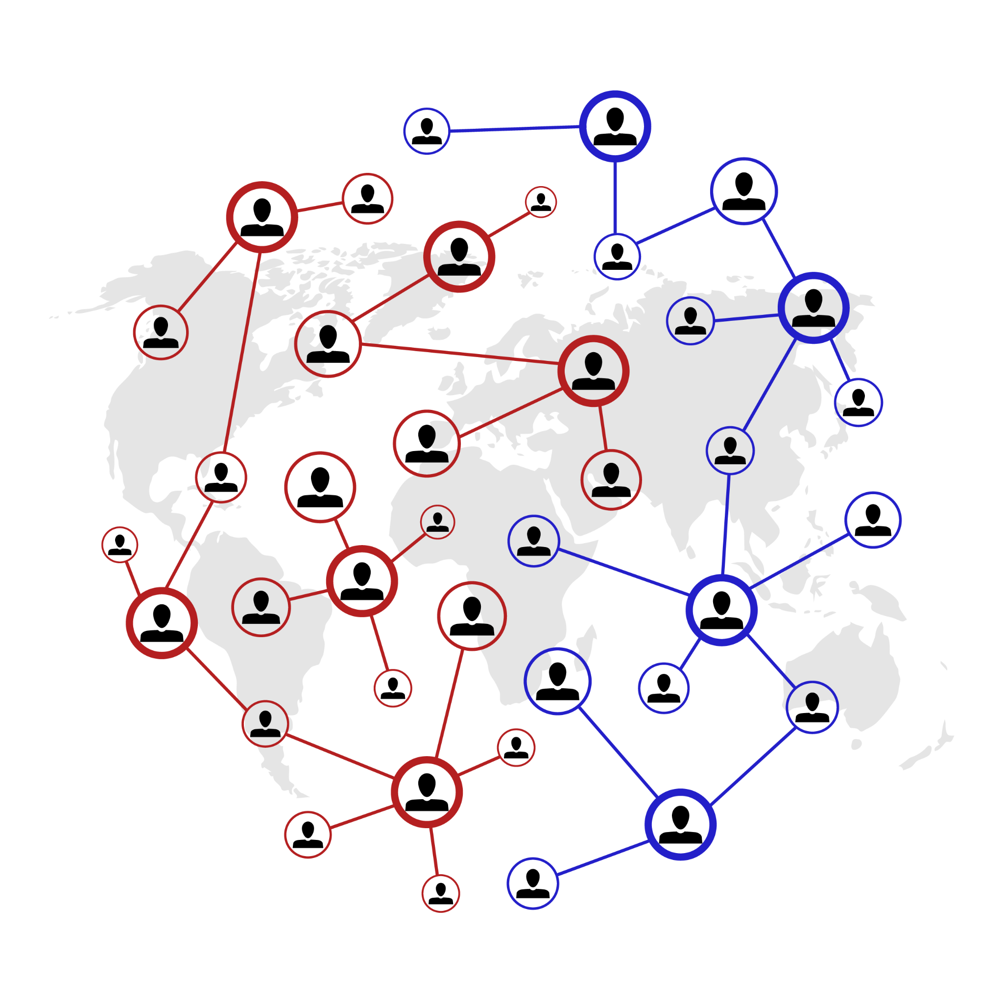
How is data organized? - Graphs or Network
Computer Science for Everyone, Everywhere (CSEE)

Slide 124
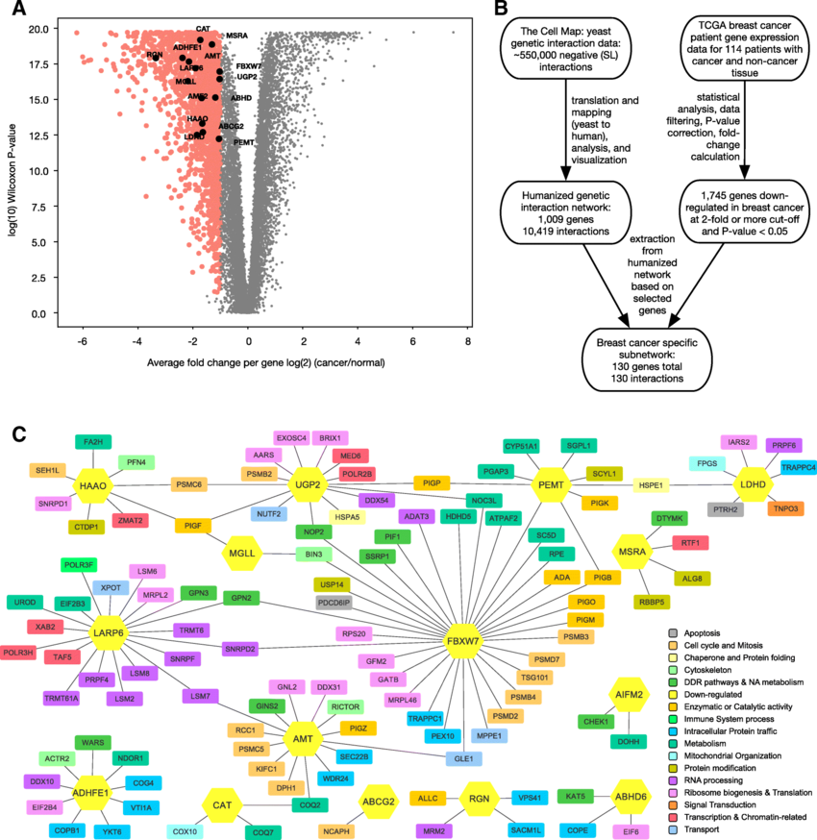
How is data organized?
- Graphs or Network
Computer Science for Everyone, Everywhere (CSEE)

Slide 125


How is data collected
•Often, besides the actual information the data represents, how data interact with each other is also important. Social Media is an example of this concept.
Computer Science for Everyone, Everywhere (CSEE)

Slide 126
Lesson 1: Kids as Data Generators
As a part of the standard, we have to help students: Store, copy, search, retrieve, modify, and delete data using a computing device.
This is not the easiest of tasks, especially when you may only have ChromeBooks at your disposal
Simple exercise:
Have the kids create 3 different Google Documents (or whatever they have access to) - the content can be on anything. One document should be okay to delete
Then, do these tasks:
STORE: Give the document a name: Store - point out on some machines we have to click on Save.
COPY: Make a Copy of the Document
RETRIEVE: Close out of Google Drive, then reopen and have them find the document. Debrief of how this process worked.
MODIFY: Open an Existing Document, put more information in it.
DELETE: Delete the file you decided to delete - have them try to find it after deletion.

Slide 127

Lesson 1 - Use Google to Understand Data Sizes

Slide 128
Lesson 2: Kids as Data Generators
Pick an aspect of the environment for kids to observe over a period of time:
Weather (I did this), Growth of a Plant, and record aspects of the data.
Weather: Temperature, sky conditions, air conditions…
Plant: Have the students plant plants. Put the plants in different places in the room (including a closet that keeps the door closed). Record information about growth. You can also have sets you water and do not water.
Other ideas: River behaviors, Lantern flies
https://gisdata-njdep.opendata.arcgis.com/

Slide 129
Lesson 2: Kids as Data Generators
The idea with this standard is not to teach kids to make standard charts. Its to help them use their creativity to model what they learned in this exercise.
You can have them put their data into Google Sheets and then use a chart.
Another idea is use a tool like abcya.com to do picture art:
Lesson Plan: https://docs.google.com/document/d/1aFFIFQgLRQTRPUMMgPQ54FRPEx1sXjlQNM53EGKv6d0/edit

Slide 130
Lesson 2: Kids as Data Generators
Help them then connect to the larger world through an on-line Dashboard system.
Google Trends: https://trends.google.com/trends/
For Example - have student use Google Trends to see about weather changes.
Look at the maps, and regions, and dates - find patterns. See if you can figure out the patterns.
Once you identify patterns - see if you can predict something about the patterns (for example, is there always a spike in weather searches around hurricanes).

Slide 131
Kids Data Resources
https://www.epa.gov/climate-change/climate-change-resources-educators-and-students
Satellite data over time: https://education.nationalgeographic.org/resource/satellite-imagery-and-change-over-time/
https://www.nesdis.noaa.gov/

Slide 132
Kids as Data Visualizers
Let children imagine what is possible - how would it be meaningful to them to understand the information.
Redesigning Google Classroom
What do they wish they had?

Slide 133
Core Idea | Performance Expectations | Lesson
Data can be organized, displayed, and presented to highlight relationships. | 8.1.5.DA.1: Collect, organize, and display data in order to highlight relationships or support a claim. | Google Doc and learning to search the Web
The type of data being stored affects the storage requirements. | 8.1.5.DA.2: Compare the amount of storage space required for different types of data. | Google folder - load different types of data into the folder and compare.
Individuals can select, organize, and transform data into different visual representations and communicate insights gained from the data. | 8.1.5.DA.3: Organize and present collected data visually to communicate insights gained from different views of the data. • 8.1.5.DA.4: Organize and present climate change data visually to highlight relationships or support a claim. | Data Sets, Google Trends
Many factors influence the accuracy of inferences and predictions. | 8.1.5.DA.5: Propose cause and effect relationships, predict outcomes, or communicate ideas using data. | Google Trends

Slide 134
Further Resources
NASA’s Kid’s Climate Change site: https://climatekids.nasa.gov/kids-guide-to-climate-change/
NOAA’s Kids’ Climate Change site: https://oceanservice.noaa.gov/kids/
Octonaut Science: https://oceanexplorer.noaa.gov/octonauts/

Slide 135
Algorithms and
Computer Programming

Slide 136
Exercise
What do you do the same every single day?
Why do you do it the same way?
What goal do you reach or how do you complete a task with it?

Slide 137
Algorithms and Programming
What is an Algorithm?
Informally: An Algorithm is a step by step process by which we complete a task.
Formal definition: An algorithm is an ordered set of unambiguous, executable steps that defines a terminating process
What is Programming?
Programming is a representation of an algorithm into a form that the computer can understand.
How are they related?
Computer scientists develop algorithms and test them through math to solve problems. Then we use programming languages to develop software based on those algorithms.

Slide 138
NJ SLS CS Standard - In a Nutshell
By the end of Grade 5
Different algorithms can achieve the same result.
Some algorithms are more appropriate for a specific use than others.
Programming languages provide variables, which are used to store and modify data.
A variety of control structures are used to change the flow of program execution (e.g., sequences, events, loops, conditionals).
Programs can be broken down into smaller parts to facilitate their design, implementation, and review. Programs can also be created by incorporating smaller portions of programs that already exist.
Individuals develop programs using an iterative process involving design, implementation, testing, and review.

Slide 139
What does that mean to us?
The standard asks that we get students to the point where they understand the purpose of a loop - not necessarily program it well, but understand its purpose and do a simple loop.
Core ideas in this standard are:
How do we represent our ideas for a program?
How do we work with data?
How do we do a simple program?

Slide 140
Algorithms and Programming
Core Idea | Performance Expectations
Different algorithms can achieve the same result. Some algorithms are more appropriate for a specific use than others. | 8.1.5.AP.1: Compare and refine multiple algorithms for the same task and determine which is the most appropriate.
Programming languages provide variables, which are used to store and modify data. | 8.1.5.AP.2: Create programs that use clearly named variables to store and modify data.
A variety of control structures are used to change the flow of program execution (e.g., sequences, events, loops, conditionals). | 8.1.5.AP.3: Create programs that include sequences, events, loops, and conditionals.

Slide 141
Algorithms and Programming - Part 2
Core Idea | Performance Expectations
Programs can be broken down into smaller parts to facilitate their design, implementation, and review. Programs can also be created by incorporating smaller portions of programs that already exist. | • 8.1.5.AP.4: Break down problems into smaller, manageable sub-problems to facilitate program development. • 8.1.5.AP.5: Modify, remix, or incorporate pieces of existing programs into one’s own work to add additional features or create a new program.
Individuals develop programs using an iterative process involving design, implementation, testing, and review. | 8.1.5.AP.6: Develop programs using an iterative process, implement the program design, and test the program to ensure it works as intended.

Slide 142
Perspective
Algorithms and Programming

Slide 143
The Anatomy of an Algorithm
An algorithms definition is deceptively simple: A step-by-step process by which we complete a task. There are many important elements to this definition!
Formal definition: An algorithm is an ordered set of unambiguous, executable steps that defines a terminating process
What is important:
It is ordered
It is step-by-step and its very clear steps
It is possible for the computer to do those steps
There is a clear way the algorithm ends
There is a result at the end of the algorithm
Montclair Computer Science Education Hub

Slide 144
Algorithms: It has order!
The key design factor for algorithms is that it has order.
Why is order important?
Often a step is dependent upon a previous step. We need to follow the direction like a path or recipe.
Is everything ordered on a computer?
Not everything in computing requires order - in fact, for many things to work they have to unordered or even random. This is one of the reasons why we say clearly it must be ordered.
Montclair Computer Science Education Hub

Slide 145
Algorithms: It is step-by-step!
Related to ordered, there must be clear, precise steps that are followed in the algorithm. This is often the hardest part of algorithms because often the “math proof” lets you describe the concept every openly, but the programming implementation does not allow that.
We often start with a “high level” concept, then refine until we get to pseudo-code (notation that uses many common programming techniques). We usually work on about three versions of the algorithm, using problem solving techniques to get us to code.
Montclair Computer Science Education Hub

Slide 146
Algorithms: Three Versions
Working on algorithms is like writing a paper - and using a similar process for writing a paper helps.
Brainstorming
  Begin with crafting a clear statement of what you want the algorithm to do. Include the following components: what is your input, what is your output, how does the algorithm end and describe in plain language how you want to go about getting to your end state/final output. Note - this should be in PLAIN LANGUAGE
Revision
  You take your brainstorming and organize it. You begin to identify programming concepts that can implement your ideas.
  Sometimes you need multiple revisions at this phase.
  Your last revision should be in a good place where you know the code you need to use.
Translation: Translate the Revision into any programming language.
Montclair Computer Science Education Hub

Slide 147
Algorithms: Version Example - Brainstorming
Our problem is to create an adding program. It will add two numbers, return a result and then ask the user if they want to add something else.
Brainstorming:
I think about the program …
I am adding two numbers, so I will need to input two numbers and save those somewhere. Then I have to add them. Then I have to tell the user the result. Then I have to see if they want to do it again.
Considerations:
How am I getting the two numbers that I am adding? Are they typing it in or am I using a Graphical User Interface (windows, something they touch) to get the info?
Montclair Computer Science Education Hub

Slide 148
Algorithms: Version Example - Revision 1
Brainstorm:
  I am adding two numbers, so I will need to input two numbers and save those somewhere. Then I have to add them. Then I have to tell the user the result.
Revision 1
Montclair Computer Science Education Hub

Slide 149
Algorithms: Version Example - Translation phase
Revision 1 - with more details
  Get two numbers from user typing in number on the keyboard
    Get first number through an input statement
    Assign my result to variable number1
    Get second number from an input statement
    Assignment my result to variable number2
  I save them in a container that holds data -> variables
    This work was done in the above steps.
  Add numbers and save in the result
    Create a result variable to hold the value of the addition.
    Add number and number 2 - save the addition value in variable result
  Print out the result for the user
    Use an output statement to the print out result
Pseudo-code (looks like code but independent of language)
number 1 = 0
number1 = input(““Please enter your first number to be added: “)
number 2 = 0
number2 = input(““Please enter your second number to be added: “)
result = 0
result = number1 + number2
print(“Your result is “ + result)
Montclair Computer Science Education Hub

Slide 150
Algorithms: Techniques for development
We use three basic techniques to develop our algorithms:
Top-down approach
  Top-down is what we did in the previous example. We start with a High-level idea and we revise it, breaking it into smaller parts until we can visible see the coding elements needed to create the program.
  Top-down approach uses a concept called step-wise refinement. This means you do multiple versions of your outline, breaking up each bullet point again and again until your bullet points can be easily translatable into code.
  We often use the Divide and Conquer Technique in Top Down - breaking the problem into smaller, more manageable pieces.
Montclair Computer Science Education Hub

Slide 151
Algorithms: Techniques for development
Bottom Up Approach:
Design a problem that you want to address with an algorithm
Then look at problems similar to it.
Use the pieces from other programs to build out your solution.
Bottom up is an engineering technique where you have goal x and supplies y, how do you get to your goal?
Combination of the two approaches
The reality is we use both approaches often together to get a robust solution.
Trying to look at problems from different points of view often help us with understanding where problems are in our logic.
Montclair Computer Science Education Hub

Slide 152
Algorithms: A computer can complete the task
Computers work in binary: yes and no, one and zero, true and false.
The computer isn’t good with “loose instructions” or instructions that are indefinite.
It is impossible for the computer to do the following instruction:
  When you are done enjoying the sunset, do this step.
Therefore the instruction must be able to end.
Montclair Computer Science Education Hub

Slide 153
Algorithms: It Ends
It must end. When try to design with infinity with caution.
For the most part, the only place that we work with the program being allowed to run infinitely are systems programs - the operating system, the computer security features, etc.
These programs work on the idea that they run infinitely until an “interrupt” event occurs. We assume a lot of interrupts will happen.
These programs are then ended either by an interrupt or the user turning off the devise.
Montclair Computer Science Education Hub

Slide 154
Algorithms: There is a result at the end
The purpose of the algorithm is to manipulate the data in some way - therefore by the time the algorithm ends - something should have happened with the data.
Examples:
  Something was stored
  Something was printed or reported to the user
  A value changed
  A value was visualized in a cool way
  A set of values were analyzed
  etc…
Montclair Computer Science Education Hub

Slide 155
Brainstorming
8.1.5.AP.1: Compare and refine multiple algorithms for the same task and determine which is the most appropriate.
Lego organization
8.1.5.AP.2: Create programs that use clearly named variables to store and modify data.
8.1.5.AP.3: Create programs that include sequences, events, loops, and conditionals.
8.1.5.AP.4: Break down problems into smaller, manageable sub-problems to facilitate program development.
8.1.5.AP.5: Modify, remix, or incorporate pieces of existing programs into one’s own work to add additional features or create a new program.
8.1.5.AP.6: Develop programs using an iterative process, implement the program design, and test the program to ensure it works as intended.

Slide 156
Simple Lessons

Slide 157
Unplugged Activities
1. Pattern Recognition: Getting loopy
Activity: https://code.org/curriculum/course1/12/Teacher#Activity1
chrome-extension://efaidnbmnnnibpcajpcglclefindmkaj/https://code.org/curriculum/course1/12/Activity12-GettingLoopy.pdf
2. Unplugged: Cup stacking
Activity: chrome-extension://efaidnbmnnnibpcajpcglclefindmkaj/https://active-living.ucalgary.ca/sites/default/files/teams/1/Coding%20Cups%20-%20MIM.pdf
Video for teachers: https://youtu.be/7zXtn8CoJ-w
3
Computer Science Education Hub

Slide 158

GETTING LOOPY
Resource: code.org
Vocabulary:
Loop - Say it with me: Loop
The action of doing something over and over again
Interdisciplinary:
ISTE Standards (formerly NETS)
CSTA K-12 Computer Science Standards
NGSS Science and Engineering Practices
NJ SLS Math, Language Arts

Slide 159
GETTING LOOPY:
VOLUNTEER TO
CREATE YOUR LOOP and ITERATION
Variation:
Go Noodle
https://app.gonoodle.com/activities/meow-moo-moo?sp=search&sn=search&st=video%20versions&sid=471

Slide 160
CUP STACK
Our language (code)
= Pick up stack
= Set bottom cup down
= Move ½ cup width forward
= Move ½ cup width backward
= Flip cup over
Computer Science for Everyone, Everywhere (CSEE)

Slide 161

CUP STACK
position of cup = 0 1 2
Computer Science for Everyone, Everywhere (CSEE)

Slide 162
Programming in Scratch
https://scratch.mit.edu/

Slide 163
Programming in Scratch
All of your Algorithms and Programming objectives can be addressed by Scratch.
Note - the Algorithms and Programming (and also the Data Standard) should be divided up over multiple years.
Grade 3: Get them started with Scratch - learn to design and visualize, create pseudocode
Grade 4: Introduce variable and if statements
Grade 5: Integrate more control structures

Slide 164
Resources for Scratch
Scratch Lessons by Year at Code for Fun: https://www.codeforfun.com/LessonPlans/
Videos to help learn the basics for Scratch: https://www.youtube.com/thetechtrain

Slide 165
Vocabulary: Algorithms and Programming
Syntax: Meaning variable: Capitalized, variables store a number. set: Sets a VARIABLE equal to a number. input: Input a number to be stored in a VARIABLE. calculate: Performs mathematical operations. +, -, *, /, = : Add, subtract, multiply, divide, equals. <, <= : Less than, less than or equal to. >, >= : Greater than, greater than or equal to. | display: Prints information to the screen. if: If a condition is true, run its block of code. Otherwise, skip the block of code. else if: See if. Follows if statement and checks if a different condition is true. start loop: Begins a repeating block of code. repeat x times: Repeats a loop x times. end loop: Stops repeating a block of code.
Montclair Computer Science Education Hub

Slide 166
Algorithms and Programming
Core Idea | Performance Expectations
Individuals develop and follow directions as part of daily life. A sequence of steps can be expressed as an algorithm that a computer can process. | 8.1.2.AP.1: Model daily processes by creating and following algorithms to complete tasks.
Real world information can be stored and manipulated in programs as data (e.g., numbers, words, colors, images). | 8.1.2.AP.2: Model the way programs store and manipulate data by using numbers or other symbols to represent information.
Computers follow precise sequences of steps that automate tasks. | 8.1.2.AP.3: Create programs with sequences and simple loops to accomplish tasks.
Complex tasks can be broken down into simpler instructions, some of which can be broken down even further. | 8.1.2.AP.4: Break down a task into a sequence of steps.
People work together to develop programs for a purpose, such as expressing ideas or addressing problems. The development of a program involves identifying a sequence of events, goals, and expected outcomes, and addressing errors (when necessary). | • 8.1.2.AP.5: Describe a program’s sequence of events, goals, and expected outcomes. 8.1.2.AP.6: Debug errors in an algorithm or program that includes sequences and simple loops.

Slide 167
Further Resources
https://code.org/educate/curriculum/elementary-school
K-2 Loops https://www.youtube.com/watch?v=74bDpGQcp1o
K-2 Video Resources (web access coming soon!) CS K-2 Data & Analysis_Full Version
CS K-2 Computing Systems Presentation (modification)
CS K-2 Computer Book

Slide 168
Impacts of Computing

Slide 169
NJ SLS CS Standard for Impacts of Computing - In a Nutshell
By the end of Grade 5
The development and modification of computing technology is driven by people’s needs and wants and can affect individuals differently.

Slide 170
What does that mean to us?
Kids today are experiencing the world in an extremely different way than even the generation 10 years ago.
They are constantly in contact with others
Life is facilitated by technology - they barely know what commercials, cliffhangers and must see TV is!
Those who have trouble accessing technology are experiencing larger access gaps

Slide 171
Impacts of Computing
Core Idea | Performance Expectations
The development and modification of computing technology is driven by individual’s needs and wants and can affect individuals differently. | 8.1.5.IC.1: Identify computing technologies that have impacted how individuals live and work and describe the factors that influenced the changes. • 8.1.5.IC.2: Identify possible ways to improve the accessibility and usability of computing technologies to address the diverse needs and wants of users

Slide 172
Perspective - Computers and Society

Slide 173


Slide 174


How is data visualized?
Computer Science for Everyone, Everywhere (CSEE)

Slide 175
AI and Life Changing Tools
ChatGPT - write a paper on computer science education …
ChatGPT - if you have a hypothetical patient with these symptoms, what illness do you think they have
ChatGPT - translate this sentence from English to Spanish: Can I help you?
ChatGPT - Generate a knitting pattern for me …
More at: Epic ChatGPT Fails: https://www.buzzfeed.com/andyneuenschwander/chatgpt-ai-fails-funny

Slide 176
Lesson 1: Tech History Museum
Create a Technology Museum in your classroom.
Students need to pick a modern technology and then pick a pre-2010 era. Then do an art project comparing now and then and where it should go to make it better.
You can then hang this on the wall as an Art Gallery or take it further. Students can do this through finding pictures online, drawing, building with various materials. Also, if you choose, it can be fun to do this in pairs or groups. If you feel brave, see if families have old cell phones or old, unused technology they are willing to share with the class.

Slide 177
Debrief
Technology | Life Before Tech | Life After Tech | Where is Tech Going

Slide 178
Impacts of Computing
Core Idea | Performance Expectations | Lesson
The development and modification of computing technology is driven by individual’s needs and wants and can affect individuals differently. | 8.1.5.IC.1: Identify computing technologies that have impacted how individuals live and work and describe the factors that influenced the changes. • 8.1.5.IC.2: Identify possible ways to improve the accessibility and usability of computing technologies to address the diverse needs and wants of users | Tech History Museum

Slide 179
Further Resources
https://www.create-learn.us/blog/history-of-computers-for-kids/
https://kids.britannica.com/kids/article/computer/352990
https://bedtimehistorystories.com/the-history-of-computer-science-for-kids/
https://computerhistory.org/

Slide 180
Conclusions
This was a boot camp experience! You will need time to decompress.
Try to integrate one idea from a lesson you learned today in your teaching - then email us at k12csed@montclair.edu and tell us how it went - better yet - take pics and video and send them to us or tag us on social media.
Thank you so much to everyone for coming today and supporting this project.
Please fill out our Post-PD survey: https://forms.gle/AJEiBHf1wcMPmyfA8
Also, and this is optional, if you could fill out this reflection, we would appreciate it:
https://forms.gle/ZcENGE9BqXUJSwqd6

