Slide 1
Grade 9-12
Computer Science Education Primer
Katherine G. Herbert, Ph.D.
Director, Montclair Computer Science Education Hub
Elliot Hu-Au
Assistant Professor, School of Computing and Department of Teaching and Learning
John Brown
High School Teacher, Passaic School District
Sumi Hagiwara, Ph.D.
Director, Montclair Computer Science for Everyone Everywhere Program.

Slide 2
Introduction

Slide 3
Schedule - Tentative (we may run over on sections but we will be out by 3:00pm)
9:00am - 9:05am - Welcome
9:05am - 9:15am - NJDOE Required Data Collection
9:20am - 10:30am - Basics of Computer Science
10:20am - 10:30am - Break
10:30am - 11:15am - Computer Systems
11:15am - 12:00am - Networks and the Internet
11:45am - 12:30pm - Working Lunch - Pedagogy and CS Education
12:30pm - 1:15pm - Data and Analysis
1:15pm - 2:30pm - Algorithms and Programming (please take break on your own during programming)
2:30pm - 3:00pm - Impacts of Computing

Slide 4
Community of Learners
Styles we adopt in this session …
We are friendly and hopefully building friendship - please welcome people - especially singletons who you do not know to your table - and feel free to use first names.
We are Inclusive and try to design for UDL.
We are Positive - everyone has a voice, perspective and contribution to give.
We try to Laugh - this is a long day with a lot of content we may not have ever seen before so we are going to try to have fun.
We Accept there is no one authority or expert in the room - everyone has human moments and we support each other through them.
We are Safe - personal stories should stay here unless you have the express permission of the person.

Slide 5
Today will be …
Jammed - packed - while we will take short breaks please feel free to give yourself breaks as we go along.
Fun
Address Some of Your Questions
Inspire New Questions
Frustrate You - In a Good Way
Be a “Springboard” for you to Explore the Standards

Slide 6
Today will not be …
Complete and exhaustive and you will have a perfect understanding of everything computing by the end of these lessons
You will not have a complete understanding of CS or the Standards but you will be in a better position to begin your journey.

Slide 7
Data Collection
Please Please Please fill out your Pre-Survey Data If you don’t … we will find you!!!
Places to get the Pre-Survey Data:
Best: Your District Content Management Systems like Genesis, LinkIt!, or other places where you grade and get student information.
Better: New Jersey School District Performance Reports
https://rc.doe.state.nj.us/
Okay and Acceptable: National Center for Education Statistics IPEDS
https://nces.ed.gov/ipeds

Slide 8
Theme for 9-12 Computer Science Education
When we look at CS for 9-12, it is continuing on building on the 6-8 CS Education. K-2 it is about identifying things that we see in everyday life and trying to put the formal words (terminology) to the things we see.
Grades 3-5 looks at trying to understand the whys of CS, while K-2 is about the whats.
Grades 6-8 try to take those why and explain them more, building on problem solving skills and connecting computing to larger concepts in society.
Grades 9-12, we are looking for students to be minimally computing literate and ideally, computing fluent. A small group of these students will move on to working in computing as a career. However, many of them should be able to incorporate computing skills into their career.
Example: Gym teacher - how do gym teachers use computing and computational thinking?
With 9-12, you can do more complicated and focused lessons. You can build upon students’ interests. Still keep it short, simple, as kinesthetic as possible (make them move and use sensory oriented techniques), help them to identify their emotions and work through them, and try to have fun.
Try to avoid keeping them solely on the computer for programming exercises.

Slide 9
Computing Literacy, Computing Fluency and Computing Expertise
Computing Literacy looks at being able to use the computer as a tool. This often focuses only on the skills that are important right now in a community.
Computing Fluency considers what skills are needed so that a person can adapt as new technologies are available. Often, we consider what are the basic concepts a person needs to know, what basic skills do they need to acquire and then what basic capabilities do they need to attain. This includes both technological as well as growth mindset techniques.
Computing Expertise recognizes mastery levels of one or more computing area. No one is an expert in all areas of computing and students need to know that.

Slide 10
Approaching Literacy, Fluency and Expertise
Computing is very good at helping people who respond to particular styles of teaching. However, it has been proven in literature significant groups of talented people do not respond well to the programming first approaches.
Literacy and Fluency techniques try to help people acquire skills without necessarily needing expertise in programming. The idea is to present the field rather than the technology.

Slide 11
Literacy, Fluency, Expertise and Teaching Challenges - What does it mean for us?

Slide 12
Computer Science
an Overview for Teachers

Slide 13
Computer Science Definition
What is Computer Science?
Computer Science is the study of the generation, storage, transportation, and manipulation of data.
In the classification of sciences, computer science is a FORMAL SCIENCE - a science like how mathematics and physics are defined as a science.
Other types of sciences besides Formal Sciences: Natural Science, Social Science, Applied Science and Interdisciplinary Sciences.
Computational Thinking is part of the mindset for Computer Science and helps us with problem solving.
Computer Science for Everyone, Everywhere (CSEE)

Slide 14
Data
So if data is so central to computing, what is data?
Data is “something” that holds meaning for the human-user that the computer will do an action on. Note - there is no truth value on this other than the importance to the user. it is often the codes used to represent those somethings to a user.
Data can be interpreted into Information. Information is the meaning the user imposes on the data.
Information can be analyzed for Knowledge. Knowledge is the observable patterns within the information that we can measure with a level of confidence.
Knowledge that we can apply reliably is Wisdom (we don’t often talk about that ;-) )

Slide 15
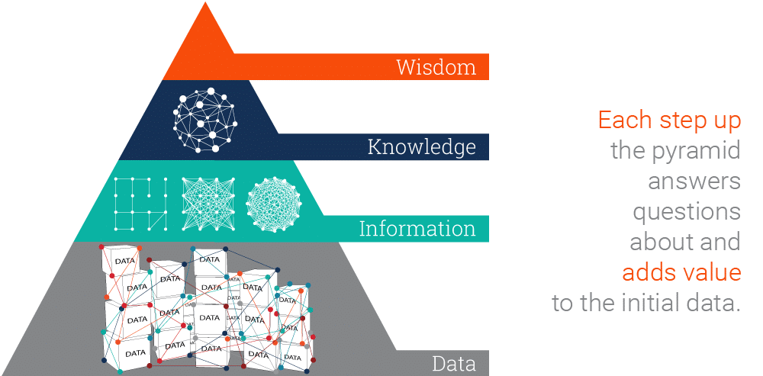
Data
Image source: https://www.ontotext.com/knowledgehub/fundamentals/dikw-pyramid/

Slide 21
Computer Science and the Standards –
What are we trying to accomplish ..
New Jersey has nearly 16,000 tech business establishments. The tech sector accounts for an estimated $56 billion of the state's economy, or 9.6% of total economic output. It is the ninth highest dollar value contribution among the 50 states and the District of Columbia. (I like to call us the Silicon Shore …)
New Jersey is generating 17,000 jobs in tech a month, while only 17% of NJ High Schoolers are considered proficient in CS.
New Jersey Universities only generate about 3,000 graduates a year - no where near the growth the state needs.
Computer Science is the fastest growing science field that can give students access to lucrative career paths and lifetime skills. However, computer science is more than just a one-course experience. It needs to be integrated into children’s learning
Citations: https://njbmagazine.com/njb-news-now/strong-decade-of-growth-for-nj-technology-industry/

Slide 22
Why Grades 9-12 Students
Grades 9-12 are one of the most critical times in a Computer Scientist’s life.
Students are deciding where they will go to college, or if they will get a job to help the family. Computing skills can change students income levels and give them social mobility.
There is a huge misconception about computing - Computer Science isn’t doing things on the computer - even professional computer scientists don’t spend as much time on the computer as people think. This starts in 3-5, get magnified through middle school and often under-represented groups are exiting computing by high school because of social factors.
Computer Science is the intersection of a lot of disciplines - Math, Engineering, Physics, Logic and Philosophy - and applied to almost every other domain … Understanding it and developing skills over time will help students to have a better understanding.
Grades 9-12 students are developing critical executive functioning skills. Incorporating computing into their leaning helps for students to see computing as a part of their future.
Grades 9-12 also see the continued emergence of various biases among students - We have to be very aware of the the social emotional learning components. We also need to use active techniques to support diversity, equity, inclusion and belonging within the field.

Slide 23
Computer Systems

Slide 24
NJ SLS CS Standard - In a Nutshell
By the end of Grade 12
• A deeper understanding of programming languages, algorithms, data structures, and computational thinking principles
• Give students an understanding of data, networks, computer security, artificial intelligence and any other computing topic that is needed.
• Develop skills relevant to industry and real-world applications

Slide 25
Computing Systems Standard
Core Idea | Performance Expectations
The usability, dependability, security, and accessibility of devices within integrated systems are important considerations in their design as they evolve. | 8.1.12.CS.1: Describe ways in which integrated systems hide underlying implementation details to simplify user experiences.
A computing system involves interaction among the user, hardware, application software, and system software. | 8.1.12.CS.2: Model interactions between application software, system software, and hardware. 8.1.12.CS.3: Compare the functions of application software, system software, and hardware.
Successful troubleshooting of complex problems involves multiple approaches including research, analysis, reflection, interaction with peers, and drawing on past experiences. | 8.1.12.CS.4: Develop guidelines that convey systematic troubleshooting strategies that others can use to identify and fix errors.

Slide 26
What do we dread about teaching this unit?

Slide 27
Lesson ideas we want to share

Slide 28
Definitions/Vocabulary
Human Computer Interaction: is a multidisciplinary field of study focusing on the design of computer technology and, in particular, the interaction between humans (the users) and computers.

Slide 29
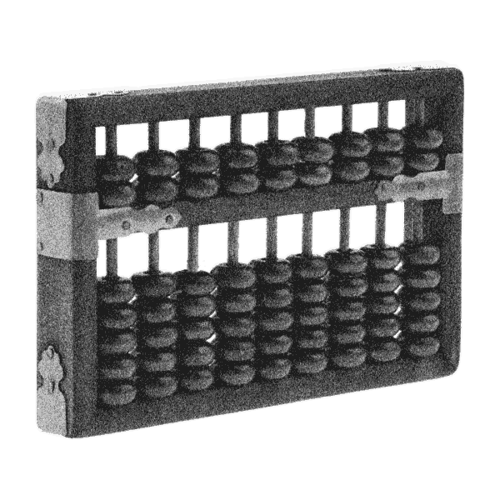
The First Computer
Computer Science for Everyone, Everywhere (CSEE)
Notes:
The first computer is generally considered to be the abacus. It was a manual computer that allowed for rapid calculations.

Slide 30
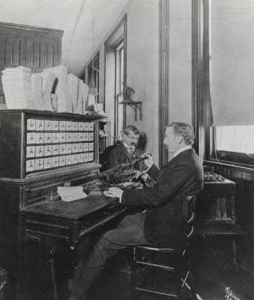
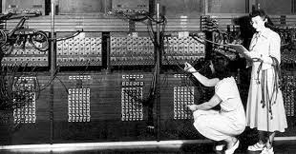
Hollerith Machine ENIAC
Notes:
Next came mechanical computers - computers that used simple machines to do the computations (Hollerith’s tabulating machine).
With the turn of the 20th century - data is exploding and everyone wants to do computations quicker - especially the military.

Slide 31
Electricity and computers…
https://palmetto.com/learning-center/blog/understanding-solar-power-electricity-terms-volts-amps-watts
https://www.thegeekpub.com/243163/what-is-resistance-ohms-electricity-basics/
Computer Science for Everyone, Everywhere (CSEE)
Notes:
Electricity offered a way to work very fast - theoretically at a speed close to light.
However, there are problems - namely electricity and reliability.

Slide 32
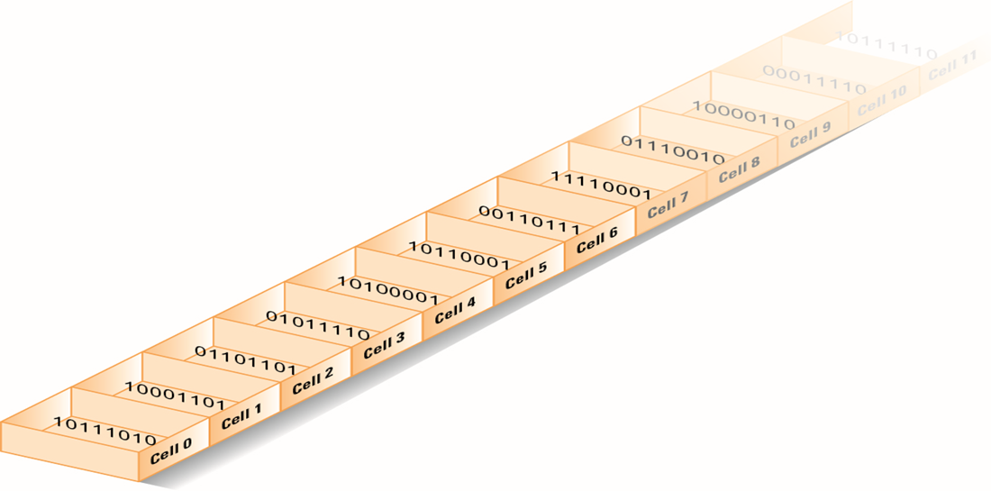
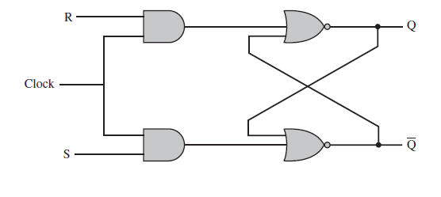
Computer memory - bits
Notes:
If we assign presence of voltage (on) the concept of “1” and absence of
voltage (power off) the concept of zero, we then had a math system to help us design ways to process the electricity with 100% reliability - Binary math!
To this day, everything on the modern computer at its most very basic level uses binary math. The circuits of the computer do approximately 100 math options, 20 of which are used frequently.

Slide 33
Counting by binary
Notes:
A Decimal Computer was just not practical. However, we could still work with the concept of power on and power off!
Math also had a ton of work on number systems - that is a number system with bases other than 10. And the cool thing was there are clear rules on how to convert numbers from one system to another.

Slide 34
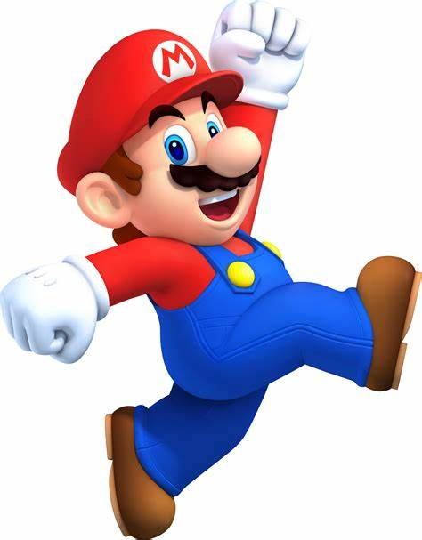
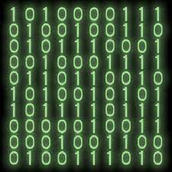
Data and Binary
Notes:
All data must be able to be mapped onto the binary number system. This type of data is called discrete data.
We can do a lot of representation with this - most text can be represented this way. Pictures used binary values to represent the presence of certain colors in a picture element or pixel. We can record sound waves and the play rapid pictures with sound over them to make movies.
Some things cannot be represented by the computer. For example - a computer cannot represent a circle completely - only an approximation of it.

Slide 35
Computer Systems
How do they talk to each other?
How does the computer know what to do?

Slide 36
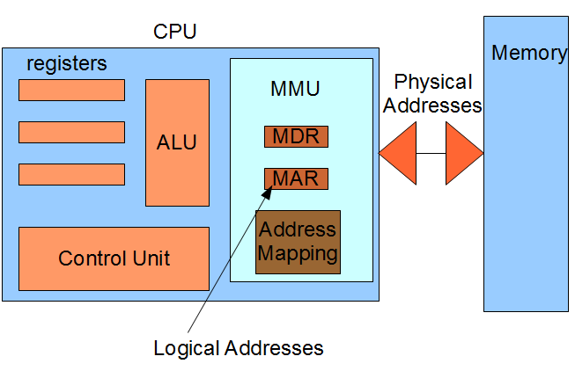
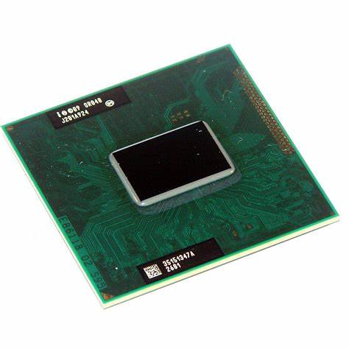
The Central Processing Unit: The Brains of the Computer
Computer Science for Everyone, Everywhere (CSEE)
Notes:
The ALU is responsible for carrying out the arithmetic and logical operations of the CPU. It consists of an arithmetic logic unit (which performs arithmetic and logical operations) and a set of registers (which store data and instructions).
The control unit is responsible for fetching, decoding, and executing instructions. It also controls the flow of data between the various components of the CPU.
The registers are used to store data and instructions. There are four types of registers: general-purpose, floating-point, control, and status. General-purpose registers can be used for any purpose. floating point registers are used for storing floating-point numbers. Control registers or unit contain control signals that tell the various components of the CPU what to do. Status registers contain information about the current state of the CPU.

Slide 37
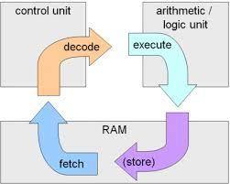
Machine Cycle
Computer Science for Everyone, Everywhere (CSEE)

Slide 38
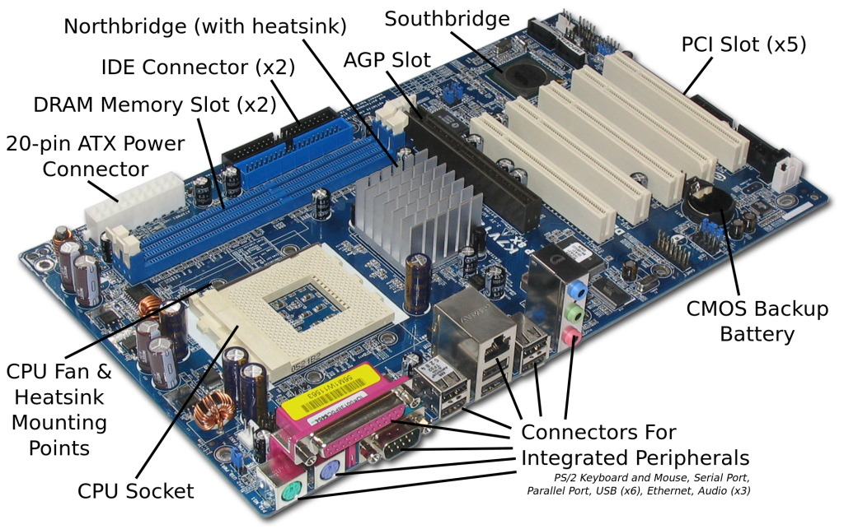
Motherboard and integrating with additional hardware
Computer Science for Everyone, Everywhere (CSEE)

Slide 39
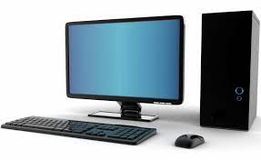
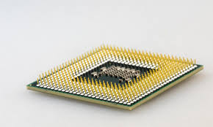
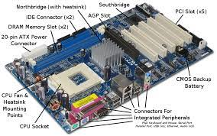
Hardware and Software Together - General Computer
The CPU does the “math” to create the actions”
The hard drive holds our programs. When we want to use the program, it is loaded into memory and run on the CPU.
The Motherboard holds the CPU and connects it to other devices like memory, hard drive USB - peripherals.
Computer Science for Everyone, Everywhere (CSEE)

Slide 40
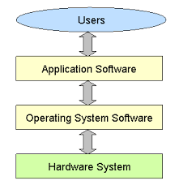
Hardware and Software Together
The program that does the thing I want to do.
The Program that manages all
of the Computer’s resources
Computer Science for Everyone, Everywhere (CSEE)
Notes:
Software is a set of programs that are used to help the computer complete a task.
Computers use to have their programs “hard coded” into them - that is if you wanted to change the program, you had to change the physical hardware.
Now, software lets a mass produce general purpose computers and then use software to do different things with them.
Software interfaces for the human user so that the user gets an experience that they expect, but the actions or directions the user wants to perform are translated by software into the 1’s and 0’s the computer needs to run a task.
All software reduces its actions down to about 20 mathematical actions on the Arithmetic Logic Unit.
Programming is a component of creating software.

Slide 41
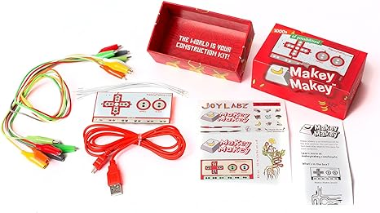
Connections for a Computer System
Computer Science for Everyone, Everywhere (CSEE)

Slide 42
Software and Operating Systems
(slides from Beekman et. al, Prentice Hall)

Slide 43
Categories of Software
Compilers and translator programs
Enable programmers to create other software
Software applications
Serve as productivity tools to help users solve problems
System software
Coordinates hardware operations

Slide 44
A Fast Machine That Can’t Think for Itself
Typical computer is only capable of:
Performing basic arithmetic operations
Such as 7 + 3 and 15 – 8
Performing simple logical comparisons
Is this number less than that number?
Are these two values identical?
Computers seem smart because they perform these operations quickly and accurately.

Slide 45
The Language of Computers
Every computer processes instructions in machine language.
Numeric codes used to represent basic operations:
Adding and subtracting numbers
Comparing numbers
Moving numbers
Repeating instructions
Programmers use high-level languages.
C++, Java, and Visual Basic

Slide 46
Executing a Program
Most programs are composed of millions of simple machine-language instructions.
The program counter inside the CPU keeps track of the address of the next instruction to be executed.
The instruction execution cycle has a three-step rhythm:
Fetch the instruction
Increment the program counter
Perform the specified task

Slide 47
Software Applications: Tools for Users
Software applications enable users to control computers without having to think like programmers.

Slide 48
Consumer Applications
Thousands of software titles are available:
Publishing programs
Accounting software
Graphics programs
Educational titles
Games
Personal-information managers
And more

Slide 49
Consumer Applications (cont.)
Documentation: Instructions for installing and using software—may be printed manuals or digital files
Updating and upgrading software
Compatibility: Read system requirements
Disclaimer—an end-user license agreement (EULA)—protects companies from errors in programs
Licensing: Buy software license not program
Distribution by direct sales or download from Web
Includes public-domain software and shareware

Slide 50
Web Applications
Growing trend toward using applications that run on remote Internet servers instead of local PCs.
Google Docs
Photoshop.com
Webmail programs: Gmail, Hotmail, Yahoo! Mail
Multiplayer games
Wikis: Wikipedia
Retail sites: Amazon.com and online auctions, eBay
Online communities: Facebook

Slide 51
Web Applications (cont.)
Mashups: Web applications that provide new services by combining data or functionality from two or more external sources
Web site might combine crime statistics from a police Web site with maps from Google to create visual representations of where crimes are occurring
Another might combine language translation with Web search to allow a user to search for terms in another language

Slide 52
Vertical-Market and Custom Software
Basic office applications are used in homes, schools, government offices, and all types of businesses.
Other applications are job specific:
Medical billing software
Library cataloging software
Legal reference software
Restaurant management software
Tend to cost far more than mass-market applications

Slide 53
System Software: The Hardware-Software Connection
System software: Class of software that includes the operating system and utility programs
Handles low-level details and hundreds of other tasks behind the scenes
User does not need to be concerned about details

Slide 54
What the Operating System Does
Every computer depends on an operating system to:
Keep hardware running efficiently
Make process of communication with hardware easier
Maintains file system
Supports multitasking
Manages virtual memory
Operating system runs continuously when computer is on

Slide 55
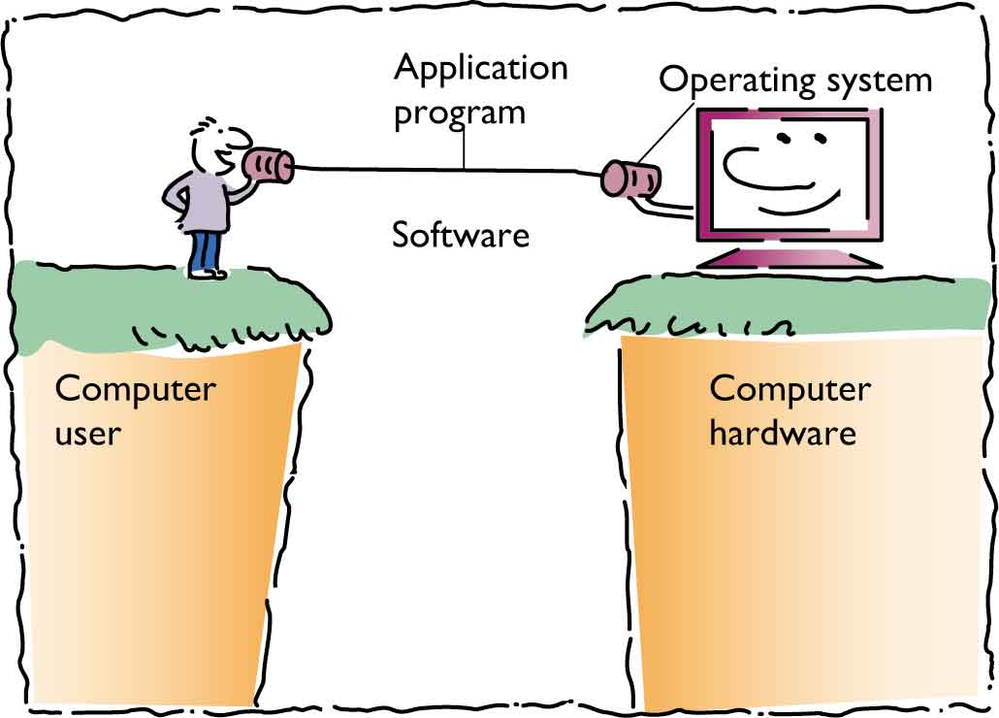
What the Operating System Does
The User’s View

Slide 56
Utility Programs
Serve as tools for doing system maintenance and repairs not handled by operating system
Utilities make it easier for users to:
Copy files between storage devices
Repair damaged data files
Translate files so different programs can read them
Guard against viruses and other harmful programs
Compress files so they take up less space

Slide 57
Device Drivers
Small programs that enable input/output devices to communicate with the computer, such as:
Keyboards
Mice
Printers
Many device drivers are bundled with peripherals
Others are sold as separate products

Slide 58
Where the Operating System Lives
Some computers store operating systems in ROM
Most modern PCs hold only a small portion of the operating system in ROM
Remainder of operating system is loaded during booting, when computer is turned on
Handheld devices may store operating system in flash memory

Slide 59
The Operating System
When you turn on the computer, the CPU automatically begins executing instructions stored in ROM. The operating system (OS) loads from the disk into part of the system’s memory.

Slide 60
The Operating System (cont.)
The Operating System (cont.)
The OS loads the application program into memory and remains in memory, so it can provide services to the application program—display on-screen menus, communicate with the printer, and perform other common actions.

Slide 61
The Operating System (cont.)
The Operating System (cont.)
To avoid losing your data file when the system is turned off, save it to the disk. When you reopen the file, the OS locates it on the disk and copies it into memory.

Slide 62
The User Interface: The Human–Machine Connection
User interface: Critically important component of software
Early users spent tedious hours writing and debugging machine-language instructions.
Later users programmed using easier languages that were still challenging.
Now, most users work with preprogrammed applications.

Slide 63
Desktop Operating Systems
MS-DOS: Standard on IBM-compatible computers in 1981
Used command-line interface that required users to type commands
Apple Macintosh introduced windows, icons, and mouse-driven, drop-down menus in 1984.
Windows and Mac OS started as single-user operating systems but today support multiple users.

Slide 64
UNIX and Linux
UNIX: Command-line, character-based OS
Internet is populated with computers running UNIX
Enables timesharing computer to communicate with several other computers at one time
OS of choice for workstations and mainframes in research and academic settings
Favored by many who require an industrial-strength, multiuser OS
Linux, a UNIX clone, is distributed and supported free

Slide 65
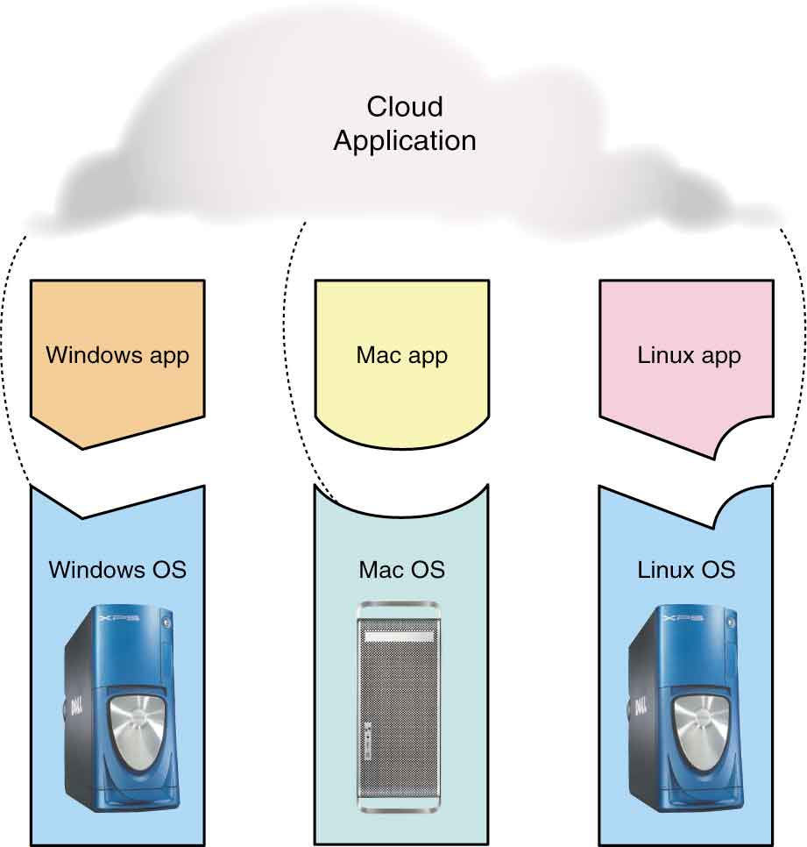
Compatibility Issues
Operating systems are designed to run on particular hardware platforms.
Applications are designed to run on particular operating systems.
Most cloud applications are designed to run on multiple platforms.

Slide 66
File Management: Where’s My Stuff?
One of the challenges of working with a computer is keeping track of the masses of information that can be collected, edited, and stored on disks.
Most computers use some kind of hierarchical file system involving directories or folders to organize files.

Slide 67
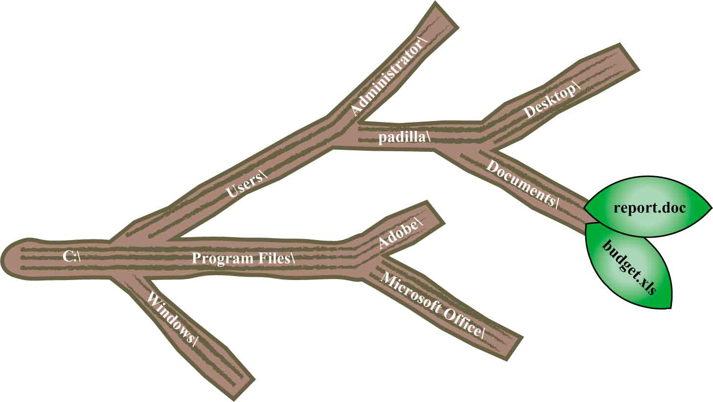
Organizing Files and Folders
Files may be placed in folders.
Folders can be placed inside folders.
Every file and folder has a unique pathname.

Slide 68
Windows Explorer and the Finder: File Managers
File management utility: Makes it easy to view, rename, copy, move, and delete files and folders
In Windows it is called Windows Explorer
In the Mac OS it is called the Finder
Can display information about a file such as size, its type, and the last time it was modified

Slide 69
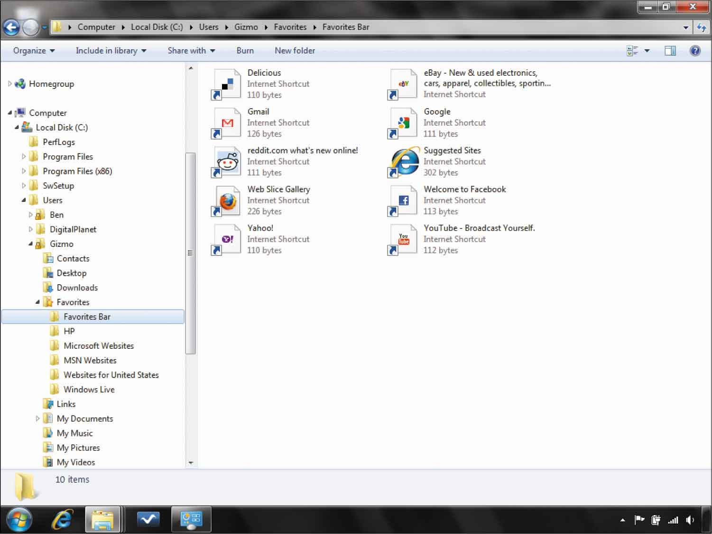
Windows Explorer and the Finder: File Managers (cont.)
Windows Explorer allows you to see the contents and location of the folder in the storage device’s hierarchy.

Slide 70
Managing Files from Applications
Most applications support four basic file-management operations:
Open: Allows you to select the file you want to work on
Save: Writes current application as a disk file
Save As: Allows you to choose the location and name of the file
Close: Allows you to stop working on a project without quitting the application

Slide 71
Locating Files
Organize files logically
Store documents in folder called Documents
Store photos in folder called Pictures
Store music in folder called Music
Modern operating systems include search tools
Search for filenames or for words and phrases
Virtual folders contain files that match certain criteria no matter where they are located

Slide 72
Disk Formatting
Hard disks are formatted by manufacturer before installing operating system:
Electronic marks are put on disk.
Disk is divided into series of concentric tracks.
Tracks are divided into sectors.
Sectors are bundled into clusters or blocks.
File system provides way to link multiple clusters to store large files

Slide 73
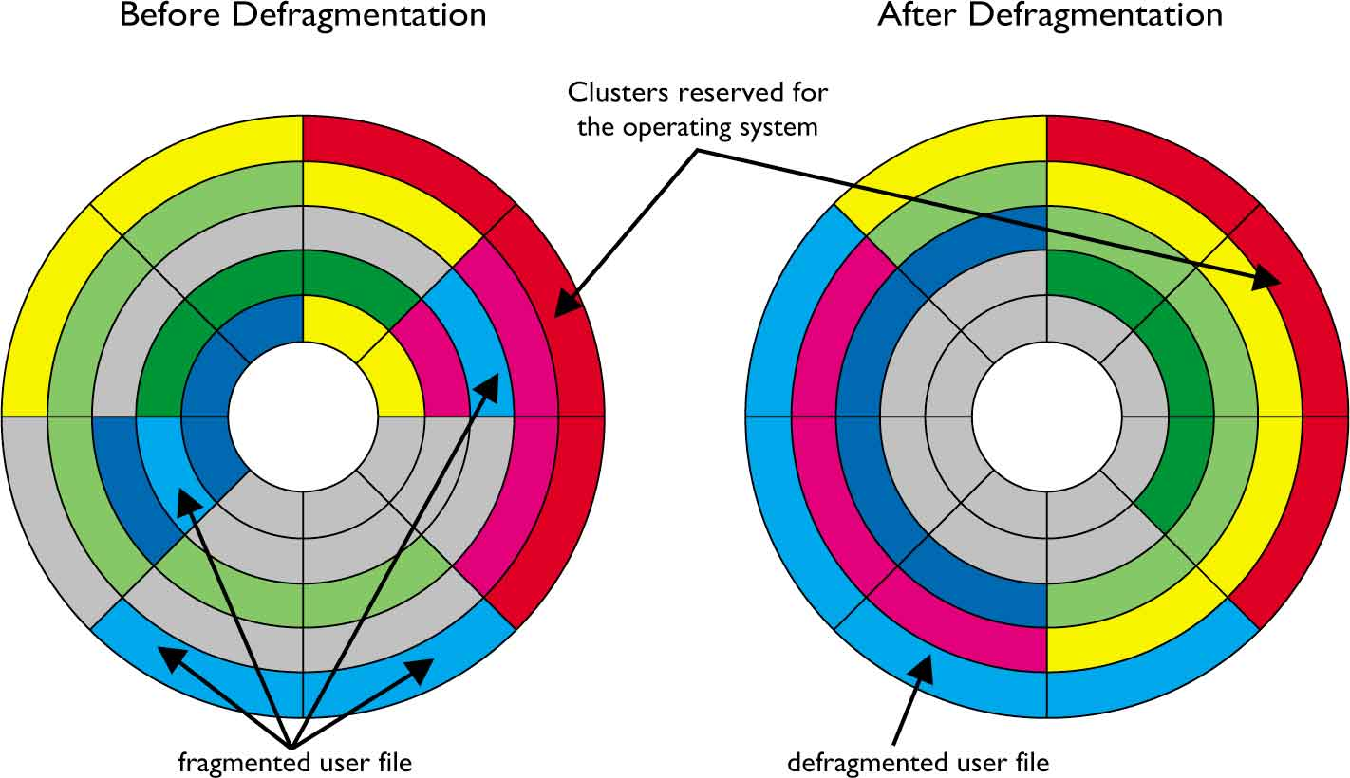
Defragmentation
Contents of file may become scattered over clusters.
Accessing information is faster if file is assigned to contiguous clusters.
A defragmentation utility eliminates fragmented files.

Slide 74
Software Piracy and Intellectual Property Laws
Software piracy: Illegal duplication of copyrighted software—is rampant
Few software companies use physical copy protection methods and that makes copying easy
Many people unaware of laws
Others simply look the other way

Slide 75
The Piracy Problem
Software industry loses billions of dollars every year to software pirates.
Business Software Alliance (BSA) estimates that more than one-third of software in use is illegally copied.
Piracy is particularly hard on small companies.
Piracy rates are highest in developing countries.
Industry organizations work with law enforcement agencies to crack down on piracy.

Slide 76
Intellectual Property and the Law
Intellectual property: Includes the results of intellectual activities in the arts, science, and industry
Copyright laws: Protects books, plays, songs, paintings, photographs, and movies
Trademark law: Protects symbols, pictures, sounds, colors, and smells.
Patent law: Protects mechanical inventions
Contract law: Covers trade secrets
Under the law, software does not fit in these categories.

Slide 77
When Good Software Goes Bad
Restart the application
Recover your work
Reboot the system
Recheck for updates
Reboot in safe mode
Research your problem
Request help
Reinstall the program
Restore the operating system
Repair the hardware
Replace the system
Recycle your old computer

Slide 78
Troubleshooting
First - don’t panic. Seriously. Every teacher who taught in covid and most students are not experts in troubleshooting basic problems on the computer. You got this.
Make a checklist for yourself and run through it:
Check all of your wires - did something fall off or out of place?
Check your internet connection - it's often not you!
If software is not running properly - close it - this works for a traditional computer and your phone.
If it is still malfunctioning, turn off the computer - wait a good 20 seconds, and turn it back on.
Computer Science for Everyone, Everywhere (CSEE)

Slide 79
Troubleshooting - When do I need help?
Sometimes the problem can’t be fixed this way. Here are some clues:
If the computer is slowing down: This usually means the computer is having storage issues:
Close some applications!
Reboot
If this isn’t working, check to see if your hard drive is too full - you probably need at least 4 Gigabytes of Storage.
Does your computer have enough memory? - if no, get more
What is your bus speed? - if too slow, you are buying a new computer.
If I get a odd thing on my monitor
If possible, use an HDMI or USB cord to connect to another monitor - like your smart tv. See if it works fine that way.
If I get a black or blue screen - there may be a serious problem. Try to make sure your back up the computer - then try to run a diagnostic. If it persists, you may need to do more research or get help.
Computer Science for Everyone, Everywhere (CSEE)

Slide 80
Lessons

Slide 81
Brainstorming
• 8.1.12.CS.1: Describe ways in which integrated systems hide underlying implementation details to simplify user experiences.
Every kid has an opinion on their phone or chromebook. Make an exercise of that - or a gaming system, their TVs, Amazon Alexa or any system.
• 8.1.12.CS.2: Model interactions between application software, system software, and hardware.
• 8.1.12.CS.3: Compare the functions of application software, system software, and hardware.
Have students create their “Dream Device”. Have them describe both how the user would interact with the device and what the look and feel of the hardware is.
• 8.1.12.CS.4: Develop guidelines that convey systematic troubleshooting strategies that others can use to identify and fix errors.
https://docs.google.com/drawings/d/1RD0z7raBvgHbSlJ3xY6vmflj5prsB3a7_uq1W_CLPCE/edit?usp=sharing

Slide 82
Operating Systems Lesson 1
Analyzing how things are written to a file.
Have students generate a google doc and a plain text doc - same content but different formats. PDF, slides, etc also fine. Look at the differences in sizes. Describe the differences between them.

Slide 83
Operating System Lesson - Crowdsourced - What do you do to teach this?

Slide 84
Model interactions between application software, system software, and hardware
Students know this better than we give credit:
Smart TVs
Phones
Gaming Systems
All of these model interactions. How can we leverage student experience to help them understand it?

Slide 85
Virtual Reality as a Computing System
CS HUB 9-12 STANDARDS PRIMER
2/8/2024

Slide 86
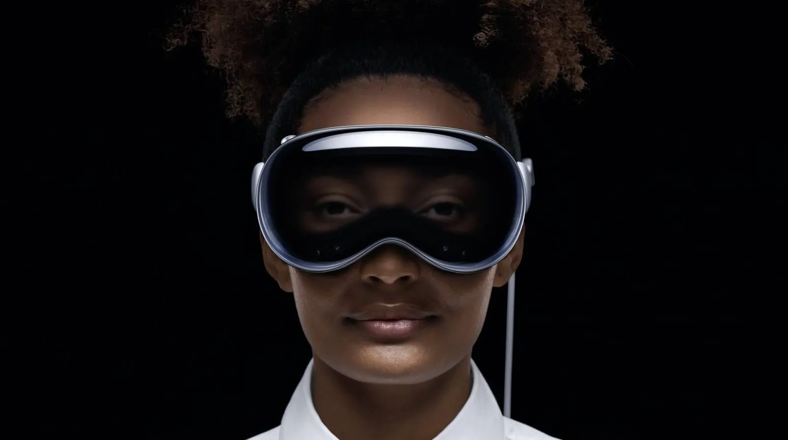
Notes:
Apple Vision Pro
- the newest hardware in the VR industry (I mean spatial computing industry)
- $3500
-great example of how software, hardware, and user experience go hand in hand

Slide 87
Computing Systems Core Ideas
The usability, dependability, security, and accessibility of devices within integrated systems are important considerations in their design as they evolve.
A computing system involves interaction among the user, hardware, application software, and system software.
Successful troubleshooting of complex problems involves multiple approaches including research, analysis, reflection, interaction with peers, and drawing on past experiences.

Slide 88
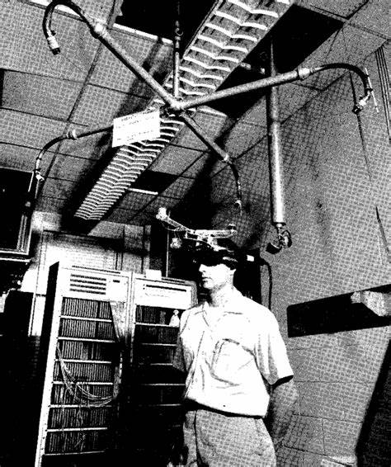
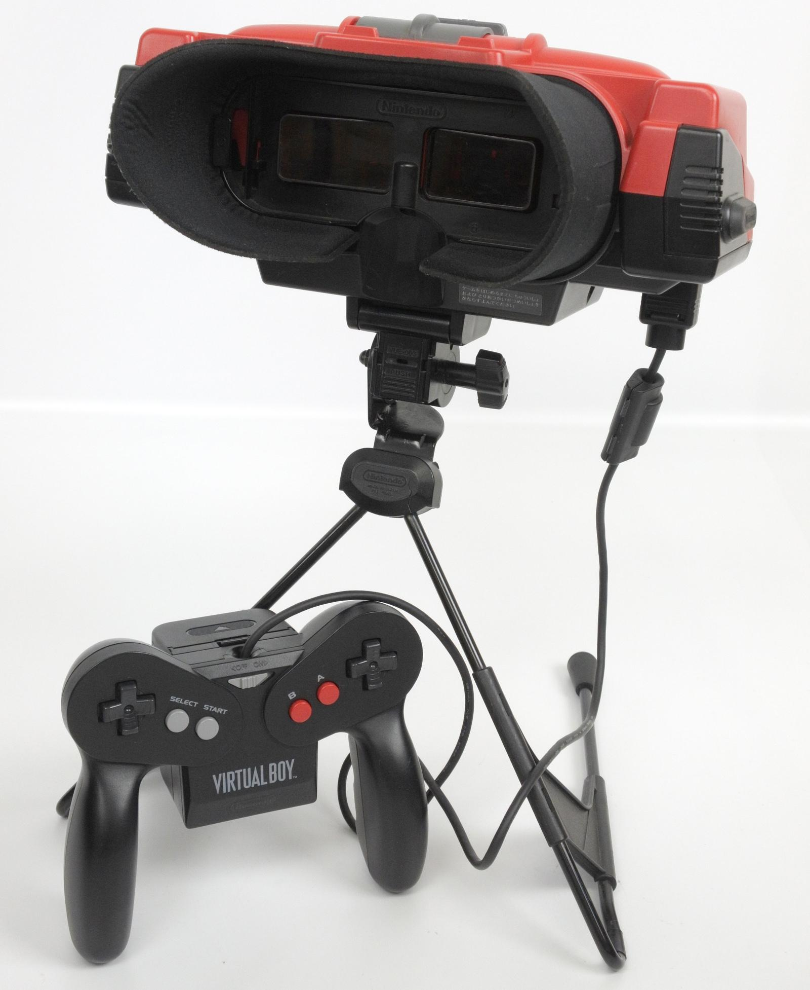
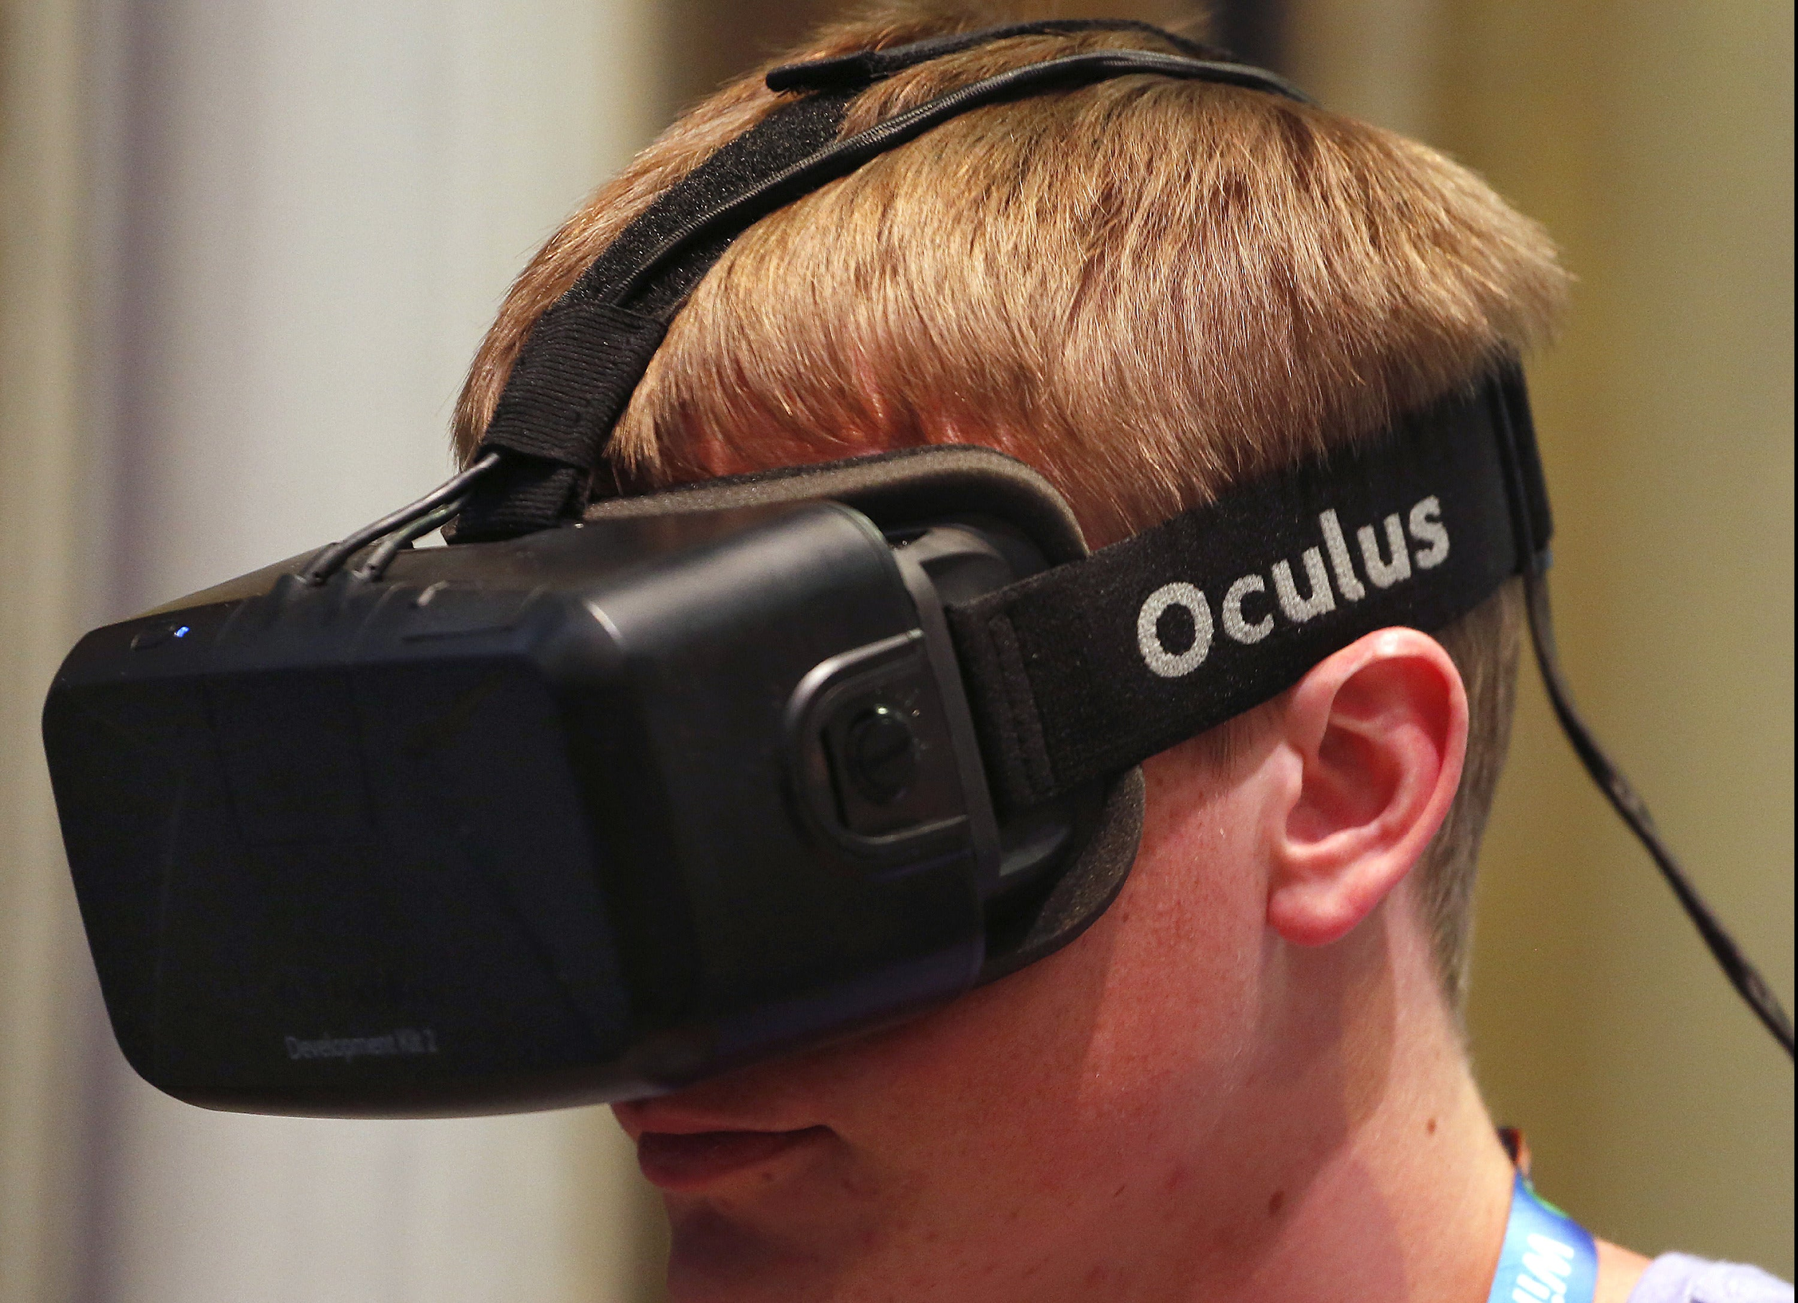
The Design of VR
Notes:
1968 – The Sword of Damocles – created by Ivan Sutherland at the University of Utah – computer graphics
1995 – Virtual Boy by Nintendo – commercial failure = monochrome display, unimpressive stereoscopic effect, poor ergonomics, no portable
2013 – Oculus Rift DK1 – Palmer Luckey

Slide 89
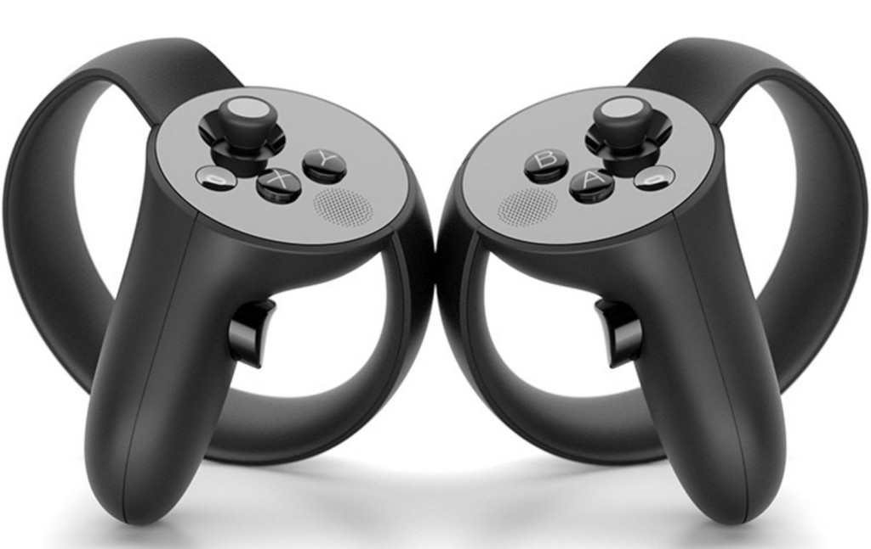
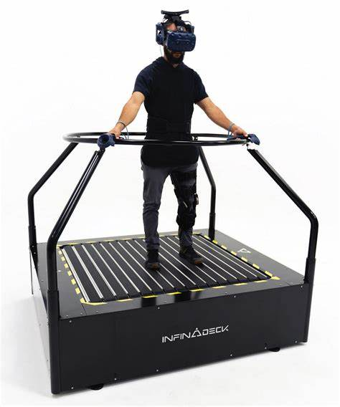
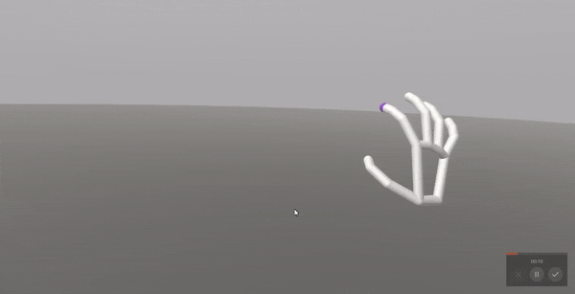
Interaction in VR

Slide 90
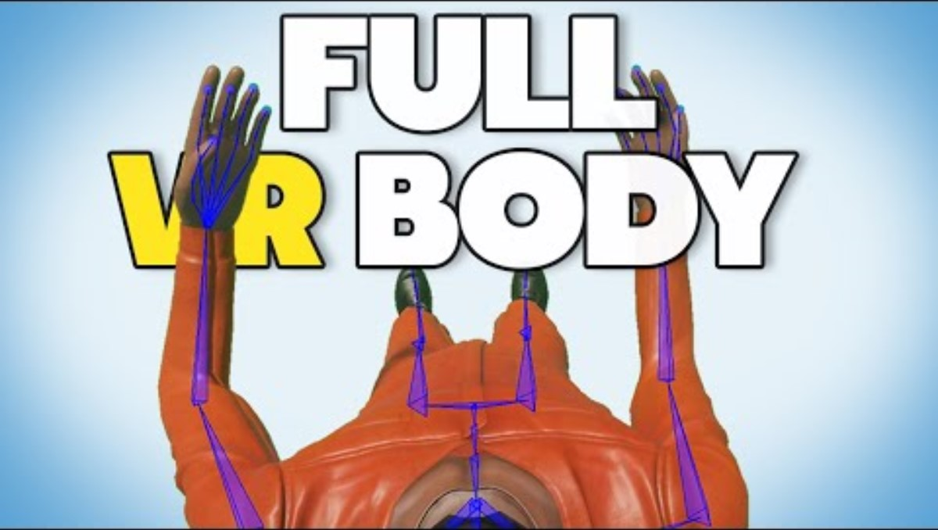
Troubleshooting VR

Slide 91
Try out VR!
Chemistry Lab Simulation
Molecular World

Slide 92
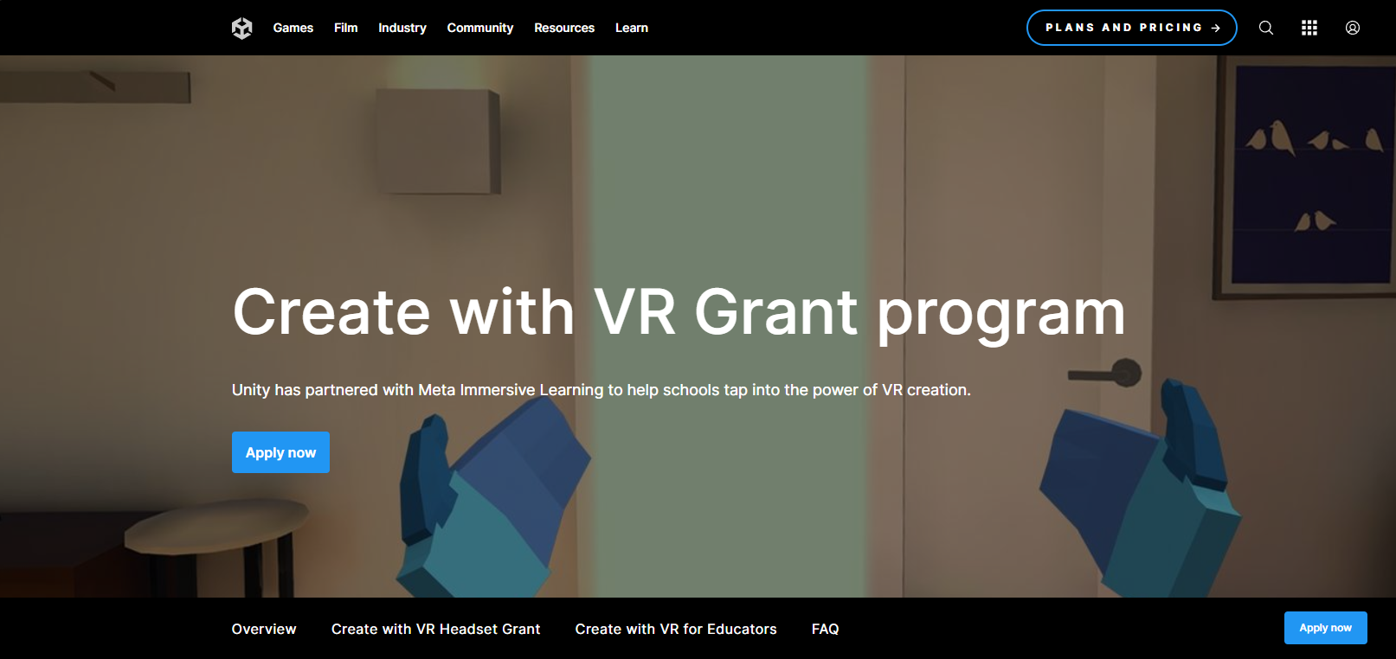
Get some VR headsets for yourself!

Slide 93
VR Lesson Crowdsourced - What ideas do we have to bring VR to our students?

Slide 94
Computing Systems Standard
Core Idea | Performance Expectations
The usability, dependability, security, and accessibility of devices within integrated systems are important considerations in their design as they evolve. | 8.1.12.CS.1: Describe ways in which integrated systems hide underlying implementation details to simplify user experiences. | Operating System Lecture
A computing system involves interaction among the user, hardware, application software, and system software. | 8.1.12.CS.2: Model interactions between application software, system software, and hardware. 8.1.12.CS.3: Compare the functions of application software, system software, and hardware. | Virtual Reality Lesson
Successful troubleshooting of complex problems involves multiple approaches including research, analysis, reflection, interaction with peers, and drawing on past experiences. | 8.1.12.CS.4: Develop guidelines that convey systematic troubleshooting strategies that others can use to identify and fix errors. | Help students to use SEL skills in growth mind set

Slide 95
Further Resources
Lesson: Human Computer
https://www.educationworld.com/a_tech/tech/tech195.shtml
https://www.azed.gov/sites/default/files/2019/09/Kindergarten%20CS%20Lessons.pdf?id=5d72d0e91dcb251298c0faa2
https://www.sfusd.edu/learning/curriculum/elementary-school/computer-science/k-2-computer-science-curriculum

Slide 96
Break

Slide 97
Networks and the Internet

Slide 98
NJSLS - CS Standards
Core Idea | Performance Expectations
The scalability and reliability of the Internet are enabled by the hierarchy and redundancy in networks. Network topology is determined by many characteristics. | 8.1.12.NI.1: Evaluate the scalability and reliability of networks, by describing the relationship between routers, switches, servers, topology, and addressing.
Network security depends on a combination of hardware, software, and practices that protect data while it is at rest, in transit, and in use. The needs of users and the sensitivity of data determine the level of security implemented. Advanced attacks take advantage of common security vulnerabilities. | • 8.1.12.NI.2: Evaluate security measures to address various common security threats. • 8.1.12.NI.3: Explain how the needs of users and the sensitivity of data determine the level of security implemented. • 8.1.12.NI.4: Explain how decisions on methods to protect data are influenced by whether the data is at rest, in transit, or in use.

Slide 99
What are the concerns or challenges we have with addressing this standard?

Slide 100
Context

Slide 101
Networks - Gr 9-12 Standard
The Gr 6-8 Network Standard is a significant change from the Gr 3-5 standard. In the Gr 3-5 standard, students have to understand basically data is transmitted both wirelessly and with wired communication.
The Gr 6-8 Standard starts to address the actual technology on how a network works.

Slide 102
Why do students need to learn this?
Students need to understand Networks because, on their person, at any given point in time they are connecting with usually one if not multiple networks.
Consider your average middle schooler: Most have a chromebook and a phone on their person. The chromebook is connecting to the school network and the phone is connecting to the larger telecommunications network. The student may also have a smart watch, smart ring or smart glasses on their person.
If the child has a significant health problem, like a cardiac, neurological, or endocrine challenge like diabetes, they may also be wearing a networked medical assistive device.
Grades 9-12 are emerging adults. Soon they will have the responsibility for making choices about phones, computers, credit cards, purchases, and other data and hardware connected to the Internet. It is important to understand what is happening to our data.

Slide 103
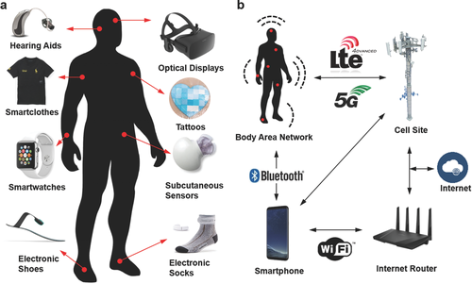
Example of Wearable
Wearable are taking the world by storm. Students will need to be able to navigate this world to understand their comfort levels and how to socialize and cope with this world.
Image Source: https://onlinelibrary.wiley.com/doi/full/10.1002/adma.201706910?_utm_campaign=mention57529&_utm_medium=inline&_utm_content=lnk241316896300&_utm_source=xakep

Slide 104
Networks - why learn them
There are two major issues at play with network and why students need to learn them:
Students need to be able to understand how to connect their devices to the network.
Students need to learn how to protect both their data and their devices from any on-line security issues.

Slide 105
Teenagers and the Economics of Hacking
In 2017, families with members under the age of 20 lost $8.7 million in hacking schemes.
In 2021, families in this same demographic lost $101 million.
The United States is the primary target for most international hacking.
New Jersey is in the top 10 states for being targeted in hacking or malicious attacks.
*Source: FBI Internet Crimes Complaint Center https://www.ic3.gov/Media/PDF/AnnualReport/2021_IC3Report.pdf

Slide 106
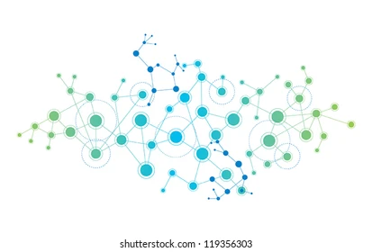
What is a network?
A connection between two or more computers so that they can share:
Data
Communication
Printing
Files
Other resources
A Network is Modeled as:
Line represents a connection
A Circle (vertex, node) represents a “thing” we are connecting - a computer, a website, etc.

Slide 107
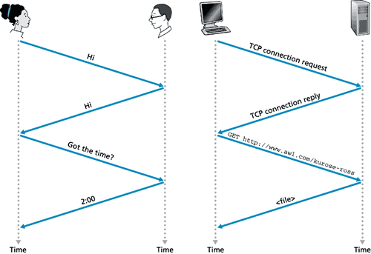
Protocols
Protocols are the system of rules by which communication happens.
Humans have protocols in their communication.
Computers use protocols to communicate with each other.

Slide 108
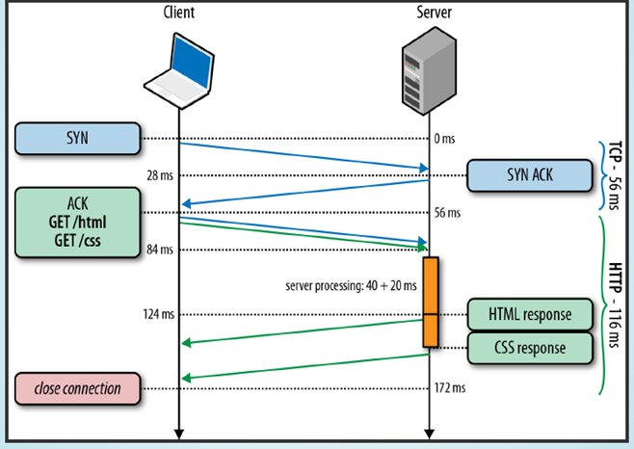
HTTP Protocol

Slide 109
More on Protocols
Protocols define how my hardware connects, how my data is transported - both in routing the data and the “driving directions” for particular data, and the format of the data going over the network.
Anything that goes over a network uses protocols.
Popular Protocols
TCP/IP: Transmission Control Protocol/Internet Protocol
SMTP/POP3/IMAP: Email
SFTP/FTP: Secure File Transfer Protocol
HTTP(S): Hypertext Transfer Protocol (Secure)

Slide 110
WWW and the Internet - are they the same thing?
NO!!!!
The Internet is the physical network of computing devices - the physical connection and how the physical connections are managed.
The World Web Web is a service that gives us a type of data that is transmitted over the Internet. It is one - albeit very large - service of the internet.
Examples of other services: Email, Instant or Private Messaging, Movie or Music Streaming, File Transfers.
These services work with one another to create a seamless experience, but they are different.

Slide 111
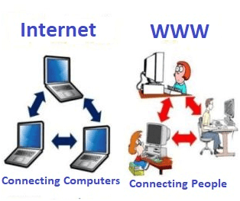
Internet vs WWW
https://www.javatpoint.com/what-is-world-wide-web

Slide 112
Networks
A network is the connection between two computational devices. Usually they are “equals”, that is both are computational devices - so a mouse connecting to a computer is usually not considered a network though many now use wireless network connections.
Network can be described (or classified) based on:
How do we connect (wireless or wired)
How it is laid out (topology)
Who owns the network?
How do we exchange information (Client/Server or Peer to Peer)

Slide 113
Basics of Networks - Ring Network

Slide 114
Basics of Networks

Slide 115
Basics of Networks - Mesh Topology (every node connected to every other node - used for Peer to Peer Networks)

Slide 116
Basics of Networks - Star Topology (used for client/server)

Slide 117
Basics of Networks

Slide 118
How a network is laid out
We call the the way a network is laid out topology.
Wireless Network: Connect to a wireless access point like a router or a repeater or an extender - Need line of sight.
Wired Networks: There is a physical wire that connects devices. There can be a lot of different layouts.

Slide 119
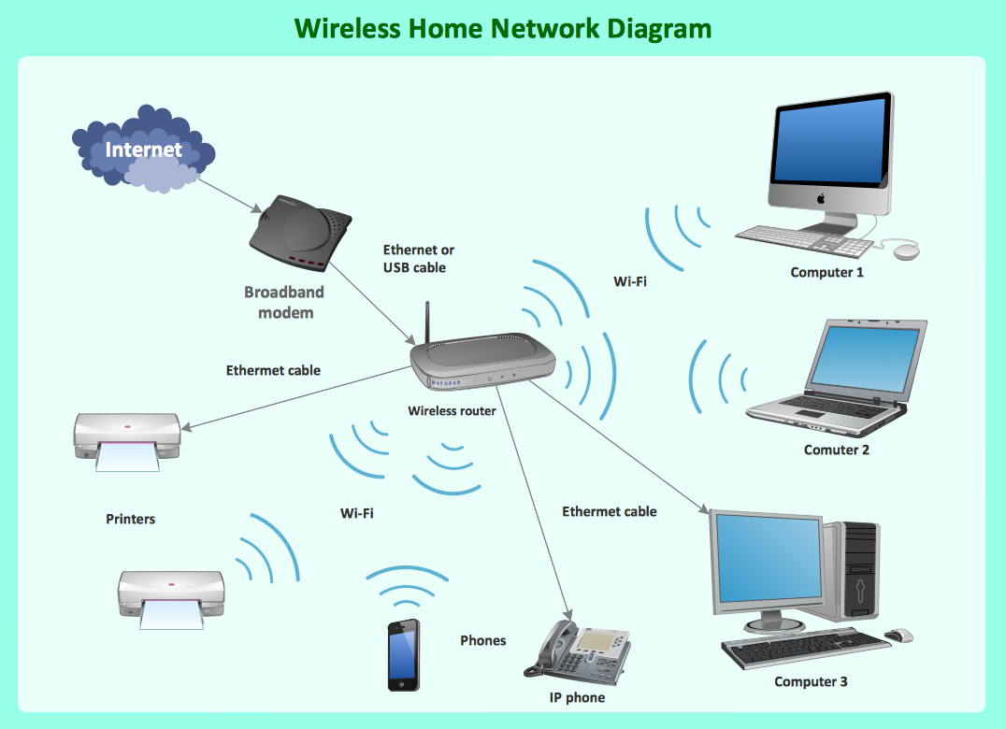
How do we connect - wired vs wireless?
Wireless
Image Credit: https://www.conceptdraw.com/How-To-Guide/what-is-a-wireless-network

Slide 120
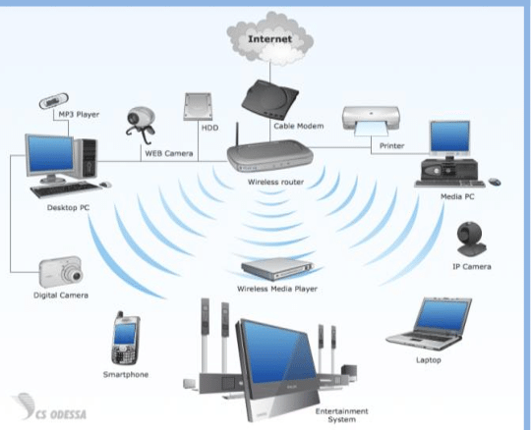
Wireless Network
Wireless Networks need “line of Sight”, that is the radio signal must be able to reach the device.
On a wired network, the signal follows a dedicated path (the wire). One a wireless network, it is broadcast.

Slide 121
An anatomy of a Protocol
A Protocol in general has a header and a body.
Header: The header gives directions about details about the message being sent.
Body: The body has the information that we are trying to transmit.
Different protocols break up the messages in different ways.

Slide 122
TCP/IP Protocol
The TCI/IP Protocol - created in the late 1960s/ early 1970s as a part of the ARPANET project.
TCP/IP is based on the idea of a packet.
Packets: a small piece of data we want to transmit from a sender to a receiver.
TCP/IP breaks a message into packets, where the header gives directions for routing the message and how to assemble the packets. The body is some small part of the data we want to send.
TCP: Collects and reassembles packets
IP: Transmits and routes packets

Slide 123
IP Addresses
When we use the Internet, we are use to using a URL or a hyperlink to access the network.
A URL is a substitute for a IP address - a unique address that identifies a computer or device on the Internet.
When we type in a URL, the servers on the network replace the URL with the IP address and then your request gets directed or routed to that address.

Slide 124
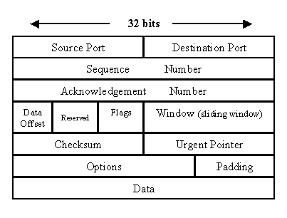
TCP/IP - anatomy of a packet

Slide 125
Error Correction and Packets
Most Protocols have error correction techniques.
Error Detection Techniques:
Checksum: tells the destination how many bits it should receive. When a computer receives a packet, it checks against the checksum that the message is the right size.
Acknowledgement: The destination sends back an acknowledgement message to indicate the message is received.
Retransmission after time out: The message is retransmitted after a certain amount of time elapses.

Slide 129
Client/Server vs Peer to Peer
Client/Server: a network model or architecture between a client and the server where the client sends a request, and the job of the server is to fulfil whatever the client’s request is. Used for majority of network needs.
Peer-to-Peer (P2P): a network is created when two or more PCs are connected and share resources without going through a separate server computer. Used for gaming and smaller activities. BitTorrent - a protocol for sharing large files - has been used for sharing movies and other large media. Facebook, Twitter and US Government use it internally.

Slide 130
Network Security
8.1.8.NI.3: Explain how network security depends on a combination of hardware, software, and practices that control access to data and systems.
• 8.1.8.NI.4: Explain how new security measures have been created in response to key malware events.

Slide 131
Network Security and Hardware
Hardware Firewall: a physical device that enforces a network boundary. Can be used to filter certain websites (i.e., your school probably has a firewall that prevents certain websites from being accessed by students)
All network links cross over this hardware allowing for the analysis of the incoming and outgoing traffic.
Access Control: Only allowing access to certain systems from certain physical locations.
Proxy server: An intermediary server that retrieves data from an Internet source, such as a webpage, on behalf of a user

Slide 132
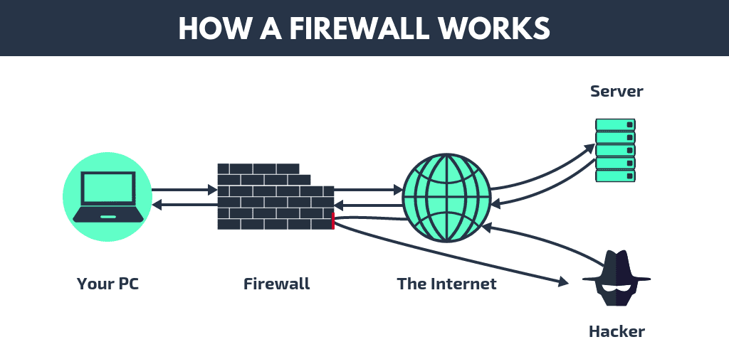
Image courtesy https://drsoft.com
Notes:
https://drsoft.com/2019/02/25/what-is-a-firewall-and-why-is-it-necessary/

Slide 133
Ways to violate Hardware Security
Manufacturer “Backdoors”
Used as a means to administer a network device, usually set with a default username / password.
Eavesdropping, Intercepting Network Packets
Unsecured messages, files, logon information, etc. can be intercepted as it is sent over the internet - especially public wifi, hotspots, etc. Packet sniffing software can be used at payment terminals
Redirecting Traffic
Routers usually come with a built-in firewall. A hacker could configure this firewall to direct traffic to a destination of their choosing, in the same way we might use it to prevent access to certain websites
DOS / DDOS Attack
One or more computers used to flood a network with packets and slow down traffic
Notes:
DDOS - think of network topology exercise from earlier - imagine entire string was filled with packets - what happens? Similar to a “traffic jam”

Slide 134
Exercise 10 - Mimic Network Interception
At your group, pick one network topology and send one of your messages.
Add in a packet that says “Password”.
Pick one group member to be the “hacker”. This person will create a packet that says “fake password”.
Send your message across your network. The hacker needs to monitor the network and see if they can replace the password with the fake password.

Slide 135
Debrief
Was your hacker able to replace the password?
How easy was it to do?
If you sent your message in a different language, or encrypted, do you think it would have been as easy to replace the password?
Interception is often done with URLs, so you are redirected to a website that looks like your trusted site but the site collects your passwords to access the real site.

Slide 136
Network Security and Software
Computer anti-virus
Software that can detect and eliminate computer viruses and malware
Often runs independently and continuously in background
Internet protection
Most modern web browsers detect potential malware and will block and warn before going to a potentially malicious website
Threat monitoring
Can include monitoring network traffic to detect and block potential attacks
Software firewall (built into computer) provides a line of defense, checking incoming and outgoing network traffic to your computer
Notes:
Examples: *Internet protection - when you go to a website and browser says “stop, not safe” - you can choose to trust and continue anyway, or not. Can go into SSL certificates if want
*Threat monitoring - Note how sometimes your work computer cannot access certain websites, software, download programs, etc. - this is usually due to specific firewall rules stating what can and cannot be accessed

Slide 137
Ways to violate Software Security
Malware: Broad consensus among antivirus software that program is malicious or obtained from flagged sources. Umbrella term for malicious software
Viruses: a type of malware designed to alter the way a computer operations, or cause harm to the computer system by inserting its own code into those programs
Worms: a standalone malware computer program that replicates itself in order to spread to other computers via a network
Rootkits: a collection of computer software, typically malicious, designed to enable access to a computer or an area of its software that is not otherwise allowed (for example, to an unauthorized user) and often masks its existence or the existence of other software
Backdoor: a typically covert method of bypassing normal authentication or encryption in a computer, product, or embedded device. Often manufacturer installed, and exploited by a hacker
Notes:
Backdoor - Often controversial, i.e. FBI-Apple encryption dispute 2015/2016

Slide 138
Network Security and Practices
Passwords
Unique sequences of characters. The longer the string with diverse characters the better.
Hashing passwords: putting a password through a hashing algorithm (bcrypt, SHA, etc) to turn plaintext into an unintelligible series of numbers and letters.
Salting passwords: a technique to protect passwords stored in databases by adding a string of 32 or more characters and then hashing them
Encrypting passwords: Encryption scrambles your password so it's unreadable and/or unusable by hackers.
Biometrics: unique physical characteristics, such as fingerprints, that can be used for automated recognition.
Multifactor Authentication: an authentication method that requires the user to provide two or more verification factors to gain access to a resource such as an application, online account, or a VPN.

Slide 139
Ways to violate Practices Security
How to get around passwords:
Brute force attack
Social Engineering
Phishing
Keylogger
Malware
How to get around biometrics:
Fingerprints easy to hack - graphite and white paper, tape, high resolution pictures
High resolution image of the eye
Social Engineering
How to get around multifactor authentication (2fa or mfa):
Simjacking - hacking your simcard
Malware can get around MFA
Text messages can be intercepted and they are not encrypted
Social Engineering

Slide 140
Key Responses to Network Security
Improved firewall rules
When a network suffers any kind of malicious attack, security experts will often analyze firewall rules and update / modify them to protect against new attacks and vulnerabilities
Software patches
When a security vulnerability is exploited in a malicious way, the vendor will update the software to protect against the vulnerability. For example, there was a major security flaw in Apple’s macOS High Sierra that allowed anyone to gain administrator access to any individual mac computer with the operating system. Apple released a “patch”, or a software update, to prevent this from occurring and protect against potential threats
Segregating the network
Segregating a network involves identifying devices on the network that contain sensitive information, and separating them from the general network. For example, at a school a server containing budget information would not reside in the same part of a network as student devices accessing the internet

Slide 141
Lessons

Slide 142
Microbits

Slide 143
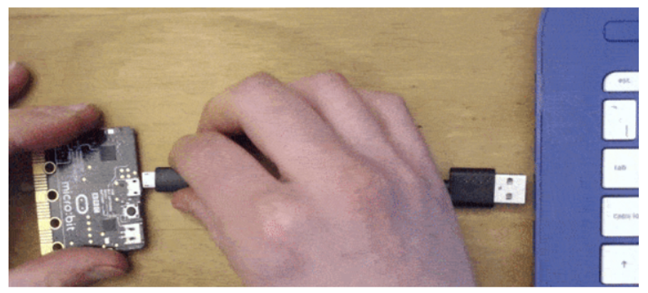
Connect your Microbit to your laptop!
If your computer is lacking a USB-A port, use a USB-A to USB-C adapter to connect your Microbit.
Yes, it is normal for your Microbit to power up and make noises and display LED lights! This is the demo program that is pre-loaded onto the hardware.

Slide 144
Please go to:
https://makecode.microbit.org/
Partner up with ONE other person at your table. If there is an odd number of people, then two people should partner up on ONE microbit.
Determine which microbit will be the SENDER, and which microbit will be the RECEIVER.
I will assign each of you a group number. Please remember your group number (or this will turn into a disaster :) )

Slide 145
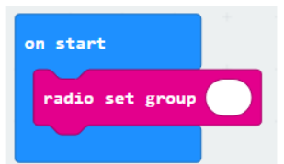
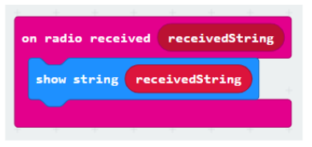
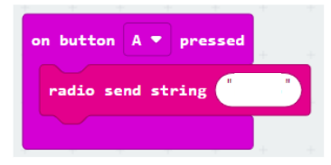
Coding your microbits…
Blocks for BOTH SENDER and RECEIVER:
Your specific group # here
Blocks for SENDER ONLY: Blocks for RECEIVER ONLY:
Enter a
custom
message

Slide 146
Test your program. Did it work?
Press the SENDER’S A button. Did the RECEIVER display the message?
Your next challenge: Modify your code so that each microbit can act as BOTH a SENDER and RECEIVER!
In other words, you should be able to send messages back and forth between both microbits!

Slide 147
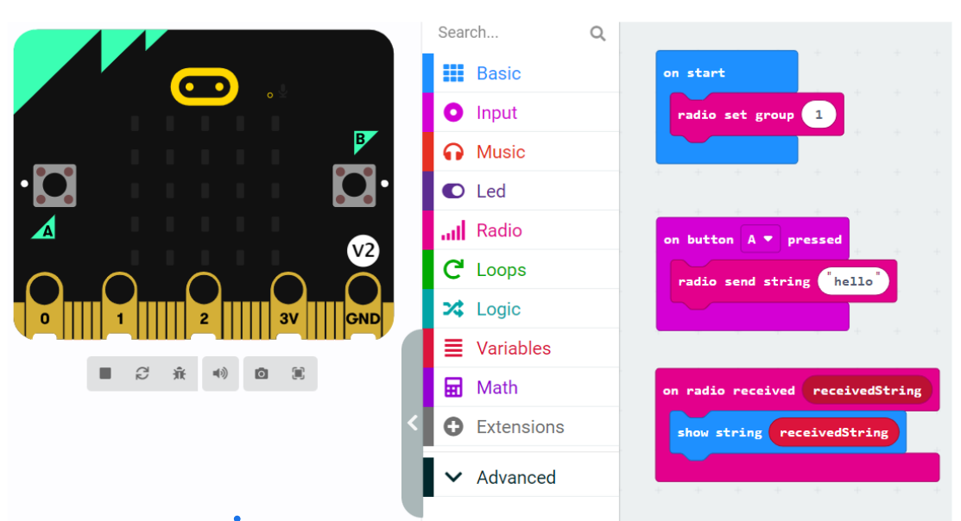
Challenges, questions & notes
To solve this challenge, both microbits simply need to have the same exact code to be able to both send and receive messages!

Slide 148
Microbit radio communication/networking
Is this a secure way for microbits to communicate with each other?
How could this system be “hacked”?
How could this communication be more secure?
Is there anything in real-world networking that is similar to how microbits communicate?

Slide 149
NJSLS - CS Standards
Core Idea | Performance Expectations | Lesson That Addresses Content
The scalability and reliability of the Internet are enabled by the hierarchy and redundancy in networks. Network topology is determined by many characteristics. | 8.1.12.NI.1: Evaluate the scalability and reliability of networks, by describing the relationship between routers, switches, servers, topology, and addressing. | Microbit Lesson Beacons of Gondor String Network Identifying networks in real life
Network security depends on a combination of hardware, software, and practices that protect data while it is at rest, in transit, and in use. The needs of users and the sensitivity of data determine the level of security implemented. Advanced attacks take advantage of common security vulnerabilities. | • 8.1.12.NI.2: Evaluate security measures to address various common security threats. • 8.1.12.NI.3: Explain how the needs of users and the sensitivity of data determine the level of security implemented. • 8.1.12.NI.4: Explain how decisions on methods to protect data are influenced by whether the data is at rest, in transit, or in use. | CyberPatriot: https://www.uscyberpatriot.org/Pages/About/What-is-CyberPatriot.aspx

Slide 150
Pedagogy

Slide 151
Approaches to Teaching CS
Storytelling
Inter-/Trans-disciplinary
Universal Design for Learning

Slide 152
Approaches to Teaching CS
Storytelling
“coding is also reflective of the imaginative and narrative elements of fiction writing workshops.” (Burke & Kafai, 2010)
Demonstration of Language, Literacy, Equity, and Bilingual/Multilingual Students
https://nyuscholars.nyu.edu/files/80078129/Fall_2020_PiLa_CS_Telenovela_Classroom_Case_Study.pdf

Slide 153
Approaches to Teaching CS
Inter-/Trans-disciplinary

Slide 154
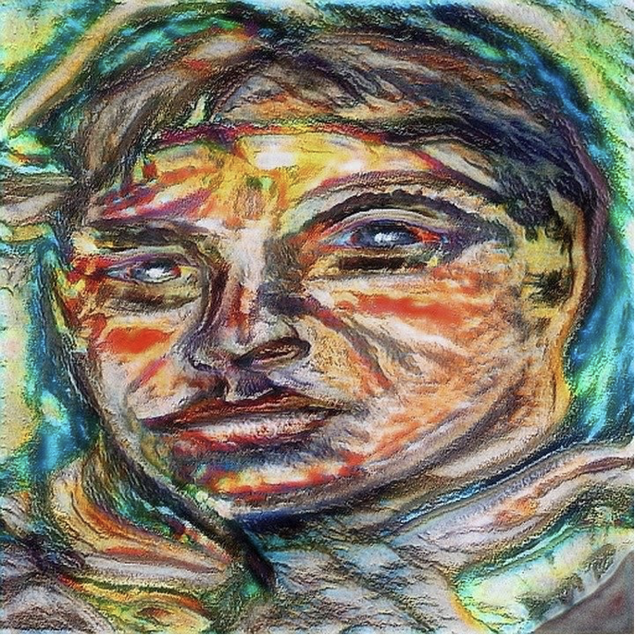
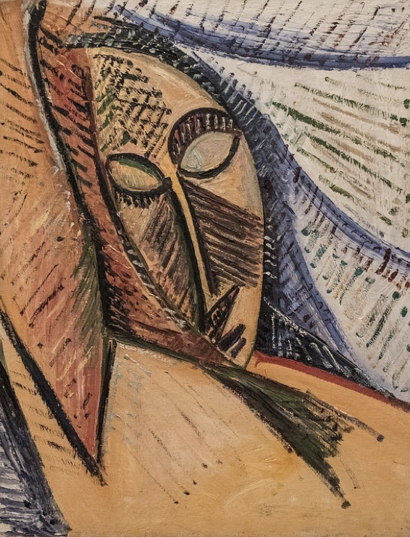
Abstraction and Art:
What is depicted in these Picasso paintings?

Slide 155
What is Scratch? - 3 minutes
Notes:
ASK: What types of projects did you see in the video?
animations, games, stories, presentations, etc.

Slide 156
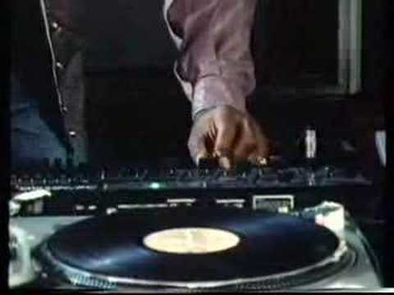
Impact of Computing
How do we impact computing technology positively/negatively?

Slide 157
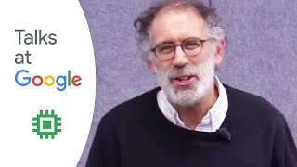
Scratch, Language, Math, and More
Notes:
Time: 19:10 - 20:50

Slide 158
Universal Design
for Learning (UDL)
Resources:
cast.org
https://udlguidelines.cast.org/
Computer Science for Everyone, Everywhere (CSEE)
Notes:
Move to the last slide

Slide 159
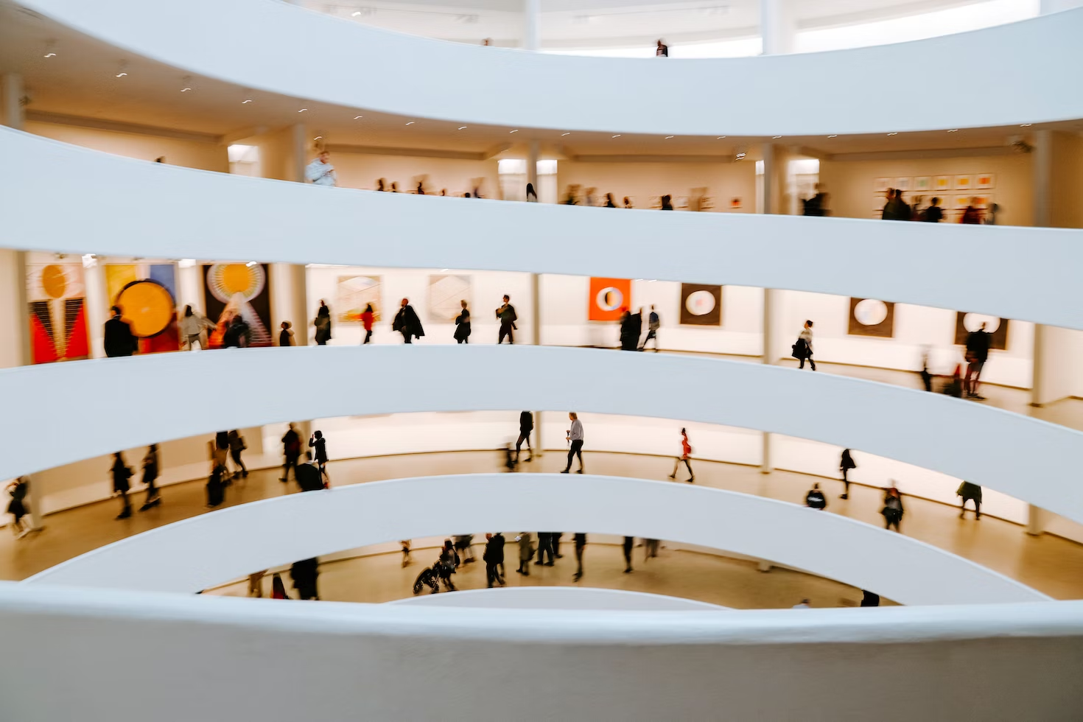
Foundations of UDL: Architecture
The Guggenheim Museum, NYC
Computer Science for Everyone, Everywhere (CSEE)

Slide 160
Computer Science for Everyone, Everywhere (CSEE)

Slide 161
UDL is…
“UDL is a framework that guides the shift from designing learning environments and lessons with potential barriers to designing barrier-free, instructionally rich learning environments and lessons” (Nelson, 2014, p. 2) --Scientifically valid framework
UDL provides a blueprint for creating instructional goals, methods, materials, and assessments that work for everyone--not a single, one-size-fits-all solution but rather flexible approaches that can be customized and adjusted for individual needs.
UDL involves helping all students succeed.
Computer Science for Everyone, Everywhere (CSEE)

Slide 162
What are the barriers?
Learning barriers are those elements of a lesson or the environment that prevent a learner from reaching the goal.
“barriers to learning are not, in fact, inherent in the capacities of learners, but instead arise in learners' interactions with inflexible educational goals, materials, methods, and assessments.”
(Dr. David Rose. Teaching Every Student in the Digital Age, p. vi)
A building barrier might be stairs;
a change made to the building might be _______________.
Computer Science for Everyone, Everywhere (CSEE)
Notes:
Move to the last slide

Slide 163
Learning barriers might be…
Removing barriers
Alphabet posters are hung on the narrowest wall because they visually look best there
Alphabet posters are hung on a spot where learners can see them easily (resource)
Learners are not motivated in math class. The goals are disconnected from their interests and experience.
The goal is rewritten to highlight an authentic application of the mathematical content to the real world.
Learners know that each day they need to come having read a chapter of the textbook and ready to take notes on that information.
Provide the reading materials in various formats (audio, digital, print) along with comprehension supports
Computer Science for Everyone, Everywhere (CSEE)

Slide 164
Data and Analysis

Slide 165
NJ SLS CS Standard - In a Nutshell
By the end of Grade 12
• Individuals select digital tools and design automated processes to collect, transform, generalize, simplify, and present large data sets in different ways to influence how other people interpret and understand the underlying information.
• Choices individuals make about how and where data is organized and stored affects cost, speed, reliability, accessibility, privacy, and integrity.
• Large data sets can be transformed, generalized, simplified, and presented in different ways to influence how individuals interpret and understand the underlying information.
• The accuracy of predictions or inferences made from a computer model is affected by the amount, quality, and diversity of data.

Slide 166
What does that mean to us?
In many ways the Data Standard is the hardest of the standards. While it is with the best of intentions we want to help students learn the skills they need to analyze data properly, these skills can often be misinterpreted for other motives.
The important points in the Data Standard continuing with data concepts both from the 6-8 standard but also the math standard.
The important thing to remember with the data standard is that we are:
1 - Trying to help students understand the nature of data
2 - Begin to use some simple analysis and visualization tools
3 - Challenge students in why they are accepting the tool’s output as fact.

Slide 167
Grade 9-12 Data Sciences Expectation
Core Idea | Performance Expectations
Individuals select digital tools and design automated processes to collect, transform, generalize, simplify, and present large data sets in different ways to influence how other people interpret and understand the underlying information. | 8.1.12.DA.1: Create interactive data visualizations using software tools to help others better understand real world phenomena, including climate change.
Choices individuals make about how and where data is organized and stored affects cost, speed, reliability, accessibility, privacy, and integrity. | • 8.1.12.DA.2: Describe the trade-offs in how and where data is organized and stored. • 8.1.12.DA.3: Translate between decimal numbers and binary numbers. • 8.1.12.DA.4: Explain the relationship between binary numbers and the storage and use of data in a computing device.
Large data sets can be transformed, generalized, simplified, and presented in different ways to influence how individuals interpret and understand the underlying information. | 8.1.12.DA.5: Create data visualizations from large data sets to summarize, communicate, and support different interpretations of real-world phenomena. .
The accuracy of predictions or inferences made from a computer model is affected by the amount, quality, and diversity of data. | 8.1.12.DA.6: Create and refine computational models to better represent the relationships among different elements of data collected from a phenomenon or process.

Slide 168
What do we dread about teaching this unit?

Slide 169
Lesson ideas we want to share

Slide 170
Definitions/Vocabulary
Organize and Transform Data: Transforming data means to convert the data into a format a tool can us. Sometimes this might also mean organizing it in a new way.
Data Cleaning: Data cleaning is the process of reviewing the data for quality issues and the modifying the data to make sure it properly represents the data we want to capture. Be very careful in this process- we need to review data for organizational errors, not change data to fit what we expect.
Simulation: programs that run various mathematical scenarios to determine the potential scope or impact that a particular scenario could have.
Refinements: Improvements that impact either the quality of the output or how fast the tools runs.

Slide 171
Perspective - Data Visualization

Slide 172
https://visme.co/blog/best-data-visualizations/

Slide 173
US 2020 Election visualization on NPR
Look at this visualization: https://www.npr.org/sections/live-updates-2020-election-results
Note: This is not a statement about who won the election, just how the information is visualized.
What visualization are you most used to?
What visualization do you feel is most representative of the data?

Slide 174
Lets try - Modeling either population or carbon emissions in Sheets.
https://www.worldometers.info/co2-emissions/co2-emissions-by-country/#google_vignette

Slide 175
More advanced visualizations
https://www.vev.design/
Free to use more advanced designs.

Slide 176
Perspective - Data Representation and Binary

Slide 177
Data and Binary
All data must be able to be mapped onto the binary number system. This type of data is called discrete data.
We can do a lot of representation with this - most text can be represented this way. Pictures used binary values to represent the presence of certain colors in a picture element or pixel. We can record sound waves and the play rapid pictures with sound over them to make movies.
Some things cannot be represented by the computer. For example - a computer cannot represent a circle completely - only an approximation of it.
Computer Science for Everyone, Everywhere (CSEE)

Slide 178
Data and Binary
Computer Science for Everyone, Everywhere (CSEE)

Slide 179
Data and Binary
Computer Science for Everyone, Everywhere (CSEE)

Slide 180
Bits, Bytes and Data Storage
Binary Digit: Bit - this is our ones and zeros.
Byte: 8 bits equal 1 byte. I can store 256 different values with 1 Byte. With 2 Bytes working together, I can store 65,536 values. One byte lets me represent all English characters (ASCII). Two bytes lets me represent all other alphabets except languages like Mandarin. Even those, the major characters can be represented (Unicode).
In working with powers of two, every time you add a bit, you are doubling the amount of data that you can store or work with.
Computer Science for Everyone, Everywhere (CSEE)

Slide 181
Computer Science for Everyone, Everywhere (CSEE)

Slide 182
Digitizing Color
RGB Colors: Binary Representation
Giving the intensities for the three constituent colors—red, green, blue—specifies color on monitor
Color intensity is represented as a numeric quantity in the range 0 through 255 (decimal)
Binary Numbers Compared with Decimal Numbers
Number of digits is the base of numbering system
Binary is two digits: 0 and 1
Decimal is 10 digits: 0 through 9
Hexadecimal is 16 digits: 0 through 9, A through F
11-‹#›

Slide 183
Place Value in a Decimal Number
To find the quantity expressed by decimal number, the digit in a place is multiplied by the place value, and the results are added
11-‹#›

Slide 184
Place Value in a Binary Number
Binary works the same way except that the place values are successive powers of 2
11-‹#›

Slide 185
Place Value in a Binary Number
Given binary representation, we can find the decimal equivalent value by multiplying the digit times the place value and adding the results
11-‹#›

Slide 186
Converting a Binary Number to Decimal
Add the decimal values for the places in the binary number showing 1's
11-‹#›

Slide 187
Black and White Colors
A byte is allocated to each RGB intensity
The smallest intensity is 0000 0000
The largest is 1111 1111 in binary
This is 255 in decimal, and FF in hex
Black (#000000) is no color; white (#FFFFFF) has full intensity for each RGB color (these are HEX)
Black: 0000 0000 0000 0000 0000 0000
White: 1111 1111 1111 1111 1111 1111 (these are binary)
11-‹#›

Slide 188
Changing a Decimal Number to a Binary Number
If the number being converted is smaller than the place value below it, copy the number into the next cell to its right; enter 0 as the binary digit.
If the number being converted is equal to or larger than the place value below it, subtract the place value from the number and copy the result into the first cell of the next column; enter a 1 as the binary digit.
11-‹#›

Slide 189
Lighten Up: Changing Color by Addition
What color does this represent:
1100 1000 1100 1000 1100 1000
Each byte contains the decimal value 200. The color is RGB(200,200,200).
In HTML, write in hexadecimal #C8C8C8
Equal amounts of red, green, and blue, closer to white than black (medium gray)
All colors with equal RGB values are black, white, or gray
11-‹#›

Slide 190
To Increase Intensity: Add in Binary
To make a lighter color of gray, change the common values to be closer to white (larger numbers)
For example, add 0001 0000 (decimal 16) to each color:
1101 1000 1101 1000 1101 1000 RGB(216,216,216)
11-‹#›

Slide 191
Lighter Still: Adding with Carry Digits
Binary addition is similar to decimal addition
Work from right to left, adding corresponding digits in each place position
Sometimes we can add the two numbers and the result is expressed as a single digit (1+0=1)
Sometimes the sum cannot be expressed in one digit and we must carry to the next highest place
(1+1=10, put down 0 and carry 1)
11-‹#›

Slide 192
11-‹#›

Slide 193
11-‹#›

Slide 194
11-‹#›

Slide 195
11-‹#›

Slide 196
Overflow
Because computers use fixed-size bit sequences, what happens when there are not enough bits to represent the correct result of a binary addition?
Called overflow exceptions
Computers report them when the computation they're told to perform overflows; programmer has to find way to recover
11-‹#›

Slide 197
Computing On Representations
Changing the Colors of a Moon Photo
Consider a scanned black and white photo of the moon
In the computer, the pixels of the photo form a long sequence of RGB triples. What values do they have?
They are all black, white, or gray
Suppose you want a colorized version?
11-‹#›

Slide 198
Removing the Smudge
You have very dark gray values (28,28,28) from a smudge on the scanner's glass
To remove the smudge and transform the pixels into the colors you remember seeing
Anything very close to black (first 2 digits are 00) can be changed to black (00xx xxxx) (0-63)
Algorithm for this is: Any three RGB bytes, each of whose first 2 bits are 00, are replaced with all zeros
11-‹#›

Slide 199
Making the Moon Orange
To shift color of moon to orange, change the white pixels:
Pick a shade of orange, say (255,213,132)
Change all the white pixels (255,255,255) to this shade
This will not change the gray of the craters
To change Light Gray into Orange Tint:
Red byte: Leave unchanged
Green byte: reduce green slightly (subtract 42)
Blue byte: reduce blue significantly (subtract 123)
11-‹#›

Slide 200
11-‹#›

Slide 201
Boosting the Red
You decide the gray parts of the moon need to be more luminous
Boost the red
Shifting the red in the orange pixels to 255 is too red
Split the difference. Add half the difference between the current value and pure red
11-‹#›

Slide 202
Digitizing Sound
An object creates sound by vibrating in a medium such as air
Vibrations push the air
Pressure waves emanate from the object and vibrate our eardrums
The force, or intensity of the push determines the volume
The frequency (number of waves per second) is the pitch
11-‹#›

Slide 203
11-‹#›

Slide 204
Analog to Digital
To convert continuous information into discrete information, convert it to bits
From zero line on graph, record with binary number the amount by which the wave is above or below it (positive or negative sound pressure)
At what points do we measure? We can't record every position of the wave
11-‹#›

Slide 205
Sampling
Take samples (measurements) at regular intervals
Number of samples in a second is the sampling rate
The faster the rate, the more accurate the recording
11-‹#›

Slide 206
How Fast a Sampling Rate?
Sampling rate should be related to the wave's frequency
Too slow a rate could allow waves to fit between the samples; we'd miss segments of sound
Guideline is Nyquist Rule: Sampling rate must be at least twice as fast as the fastest frequency
Human perception can hear sound up to 20,000 Hz, so 40,000 Hz sampling rate is enough.
Standard for digital audio is 44,100 Hz (44.1 KHz)
11-‹#›

Slide 207
ADC, DAC
Digitizing Process:
Sound is picked up by a microphone (called a transducer)
The signal is fed into an analog-to-digital converter (ADC), which samples it at regular intervals and outputs binary numbers to memory
To play the sound, the process is reversed
Numbers are read from memory into digital-to-analog converter (DAC), which creates an electrical wave by filling in between the digital values
Electrical signal is output to speaker, which converts it to a sound wave
11-‹#›

Slide 208
11-‹#›

Slide 209
How Many Bits per Sample?
How accurate must the samples be?
Bits must represent both positive and negative values
The more bits, the more accurate the measurement
The digital representation of audio CDs uses 16 bits (records 65,536 levels, half above and half below the zero line)
11-‹#›

Slide 210
11-‹#›

Slide 211
Advantages of Digital Sound
We can compute the representation
MP3 Compression
One computation is to compress the digital audio (reduce number of bits needed)
Remove waves that are outside range of human hearing
MP3 usually gets a compression rate of 10:1
Lower bandwidth requirements, popular for Internet transmission
Reproducing the Sound Recording
Bit file can be copied without losing any information
Original and copy are exactly the same
11-‹#›

Slide 212
Digitizing Images and Video
It would take 51 minutes to display an 8 x 10 color image scanned at 300 pixels per inch (21.6 MB) with a 56kb/s modem
How can we see screen-size pictures in second while surfing the web?
Typical computer screen has under 100 pixels per inch
Storing picture digitized at 100 ppi saves a factor of 9 in memory (reducing resolution)
This would still take 5 1/2 minutes to send at 56kb/s
Solution: JPEG Compression scheme
11-‹#›

Slide 213
Compression
Changing the representation to use fewer bits to store or transmit information
Example: fax is a long sequence of 0's and 1's encoding where page is white or black. Run length encoding is used to specify length of first sequence of 0's, following sequence of 1's, etc.
Lossless compression—original representation can be perfectly reproduced
11-‹#›

Slide 214
JPEG
Used for still images
Our eyes are not very sensitive to small changes in hue (gradation of color), but are sensitive to small changes in brightness
Store a less accurate description of hue (fewer pixels)
Gets a 20:1 compression ratio without eyes being able to perceive the difference
11-‹#›

Slide 215
11-‹#›

Slide 216
(Aside) GIF Image Encoding
GIF encoding is a lossless method for simple still images such as artwork, cartoons, icons, etc.
First we create a color table with each color a 1-byte number (so can have max of 256 colors)
FF0000 1
FFFFFF 2
00FF00 3
11-‹#›

Slide 217
(Aside) GIF Image Encoding
Image is represented as runs of pixels of some color (run-length encoding)
Hungary flag shown is encoded as
[15x9] 45:1, 45:2, 45:3
Says the image is 15x9 pixels
Starting from the upper right corner, has 45 pixels in a row of color 1, then 45 in a row of color 2, etc.
11-‹#›

Slide 218
(Aside) GIF Image Encoding
Italy flag shown is encoded as:
[15x9] 5:3,5:2,5:1,5:3,5:2,5:1,5:3,5:2,5:1,
5:3,5:2,5:1,5:3,5:2,5:1,5:3,5:2,5:1,
5:3,5:2,5:1,5:3,5:2,5:1,5:3,5:2,5:1
How much space is saved?
Raw: 9x15 pixels x 3 RGB bytes = 405 bytes
Hungary: 12 byte table +(3 pairs x 2 bytes) = 18 bytes
Italy: 12 byte table +(27 pairs x 2 bytes)= 66 bytes
11-‹#›

Slide 219
MPEG Compression Scheme
Same idea as JPEG, applied to motion pictures
JPEG-like compression is applied to each frame
Then "interframe coherency" is used
MPEG only has to record and transmit the differences between one frame and the next
Results in huge amounts of compression
11-‹#›

Slide 220
Optical Character Recognition (OCR)
Consider a system to read a license plate to deduct toll from car's account… what are the difficulties?
Computer must capture image of license plate, but camera will also see other highway images
Frame grabber recognizes when to snap image and send to computer for processing
Computer must figure out where the plate is within the image
Scans groups of pixels looking for edges where color changes
Looks for features
Classifier matches features to letters of alphabet
11-‹#›

Slide 221
OCR Technology
Enables computer to "read" printed characters
Sorting mail by reading zip codes, addresses
Reading account numbers, handwritten numbers on bank checks
Assistive technology: convert books to audio
Digital libraries: scan documents and convert to digital formats
11-‹#›

Slide 222
Virtual Reality: Fooling the Senses
Creating an entire digital world, with varying levels of “immersion” in that world
Applies to all senses and tries to eliminate the cues that keep us grounded in reality
Haptic devices
Input/output technology for sense of touch and feel
Haptic glove enables computer to detect where our fingers are. When we bring our fingers close enough together, gloves stop their movement so we feel like we're holding something
11-‹#›

Slide 223
The Challenge of Latency
The challenge is for the system to operate fast and precisely enough to appear natural
Latency is the time it takes for information to be delivered
Too long latency period ruins the illusion
Absolute limit to how fast information can be transmitted—speed of light
11-‹#›

Slide 224
The Challenge of Bandwidth
Virtual world models require immense amounts of storage space and data transmission
Bandwidth is how much information can be transmitted per unit time
Higher bandwidth usually means lower latency
11-‹#›

Slide 225
Bits Are It
Bias-Free Universal Medium Principle:
Bits can represent all discrete information, but have no inherent meaning
Bits: The Universal Medium
Everything that can be represented in a sensible way, can be manipulated
Bits: Bias-Free
The meaning of bits comes entirely from the interpretation placed on them through programs
Bits are Not Necessarily Binary Numbers
Bits can be interpreted as binary numbers, or not, depending on use
11-‹#›

Slide 226
11-‹#›

Slide 227
Perspective - Large (not necessarily Big) Data Sets

Slide 228
Large Data vs Big Data
Large Data are data sets of immense size
Big Data are data sets of immense size that conform to the 5Vs:
Velocity
Veracity
Volume
Variety
Value

Slide 229
Data Dashboards
Covid -19 Dashboards:
NY Times: https://www.nytimes.com/interactive/2021/us/covid-cases.html
University of Washington: https://covid19.healthdata.org/global?view=cumulative-deaths&tab=trend

Slide 230
How is data organized?
Computer Science for Everyone, Everywhere (CSEE)

Slide 231
How is data organized? - Tables
Computer Science for Everyone, Everywhere (CSEE)

Slide 232
How is data organized? - Graphs or Network
Computer Science for Everyone, Everywhere (CSEE)

Slide 233
How is data organized?
- Graphs or Network
Computer Science for Everyone, Everywhere (CSEE)

Slide 234
How is data collected
•Often, besides the actual information the data represents, how data interact with each other is also important. Social Media is an example of this concept.
Computer Science for Everyone, Everywhere (CSEE)

Slide 235
Lesson 1: File Formats
As a part of the standard, we have to help students understand file formats. In general we have the following formats:
Proprietary: MS Office, Comma Seperated Values (CSV) PDF, Kindle Book, etc…
Text: ASCII, Unicode
Image: JPEG, PNG
Video: MP4
Sound: MP3, WAV

Slide 236
Lesson 1 - File Formats
We can use a plain text editor to see what type a file is when we don’t know what it is.
There are websites on-line that will analyze the content.
Use a tool like Notepad to look at the file header.

Slide 237
Lesson 2: Comma Separated Values and Data: IMDB
There are many publicly available data sets.
Sources for data:
https://www.kaggle.com/datasets
https://data.gov/
https://careers.uw.edu/blog/2021/10/05/21-places-to-find-free-datasets-for-data-science-projects-shared-article-from-dataquest/
https://www.ncdc.noaa.gov/cdo-web/datasets
At Kaggle, you can get the Internet Movie Database (IMDB) and teach students about data formats.

Slide 238
Lesson 2:CSV and IMDB

Slide 239
Lesson 2: CSV and IMDB

Slide 240
Lesson 2: CSV
Have children create a spreadsheet - maybe of observations about the weather or something else having to do with climate.
Use the tools in Google Sheets (Download as) to change the format from a spreadsheet to a comma separated value file.
Also, try using a spreadsheet software to view a CSV file.

Slide 241
Perspective Computational Models

Slide 242
Lesson 3 - Climate Change Simulation
https://scied.ucar.edu/activity/very-simple-climate-model-activity

Slide 243
Perspective - More on
Data Sciences, Data and Analysis

Slide 244
Kids as Data Visualizers
Let children imagine what is possible - how would it be meaningful to them to understand the information.
Redesigning Google Classroom
What do they wish they had?

Slide 245
Grade 9-12 Data Sciences Expectation
Core Idea | Performance Expectations | Lessons
Individuals select digital tools and design automated processes to collect, transform, generalize, simplify, and present large data sets in different ways to influence how other people interpret and understand the underlying information. | 8.1.12.DA.1: Create interactive data visualizations using software tools to help others better understand real world phenomena, including climate change. | Basic Word Clouds, Google Maps Excel and Sheets both have ways to change a Map based on data https://www.oedb.org/ilibrarian/9-data-visualization-tools-for-librarians-and-educators/
Choices individuals make about how and where data is organized and stored affects cost, speed, reliability, accessibility, privacy, and integrity. | • 8.1.12.DA.2: Describe the trade-offs in how and where data is organized and stored. • 8.1.12.DA.3: Translate between decimal numbers and binary numbers. • 8.1.12.DA.4: Explain the relationship between binary numbers and the storage and use of data in a computing device. | Binary
Large data sets can be transformed, generalized, simplified, and presented in different ways to influence how individuals interpret and understand the underlying information. | 8.1.12.DA.5: Create data visualizations from large data sets to summarize, communicate, and support different interpretations of real-world phenomena. . | Vev, sheets
The accuracy of predictions or inferences made from a computer model is affected by the amount, quality, and diversity of data. | 8.1.12.DA.6: Create and refine computational models to better represent the relationships among different elements of data collected from a phenomenon or process. | Climate Change

Slide 246
Further Resources
NASA’s Kid’s Climate Change site: https://climatekids.nasa.gov/kids-guide-to-climate-change/
NOAA’s Kids’ Climate Change site: https://oceanservice.noaa.gov/kids/
Octonaut Science: https://oceanexplorer.noaa.gov/octonauts/

Slide 247
Algorithms and
Computer Programming

Slide 248
Algorithms and Programming
What is an Algorithm?
Informally: An Algorithm is a step by step process by which we complete a task.
Formal definition: An algorithm is an ordered set of unambiguous, executable steps that defines a terminating process
What is Programming?
Programming is a representation of an algorithm into a form that the computer can understand.
How are they related?
Computer scientists develop algorithms and test them through math to solve problems. Then we use programming languages to develop software based on those algorithms.

Slide 249
NJ SLS CS Standard - In a Nutshell
By the end of Grade 12
• Individuals evaluate and select algorithms based on performance, reusability, and ease of implementation.
• Programmers choose data structures to manage program complexity based on functionality, storage, and performance trade-offs.
• Trade-offs related to implementation, readability, and program performance are considered when selecting and combining control structures.
• Complex programs are designed as systems of interacting modules, each with a specific role, coordinating for a common overall purpose. Modules allow for better management of complex tasks.
• Complex programs are developed, tested, and analyzed by teams drawing on the members’ diverse strengths using a variety of resources, libraries, and tools.

Slide 250
What does that mean to us?
The standard asks that we get students to the point where they understand the purpose of the code and can make choices based on optimizing the code. Core ideas in this standard are:
Understanding that there is more than one way to solve a problem
There are factors like storage size and time that impact our decisions.
Modular Programming can help with development

Slide 251
Algorithms and Programming
Core Idea | Performance Expectations
Individuals evaluate and select algorithms based on performance, reusability, and ease of implementation. | 8.1.12.AP.1: Design algorithms to solve computational problems using a combination of original and existing algorithms.
Programmers choose data structures to manage program complexity based on functionality, storage, and performance trade-offs. | 8.1.12.AP.2: Create generalized computational solutions using collections instead of repeatedly using simple variables.
Trade-offs related to implementation, readability, and program performance are considered when selecting and combining control structures. | 8.1.12.AP.3: Select and combine control structures for a specific application based upon performance and readability, and identify trade-offs to justify the choice. • 8.1.12.AP.4: Design and iteratively develop computational artifacts for practical intent, personal expression, or to address a societal issue.

Slide 252
Algorithms and Programming - Part 2
Core Idea | Performance Expectations
Complex programs are designed as systems of interacting modules, each with a specific role, coordinating for a common overall purpose. Modules allow for better management of complex tasks. | • 8.1.12.AP.5: Decompose problems into smaller components through systematic analysis, using constructs such as procedures, modules, and/or objects. • 8.1.12.AP.6: Create artifacts by using procedures within a program, combinations of data and procedures, or independent but interrelated programs.
Complex programs are developed, tested, and analyzed by teams drawing on the members’ diverse strengths using a variety of resources, libraries, and tools. | • 8.1.12.AP.7: Collaboratively design and develop programs and artifacts for broad audiences by incorporating feedback from users. • 8.1.12.AP.8: Evaluate and refine computational artifacts to make them more usable and accessible. • 8.1.12.AP.9: Collaboratively document and present design decisions in the development of complex programs.

Slide 253
What do we dread about teaching this unit?

Slide 254
Resources - Algorithms - from Brookshear

Slide 255
5.1 The Concept of an Algorithm
Algorithms from previous chapters
Converting from one base to another
Correcting errors in data
Compression
Many researchers believe that every activity of the human mind is the result of an algorithm

Slide 256
Formal Definition of Algorithm
An algorithm is an ordered set of unambiguous, executable steps that defines a terminating process
The steps of an algorithm can be sequenced in different ways
Linear (1, 2, 3, …)
Parallel (multiple processors)
Cause and Effect (circuits)

Slide 257
Formal Definition of Algorithm
A Terminating Process
Culminates with a result
Can include systems that run continuously
Hospital systems
Long Division Algorithm
A Non-terminating Process
Does not produce an answer
Chapter 12 : “Non-deterministic Algorithms”

Slide 258
The Abstract Nature of Algorithms
There is a difference between an algorithm and its representation.
Analogy: difference between a story and a book
A Program is a representation of an algorithm.
A Process is the activity of executing an algorithm.

Slide 259
Module 4.2 – Representing an Algorithm and Pseudocode

Slide 260
5.2 Algorithm Representation
Is done formally with well-defined Primitives
A collection of primitives constitutes a programming language.
Is done informally with Pseudocode
Pseudocode is between natural language and a programming language.

Slide 261
Figure 5.2 Folding a bird from a square piece of paper

Slide 262
Figure 5.3 Origami primitives

Slide 263
Designing a Pseudocode Language
Choose a common programming language
Loosen some of the syntax rules
Allow for some natural language
Use consistent, concise notation
We will use a Python-like Pseudocode

Slide 264
Pseudocode Primitives
Assignment
name = expression
example
RemainingFunds = CheckingBalance +
SavingsBalance

Slide 265
Pseudocode Primitives (continued)
Conditional selection
if (condition):
activity
example
if (sales have decreased):
lower the price by 5%

Slide 266
Pseudocode Primitives (continued)
Conditional selection
if (condition):
activity
else:
activity
example
if (year is leap year):
daily total = total / 366
else:
daily total = total / 365

Slide 267
Pseudocode Primitives (continued)
Repeated execution
while (condition):
body
example
while (tickets remain to be sold):
sell a ticket

Slide 268
Pseudocode Primitives (continued)
Indentation shows nested conditions
if (not raining):
if (temperature == hot):
go swimming
else:
play golf
else:
watch television

Slide 269
Pseudocode Primitives (continued)
Define a function
def name():
example
def ProcessLoan():
Executing a function
if (. . .):
ProcessLoan()
else:
RejectApplication()

Slide 270
Figure 5.4 The procedure Greetings in pseudocode
def Greetings():
Count = 3
while (Count > 0):
print('Hello')
Count = Count - 1

Slide 271
Pseudocode Primitives (continued)
Using parameters
def Sort(List):
.
.
Executing Sort on different lists
Sort(the membership list)
Sort(the wedding guest list)

Slide 272
Module 4.3 – Developing Algorithms

Slide 273
5.3 Algorithm Discovery
The first step in developing a program
More of an art than a skill
A challenging task

Slide 274
Polya’s Problem Solving Steps
1. Understand the problem.
2. Devise a plan for solving the problem.
3. Carry out the plan.
4. Evaluate the solution for accuracy and its potential as a tool for solving other problems.

Slide 275
Polya’s Steps in the Context of Program Development
1. Understand the problem.
2. Get an idea of how an algorithmic function might solve the problem.
3. Formulate the algorithm and represent it as a program.
4. Evaluate the solution for accuracy and its potential as a tool for solving other problems.

Slide 276
Getting a Foot in the Door
Try working the problem backwards
Solve an easier related problem
Relax some of the problem constraints
Solve pieces of the problem first (bottom up methodology)
Stepwise refinement: Divide the problem into smaller problems (top-down methodology)

Slide 277
Ages of Children Problem
Person A is charged with the task of determining the ages of B’s three children.
B tells A that the product of the children’s ages is 36.
A replies that another clue is required.
B tells A the sum of the children’s ages.
A replies that another clue is needed.
B tells A that the oldest child plays the piano.
A tells B the ages of the three children.
How old are the three children?

Slide 278
Figure 5.5

Slide 279
Module 4.5: Algorithmic Constructs

Slide 280
Constructs
An Algorithmic or Programming construct is a way the designer can use basic concepts from logic to then implement part of the algorithm.
Examples include assignment statements, iteration and flow-of-control structures. There are additional ones you will study more in programming languages.

Slide 281
5.4 Iterative Structures
A collection of instructions repeated in a looping manner
Examples include:
Sequential Search Algorithm
Insertion Sort Algorithm

Slide 282
Figure 5.6 The sequential search algorithm in pseudocode
def Search (List, TargetValue):
if (List is empty):
Declare search a failure
else:
Select the first entry in List to be TestEntry
while (TargetValue > TestEntry and entries remain):
Select the next entry in List as TestEntry
if (TargetValue == TestEntry):
Declare search a success
else:
Declare search a failure

Slide 283
Figure 5.7 Components of repetitive control

Slide 284
Iterative Structures
Pretest loop:
while (condition):
body
Posttest loop:
repeat:
body
until(condition)

Slide 285
Figure 5.8 The while loop structure

Slide 286
Figure 5.9 The repeat loop structure

Slide 287
Figure 5.10 Sorting the list Fred, Alex, Diana, Byron, and Carol alphabetically

Slide 288
Figure 5.11 The insertion sort algorithm expressed in pseudocode
def Sort(List):
N = 2
while (N <= length of List):
Pivot = Nth entry in List
Remove Nth entry leaving a hole in List
while (there is an Entry above the
hole and Entry > Pivot):
Move Entry down into the hole leaving
a hole in the list above the Entry
Move Pivot into the hole
N = N + 1

Slide 289
Module 5.6 – An Example with Recursion

Slide 290
5.5 Recursive Structures
Repeating the set of instructions as a subtask of itself.
Multiple activations of the procedure are formed, all but one of which are waiting for other activations to complete.
Example: The Binary Search Algorithm

Slide 291
Example: Fibonacci Sequences
Fibonacci Sequences are defined as follows:
F(0) = 1
F(1) = 1
F(n) = F(n-1) + F(n-2)
In Fibonacci, we have two base cases that are “reachable” no matter the value of n and then an operation we do if we are computing the Fibonacci number for a number greater than 1.
We want to use this concept now in designing algorithms.
1. Identify the base case(s)
2. Identify work that can be done for the non-base cases towards finding the answer
3. Ensure that the base case(s) are always reachable.

Slide 292
Figure 5.12 Applying our strategy to search a list for the entry John

Slide 293
Figure 5.13 A first draft of the binary search technique
if (List is empty):
Report that the search failed
else:
TestEntry = middle entry in the List
if (TargetValue == TestEntry):
Report that the search succeeded
if (TargetValue < TestEntry):
Search the portion of List preceding TestEntry for
TargetValue, and report the result of that search
if (TargetValue > TestEntry):
Search the portion of List following TestEntry for
TargetValue, and report the result of that search

Slide 294
Figure 5.14 The binary search algorithm in pseudocode
def Search(List, TargetValue):
if (List is empty):
Report that the search failed
else:
TestEntry = middle entry in the List
if (TargetValue == TestEntry):
Report that the search succeeded
if (TargetValue < TestEntry):
Sublist = portion of List preceding TestEntry
Search(Sublist, TargetValue)
if (TargetValue < TestEntry):
Sublist = portion of List following TestEntry
Search(Sublist, TargetValue)

Slide 295
Figure 5.15 Recursively Searching

Slide 296
Figure 5.16 Second Recursive Search

Slide 297
Figure 5.17 Second Recursive Search, Second Snapshot

Slide 298
Recursive Control
Requires initialization, modification, and a test for termination (base case)
Provides the illusion of multiple copies of the function, created dynamically in a telescoping manner
Only one copy is actually running at a given time, the others are waiting

Slide 299
Module 5.7: Efficiency and Correctness

Slide 300
5.6 Efficiency and Correctness
The choice between efficient and inefficient algorithms can make the difference between a practical solution and an impractical one
The correctness of an algorithm is determined by reasoning formally about the algorithm, not by testing its implementation

Slide 301
Efficiency
Measured as number of instructions executed
Uses big theta notation:
Example: Insertion sort is in Θ(n²)
Incorporates best, worst, and average case analysis

Slide 302
Figure 5.18 Applying the insertion sort in a worst-case situation

Slide 303
Figure 5.19 Graph of the worst-case analysis of the insertion sort algorithm

Slide 304
Figure 5.20 Graph of the worst-case analysis of the binary search algorithm

Slide 305
Software Verification
Proof of correctness (with formal logic)
Assertions
Preconditions
Loop invariants
Testing is more commonly used to verify software
Testing only proves that the program is correct for the test cases used

Slide 306
Chain Separating Problem
A traveler has a gold chain of seven links.
He must stay at an isolated hotel for seven nights.
The rent each night consists of one link from the chain.
What is the fewest number of links that must be cut so that the traveler can pay the hotel one link of the chain each morning without paying for lodging in advance?

Slide 307
Figure 5.21 Separating the chain using only three cuts

Slide 308
Figure 5.22 Solving the problem with only one cut

Slide 309
Figure 5.23 The assertions associated with a typical while structure

Slide 310
Resources - Software Engineering - Brookshear

Slide 311
Chapter 7: Software Engineering
7.1 The Software Engineering Discipline
7.2 The Software Life Cycle
7.3 Software Engineering Methodologies
7.4 Modularity
7.5 Tools of the Trade
7.6 Quality Assurance
7.7 Documentation
7.8 The Human-Machine Interface
7.9 Software Ownership and Liability

Slide 312
Module 5.8: What is Software Engineering

Slide 313
7.1 The Software Engineering Discipline
Distinct from other engineering fields
Lack of prefabricated components
Lack of metrics
Practitioners versus Theoreticians
Professional Organizations: ACM, IEEE, etc.
Codes of professional ethics
Standards

Slide 314
Computer Aided Software Engineering (CASE) tools
Project planning
Project management
Documentation
Prototyping and simulation
Interface design
Programming

Slide 315
Module 5.9: The Life of Software

Slide 316
7.2 The Software Life Cycle
Effort put into the development of software can make a tremendous difference when modifications are required
Unlike manufactured products, maintenance consists of correcting and updating
Ongoing maintenance requires that someone can understand the program and its documentation

Slide 317
Figure 7.1 The software life cycle

Slide 318
Figure 7.2 The development phase of the software life cycle – Waterfall Model

Slide 319
Other Software Development Models
Validation and Verification Model (V-model)
Incremental Model
Iterative Model
Spiral Model
Relational Unified Model
The Agile Model
The Scrum Model
Extreme Programming Model

Slide 320
Requirement Analysis Stage
Requirements
Application oriented
Specifications
Technically oriented
Software requirements document

Slide 321
Design Stage
Methodologies and tools (discussed later)
Human interface (psychology and ergonomics)

Slide 322
Implementation Stage
Create system from design
Write programs
Create data files
Develop databases
Role of “software analyst” versus “programmer”

Slide 323
Testing Stage
Validation testing
Confirm that system meets specifications
Defect testing
Find bugs

Slide 324
7.3 Software Engineering Methodologies
Waterfall Model
Incremental Model
Prototyping (Evolutionary vs. Throwaway)
Open-source Development
Agile Methods

Slide 325
7.4 Modularity
Functions − Imperative paradigm
Structure charts
Objects − Object-oriented paradigm
Collaboration diagrams
Components − Component architecture

Slide 326
Figure 7.3 A simple structure chart

Slide 327
Figure 7.4 The structure of PlayerClass and its instances

Slide 328
Figure 7.5 The interaction between objects resulting from PlayerA’s serve

Slide 329
Figure 7.6 A structure chart including data coupling

Slide 330
Coupling versus Cohesion
Coupling
Control coupling
Data coupling
Cohesion
Logical cohesion
Functional cohesion

Slide 331
Figure 7.7 Logical and functional cohesion within an object

Slide 332
7.5 Tools of the Trade
Data Flow Diagram
Entity-Relationship Diagram
One-to-one relation
One-to-many relation
Many-to-many relation
Data Dictionary

Slide 333
Figure 7.8 A simple dataflow diagram

Slide 334
Figure 7.9 A simple use case diagram

Slide 335
Figure 7.10 A simple class diagram

Slide 336
Unified Modeling Language
Use Case Diagram
Use cases
Actors
Class Diagram

Slide 337
Figure 7.11 One-to-one, one-to-many, and many-to-many relationships between entities of types X and Y

Slide 338
Figure 7.12 A class diagram depicting generalizations

Slide 339
Figure 7.13 A sequence diagram depicting a generic volley

Slide 340
Design Patterns
Well designed “templates” for solving recurring problems
Examples:
Adapter pattern: Used to adapter a module’s interface to current needs
Decorator pattern: Used to control the complexity involved when many different combinations of the same activities are required
Inspired by the work of Christopher Alexander in architecture

Slide 341
Simulating a System
Structured Walkthroughs
Each member of the design team is given a CRC card (Class-responsibility-collaboration)
“Theatrical” experiment – role playing

Slide 342
7.6 Quality Assurance
Glass-box testing
Pareto principle
Basis path testing
Black-box testing
Boundary value analysis
Redundancy testing
Beta testing

Slide 343
7.7 Documentation
User Documentation
Printed book for all customers
On-line help modules
System Documentation
Source code
Design documents
Technical Documentation
For installing, customizing, updating, etc.

Slide 344
7.8 The Human-Machine Interface
Idea that a software system is a tool which is designed for the convenience of the human using it
Ergonomics – physical abilities of humans
Cognetics – mental abilities of humans
Habits
Attention

Slide 345
7.9 Software Ownership and Liability
Copyright
Allow a product to be released while retaining ownership of intellectual property
Asserted in all works:
Specifications
Source code
Final product

Slide 346
Intellectual Property
Software License
A legal agreement that grants the user certain permissions without transferring ownership
Patents
Must demonstrate that it is new, usable, and not obvious to others with similar backgrounds
Process is expensive and time-consuming

Slide 347
Impacts of Computing

Slide 348
NJ SLS CS Standard for Impacts of Computing - In a Nutshell
By the end of Grade 12:
The design and use of computing technologies and artifacts can positively or negatively affect equitable access to information and opportunities.

Slide 349
Impacts of Computing
Core Idea | Performance Expectations
Advancements in computing technology can change individuals’ behaviors. Society is faced with trade-offs due to the increasing globalization and automation that computing brings. | • 8.1.8.IC.1: Compare the trade-offs associated with computing technologies that affect individual’s everyday activities and career options. • 8.1.8.IC.2: Describe issues of bias and accessibility in the design of existing technologies.

Slide 350
Perspective - Computers and Society

Slide 352
How is data visualized?
Computer Science for Everyone, Everywhere (CSEE)

Slide 353
AI and Life Changing Tools
ChatGPT - write a paper on computer science education …
ChatGPT - if you have a hypothetical patient with these symptoms, what illness do you think they have
ChatGPT - translate this sentence from English to Spanish: Can I help you?
ChatGPT - Generate a knitting pattern for me …
More at: Epic ChatGPT Fails: https://www.buzzfeed.com/andyneuenschwander/chatgpt-ai-fails-funny

Slide 354
Lesson 1: Computing Art Crawl!!!
Have students do an art project based on one trade-off that they observe with technology. Many have just gotten their phones - ask them about the tradeoffs they observe since getting phones.

Slide 355
Lesson 2: Bias in Algorithms
Computers represent the people who program them - therefore there are biases in them.
Exercise - look at various images created by AIs - What patterns do you see?
For example - ask an AI generator to generate a picture of a person in a certain career field - what genders and races do you observe?
https://www.bloomberg.com/graphics/2023-generative-ai-bias/

Slide 356
Conclusions
This was a boot camp experience! You will need time to decompress.
Try to integrate one idea from a lesson you learned today in your teaching - then email us at k12csed@montclair.edu and tell us how it went - better yet - take pics and video and send them to us or tag us on social media.
Thank you so much to everyone for coming today and supporting this project.
Please fill out our Post-PD survey: https://forms.gle/AJEiBHf1wcMPmyfA8
Also, and this is optional, if you could fill out this reflection, we would appreciate it:
https://forms.gle/ZcENGE9BqXUJSwqd6

