Slide 1
D
A
The New Jersey Student Learning Standards
Computer Science & Design Thinking
8.1.2
Data & Analysis
8.1.2

Slide 2
New Jersey Student Learning Standards
D
A
Technology:
8.1.2.DA.1: Collect and present data, including climate change data, in various visual formats.
8.1.2.DA.2: Store, copy, search, retrieve, modify, and delete data using a computing device.
8.1.2.DA.3: Identify and describe patterns in data visualizations.
8.1.2.DA.4: Make predictions based on data using charts or graphs.
8.1.2

Slide 3
I
D
A
Core Concept 8.1.2 Data & Analysis
Computing systems exist to process data. The amount of digital data generated in the world is rapidly expanding, so the need to process data effectively is increasingly important. Data is collected and stored so that it can be analyzed to better understand the world and make more accurate predictions.
8.1.2

Slide 4
D
A
Topics Covered
Data Collection, Storage, Visualization & Analysis
Climate Change
Extreme Weather
Pollution
Student Challenge
Works Cited
8.1.2

Slide 5
D
A
Data
Collection, Storage, Visualization & Analysis
8.1.2

Slide 6
D
A
Data Collection
People collect data about other people and the world around them. People collect data in different ways depending on what information they need and the material or resources available to them.
8.1.2

Slide 7
D
A
The New Jersey Student Learning Standards
Computer Science & Design Thinking
8.1.2
Data & Analysis
8.1.2

Slide 8
New Jersey Student Learning Standards
D
A
Technology:
8.1.2.DA.1: Collect and present data, including climate change data, in various visual formats.
8.1.2.DA.2: Store, copy, search, retrieve, modify, and delete data using a computing device.
8.1.2.DA.3: Identify and describe patterns in data visualizations.
8.1.2.DA.4: Make predictions based on data using charts or graphs.
8.1.2

Slide 9
I
D
A
Core Concept 8.1.2 Data & Analysis
Computing systems exist to process data. The amount of digital data generated in the world is rapidly expanding, so the need to process data effectively is increasingly important. Data is collected and stored so that it can be analyzed to better understand the world and make more accurate predictions.
8.1.2

Slide 10
D
A
Topics Covered
Data Collection, Storage, Visualization & Analysis
Climate Change
Extreme Weather
Pollution
Student Challenge
Works Cited
8.1.2

Slide 11
D
A
Data
Collection, Storage, Visualization & Analysis
8.1.2

Slide 12
D
A
Data Collection
People collect data about other people and the world around them. People collect data in different ways depending on what information they need and the material or resources available to them.
8.1.2

Slide 13
D
A
Data Collection
Here are three common methods used by students like you:
Surveys and Questionnaires
Observation
Interviews
8.1.2

Slide 14
D
A
Data Collection
Surveys and Questionnaires
These collection methods involve asking people questions either in person, over the phone, through mail, or online.
8.1.2

Slide 15
D
A
Data Collection
Observation
Data collectors can observe or look at people or phenomena directly.
8.1.2

Slide 16
D
A
Data Collection
Each method has its good parts and not so good parts. Sometimes data collectors use several methods together in order to get data that is detailed and reliable.
8.1.2

Slide 17
D
A
Data Storage
After data is collected it is stored in a safe place until you are ready to use it. Data can be stored in different ways based on the type and amount.
8.1.2

Slide 18
D
A
Data Storage
The two methods you are likely to use are:
Paper file folder.
Spreadsheet program.
8.1.2

Slide 19
D
A
Data Storage
❏Paper file folders can store documents used in the collection of data until you are ready to work with the information.
8.1.2

Slide 20
D
A
Data Storage
Spreadsheet programs are a type of software applications program used to organize, analyze, and change data in a tabular format.
8.1.2

Slide 21
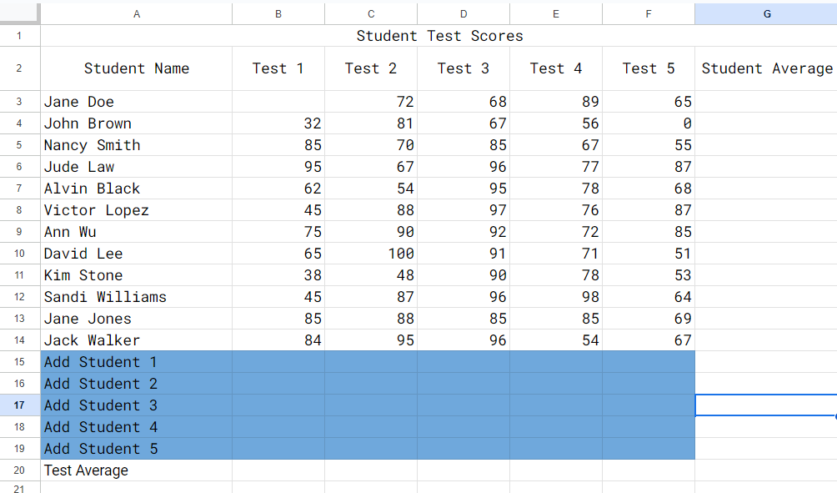
D
A
Data Storage
Two popular spreadsheet programs used in school
are Microsoft Excel
and Google Sheets.
8.1.2

Slide 22
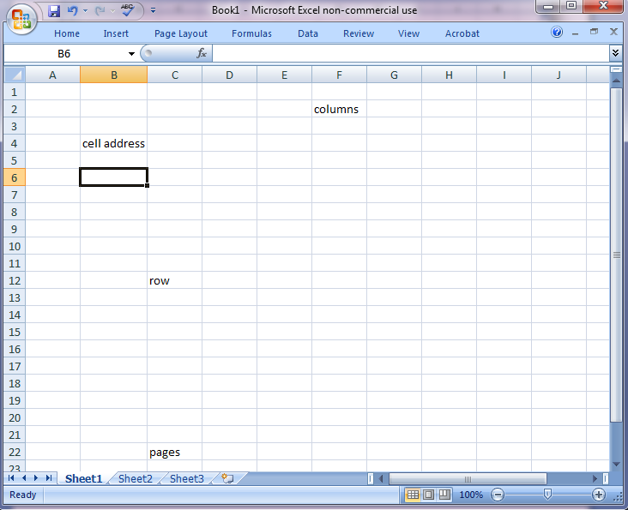
D
A
Data Storage
Spreadsheet is the common name for software
programs that are
used to do math.
A picture of a
spreadsheet is
shown.
8.1.2

Slide 23
D
A
Data Storage
A spreadsheet is made up of columns and rows. Each column is labeled with a capital letter. Every
row is labeled with a
number. The intersection
between a column and row
is called a cell. Every page
in a spreadsheet is called a sheet.
8.1.2

Slide 24
D
A
Data Storage
Below are a few things people use a spreadsheet for.
Create, order, and sort lists in table form.
Perform math calculations.
Convert a data table into a chart or graph.
8.1.2

Slide 25
D
A
Data Visualization
Data Visualization
Spreadsheets can create visual representations of data through charts and graphs. This allows users to visualize trends, patterns, and relationships within the data more easily. Let’s look at visualizations!
8.1.2

Slide 26
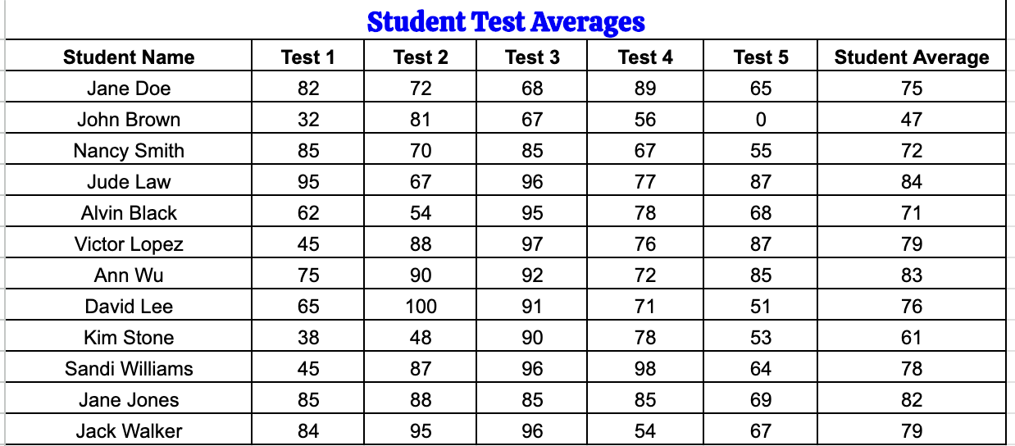
D
A
Data Visualization
Here is a spreadsheet that contains data on student test scores in tabular form.
8.1.2

Slide 27
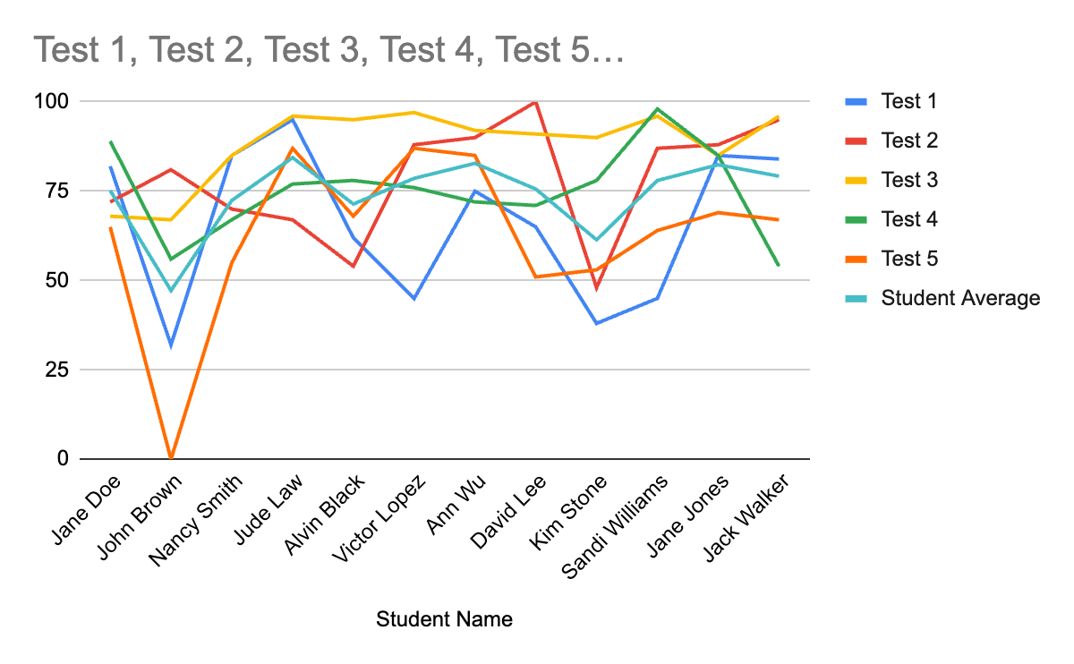
D
A
Data Visualization
8.1.2
Here is the same data shown as a line chart.

Slide 28
D
A
Data Visualization
When examining line charts, look for the following line behaviors:
Increase is when the line goes up.
Decrease is when the line goes down.
Steady state is when the line stays the same.
8.1.2

Slide 29
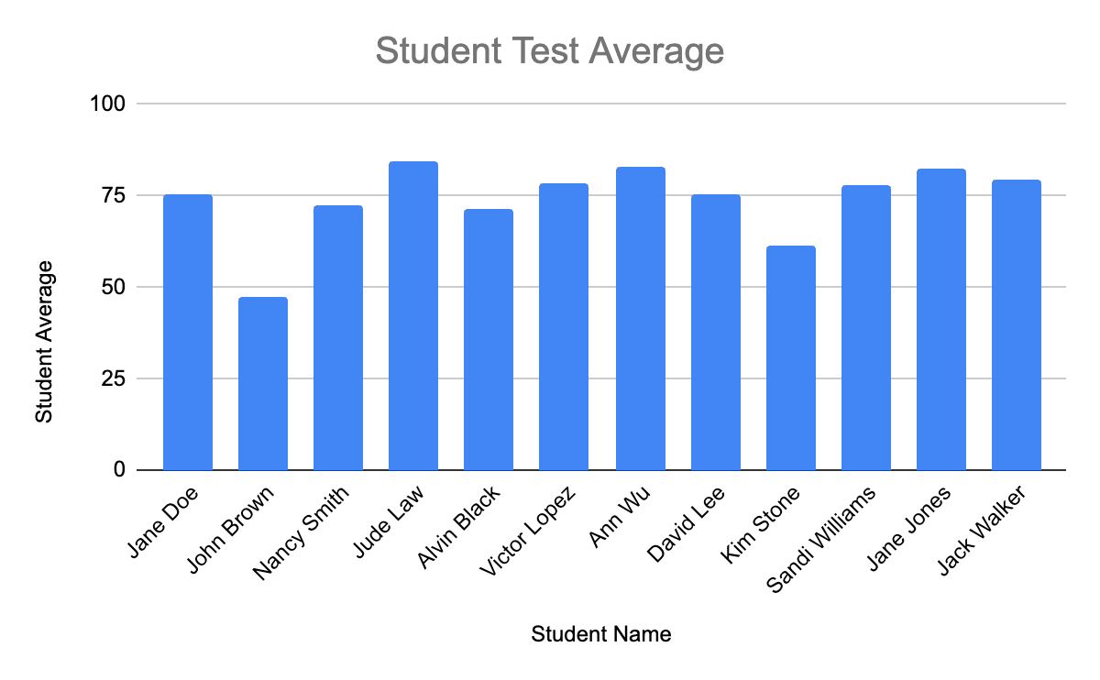
D
A
Data Visualization
Student Name | Test 1
Jane Doe | 82
John Brown | 32
Nancy Smith | 85
Jude Law | 95
Alvin Black | 62
Victor Lopez | 45
Ann Wu | 75
David Lee | 65
Kim Stone | 38
Sandi Williams | 45
Jane Jones | 85
Jack Walker | 84
8.1.2
Bar graph shows test score for each student.

Slide 30
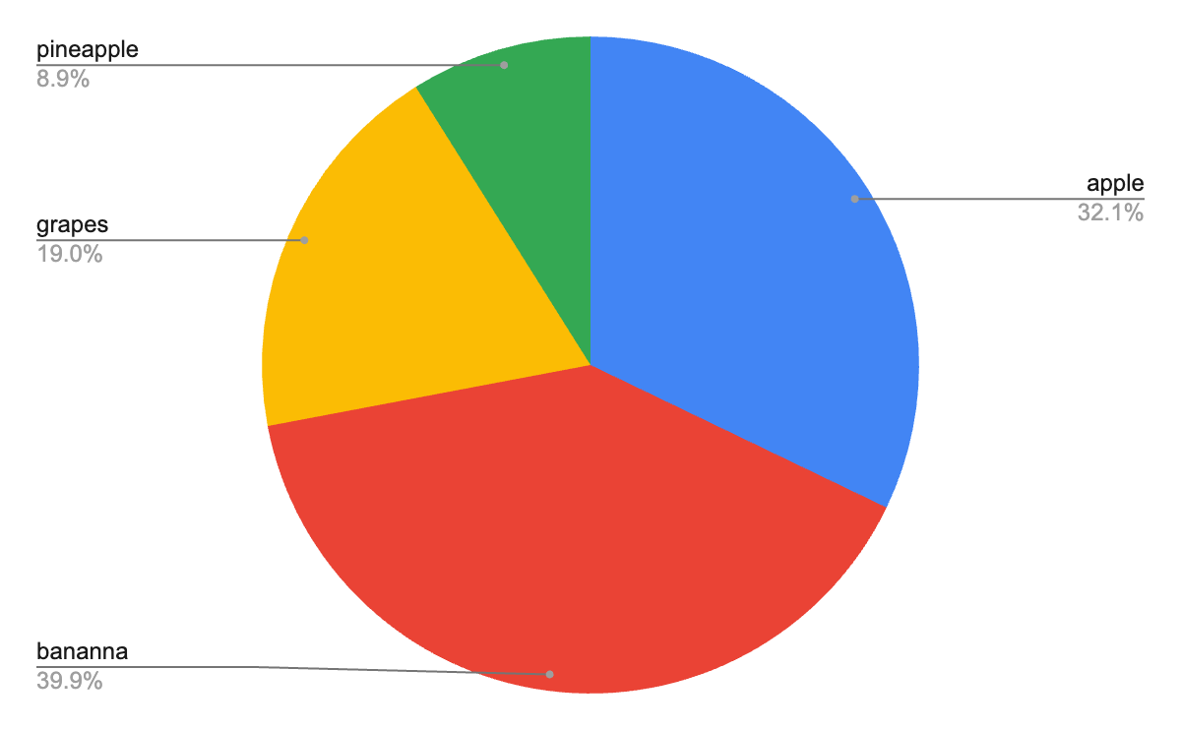
D
A
Data Visualization
Favorite Fruit
apple | 54
banana | 67
grapes | 32
pineapple | 15
8.1.2
Pie charts show data as percents of a whole.

Slide 31
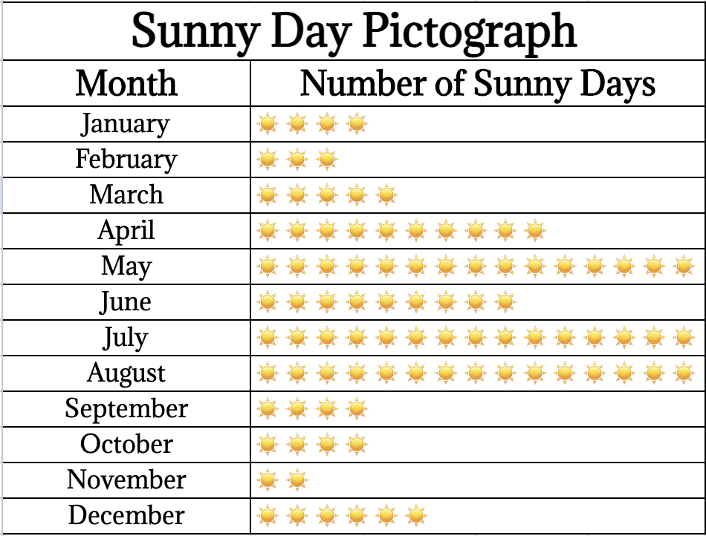
D
A
Data Visualization
Pictographs, is an easy way to display data by using symbols to communicate facts graphically.
8.1.2

Slide 32
D
A
Data Analysis
We look at tables, charts, and graphs to find meaning in the data. The goal is to find patterns so that we can make predictions. A prediction is a really good guess.
8.1.2

Slide 33
D
A
Climate Change
8.1.2

Slide 34
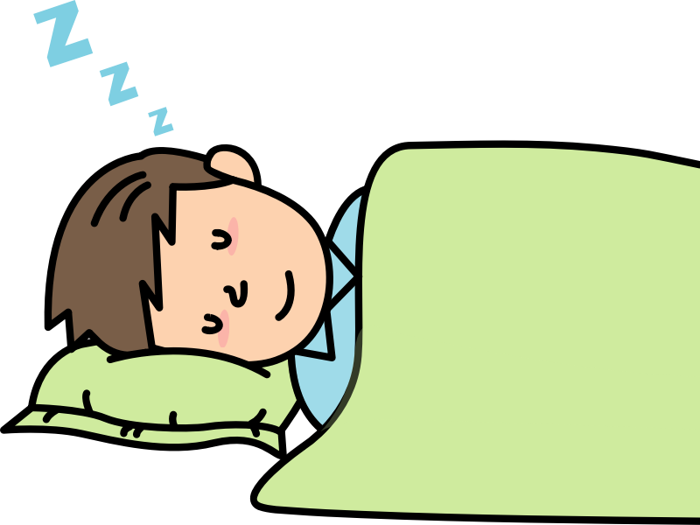
What is Climate Change?
D
A
Let’s suppose you are sleeping and your caregiver comes in and places a lot of extra blankets on you. At first you are OK but over time you get warmer and warmer. You get so hot that you feel as though you are burning up and all you want to do it push the blankets off you to release the heat
and cool down!
8.1.2

Slide 35
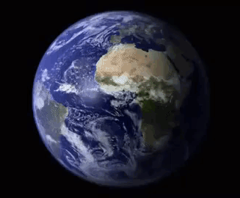
What is Climate Change?
D
A
Surrounding the Earth is a big layer that acts as a blanket covering our planet. We call it our atmosphere. The atmosphere is made up of gases like carbon dioxide,
methane, and water vapor,
which helps keep our planet
warm, just like a blanket
keeps you warm at night.
8.1.2

Slide 36
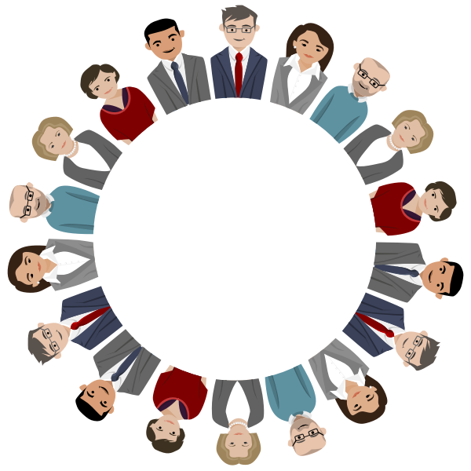
What is Climate Change?
D
A
Over time, people all around the world have been doing things that add extra blankets to our planet.
8.1.2

Slide 37
What is Climate Change?
D
A
Human activities like
burning coal, oil, and gas for energy,
reducing the size of our forest, and
industrialization (manufacturing)
have released extra gases into
the air. The effect is like adding
extra blankets. This has made the
Earth warmer than it should be.
8.1.2

Slide 38
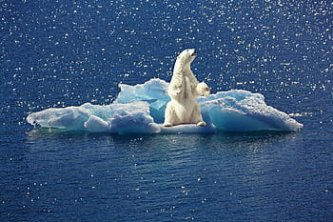
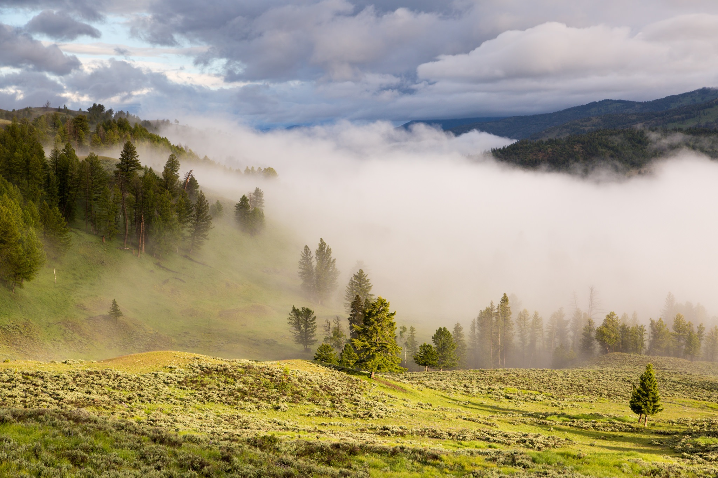
What is Climate Change?
D
A
As our Earth gets warmer, all sorts of problems begin to happen. Look at the diagram below.
Melting ice at North and South Pole.
Sea level rises.
Pollution and extreme weather.
8.1.2

Slide 39
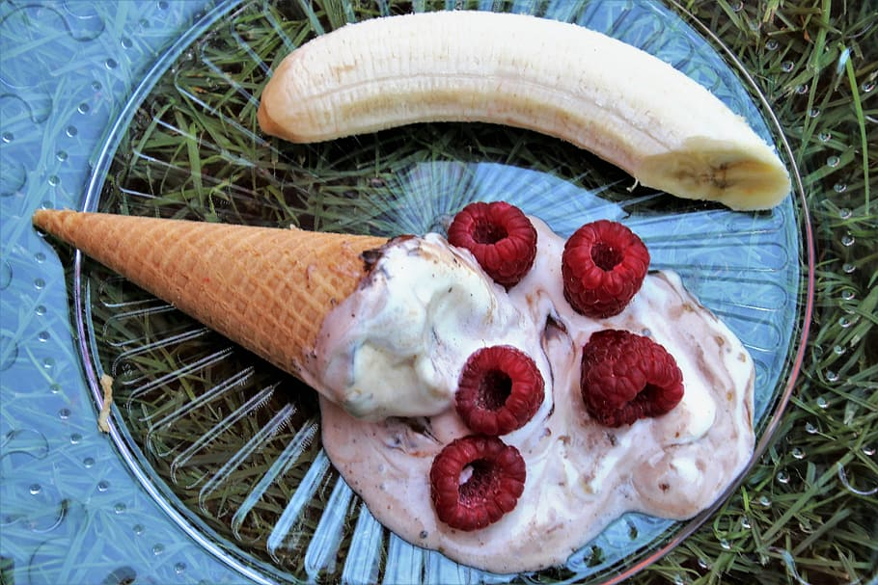
What is Climate Change?
D
A
Think of it like leaving a bowl of ice cream outside on a summer day. Your ice cream melts after a while, it loses it taste and no matter what you do, it does not taste the same anymore.
8.1.2

Slide 40
What is Climate Change?
D
A
And so! Climate change is the permanent change in the Earth’s weather pattern caused by human activity. It adversely impacts all living things and can result in:
rising temperatures,
sea level rise,
extreme weather events,
shifts in ecosystems,
disruptions to agriculture, and
problems with local economies.
8.1.2

Slide 41
What is Climate Change?
D
A
Climate change causes Global warming, a long-term increase in Earth's average surface temperature, primarily due to human activities that release greenhouse gases into the atmosphere. These greenhouse gases, trap heat from the sun in the Earth's atmosphere, leading to a warming.
8.1.2

Slide 42
D
A
Extreme Weather
8.1.2

Slide 43
What is Extreme Weather?
D
A
The word extreme means reaching the maximum or highest amount. Extreme weather refers to severe or unusual weather events that are very different from what is expected.
8.1.2

Slide 44
What is Extreme Weather?
D
A
These events often involve extreme temperatures, precipitation, wind speeds, or other weather conditions. Examples of extreme weather events include:
Heatwaves
Cold snaps
Heavy rainfall
Droughts
Hurricanes, typhoons, and cyclones
Tornadoes
Thunderstorms
8.1.2

Slide 45
What is Extreme Weather?
D
A
Heatwaves
Prolonged periods of unusually high temperatures, often accompanied by high humidity, which can pose health risks and lead to heat-related illnesses and deaths.
8.1.2

Slide 46
What is Extreme Weather?
D
A
Cold Snaps
Sudden and severe drops in temperature, resulting in freezing conditions, frost, and sometimes blizzards or ice storms.
8.1.2

Slide 47
What is Extreme Weather?
D
A
Heavy Rainfall
Intense and prolonged periods of rain leading to flooding, landslides, and waterlogged infrastructure.
8.1.2

Slide 48
What is Extreme Weather?
D
A
Droughts
Extended periods of abnormally low rainfall, resulting in water shortages, crop failures, and ecological stress.
8.1.2

Slide 49
What is Extreme Weather?
D
A
Hurricanes, typhoons, and cyclones: Powerful tropical storms characterized by strong winds, heavy rainfall, and storm surges, which can cause widespread devastation and loss of life.
8.1.2

Slide 50
What is Extreme Weather?
D
A
Tornadoes
Violently rotating columns of air that extend from thunderstorms to the ground, capable of causing severe damage to buildings and infrastructure in their path.
8.1.2

Slide 51
What is Extreme Weather?
D
A
Thunderstorms
Storms characterized by lightning, thunder, heavy rain, and sometimes hail or strong winds, which can result in localized flooding, property damage, and power outages.
8.1.2

Slide 52
What is Extreme Weather?
D
A
Extreme weather events are associated with climate change, as rising global temperatures can lead to changes in weather patterns, increased frequency and intensity of extreme events, and changes to regional climates.
8.1.2

Slide 53
What is Extreme Weather?
D
A
Managing and mitigating the impacts of extreme weather require preparedness, resilience, and effective disaster response strategies at the local, national, and global levels.
8.1.2

Slide 54
D
A
Pollution
8.1.2

Slide 55
D
A
What is Pollution?
Pollution is when something harmful is added to the environment that is harmful or has a poisonous effect. Pollutants can make humans, wildlife, trees, and even our food sources unhealthy or sick.
8.1.2

Slide 56
D
A
What is Pollution?
Pollution can be grouped based on where it comes from, its impact, and the environment it affects. Main types of pollution include:
1. Air Pollution
2. Water Pollution
3. Soil Pollution
4. Noise Pollution
5. Light Pollution
6. Thermal Pollution
7. Plastic Pollution
8. e-Waste Pollution
8.1.2

Slide 57
D
A
What is Pollution?
Air Pollution
This type of pollution occurs when harmful substances, such as gases, particulate matter, and chemicals, are released into the air. Common sources include vehicle emissions, industrial activities, and burning of fossil fuels like coal oil and methane gas. Air pollution can lead to respiratory problems, cardiovascular diseases, and environmental damage.
8.1.2

Slide 58
D
A
What is Pollution?
Water Pollution
Water pollution occurs when contaminants, such as chemicals, sewage, and waste, enter bodies of water like rivers, lakes, and oceans. Sources of water pollution include industrial discharge, agricultural runoff, and improper waste disposal. Water pollution can harm aquatic ecosystems, affect drinking water quality, and pose risks to human health.
8.1.2

Slide 59
D
A
What is Pollution?
Soil Pollution
Soil pollution occurs when contaminants, such as heavy metals, pesticides, and industrial chemicals, accumulate in the soil. This can result from activities like improper waste disposal, agricultural practices, and industrial activities. Soil pollution can degrade soil quality, harm plants and animals, and affect food safety.
8.1.2

Slide 60
D
A
What is Pollution?
Noise Pollution
Noise pollution refers to excessive or disruptive noise that interferes with normal activities and causes discomfort or harm to humans and animals. Sources of noise pollution include transportation, industrial machinery, construction activities, and urbanization. Exposure to long periods of high noise levels can lead to hearing loss, stress, and other health problems.
8.1.2

Slide 61
D
A
What is Pollution?
Light Pollution
Light pollution occurs when artificial light sources, such as streetlights and billboards, disrupt natural light cycles and cause excessive brightness at night. This can affect wildlife behavior, disrupt ecosystems, and interfere with astronomical observations. Light pollution can also contribute to energy waste and affect human health and sleep patterns.
8.1.2

Slide 62
D
A
What is Pollution?
Thermal Pollution
Thermal pollution refers to the excessive heat released into water bodies from industrial processes, power plants, and urban runoff. This can disrupt aquatic ecosystems, decrease oxygen levels in water, and harm aquatic organisms.
8.1.2

Slide 63
D
A
What is Pollution?
Plastic Pollution
Plastic pollution occurs when plastic materials accumulate in the environment, particularly in oceans, rivers, and landfills. This can harm wildlife, marine ecosystems, and human health. Plastic pollution also contributes to environmental degradation and the spread of microplastics throughout the food chain.
8.1.2

Slide 64
D
A
What is Pollution?
E-waste Pollution
E-waste is short for electronic waste. E-waste pollution occurs when discarded electronic devices (old computers, laptops, mobile phones, televisions) or appliances (refrigerators, washers, dryers) are thrown in dumps, landfills or incinerated (burned).
8.1.2

Slide 65
D
A
What is Pollution?
E-waste Pollution
E-waste pollution is a significant environmental concern due to the toxic materials like lead, mercury, cadmium, and hazardous chemicals. such as brominated flame retardants. Improper disposal of e-waste can lead to the release of these harmful substances into the environment, contaminating soil, water, and air, and posing risks to human health and ecosystems.
8.1.2

Slide 66
D
A
What is Pollution?
These are some of the main types of pollution, each with its own sources, impacts, and challenges.
8.1.2

Slide 67
D
A
Student Challenge
8.1.2

Slide 68
D
A
Climate Change Project
Each of us can positively contribute to making our environment a better place. You will take a survey that will help decide what type of climate change project our class will work on. We will use the scientific method to study the problem, collect data, recommend solutions and present our findings.
8.1.2

Slide 69
Works Cited
D
A
Gore, Al (2007) An Inconvenient Truth: The Crisis of Global Warming. Penguin Books Ltd.
OpenAI. (Year). ChatGPT [Computer software]. Retrieved from https://www.openai.com/chatgpt
8.1.2

