Slide 1
Committed: Remembering Native Kinship in and beyond Institutions
Dr. Susan Burch, Middlebury College

Slide 2
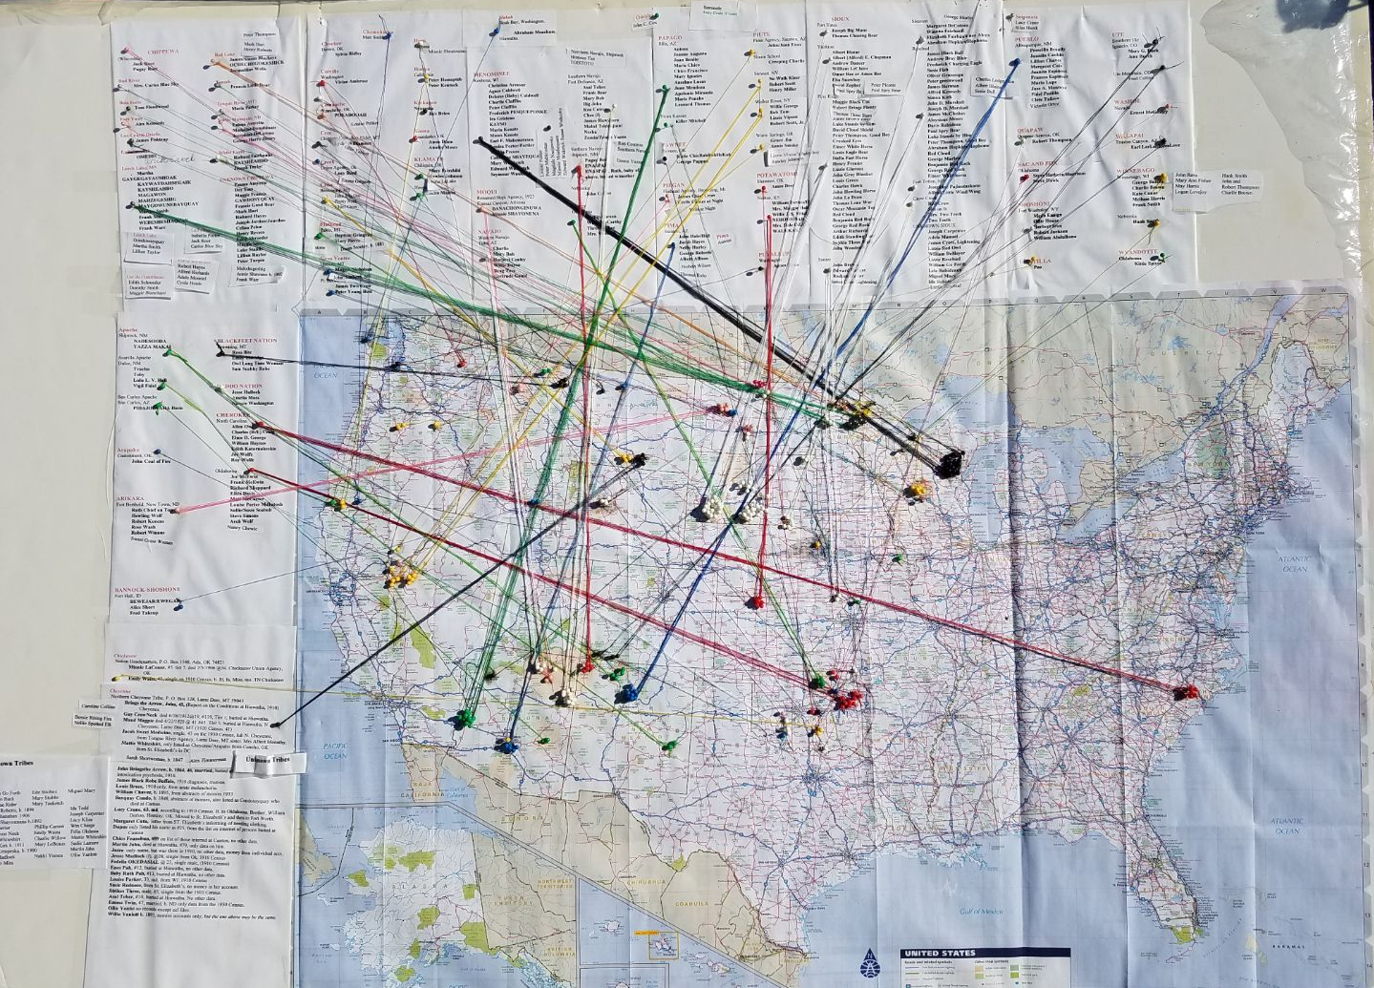
Notes:
The late Bois Forte Chippewa Tribal Historian Kay Davis made this map around 2010 to emphasize kinship ties and Indigenous identities of the people stolen away to the federal institution in Canton, South Dakota. Names of Native nations and their members institutionalized at the Indian Asylum frame the left side and top. Pins and colored string connect the tribal information to geographic locations of reservations on a standard map of the continental United States. Davis brought this map with her in 2013 to the annual honoring ceremony on the grounds of the former asylum.

Slide 3
Notes:
In this color photo from 2015, Faith O’Neil and Pete Alcaraz stand behind the Canton Asylum cemetery marker. Split rail fencing and a golf cart are in the background. O’Neil, holding a photograph that is important to her, looks both solemn and resolute.

Slide 4
Notes:
Color photo of Kay Davis’ map again

Slide 5
Thank you
Dr. Susan Burch
Sburch@middlebury.edu

