Slide 1
Dissertation Webinar:
The Final Stretch
From Dissertation Defense to Commencement
Prepared by The Graduate School
February 2022
Notes:
Jenny & Nelly; housekeeping: chat box for questions and Q&A at the end; mute mics.; this will be recorded; Nelly and Jenny alternate reading chat box

Slide 2
Contacts at The Graduate School
Associate Dean of
The Graduate School
Assistant to Dean Herness
Rebecca Shiffer-Newton
shifferr@montclair.edu
Office Phone: 973-655-4368
Key person!
Takes care of all the doctoral forms through docstudy@montclair.edu
Obtains the Dean’s signatures where
needed
Coordinates the publication of your defenses’ location and day/time:
Publishes it on TGS’ website.
Dr. Nelly Lejter
lejtern@Montclair.edu
Oversee progress of all doctoral students from the point of reaching Candidacy to graduation
Sets the calendar of dissertation deadlines
Coordinates the outside observer for dissertation defenses
Works with Doctoral Program Directors (DPDs) to improve processes and procedures from Candidacy to dissertation submission
Reviews policies in doctoral programs and recommends revisions to DPDs and TGS Dean
Notes:
Nelly

Slide 3
Contacts at The Graduate School
Graduate Assistant for Doctoral Students
TGS Requirement:
Students need to visit Jenny at least once during their final semester to review their dissertation formatting with her.
The sooner you meet with her, the better!
She can help you with:
Your signature page
Your prefatory pages
Formatting your references
Filling out your ETD Form
APA Style 7th Edition
Grammar and content
Organization and flow
Analyzing and synthesizing your ideas
The Literature Review
Preparing your defense presentation
Jennifer Haber
haberj2@montclair.edu
Works through The Graduate School to support doctoral students
Provides one-on-one writing consultations to doctoral students working on their dissertations:
25 and 50-minute sessions
Helps to review and approve dissertation formatting and all prefatory pages
Tracks doctoral students’ progress towards final dissertation submission and graduation
Improves and/or creates writing resources for doctoral students
Notes:
Jenny

Slide 4
“You Can Book Me!”
To schedule an appointment with Jenny, visit: https://writingwithjenny.youcanbook.me/
Important Note:
You can start booking appointments with Jenny through
“You Can Book Me” starting the week of Monday, February 21st!
Notes:
Jenny

Slide 5
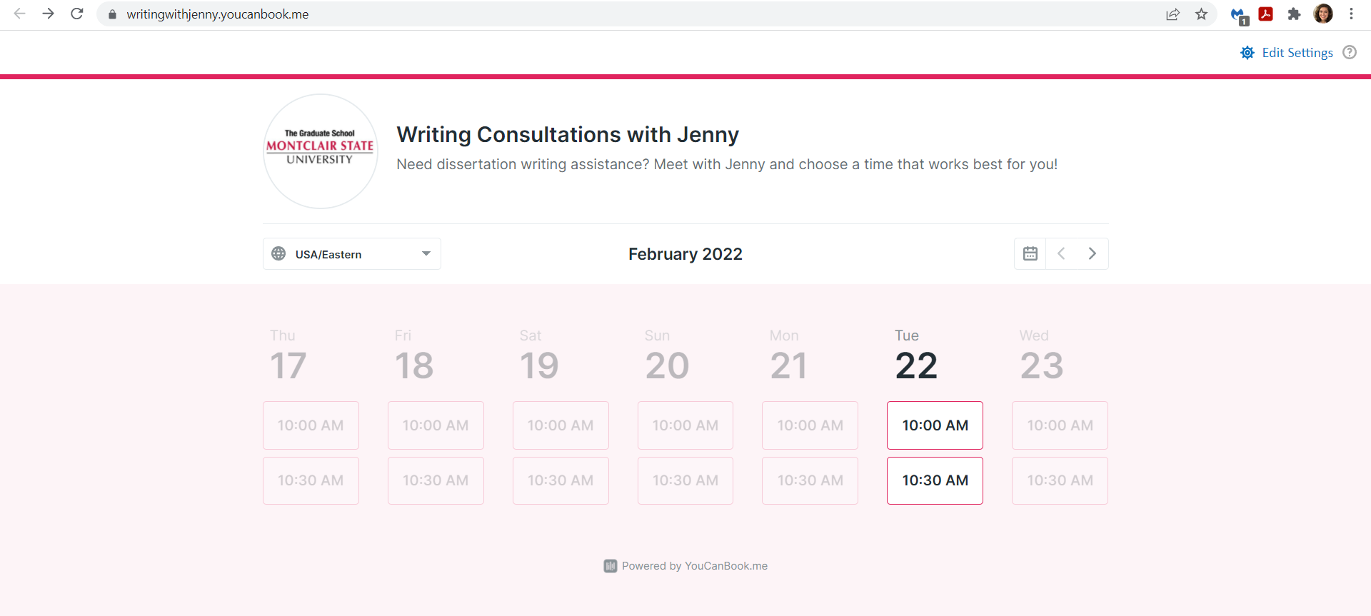
How to Schedule Appointments with Jenny
Notes:
Jenny

Slide 6
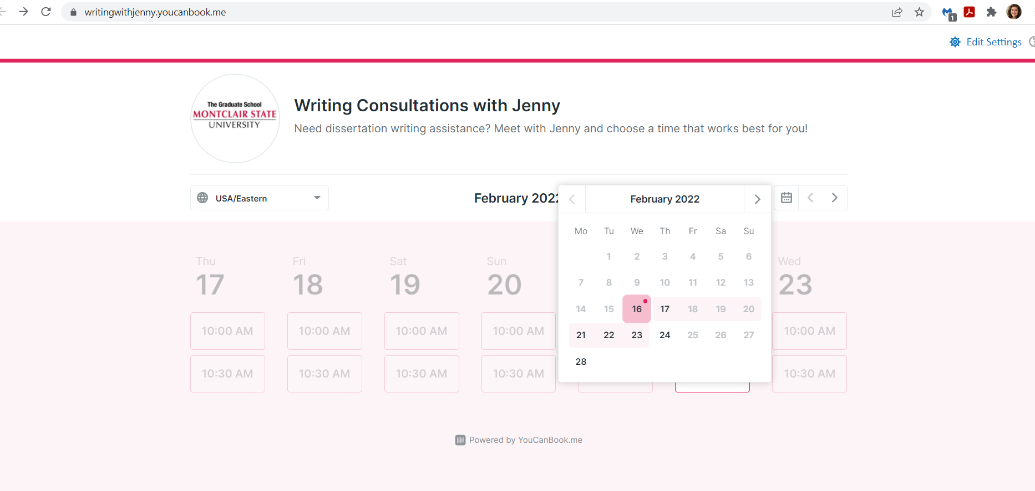
How to Schedule Appointments with Jenny
Notes:
Jenny

Slide 7
How to Schedule Appointments with Jenny
Notes:
Jenny

Slide 8
Enrollment and Coursework
It is never too early to start thinking about and planning for your dissertation!
NOTE: PhD in Environmental Science & Management students: Submit Forms B+C before the Qualifying Experience Examinations, then Form A.
Culminating Activity
Once completed: Form A
Form A approved: student becomes doctoral candidate
Candidacy
Select your Dissertation Chair
Coordinate with Chair to determine the faculty in your Committee
Form B (and Form C for external committee members outside of MSU)
Form G: register for Dissertation Advisement
The Life Cycle
of a PhD Student
Dissertation Committee
Dissertation Proposal
Once completed: Form D
Time limit to complete doctoral degree:
10 years for students who started with a Bachelor’s degree
7 years for students who started with a Master’s degree
Form E – Approval of Defense Date
Form F - Report of Defense
Dissertation Defense
Notes:
Nelly

Slide 9
Order of Doctoral Forms
Form A - Admission to Doctoral Candidacy (Note: Students in the PhD in Environmental Science & Management program: Submit Forms B+C before the Qualifying Experience Examinations, then Form A)
Form B and Form C - Approval of Dissertation Committee and Outside Members
Form G - Dissertation Advisement/Dissertation Extension
Form D - Dissertation Proposal Approval
Form E - Dissertation Defense Date Approval
Send a draft of your dissertation with your signature page for formatting approval
Form F - Report of Dissertation Defense
Notes:
Nelly–then turn to Jenny

Slide 10
Enrollment and Coursework
It is never too early to start thinking about and planning for your dissertation!
Select your Dissertation Chair
Coordinate with Chair to determine the faculty in your Committee
Form B and Form C for external committee members outside of MSU
Dissertation Committee
Qualifying Experience
Examinations
Once successfully completed and exams are passed: Form A
The Life Cycle
of an
ENSM PhD Student
Form A approved: student becomes doctoral candidate
Culminating Activity
Candidacy
Form G: register for Dissertation Advisement
Dissertation Proposal
Once completed: Form D
Time limit to complete doctoral degree:
10 years for students who started with a Bachelor’s degree
7 years for students who started with a Master’s degree
Form E – Approval of Defense Date
Form F - Report of Defense
Dissertation Defense
Notes:
Jenny

Slide 11
Order of Doctoral Forms:
For Environmental Science and Management
Form B and Form C - Approval of Dissertation Committee and Outside Members
Form A - Admission to Doctoral Candidacy
Form G - Dissertation Advisement/Dissertation Extension
Form D - Dissertation Proposal Approval
Form E - Dissertation Defense Date Approval
Send a draft of your dissertation with your signature page for formatting approval
Form F - Report of Dissertation Defense
Notes:
Jenny

Slide 12
Suggested Timelines for:
Completion and Defense of Doctoral Dissertation
Important Notes:
Minimum timelines for students planning to graduate in May 2022, August 2022, and January 2023 are provided
Examples are based on a chapters-based dissertation; articles-based dissertations can use the same timelines
Illustrate the level of engagement expected of the Dissertation Committee members with the doctoral student during the final stages of the dissertation process
Always check program-specific requirements regarding the specific sequence required from proposal to dissertation defense
Notes:
Jenny

Slide 13
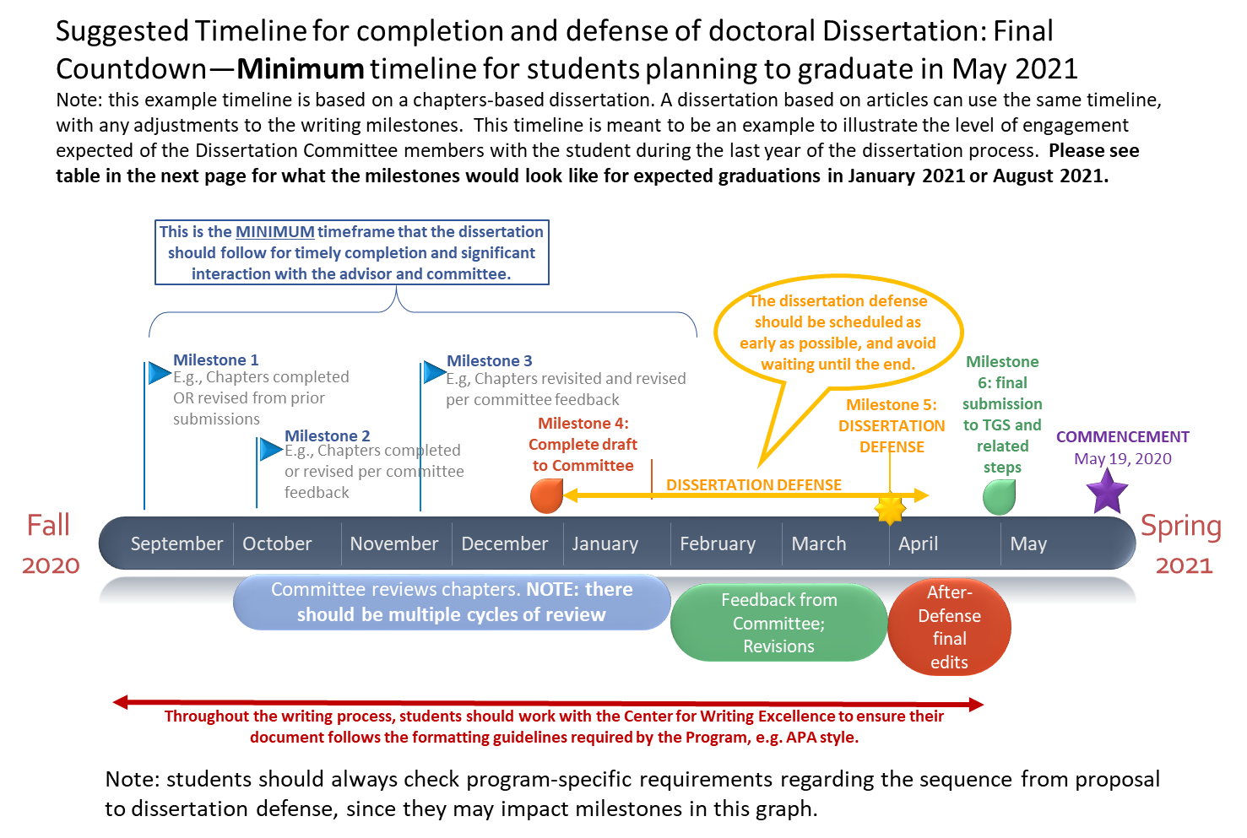
May 2022 Timeline
May 2022
2021
2022
Notes:
Nelly

Slide 14
Dissertation Defense and Submission Deadlines:
Academic Year 2021-2022
Requested Degree Conferral | Application for Graduation | Request for Dissertation Defense Date | Request for Approval of Signature Page | Dissertation Defense Date Approval | Submission of Completed Signature Page, Completed Embargo Form, and Dissertation Filing Fee to TGS | Final Submission of Dissertation to TGS via Email | Electronic Submission of APPROVED document to ProQuest; Survey of Earned Doctorates
May 2022 | February 15th, 2022 | March 31, 2022 | Prior to Defense Date | Defense Date Approved by April 8, 2022 | Prior to Final Submission of Dissertation via Email | May 6, 2022 | May 12, 2022
Notes:
Nelly

Slide 15
Dissertation Defense and Submission Deadlines:
Academic Year 2021-2022
Requested Degree Conferral | Application for Graduation | Request for Dissertation Defense Date | Request for Approval of Signature Page | Dissertation Defense Date Approval | Submission of Completed Signature Page, Completed Embargo Form, and Dissertation Filing Fee to TGS | Final Submission of Dissertation to TGS via Email | Electronic Submission of APPROVED document to ProQuest; Survey of Earned Doctorates
August 2022 | August 15, 2022 | June 20, 2022 | Prior to Defense Date | Only by Approval of Dissertation Chair | Prior to Final Submission of Dissertation via Email | August 15, 2022 | August 22, 2022
Notes:
Nelly

Slide 16
Dissertation Defense and Submission Deadlines:
Academic Year 2022-2023
Requested Degree Conferral | Application for Graduation | Request for Dissertation Defense Date | Request for Approval of Signature Page | Dissertation Defense Date Approval | Submission of Completed Signature Page, Completed Embargo Form, and Dissertation Filing Fee to TGS | Final Submission of Dissertation to TGS via Email | Electronic Submission of APPROVED document to ProQuest; Survey of Earned Doctorates
January 2023 | September 15, 2022 | November 1, 2022 | Prior to Defense Date | Defense Date Approved by December 5, 2022 | Prior to Final Submission of Dissertation via Email | December 21, 2022 | January 9, 2023
Notes:
Nelly

Slide 17
Are You Ready to Defend?
When your dissertation is defendable:
A defendable dissertation is a complete draft that your committee members deem ready for you to defend.
It is not the final, definitive draft but the formatting and all components must be in place, including the abstract and conclusions.
It should likely be ready for final submission after relatively minor revisions.
Notes:
Nelly

Slide 18
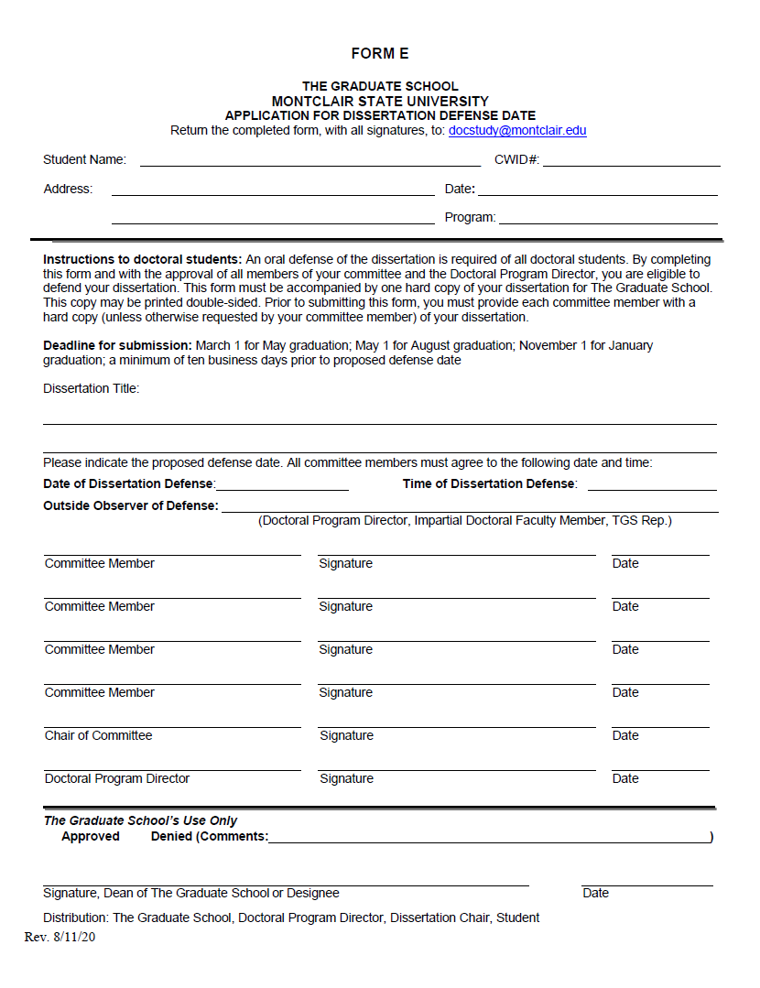
Before the Defense
Confirm the date and time of your defense with your advisor and dissertation committee members
Fill out Form E and obtain all committee members’ signatures
Send docstudy@montclair.edu the following materials:
Completed Form E as a PDF
A draft of your dissertation as a Word document or PDF
Signature page required by TGS as a PDF
Notes:
Jenny

Slide 19
3. Signature page required by TGS as a PDF
Note: TGS needs to approve this page before any signatures are obtained.
Notes:
Jenny

Slide 20
Signature Page Update: Fillable Documents
Notes:
Jenny [no acronyms (e.g., TETD or ENSM); students need to fill in the document electronically while members can do so electronically or manually]

Slide 21
Before the Defense
Completed Form E as a PDF
Your defense date will be approved
Rebecca Shiffer-Newton will obtain Dr. Herness’ signature and send it back to you via email
A draft of your dissertation as a Word document or PDF
Your dissertation’s prefatory pages will be reviewed
Jenny Haber will approve or approve them with conditions (may suggest a writing consultation to fix formatting issues)
Signature page required by TGS as a PDF
Your signature page will be reviewed and must be approved before the defense date
Jenny Haber will approve this page or edit the page for you
Once approved, it has to be signed by all dissertation committee members after your defense
Notes:
Jenny

Slide 22
Preparing for the Defense
Organize your materials for presentation (e.g., PowerPoint, Google Slides, Prezi, etc.)
Practice presenting and addressing questions
Time your presentation
Prepare to wear business formal attire
Seek advice from Dissertation Chair/committee members to anticipate the types of questions that will be asked
If your Dissertation Defense is over Zoom:
Prepare Zoom link
Practice sharing your screen
Adjust Zoom settings to allow for breakout rooms
Consider adding a professional virtual background or find a room with a white backdrop
Notes:
Jenny & Nelly

Slide 23
During the Defense
The Dissertation Chair, committee members, and impartial doctoral faculty member or TGS representative will be in attendance
Take notes on any feedback you are given during/after your presentation
The desired outcome:
The defense was successful
You passed
The Dissertation Chair says, “Congratulations, Dr. [insert name here]!”
The Dissertation Chair will coordinate the signing of
Form F – Report of Dissertation Defense by all committee members
Notes:
Nelly

Slide 24
After the Defense
Form F is completed by your committee at the end of the defense and includes three possible outcomes:
Pass – no substantive revisions
Pass with Conditions – substantive revisions
Fail – second defense required
The completed, signed Form F needs to reach TGS as soon as possible after the defense.
Get to work on the suggested revisions your committee gave you and keep in touch with your Chair and committee as needed.
Notes:
Nelly

Slide 25
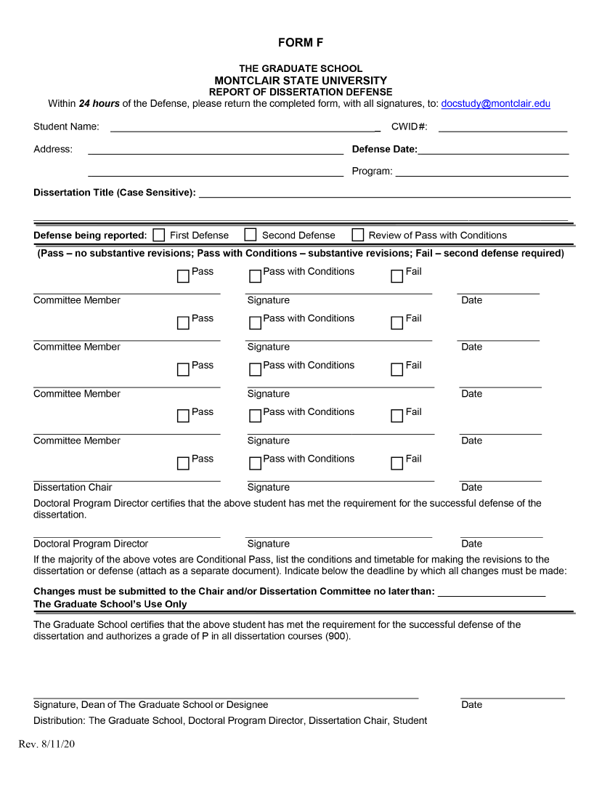
Form F: TGS needs this form back 24 hours after the defense
Notes:
Nelly

Slide 26
After the Defense
When revising your dissertation:
Use the Final Manuscript Submission and Post-Submission Instructions to review your work and final steps. → a.k.a. the “Final Steps Document”
Located on pg. 27 of the Doctoral Procedures Manual.
Don’t forget to celebrate this major milestone in your career!
Notes:
Jenny

Slide 27
First Page
of the
Final Steps Document
Notes:
Jenny

Slide 28
The Final Submission
Once all final dissertation revisions are complete and your committee approves:
The required TGS signature page must be signed and submitted to docstudy@montclair.edu as a PDF
The final manuscript must be submitted as a Word document or PDF to docstudy@montclair.edu
Jenny Haber from TGS will then:
Review your final manuscript with Dr. Lejter
Alert you to any formatting issues
Approve the document
Re-insert the completed signature page into your dissertation
Send the finalized, approved manuscript back to you for publication
Notes:
Jenny

Slide 29
The Final Steps
Once the final dissertation is ready for publication, an email will be sent out with instructions for completing the following:
Send a $100 check for the dissertation filing fee
Fill out the Survey of Earned Doctorates
Submit the dissertation to UMI/ProQuest
Fill out and submit the ETD Form
Check your email for instructions about regalia, hooding, and all other matters related to Commencement!
We will also ask you to confirm your name and dissertation title for the Commencement booklet.
Notes:
Jenny

Slide 30
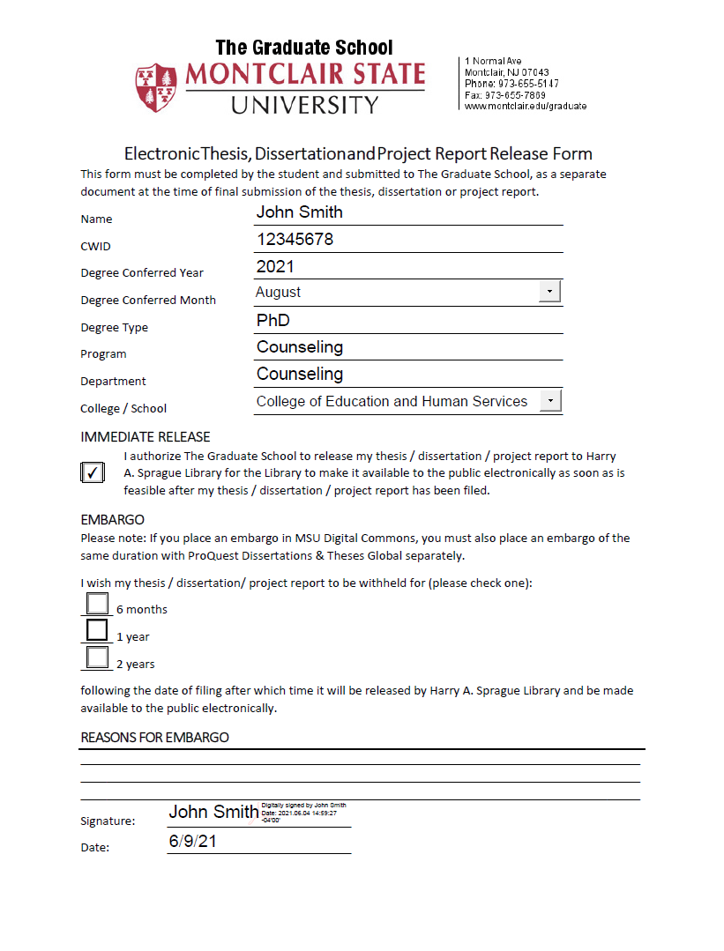
Please Note:
Reach out to Jenny for assistance when completing this form.
ETD Form
Notes:
Jenny

Slide 31
8. Have your Chair approve revisions and finalize your signature
page
9. Submit signed signature page and Dissertation Filing Fee to TGS
1. Write your dissertation
16. Go to Commencement and get hooded!
R
E
15. Complete any necessary
Commencement forms/actions
2. Apply for Graduation (via Nest)
10. Send electronic file to TGS for
approval of formatting
7. Make revisions
C
A
6. Circulate approved signature page to all committee members
3. Schedule your Defense
11. Work with TGS to finalize formatting
14. Complete Survey of Earned Doctorates
P
4. Send Form E, signature page, and dissertation draft to TGS for approval
12. Receive final, approved copy (.pdf) of dissertation from
TGS
13. Submit .pdf of final copy to UMI/ProQuest
5. Defend
Notes:
Nelly

Slide 32
Formatting Your Dissertation
Style Manual/Citing Sources: American Psychological Association (APA) - 7th edition
Typeface: 12 point font, Times New Roman
Spacing: double-spaced, left aligned, ragged right
Margins: 1” top, bottom, left, and right
Tables and Figures: stay within the margins
Review the APA Style Dissertation Guidelines: Formatting Your Dissertation for more information
Notes:
Jenny

Slide 33
Potential Life-Saving Formatting Tips!
Format your signature page and have TGS approve it before your defense.
Automate, Automate, Automate – your table of contents, list of tables, list of figures, references, and page numbers
Tables and Figures – use the “insert caption” function in Word to name and number them
Margins – set your margins and spacing from the start
Landscape Pages – use the “section break” function in Word
Notes:
Jenny

Slide 34
Sample Dissertation Templates
Note: Available on the Doctoral Students Web Page
Notes:
Jenny = Share sample dissertation template via Screen Share

Slide 35
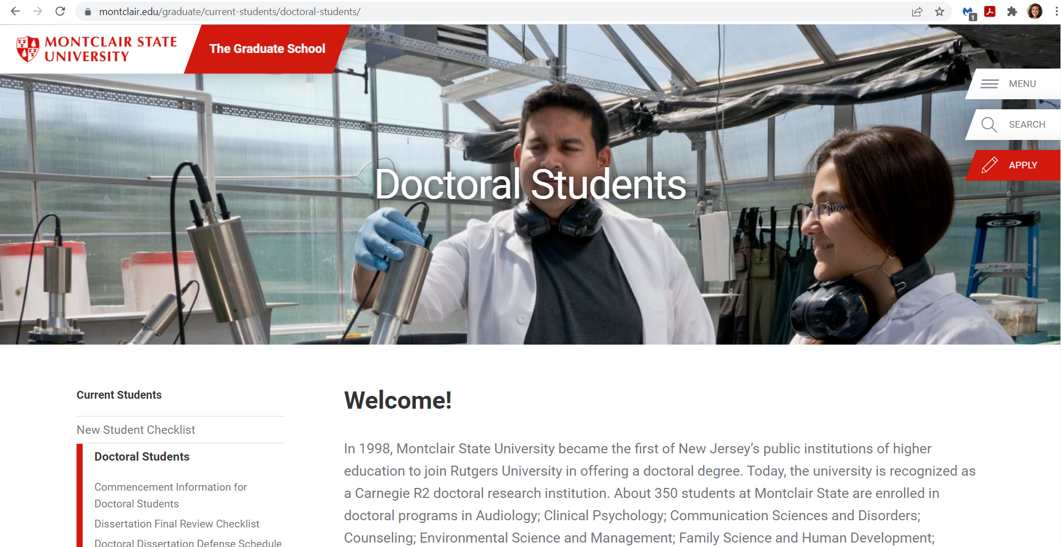
IMPORTANT: Doctoral Students Web Page
Notes:
Nelly and Jenny

Slide 36
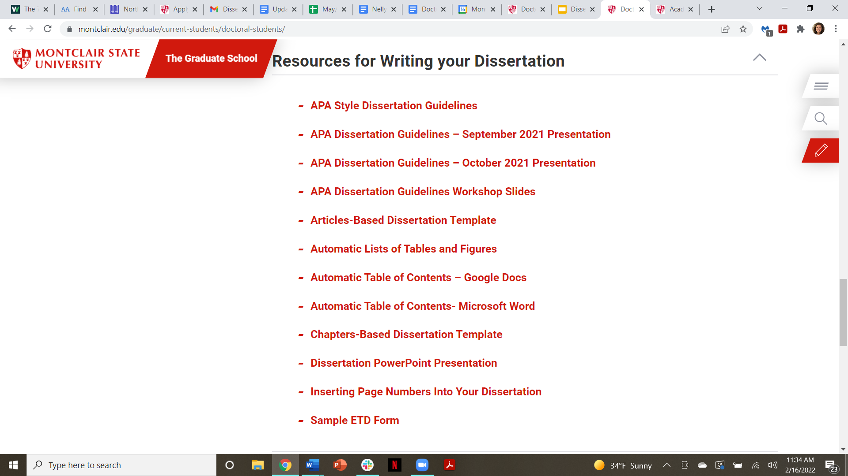
IMPORTANT: Doctoral Students Web Page
Notes:
Nelly and Jenny

Slide 37
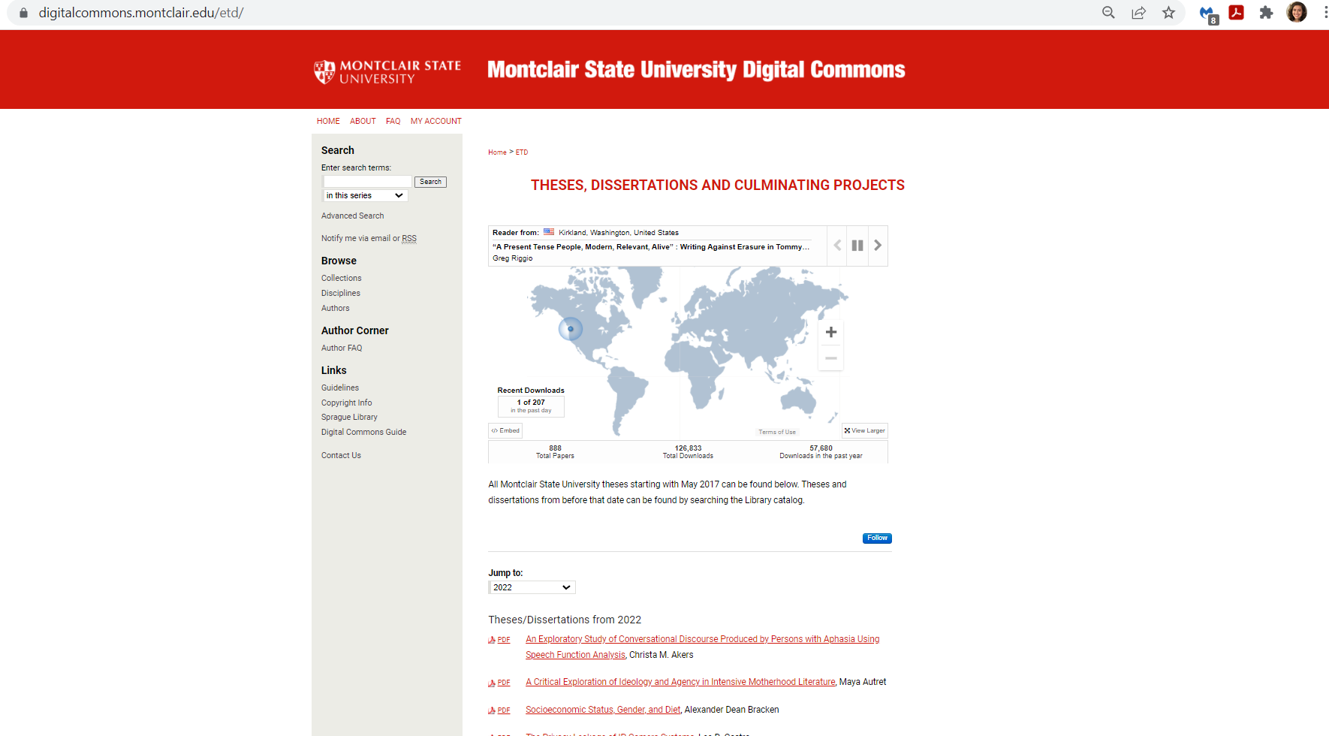
Digital Commons: Example Dissertations
Notes:
Jenny = Share sample dissertation template via Screen Share

Slide 38
Helpful Links for Doctoral Students from TGS
Graduate Policy Manual
Doctoral Procedures Manual 2021-2022
Doctoral Students web page for The Graduate School
APA Style Dissertation Guidelines: Formatting Your Dissertation
Montclair State University Digital Commons
Notes:
Nelly and Jenny

Slide 39
APA 7th Edition Resources
APA Editing Services - Scribbr:
https://www.scribbr.com/proofreading-editing/apa-editing-services/
Free APA Citation Generator - Scribbr:
https://www.scribbr.com/apa-citation-generator/
PERRLA - Automatically Translates Papers into APA 7th edition:
https://www.perrla.com/#/how-it-works
CWE Digital Dashboard - APA 7th Edition Resources:
https://www.montclair.edu/center-for-writing-excellence/digitaldashboard/resources-for-writers/citing-sources/#APA
Notes:
Jenny

Slide 40
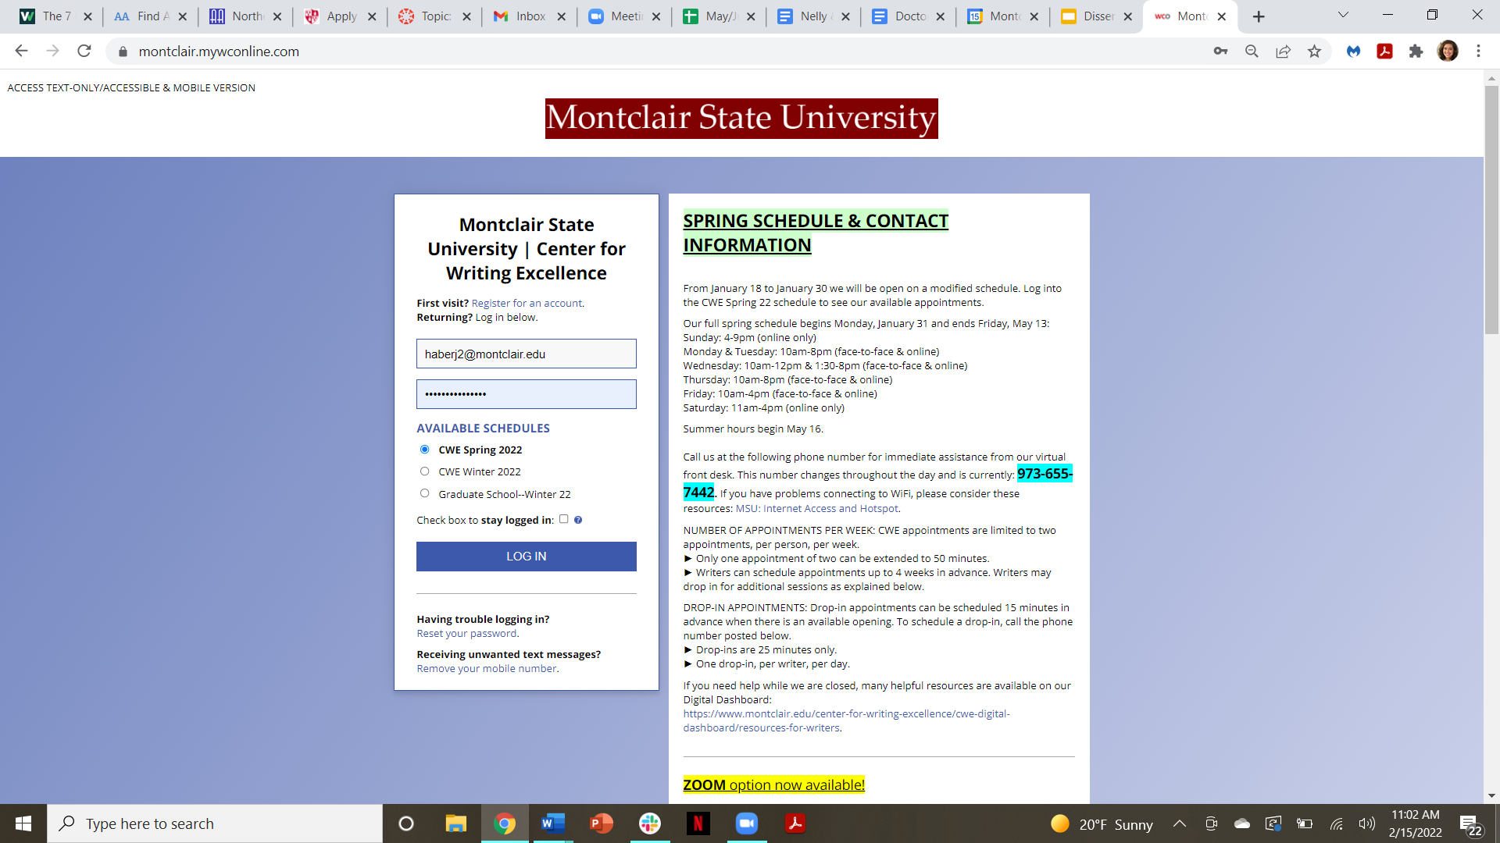
CWE Appointments
Appointment
Modalities:
Face-to-Face
Zoom
Chat
Notes:
Jenny

Slide 41
CWE Writing Resources
Dissertation Writing Tips:
https://www.montclair.edu/center-for-writing-excellence/digitaldashboard/resources-for-writers/writing-at-the-graduate-level/#d.en.44641
Guidelines for Writing a Literature Review:
http://www.duluth.umn.edu/~hrallis/guides/researching/litreview.html
Literature Reviews:
http://writingcenter.unc.edu/handouts/literature-reviews/
Sample Literature Review:
https://www.google.com/url?sa=t&rct=j&q=&esrc=s&source=web&cd=&ved=2ahUKEwjFtequ84rxAhXgF1kFHVQjACYQFjABegQIAxAD&url=https%3A%2F%2Fwestoahu.hawaii.edu%2Fnoeaucenter%2Fwp-content%2Fuploads%2F2019%2F10%2FSample-Literature-Review.pdf&usg=AOvVaw3SKcvmCV4AI7IxxNwduUFC
Notes:
Jenny

Slide 42
Questions?
Notes:
Nelly and Jenny

