Slide 1
Completing a Master’s Thesis at Montclair State University
Prepared by Alison VanOrden at The Graduate School

Slide 2
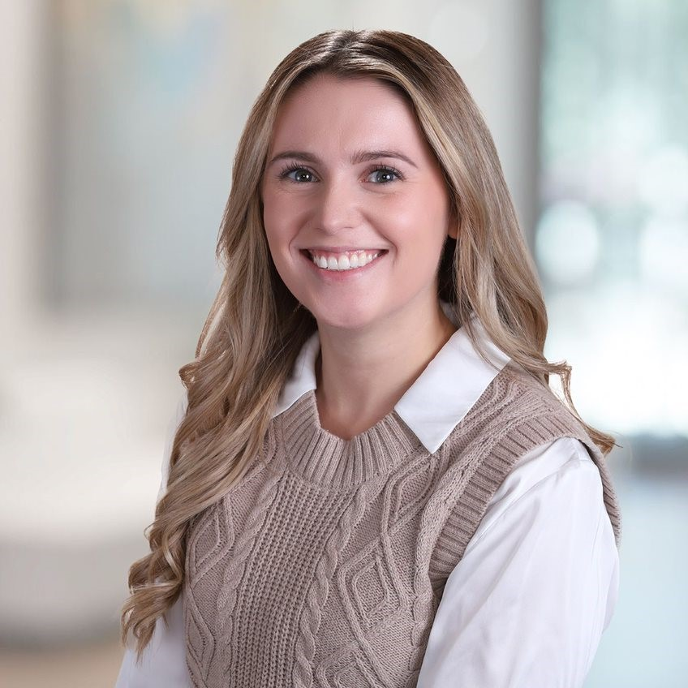
The Graduate School Thesis Contact
Master’s Student in the Clinical Psychology Program (Forensic Concentration) and the Business Analytics Program
Services to Thesis Students
Primary point of contact for all thesis questions
Support with registration and final submission
Office hours: in-person and virtual
Thesis Reviews & Revisions
Can provide writing assistance with sentence structure, syntax, grammar, and other general writing queries
Reviews formatting and thesis components to ensure compliance with The Graduate School’s guidelines
Contact Info
Email: thesisinquiry@montclair.edu
Alison VanOrden
Thesis Process Coordinator

Slide 3
An Overview of the Thesis Process
Identify Thesis Topic
Select Sponsor & Committee
Thesis Outline and Approval
IRB Approval*
Register for Thesis Course
Research and Write Thesis
Register for Thesis Extension*
Oral Examination*
Submit Final Thesis
* Indicates a step which may be optional for students depending on their thesis and specific program requirements.

Slide 4
Important Deadlines
Action | Deadline
Register for Thesis (698) Course | Semester of Intended Graduation or Earlier
Oral Defense (Optional) | 6 Weeks Before Graduation
Final Thesis Submission | 3 Weeks Before Graduation

Slide 5
Step 1: Identify a Thesis Topic
You should begin considering a thesis topic as soon as possible to ensure timely completion of your degree.
Some things to consider when selecting a topic:
Prior and supporting research/literature
Faculty member with expertise or interest in this topic
Relevance for your degree and future aspirations

Slide 6
Step 2: Selecting Your Sponsor & Committee
Selecting a thesis sponsor is extremely important.
Things to consider when selecting a sponsor:
Availability
Relevant expertise and experience
Rapport and work style
Reach out to Graduate Program Coordinator (GPC) if you need assistance
Committee will consist of your Sponsor + 2-3 additional faculty members

Slide 7
Thesis Sponsor & Committee Member Requirements
Sponsor
Full-time tenured or tenure-track faculty
Holding graduate faculty status
Within your department
Committee Members
Need approval from GPC and The Graduate School if they do not meet above criteria
External Faculty
1 External Faculty member allowed on Committee
Requires GPC approval, Department Chair approval & The Graduate School approval
Must fill out the Approval of an External Thesis Committee Member form and send it to thesisinquiry@montclair.edu along with a copy of the faculty’s CV

Slide 8
Step 3: Approval of your Thesis Topic
Once your committee is selected, outline your thesis with your sponsor
Include:
Clear statement of research issue
Extended literature review
Proposed research design/methodology
An annotated bibliography
Submit outline to thesis committee for approval

Slide 9
Step 4: Institutional Review Board Approval
Not all thesis topics require IRB approval
Consult with sponsor about IRB approval
If IRB approval is needed, allow 3-6 weeks for processing
IRB Approval Process
Request a Cayuse IRB Account
Submissions done through Shibboleth
IRB Training workshops can be found here
IRB Contact Information
IRB Website
reviewboard@montclair.edu
973-655-7583

Slide 10
Step 5: Registering for the Thesis Course (698)
To register, submit the following to thesisinquiry@montclair.edu
Approval for Writing a Master’s Thesis
Thesis proposal
The Graduate School will approve, sign & send the form to the Office of the Registrar who will enroll you in your thesis course
*Please note that you do not use NEST to register for Thesis (698) or Thesis Extension (699) Courses

Slide 11
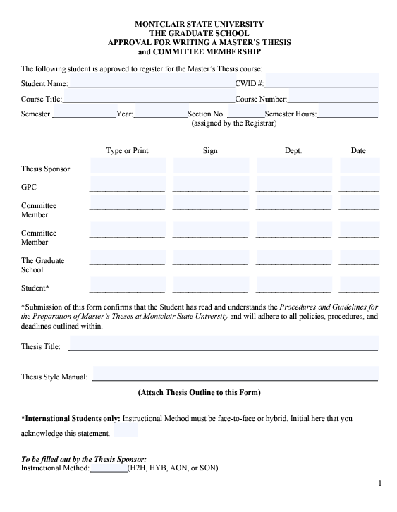
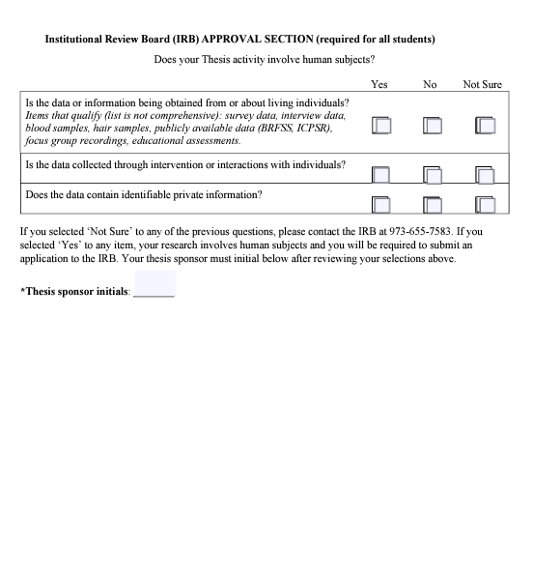

Slide 12
Step 6: Research & Write Your Thesis
Your thesis committee will specify a particular citation style manual for you to utilize
Maintain duplicates of all research materials and drafts
Budget your time accordingly
Keep the University Calendar in mind
Thesis Writing Support:
Book thesis-specific writing consultations with Alison from The Graduate School here
Book an appointment with the Center for Writing Excellence here

Slide 13
Step 6 Continued: Thesis Formatting
The Graduate School requires the following format in this order:
Abstract
Thesis Signature Page
Title Page
Copyright Page
Acknowledgements
Table of Contents
List of Figures
List of Illustrations
Thesis Text
References/Works Cited/Bibliography
Appendices
Supplemental Figures and Illustrations

Slide 14
Step 7: Register for Thesis Extension
Students who do not finish their Master’s Thesis in the semester they registered for the course must register for the Master’s Thesis Extension Course (699) for each subsequent semester until Master’s Thesis is completed and approved by The Graduate School
To register:
Fill out Thesis Extension Application before each semester
Send the fully completed form to: thesisinquiry@montclair.edu
*Please note: you do NOT use NEST to register for Thesis Extension (699) Course. The Office of the Registrar will register you for this course.

Slide 15
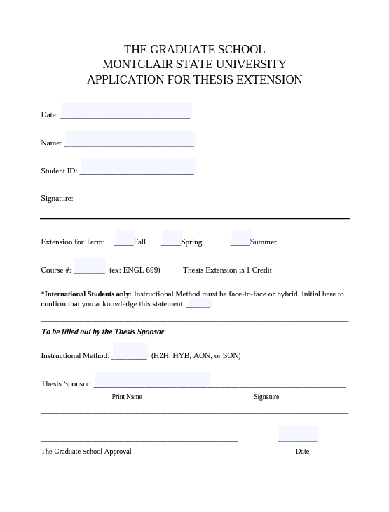

Slide 16
Step 8: Oral Defense
Program Dependent
Date will be determined by thesis sponsor
Should be at least 6 weeks prior to graduation date
Format depends on graduate program
Thesis sponsor normally leads the examination
10-20 minutes long typically
At the end, thesis committee along with thesis sponsor give one of three outcomes:
Approved
Approved with modifications
Not approved
If this happens, thesis committee will recommend further action

Slide 17
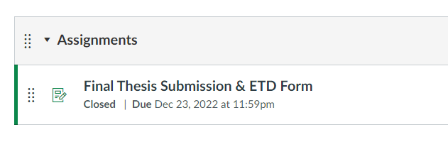
Step 9: Submitting Your Final Thesis
Submissions are managed through the Master Your Thesis Canvas Course
Students submit the following:
Final Thesis (PDF)
ETD Form

Slide 18
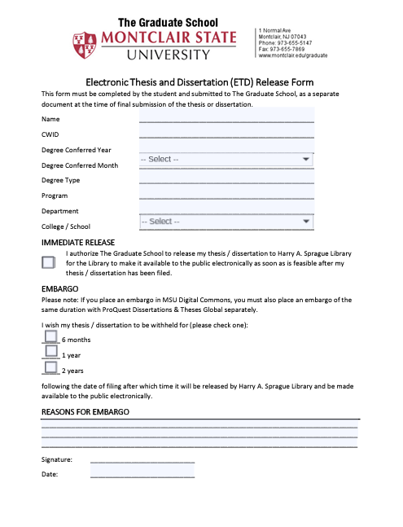

Slide 19
Questions??? Email: thesisinquiry@montclair.edu

Slide 20
The Graduate School Forms
Approval for Writing a Master’s Thesis (698 Registration)
Approval for External Committee Member
Thesis Extension Form (699 Registration)
ETD Form

