Slide 1
Dissertation Timeline: The Final Semester
From Dissertation Defense to Commencement
Prepared by The Graduate School
January 2021

Slide 2
Contacts at The Graduate School
Associate Dean of
The Graduate School
Dr. Nelly Lejter
lejtern@Montclair.edu
Graduate Student
Assistance Coordinator
Serves as the second in authority at The Graduate School and acts for the TGS Dean
Coordinates doctoral policy and implementation with academic departments
Works closely with departments and programs, as well as Graduate Council, on curriculum issues such as development of new programs or changes to programs
Regularly attends Dissertation Defenses as the external designated observer.
Caren Ferrante
ferrantec@Montclair.edu
Office Phone: 973-655-4403
Questions regarding:
Matriculation
Dissertation advisement
Submission of final dissertation
All things doctoral!

Slide 3
Contacts at the CWE
Writing Consultant/Graduate Assistant
Jennifer Haber
haberj2@montclair.edu
Provides one-on-one writing consultation for graduate students through the CWE
Reviews theses and dissertations

Slide 4
Enrollment and Coursework
Culminating Activity
Once completed: Form A
Candidacy
Form A approved: student becomes doctoral candidate
Dissertation proposal
Dissertation Defense
Dissertation Committee
It is not too early to start thinking about and planning for your dissertation!
The Lifecycle of a PhD Student
Select your Dissertation Chair
Coordinate with Chair who will be the faculty in your Committee
Form B (if external members outside MSU, also form C)
Form G begins registering for Dissertation Advisement
Once completed: Form D
Time limit to complete doctoral degree:
10 years for students who started with a Bachelor’s degree
7 years for students who started with a Master’s degree
Form E – Approval of Defense Date
Form F-Report of Defense
Notes:
Nelly to talk about research/committee. ENV committee before Candidacy.

Slide 5
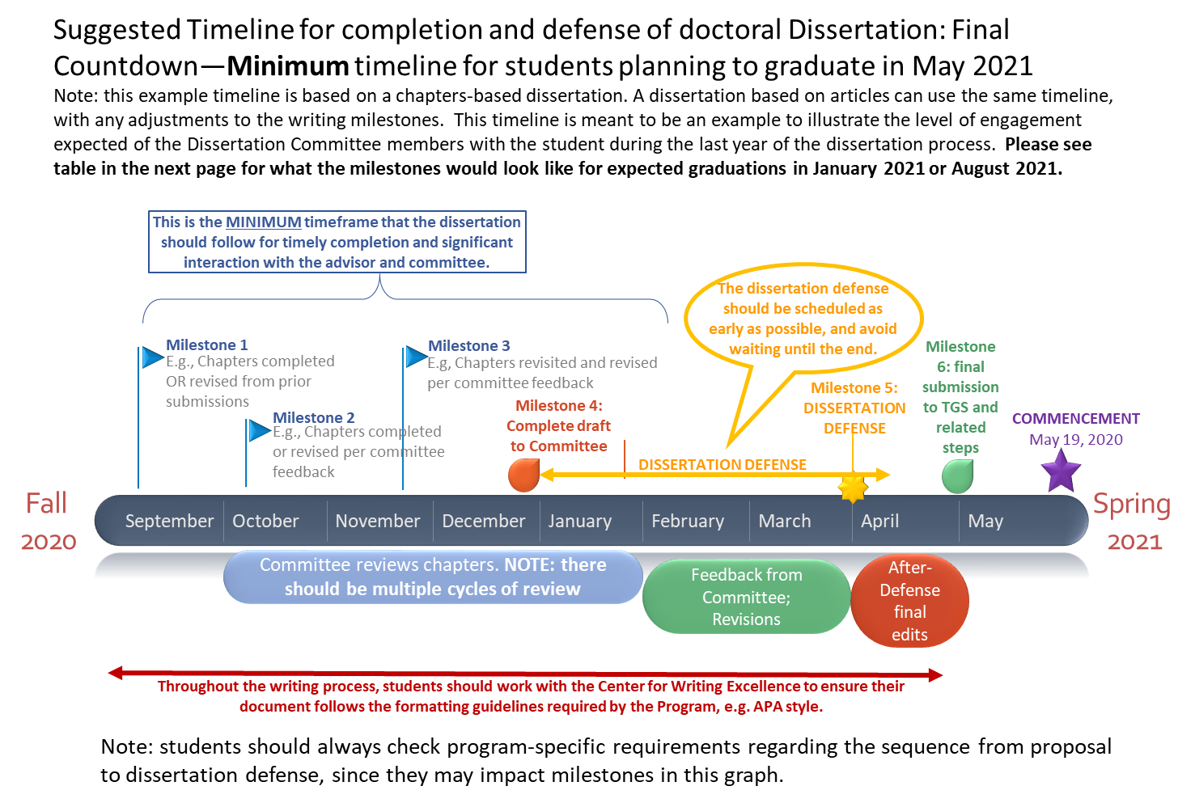
Nov 7
Dec 20
6 days
Today
17 days
24 days
16 days
25 days
Notes:
The graph in the next slide represents the minimum timeline. As much as possible, students should get an early start on dissertation writing to allow for substantive feedback from the advisor and committee.
The milestones in dissertation writing are likely to vary from what the graph shows. For example, there will likely be several iterations of different chapters, as the student progresses. The milestones included here are illustrative of the overall process but each student and advisor should work on their specific timeline and milestones.
All dissertation defenses must be advertised in the campus community at least two weeks prior to the event.
Students must confirm that TGS approves formatting of the dissertation according to the Dissertation Handbook guidelines.
The final submission to TGS, Milestone 6, includes several administrative steps that the student needs to complete before the Registrar clears them for graduation, including payment of dissertation filing fee and filling out forms for embargo/release, and UMI submission. TGS will be in contact with the student after the defense to complete these steps.

Slide 6
Dissertation Defense and Submission Deadlines: Academic Year 2020-2021
Requested Degree Conferral | Application for Graduation | Request for Dissertation Defense Date (see pg. 20) | Request for Approval of Signature Page (see pg. 21) | Dissertation Defense Date Approval (see pg. 21) | Submission of Completed Signature Page, Completed Embargo form, and Dissertation Filing Fee to TGS (see pg. 23) | Final Submission of Dissertation to TGS via E-mail (see pages 24-26) | Electronic Submission of APPROVED document to Pro-Quest (see pg. 25)
May 2021 | December 21, 2020 | March 12, 2021 | Prior to Defense Date | April 26, 2021 | Prior to Final Submission of Dissertation via E-mail | May 14, 2021 | May 21, 2021
August 2021 | June 1, 2021 | June 16, 2021 | Prior to Defense Date | Only by Approval of Dissertation Chair | Prior to Final Submission of Dissertation via E-mail | August 2, 2021 | August 20, 2021
January 2021 | October 2, 2020 | November 2, 2020 | Prior to Defense Date | December 15, 2020 | Prior to Final Submission of Dissertation via E-mail | December 21, 2020 | January 13, 2021

Slide 7
Are you ready to defend? 1. When is the document ready?
A defendable dissertation is a complete draft that the committee deems ready for you to defend.
It is not the final, definitive draft but the formatting and all components must be in place, including the abstract and conclusions.
It should be likely to be ready for final submission after relatively minor revisions.
Use the template for the dissertation pages TGS provides (available in the Policy Manual)

Slide 8
Are you ready to defend? 2. How do you get the defense date approved?
Once Committee agrees on defense date:
Submit form E with all required signatures
You can find Form E here (this hyperlink only works if you are viewing the slide show)
You can find all doctoral forms here
Send PDF (do not print!) of your dissertation draft along with form E to: docstudy@montclair.edu; please copy Rebecca Shiffer at shifferr@montclair.edu

Slide 9
Formatting of the dissertation (1)
Style Manual: Check with your program
Publication Manual of the American Psychological Association: moving from 6th to 7th edition. Students completing dissertations in the Fall 2020 semester or later should be following the 7th edition.
You do not need to print your dissertation to submit it!
Typeface: 12 point, Times New Roman
Spacing: double spaced, left aligned, ragged right
Margins: must be consistent throughout the document
All margins: 1”

Slide 10
Formatting of the dissertation (2)
Check the Dissertation Procedures & Guidelines Manual: A Guide from Candidacy to Dissertation Defense and Graduation for all formatting requirements (these slides do not include all of them)
You want to present a polished document to the faculty for the defense. The Center for Writing Excellence has evening hours, and you can make an appointment here for any questions or help you need regarding style, formatting, etc.
Use automated table of contents and index! Do not do this manually.
Use the section breaks feature in Word to take care of pagination.

Slide 11
Before the defense: To Do
Send a signature page to TGS in Word format. It will be approved and sent back to you in PDF format, ready for your committee signatures following the defense.
Confirm TGS approval of the defense and defense date
TGS (Rebecca Shiffer) will send you back Form E with TGS Dean Herness’ signature indicating approval.
Confirm day/time of the defense. If you have not done this yet, reach out to your advisor ASAP! Dissertations can take place in Zoom for 2020-2021; TGS can help with the link.
Prepare!

Slide 12
Preparing for the defense
Seek advice from your Chair/committee on the types of questions they may ask during the presentation.
Organize your material for presentation.
Work with your advisor in practicing sharing your screen in Zoom.
Check with your advisor the flow of the meeting in Zoom and how they plan to address the public section of the defense as well as committee deliberations.
Practice presenting the material and addressing questions. It is a good idea to time your presentation to follow the guidelines from your Chair.

Slide 13
At the Defense
Attendance by the candidate and all member of the committee is required, along with an impartial Doctoral Faculty Member or TGS representative.
This year, all Dissertation Defenses will be scheduled virtually.
The Dissertation Chair will coordinate the signatures of FORM F – Report of Dissertation Defense .
Make notes of all the comments you are receiving from the committee regarding revisions to your draft.
The desired outcome of this meeting is the chair's greeting you with the statement "Congratulations, Dr. _."! The defense was successful, and the committee has passed your dissertation.

Slide 14
After the Defense
FORM F is completed by the committee at the end of the defense, with three possible outcomes:
- Pass – no substantive revisions
- Pass with Conditions – substantive revisions
- Fail – second defense required
The completed, signed Form F needs to reach TGS as soon as possible after the defense.
Get to work on the revisions as soon as possible and keep in touch with your Chair and committee as needed.

Slide 15
After the Defense: To Do
Celebrate this major milestone in your career!
Complete all revisions until committee and Chair are satisfied with the final draft
Use the Final Review Checklist Prior to Post-Defense Submission—page 24 of the Dissertation Procedures & Guidelines Manual: A Guide from Candidacy to Dissertation Defense and Graduation
If you have answered “NO” to any of the questions in the checklist, please revise your document as necessary. If the document is submitted with any of the basic issues listed above, it will be returned to you for revision. This may result in the delay of your degree conferral!

Slide 16
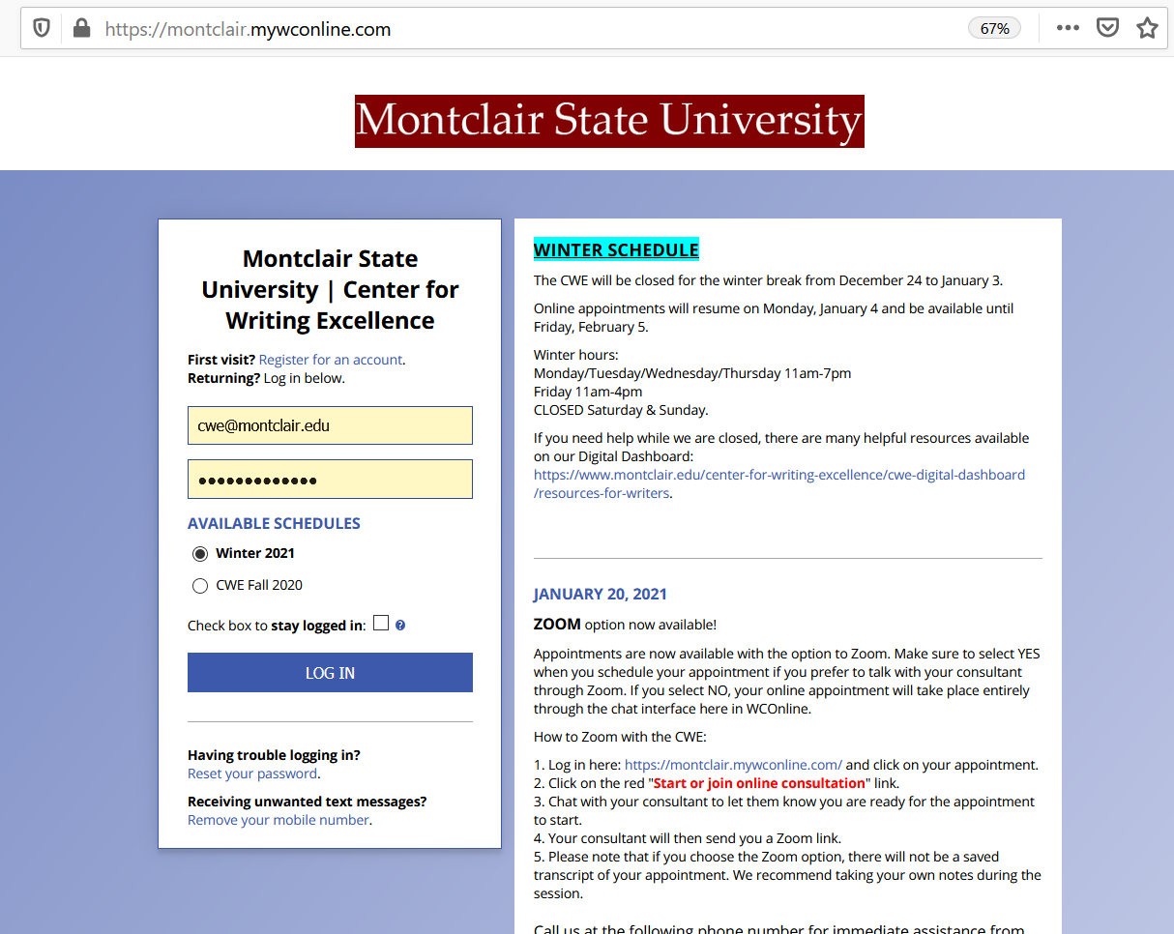
Contacts at the CWE
Writing Consultant/Graduate Assistant
Jennifer Haber
haberj2@montclair.edu
Provides one-on-one writing consultations for graduate students through the CWE:
25-minute & 50-minute sessions
Predominantly works with graduate students on master’s theses/dissertations
Involved in the finalization process of master’s theses/dissertations
Reviews any works that contain writing, including resumes, cover letters, assignments, etc.
Evening availability during Spring 2021
To schedule an appointment, call: 862-210-4200

Slide 17
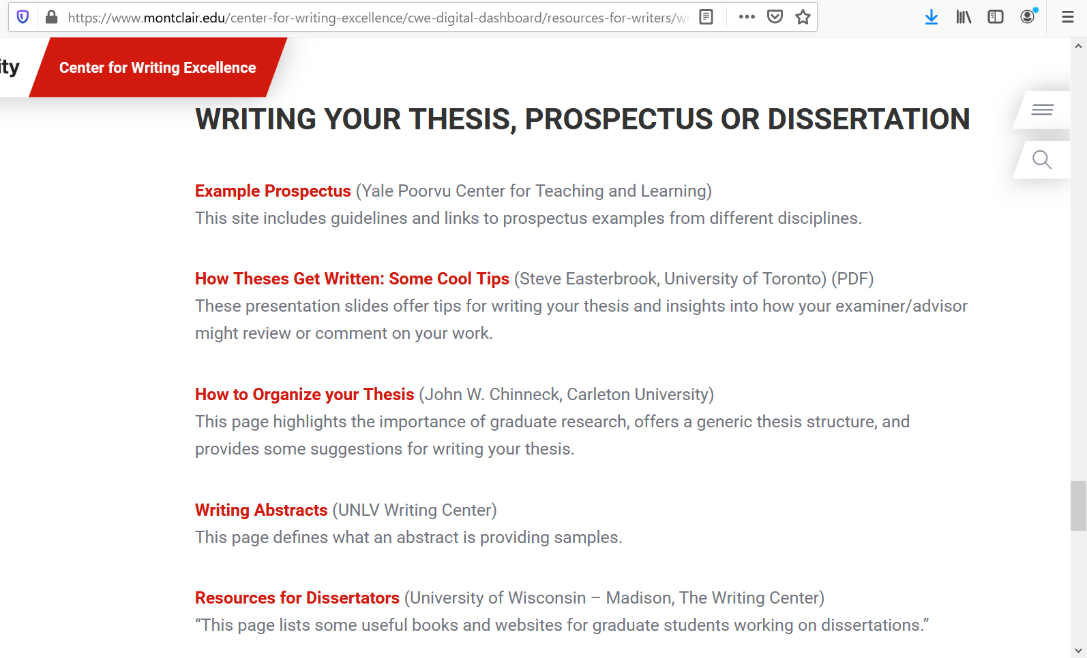
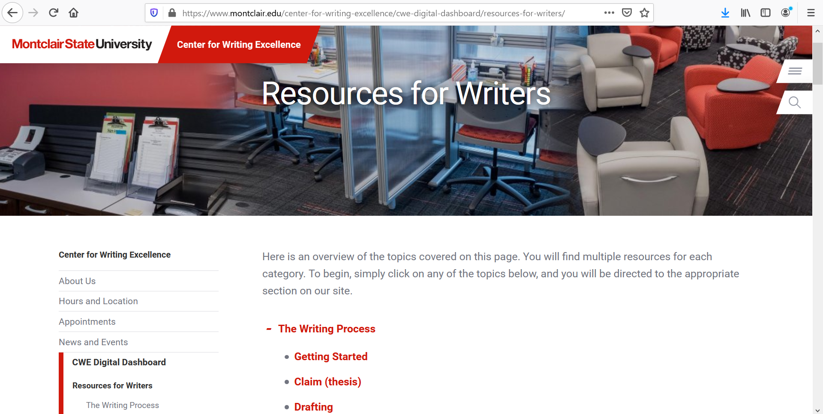
CWE Digital Dashboard
Resources for Writers page:
https://www.montclair.edu/center-for-writing-excellence/cwe-digital-dashboard/resources-for-writers/?wp_logged_in=true
Writing Your Thesis, Prospectus or Dissertation page:
https://www.montclair.edu/center-for-writing-excellence/cwe-digital-dashboard/resources-for-writers/writing-at-the-graduate-level/#d.en.44641

Slide 18
Potential life-saving tips!
Table of Contents – automate it from the beginning with Headers!
Headers – read up on customizing your heading styles in Word, this will help with your formatting as well as your ToC.
Format your signature page and have TGS approve it before your defense.
Automate your list of References—check with your Chair.
Tables and Figures – if you’re using tables and figures, keep them within the margins, consistent with your style manual, and legible. Use the “insert caption” function in Word for the numbering and title.
Margins – set your margins and spacing from the start and adhere to them throughout.
Landscape pages: you can do this with the “section break” function.
Start saving for your regalia.

Slide 19
The final submission
Once all revisions are done and the Committee and Chair have approved, the signature page(s) can be finalized and submitted to docstudy@Montclair.edu
After the signature page is submitted, the final manuscript should be submitted as a Word document to docstudy@Montclair.edu
The Graduate School will review your document for formatting. If your document does not adhere to formatting requirements as set forth in the appropriate Dissertation Manual, your document will be returned to you for editing. You may be referred to your Chair and/or the CWE as resources.
Once the document has been approved, TGS will create the final electronic document, including the signature page with all the signatures.

Slide 20
And the final steps are:
Once the final dissertation is ready for publication, an email will be sent with instructions for completing the following:
Send $100 check for dissertation filing fee
Fill out the Survey of Earned Doctorates
Submit the dissertation to UMI
Fill out and submit the embargo form
Check your email for instructions about regalia, hooding, etc and all matters connected to Commencement!
We will also ask to confirm your name and dissertation title for the Commencement booklet

Slide 21
1. Write your dissertation
2. Apply for Graduation (via Nest)
3. Schedule your Defense
4. Send a draft of your signature page to TGS for approval
5. Defend
6. Circulate approved signature page to all committee members
7. Make revisions
8. Have your Chair approve revisions and finalize your signature pages
9. Submit signature pages and Dissertation Filing Fee to TGS
10. Send electronic file to TGS for approval of formatting
11. Work with TGS to finalize formatting
12. Receive final, approved copy (.pdf) of dissertation from TGS
13. Submit .pdf of final copy to UMI/ProQuest
14. Complete Survey of Earned Doctorates
15. Complete any necessary Commencement forms/actions
16. Go to Commencement and get hooded!

Slide 22
Important contacts at TGS!
Caren Ferrante, Graduate Student Assistance Coordinator: 973-655-4403 ferrantec@montclair.edu. Your primary point of contact for all matters connected to dissertation.
Nelly Lejter, Associate Dean: 973-655-7175, lejtern@montclair.edu
Rebecca Shiffer Newton, Assistant to Dean Herness: shifferr@montclair.edu, 973-655-4368
Key person! She takes care of all the forms and of getting the Dean’s signatures where needed. She coordinates the publication of your defenses’ location and day/time, published in TGS’ web site.
Jenny Haber - GA and CWE liaison haberj2@montclair.edu
She is your go-to person for writing, editing and formatting

Slide 23
Helpful Links for Doctoral Students
Graduate Policy Manual
Procedures & Guidelines Manual: from Candidacy to Dissertation Defense and Graduation for Doctoral Candidates and Doctoral Faculty
Doctoral Student webpage for
The Graduate School

Slide 24
Questions?

