Slide 1

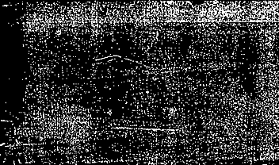

The Armenian Genocide

Slide 2
Genocide is:
acts committed with intent to destroy, in whole or in part, a national, ethnical, racial or religious group.
killing members of the group.
causing serious physical or mental harm.
forcibly transferring children of the group to another group.

Slide 3
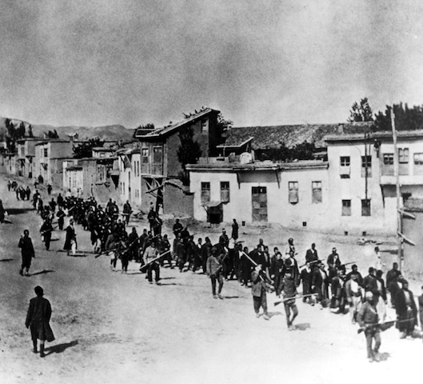

What was the Armenian genocide?
The systematic annihilation of 1.5 million Ottoman Armenians during World War I (1915) by the Young Turks.

Slide 4

Why did the Armenian Genocide happened?
https://www.youtube.com/watch?v=BSchiqWIB6g

Slide 5
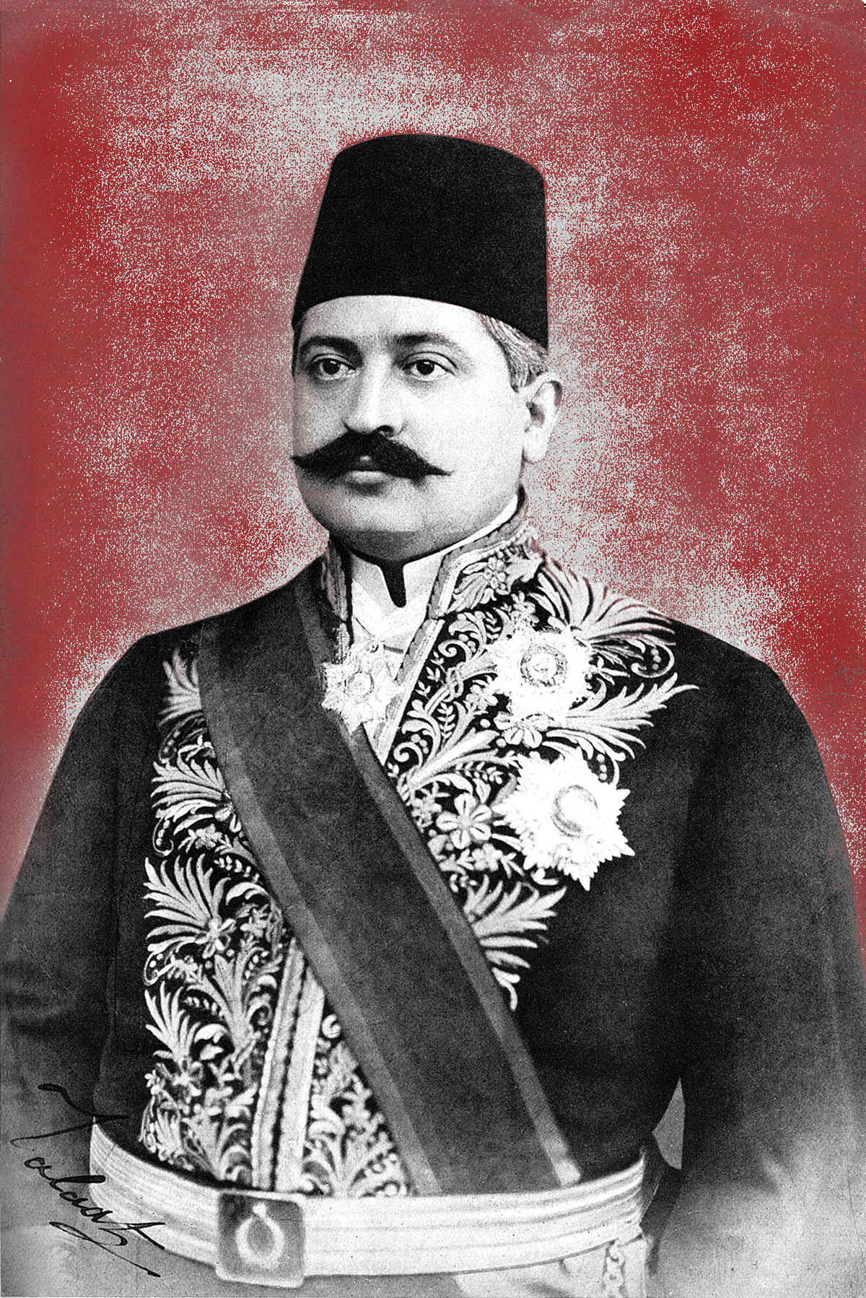
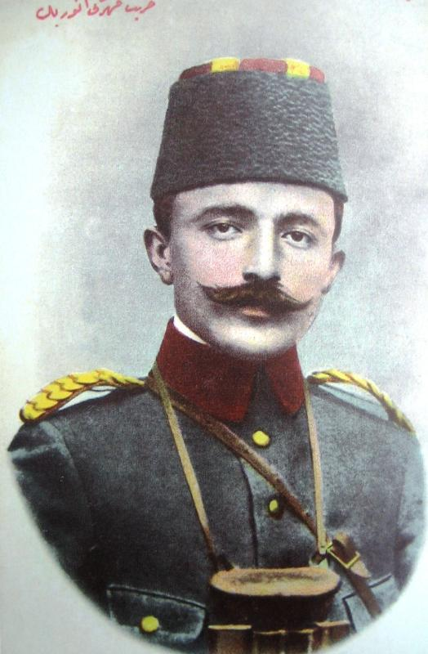
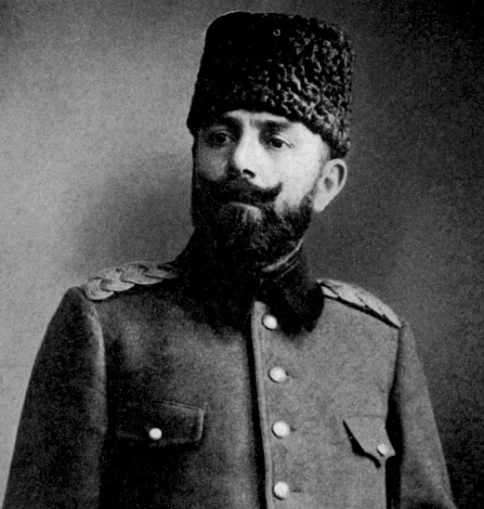
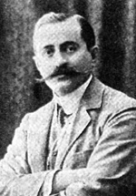
Who was responsible for the Armenian genocide?
The Main Leaders of the Young Turks
Talaat Pasha
Enver Pasha
Djemal Pasha
Behaeddin Shakir Bey

Slide 6
The Three phases of Armenian genocide:
Phase one – Draft 60,000 Armenian men into the Ottoman Army.
Phase two - started on April 24, 1915 with the arrest of Armenian intellectuals and elites.
Phase three – exile of women, children, elderly people to the desert of Syria.

Slide 7
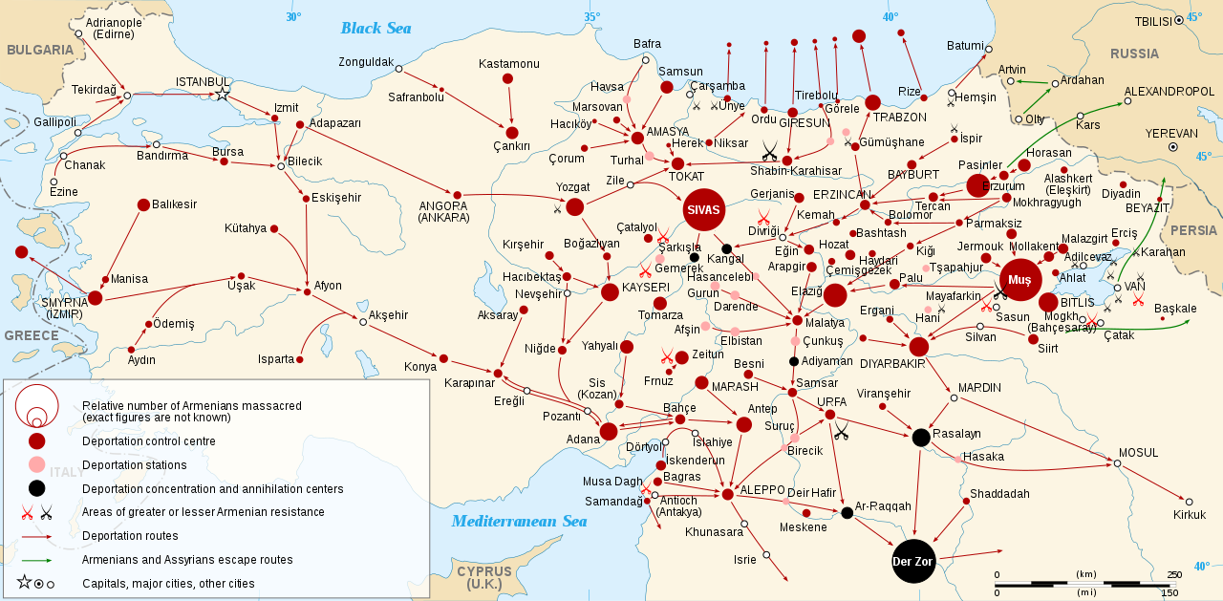
The Armenian Genocide deportation map
Notes:
The size of the circle represents the number of deaths.
The red lines represent the deportation routes – Turkish troops forced Armenians into the desert without food or water, to die of starvation.

Slide 8
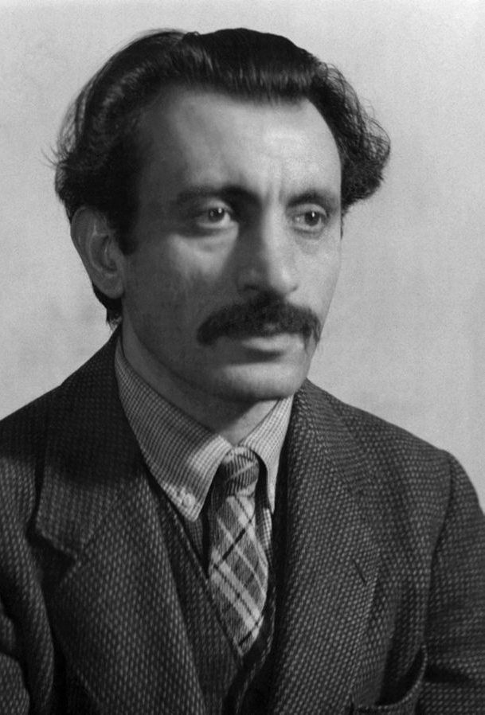
Arshile Gorky – Artist
Born as Vosdanig Adoian in 1905.
A victim of the Armenian Genocide.
Moved to New York and changed his name.
Remembers his mother, Sushan der Marderosian, dying in his arms.
His most famous painting is The Artist and His Mother which is based on a photograph Gorky and his mother took in 1912.
Notes:
He was 10 years old during the Armenian Genocide.

Slide 9
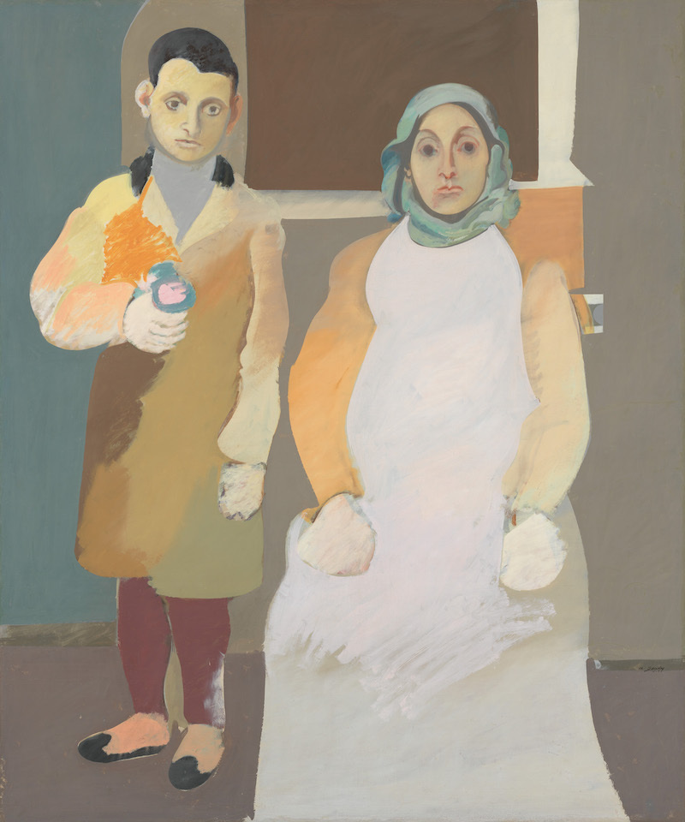
Arshile Gorky- The Artist and His Mother
On a piece of paper:
Write down 5+ things that you notice about this painting. What do you see?
(Colors, shapes, things, distance, perspective, details…etc.)
Notes:
Is it a cheerful, joyful painting? Or is it a depressed, miserable painting?
The theme of the painting is loss.
She has a mask-like face, no facial expression.
She looks like a statue.
Gorky paints her body flat like.
She has an image of dead person.
Her dress is ghost white.
There is a distance between Gorky and his mother.
Gorky has a sign of life. His face is sad.
His body posture is in three dimension.

Slide 10
Arshile Gorky- The Artist and His Mother
https://www.youtube.com/watch?v=VRmU5Lr2ao8&index=8&t=0s&list=LLMSHp7wsR_7dk_4Z7VTdnww
Compare and contrast the photo to the video.
What does this artwork show us about the Armenian Genocide?
Notes:
The theme of the painting is loss.
She has a mask-like face, no facial expression.
She looks like a statue.
Gorky paints her body flat like.
She has an image of dead person.
Her dress is ghost white.
There is a distance between Gorky and his mother.
Gorky has a sign of life. His face is sad.
His body posture is in three dimension.

Slide 11
Armenian Genocide Survivor Testimony
https://www.youtube.com/watch?v=Xq9FgRQcJXQ&index=28&list=LLMSHp7wsR_7dk_4Z7VTdnww&t=0s

Slide 12
Do you think the United States should use the word Genocide when talking about the Armenian Genocide?
Why?
Notes:
We watched in the first video that the United States does not use the word genocide when talking about the Armenian Genocide..

Slide 13
List 3-5 thing you learned the Armenian Genocide

