Slide 1


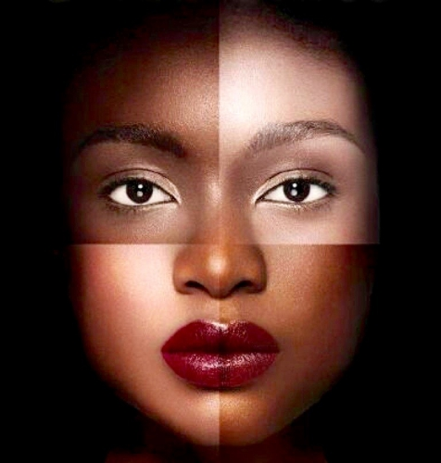

Colorism: A look at Skin Color Discrimination
Makeda Bozeman

Slide 2
A Safe Space
Key Things to Remember:
Give the speaker the respect he/ or she deserves
Make “I” statements when giving responses
DO NOT put down or ridicule someone with a difference of opinion
This is a safe space where we will respect everyone’s ideas and opinions.
Topics like Racism and color discrimination, can be difficult to talk about and may cause differing in opinions. Everyone is to be heard and respected.

Slide 3
Introduction
What is colorism?
What is skin tone discrimination?

Slide 4
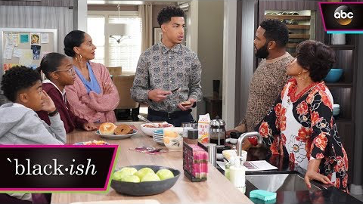
The Role of Colorism

Slide 5
Anticipation Guides
Can you identify 3 examples of colorism?
This can be in the media, personal life, employment, and education.
Take out a sheet of paper and write these 3 examples. You have 3 minutes.

Slide 6
Racism vs. Colorism
In today’s society skin color has become a signifier of a person’s identity and value. In the United States especially we have a diverse population of residents, but still somehow race matters, and so does skin color.
As America becomes more diverse (interracial unions and immigration) skin color will be more important than race, because a person’s skin color is an irrefutable fact versus race which is a man-made classification used to divide and control the minority.
Skin color continues to be the most obvious criteria used when determining how a person will be judged. After hundreds of years of deep-rooted racism in this country, we already have an understanding that darker skin is demonized versus light skin which is prized. The privileging of lighter skin over darker skin is the root of colorism.

Slide 7
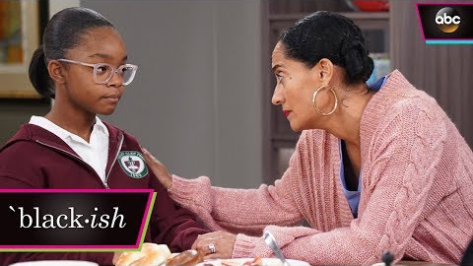
'Black Like Us’
The Effects of Colorism
z

Slide 8
A Brief look at the History of Colorism
Colorism is discrimination based on skin color. Colorism disadvantages dark-skinned people while privileging those with light skin.
Researchers have linked colorism to smaller income, lower marriage rates, longer prison terms, and fewer jobs for darker-skinned people.
Colorism in the United States is deeply rooted in Slavery. Fair-skin slaves would receive preferential treatment from Slave owners.
Once slavery ended in the United States the remnants of colorism remained.
Nittle, Nadra Kareem. (2018, December 7). The Roots of Colorism, or Skin Tone Discrimination. Retrieved from https://www.thoughtco.com/what-is-colorism-2834952

Slide 9
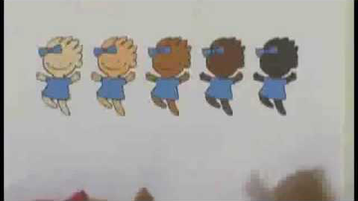
Colorism and Children: S-I-T Activity 2
After the video take a few moments to reflect
Write down: 3 minutes
1 thing you found Surprising
1 thing you found Interesting
And 1 thing you found Troubling
We will discuss as a class

Slide 10
Media
Employment
Whitening creams are best sellers in the U.S. and Asia, because light skin is highly regarded. The skin bleaching industry is a multi-billion dollar industry.
In Hollywood darker skin actors and actresses have a harder time getting roles than their lighter skin counterparts.
Light-skin Latinos make on average $5,000 more than dark-skin Latinos.
Employers have increased the amount of African Americans hired, but positions of power tend to be held by people of lighter skin.

Slide 11
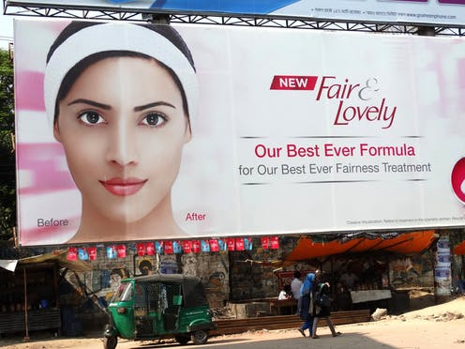
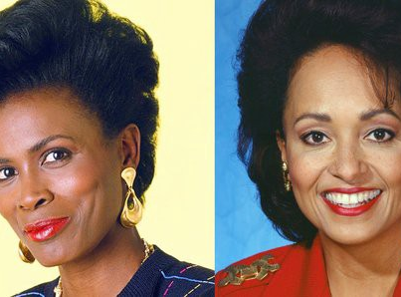
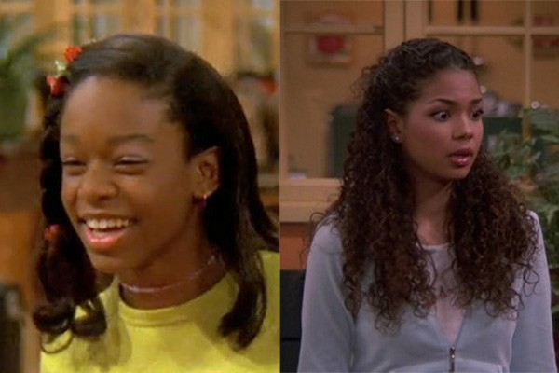
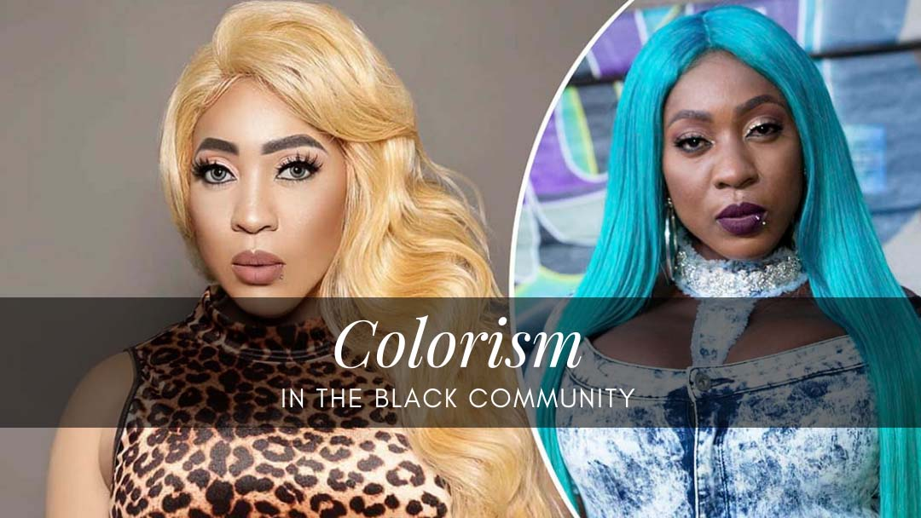
Colorism in popular Media
z

Slide 12

“The Hate U Give”
Color Representation
z

Slide 13
Research Study
Margaret L. Hunter conducted a study with 1,310 African American women.
In the study the color of African American women’s skin was a statistically significant predictor of educational attainment.
Hunter hypothesized that lighter skinned African American women received higher annual earnings compared to their darker skinned counter parts.
The study showed that for every increment of lightness women received a $673 annual income increase.
Women who were described as very light brown made more than $2,600 more a year than women of a similar background who was described as very dark brown.
Hunter’s findings conclude that the skin color of an African American woman directly affects income.

Slide 14
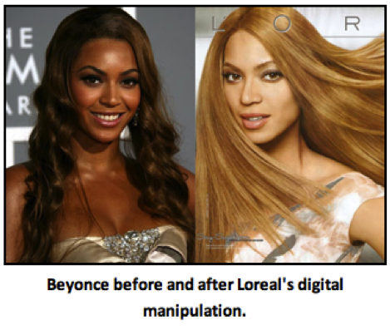
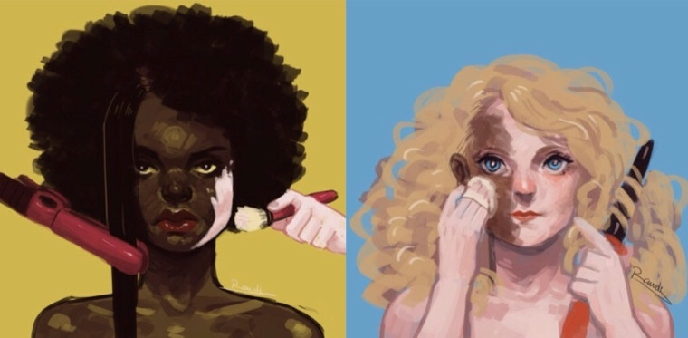
Analyzing Images Activity
z
Take a few minutes to view the pictures.
Write down the first 3 things that come mind.
Take 3 minutes. Discuss with a partner. Then we will discuss as a class.

Slide 15
Brief History of Intraracial Perpetuation
In today’s society colorism continues and some white people still prefer lighter skinned African Americans, because they seem less menacing and look more like them.
Whereas in the black community post-civil war, elite mulattos wanted to maintain the advantages and privileged given to them during slavery, and in order to do so they established separate communities and skin tone was the way to gain access.
Forming social clubs like the Blue Vein Society of Nashville, creating separate churches, the former way to gain admission was if the applicant’s skin color was light enough for the veins in the wrist to be visible.
In later years, the paper bag test was sometimes used, placing one’s arm side by side with a brown paper bag, and if their arm was lighter than the bag, the applicant was able to again entry.

Slide 16
Education
Criminal Justice System
A 2013 study found inequalities between light-skin and dark-skin African American girls. The study showed that dark-skin girls were three times more likely to be suspended from school compared to light-skin African American girls.
A university study of more than 12,000 imprisoned African American women in North Carolina found that the sentences lighter-skin women received were shorter than the sentences of darker-skin women
When we take a look at the criminal justice system dark-skinned black men received longer prison sentences compared to that of lighter skinned black men.

Slide 17
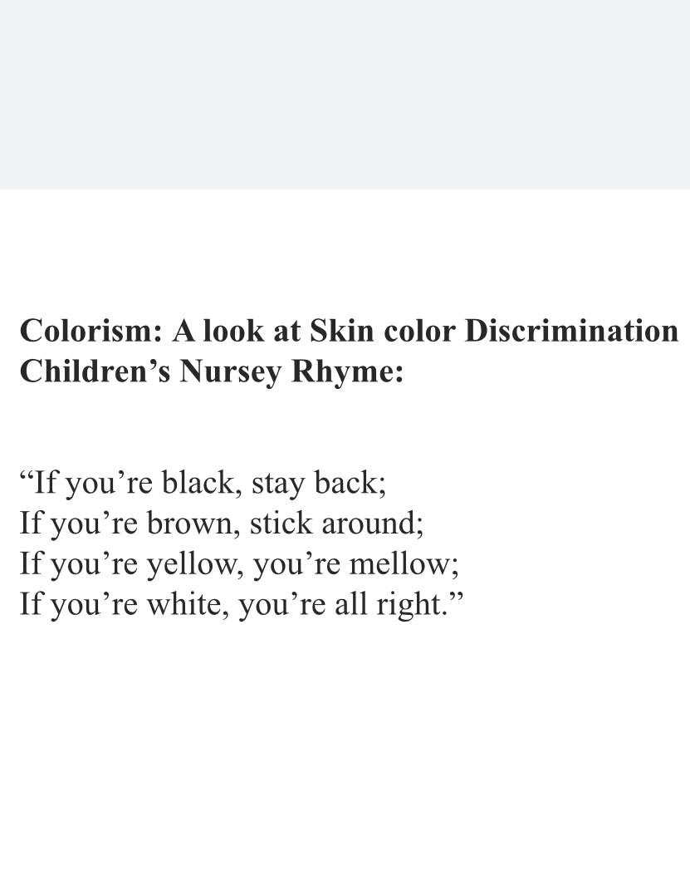
Think-Pair-Share Activity
Reflect on the handout
Pair up with a partner and share your responses (3 mins)
After 3 mins we will come together as a class and discuss collectively

Slide 18
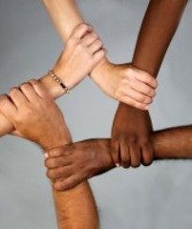
Call to Action
What steps can we take?
How can we combat colorism in today’s society?
z

Slide 19

3-2-1 : Exit Ticket
On a piece of paper you will write:
3 things you have learned from today’s lesson on colorism
2 things you still have questions about
1 thing you enjoyed about the lesson
Take 2 minutes to write
Be prepared to share

