Slide 1
Cash Sales / Customer Accounts / Internal Service Delivery
Confirmation Session
June 6, 2019

Slide 2
Agenda
Agenda
  FDM Overview
  What is a Confirmation Session?
  What is a Cash Sale, Customer Invoice, and Internal Service Delivery?
  Benefits
  Workflow
Demo of Configuration of Business Processes
  Create Cash Sale
  Create Customer Invoice
  Create Internal Service Delivery
Q & A

Slide 3
Ease of Use Features
Driver Worktags
Inherited & Related Worktags
Revenue & Spend Categories
Notes:
For those not familiar The FDM is a set of codes used to classify & record financial transactions. Under PeopleSoft Financial Management System we had a very simple chart using only fund account and department. With Workday the quantity of financial attributes has been expanded to allow for improved financial management & reporting. Workday refers to these attributes as Worktags.

Slide 4



Worktags
Cost Center
Cost Center
Division
Fund
Program
Expense Items
Project
Drivers
Related
& Optional
Location
Gift
Activity
Grant
Spend Category
Revenue Category

Slide 5
A Confirmation Session is

An Introduction to Workday key concepts
A demonstration of the system configurations of business processes that have been built so far
A visualization of the system for the end users
An opportunity for you to see the features of the system and share that information with your colleagues
Notes:
A Confirmation Session:
Introduces Workday key concepts
A demonstration of the system configurations of business processes that have been built so far
Provides you, as an end user, with a visualization of the system
Opportunity for you to see the features of the system and share that information with your colleagues

Slide 6
A Confirmation Session is not

Time for redesign
Formal testing
Validating customer data
Training of SME’s or any other Customer staff
Notes:
A Confirmation Session:
Introduces Workday key concepts
A demonstration of the system configurations of business processes that have been built so far
Provides you, as an end user, with a visualization of the system
Opportunity for you to see the features of the system and share that information with your colleagues

Slide 7
Cash Sales
What is a Cash Sale?
  A business process that replaces the Cash Receipt Transmittal Form (CRM). It is a paperless transaction that records a sale and payment as a single transaction. There is no accounts receivable recorded and as such is not applied directly to a customer invoice.
  Despite its name, payment methods other than cash can be used.

Slide 8
Cash Sale Benefits
Current
Manual process
Paper driven (cash transmittal –CRM- form)
Difficult to track / report
Delays in revenue being recorded
Future
Trackable
Transparency/Clarity in the process
Simplified process
Immediate recording of revenue upon approval
Reporting

Slide 9
Cash Sales Business Process
Notification of approval
{Initiator} Cost center finance specialist
{Approver 1} Cost center manager
{Approver 2} Deposit payment specialist
Revenue is recorded
Deposit is made with Bank by Cashier’s office.

Slide 10
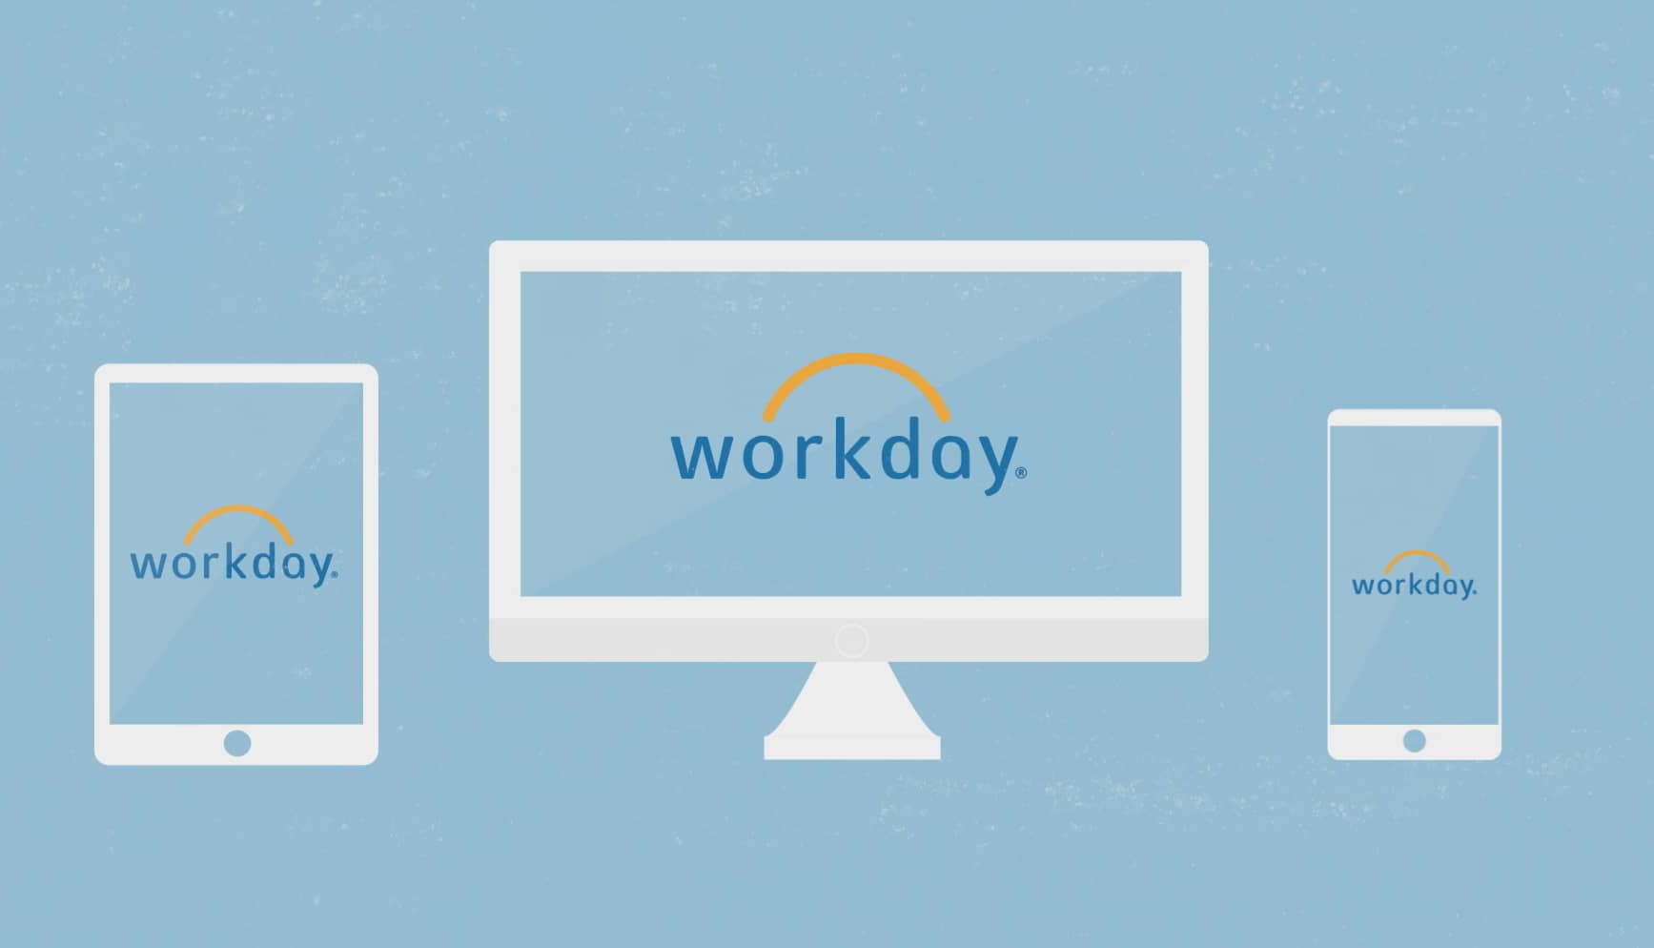
Demo – Cash Sales
Notes:
Let’s get started with the demo. We do have limited time. However, if you have a question regarding something we are demonstrating, please stop us.

Slide 11
Customer Invoices
What is a Customer Invoice?
  A binding settlement of outstanding amounts.
  It is created after confirmation that goods have been delivered or a service has been performed.
  Workday also allows to create an invoice for a pre-defined or contractual billing schedule for an ongoing project, subscription, or membership.
  Invoices can be printed and/or emailed from Workday.
  Workday considers customers to be a type of business entity and to record your sales and create receivables accounting you use customer invoices.

Slide 12
Customer Invoice Benefits
Current
Off-the-books/records customer invoicing
Invoice formats not consistent throughout University
Difficult to track / report
Delays in revenue being recorded
Future
Trackable
Transparency/Clarity in the process
Immediate recording of revenue upon approval
Reporting
Uniform invoice format

Slide 13
Customer Invoice Business Process
{Initiator} Cost center finance specialist
{Approver 1}
Cost center manager
{Approver 2} Customer billing specialist
Notification sent to Cost center finance specialist of approval and of invoice being ready for print and distribution
Receivable and Revenue is recorded

Slide 14
Demo – Create Customer Invoice
Notes:
Let’s get started with the demo. We do have limited time. However, if you have a question regarding something we are demonstrating, please stop us.

Slide 15
Internal Service Delivery
What is Internal Service Delivery?
  A business process to track and record the sales and purchases of good and services internally.
  Internal service providers:
    Red Hawk Dollars
    Parking
    Police
    Conference Center
    Animal Care

Slide 16
Internal Service Benefits
Current
Off-the-books/records inter-departmental invoicing
Paper driven
Difficult to track / report
Delays in revenue and expense being recorded
Difficult process – more of an accounting journal
Future
Simplified
Trackable
Transparency/Clarity in the process
Easy access
Immediate recording of revenue upon approval
Reporting

Slide 17
Internal Service Delivery Business Process
{Approver 1} Cost center manager, if not grant or gift. If grant or gift, then, Grant or Gift manager approves.
{Initiator} Cost center finance specialist
{Approver 2} (Grant Only) Award Contract Specialist (Grant Accountant)
Notification sent to Cost center finance specialist of approval and of invoice being ready for print and distribution
{Approver 3} Internal service provider
Inter-departmental revenue and expense are recorded
Notification sent to Cost center finance specialist of approval

Slide 18
Demo – Create Internal Service Delivery
Notes:
Let’s get started with the demo. We do have limited time. However, if you have a question regarding something we are demonstrating, please stop us.

Slide 19

Q & A
workday2020@Montclair.edu

Slide 20
THANK YOU!
Please complete survey
workday2020@Montclair.edu

